Slide 1
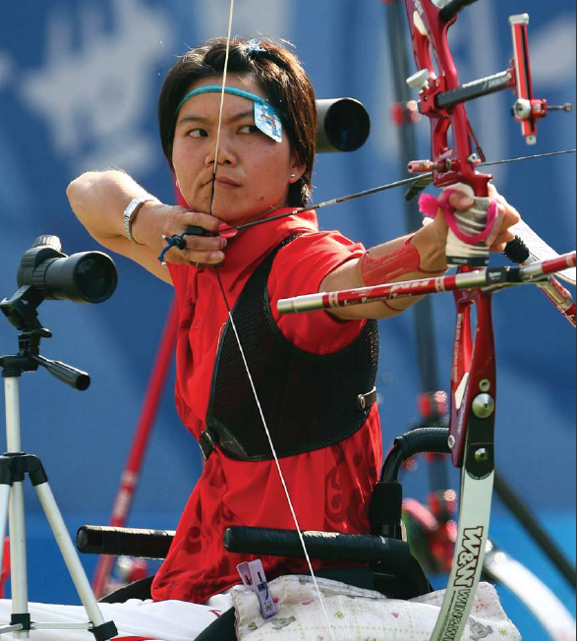
UNIT 8B: MOTIVATION AND EMOTION: EMOTIONS, STRESS AND HEALTH

Slide 2
Drive Reduction Theory
Arousal Theory
Theories
Maslow’s Hierarchy of Needs
Human Drives
Sources
Measures
Intrinsic/
Extrinsic Motivation
Motivation & Emotion
Motivation
Stress
Explain complex motives (eating, aggression, achievement and sex)
Effects
Coping
Theories of Emotion
Opponent Process
James-Lange
Cognitive Appraisal
Cannon-Bard
Schachter two-factor

Slide 3
UNIT OVERVIEW
Theories of Emotion
Embodied Emotion
Expressed Emotion
Experienced Emotion
Stress and Health

Slide 4
THEORIES OF EMOTION
Notes:
Emotions are our body’s adaptive response. They exist to give us interesting experiences and enhance our survival

Slide 5
Drive Reduction Theory
Arousal Theory
Theories
Maslow’s Hierarchy of Needs
Human Drives
Sources
Measures
Intrinsic/
Extrinsic Motivation
Motivation & Emotion
Motivation
Stress
Explain complex motives (eating, aggression, achievement and sex)
Effects
Coping
We are here
Theories of Emotion
Opponent Process
James-Lange
Cognitive Appraisal
Cannon-Bard
Schachter two-factor

Slide 6
THEORIES OF EMOTION
Emotion
Physiological arousal
Expressive behavior
Conscious experience
Notes:
Theories of Emotion
Emotions are a mix of physiological arousal (heart pounding), expressive behaviors (quickened walking pace), and consciously experienced thoughts (is this a kidnapping?) and feelings (a sense of fear and later joy—finding a missing child in the store)
Two controversies:
Does your physiological arousal precede or follow your emotional experience? (sense of fear and then racing heart)
Does cognition (thinking) always precede emotion? (Did I think about the kidnapping threat before reacting emotionally?)
Commonsense view:
First comes awareness, then the physiological feeling (when you become happy, your heart starts beating faster)

Slide 7
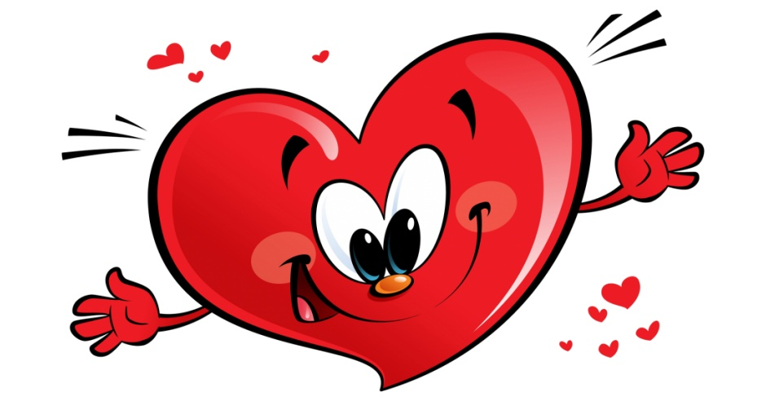
COMMONSENSE THEORY OF EMOTION
First comes awareness, then the physiological feeling (when you become happy, your heart starts beating faster)
Notes:
Theories of Emotion
Commonsense view:
First comes awareness, then the physiological feeling (when you become happy, your heart starts beating faster)

Slide 8
THEORIES
James-Lange Theory
Cannon-Bard Theory
Schachter-Singer Theory
Opponent Process Theory
Cognitive-Appraisal Theory

Slide 9
Drive Reduction Theory
Arousal Theory
Theories
Maslow’s Hierarchy of Needs
Human Drives
Sources
Measures
Intrinsic/
Extrinsic Motivation
Motivation & Emotion
Motivation
Stress
Explain complex motives (eating, aggression, achievement and sex)
Effects
Coping
We are here
Theories of Emotion
Opponent Process
James-Lange
Cognitive Appraisal
Cannon-Bard
Schachter two-factor

Slide 10
JAMES LANGE THEORY
William James and Carl Lange proposed an idea that was diametrically opposed to the common-sense view. The James-Lange Theory proposes that physiological activity precedes the emotional experience.

Slide 11
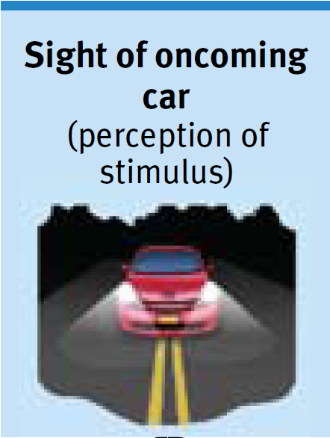
THEORIES OF EMOTION
James-Lange theory
Notes:
William James (psychologist) and Carl Lange’s (physiologist) theory
Commonsense view is backwards
Feeling of fear followed your body’s response to a car skidding on a slippery road
James-Lange theory—first comes a distinct physiological response, then comes our experienced emotion

Slide 12
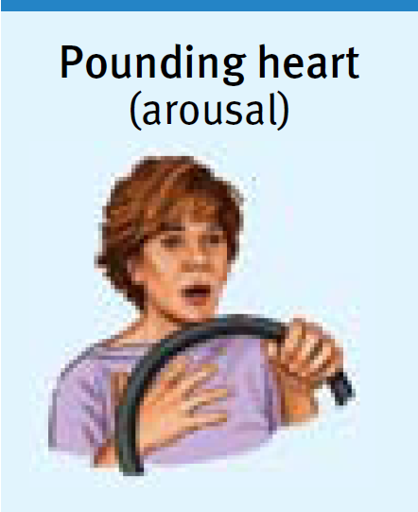
THEORIES OF EMOTION
James-Lange theory
Notes:
William James (psychologist) and Carl Lange’s (physiologist) theory
Commonsense view is backwards
Feeling of fear followed your body’s response to a car skidding on a slippery road
James-Lange theory—first comes a distinct physiological response, then comes our experienced emotion

Slide 13
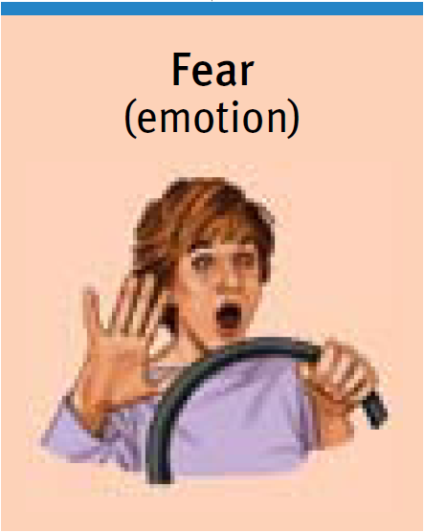
THEORIES OF EMOTION
James-Lange theory
Notes:
William James (psychologist) and Carl Lange’s (physiologist) theory
Commonsense view is backwards
Feeling of fear followed your body’s response to a car skidding on a slippery road
James-Lange theory—first comes a distinct physiological response, then comes our experienced emotion

Slide 14
Drive Reduction Theory
Arousal Theory
Theories
Maslow’s Hierarchy of Needs
Human Drives
Sources
Measures
Intrinsic/
Extrinsic Motivation
Motivation & Emotion
Motivation
Stress
Explain complex motives (eating, aggression, achievement and sex)
Effects
Coping
Theories of Emotion
Opponent Process
We are here
James-Lange
Cognitive Appraisal
Cannon-Bard
Schachter two-factor

Slide 15
CANNON-BARD THEORY
Walter Cannon and Phillip Bard questioned the James-Lange Theory and proposed that an emotion-triggering stimulus and the body's arousal take place simultaneously.
Notes:
1) Cannon suggested that body’s responses were not distinct enough to evoke different emotions. 2) Physiological responses seemed too slow to trigger sudden emotions.

Slide 16
THEORIES OF EMOTION
Cannon-Bard theory
Notes:
Walter Cannon (physiologist) and Philip Bard (physiologist)
Cannon thought the body’s responses were not distinct enough to evoke the different emotions
Changes in heart rate, perspiration and body temperature seemed too slow to trigger sudden emotion
Physiological arousal and emotions occur simultaneously
Cannon-Bard theory implies that your heart begins to pound as you experience fear; one does not cause the other

Slide 17
THEORIES OF EMOTION
Cannon-Bard theory
Notes:
Walter Cannon (physiologist) and Philip Bard (physiologist)
Cannon thought the body’s responses were not distinct enough to evoke the different emotions
Changes in heart rate, perspiration and body temperature seemed too slow to trigger sudden emotion
Physiological arousal and emotions occur simultaneously
Cannon-Bard theory implies that your heart begins to pound as you experience fear; one does not cause the other

Slide 18
Drive Reduction Theory
Arousal Theory
Theories
Maslow’s Hierarchy of Needs
Human Drives
Sources
Measures
Intrinsic/
Extrinsic Motivation
Motivation & Emotion
Motivation
Stress
Explain complex motives (eating, aggression, achievement and sex)
Effects
Coping
Theories of Emotion
Opponent Process
We are here
James-Lange
Cognitive Appraisal
Cannon-Bard
Schachter two-factor

Slide 19
SCHACTER-SINGER TWO FACTOR THEORY
Stanley Schachter and Jerome Singer proposed yet another theory which suggests our physiology and cognitions create emotions. Emotions have two factors–physical arousal and cognitive label.

Slide 20
THEORIES OF EMOTION
Two-factor theory
Schachter-Singer
Notes:
Stanley Schacter and Jerome Singer
Our physiology and our cognitions (perceptions, memories and interpretations) together create emotion
Two factor theory—physical arousal + a cognitive label = emotion
Our experience of emotion grows from our awareness of our body’s arousal
Emotions are physiologically similar

Slide 21
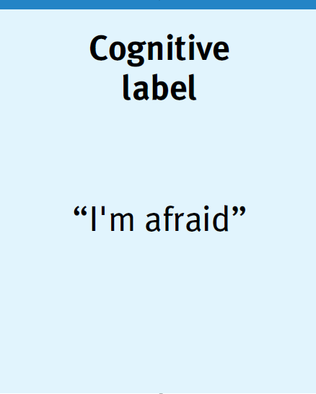
THEORIES OF EMOTION
Two-factor theory
Schachter-Singer
Notes:
Stanley Schacter and Jerome Singer
Our physiology and our cognitions (perceptions, memories and interpretations) together create emotion
Two factor theory—physical arousal + a cognitive label = emotion
Our experience of emotion grows from our awareness of our body’s arousal
Emotions are physiologically similar

Slide 22
THEORIES OF EMOTION
Two-factor theory
Schachter-Singer
Notes:
Stanley Schacter and Jerome Singer
Our physiology and our cognitions (perceptions, memories and interpretations) together create emotion
Two factor theory—physical arousal + a cognitive label = emotion
Our experience of emotion grows from our awareness of our body’s arousal
Emotions are physiologically similar

Slide 23
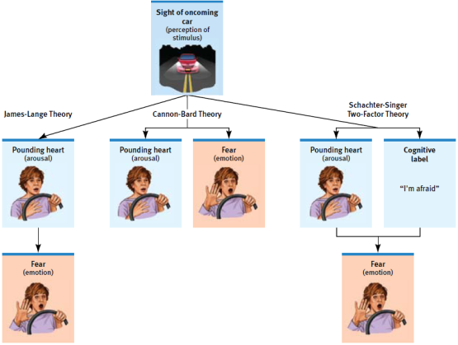
THEORIES OF EMOTION

Slide 24
Drive Reduction Theory
Arousal Theory
Theories
Maslow’s Hierarchy of Needs
Human Drives
Sources
Measures
Intrinsic/
Extrinsic Motivation
Motivation & Emotion
Motivation
Stress
Explain complex motives (eating, aggression, achievement and sex)
Effects
Coping
Theories of Emotion
Opponent Process
We are here
James-Lange
Cognitive Appraisal
Cannon-Bard
Schachter two-factor

Slide 25
OPPONENT-PROCESS THEORY
Opponent process theory suggests that any given emotion also has an opposed emotion. (Fear/Relief or Sadness/Happiness)
Activation of one member of the pair automatically suppresses the opposite emotion
But the opposing emotion can serve to diminish the intensity of the initial emotion.

Slide 26
OPPONENT-PROCESS THEORY
The opponent-process theory states that when one emotion is experienced, the other is suppressed.
For example, if you are frightened by a mean dog, the emotion of fear is expressed and relief is suppressed. If the fear-causing stimulus continues to be present, after a while the fear decreases and the relief intensifies.

Slide 27
Drive Reduction Theory
Arousal Theory
Theories
Maslow’s Hierarchy of Needs
Human Drives
Sources
Measures
Intrinsic/
Extrinsic Motivation
Motivation & Emotion
Motivation
Stress
Explain complex motives (eating, aggression, achievement and sex)
Effects
Coping
Theories of Emotion
Opponent Process
James-Lange
We are here
Cognitive Appraisal
Cannon-Bard
Schachter two-factor

Slide 28
COGNITIVE-APPRAISAL THEORY
Sequence
Stimulus (object, event, or thought)
Appraisal of how this affects your well-being (consciously or unconsciously)
Emotion (fear, anger, happiness, …)
Physiological responses and behavior
For an emotion to occur, it is necessary to first think about the situation.

Slide 29
COGNITION AND EMOTION
What is the connection between how we think (cognition) and how we feel (emotion)?
Can we change our emotions by changing our thinking?

Slide 30
EMBODIED EMOTION
Notes:
Embodied Emotion
Feeling without a body is like breathing without lungs
Some physical responses are easy to notice, others—many taking place at the level of brain neurons—happen without your awareness

Slide 31
EMOTIONS AND THE AUTONOMIC NERVOUS SYSTEM
Autonomic nervous system
Sympathetic nervous system
arousing
Parasympathetic nervous system
Calming
Moderate arousal is ideal
Notes:
Emotions and the Autonomic Nervous System
Autonomic Nervous System which mobilizes your body for action/crises (sympathetic division) and calms it when the crisis passes (parasympathetic division)
Preparing you to fight or flee
Sympathetic division releases stress hormones epinephrine (adrenaline) and norepinephrine (noradrenaline) → increases extra sugar into your bloodstream, respiration increases, heart rate/breathing increases, digestion slows
If wounded, you would clot easier because more blood is being pumped through your body
Parasympathetic division reverts your bodily functions and calms the body
Arousal in short spurts is adaptive (when taking a test it helps to be a little nervous—but not too much)

Slide 32
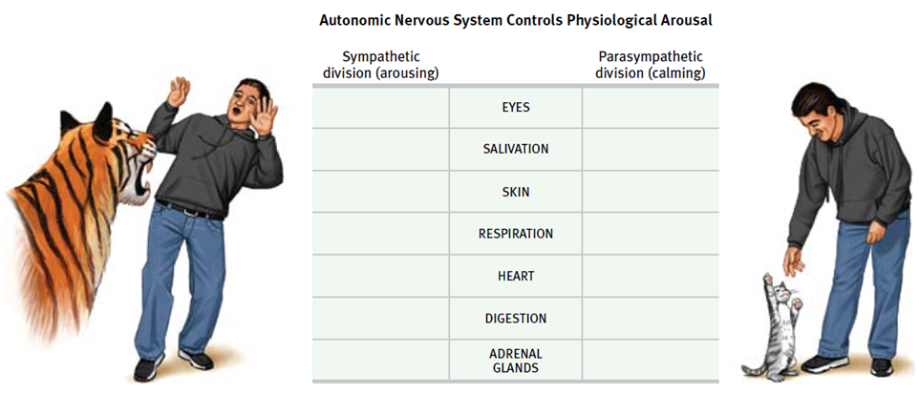
EMOTIONS AND THE AUTONOMIC NERVOUS SYSTEM

Slide 33
EMOTIONS AND THE AUTONOMIC NERVOUS SYSTEM

Slide 34
EMOTIONS AND THE AUTONOMIC NERVOUS SYSTEM

Slide 35
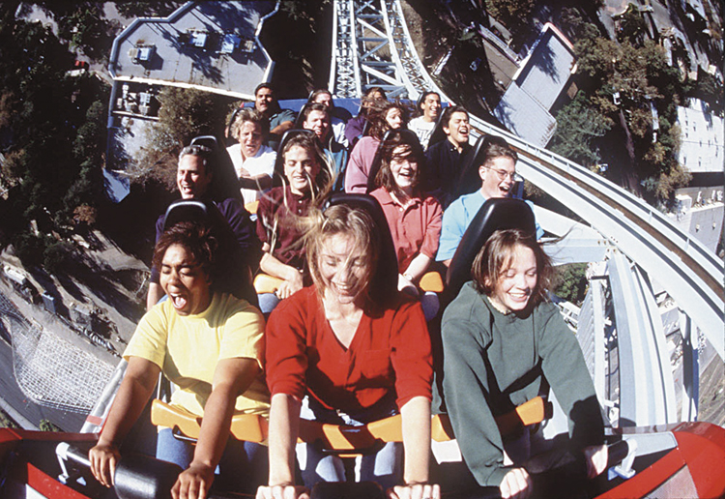
PHYSIOLOGICAL SIMILARITIES AMONG SPECIFIC EMOTIONS
Different movie experiment
Notes:
Physiological Similarities Among Specific Emotions
Physiological differences among fear, anger, love and boredom are similar in the way individuals respond to certain stimuli→ thus have similar physiological arousal, but the emotion has a different look between people

Slide 36
PHYSIOLOGICAL SIMILARITIES AMONG SPECIFIC EMOTIONS
Differences in brain activity
Amygdala - ⬆ activity when watching fearful faces
Frontal lobes
- emotions (right hemisphere)
+ emotions (left hemisphere)
Polygraph
Notes:
Physiological Differences Among Specific Emotions
Finger temperatures and hormone secretions that accompany fear and rage do sometimes differ
Fear and joy stimulate different facial muscles
During fear, brow muscles tense; during joy, muscles in the cheeks and under the eyes pull into a smile
When watching fearful faces, people show more activity in the amygdala (emotional control center in the brain’s limbic system)
Negative emotions tend to be linked to the right hemisphere & positive emotions to the left hemisphere
Generally negative personalities (depression-prone) show more right-frontal lobe activity; positive moods tend to trigger more left frontal lobe activity

Slide 37
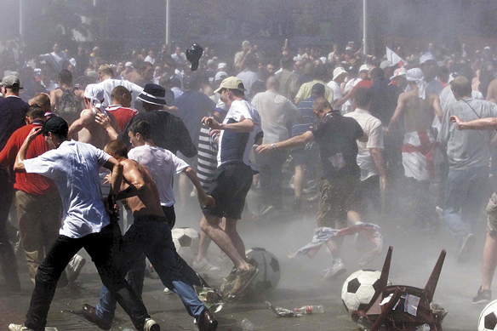
COGNITION AND EMOTION: COGNITION CAN DEFINE EMOTION
Spill over effect
Schachter-Singer experiment
Arousal fuels emotions, cognition channels it
Notes:
Cognition and Emotion
What is the connection between what we think and how we feel?
Can we experience emotion apart from thinking? Or do we become what we think?
Cognition Can Define Emotion
Our arousal response to one event spills over into our response to the next event (spillover effect)
“Catch” the apparent emotion of the person you are with (happy, angry, sad, etc…)
Aroused people react more with hostility in anger-provoking situations
Arousal + label (angry) = emotion—Schachter-Singer’s two factor theory
Arousals fuel emotion, cognition channels it
Cognition Does Not Always Precede Emotion
We have many emotional reactions apart from, or even before, our interpretations of the situation
You’ve hurt someone’s feelings, you have other conversations, but the feelings linger
The arousal lingers, but without a label
A quickly flashed stimulus, such as a smiling or angry face or a disgusting scene, can prime a mood or specific emotion and lead us to feel better or worse about a follow-up stimulus
Flashed a happy face over and over and participants drank about 50% more of a fruit-flavored drink then those who were exposed to an angry face
Some emotions take a “low road” through neural pathways that bypass the cortex (which offers the alternative “high road” pathway
Runs from the eye/ear through the thalamus to the amygdala, bypassing the cortex
This shortcut enables our quick, lightning emotional response before our intellect intervenes (we may be unaware of what has transpired)
When fearful eyes were flashed too briefly for people to consciously perceive them, fMRI scans revealed that their amygdala was alerted. When flashed happy eyes, it did not have this effect.

Slide 38
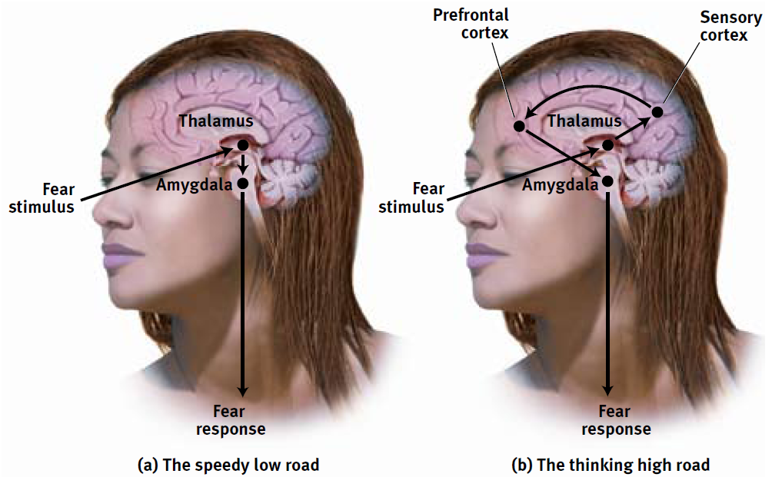
COGNITION AND EMOTION: COGNITION DOES NOT ALWAYS PRECEDE EMOTION
Influence of the amygdala

Slide 39
COGNITION AND EMOTION: COGNITION CAN DEFINE EMOTION
Arousal fuels emotions, cognition channels it
Some emotional response involves no conscious thinking
Conscious appraisal of situation – must decide if beneficial or harmful to our well-being
Emotions greatly influenced by memories, expectations and interpretations
Notes:
Two routes to the emotion
Robert Zajonc and Joseph LeDoux demonstrated that some emotional response (likes, dislikes, fears) involve no conscious thinking
We may fear a spider even if we know it is harmless
Emotion researcher Richard Lazarus noted that some sort of cognitive appraisal of the situation, otherwise how would we know what we are reacting to?
The appraisal may be effortless and we may not be conscious of it, but it is still a mental function
Emotions arise when we appraise an event as beneficial or harmful to our well-being, whether we truly know it is or not (we appraise the sound of rustling in the bushes as the presence of a threat. Later we realize it was just the wind.
Our emotions are greatly influenced by our memories, expectations and interpretations
Some people blow incidents out of proportion
If people think positively it can help them feel better

Slide 40
EXPRESSED EMOTION
Notes:
Expressed Emotion
People’s expressed emotion reveals their emotion (nonverbal language = body posture, tone of voice, facial expressions)
Smile is the single universal signal for communication
A Hindu classic dance uses the trained face and body to convey 10 different emotions

Slide 42
GENDER, EMOTION AND NONVERBAL BEHAVIOR
Women are much better at discerning nonverbal emotions than men. When shown sad, happy, and scary film clips women expressed more emotions than men.
Notes:
OBJECTIVE 9| Describe some gender differences in perceiving and communicating emotions.
Gender, Emotion and Nonverbal Behavior
When given small hints of physical/nonverbal cues detecting harm or fear, women tend to surpass men at reading people’s emotional cues
Women tend to show more emotion when watching a scary, funny or sad film
Also women have an edge in spotting lies, and detecting a true, romantic couple relationship than a phony one
ASK—how might you feel when you say goodbye to fellow classmates after graduation who you most likely will not see much anymore?
Males tend to have simple responses (I’ll feel bad)
Females express more complex emotions (It will be bittersweet; I’ll feel both happy and sad)
Females are more emotional responsive in both positive and negative situations (more open to feelings)
Anger strikes most people as a more masculine emotion—people are quicker to see anger on men’s faces
Women are more likely than men to be empathetic (identify with others and can understand what it is like in other’s shoes)
Also more inclined to express empathy (cry when others are crying)
Mirror neurons comprise neural systems that activate when we are imagining what other people are feeling or doing. Some researchers think that mirror neurons are the physiological mechanism of empathy

Slide 43
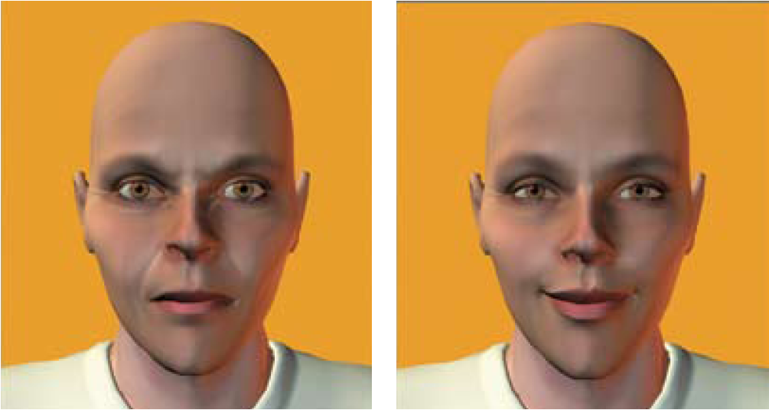
GENDER, EMOTION, AND NON VERBAL BEHAVIOR
Notes:
If a gender neutral face is made to look angry, most people will identify it as male, if made to smile, most will identify as female
**women have greater emotional literacy**

Slide 44
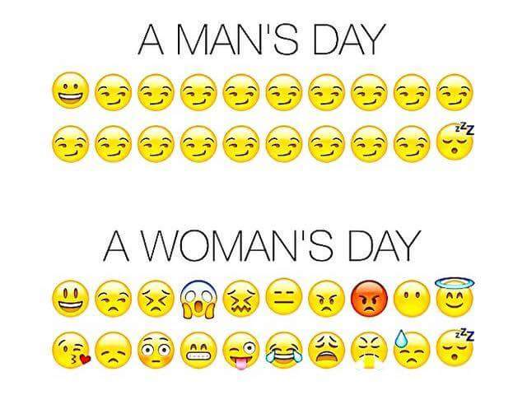
GENDER, EMOTION, AND NONVERBAL BEHAVIOR
Women are more emotionally responsive in both positive and negative situations (more open to feelings)
Women more likely than men to be empathetic
Notes:
Gender, Emotion and Nonverbal Behavior
When given small hints of physical/nonverbal cues detecting harm or fear, women tend to surpass men at reading people’s emotional cues
Women tend to show more emotion when watching a scary, funny or sad film
Also women have an edge in spotting lies, and detecting a true, romantic couple relationship than a phony one
ASK—how might you feel when you say goodbye to fellow classmates after graduation who you most likely will not see much anymore?
Males tend to have simple responses (I’ll feel bad)
Females express more complex emotions (It will be bittersweet; I’ll feel both happy and sad)
Females are more emotional responsive in both positive and negative situations (more open to feelings)
Anger strikes most people as a more masculine emotion—people are quicker to see anger on men’s faces
Women are more likely than men to be empathetic (identify with others and can understand what it is like in other’s shoes)
Also more inclined to express empathy (cry when others are crying)
Mirror neurons comprise neural systems that activate when we are imagining what other people are feeling or doing. Some researchers think that mirror neurons are the physiological mechanism of empathy

Slide 45
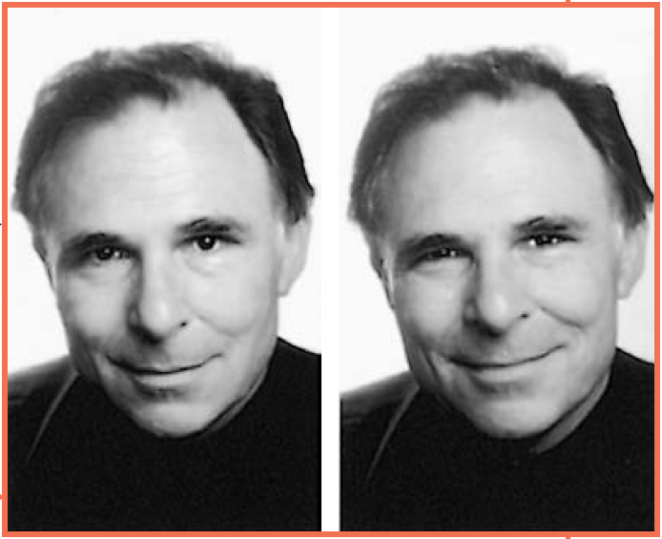
DETECTING EMOTION
Duchenne smile
Notes:
Detecting Emotion
Different cultures communicate verbally and nonverbally with different meanings
A firm handshake may signal dominance/control or an outgoing personality
Our bodies are able to detect nonverbal cues of anger, threats, happiness, etc…
**DEMO: Have students pretend to draw a capital E on their forehand using your dominant hand. What direction does the E face? If it is orientated so that someone looking at the student would have seen it in the correct position, it is likely that the student high in public self-awareness and are sensitive to social rejection. People who draw an E the correct way are likely to draw from an internal perspective and are less likely to express their true emotions.
Experience can sensitize us to particular emotions
Physically abused children will view a series of fear/angry faces with angry more than those who are not abused
Hard to control facial muscles reveal signs of emotion you would otherwise be hoping to conceal
Raising the inner part of your eyebrow reveals distress or worry
Eyebrows raised and pulled together signal fear
A feigned smile (fake smile) can continue for more than 4-5 seconds and are switched on and off more abruptly than a genuine, happy smile
Difficult to detect deceiving expressions
Only about 54% accuracy rate of detecting lies in 206 studies (difficult to tell)
People believe one sign of lying is averting (turn away) one’s gaze
Introverts do well at reading others’ emotions whereas extroverts are generally easier to read
Electronic communication use emoticons ( ☺) to express expressions behind the screen. Can’t read nonverbal physical cues –judged solely by your words
Can misread texts or emails—you may think you are just kidding with your words, but others can read it differently and offensively

Slide 46
EXPRESSED EMOTION
Emotions are expressed on the face, by the body, and by the intonation of voice. Is this non-verbal language of emotion universal?

Slide 48
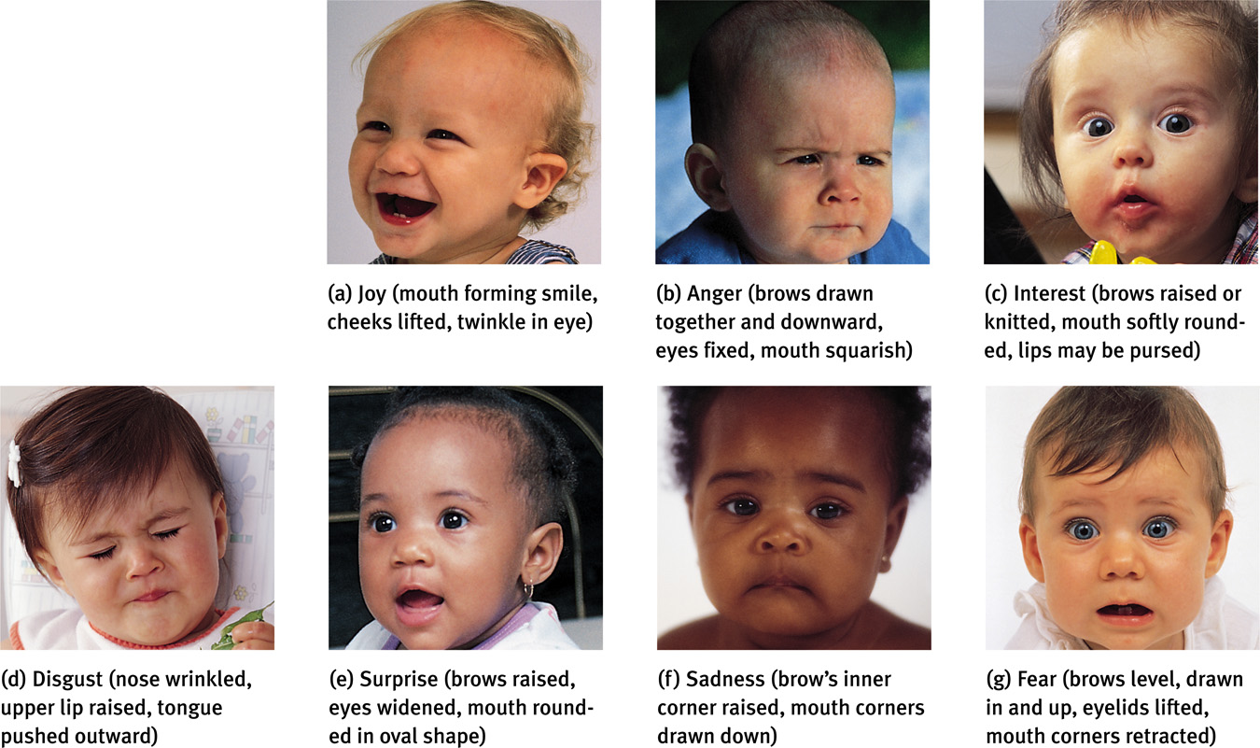
EXPRESSED EMOTIONS

Slide 49
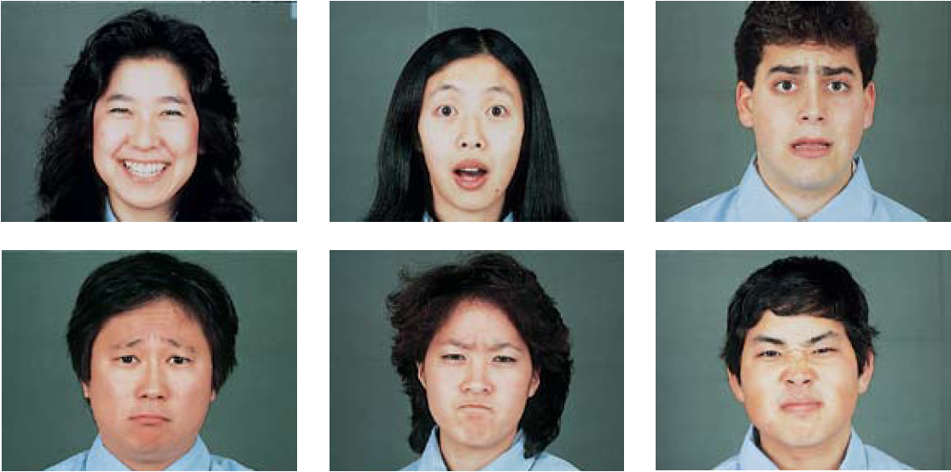
CULTURE AND EMOTIONAL EXPRESSION
Notes:
Culture and Emotional Expression
Are there acceptable gender “rules” for emotional expression?
Two men kissing each other in greeting
Two women patting each other on the behind during a sport’s competition
Men crying at a sad movie
Women violently expressing anger
Men hugging to celebrate an occasion
These are acceptable “rules” within our culture for expression emotions for each other
The meaning of gestures varies in each culture
Chinese clap their hands to show disappointment
We give the thumbs up sign when things are good, but it is taken offensively in other cultures
Do facial expressions also have different meanings in different cultures?
Paul Ekman, Wallace Friesen and other showed photographs of various facial expressions to people in different parts of the world and asked them to guess the emotion (video—History of nonverbal expression)
They also asked people in New Guinea to display various emotions in response to statements like “Pretend your child had died”. When the researchers videotaped their responses and showed them to North American college students, they were able to identify them fairly easily.
Conclusions: Regardless of cultural background, a smile is a smile around the world and similar for other facial expressions
However some cultures differ in how much emotion they express
Cultures which strive for individuality (US) display more visible emotions
Other cultures which encourages people to conform to society are less visibly displayed = collectivist cultures which conform to group standards (Asian)
Even blind children from birth exhibit the common facial expressions associated with emotions like joy, sadness, fear and anger (genetically predisposed)
Charles Darwin speculated that even in prehistoric times, before our ancestors communicated words, their ability to convey threats, greetings and submission with facial expressions helped them survive
That shared heritage, he believed, is why all human express the basic emotions with similar facial expressions
It has been adaptive for us to interpret faces in particular contexts
Movie directors create contexts and soundtracks that amplify our perceptions of particular emotions

Slide 50
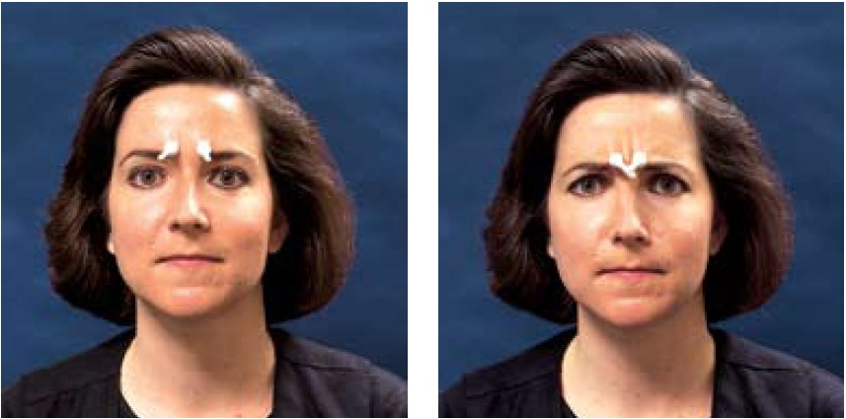
THE EFFECTS OF FACIAL EXPRESSIONS
Facial feedback
Notes:
Effects of Facial Expressions---John Cleese—The Human Face video
Expressions not only communicate emotion, they also amplify and regulate it and feed our feelings
DEMO: Place your pointer fingers on the inner part of your eyebrow. Now fake a big grin. Now scowl. Can you feel the “smile therapy” difference in your facial muscles?
In the absence of competing emotions, the facial feedback effect on experienced emotional expressions states that when a facial expression of anger or happiness intensifies feelings of anger or happiness continues and increases
A heartier smile with raised cheeks and a crinkle in the eye enhances positive feelings even more when you are reacting to something pleasant or funny
Walking with your shoulders back and your head upright (instead of down) will increase your step and encourage a mood shift

Slide 51
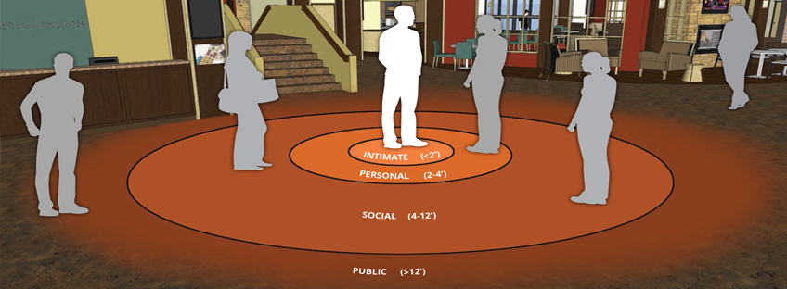
PROXEMICS

Slide 52
PROXEMICS

Slide 53
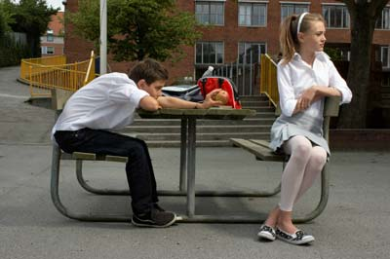
UNCOMFORTABLE
Which direction are the feet pointing?
Arms or legs crossed / hands clasped
Looking around the room
Agrees as much as possible

Slide 54
BOREDOM
Fidgeting shows boredom and restlessness.
Tapping of the foot is distracting and a sure sign of boredom.
Slow looks around the room/ceiling or a fixed gaze
Notes:
A bored facial expression is shown by half-open eyelids, just like the face of a tired person. The difference is raised eyebrows, which show a feeling of dissatisfaction or a lack of excitement

Slide 55
FLIRTING

Slide 56
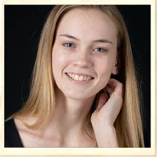
WOMEN
Primping
Eyes turned downward
Held tilting
Exposure of the neck
Smile (coy)” an expression combining a half-smile and lowered eyes”

Slide 57
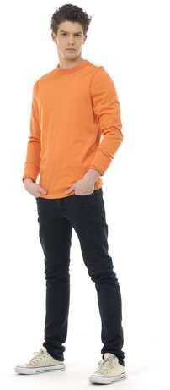
MEN
Eye contact
Proximity
Caressing of self
Needless touch
Parading
Samson pose

Slide 58
BODY LANGUAGE
Have you ever seen this?
Samson Pose

Slide 59
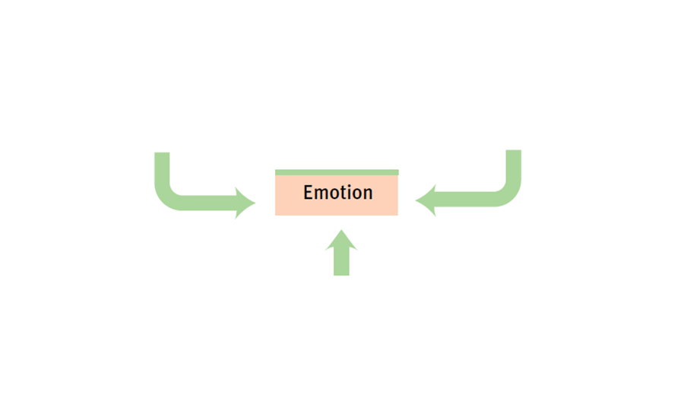
LEVELS OF ANALYSIS FOR THE STUDY OF EMOTION
Notes:
Analyzing Emotion
Emotions rely heavily on the interplay of biological, psychological and social-cultural determinants.

Slide 60
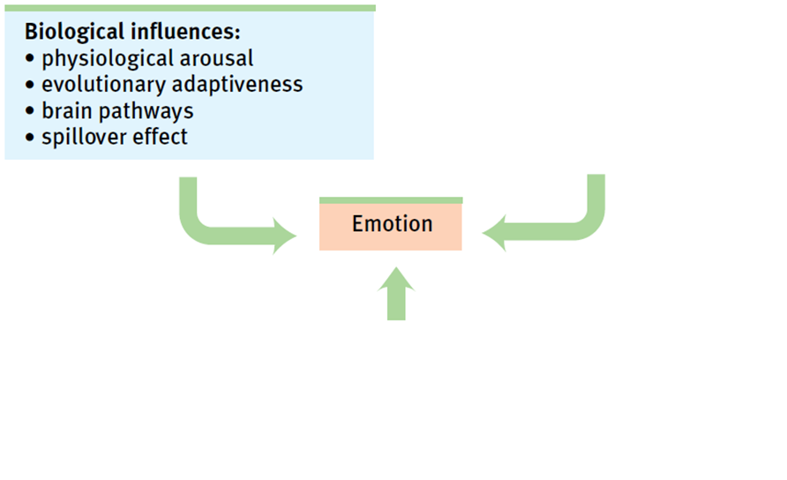
LEVELS OF ANALYSIS FOR THE STUDY OF EMOTION
Notes:
Analyzing Emotion
Emotions rely heavily on the interplay of biological, psychological and social-cultural determinants.

Slide 61
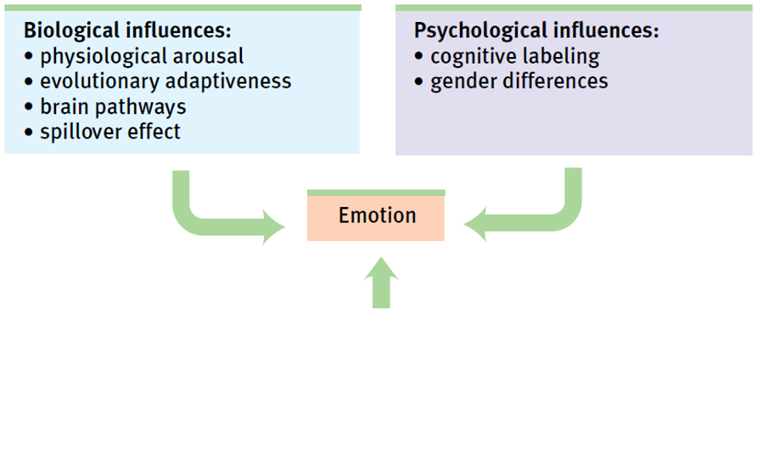
LEVELS OF ANALYSIS FOR THE STUDY OF EMOTION
Notes:
Analyzing Emotion
Emotions rely heavily on the interplay of biological, psychological and social-cultural determinants.

Slide 62
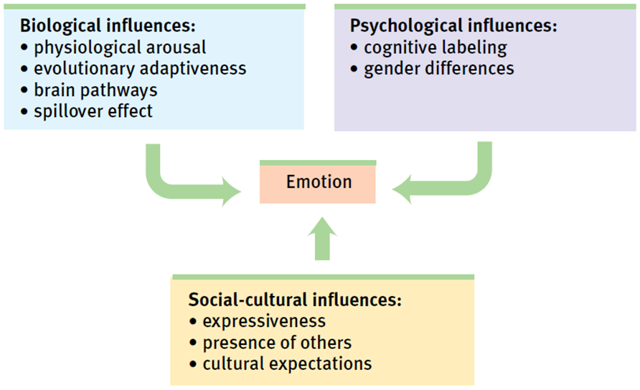
LEVELS OF ANALYSIS FOR THE STUDY OF EMOTION
Notes:
Analyzing Emotion
Emotions rely heavily on the interplay of biological, psychological and social-cultural determinants.

Slide 63
EXPERIENCED EMOTION
Notes:
Experienced Emotion
Carroll Izard (1977) isolated 10 basic emotions most of which are present in infancy
Joy, interest-excitement, surprise, sadness, anger, disgust, contempt, fear, shame, guilt)
Tracey and Richard Robins (2004) believe that pride is also a distinct emotion signaled by a small smile, head slightly tilted back and an open posture
Philip Shaver (1996) believe that love may be a basic emotion too
Izard has argued that other emotions are combinations of these original 10—with love being a mixture of joy and interest-excitement

Slide 64
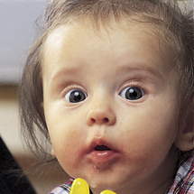
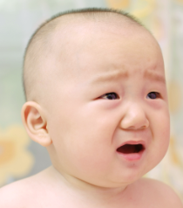
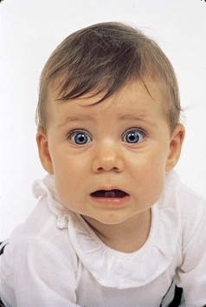
(a) Joy (mouth forming smile, cheeks lifted, twinkle in eye)
(b) Anger (brows drawn together and downward, eyes fixed, mouth squarish)
(c) Interest (brows raised or knitted, mouth softly rounded,
lips may be pursed)
(d) Disgust (nose wrinkled, upper lip raised, tongue pushed outward)
(e) Surprise (brows raised, eyes widened, mouth rounded in oval shape)
(f) Sadness (brow’s inner corners raised, moth corners drawn down)
(g) Fear (brows level, drawn in and up, eyelids lifted, mouth corners retracted)
Figure 8B.15 Infants’ naturally occurring emotions To identify the emotions present from birth, Carroll Izard analyzed the facial expressions of infants.
© 2011 by Worth Publishers

Slide 65
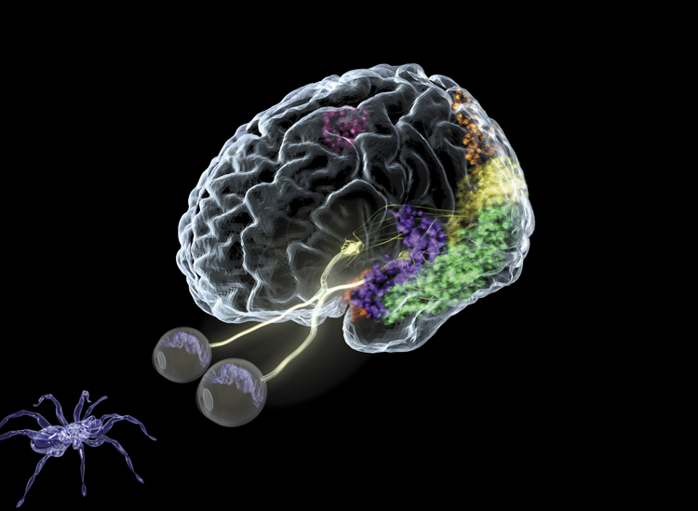
FEAR
Adaptive value of fear
The biology of fear
amygdala
Notes:
Fear
Fear can be poisonous. It can torment us, rob us of sleep and preoccupy our thinking
Fear can be contagious
Fear is adaptive (it’s an alarm system which prepares our bodies to flee from danger)
Learning fear
The “politics of fear” build upon people’s fear (of terrorists, immigrants, criminals)
Through conditioning a short list of naturally painful and frightening events can multiple into a long list of human fears (fear of failure/success, fear of another race/nation, etc…)
A learned fear (by observing others) is remembered and persists even months later
Biology of Fear
One key to fear learning lies in the amygdala—associates fear with certain situations
Some people with phobias have intense fears of specific objects or situations that disrupt their ability to cope
Experience and our genes helps to shape our fearlessness or fearfulness
Scientists have isolated a gene that influences the amygdala’s response to frightening situations. People with a short version of this gene have less of a protein that speeds the reuptake of the neurotransmitter serotonin

Slide 66
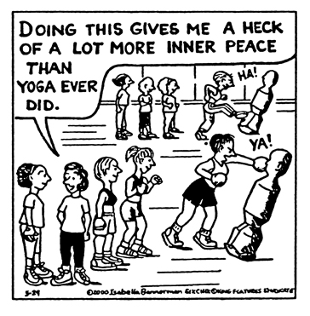
ANGER
Anger
Evoked by events
Catharsis
Expressing anger can increase anger
Notes:
Anger
Anger is a short madness that carries the mind away and can be many times more hurtful than the injury that caused it
Sometimes anger is a response to a friend or loved ones harmful mistakes or words
Simple acts like a dead cell phone, traffic jam, aches and pains can cause anger
Chronic hostility is linked to heart disease
How do we respond to anger?
Boys: walk it off or work it off at the gym
Girls: talking with a friend, listening to music or writing
Releasing hostile feelings in a healthy way instead of internalizing them can better for the body and mind→primarily a suggestion for Western cultures where individuals can express themselves more
By doing so, we can experience an emotional release (catharsis). The catharsis hypothesis maintains that “releasing” aggressive energy (through action or fantasy) relieves aggressive urges
A cooling-off period, along with engaging in behaviors that promote positive emotions will help people feel less angry in the long run
Expressing anger can be temporarily calming if it does not leave us feeling guilty or anxious
Sometimes expressing anger can lead to more anger and exhibit more hostility than a person had been feeling prior to releasing anger
Brad Bushman (2002): “Venting to reduce anger is like using gasoline to put out a fire”
Anger primes prejudice
After 9/11, Americans who responded with anger more than fear displayed intolerance for immigrants and Muslims
Best way to handle our anger?
1. Wait (cooling off period)
2. Deal with anger in a way that involves neither being chronically angry over every little annoyance, nor sulking and rehearsing your grievances
Exercising, playing an instrument, talking with a friend
Civility means not only keeping silent about trivial (minor) irritations but also communicating important ones clearly and assertively

Slide 67
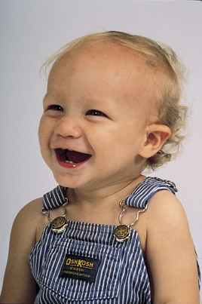
HAPPINESS
Happiness
Feel-good, do-good phenomenon
When we feel happy, we more often help others
Random Acts of Kindness
Well-being
self perceived happiness or satisfaction with life
Notes:
Happiness
People who are happy perceive the world to be safer, feel more confident, make decisions more easily, rate job applicants more favorably, are more cooperative and tolerant, and live healthier more energetic, satisfied lives
Positive emotions fuel upward spirals in your future, your relationships and your hopes
Human faces video with John Cleese—women who smiled happily (rather than a fake smile) in their 1950s yearbook photo were more likely to be married and happy in their middle age
DEMO: Make a list of the top 10 things that make you happy on a piece of paper. Categorize the list into material and non-material items. Create a class list of the individual responses to see which category is larger.
Feel-good,do good phenomenon
When we feel happy, we more often help others (someone drop’s their papers or money on the ground, it feels good to help them out)
Daily “random act of kindness”
Research often has been more focused on negative emotions than positive ones
Can make our lives miserable if we focus on the negatives often seeking therapeutic help
Subjective Well-Being
Assessed as either feelings of happiness (high ratio of positive to negative feelings) or as a sense of satisfaction with life
“Positive Psychology” is on the rise

Slide 68
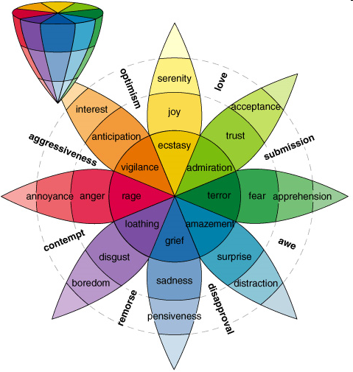
THE NATURE OF EMOTIONS by Plutchik
His three-dimensional model describes the relations among emotion concepts.
The cone’s vertical dimension represents loss of intensity
The circle represents degrees of similarity among the emotions.
The 8 sectors are designed to indicate that there are 8 primary emotion dimensions defined by the theory arranged as 4 pairs of opposites.

Slide 69
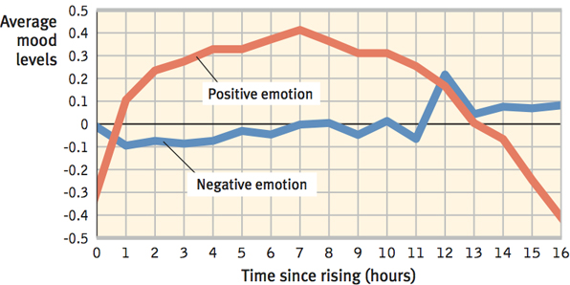
HAPPINESS: THE SHORT LIFE OF EMOTIONAL UPS AND DOWNS
Watson’s studies
**WE OVERESTIMATE THE DURATION OF OUR EMOTIONS AND UNDERESTIMATE OUR CAPACITY TO ADAPT**
Notes:
Short Life of Emotional Ups and Downs
David Watson (2000) and Daniel Kahneman discovered that positive emotion rises over the early to middle part of most days (see chart)
Stressful events (argument, sick child, car problem) trigger bad moods
But, people tend to rebound from bad days to better than usual good days the following day
Emotional ups and downs tend to balance
Even struck by tragedy, paralysis or disease are not permanently depressing
People often think that their lives would be deflated by a breakup in a romantic relationship→After a recovery period, those who do suffer breakups are not noticeably less happy than those who don’t
**We overestimate the duration of our emotions and underestimate our capacity to adapt
Picture on slide: Anna Putt of South Midlands, England suffered a brainstem stroke which left her “locked-in”. After months of therapy, she was able to “talk” by nodding letters, moving an electric wheelchair with her head and to use a computer by nodding while wearing spectacles that guide a cursor.

Slide 70
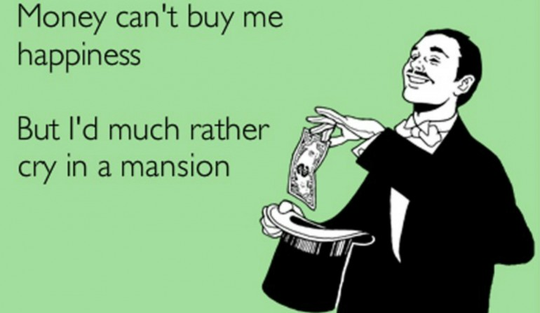
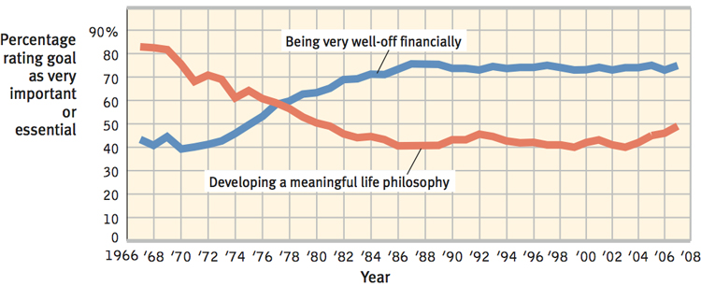
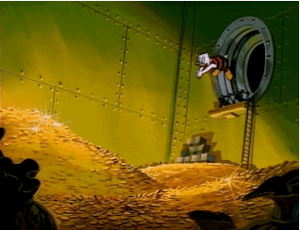
HAPPINESS: WEALTH AND WELL-BEING
Once enough money for comfort and security, continuing to pile up money does not increase happiness even more
DIMINISHING RETURNS/DIMINISHING MARGINAL UTILITY
Notes:
Wealth & Well-Being
Most Americans in a survey would indicate that being “very well off” and being able to support a family are extremely important or essential to happiness
Generally those with lots of money are typically happier than those who struggle to afford life’s basic needs and are less stressed by poverty and lack of control over their lives
Once one has enough money for comfort and security, continuing to pile up money does not increase happiness even more (diminishing returns/diminishing marginal utility)
Robert Cummins (2006) noted that the power of more money increases happiness in lower incomes, but diminishes as income rises
John Cacioppo (2008) notes that today’s happiness predicts tomorrow’s income better than today’s income predicts tomorrow’s happiness

Slide 71
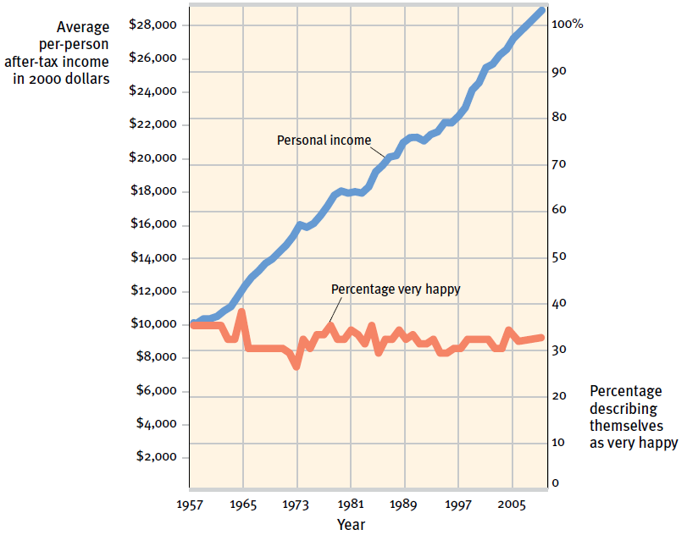
HAPPINESS: WEALTH AND WELL BEING
Notes:
Does money buy happiness?
The average American’s buying power (buying more cars, electronics) has more than tripled in the last 40 years, but their levels of happiness
Those striving hardest for wealth tend to live with lower well-being
Especially try for those seeking money to prove themselves, gain power or show off rather than support their families
Instead, those who strive for “intimacy, personal growth and contribution to the community” experience a higher quality of life and a greater psychological well being
Subjective well-being (happiness + satisfaction) rank Mexico and Puerto Rico at the top of the charts leaving wealthy Western nations towards the bottom
We are paralyzed by having too many things to choose from for everything from grocery items to entertainment choices (spend more time wondering what they will buy and do instead of buying and doing)
People in lower income nations report higher levels of happiness and feel less burdened by regret over not choosing the right thing to do or buy
Politics: Should be more concerned about individuals’ well-being because of its value to its citizens and they will have positive spillover effects for the society as a whole” –see Sean’s article about Happiness
Those who value love over money have a higher satisfaction of life

Slide 72
HAPPINESS: TWO PSYCHOLOGICAL PHENOMENA: ADAPTATION AND COMPARISION
Happiness and Prior Experience
Adaptation-level phenomenon
Happiness and others’ attainments
Relative deprivation
Notes:
Adaptation & Comparison Phenomena
Happiness and Prior Experience
Adaptation-level phenomenon: our tendency to judge various stimuli relative to those we have previously experienced
Harry Helson explained we adjust our neutral levels—the points at which sounds seem neither loud nor soft, temperatures neither hot nor cold, events neither pleasant nor unpleasant—based on our experiences
We then notice and react to variations up or down from these levels
The neutral level keeps changes as new stimuli is introduced
Happiness & Others’ Attainments
Happiness is relative not only to our past experience, but to our comparisons with others
Whether we feel good or bad depends on who those others are
Concept of relative deprivation—the sense that we are worse off than others whom we compare ourselves
Alex Rodriguez’s 10-year, $275 million baseball contract made him temporarily happy, but likely also diminished other star players’ satisfaction with their lesser multi-million dollar contracts
As people climb the latter of success, they mostly compare themselves with peers who are at or above their current level (creates envy for those above us)
If we compare ourselves to those who are not as well-off, our personal satisfaction and thankfulness in our own lives increases

Slide 73
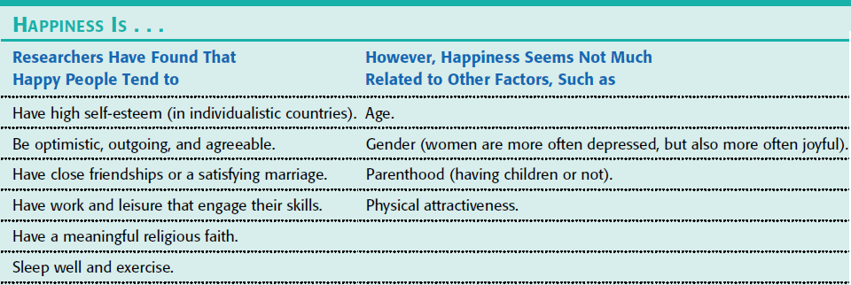
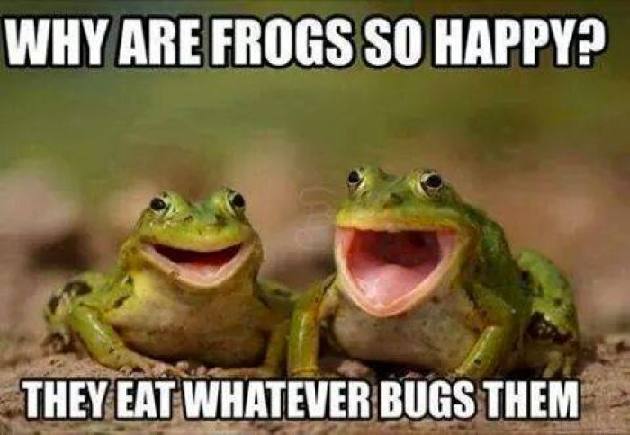
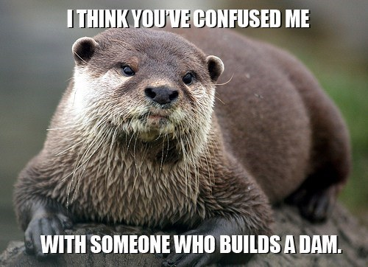
HAPPINESS: PREDICTORS OF HAPPINESS
Notes:
Predictors of Happiness
Some people are normally joyful or gloomy based on their cultural standards
Westerners value self-esteem and social acceptance matters more in collectivist (group) cultures
Across countries, research does reveal several predictors of happiness (see chart)
Tasks and relationships do affect our happiness, so does our genes and the quality of the relationship you have
Genes influence the personality traits which make us happy
People’s happiness set point is not fixed
Satisfaction may rise or fall and happiness can be influenced by factors we cannot control

Slide 74
STRESS AND HEALTH
Notes:
Stress & Health
High levels of stress can bring on skin rashes, asthma attacks or high blood pressure (hypertension), can also increase our risk for serious illness and death
Behavioral medicine was created to study how stress and healthy and unhealthy behaviors influence health and illness which integrates behavioral and medical knowledge
Health psychology provides psychology’s contribution to behavioral medicine
Ask: How do our emotions and personality influence our risk of disease? What attitudes and behaviors help prevent illness and promote health and well-being? How can we reduce or control stress?

Slide 75
Drive Reduction Theory
We are here
Arousal Theory
Theories
Maslow’s Hierarchy of Needs
Human Drives
Sources
Measures
Intrinsic/
Extrinsic Motivation
Motivation & Emotion
Motivation
Stress
Explain complex motives (eating, aggression, achievement and sex)
Effects
Coping
Theories of Emotion
Opponent Process
James-Lange
Cognitive Appraisal
Cannon-Bard
Schachter two-factor

Slide 76
HEALTH PSYCHOLOGY
Health psychology is a field of psychology that contributes to behavioral medicine. The field studies stress-related aspects of disease and asks the following questions:
How do emotions and personality factors influence the risk of disease?
What attitudes and behaviors prevent illness and promote health and well-being?
How do our perceptions determine stress?
How can we reduce or control stress?

Slide 77
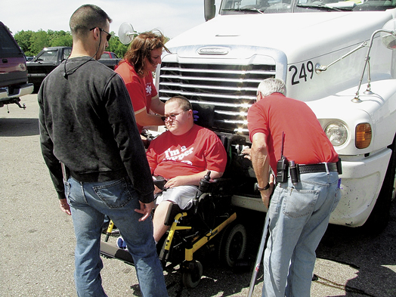
INTRODUCTION
Health psychology
Behavioral medicine

Slide 78
STRESS AND ILLNESS
Stress
Stress appraisal
Notes:
Stress & Illness
Stress is the process by which we appraise and cope with environmental threats and challenges
Stress arises less from the events themselves than how we appraise them
Stress can be a stimulus (missing an appointment) or a response (sweating while taking a test)
When short lived, or when perceived as challenges, stressors can have positive effects
A momentary stress can mobilize the immune system for fending off infections and healing wounds
Stress also motivates us to conquer problems and win games; successful leaders/athletes thrive and excel when aroused by a challenge
Some rebound after a stressful challenge feeling stronger self-esteem and a sense of purpose
Stressors can also threaten us and experiencing severe or prolonged stress can harm us
PTSD soldiers continue to have circulatory, digestive and respiratory problems in the future and are prone to infectious diseases

Slide 79
STRESS
A state of psychological tension or strain
A reaction to a stimulus that disturbs our physical or mental equilibrium.
A stressful event can trigger the “fight-or-flight” response, causing hormones such as adrenaline and cortisol to surge through the body.

Slide 80
TYPES OF STRESS – ACUTE STRESS
Stress resulting from specific events or situations that involve novelty, unpredictability, or a threat to you physically.
Fires the SNS
Helps you deal with danger.
Examples – almost getting into a car accident, giving a public speech, playing a sport, running from a zombie, etc.

Slide 81
TYPES OF STRESS – CHRONIC STRESS
Response to emotional pressure suffered for a prolonged period over which an individual perceives he or she has no control. It involves an endocrine system response in which occurs a release of corticosteroids.
This has long term negative effects on your health.

Slide 82
TEENS AND STRESS
Many American teens report experiencing stress at unhealthy levels, appear uncertain in their stress management techniques and experience symptoms of stress in numbers that mirror adults’ experiences.
Notes:
Lowell Mill Girls - female workers who came to work for the textile corporations in Lowell, Massachusetts, during the Industrial Revolution in the United States.
As young as 15, 73 hours a week, cramped quarters, and sexual harassment or assault in the workplace.
Alexander Gray, a pump boy aged 10 years old. reported in 1842 Royal Commision into working conditions, said: "I pump out the water in the under bottom of the pit to keep the men’s room dry. I am obliged to pump fast or the water would cover me. I had to run away a few weeks ago as the water came up so fast that could not pump at all. The water frequently covers my legs. I have been two years at the pump. I am paid 10 pence a day. No holiday but the Sabbath. I go down at three, sometimes five in the morning, and come up at six or seven at night.

Slide 83
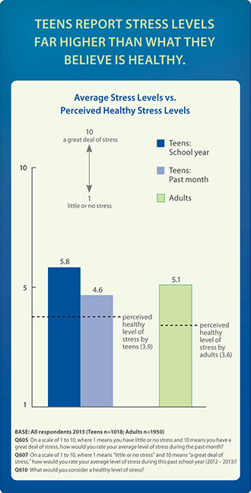
TEEN STRESS REPORTING

Slide 84
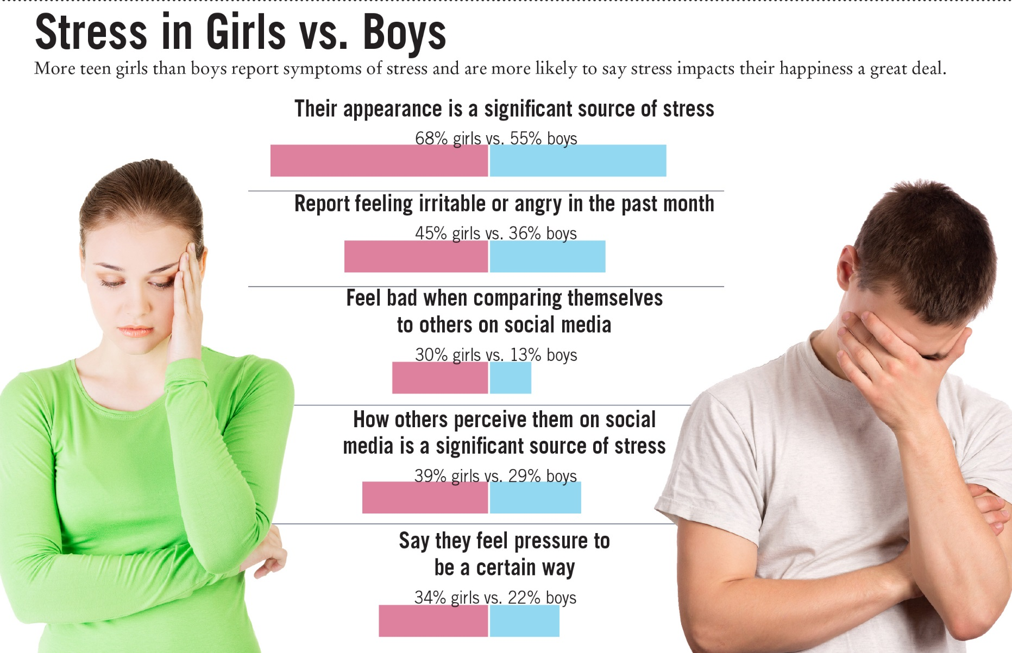
GENDER DIFFERENCE?

Slide 85
RESPONSES TO STRESS
Men and women respond differently
Men – socially withdraw, turn to alcohol, become aggressive
Women – nurturing, bonding together (oxytocin)

Slide 86
STRESS – EVOLUTIONARY PERSPECTIVE
Stress gave/gives a survival advantage to dangerous situations.
Stress, like fever and pain, is useful in certain situations.

Slide 87
STRESS AND ILLNESS: THE STRESS RESPONSE SYNDROME
According to Selye, a stress response to any kind of stimulation is similar.
The stressed individual goes through three phases.
Selye’s general adaptation syndrome (GAS)
Alarm
Resistance
Exhaustion
Notes:
Stress Response System
Walter Cannon confirmed that the stress response is part of a unified mind-body system:
Extreme cold, lack of oxygen and emotion-arousing incidents all trigger an outpouring of the stress hormones epinephrine and norepinephrine from the central core of the adrenal glands
The sympathetic division of the autonomic nervous system increased heart rate and respiration, diverts blood from digestion to the skeletal muscles, dulls pain and releases sugar and fat from the body’s stores—all to prepare the body for the fight or flight adaptive response
Additional stress response system = on orders from the cerebral cortex (via the hypothalamus and pituitary gland), the outer part of the adrenal glands secrete glucocorticoid stress hormones such as cortisol
There are alternatives to flight/fight → withdraw/pull back/conserve energy
*Men and women react to stress in different ways—men tend to internalize where women seek and give support (tend and befriend

Slide 88
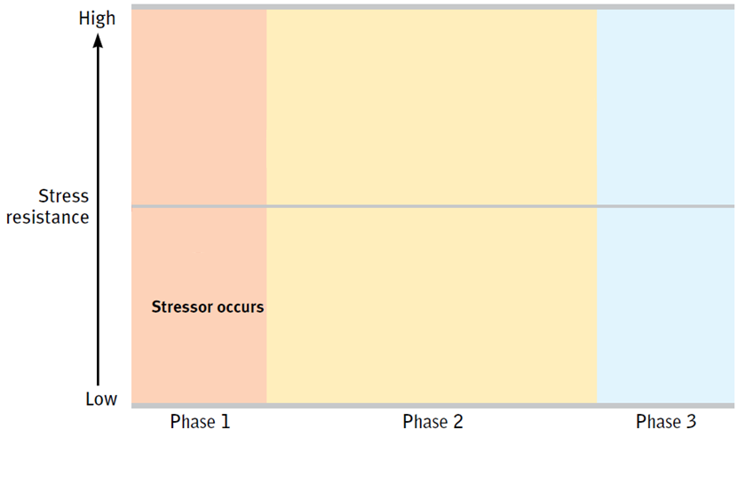
STRESS AND ILLNESS GENERAL ADAPTATION SYNDROME
Notes:
Canadian scientist Hans Selye studied animals’ reactions to various stressors (electric shock, surgical trauma and immobilizing restraint)
He discovered that the body’s adaptive response was so general → General adaptation syndrome (GAS)

Slide 89
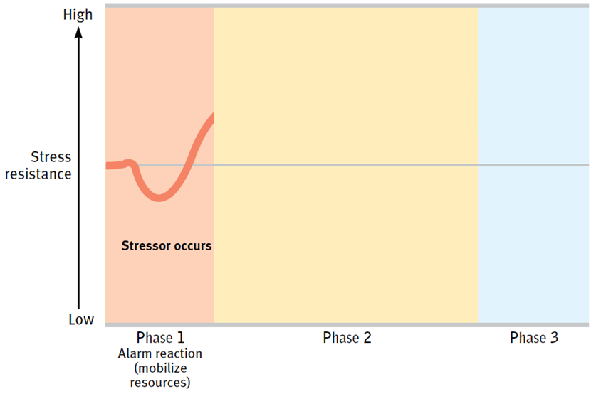
STRESS AND ILLNESS GENERAL ADAPTATION SYNDROME
Notes:
Three phases of a physical or emotional trauma
Phase 1: experience an alarm reaction due to the sudden activation of your sympathetic nervous system (heart rate increases, blood is diverted to your skeletal muscles, feel the faintness of shock)
Phase 2: resistance (your temperature, blood pressure and respiration remain high and there is a sudden outpouring of stress hormones. If persistent, the stress may eventually deplete your body’s reserves)
The body’s resistance can only go so long until exhaustion sets in
Phase 3: Exhaustion: you are more vulnerable to illness or even (in extreme cases) collapse and death
The brain’s production of new neurons slows, severe stress tends to age people

Slide 90
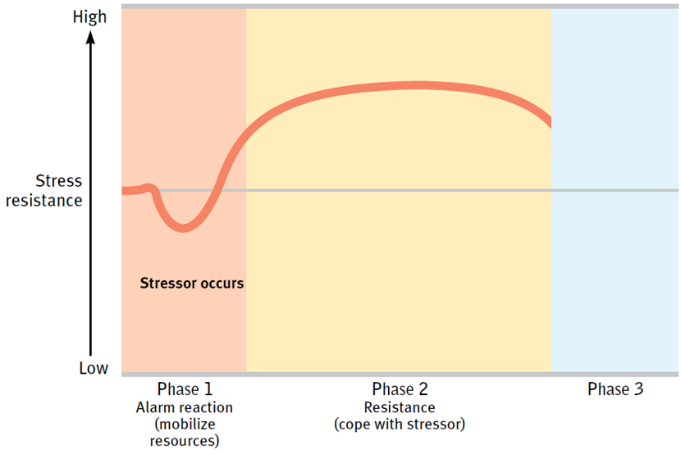
STRESS AND ILLNESS GENERAL ADAPTATION SYNDROME
Notes:
Three phases of a physical or emotional trauma
Phase 1: experience an alarm reaction due to the sudden activation of your sympathetic nervous system (heart rate increases, blood is diverted to your skeletal muscles, feel the faintness of shock)
Phase 2: resistance (your temperature, blood pressure and respiration remain high and there is a sudden outpouring of stress hormones. If persistent, the stress may eventually deplete your body’s reserves)
The body’s resistance can only go so long until exhaustion sets in
Phase 3: Exhaustion: you are more vulnerable to illness or even (in extreme cases) collapse and death
The brain’s production of new neurons slows, severe stress tends to age people

Slide 91
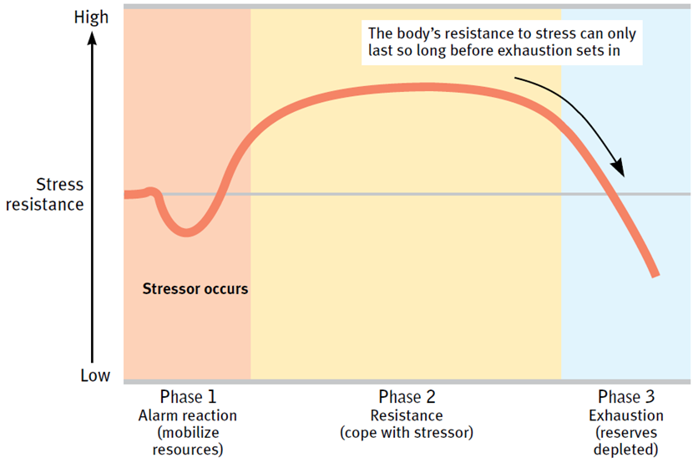
STRESS AND ILLNESS GENERAL ADAPTATION SYNDROME
Notes:
Three phases of a physical or emotional trauma
Phase 1: experience an alarm reaction due to the sudden activation of your sympathetic nervous system (heart rate increases, blood is diverted to your skeletal muscles, feel the faintness of shock)
Phase 2: resistance (your temperature, blood pressure and respiration remain high and there is a sudden outpouring of stress hormones. If persistent, the stress may eventually deplete your body’s reserves)
The body’s resistance can only go so long until exhaustion sets in
Phase 3: Exhaustion: you are more vulnerable to illness or even (in extreme cases) collapse and death
The brain’s production of new neurons slows, severe stress tends to age people

Slide 92
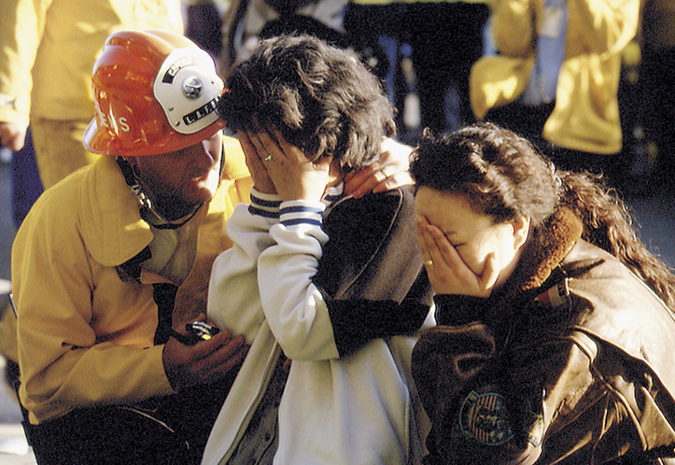
STRESS AND ILLNESS: STRESSFUL LIFE EVENTS
Catastrophes
Unpredictable, larger-scale events
Nearly everyone appraises as threatening
Can have significant health consequences
Notes:
Stressful Life Events (stressors)
Catastrophes
Catastrophes are unpredictable, larger-scale events (war/natural disasters) that nearly everyone appraises as threatening
Can have significant health consequences of difficulty concentrating and sleeping, increased rates of depression and anxiety, suicide rates increase

Slide 93
STRESS AND ILLNESS: STRESSFUL LIFE EVENTS
Significant life changes
Death of a loved one, loss of job, leaving home, marriage/divorce
Often felt during young adulthood (life transitions and insecurities)
Cluster of changes puts one even more at risk for stress-related illnesses
Notes:
Significant Life Changes
Death of a loved one, the loss of a job, leaving home, a marriage and divorce
Life transitions and insecurities are often felt during young adulthood
People who were recently fired, widowed or divorced are more vulnerable to disease
Experiencing a cluster of crises puts one even more at risk

Slide 94
MEASURES OF STRESSORS - SRRS
Social Readjustment Rating Scale (SRRS)
Assesses impact of major life changes
A total of 150 or less is good, suggesting a low level of stress in your life and a low probability of developing a stress-related disorder.
If your score is 300 or more, statistically you stand an almost 80% chance of getting sick in the near future.
If your score is 150 to 299, the chances are about 50%. At less than 150, about 30%.
This scale seems to suggest that change in ones life requires an effort to adapt and then an effort to regain stability.

Slide 95
SRRS
Life Event | Value
Death of Spouse | 100
Divorce | 73
Marital separation | 65
Jail term | 63
Death of close family member | 63
Personal injury or illness | 53
Marriage | 50
Fired at work | 47
Marital reconciliation | 45
Retirement | 45
Change in health of family member | 44
Pregnancy | 40
Sex difficulties | 39
Gain of new family member | 39
Business readjustment | 39
Change in financial state | 38
Death of close friend | 37
Change to a different line of work | 36
Change in number of arguments with spouse | 35
Home Mortgage over $100,000* | 31
Foreclosure or mortgage or loan | 30
Change in responsibilities at work | 29
Son or daughter leaving home | 29
Trouble with in-laws | 29
Outstanding personal achievement | 28
Spouse begins or stops work | 26
Begin or end school | 26
Change in living conditions | 25
Revision of personal habits | 24
Trouble with boss | 23
Change in work hours or conditions | 20
Change in residence | 20
Change in schools | 20
Change in recreation | 19
Change in church activities | 19
Change in social activities | 18
Mortgage or loan of less than $100,000* | 17
Change in sleeping habits | 16
Change in number of family get-togethers | 15
Change in eating habits | 15
Single person living alone | **
Other- describe | **
Total:

Slide 96
COLLEGE UNDERGRAD STRESS SCORE
The average score is 1247 with scores ranging from 182 to 2571. The normal range is from 800 to 1700.
The average college student experiences 15 to 20 stressful events a year.

Slide 97
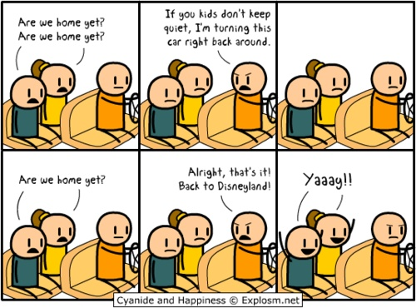
STRESS AND ILLNESS: STRESSFUL LIFE EVENTS
Daily hassles
Everyday annoyances
Some can shrug off annoyances while others easily bothered
Over time, little stressors can add up and take toll on our well-being
Psychological and physical consequences
Depends on personality, coping style and rest of the day
Notes:
Daily Hassles
Everyday annoyances (traffic jams, aggravating housemates, long lines at the store, too many things to do, mass emails, obnoxious cell phone talkers—may be the most significant stressors
Some people can shrug off these stressors while others are easily bothered by them
People’s difficulty of letting go of unattainable goals is another everyday stressor with health consequences
Over time these little stressors can add up and take a toll on our well-being and health
Some minorities struggle with pressures with racism and prejudice that can have both psychological and physical consequences (high blood pressure)
A person’s response to daily hassles depends on their personality, coping style and how the rest of the day has gone

Slide 98
STRESSORS TURN INTO STRESS THROUGH APPRAISAL
Differences in reaction to stressors may be due to an individual’s appraisal

Slide 99
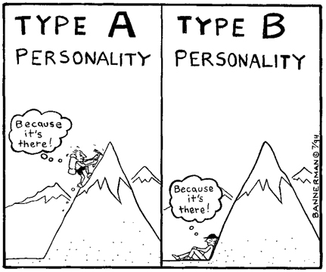
STRESS AND ILLNESS
Stress can be adaptive. In a fearful or stress- causing situation, we can run away and save our lives. Stress can be maladaptive. If it is prolonged (chronic stress), it increases our risk of illness and health problems.

Slide 100
STRESS AND CAUSE OF DEATH
Prolonged stress combined with unhealthy behaviors may increase our risk for one of today's four leading diseases.

Slide 101
STRESS AND HEART DISEASE
Frequent or chronic stress can cause damage to the heart and blood vessels
Type A personality
Competitive, hard-driving, impatient, verbally aggressive, and anger-prone people
Respond to life events with impatience and hostility
Correlated with development of heart disease
Type B personality
Relaxed and easygoing
Notes:
Stress & the Heart
Elevated blood pressure is just one of the factors which increase the risk of coronary heart disease (the closing of the vessels that nourish the heart muscles)
Leading cause of death in North America
Who is at risk?
Hypertension and family history of coronary heart disease
Physiological and behavioral factors (smoking, obesity, high-fat diet, physical inactivity and elevated cholesterol levels) increase the risk
Psychological factors of stress and personality play a large role = heart attack
Type A personality = reactive, competitive, hard-driving, impatient, time-conscious, supermotivated, verbally aggressive and easily angered—more vulnerable to heart attacks
Toxic core = negative emotions (anger associated with an aggressive reactive temperament)
Those who reported being hot-tempered were 5x more likely to have a heart attack by age 55
Type B personality = easygoing, relaxed—less risk of heart attack
Pessimists are also vulnerable to heart disease (2x as likely as optimists)
Depression also increases the risk of heart attack/death (4x more likely than happier people)

Slide 102
STRESS AND THE HEART
Coronary heart disease
Type A versus Type B
Type A
Type B
Notes:
Stress & the Heart
Elevated blood pressure is just one of the factors which increase the risk of coronary heart disease (the closing of the vessels that nourish the heart muscles)
Leading cause of death in North America
Who is at risk?
Hypertension and family history of coronary heart disease
Physiological and behavioral factors (smoking, obesity, high-fat diet, physical inactivity and elevated cholesterol levels) increase the risk
Psychological factors of stress and personality play a large role = heart attack
Type A personality = reactive, competitive, hard-driving, impatient, time-conscious, supermotivated, verbally aggressive and easily angered—more vulnerable to heart attacks
Toxic core = negative emotions (anger associated with an aggressive reactive temperament)
Those who reported being hot-tempered were 5x more likely to have a heart attack by age 55
Type B personality = easygoing, relaxed—less risk of heart attack
Pessimists are also vulnerable to heart disease (2x as likely as optimists)
Depression also increases the risk of heart attack/death (4x more likely than happier people)

Slide 104
STRESS AND THE IMMUNE SYSTEM
B lymphocytes fight bacterial infections, T lymphocytes attack cancer cells and viruses, and microphages ingest foreign substances. During stress, energy is mobilized away from the immune system making it vulnerable.
Lennart Nilsson/ Boehringer Ingelhein International GmbH
Notes:
OBJECTIVE 7| Describe the effect of stress on immune system functioning.
Stress & Susceptibility to Disease
Stress disrupts the bodies disease-fighting immune system and triggers persistent inflammation which can produce problems like asthma or clogged arteries and depression
Stress-related Psychophysiological illness = hypertension and some headaches
Stress effects our resistance to disease, which led to the field of psychoneuroimmunology (PNI)—studies how psychological, neural and endocrine processes affect our immune system and how all these factors influence our health and wellness
Our immune system is a complex surveillance system that defends our body by isolating and destroying bacteria, viruses and other foreign substances
Two types of white blood cells (lymphocytes)
B lymphocytes from in the bone marrow and release antibodies that fight bacterial infections
T lymphocytes form in the thymus and other lymphatic tissue and attack cancer cells, viruses and foreign substances “even good ones” such as transplanted organs
Age, nutrition, genetics, body temperature and stress all influence the immune system’s activity
It takes energy to fight infections and maintain fevers. Thus, when diseased our bodies reduce muscular energy output by inactivity and increased sleep
Stress triggers an aroused fight or flight response, diverting energy from the disease-fighting immune system to the muscles and the brain, making us more vulnerable to illness

Slide 105
STRESS AND COLDS
People with the highest life stress scores were also the most vulnerable when exposed to an
experimental cold virus.

Slide 106
STRESS AND AIDS
Stress and negative emotions may accelerate the progression from human immunodeficiency virus (HIV) to acquired immune deficiency syndrome (AIDS).
Notes:
OBJECTIVE 8| Discuss the findings on the link between stress and AIDS.
Stress & AIDS
AIDS is an immune disorder (an acquired immune deficiency syndrome) caused by the Human immunodeficiency virus (HIV) which is spread by the exchange of fluids—primarily blood and semen
When HIV manifests itself as AIDS, the person has difficulty fighting off other diseases (pneumonia)
→ Being HIV positive means that one is infected with the virus that causes AIDS. Having AIDS means that one has symptoms of diseases that result from a deficient immune system
Stress & negative emotions do correlate with:
A progression from HIV infections to AIDS
The speed of decline in those infected
If an HIV-infected person who is under high levels of stress can participate in cognitive therapy, support groups, relaxation training, it may help to reduce the distress and help control the disease
Help stop the spread of HIV/AIDS with the ABCs (abstinence, being faithful and condom use)

Slide 107
STRESS AND CANCER
Stress does not create cancer cells. Researchers disagree on whether stress influences the progression of cancer. However, they do agree that avoiding stress and having a hopeful attitude cannot reverse advanced cancer.
Notes:
OBJECTIVE 9| Discuss the findings on the link between stress and cancer.
Stress & Cancer
Stress & negative emotions has been linked to cancer’s rate of progression
People are at an increased risk for cancer within a year after experiencing depression, helplessness and bereavement
Although other researchers have found no link between stress and human cancer
Stress DOES NOT create cancer cells. At worst it may affect the growth by weakening the body’s natural defenses against cancerous cells
Biological processes of cancer or AIDS are not likely to be completed stopped by avoiding stress or maintaining a relaxed but determined spirit, but it will keep the self-esteem and mental state of a person in a higher well-being
Conclusions:
Stress invigorates our lives by arousing and motivating us—an unstressed life would not be challenging or productive
Behavioral medicine suggests that the mind and body interact; everything psychological is simultaneously physiological

Slide 108
HEALTH-RELATED CONSEQUENCES
Stress can have a variety of health-related consequences.

