Slide 1
Broad Patterns of Evolution
http://www.nobelprize.org/nobel_prizes/medicine/laureates/1995/illpres/consequences.html
Fossils
Speciation and Extinction
Gene sequence and regulation change cause major change in body plans
Goals of evolution

Slide 2
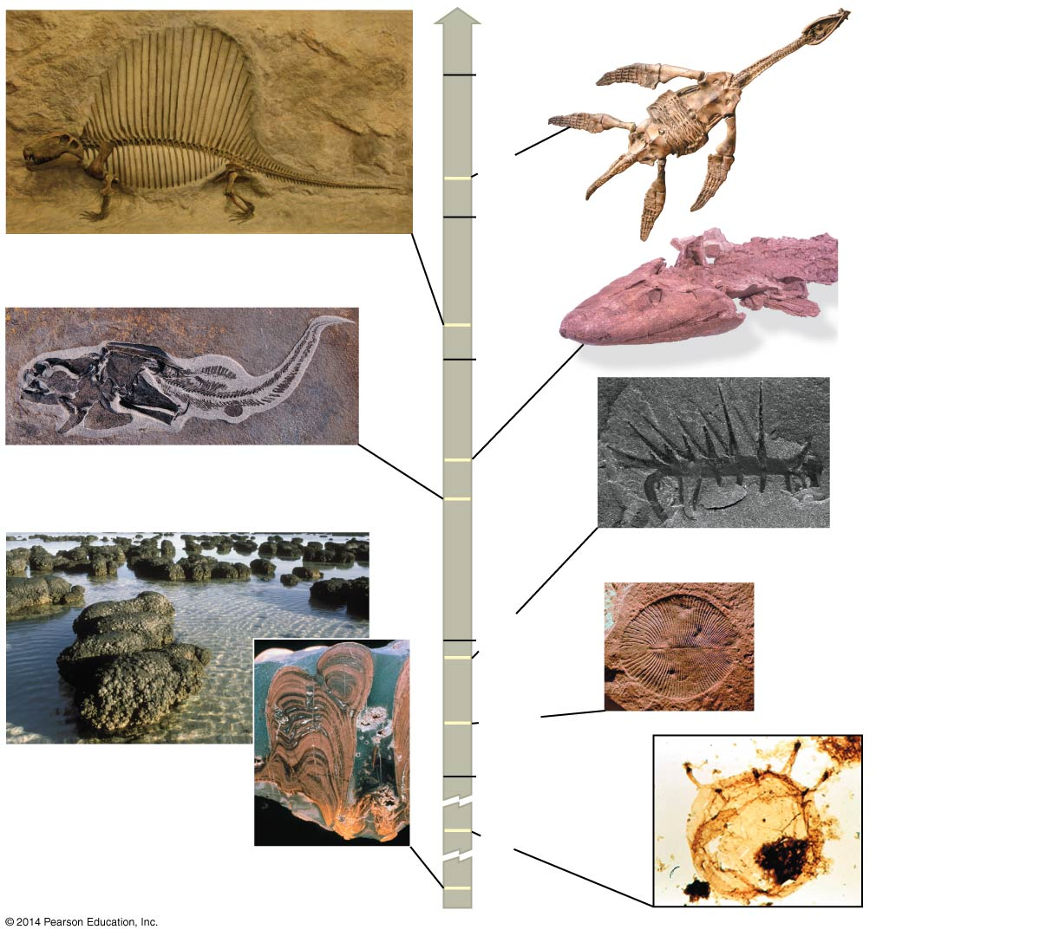
Figure 23.2
1 m
100
mya
Rhomaleosaurus
victor
175
0.5 m
200
Dimetrodon
270
Tiktaalik
300
4.5 cm
Coccosteus cuspidatus
375
400
1 cm
Hallucigenia
500
510
2.5 cm
Dickinsonia
costata
560
Stromatolites
600
1,500
3,500
Tappania
Notes:
2
Figure 23.2 Documenting the history of life

Slide 3
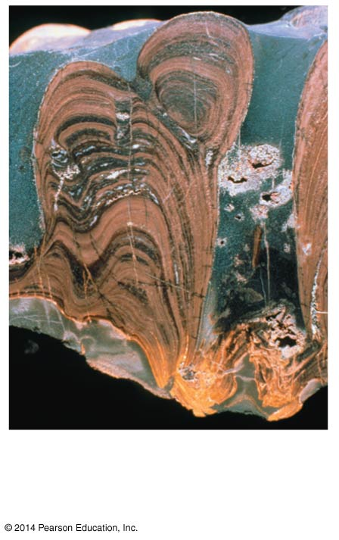
Stromatolite cross
section
Notes:
3
Figure 23.2a Documenting the history of life (part 1: stromatolite cross section)

Slide 4
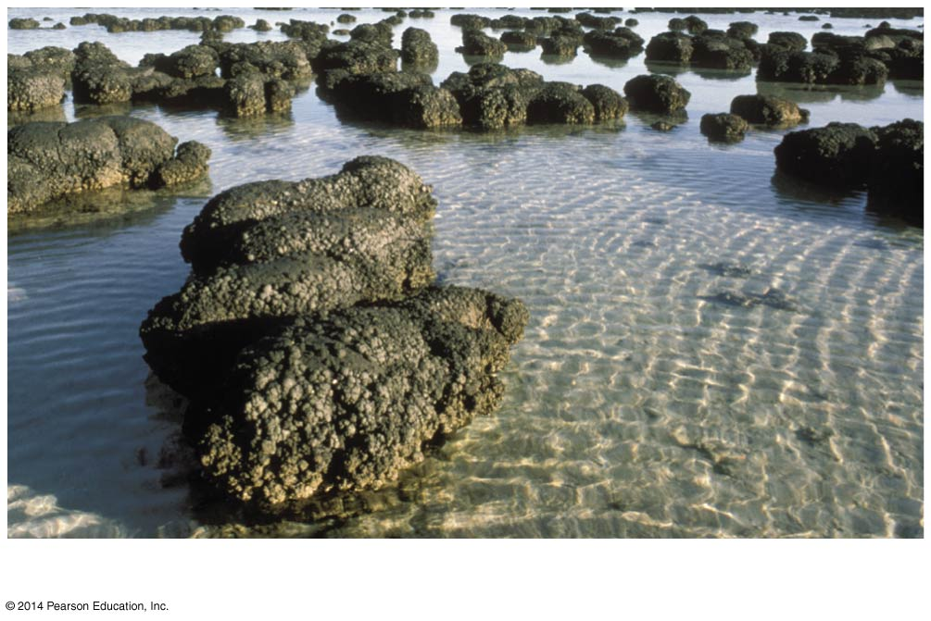
Stromatolites
Notes:
4
Figure 23.2b Documenting the history of life (part 2: stromatolite rocks)

Slide 5
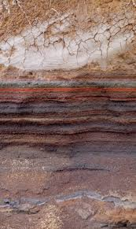
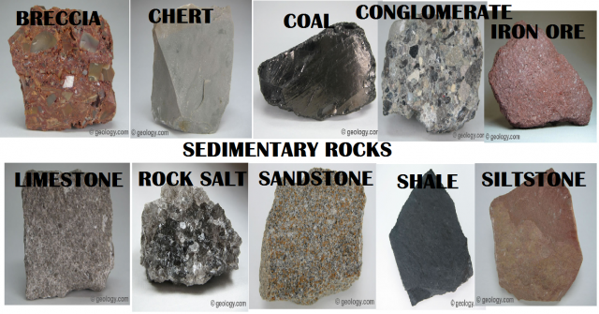
Sedimentary rocks are deposited into layers called strata and are the richest source of fossils

Slide 6
Weakness of Fossils
Few individuals have fossilized, and even fewer have been discovered
The fossil record is biased in favor of species that
Existed for a long time
Were abundant and widespread
Had hard parts
Notes:
6

Slide 7
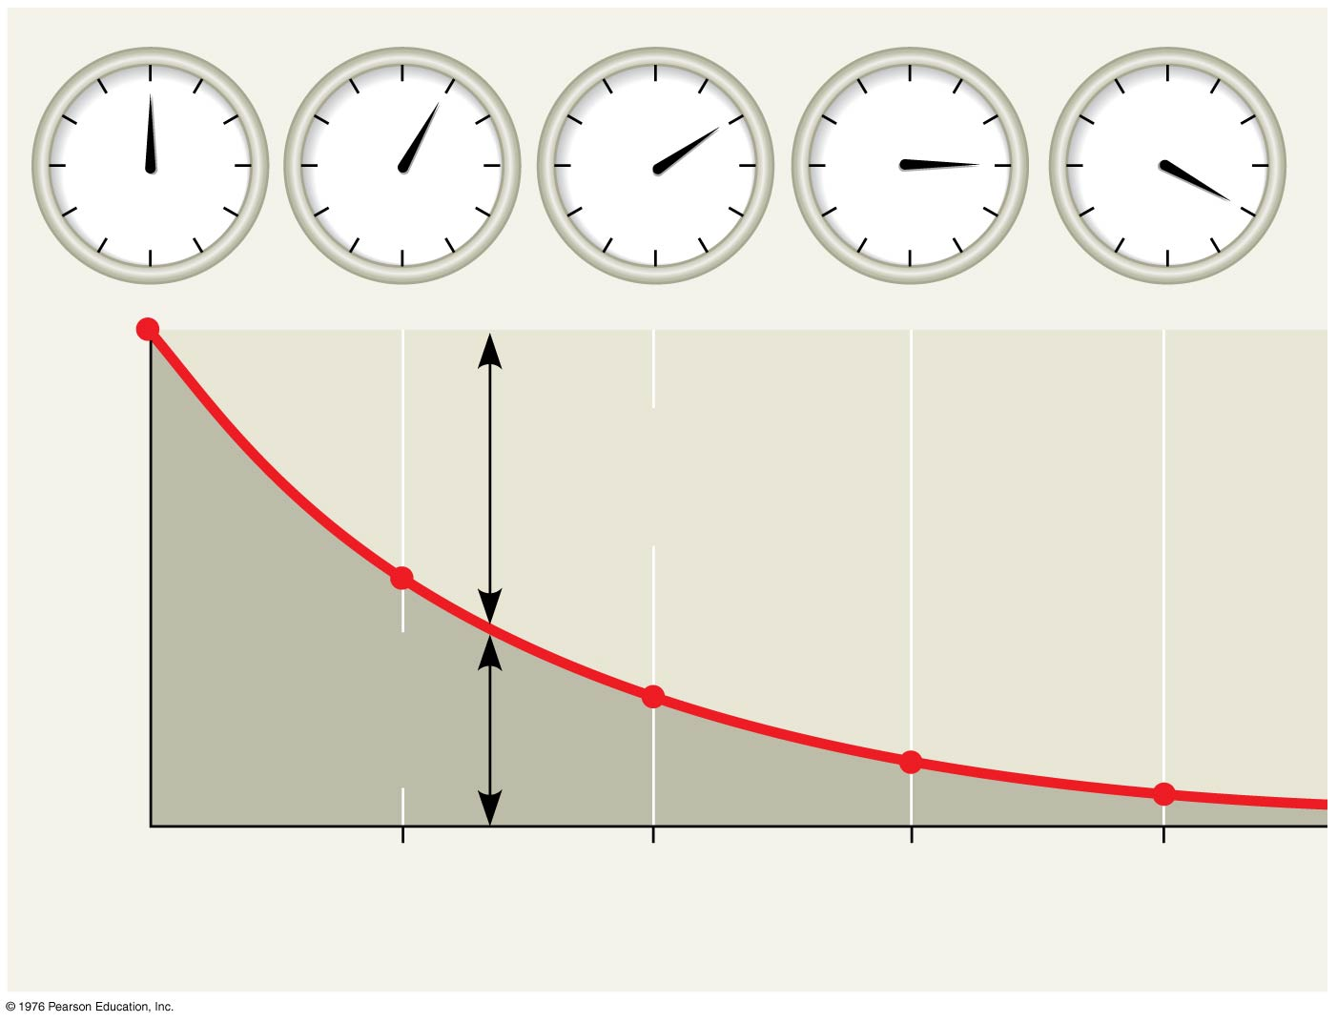
Figure 23.3
Accumulating
“daughter”
isotope
Fraction of parent
isotope remaining
½
Remaining
“parent”
isotope
¼
⅛
1
16
1
2
3
4
Time (half-lives)
Notes:
7
Figure 23.3 Radiometric dating

Slide 8
The Origin of New Groups of Organisms
Mammals belong to the group of animals called tetrapods
The evolution of unique mammalian features can be traced through gradual changes over time
Notes:
8

Slide 9
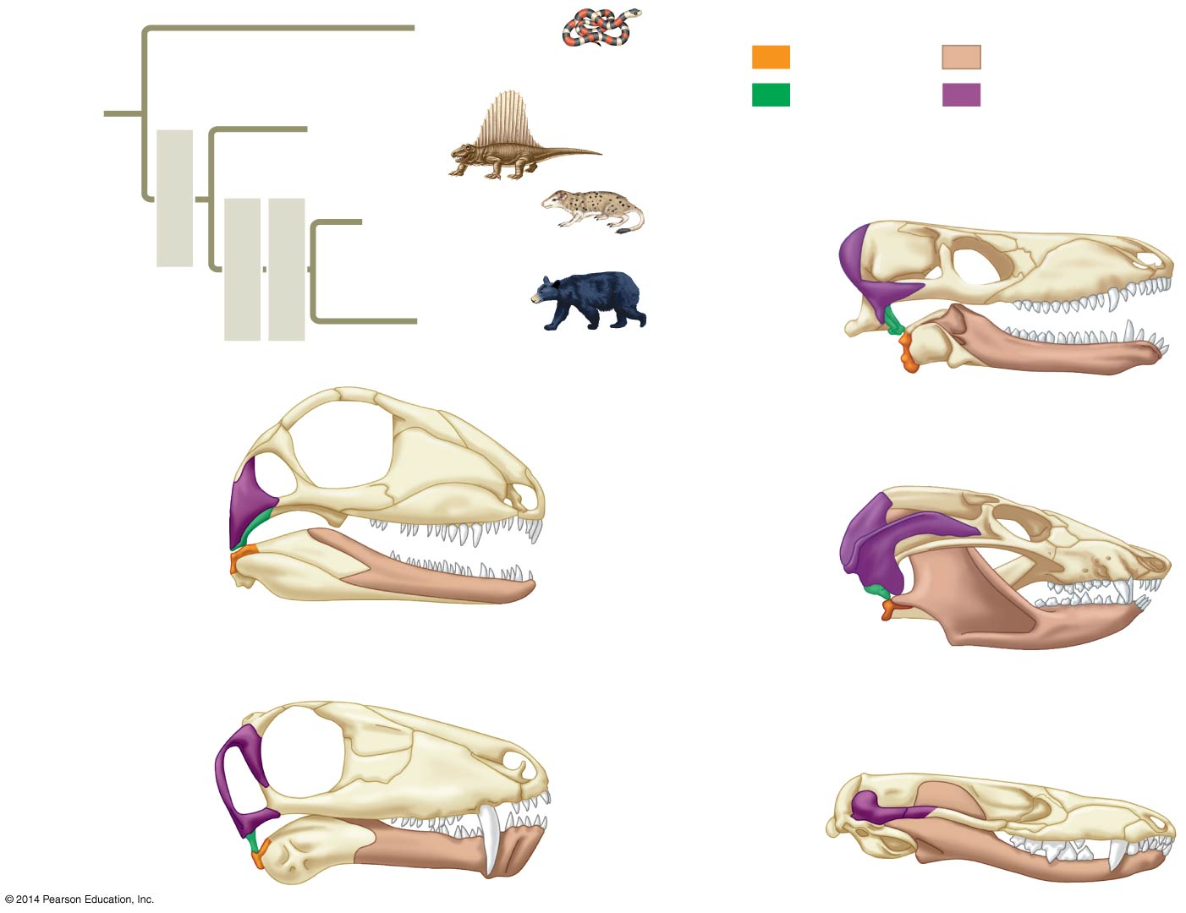
Figure 23.4
Reptiles
(including
dinosaurs and birds)
Key to skull bones
Articular
Dentary
OTHER
TETRA-
PODS
Quadrate
Squamosal
†Dimetrodon
Early cynodont (260 mya)
Synapsids
†Very late (non- mammalian) cynodonts
Temporal
fenestra
(partial view)
Therapsids
Cynodonts
Mammals
Synapsid (300 mya)
Hinge
Later cynodont (220 mya)
Temporal
fenestra
Hinge
Original hinge
New hinge
Therapsid (280 mya)
Very late cynodont (195 mya)
Temporal
fenestra
Hinge
Hinge
Notes:
9
Figure 23.4 Exploring the origin of mammals

Slide 10
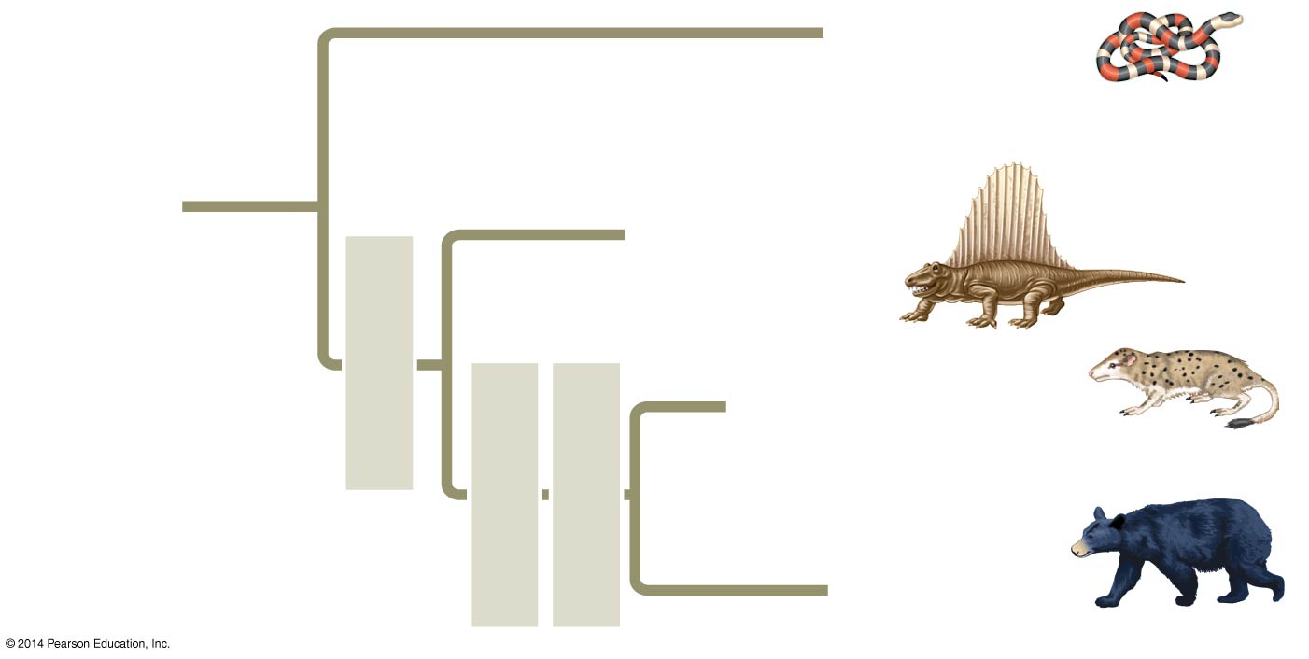
Figure 23.4a
Reptiles
(including
dinosaurs and birds)
OTHER
TETRAPODS
†Dimetrodon
Synapsids
†Very late (non- mammalian) cynodonts
Therapsids
Cynodonts
Mammals
Notes:
10
Figure 23.4a Exploring the origin of mammals (part 1: tetrapod tree)

Slide 11
Synapsids (300 mya) had single-pointed teeth, large temporal fenestra, and a jaw hinge between the articular and quadrate bones
Notes:
11

Slide 12
Therapsids (280 mya) had large dentary bones, long faces, and specialized teeth, including large canines
Notes:
12

Slide 13
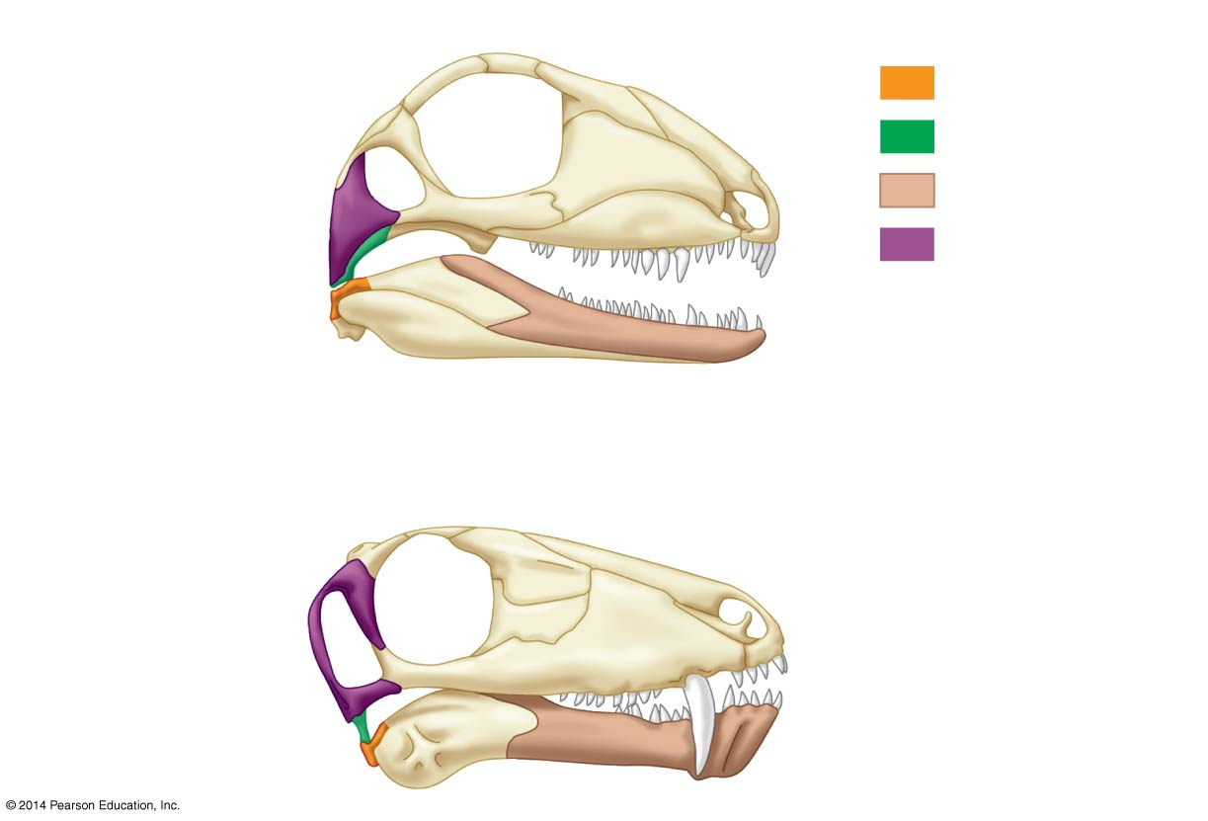
Figure 23.4b
Synapsid (300 mya)
Key to skull bones
Articular
Quadrate
Temporal
fenestra
Dentary
Squamosal
Hinge
Therapsid (280 mya)
Temporal
fenestra
Hinge
Notes:
13
Figure 23.4b Exploring the origin of mammals (part 2: synapsids and therapsids)

Slide 14
Early cynodonts (260 mya) had large dentary bones in the lower jaw, large temporal fenestra in front of the jaw hinge, and teeth with several cusps
Notes:
14

Slide 15
Later cynodonts (220 mya) had teeth with complex cusp patterns and an additional jaw hinge between the dentary and squamosal bones
Notes:
15

Slide 16
Very late cynodonts (195 mya) lost the original articular-quadrate jaw hinge
The articular and quadrate bones formed inner ear bones that functioned in transmitting sound
In mammals, these bones became the hammer (malleus) and anvil (incus) bones of the ear
Notes:
16

Slide 17
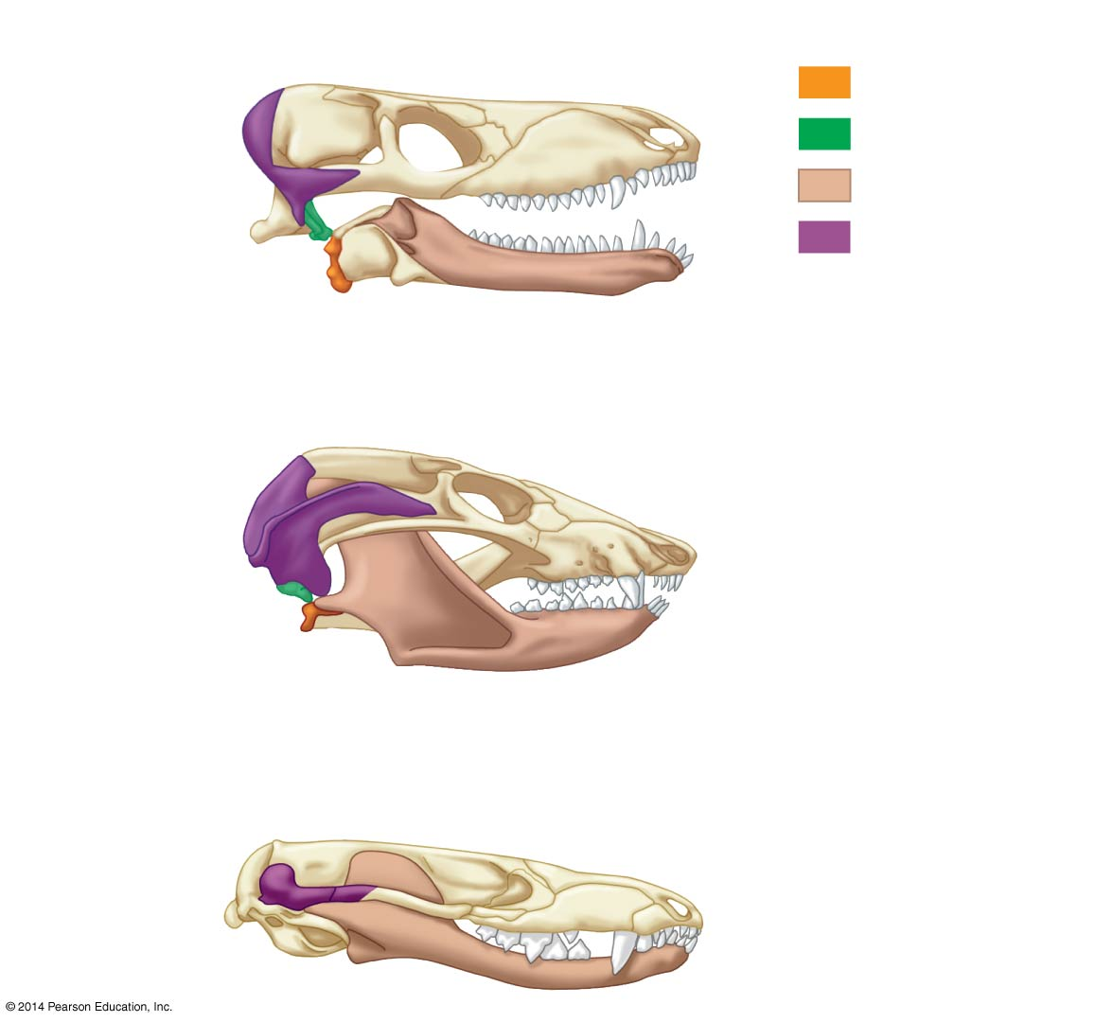
Figure 23.4c
Early cynodont (260 mya)
Key to skull bones
Articular
Temporal
fenestra
(partial view)
Quadrate
Dentary
Squamosal
Hinge
Later cynodont (220 mya)
Original hinge
New hinge
Very late cynodont (195 mya)
Hinge
Notes:
17
Figure 23.4c Exploring the origin of mammals (part 3: cynodonts)

Slide 18
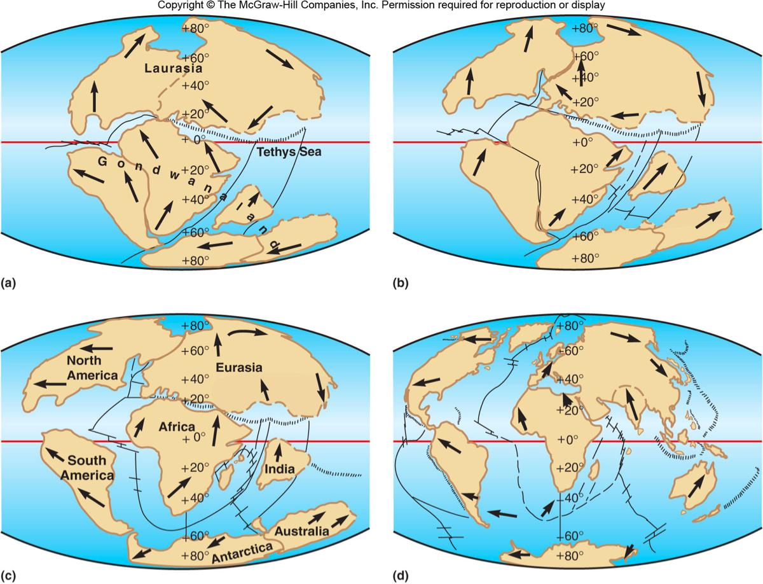
Effects of Continental Drift
1.) Climate change!
regional
continental
2.) Macroevolution due to allopatric speciation

Slide 19
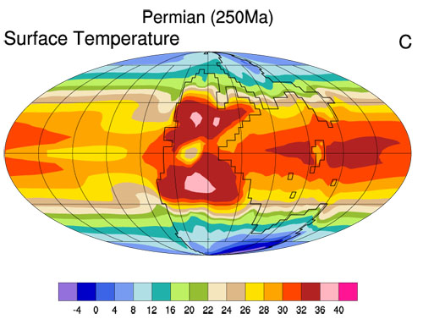
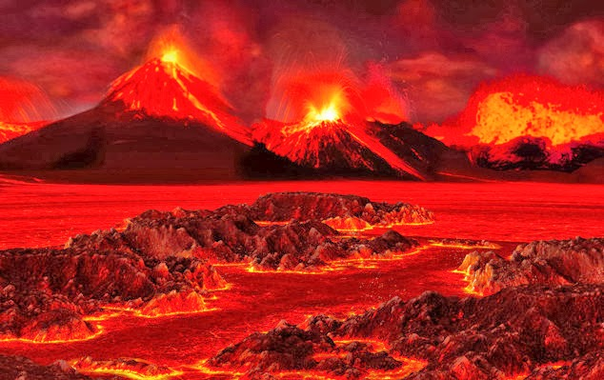
5 Mass Extinctions?
Permian – 96% of marine life
Leading hypothesis: Supreme Volcanism
Mechanism (besides lava)
Raise global temperature 6 deg
Slow ocean water mixing → H₂S

Slide 20
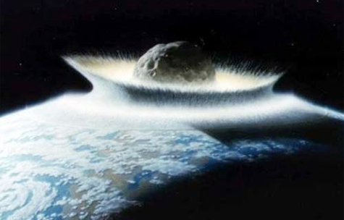
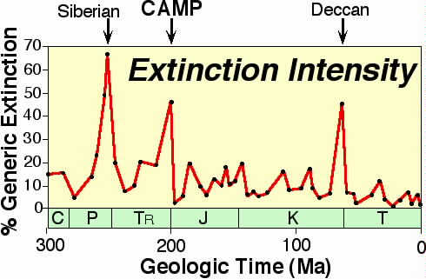
5 Mass Extinctions?
Cretaceous
50% of marine life, families of plants and animals, and all of the dinosaurs (except birds)
Leading hypothesis: Meteorite
High cloud of debris – blocking sun

Slide 21
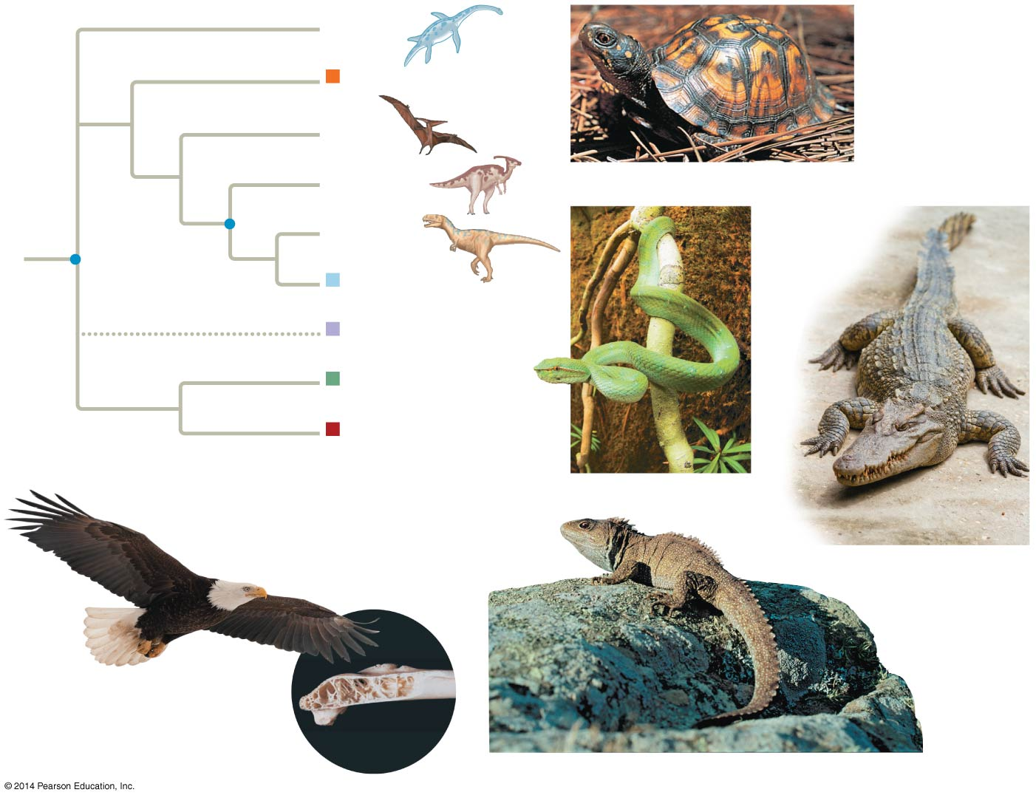
Figure 27.26
†Plesiosaurs
Crocodilians
†Pterosaurs
Common
ancestor
of reptiles
†Ornithischian
dinosaurs
Turtles
†Saurischian
dinosaurs other
than birds
Common
ancestor
of dinosaurs
Birds
Turtles
Tuataras
Squamates
Squamates
Crocodilians
Birds
Tuataras
Notes:
21
Figure 27.26 Exploring reptilian diversity

Slide 22
Effect of Mass Extinction
Loss of novel traits
Alter communities
Loss of Diversity
Adaptive Radiation

Slide 23
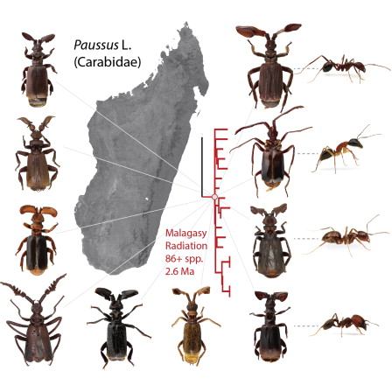
Adaptive Radiation
Periods of evolutionary change in which groups of organisms form many new species
whose adaptations allow them to fill different ecological niches in their communities

Slide 24
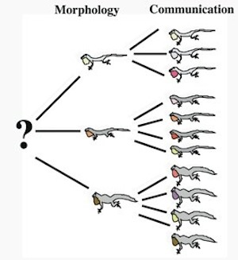
Adaptive Radiation
Definitely after 5 Mass Extinctions
Also occurred when groups posses major evolutionary innovations
Seeds, exoskeleton, or little competition land plants

Slide 26
Major changes in body form can result from changes in the sequences and regulation of developmental genes
Studying genetic mechanisms of change can provide insight into large-scale evolutionary change
Notes:
26

Slide 27
Effects of Development Genes
Genes that program development influence the rate, timing, and spatial pattern of changes in an organism’s form as it develops into an adult
Heterochrony is an evolutionary change in the rate or timing of developmental events
Notes:
27

Slide 28
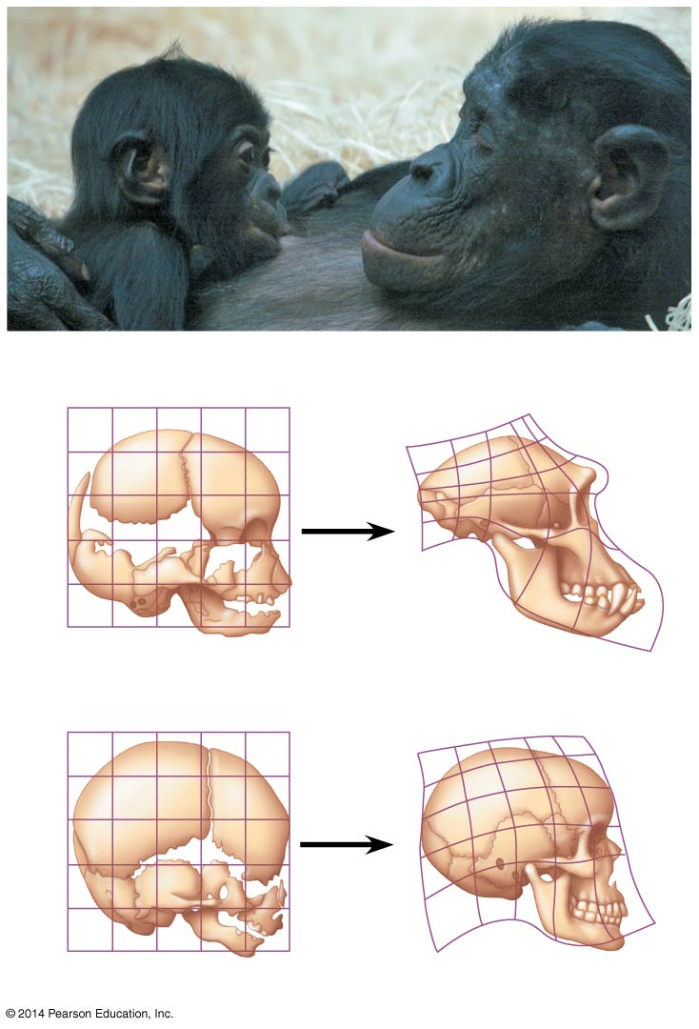
Figure 23.16
Chimpanzee infant
Chimpanzee adult
Chimpanzee fetus
Chimpanzee adult
Human fetus
Human adult
Notes:
28
Figure 23.16 Relative skull growth rates

Slide 29
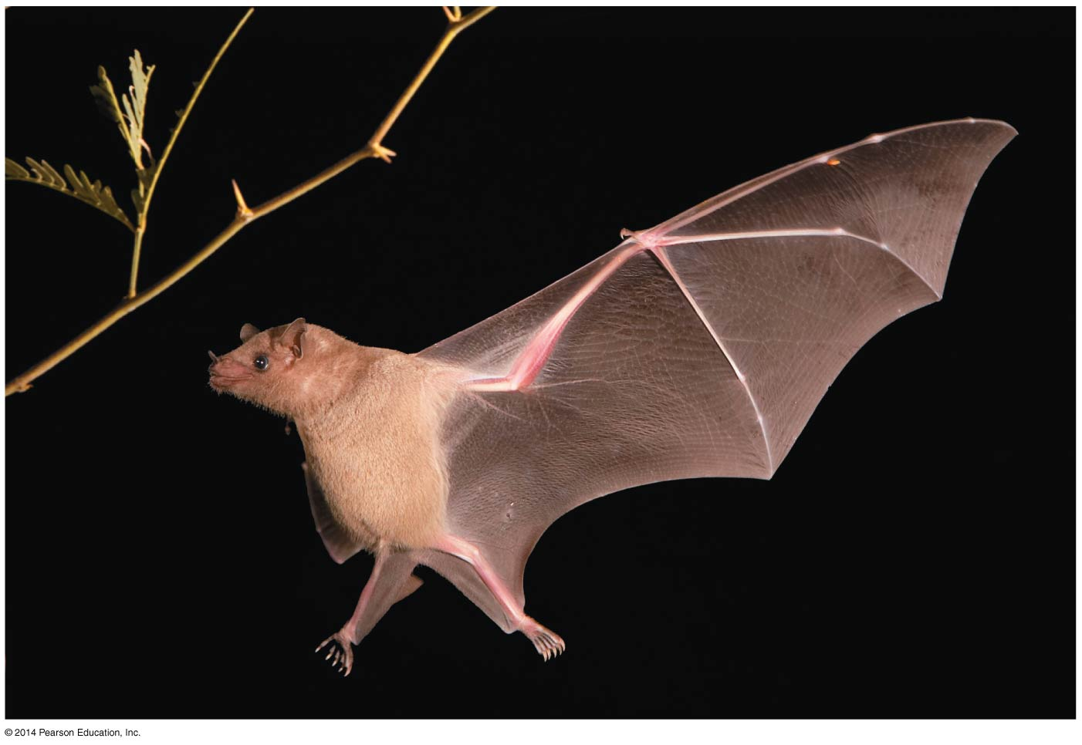
Heterochrony of finger bones
Hand and
finger bones
Notes:
29
Figure 23.17 Elongated hand and finger bones in a bat wing

Slide 30
Changes in Spatial Pattern
Substantial evolutionary change can also result from alterations in genes that control the placement and organization of body parts
Homeotic genes determine such basic features as where wings and legs will develop on a bird or how a flower’s parts are arranged
Notes:
30
Homeotic genes are genes which regulate the development of anatomical structures in various organisms such as insects, mammals, and plants. This regulation is done via the programming of various transcription factors by the homeotic genes, and these factors affect genes through regulatory genetic pathways.

Slide 31
Hox genes are a class of homeotic genes that provide positional information during animal development
If Hox genes are expressed in the wrong location, body parts can be produced in the wrong location
For example, in crustaceans, a swimming appendage can be produced instead of a feeding appendage
Notes:
31

Slide 32
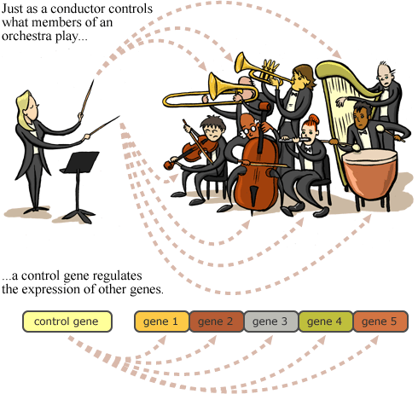

Slide 33
The Evolution of Development
Adaptive evolution of both new and existing genes may have played a key role in shaping the diversity of life
Developmental genes may have been particularly important in this process
Notes:
33

Slide 34
Changes in Gene Sequence
New morphological forms likely come from gene duplication events that produce new developmental genes
A possible mechanism for the evolution of six-legged insects from a many-legged crustacean ancestor has been demonstrated in lab experiments
Specific changes in the Ubx gene have been identified that can “turn off” leg development
Notes:
34

Slide 35
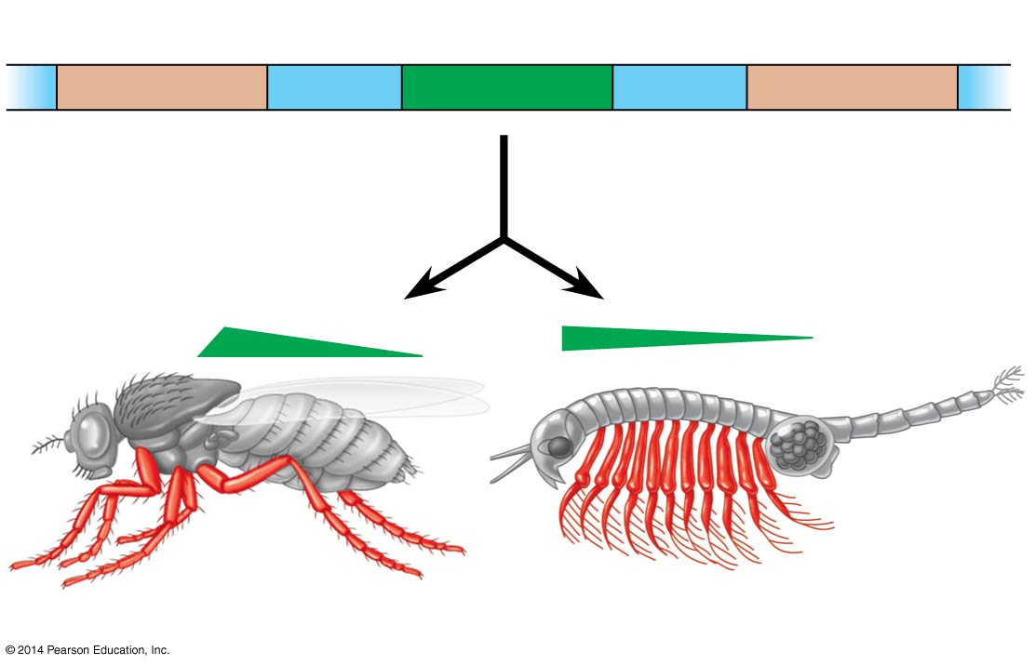
Figure 23.19
Hox gene 6
Hox gene 7
Hox gene 8
Ubx
About 400 mya
Drosophila
Artemia
Notes:
35
Figure 23.19 Origin of the insect body plan

Slide 36
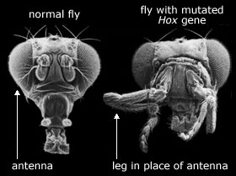
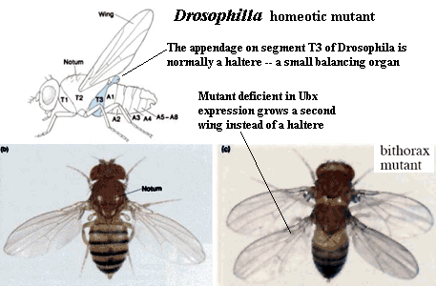

Slide 37
Changes in Gene Regulation
Changes in morphology likely result from changes in the regulation of developmental genes rather than changes in the sequence of developmental genes
For example, threespine sticklebacks in lakes have fewer spines than their marine relatives
The gene sequence remains the same, but the regulation of gene expression is different in the two groups of fish
Notes:
37

Slide 38
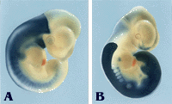
Razor-sharp Boundaries The blue color reveals the specific activity of two homeotic genes in mouse embryos. In figure A the HOX-D 2 gene is active earlier and nearer the embryo's head-end than the HOX-D 4 gene shown in figure B. In both cases there is a razor-sharp boundary at the upper end of the segment whereas gene activity is more diffuse further down.

Slide 39
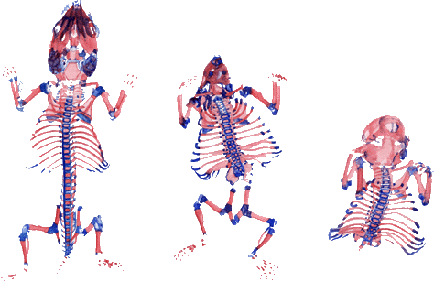
Normal mouse embryo | Retinoic acid: loss of many vertebrae | More retinoic acid: no posterior region formed

