Slide 1
Overview: Discovering Ecology
Ecology is the scientific study of the interactions between organisms and the environment
These interactions determine the distribution of organisms and their abundance
Modern ecology includes observation and experimentation
Notes:
1

Slide 2
The rediscovery of the nearly extinct harlequin toad in Costa Rica raises many ecological questions
What environmental factors limit their geographic distribution?
What factors (food, pathogens) affect population size?
Notes:
2

Slide 3
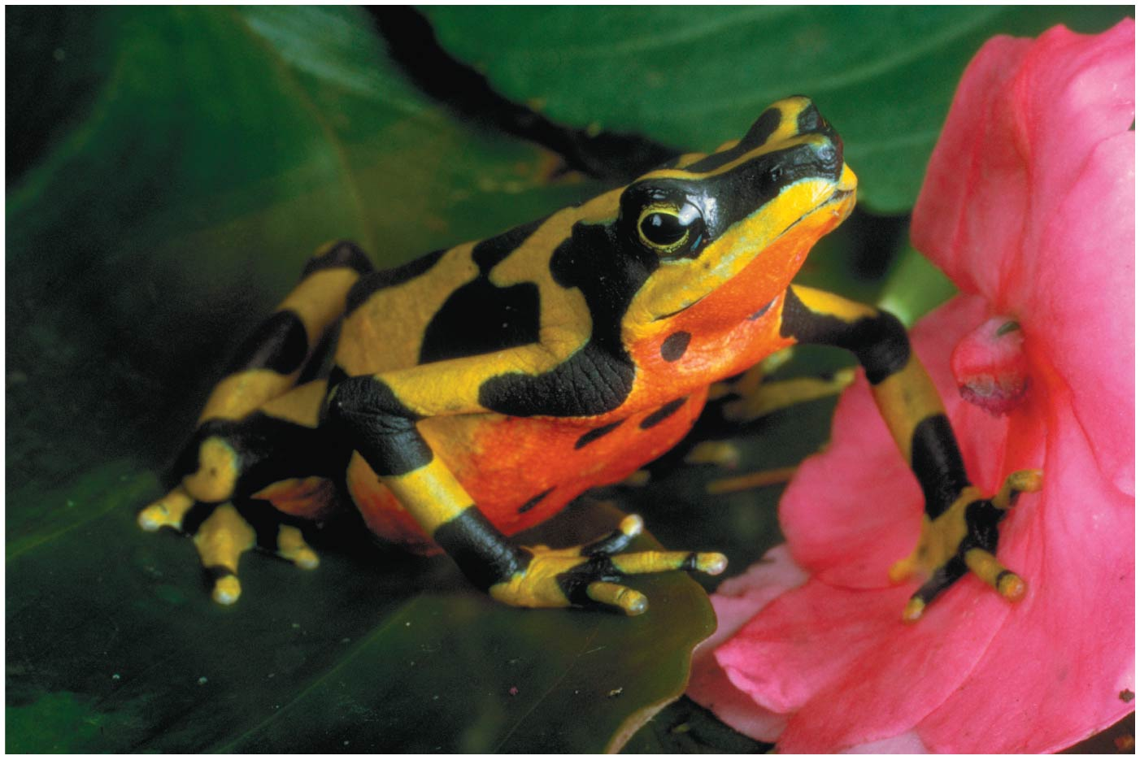
Figure 40.1
Notes:
3
Figure 40.1 What threatens this amphibian’s survival?

Slide 4
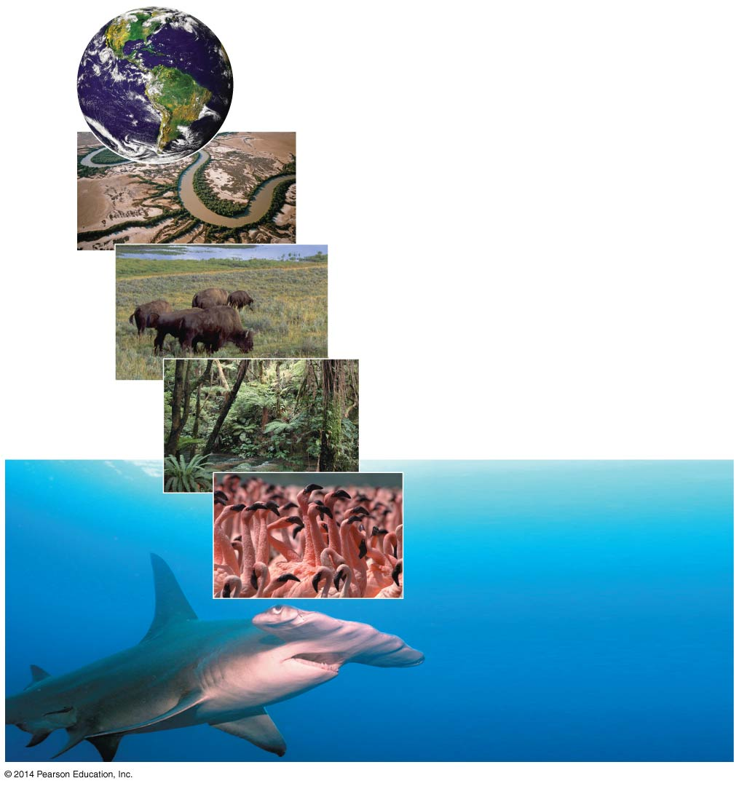
Figure 40.2
Global ecology
Landscape ecology
Ecosystem ecology
Community ecology
Population ecology
Organismal ecology
Notes:
4
Figure 40.2 Exploring the scope of ecological research

Slide 5
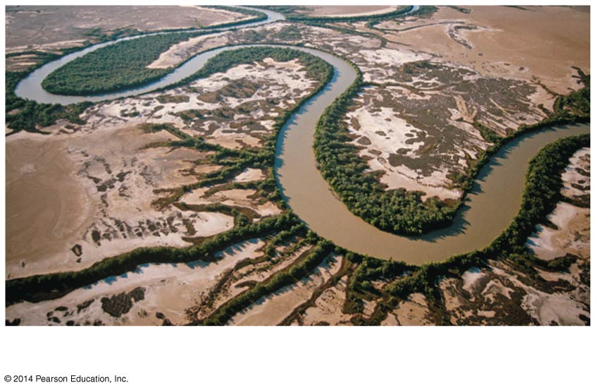
Figure 40.2b
Landscape ecology
Notes:
5
Figure 40.2b Exploring the scope of ecological research (part 2: landscape)

Slide 6
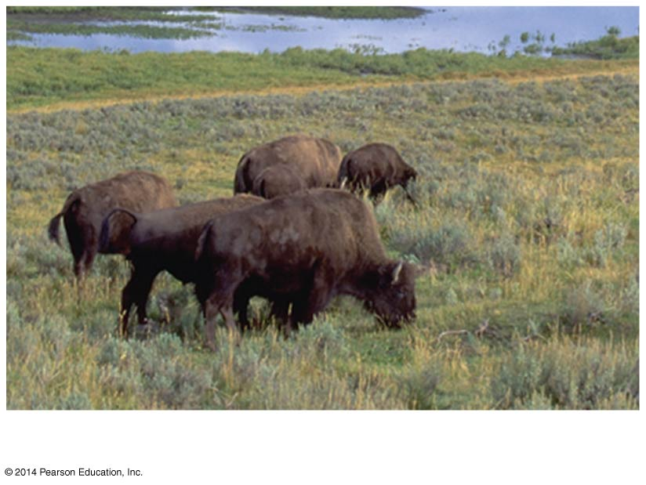
Figure 40.2c
Ecosystem ecology
Notes:
6
Figure 40.2c Exploring the scope of ecological research (part 3: ecosystem)

Slide 7
Community ecology deals with the whole array of interacting species in a community
A community is a group of populations of different species in an area
Notes:
7

Slide 8
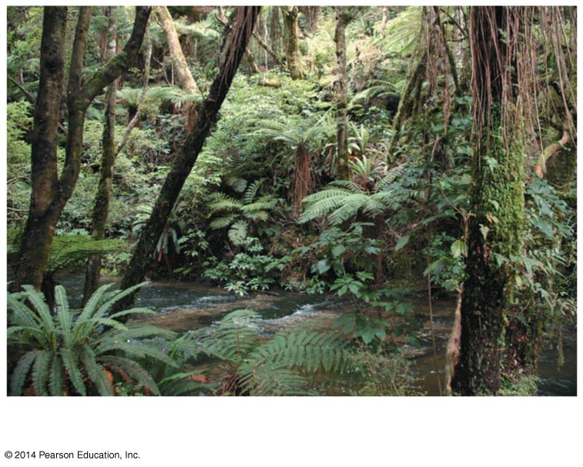
Figure 40.2d
Community ecology
Notes:
8
Figure 40.2d Exploring the scope of ecological research (part 4: community)

Slide 9
Population ecology focuses on factors affecting population size over time
A population is a group of individuals of the same species living in an area
Notes:
9

Slide 10
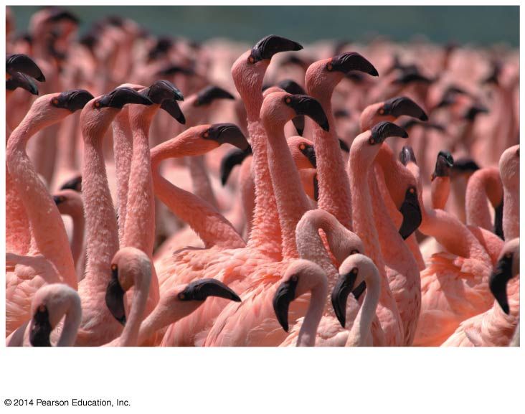
Figure 40.2e
Population ecology
Notes:
10
Figure 40.2e Exploring the scope of ecological research (part 5: population)

Slide 11
Concept 40.1: Earth’s climate influences the structure and distribution of terrestrial biomes
The long-term prevailing weather conditions in an area constitute its climate
Four major abiotic components of climate are temperature, precipitation, sunlight, and wind
Notes:
11

Slide 12
Abiotic factors are the nonliving chemical and physical attributes of the environment
Biotic factors are the other organisms that make up the living component of the environment
Macroclimate consists of patterns on the global, regional, and landscape level
Notes:
12

Slide 13
Global Climate Patterns
Global climate patterns are determined largely by solar energy and the planet’s movement in space
The warming effect of the sun causes temperature variations, which drive evaporation and the circulation of air and water
This causes latitudinal variations in climate
Notes:
13

Slide 14
Latitudinal variation in sunlight intensity is caused by the curved shape of Earth
Sunlight strikes the tropics, regions between 23.5° north and 23.5° south latitude, most directly
At higher latitudes, where sunlight strikes Earth at an oblique angle, light is more diffuse
Notes:
14

Slide 15
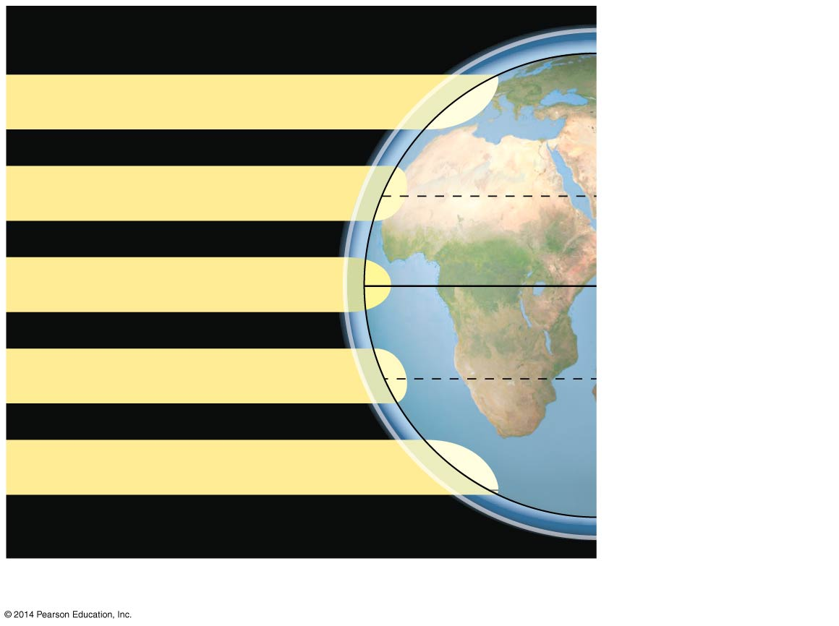
Figure 40.3a
Atmosphere
90°N (North Pole)
Low angle of incoming sunlight
23.5°N (Tropic of
Cancer)
Sun overhead at equinoxes
0° (Equator)
23.5°S (Tropic of
Capricorn)
Low angle of incoming sunlight
90°S (South Pole)
Latitudinal variation in sunlight intensity
Notes:
15
Figure 40.3a Exploring global climate patterns (part 1: sunlight intensity)

Slide 16
Global air circulation and precipitation patterns are initiated by intense solar radiation near the equator
Warm, wet air rising near the equator creates precipitation in the tropics
Dry air descending at 30° north and south latitudes causes desert conditions
This pattern of precipitation and drying is repeated at the 60° north and south latitudes and the poles
Notes:
16

Slide 17
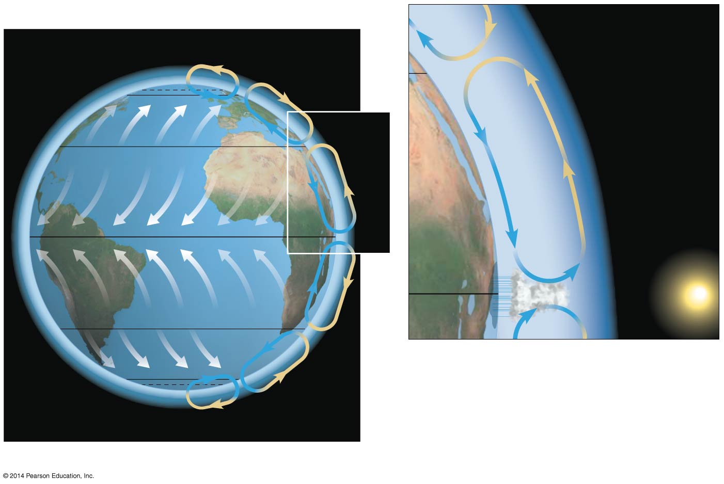
Figure 40.3b
66.5°N (Arctic Circle)
Descending
dry air
absorbs
moisture.
30°N
60°N
Westerlies
30°N
Ascending
moist air
releases
moisture.
Northeast trades
0°
Southeast trades
0°
30°S
Westerlies
60°S
66.5°S (Antarctic Circle)
Global air circulation and precipitation patterns
Notes:
17
Figure 40.3b Exploring global climate patterns (part 2: air circulation and precipitation)

Slide 18
Seasonality
Seasonal variations of light and temperature increase steadily toward the poles
Seasonality at high latitudes is caused by the tilt of Earth’s axis of rotation and its annual passage around the sun
Belts of wet and dry air straddling the equator shift throughout the year with the changing angle of the sun
Changing wind patterns affect ocean currents
Notes:
18

Slide 19
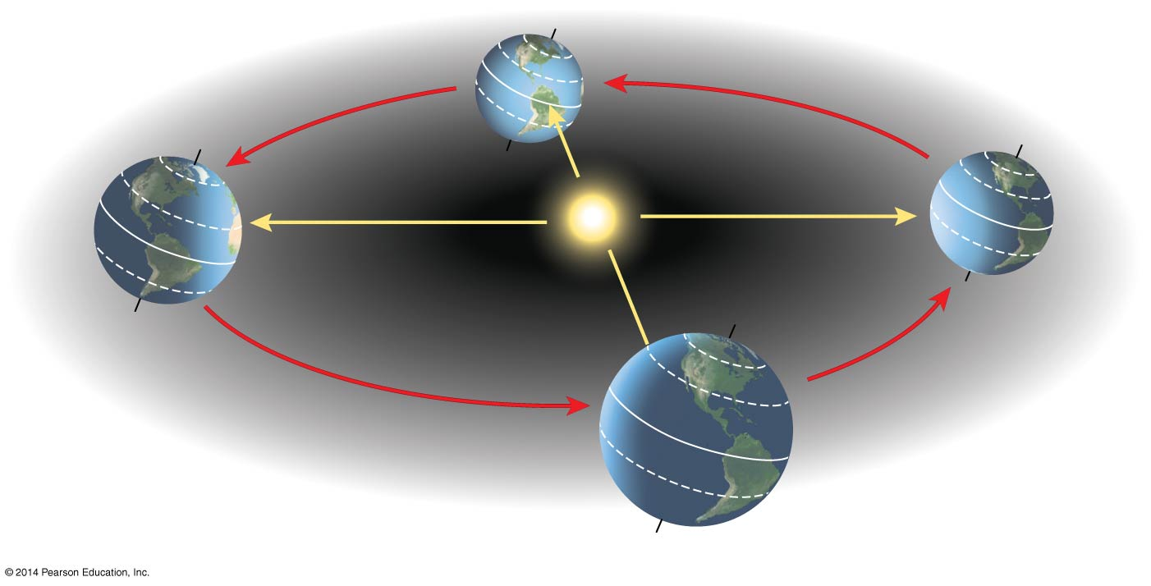
Figure 40.4
March equinox
December solstice
Constant tilt
of 23.5°
60°N
30°N
June solstice
0° (equator)
30°S
September equinox
Notes:
19
Figure 40.4 Seasonal variation in sunlight intensity

Slide 20
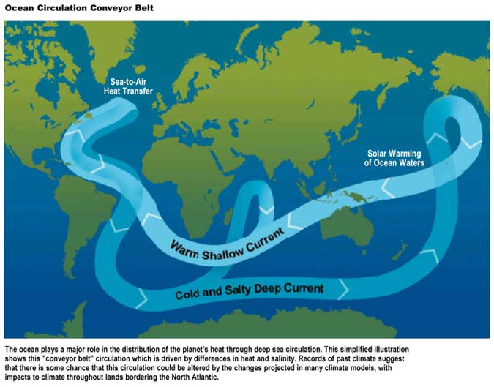

Slide 21
Bodies of Water
Oceans, their currents, and large lakes moderate the climate of nearby terrestrial environments
The California Current carries cold water southward along western North America
The Gulf Stream carries warm water from the equator to the North Atlantic
Notes:
21

Slide 22
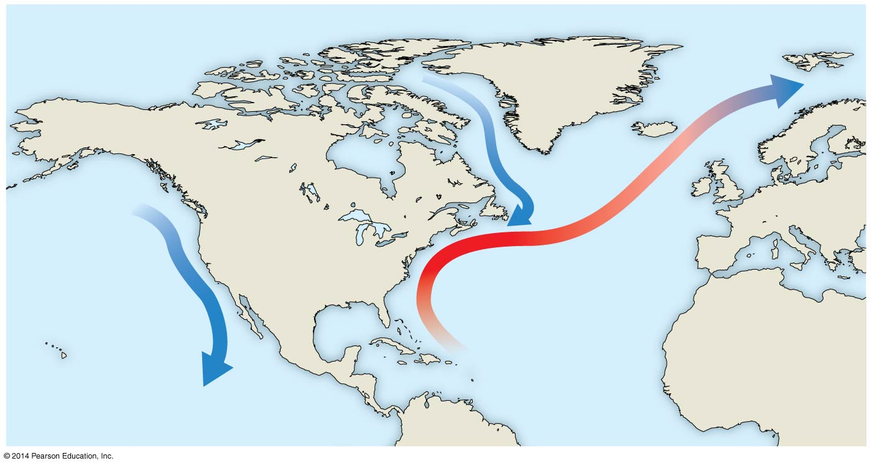
Figure 40.5
Labrador
Current
California
Current
Gulf Stream
PACIFIC
OCEAN
ATLANTIC
OCEAN
Notes:
22
Figure 40.5 Circulation of surface water in the oceans around North America

Slide 23
During the day, air rises over warm land and draws a cool breeze from the water across the land
As the land cools at night, air rises over the warmer water and draws cooler air from land back over the water, which is replaced by warmer air from offshore
Notes:
23

Slide 24
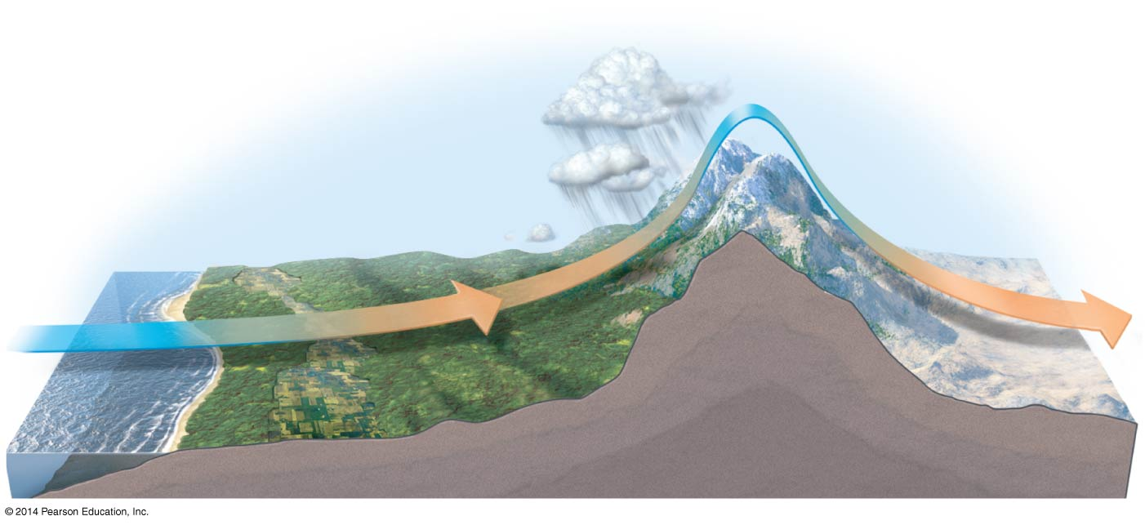
Figure 40.6
Air flow
Leeward side
of mountains
Mountain
range
Ocean
Notes:
24
Figure 40.6 How large bodies of water and mountains affect climate

Slide 25
Mountains
Rising air releases moisture on the windward side of a peak and creates a “rain shadow” as it absorbs moisture on the leeward side
Many deserts are found in the “rain shadow” of mountains
Notes:
25

Slide 26
Mountains affect the amount of sunlight reaching an area
In the Northern Hemisphere, south-facing slopes receive more sunlight than north-facing slopes
Every 1,000-m increase in elevation produces a temperature drop of approximately 6°C
Notes:
26

Slide 27
Climate and Terrestrial Biomes
Biomes are major life zones characterized by vegetation type (terrestrial biomes) or physical environment (aquatic biomes)
Climate is very important in determining why terrestrial biomes are found in certain areas
Climate affects the latitudinal patterns of terrestrial biomes
Notes:
27

Slide 28
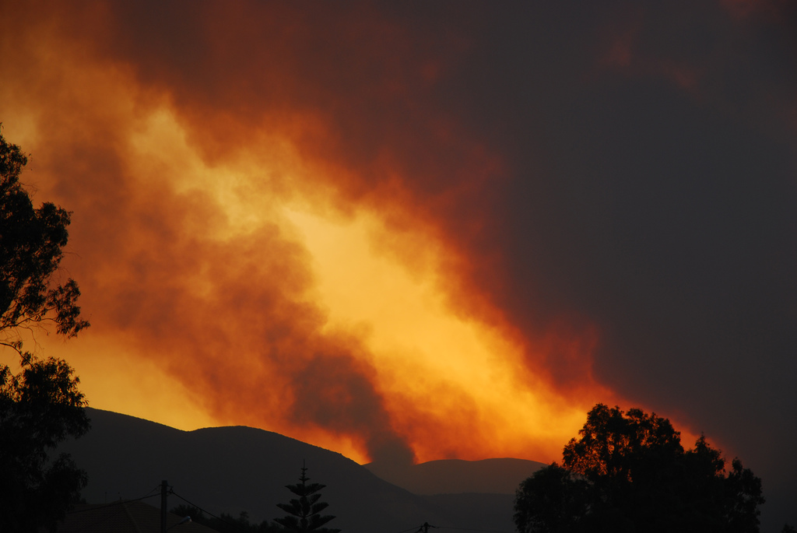
Natural and human-caused disturbances alter the distribution of biomes
A disturbance is an event that changes a community by removing organisms and altering resource availability
For example, frequent fires kill woody plants preventing woodlands from establishing
Notes:
28

Slide 29
Concept 40.3: Interactions between organisms and the environment limit the distribution of species
Species distributions are the result of ecological and evolutionary interactions through time
Ecological time is the minute-to-minute time frame of interactions between organisms and the environment
Evolutionary time spans many generations and captures adaptation through natural selection
Notes:
29

Slide 30
Ecologists ask questions about where species occur and why species occur where they do
Notes:
30

Slide 31
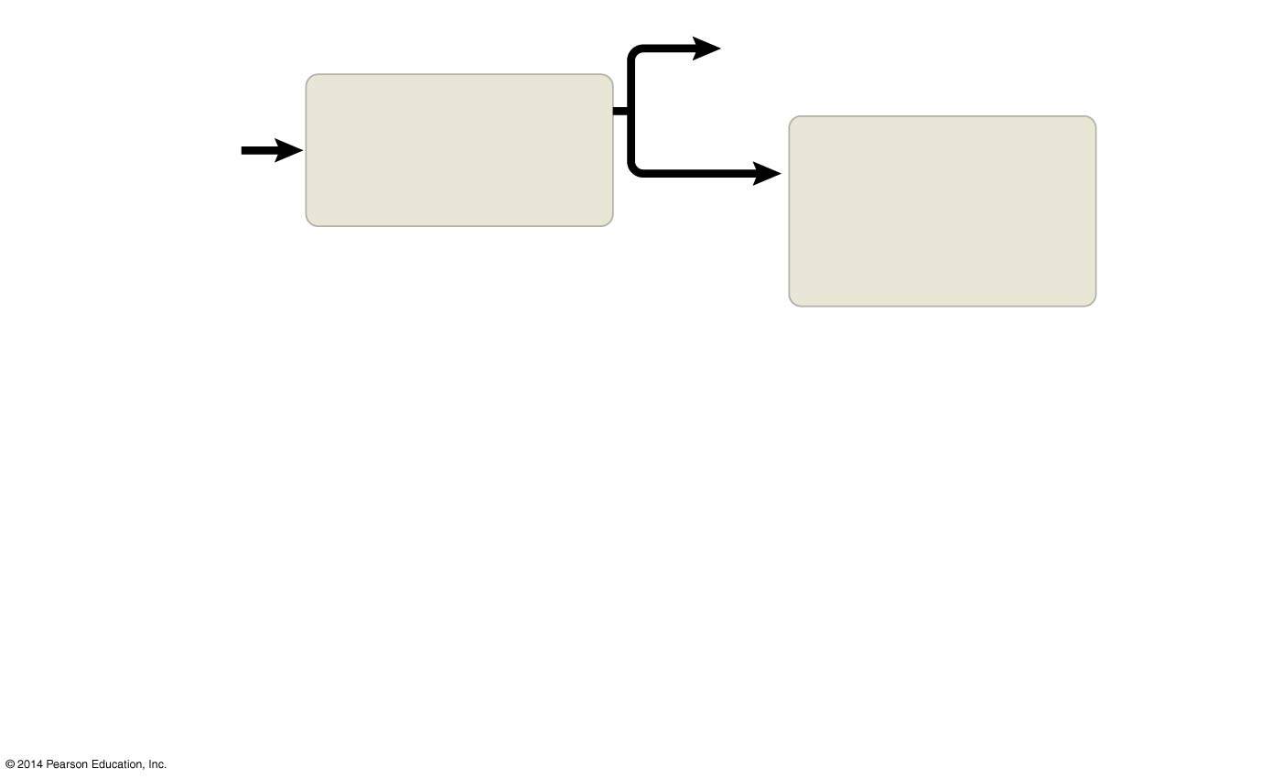
Figure 40.12-1
Yes
Area inaccessible
or insufficient time
Why is species
X absent from
an area?
Does dispersal
limit its
distribution?
Do biotic factors
(other species)
limit its
distribution?
No
Notes:
31
Figure 40.12-1 Flowchart of factors limiting geographic distribution (step 1)

Slide 32
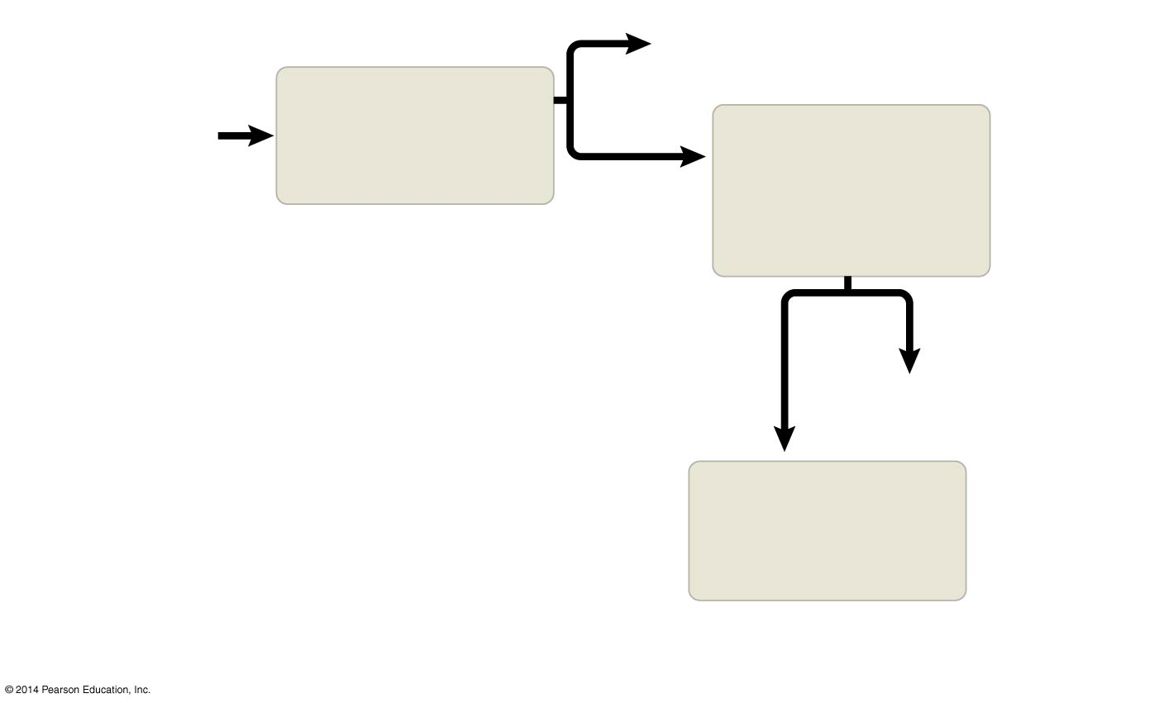
Figure 40.12-2
Yes
Area inaccessible
or insufficient time
Why is species
X absent from
an area?
Does dispersal
limit its
distribution?
Do biotic factors
(other species)
limit its
distribution?
No
Yes
No
Predation, parasitism,
competition, disease
Do abiotic factors
limit its
distribution?
Notes:
32
Figure 40.12-2 Flowchart of factors limiting geographic distribution (step 2)

Slide 33
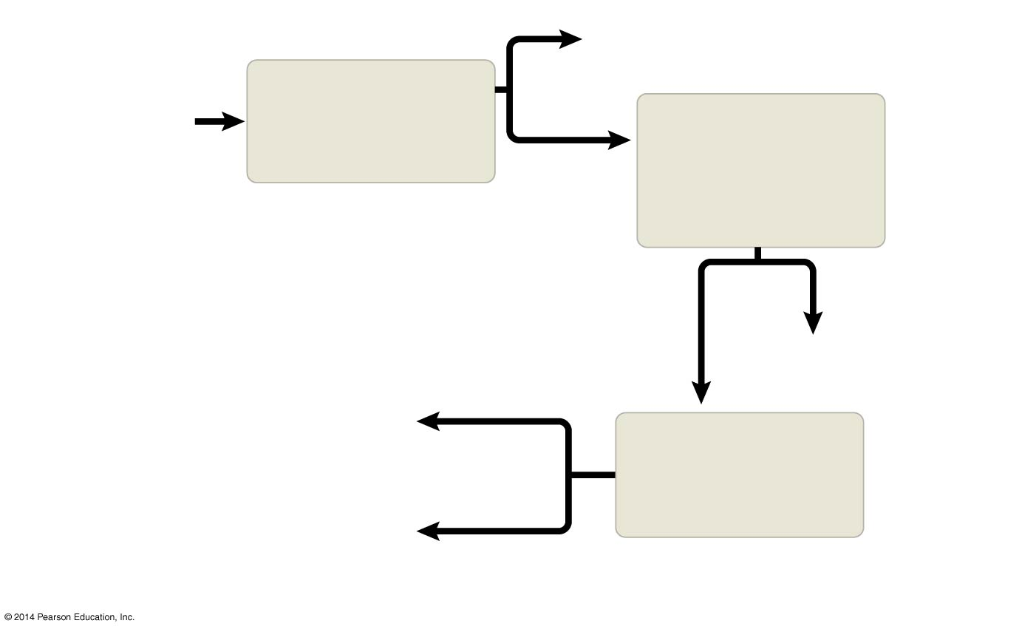
Figure 40.12-3
Yes
Area inaccessible
or insufficient time
Why is species
X absent from
an area?
Does dispersal
limit its
distribution?
Do biotic factors
(other species)
limit its
distribution?
No
Yes
No
Chemical
factors
Predation, parasitism,
competition, disease
Water, oxygen, salinity,
pH, soil nutrients, etc.
Do abiotic factors
limit its
distribution?
Temperature, light,
soil structure, fire,
moisture, etc.
Physical
factors
Notes:
33
Figure 40.12-3 Flowchart of factors limiting geographic distribution (step 3)

Slide 34
Dispersal and Distribution
Dispersal is the movement of individuals away from centers of high population density or from their area of origin
Dispersal contributes to the global distribution of organisms
Notes:
34

Slide 35
Transplants indicate if dispersal is a key factor limiting species distributions
Transplants include organisms that are intentionally or accidentally relocated from their original distribution
If a transplant is successful, it indicates that the species’ potential range is larger than its actual range
Species transplants can disrupt the communities or ecosystems to which they have been introduced
Notes:
35

Slide 36
Biotic Factors
Biotic factors that affect the distribution of organisms may include
Predation
Herbivory
For example, sea urchins can limit the distribution of seaweeds
Mutualism
Parasitism
Competition
Notes:
36

Slide 37
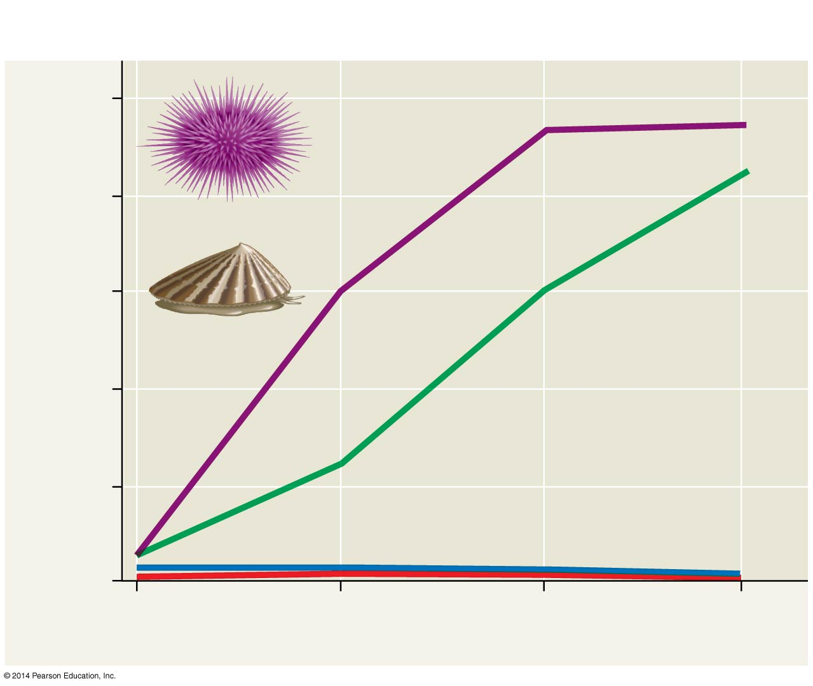
Figure 40.13
Results
100
Both limpets and urchins
removed
80
Sea urchin
Only urchins
removed
60
Seaweed cover (%)
Limpet
40
Only limpets removed
20
Control (both urchins and limpets present)
0
August
1982
February
1983
August
1983
February
1984
Notes:
37
Figure 40.13 Inquiry: Does feeding by sea urchins limit seaweed distribution?

Slide 38
Abiotic Factors
Abiotic factors affecting the distribution of organisms include
Temperature
Water and oxygen
Salinity
Sunlight
Rocks and soil
Notes:
38

Slide 39
3/29
https://www.ttuhsc.edu/som/physiology/faculty/altenberg/project2.aspx
Biomedical Engineering
Populations
Density
Dispersion
Demographics
Growth
Hope to study growth
https://www.youtube.com/watch?v=-JIuKjaY3r4

Slide 42
Populations
Population ecology explores how biotic and abiotic factors influence density, distribution, and size of populations
A population is a group of individuals of a single species living in the same general area
Populations are described by their boundaries and size
Notes:
42

Slide 43
Density and Dispersion
Density is the number of individuals per unit area or volume
Dispersion is the pattern of spacing among individuals within the boundaries of the population
Notes:
43

Slide 44
Density: A Dynamic Perspective
In most cases, it is impractical or impossible to count all individuals in a population
Sampling techniques can be used to estimate densities and total population sizes
Population density can be estimated by extrapolation from small samples or an index of population size (e.g., number of nests)
Notes:
44

Slide 45
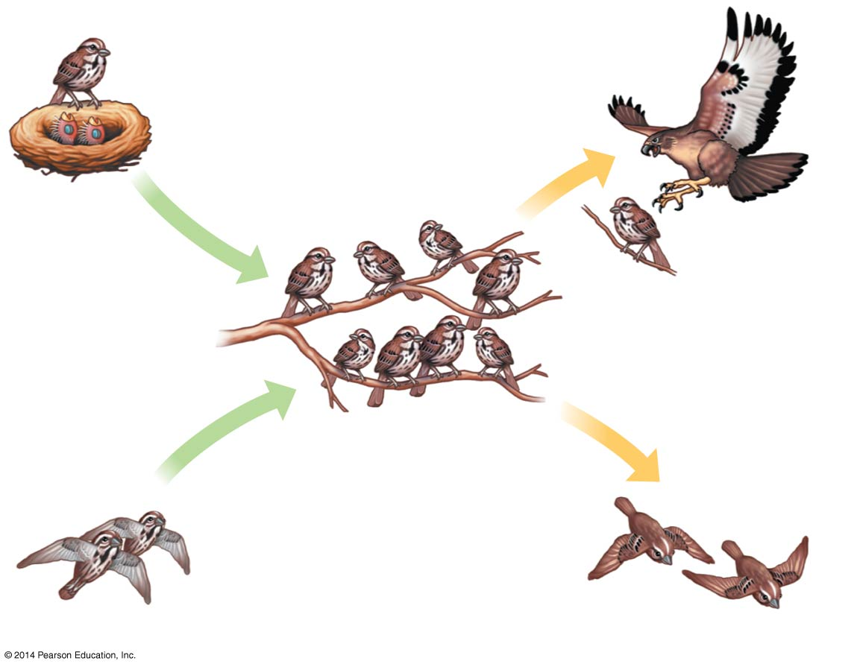
Figure 40.14
Births
Deaths
Births and
immigration
add individuals to
a population.
Deaths and
emigration
remove individuals
from a population.
Immigration
Emigration
Notes:
45
Figure 40.14 Population dynamics

Slide 46
Patterns of Dispersion
Environmental and social factors influence the spacing of individuals in a population
The most common pattern of dispersion is clumped, in which individuals aggregate in patches
A clumped dispersion may be influenced by resource availability and behavior
Notes:
46

Slide 47
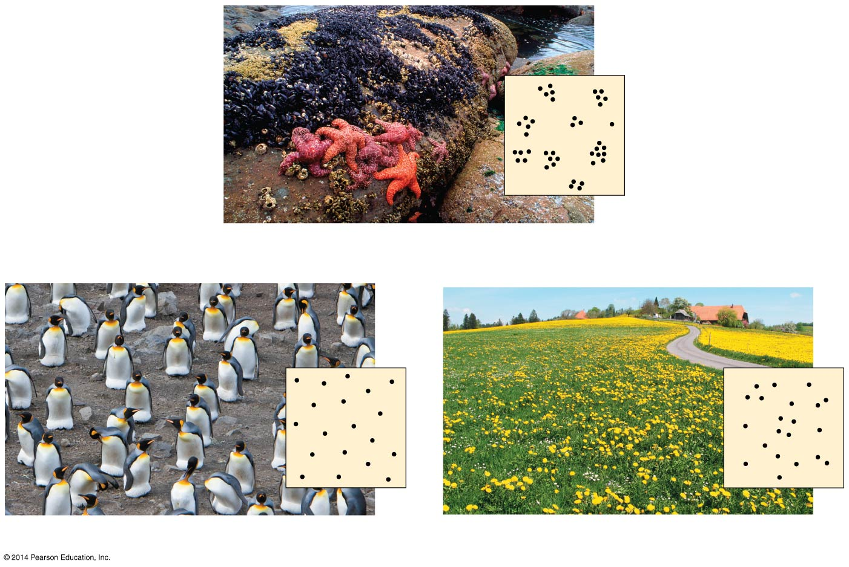
Figure 40.15
(a) Clumped
(b) Uniform
(c) Random
Notes:
47
Figure 40.15 Patterns of dispersion within a population’s geographic range

Slide 48
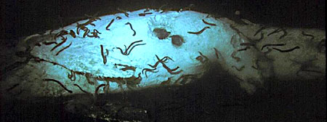
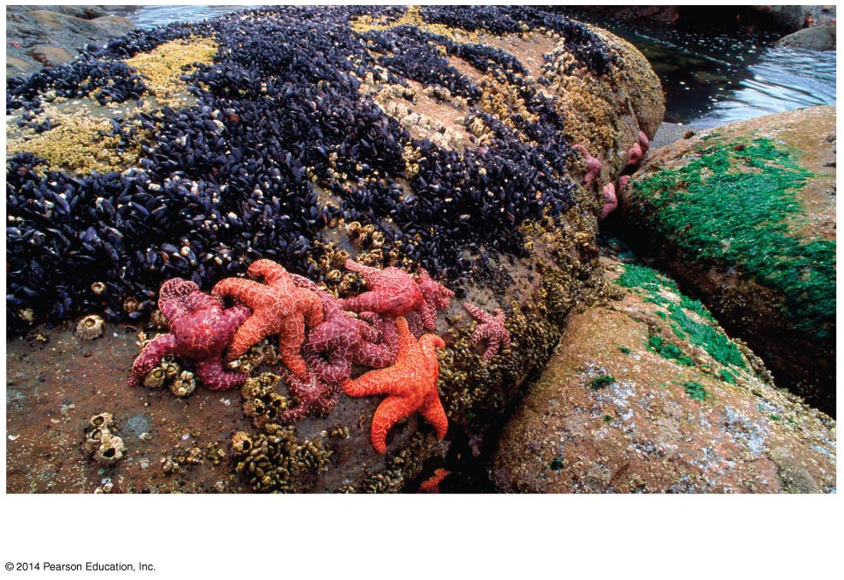
Figure 40.15a
(a) Clumped
Notes:
48
Figure 40.15a Patterns of dispersion within a population’s geographic range (part 1: clumped)

Slide 49
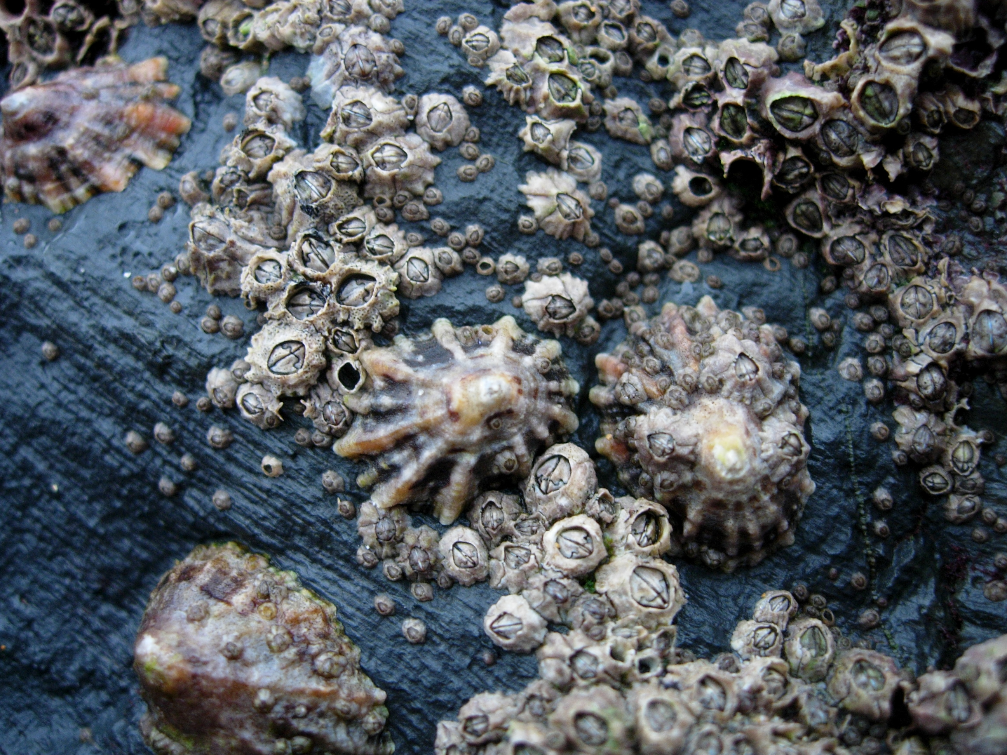
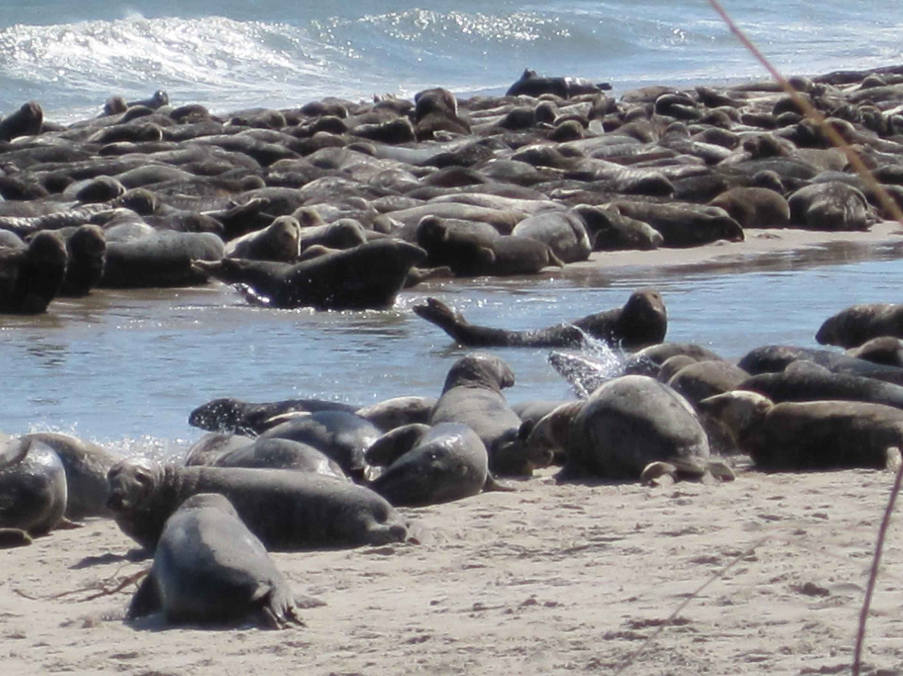
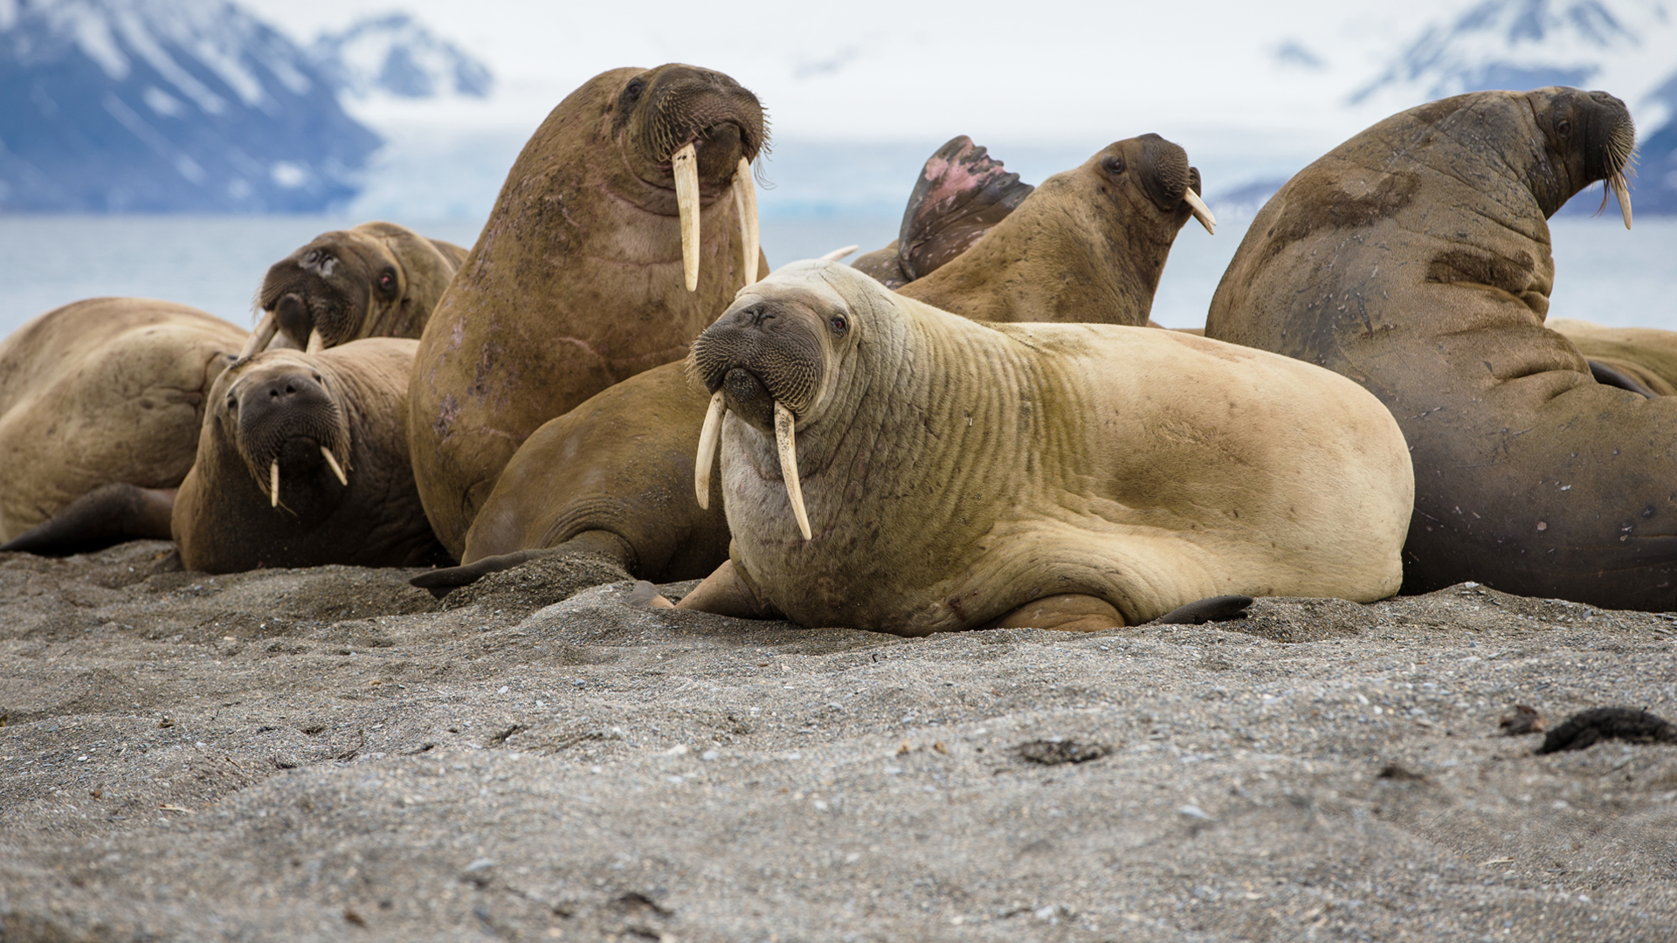

Slide 50
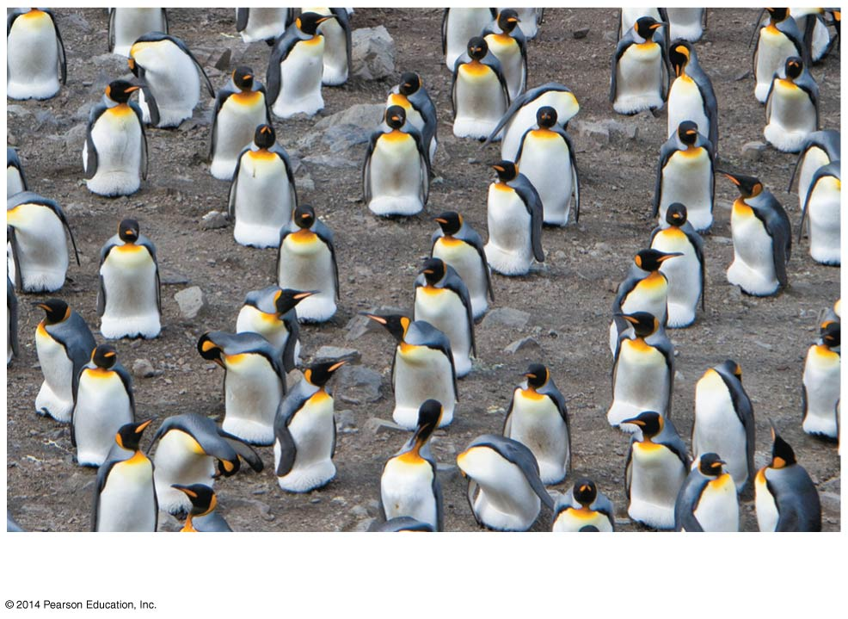
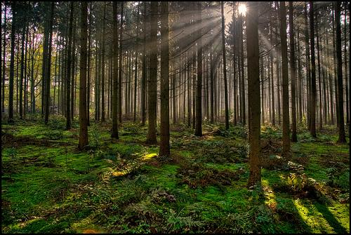
Figure 40.15b
(b) Uniform
Notes:
50
Figure 40.15b Patterns of dispersion within a population’s geographic range (part 2: uniform)

Slide 51
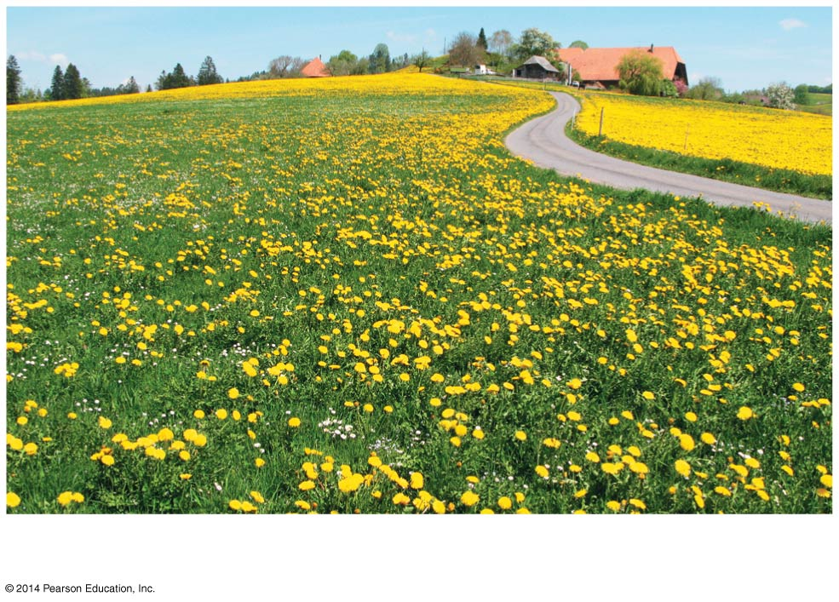
Figure 40.15c
(c) Random
Notes:
51
Figure 40.15c Patterns of dispersion within a population’s geographic range (part 3: random)

Slide 52
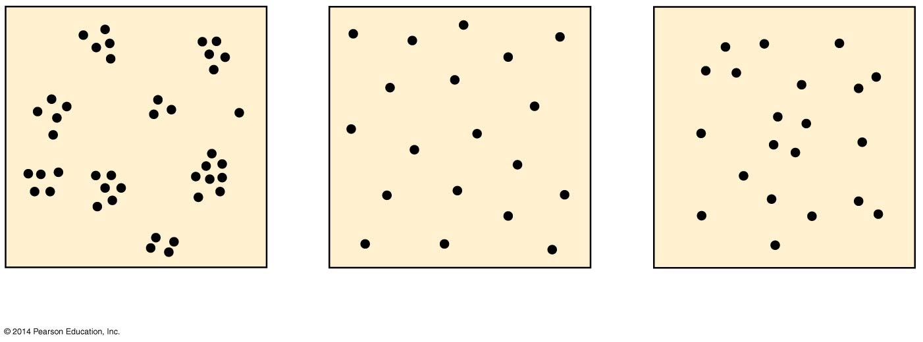
Figure 40.15d
(a) Clumped
(b) Uniform
(c) Random
Notes:
52
Figure 40.15d Patterns of dispersion within a population’s geographic range (part 4: diagrams)

Slide 53
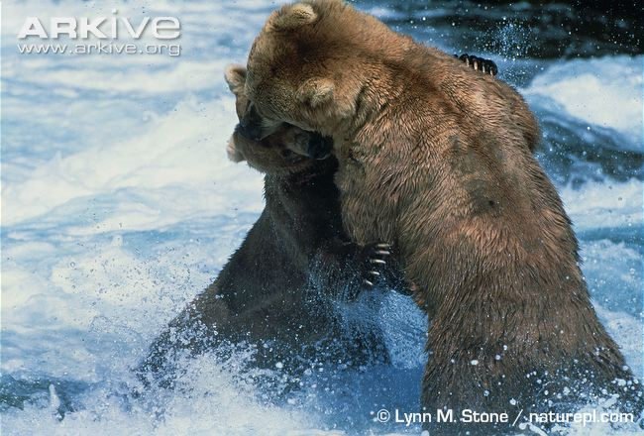
A uniform dispersion is one in which individuals are evenly distributed
It may be influenced by social interactions such as territoriality, the defense of a bounded space against other individuals
Notes:
53

Slide 54
In a random dispersion, the position of each individual is independent of other individuals
It occurs in the absence of strong attractions or repulsions
Notes:
54

Slide 55
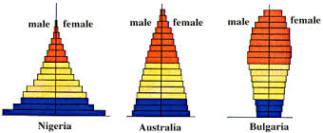
Demographics
Demography is the study of the vital statistics of a population and how they change over time
Death rates and birth rates are of particular interest to demographers
Notes:
55

Slide 56
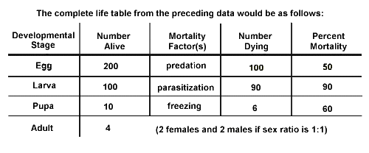
Life Tables
A life table is an age-specific summary of the survival pattern of a population
It is best made by following the fate of a cohort, a group of individuals of the same age, from birth to death
Notes:
56

Slide 58
Survivorship Curves
A survivorship curve is a graphic way of representing the data in a life table
Survivorship curves plot the proportion or numbers of a cohort still alive at each age
Notes:
58

Slide 59
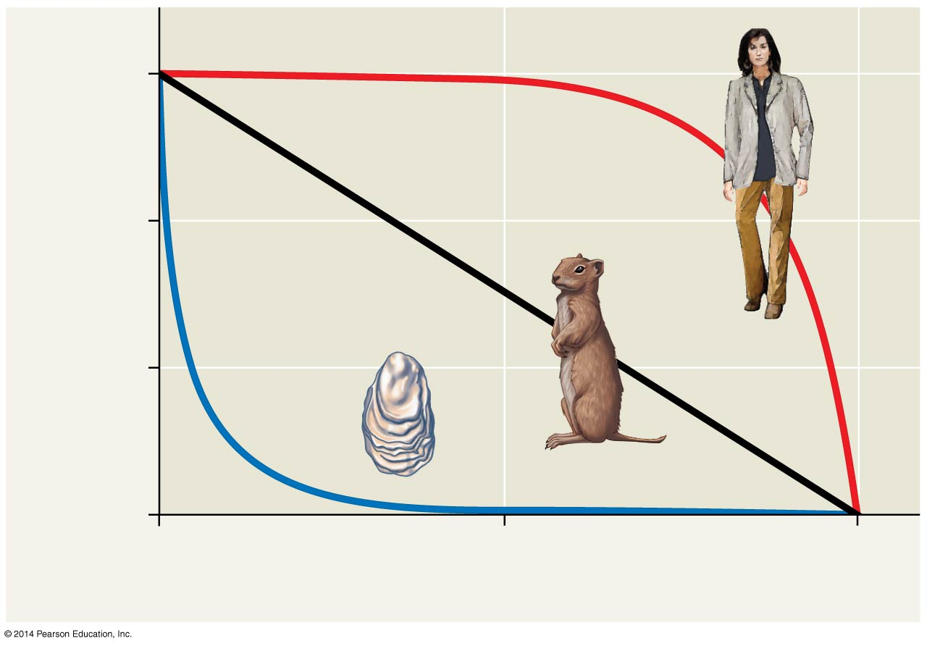
Figure 40.16
1,000
I
100
Number of survivors (log scale)
II
10
III
1
0
50
100
Percentage of maximum life span
Notes:
59
Figure 40.16 Idealized survivorship curves: types I, II, and III

Slide 60
Survivorship curves can be classified into three general types
Type I: low death rates during early and middle life and an increase in death rates among older age groups
Type II: a constant death rate over the organism’s life span
Type III: high death rates for the young and a lower death rate for survivors
Many species are intermediate to these curves
Notes:
60

Slide 61
Reproductive Rates
For species with sexual reproduction, demographers often concentrate on females in a population
A reproductive table, or fertility schedule, is an age-specific summary of the reproductive rates in a population
It describes the reproductive patterns of a population
Notes:
61

Slide 62
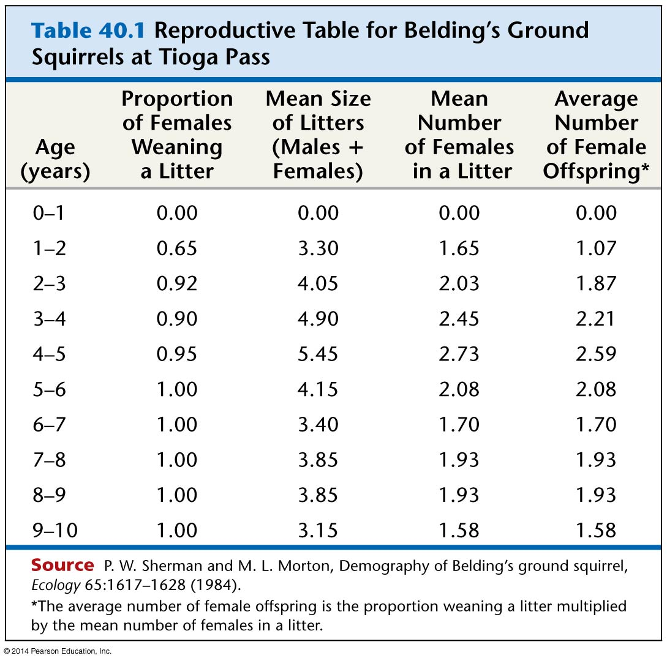
Table 40.1
Notes:
62
Table 40.1 Reproductive table for Belding’s ground squirrels

Slide 63
Concept 40.5: The exponential and logistic models describe the growth of populations
Unlimited growth occurs under ideal conditions; in nature, growth is limited by various factors
Ecologists study growth in both idealized and realistic conditions
Notes:
63

Slide 64
3/30
1.) Population Growth
2.) Exponential Growth
3.) Logistic Growth
4.) Limiting Factors
Density Independent
Density Dependant
5.) Vote at 2:55 on time
https://www.youtube.com/watch?v=VcSX4ytEfcE

Slide 65
Who is really overpopulated? | U.S.A. | India
Production / consumption of goods & services | 21% | 1%
Use of world's non-renewable resources | 25% | 3%
Creation of world's trash and pollution | 25% | 3%
Percent of world's population | 5% | 16%
 | ~280 million | ~1.10 billion

Slide 66
Elapsed time | Year | Human Population
~2,000,000 years | ~10,000 BC | 5 - 10 million
10,000 years | 1 A.D. | 170 million
1,800 years | 1800 | 1,000,000,000
130 years | 1930 | 2,000,000,000
30 years | 1960 | 3,000,000,000
15 years | 1975 | 4,000,000,000
12 years | 1987 | 5,000,000,000
12 years | 1999 | 6,000,000,000
51 years | 2050 | ??? 8,500,000,000 ???

Slide 67
Elapsed time | Year | Human Population
~2,000,000 years | ~10,000 BC | 5 - 10 million
10,000 years | 1 A.D. | 170 million
1,800 years | 1800 | 1,000,000,000
 | 1930 | 2,000,000,000
 | 1960 | 3,000,000,000
 | 1975 | 4,000,000,000
 | 1987 | 5,000,000,000
 | 1999 | 6,000,000,000
 | 2050 | ??? 8,500,000,000 ???

Slide 68
Elapsed time | Year | Human Population
~2,000,000 years | ~10,000 BC | 5 - 10 million
10,000 years | 1 A.D. | 170 million
1,800 years | 1800 | 1,000,000,000
130 years | 1930 | 2,000,000,000
 | 1960 | 3,000,000,000
 | 1975 | 4,000,000,000
 | 1987 | 5,000,000,000
 | 1999 | 6,000,000,000
 | 2050 | ??? 8,500,000,000 ???

Slide 69
Elapsed time | Year | Human Population
~2,000,000 years | ~10,000 BC | 5 - 10 million
10,000 years | 1 A.D. | 170 million
1,800 years | 1800 | 1,000,000,000
130 years | 1930 | 2,000,000,000
30 years | 1960 | 3,000,000,000
 | 1975 | 4,000,000,000
 | 1987 | 5,000,000,000
 | 1999 | 6,000,000,000
 | 2050 | ??? 8,500,000,000 ???

Slide 70
Elapsed time | Year | Human Population
~2,000,000 years | ~10,000 BC | 5 - 10 million
10,000 years | 1 A.D. | 170 million
1,800 years | 1800 | 1,000,000,000
130 years | 1930 | 2,000,000,000
30 years | 1960 | 3,000,000,000
15 years | 1975 | 4,000,000,000
 | 1987 | 5,000,000,000
 | 1999 | 6,000,000,000
 | 2050 | ??? 8,500,000,000 ???

Slide 71
Elapsed time | Year | Human Population
~2,000,000 years | ~10,000 BC | 5 - 10 million
10,000 years | 1 A.D. | 170 million
1,800 years | 1800 | 1,000,000,000
130 years | 1930 | 2,000,000,000
30 years | 1960 | 3,000,000,000
15 years | 1975 | 4,000,000,000
12 years | 1987 | 5,000,000,000
 | 1999 | 6,000,000,000
 | 2050 | ??? 8,500,000,000 ???

Slide 72
Elapsed time | Year | Human Population
~2,000,000 years | ~10,000 BC | 5 - 10 million
10,000 years | 1 A.D. | 170 million
1,800 years | 1800 | 1,000,000,000
130 years | 1930 | 2,000,000,000
30 years | 1960 | 3,000,000,000
15 years | 1975 | 4,000,000,000
12 years | 1987 | 5,000,000,000
12 years | 1999 | 6,000,000,000
 | 2050 | ??? 8,500,000,000 ???

Slide 73
Elapsed time | Year | Human Population
~2,000,000 years | ~10,000 BC | 5 - 10 million
10,000 years | 1 A.D. | 170 million
1,800 years | 1800 | 1,000,000,000
130 years | 1930 | 2,000,000,000
30 years | 1960 | 3,000,000,000
15 years | 1975 | 4,000,000,000
12 years | 1987 | 5,000,000,000
12 years | 1999 | 6,000,000,000
51 years | 2050 | ??? 8,500,000,000 ???

Slide 74
3/31

Slide 75
Per Capita Rate of Increase
Change in population size can be defined by the equation
If immigration and emigration are ignored, a population’s growth rate (per capita increase) equals birth rate minus death rate
Change in
population
size
Immigrants
entering
population
Emigrants
leaving
population
=
Births
+
−
Deaths
−
Notes:
75

Slide 76
The population growth rate can be expressed mathematically as
ΔN
Δt
= B −D
where ΔN is the change in population size, Δt is the time interval, B is the number of births, and D is the number of deaths
Notes:
76

Slide 77
Births and deaths can be expressed as the average number of births and deaths per individual during the specified time interval
B = bN
D = mN
where b is the annual per capita birth rate, m (for mortality) is the per capita death rate, and N is population size
Notes:
77

Slide 78
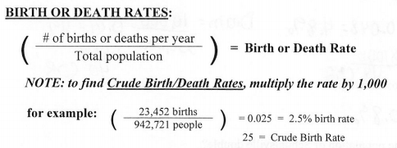

Slide 79
The population growth equation can be revised
ΔN
Δt
= bN −mN
Notes:
79

Slide 80
The per capita rate of increase (r) is given by
r = b − m
Zero population growth (ZPG) occurs when the birth rate equals the death rate (r = 0)
Notes:
80

Slide 81
Change in population size can now be written as
ΔN
Δt
= rN
Notes:
81

Slide 82
Instantaneous growth rate can be expressed as
dN
dt
= r_{inst}N
where r_{inst} is the instantaneous per capita rate of increase
Notes:
82

Slide 83
Exponential Growth
Exponential population growth is population increase under idealized conditions
Under these conditions, the rate of increase is at its maximum, denoted as r_{max}
The equation of exponential population growth is
dN
dt
= r_{max}N
Notes:
83

Slide 84
Exponential population growth results in a J-shaped curve
Notes:
84

Slide 85
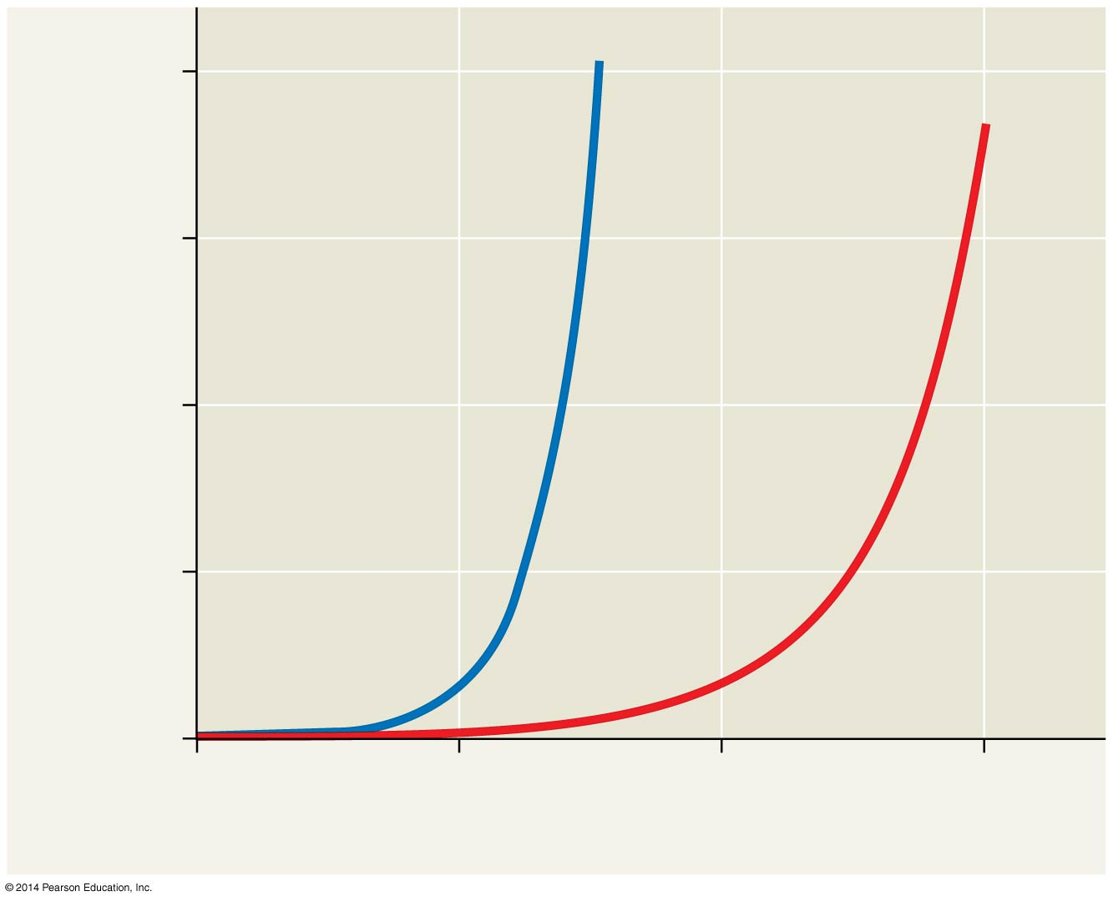
Figure 40.17
2,000
dN
= 1.0N
dt
1,500
dN
= 0.5N
dt
Population size (N)
1,000
500
0
0
5
10
15
Number of generations
Notes:
85
Figure 40.17 Population growth predicted by the exponential model

Slide 86
The J-shaped curve of exponential growth characterizes populations in new environments or rebounding populations
For example, the elephant population in Kruger National Park, South Africa, grew exponentially after hunting was banned
Notes:
86

Slide 87
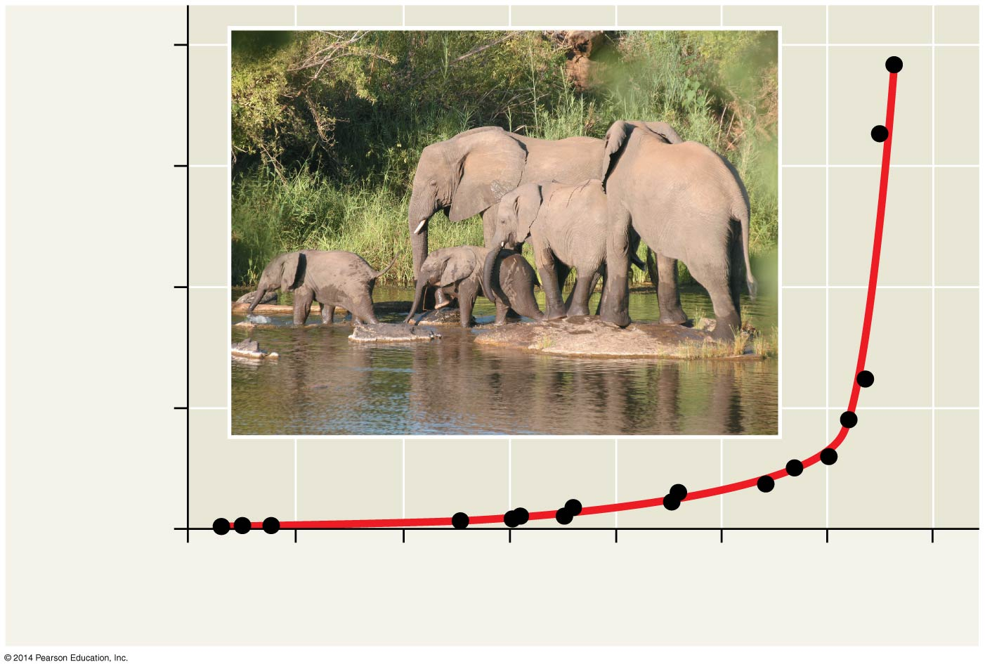
Figure 40.18
8,000
6,000
Elephant population
4,000
2,000
0
1900
1910
1920
1930
1940
1950
1960
1970
Year
Notes:
87
Figure 40.18 Exponential growth in the African elephant population of Kruger National Park, South Africa

Slide 88
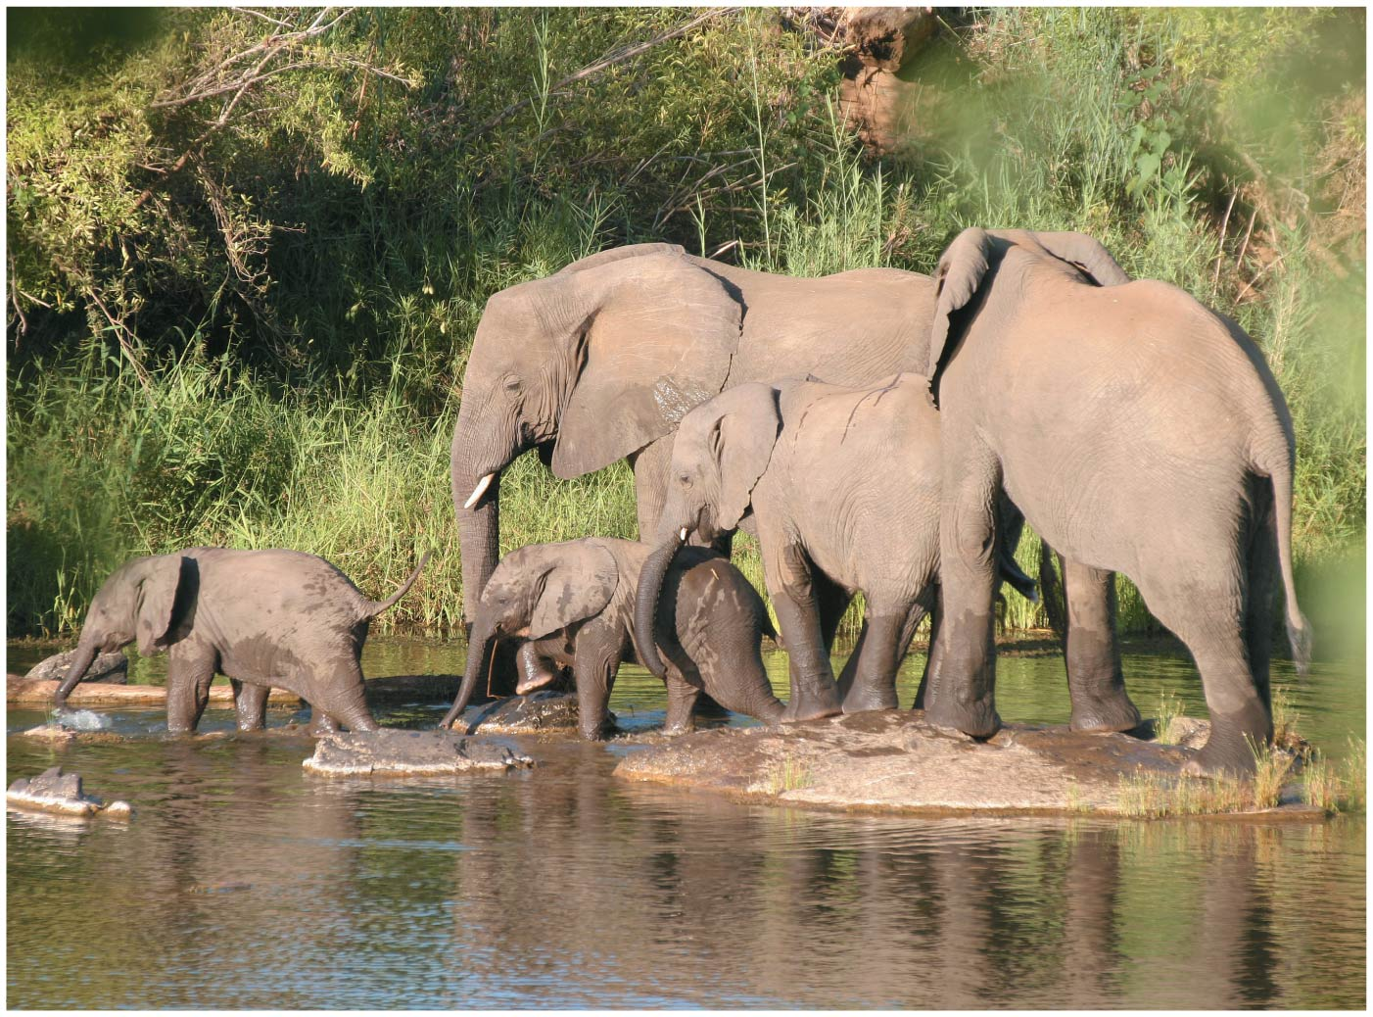
Figure 40.18a
Notes:
88
Figure 40.18a Exponential growth in the African elephant population of Kruger National Park, South Africa (photo)

Slide 89
Carrying Capacity
Exponential growth cannot be sustained for long in any population
A more realistic population model limits growth by incorporating carrying capacity
Carrying capacity (K) is the maximum population size the environment can support
Carrying capacity varies with the abundance of limiting resources
Notes:
89

Slide 90
The Logistic Growth Model
In the logistic population growth model, the per capita rate of increase declines as carrying capacity is reached
The logistic model starts with the exponential model and adds an expression that reduces per capita rate of increase as N approaches K
dN
dt
(K −N)
K
= r_{max}N
Notes:
90

Slide 91
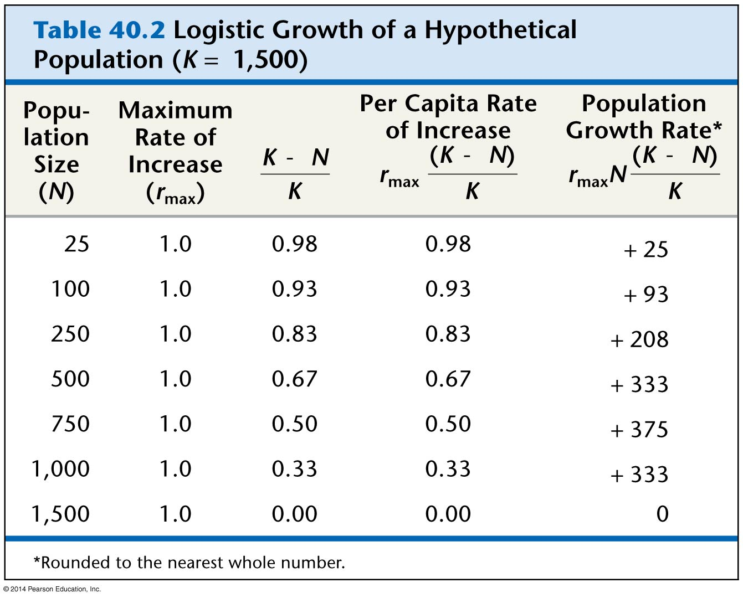
Table 40.2
Notes:
91
Table 40.2 Logistic growth of a hypothetical population (K = 1,500)

Slide 92
The logistic model of population growth produces a sigmoid (S-shaped) curve
Notes:
92

Slide 93
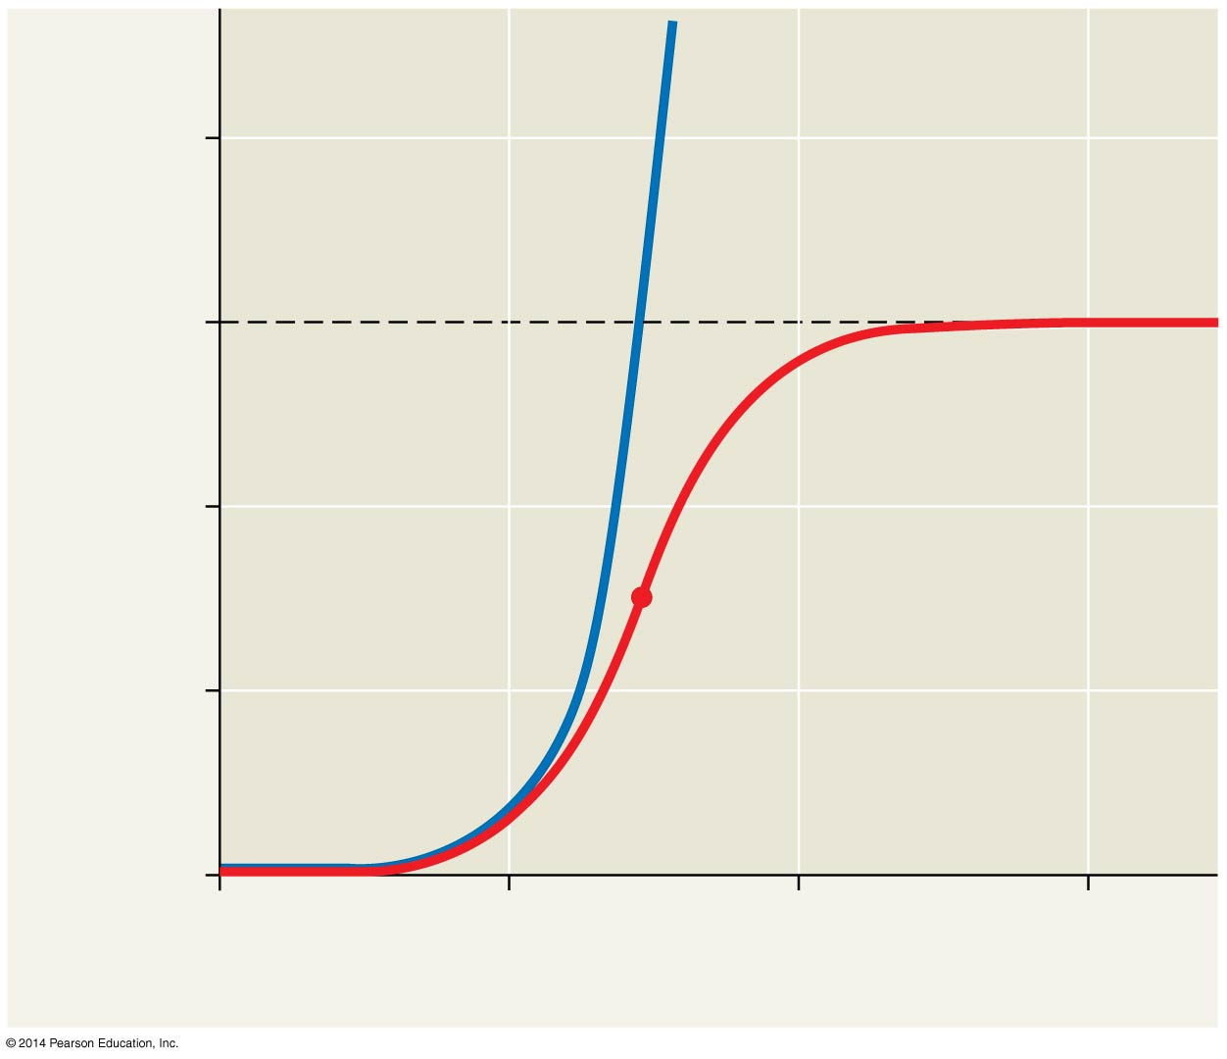
Figure 40.19
Exponential
growth
2,000
dN
= 1.0N
dt
1,500
K = 1,500
Logistic growth
Population size (N)
dN
(1,500 − N)
= 1.0N
dt
1,500
1,000
500
Population growth
begins slowing here.
0
0
5
10
15
Number of generations
Notes:
93
Figure 40.19 Population growth predicted by the logistic model

Slide 94
The Logistic Model and Real Populations
The growth of many laboratory populations, including paramecia, fits an S-shaped curve when resources are limited
These organisms are grown in a constant environment lacking predators and competitors
Animation: Population Ecology
Notes:
94

Slide 95
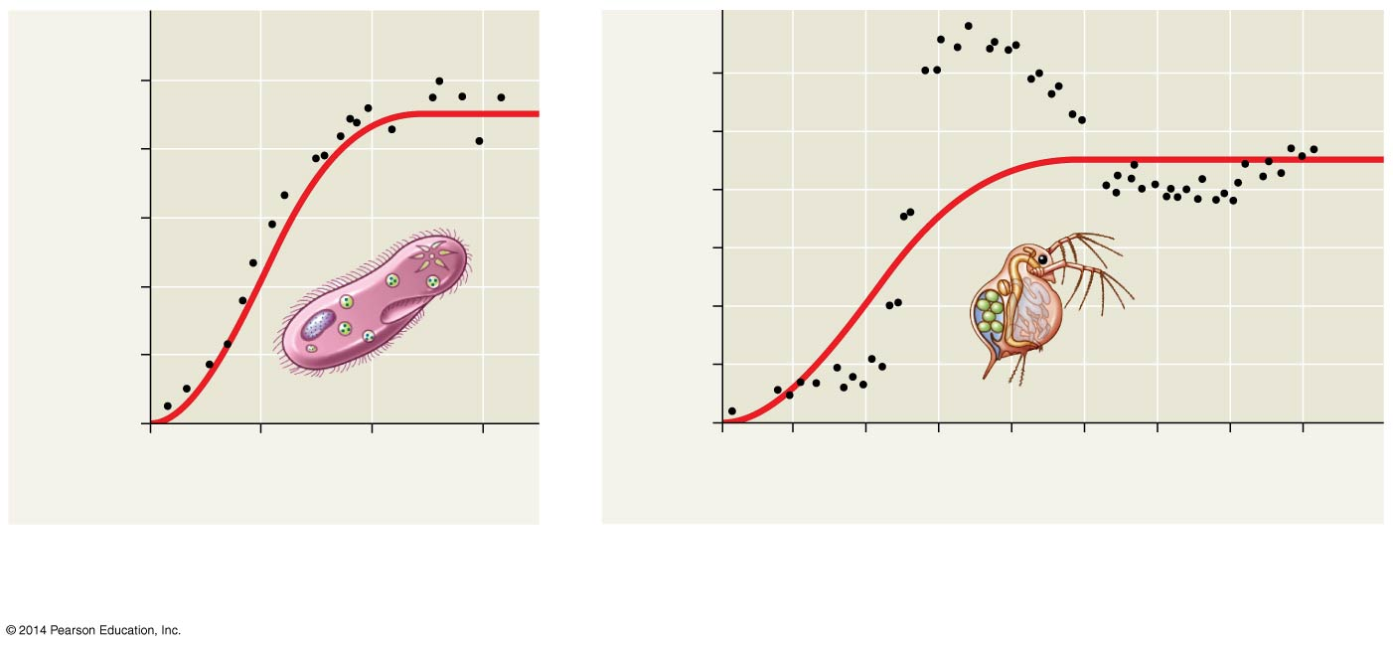
Figure 40.20
1,000
180
800
150
120
Number of Paramecium/mL
Number of Daphnia/50 mL
600
90
400
60
200
30
0
0
0
5
10
15
0
20
40
60
80
100
120
140
160
Time (days)
Time (days)
(a) A Paramecium population
in the lab
(b) A Daphnia (water flea) population in the lab
Notes:
95
Figure 40.20 How well do these populations fit the logistic growth model?

Slide 96
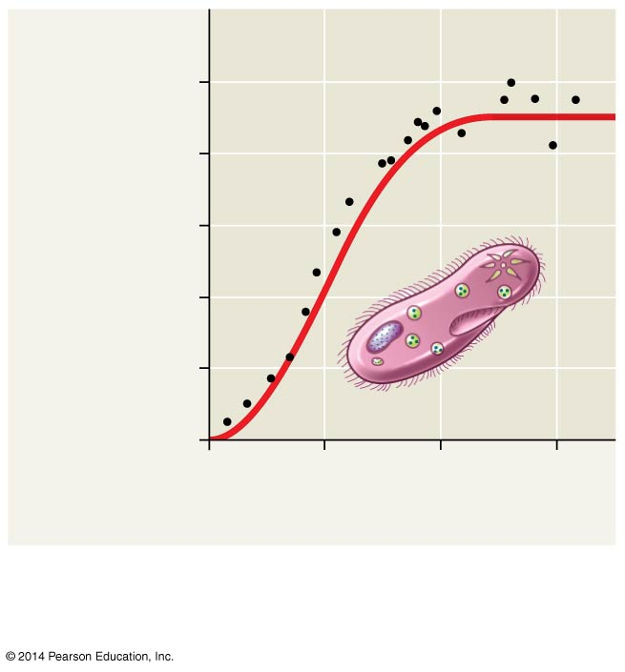
Figure 40.20a
1,000
800
Number of
Paramecium/mL
600
400
200
0
0
5
10
15
Time (days)
(a) A Paramecium population
in the lab
Notes:
96
Figure 40.20a How well do these populations fit the logistic growth model? (part 1: Paramecium)

Slide 97
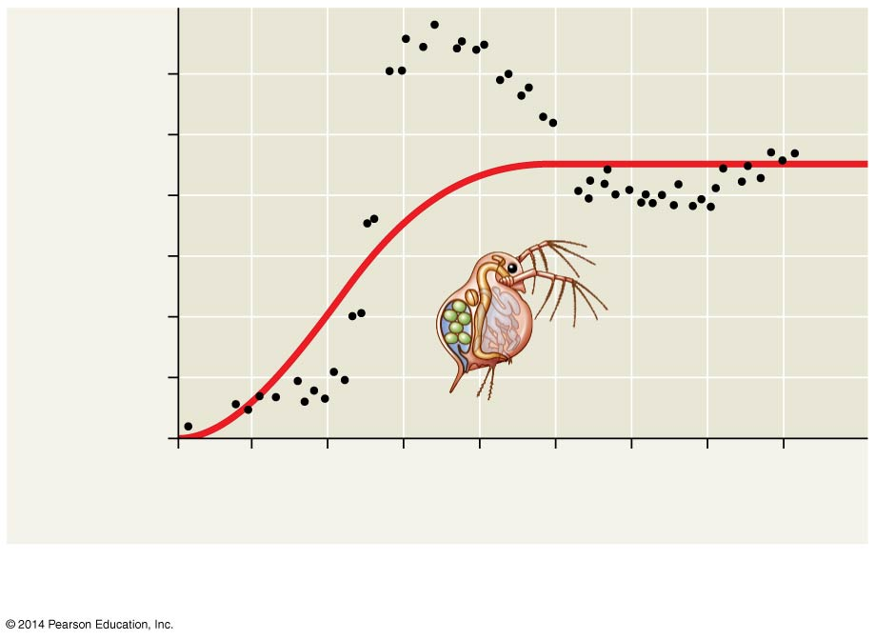
Figure 40.20b
180
150
120
Number of
Daphnia/50 mL
90
60
30
0
0
20
40
60
80
100
120
140
160
Time (days)
(b) A Daphnia (water flea) population in the lab
Notes:
97
Figure 40.20b How well do these populations fit the logistic growth model? (part 2: Daphnia)

Slide 98
Some populations overshoot K before settling down to a relatively stable density
Some populations fluctuate greatly and make it difficult to define K
Notes:
98

Slide 99
The logistic model fits few real populations but is useful for estimating possible growth
Conservation biologists can use the model to estimate the critical size below which populations may become extinct
Notes:
99

Slide 100
Concept 40.6: Population dynamics are influenced strongly by life history traits and population density
An organism’s life history comprises the traits that affect its schedule of reproduction and survival
The age at which reproduction begins
How often the organism reproduces
How many offspring are produced during each reproductive cycle
Notes:
100

Slide 101
“Trade-offs” and Life Histories
Organisms have finite resources, which may lead to trade-offs between survival and reproduction
Selective pressures influence the trade-off between the number and size of offspring
Some plants produce a large number of small seeds, ensuring that at least some of them will grow and eventually reproduce
Notes:
101

Slide 102
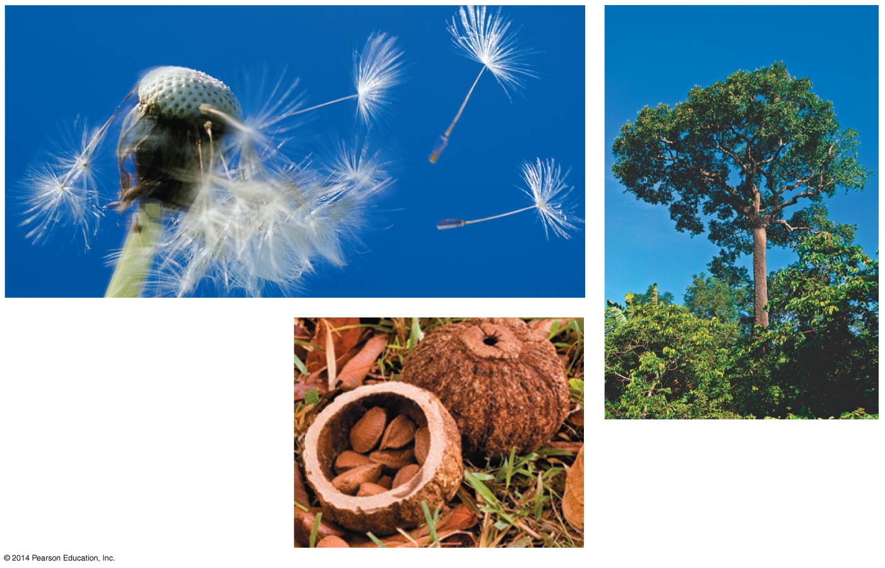
Figure 40.21
Dandelions grow
quickly and release
a large number of
tiny fruits.
The Brazil nut tree
(above), produces a
moderate number of
large seeds in pods (left).
Notes:
102
Figure 40.21 Variation in the size of seed crops in plants

Slide 103
Figure 40.21a
Dandelions grow quickly and release a large number of tiny fruits.
Notes:
103
Figure 40.21a Variation in the size of seed crops in plants (part 1: dandelion seeds)

Slide 104
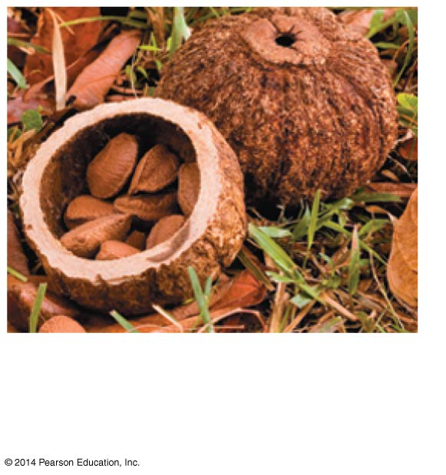
Figure 40.21ba
The Brazil nut tree produces
a moderate number of
large seeds in pods.
Notes:
104
Figure 40.21ba Variation in the size of seed crops in plants (part 2a: Brazil nuts)

Slide 105
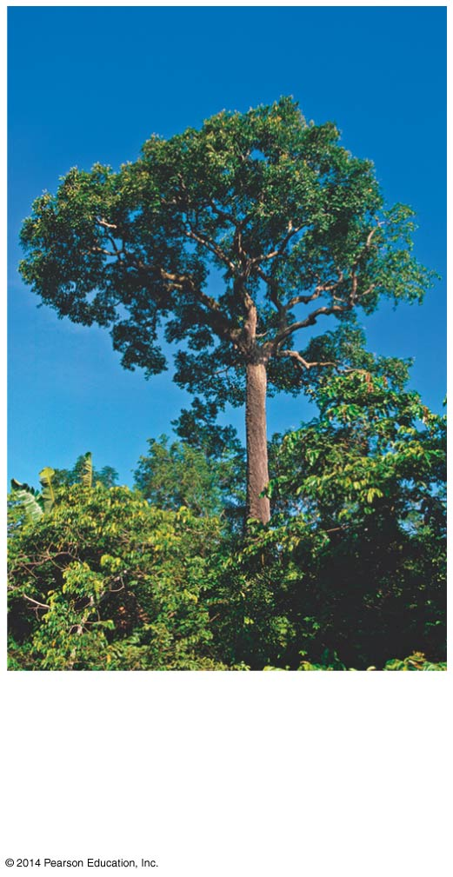
Figure 40.21bb
The Brazil nut tree
produces a moderate
number of large seeds
in pods.
Notes:
105
Figure 40.21bb Variation in the size of seed crops in plants (part 2b: Brazil nut tree)

Slide 106
Other types of plants produce a moderate number of large seeds that provide a large store of energy that will help seedlings become established
Notes:
106

Slide 107
K-selection, or density-dependent selection, selects for life history traits that are sensitive to population density
r-selection, or density-independent selection, selects for life history traits that maximize reproduction
Notes:
107

Slide 108
Population Change and Population Density
In density-independent populations, birth rate and death rate do not change with population density
In density-dependent populations, birth rates fall and death rates rise with population density
Notes:
108

Slide 109
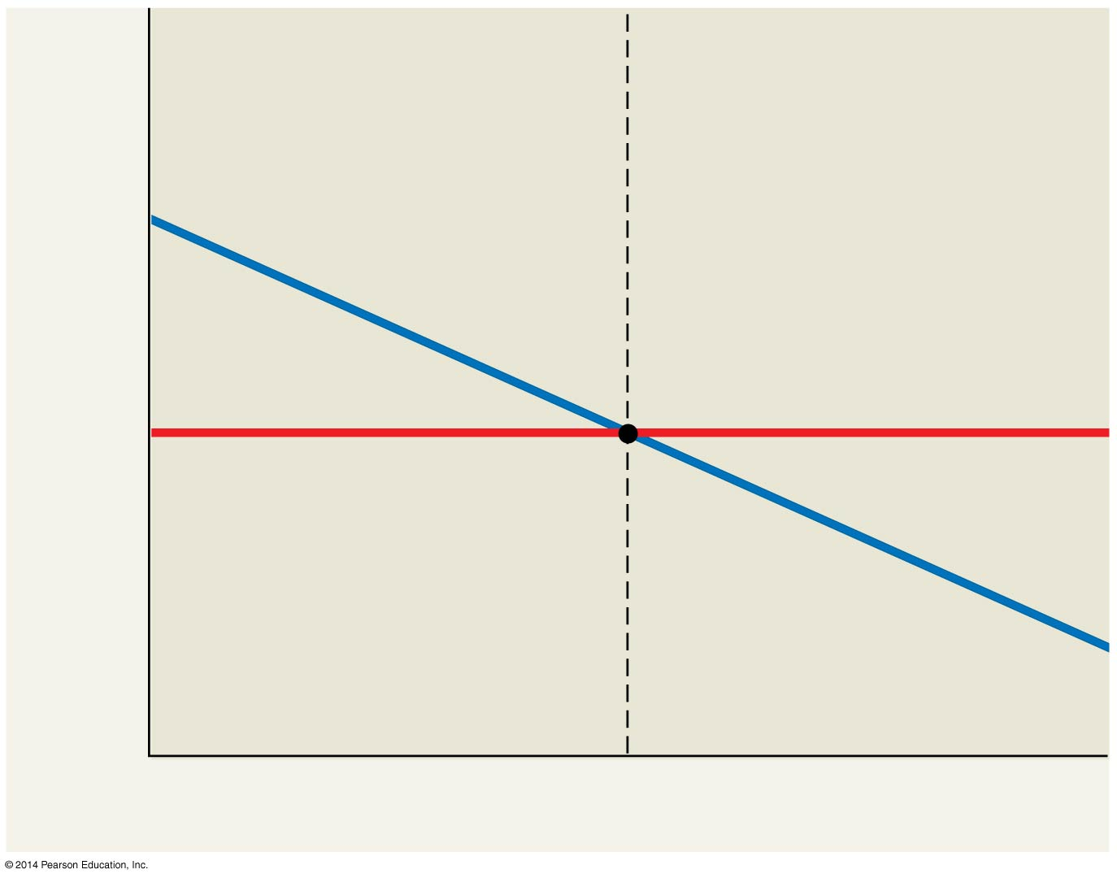
Figure 40.22
When population
density is low, b > m. As
a result, the population
grows until the density
reaches Q.
When population
density is high, m > b,
and the population
shrinks until the
density reaches Q.
Equilibrium density (Q)
Birth or death rate
per capita
Density-independent
death rate (m)
Density-dependent
birth rate (b)
Population density
Notes:
109
Figure 40.22 Determining equilibrium for population density

Slide 110
Mechanisms of Density-Dependent Population Regulation
Density-dependent birth and death rates are an example of negative feedback that regulates population growth
Density-dependent birth and death rates are affected by many factors, such as competition for resources, territoriality, disease, predation, toxic wastes, and intrinsic factors
Notes:
110

Slide 111
Competition for resources occurs in crowded populations; increasing population density intensifies competition for resources and results in a lower birth rate
Notes:
111

Slide 112
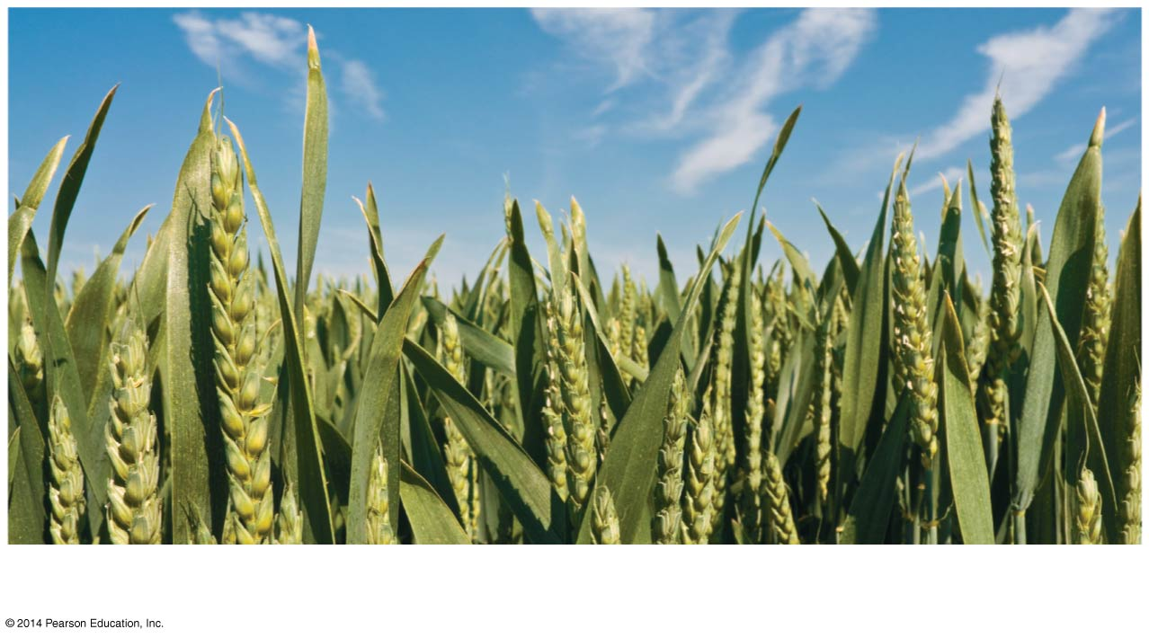
Figure 40.23a
Competition for resources
Notes:
112
Figure 40.23a Exploring mechanisms of density-dependent regulation (part 1: competition for resources)

Slide 113
Toxic wastes produced by a population can accumulate in the environment, contributing to density-dependent regulation of population size
Notes:
113

Slide 114
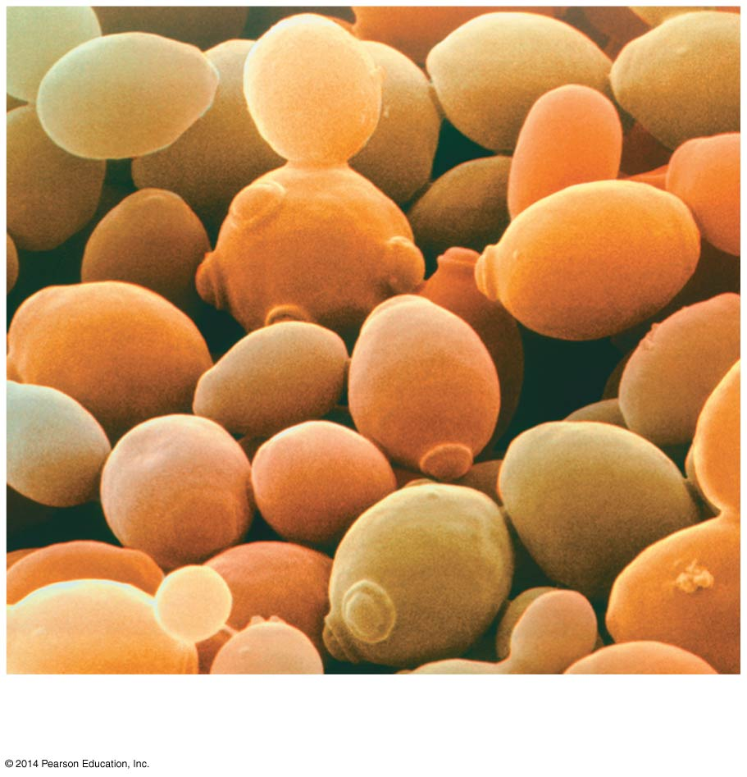
Figure 40.23d
Toxic wastes
5 μm
Notes:
114
Figure 40.23d Exploring mechanisms of density-dependent regulation (part 4: toxic wastes)

Slide 115
Predation may increase with increasing population size due to predator preference for abundant prey species
Notes:
115

Slide 116
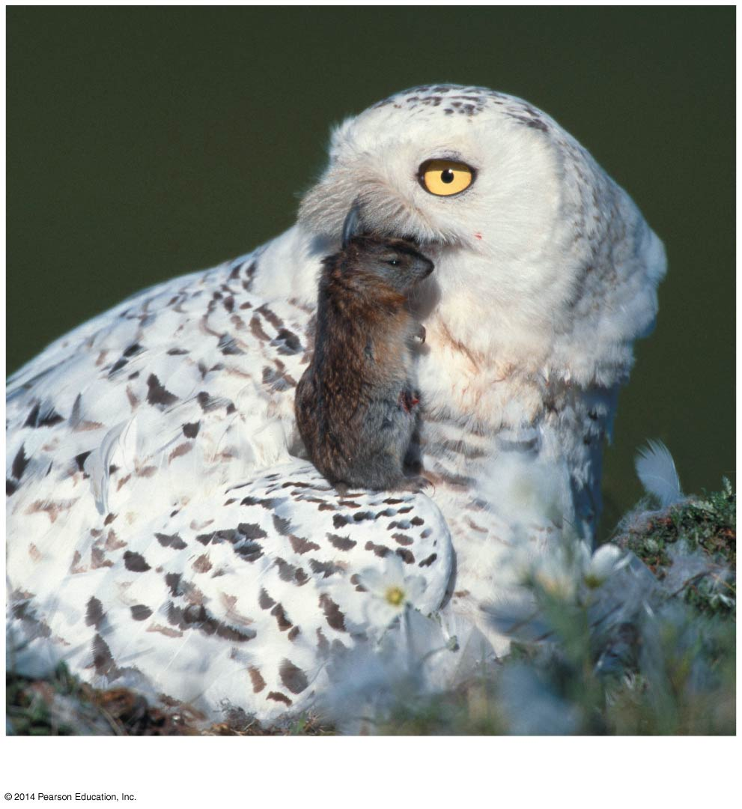
Figure 40.23b
Predation
Notes:
116
Figure 40.23b Exploring mechanisms of density-dependent regulation (part 2: predation)

Slide 117
Territoriality can limit population density when space becomes a limited resource
Notes:
117

Slide 118
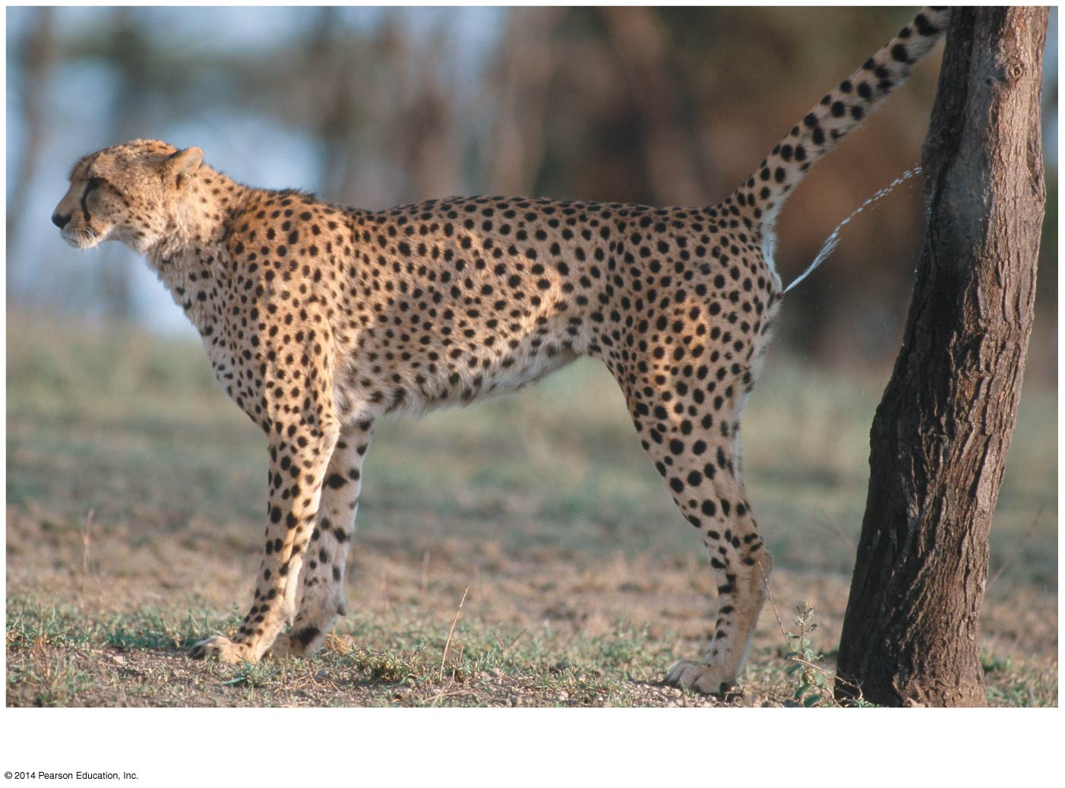
Figure 40.23e
Territoriality
Notes:
118
Figure 40.23e Exploring mechanisms of density-dependent regulation (part 5: territoriality)

Slide 119
Disease transmission rates may increase with increasing population density
Notes:
119

Slide 120
Figure 40.23c
Disease
Notes:
120
Figure 40.23c Exploring mechanisms of density-dependent regulation (part 3: disease)

Slide 121
Intrinsic factors (for example, physiological factors like hormonal changes) appear to regulate population size
Notes:
121

Slide 122
Figure 40.23f
Intrinsic factors
Notes:
122
Figure 40.23f Exploring mechanisms of density-dependent regulation (part 6: intrinsic factors)

Slide 123
Population Dynamics
The study of population dynamics focuses on the complex interactions between biotic and abiotic factors that cause variation in population size
Notes:
123

Slide 124
Stability and Fluctuation
Long-term population studies have challenged the hypothesis that populations of large mammals are relatively stable over time
Both weather and predator population can affect population size over time
For example, the moose population on Isle Royale collapsed during a harsh winter and when wolf numbers peaked
Notes:
124

Slide 125
Figure 40.24
50
2,500
Wolves
Moose
40
2,000
30
1,500
Number of wolves
Number of moose
20
1,000
10
500
0
0
1955
1965
1975
1985
1995
2005
Year
Notes:
125
Figure 40.24 Fluctuations in moose and wolf populations on Isle Royale, 1959–2011

Slide 126
Immigration, Emigration, and Metapopulations
Metapopulations are groups of populations linked by immigration and emigration
Local populations within a metapopulation occupy patches of suitable habitat surrounded by unsuitable habitat
Populations can be replaced in patches after extinction or established in new unoccupied habitats through migration
Notes:
126

Slide 127
Figure 40.25
°
Aland
Islands
EUROPE
Occupied patch
5 km
Unoccupied patch
Notes:
127
Figure 40.25 The Glanville fritillary: a metapopulation

Slide 128
Figure 40.25a
Notes:
128
Figure 40.25a The Glanville fritillary: a metapopulation (photo)

Slide 129
Figure 40.UN01a
dN
= r_{max} N
dt
Population size (N)
Number of generations
Notes:
129
Figure 40.UN01a Summary of key concepts: exponential and logistic models (part 1)

Slide 130
Figure 40.UN01b
K = carrying capacity
Population size (N)
dN
(K − N)
= r_{max} N
dt
K
Number of generations
Notes:
130
Figure 40.UN01b Summary of key concepts: exponential and logistic models (part 2)

Slide 131
Figure 40.UN02
Notes:
131
Figure 40.UN02 Test your understanding, question 5 (kelp abundance)

Slide 132
Figure 40.UN03
100
Mean height (cm)
50
0
3,000
Altitude (m)
2,000
Sierra Nevada
1,000
Great Basin
Plateau
0
Seed collection sites
Notes:
132
Figure 40.UN03 Test your understanding, question 7 (plant height and elevation)

