Slide 1
Overview: Locating Genes Along Chromosomes
Mendel’s “hereditary factors” were genes
Today we know that genes are located on chromosomes
The location of a particular gene can be seen by tagging isolated chromosomes with a fluorescent dye that highlights the gene
Notes:
1

Slide 2
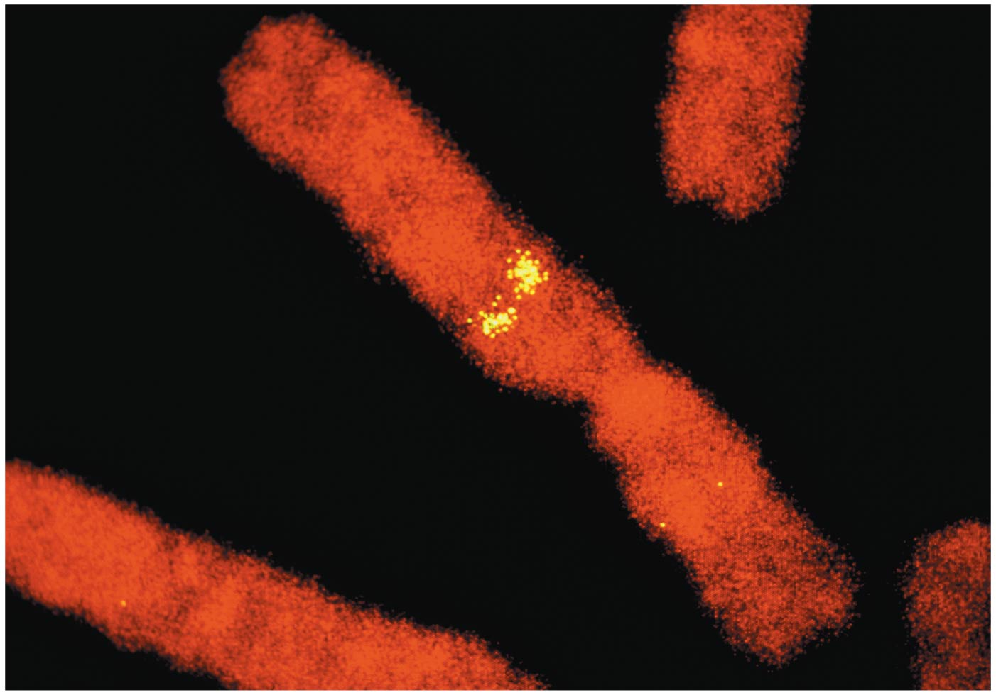
Figure 12.1
Notes:
2
Figure 12.1 Where are Mendel's hereditary factors located in the cell?

Slide 3
Concept 12.1: Mendelian inheritance has its physical basis in the behavior of chromosomes
Mitosis and meiosis were first described in the late 1800s
The chromosome theory of inheritance states
Mendelian genes have specific loci (positions) on chromosomes
Chromosomes undergo segregation and independent assortment
The behavior of chromosomes during meiosis can account for Mendel’s laws of segregation and independent assortment
Notes:
3

Slide 4
1/13
Some Mendel
Some Chromosomal Inheritance
Where are Mendel’s alleles?
Barr Bodies
Linked Genes
Lets review!
Things to Study: Nondisjunctions

Slide 5
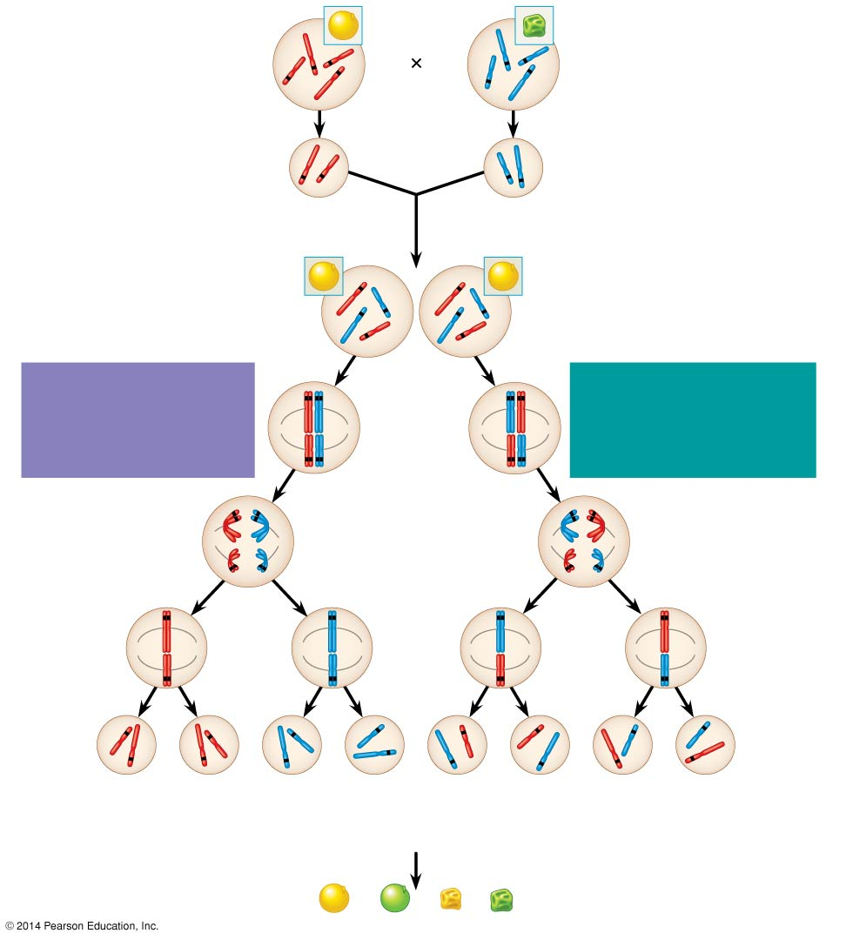
Figure 12.2
P Generation
Yellow-round
seeds (YYRR)
Green-wrinkled
seeds (yyrr)
Y
r
y
Y
R
R
y
r
Meiosis
Fertilization
y
r
Gametes
R
Y
All F₁ plants produce
yellow-round seeds (YyRr).
F₁ Generation
R
R
r
y
r
y
Y
Y
LAW OF SEGREGATION
The two alleles for each
gene separate.
Meiosis
LAW OF INDEPENDENT
ASSORTMENT Alleles of
genes on nonhomologous
chromosomes assort
independently.
R
r
Metaphase
I
r
R
Y
y
Y
y
1
1
R
r
r
R
Anaphase I
Y
y
Y
y
R
r
Metaphase
II
r
R
2
2
Y
y
Y
y
Y
Y
y
y
Y
Y
y
y
R
R
r
r
r
r
R
R
1
/
YR
1
/
yr
YR
1
/
Yr
1
/
yR
F₂ Generation
4
4
4
4
3
An F₁ × F₁ cross-fertilization
3
Fertilization
recombines the R and
r alleles at random.
Fertilization results in the
9:3:3:1 phenotypic ratio
in the F₂ generation.
9
: 3
: 3
: 1
Notes:
5
Figure 12.2 The chromosomal basis of Mendel’s laws

Slide 6
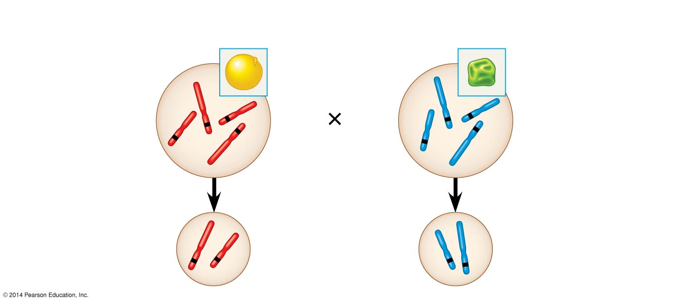
Figure 12.2a
P Generation
Yellow-round
seeds (YYRR)
Green-wrinkled
seeds (yyrr)
Y
y
r
R
R
r
Y
y
Meiosis
Fertilization
R
Y
y
r
Gametes
Notes:
6
Figure 12.2a The chromosomal basis of Mendel’s laws (part 1)

Slide 7
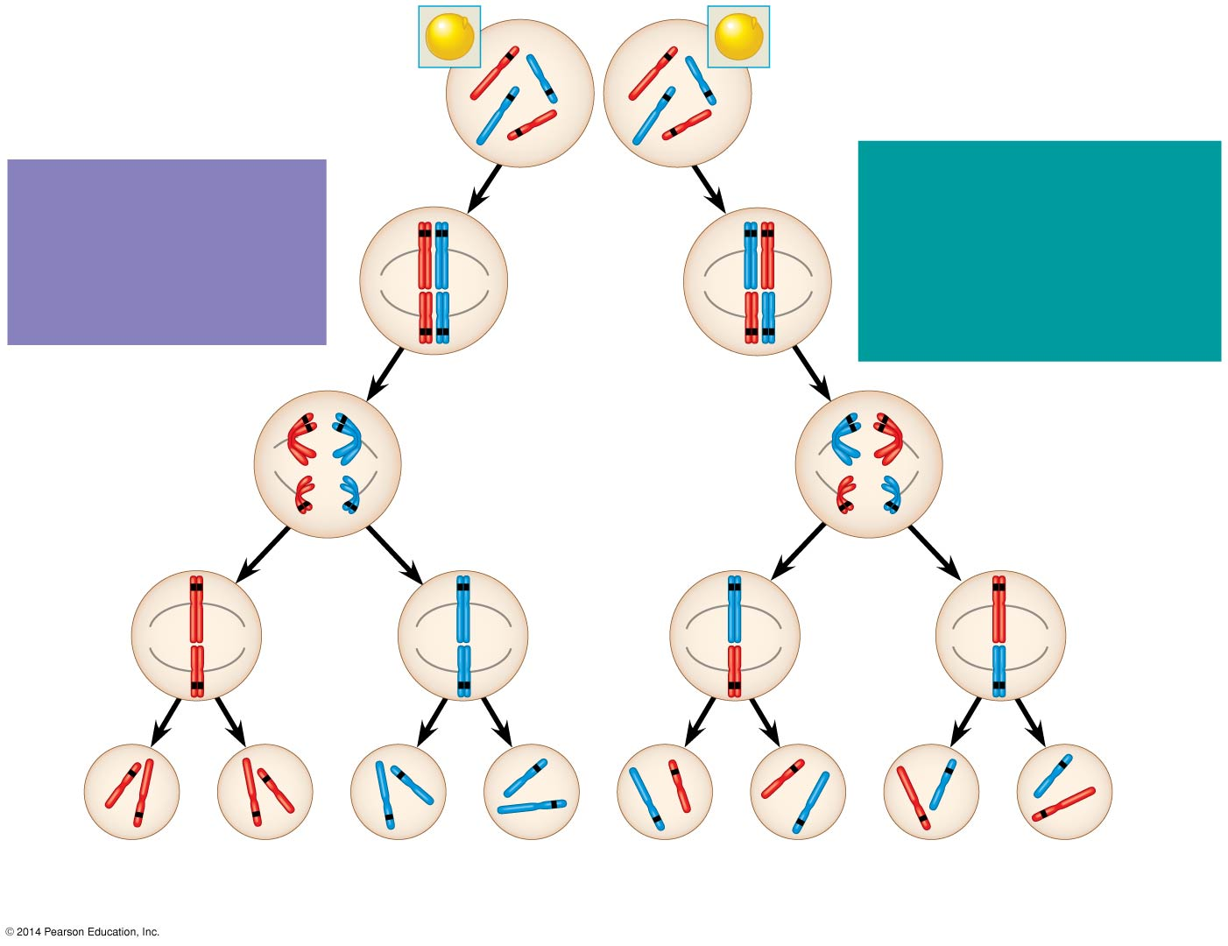
Figure 12.2b
F₁ Generation
All F₁ plants produce
yellow-round seeds (YyRr).
R
R
r
y
r
y
Y
Y
LAW OF
SEGREGATION
The two alleles for
each gene separate.
Meiosis
LAW OF INDEPENDENT
ASSORTMENT
Alleles of genes on
nonhomologous
chromosomes assort
independently.
R
r
Metaphase
I
r
R
Y
y
Y
y
1
1
R
r
r
R
Anaphase I
Y
y
Y
y
R
r
Metaphase
II
r
R
2
2
Y
y
Y
y
Y
Y
y
y
Y
Y
y
y
R
R
r
r
r
r
R
R
1
/
YR
1
/
yr
1
/
Yr
1
/
yR
4
4
4
4
Notes:
7
Figure 12.2b The chromosomal basis of Mendel’s laws (part 2)

Slide 8
Figure 12.2c
LAW OF
SEGREGATION
LAW OF
INDEPENDENT
ASSORTMENT
F₂ Generation
3
Fertilization
recombines the
R and r alleles
at random.
An F₁ × F₁ cross-fertilization
3
Fertilization results
in the 9:3:3:1
phenotypic ratio in
the F₂ generation.
9
: 3
: 3
: 1
Notes:
8
Figure 12.2c The chromosomal basis of Mendel’s laws (part 3)

Slide 9
Morgan’s Experimental Evidence: Scientific Inquiry
Thomas Hunt Morgan and his students began studying the genetics of the fruit fly, Drosophila melanogaster, in 1907
Several characteristics make fruit flies a convenient organism for genetic studies
They produce many offspring
A generation can be bred every two weeks
They have only four pairs of chromosomes
Notes:
9

Slide 10
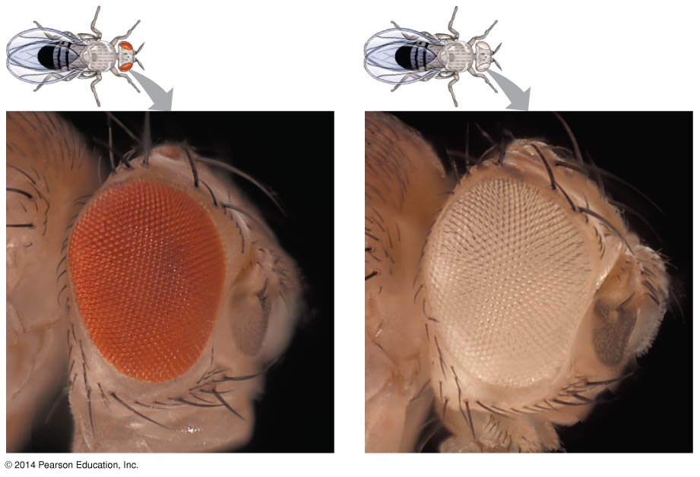
Figure 12.3
Notes:
10
Figure 12.3 Morgan’s first mutant

Slide 11
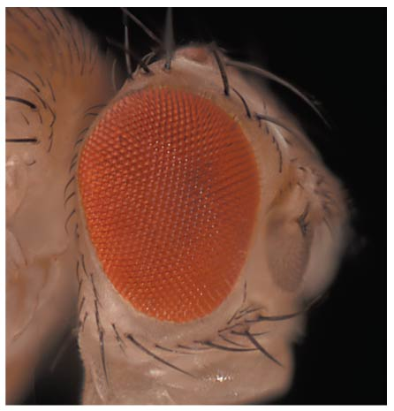
Figure 12.3a
mutant (part 1: wild-type)
Notes:
11
Figure 12.3a Morgan’s first mutant (part 1: wild-type)

Slide 12
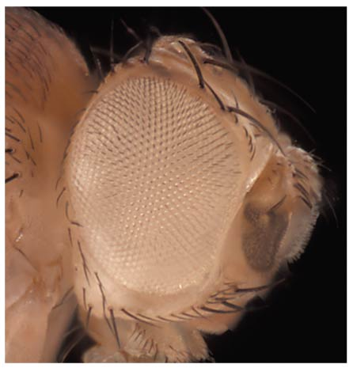
Figure 12.3b
(part 2: mutant)
Notes:
12
Figure 12.3b Morgan’s first mutant (part 2: mutant)

Slide 13
Correlating Behavior of a Gene’s Alleles with Behavior of a Chromosome Pair
In one experiment, Morgan mated male flies with white eyes (mutant) with female flies with red eyes (wild type)
The F₁ generation all had red eyes
The F₂ generation showed the classical 3:1 red:white ratio, but only males had white eyes
Morgan concluded that the eye color was related to the sex of the fly
Notes:
13

Slide 14
Morgan determined that the white-eyed mutant allele must be located on the X chromosome
Morgan’s finding supported the chromosome theory of inheritance
Notes:
14

Slide 15
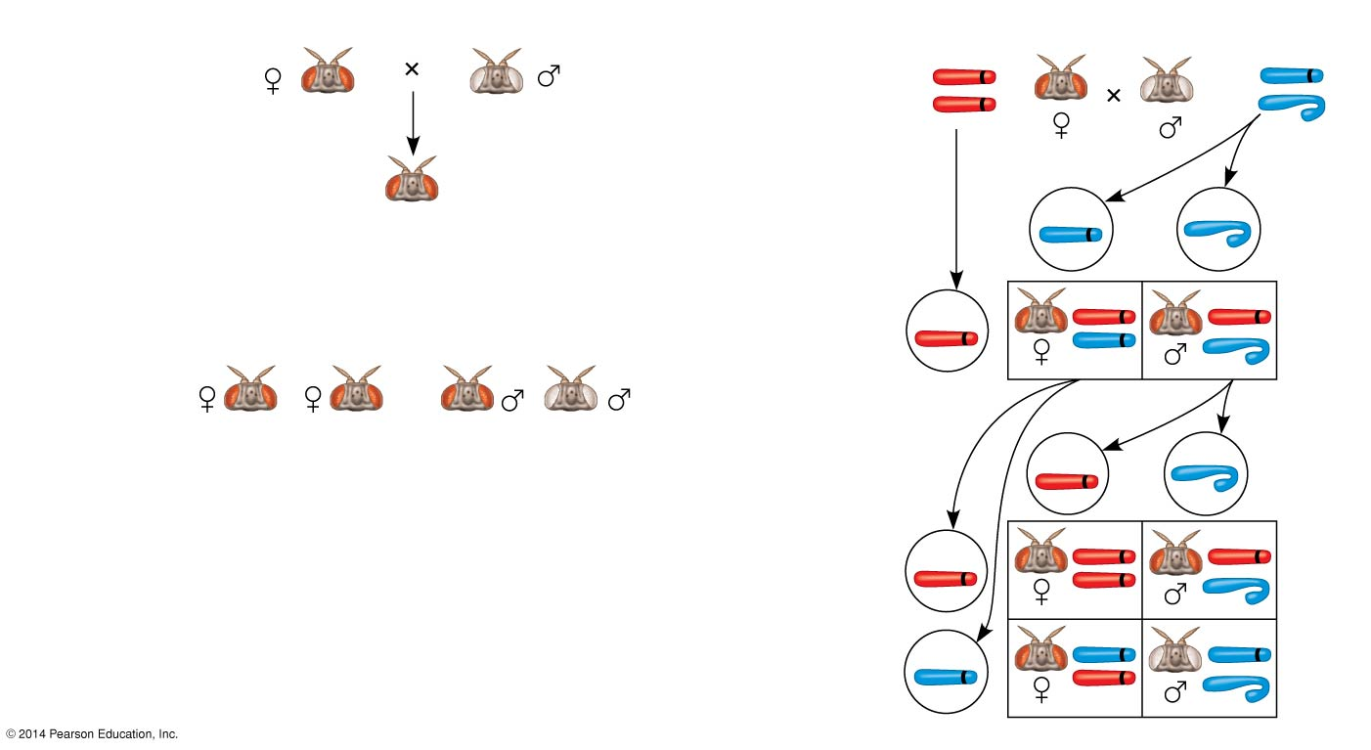
Figure 12.4
Experiment
Conclusion
P
Generation
P
Generation
X
w⁺
X
w
X
w⁺
Y
F₁
Generation
All offspring
had red eyes.
w
Sperm
Eggs
F₁
Generation
w⁺
w⁺
w⁺
Results
F₂
Generation
w
w⁺
Sperm
Eggs
w⁺
w⁺
w⁺
F₂
Generation
w⁺
w
w
w
w⁺
Notes:
15
Figure 12.4 Inquiry: In a cross between a wild-type female fruit fly and a mutant white-eyed male, what color eyes will the F₁ and F₂ offspring have?

Slide 16
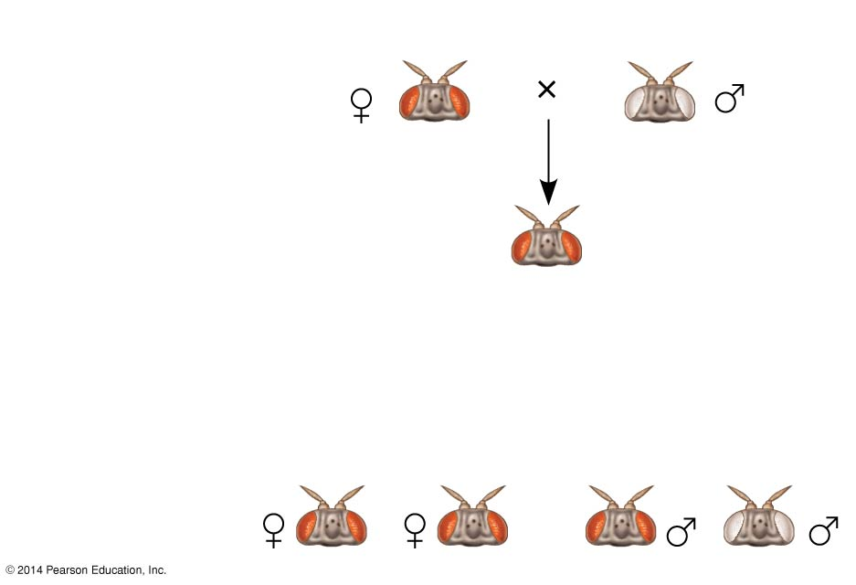
Figure 12.4a
Experiment
P
Generation
F₁
Generation
All offspring
had red eyes.
Results
F₂
Generation
Notes:
16
Figure 12.4a Inquiry: In a cross between a wild-type female fruit fly and a mutant white-eyed male, what color eyes will the F₁ and F₂ offspring have? (part 1: experiment and results)

Slide 17
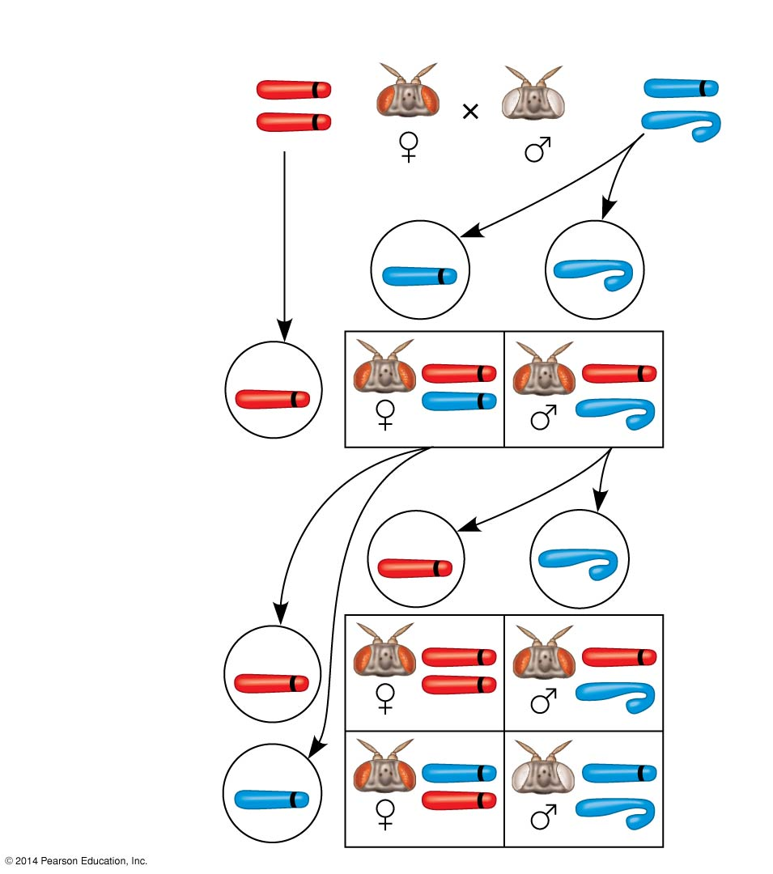
Figure 12.4b
Conclusion
P
Generation
w⁺
w
X
X
X
Y
w⁺
w
Sperm
Eggs
F₁
Generation
w⁺
w⁺
w⁺
w
w⁺
Sperm
Eggs
w⁺
w⁺
F₂
Generation
w⁺
w⁺
w
w
w
w⁺
Notes:
17
Figure 12.4b Inquiry: In a cross between a wild-type female fruit fly and a mutant white-eyed male, what color eyes will the F₁ and F₂ offspring have? (part 2: conclusion)

Slide 18
Concept 12.2: Sex-linked genes exhibit unique patterns of inheritance
In humans and some other animals, there is a chromosomal basis of sex determination
Notes:
18

Slide 19
The Chromosomal Basis of Sex
In humans and other mammals, there are two varieties of sex chromosomes: a larger X chromosome and a smaller Y chromosome
Only the ends of the Y chromosome have regions that are homologous with corresponding regions of the X chromosome
The SRY gene on the Y chromosome is required for the developments of testes
Notes:
19

Slide 20
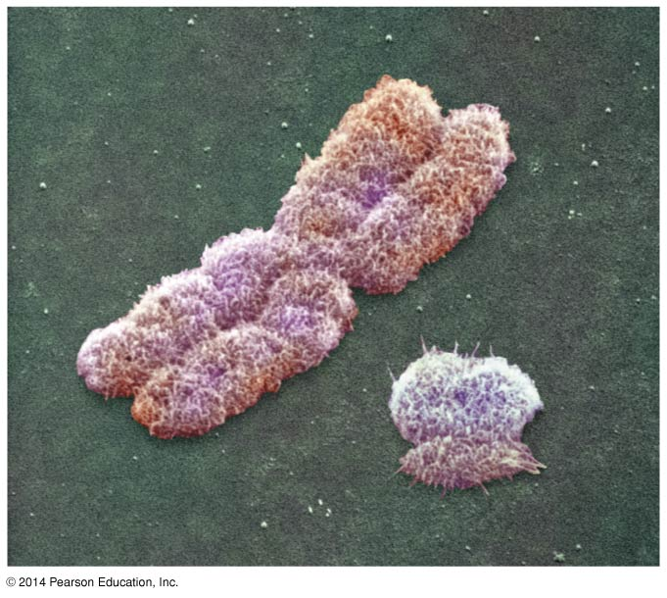
Figure 12.5
X
Y
Notes:
20
Figure 12.5 Human sex chromosomes

Slide 21
Females are XX, and males are XY
Each ovum contains an X chromosome, while a sperm may contain either an X or a Y chromosome
Other animals have different methods of sex determination
Notes:
21

Slide 22
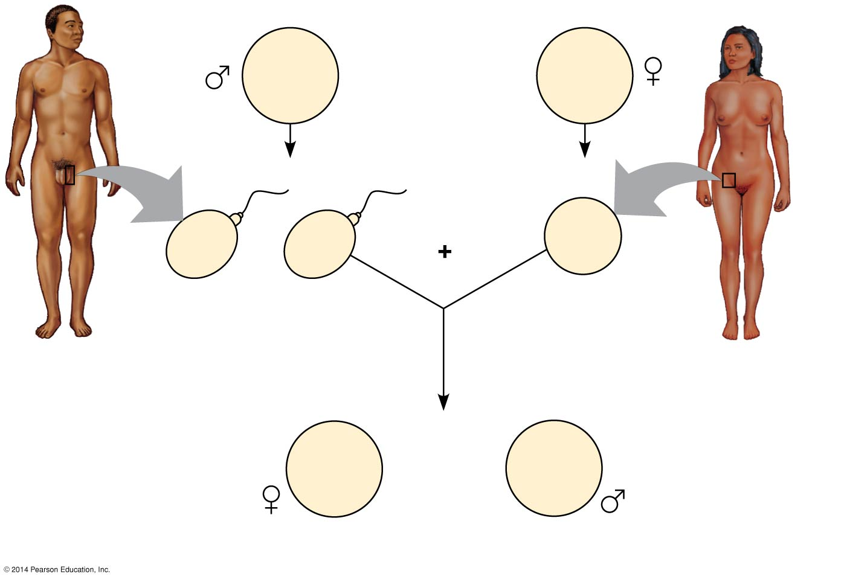
Figure 12.6
44 +
XY
Parents
44 +
XX
22 +
X
22 +
Y
22 +
X
or
Sperm
Egg
44 +
XX
44 +
XY
or
Zygotes (offspring)
Notes:
22
Figure 12.6 The mammalian X-Y chromosomal system of sex determination

Slide 23
A gene that is located on either sex chromosome is called a sex-linked gene
Genes on the Y chromosome are called Y-linked genes; there are few of these
Genes on the X chromosome are called X-linked genes
Notes:
23

Slide 24
Inheritance of X-Linked Genes
X chromosomes have genes for many characters unrelated to sex, whereas the Y chromosome mainly encodes genes related to sex determination
Notes:
24

Slide 25
X-linked genes follow specific patterns of inheritance
For a recessive X-linked trait to be expressed
A female needs two copies of the allele (homozygous)
A male needs only one copy of the allele (hemizygous)
X-linked recessive disorders are much more common in males than in females
Notes:
25

Slide 26
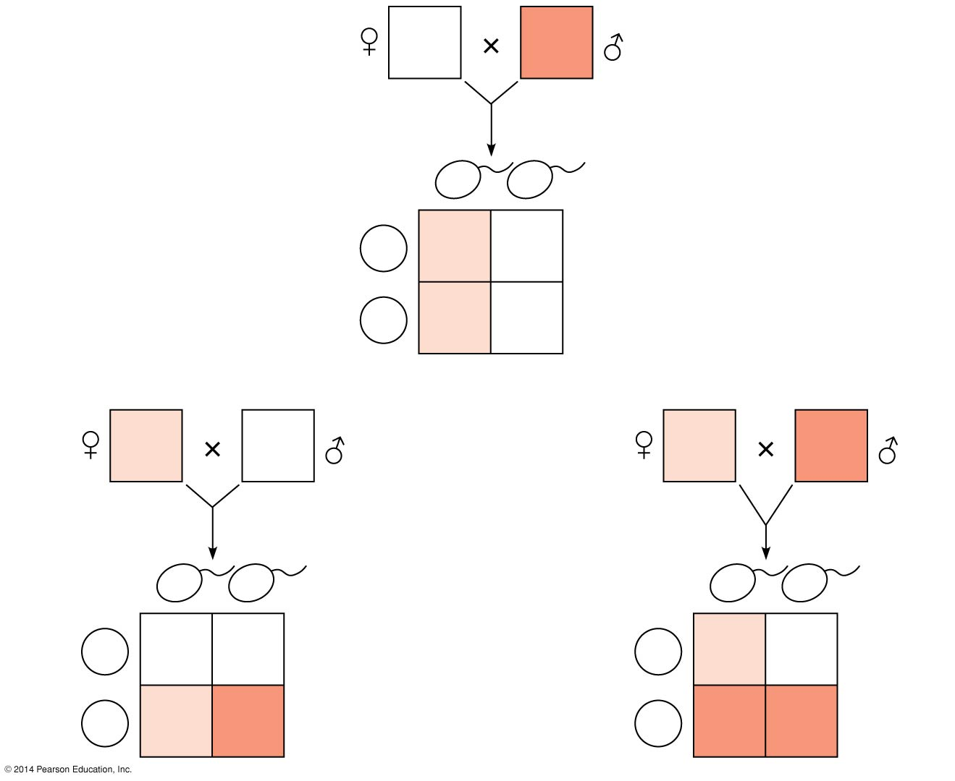
Figure 12.7
X^{N}X^{N}
X^{n}Y
X^{n}
Y
Sperm
Eggs
X^{N}
X^{N}X^{n}
X^{N}Y
X^{N}
X^{N}X^{n}
X^{N}Y
(a)
X^{N}X^{n}
X^{N}Y
X^{N}X^{n}
X^{n}Y
X^{N}
Y
Sperm
X^{n}
Y
Sperm
Eggs
X^{N}
X^{N}X^{N}
X^{N}Y
Eggs
X^{N}
X^{N}X^{n}
X^{N}Y
X^{n}
X^{N}X^{n}
X^{n}Y
X^{n}
X^{n}X^{n}
X^{n}Y
(b)
(c)
Notes:
26
Figure 12.7 The transmission of X-linked recessive traits

Slide 27
Some disorders caused by recessive alleles on the X chromosome in humans
Color blindness (mostly X-linked)
Duchenne muscular dystrophy
Hemophilia
Notes:
27

Slide 28
X Inactivation in Female Mammals
In mammalian females, one of the two X chromosomes in each cell is randomly inactivated during embryonic development
The inactive X condenses into a Barr body
If a female is heterozygous for a particular gene located on the X chromosome, she will be a mosaic for that character
Notes:
28

Slide 29
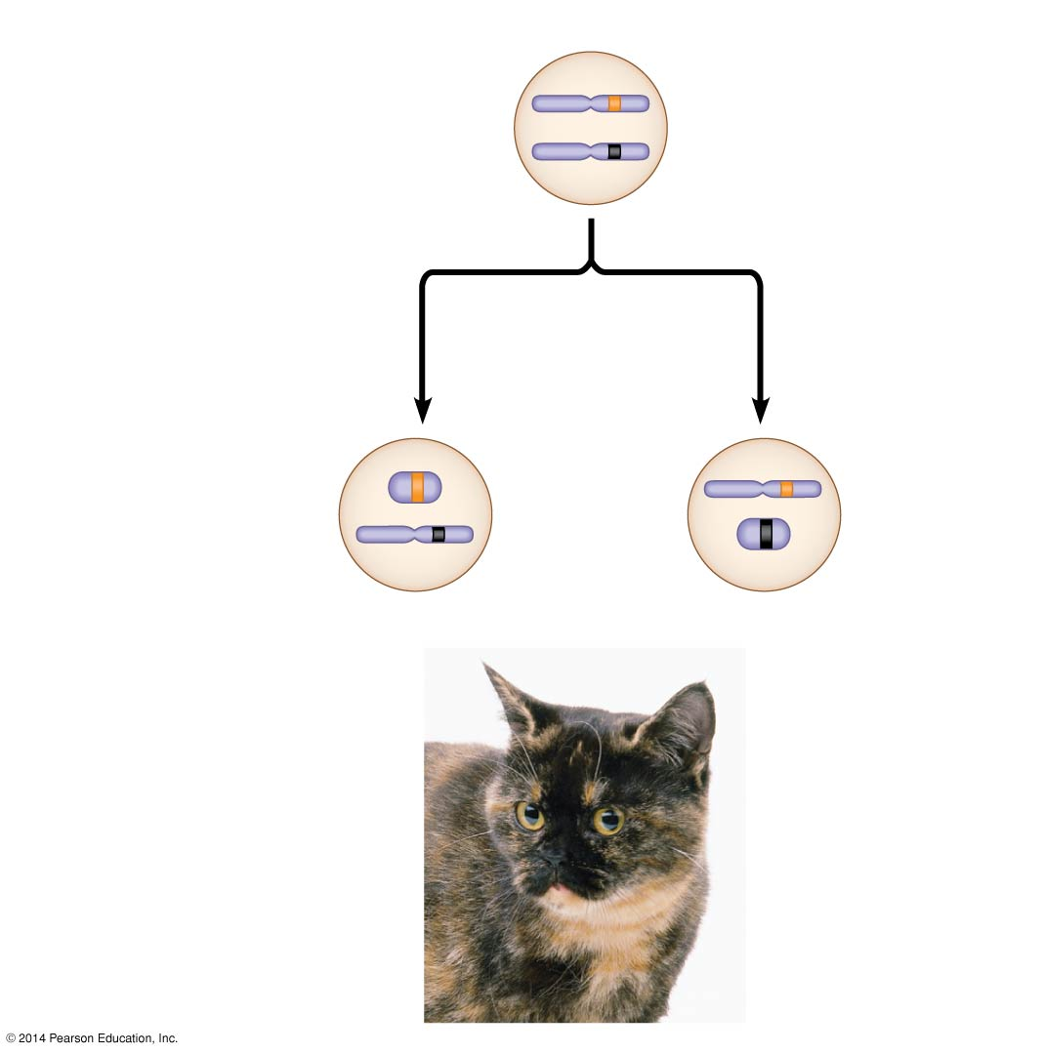
Figure 12.8
X chromosomes
Allele for
orange fur
Early embryo:
Allele for
black fur
Cell division and
X chromosome
inactivation
Two cell
populations
in adult cat:
Active X
Active X
Inactive
X
Black fur
Orange fur
Notes:
29
Figure 12.8 X inactivation and the tortoiseshell cat

Slide 30
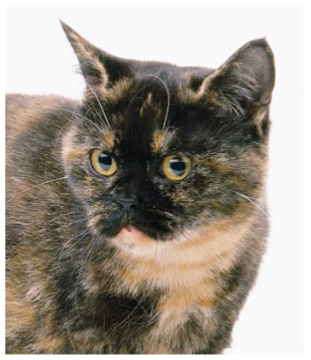
Figure 12.8a
Notes:
30
Figure 12.8a X inactivation and the tortoiseshell cat (photo)

Slide 31
Concept 12.3: Linked genes tend to be inherited together because they are located near each other on the same chromosome
Each chromosome has hundreds or thousands of genes (except the Y chromosome)
Genes located on the same chromosome that tend to be inherited together are called linked genes
http://learn.genetics.utah.edu/content/pigeons/geneticlinkage/
Notes:
31

Slide 32
How Linkage Affects Inheritance
Morgan did experiments with fruit flies that show how linkage affects inheritance of two characters
Morgan crossed flies that differed in traits of body color and wing size
Notes:
32

Slide 33
Morgan found that body color and wing size are usually inherited together in specific combinations (parental phenotypes)
He reasoned that since these genes did not assort independently, they were on the same chromosome
Notes:
33

Slide 34
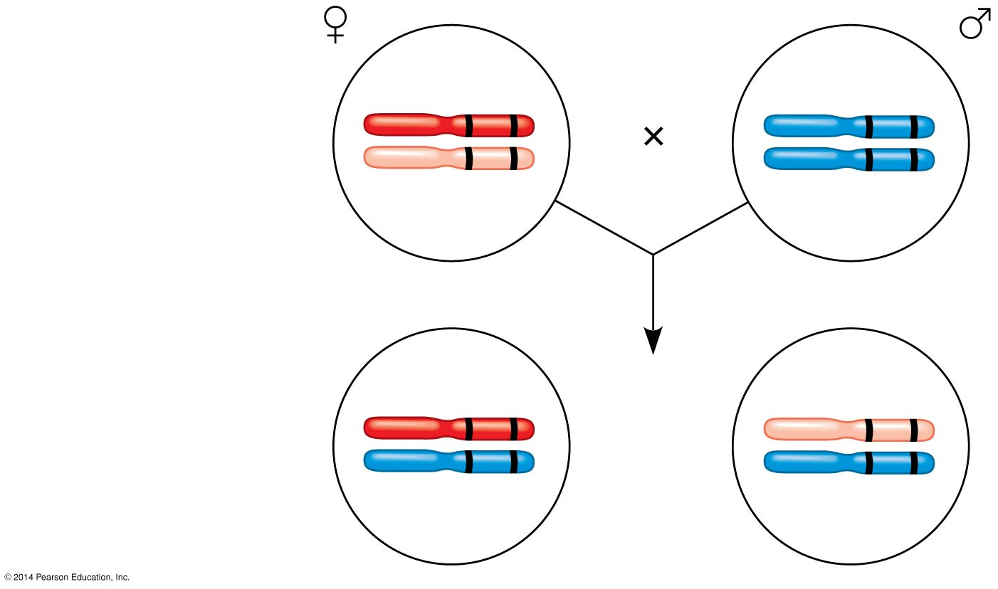
Figure 12.UN01
F₁ dihybrid female
and homozygous
recessive male
in testcross
b⁺ vg⁺
b vg
b vg
b vg
b⁺ vg⁺
b vg
Most offspring
or
b vg
b vg
Notes:
34
Figure 12.UN01 In-text figure, testcross, p. 234

Slide 35
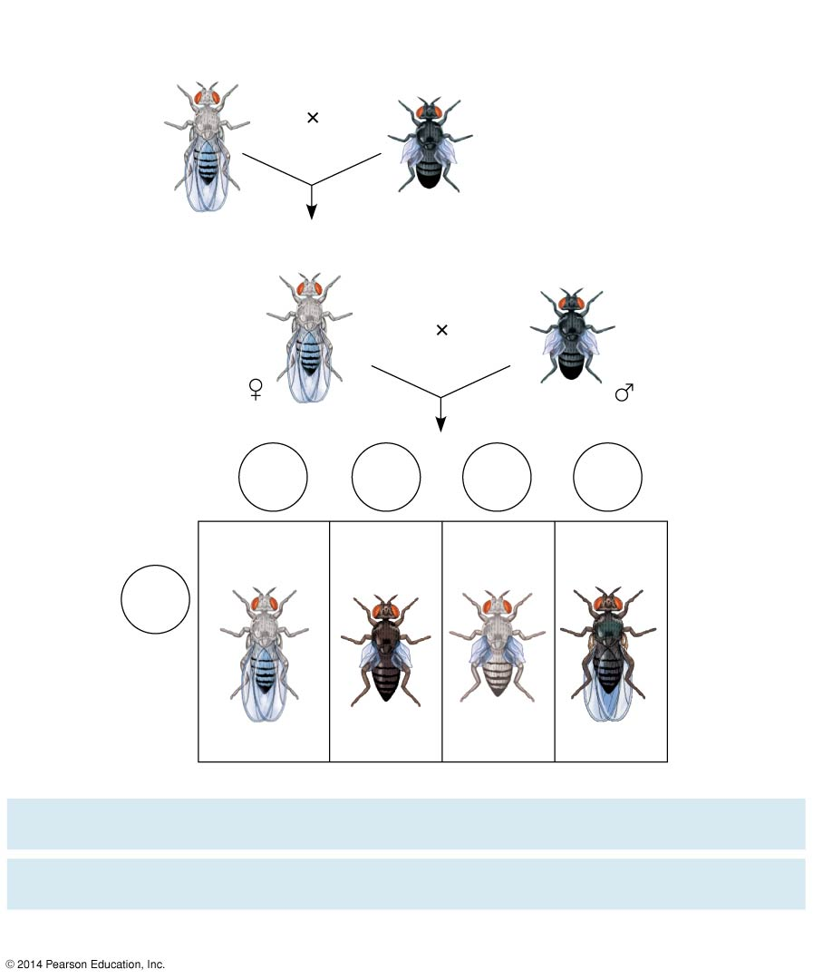
Figure 12.9
Experiment
P Generation
(homozygous)
Wild type
(gray body,
normal wings)
Double mutant
(black body,
vestigial wings)
b⁺ b⁺ vg⁺ vg⁺
b b vg vg
F₁ dihybrid testcross
Homozygous
recessive (black
body, vestigial
wings)
Wild-type F₁ dihybrid
(gray body, normal wings)
b⁺ b vg⁺ vg
b b vg vg
Testcross
offspring
Eggs
b⁺ vg⁺
b vg
b⁺ vg
b vg⁺
Wild-type
(gray-normal)
Black-
vestigial
Gray-
vestigial
Black-
normal
b vg
Sperm
b⁺ b vg⁺ vg
b b vg vg
b⁺ b vg vg
b b vg⁺ vg
PREDICTED RATIOS
Genes on different
chromosomes:
1
:
1
:
1
:
1
Genes on some
chromosome:
1
:
1
:
0
:
0
Results
965
:
944
:
206
:
185
Notes:
35
Figure 12.9 Inquiry: How does linkage between two genes affect inheritance of characters?

Slide 36
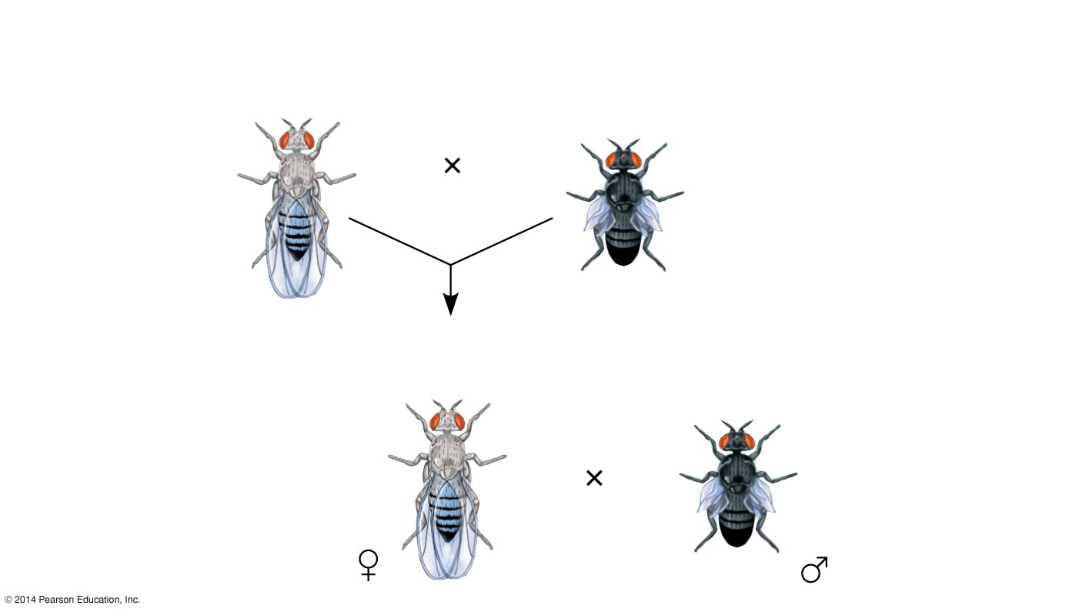
Figure 12.9a
Experiment
P Generation
(homozygous)
Wild type
(gray body,
normal wings)
Double mutant
(black body,
vestigial wings)
b⁺ b⁺ vg⁺ vg⁺
b b vg vg
F₁ dihybrid testcross
Wild-type F₁ dihybrid
(gray body, normal wings)
Homozygous
recessive (black
body, vestigial
wings)
b⁺ b vg⁺ vg
b b vg vg
Notes:
36
Figure 12.9a Inquiry: How does linkage between two genes affect inheritance of characters? (part 1: experiment)

Slide 37
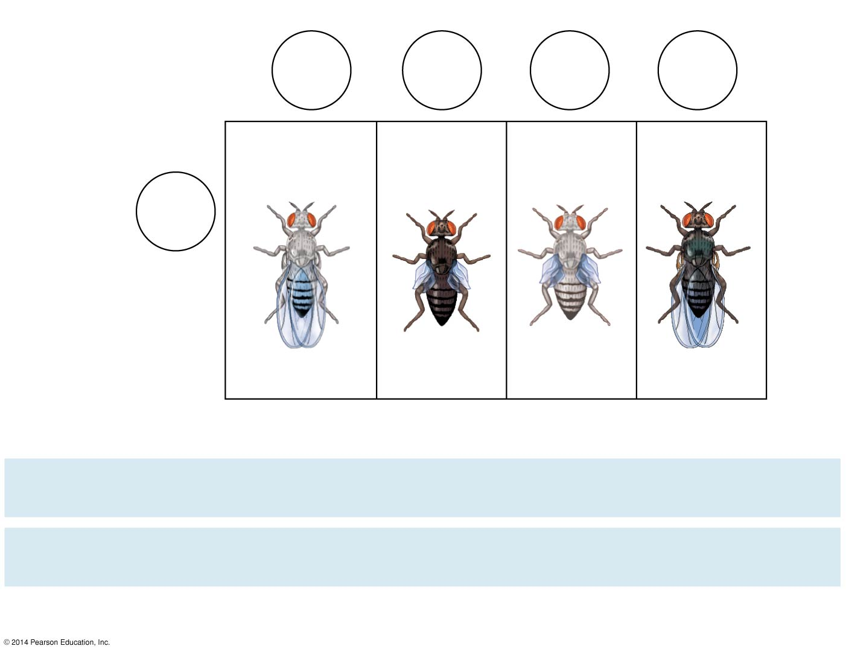
Figure 12.9b
Experiment
Testcross
offspring
Eggs
b⁺ vg⁺
b vg
b⁺ vg
b vg⁺
Wild-type
(gray-normal)
Black-
vestigial
Gray-
vestigial
Black-
normal
b vg
Sperm
b⁺ b vg⁺ vg
b b vg vg
b⁺ b vg vg
b b vg⁺ vg
PREDICTED RATIOS
Genes on different
chromosomes:
1
:
1
:
1
:
1
Genes on same
chromosome:
1
:
1
:
0
:
0
Results
965
:
944
:
206
:
185
Notes:
37
Figure 12.9b Inquiry: How does linkage between two genes affect inheritance of characters? (part 2: results)

Slide 38
However, nonparental phenotypes were also produced
Understanding this result involves exploring genetic recombination, the production of offspring with combinations of traits differing from either parent
Notes:
38

Slide 39
Genetic Recombination and Linkage
The genetic findings of Mendel and Morgan relate to the chromosomal basis of recombination
Notes:
39

Slide 40
Recombination of Unlinked Genes: Independent Assortment of Chromosomes
Mendel observed that combinations of traits in some offspring differ from either parent
Offspring with a phenotype matching one of the parental phenotypes are called parental types
Offspring with nonparental phenotypes (new combinations of traits) are called recombinant types, or recombinants
A 50% frequency of recombination is observed for any two genes on different chromosomes
Notes:
40

Slide 41
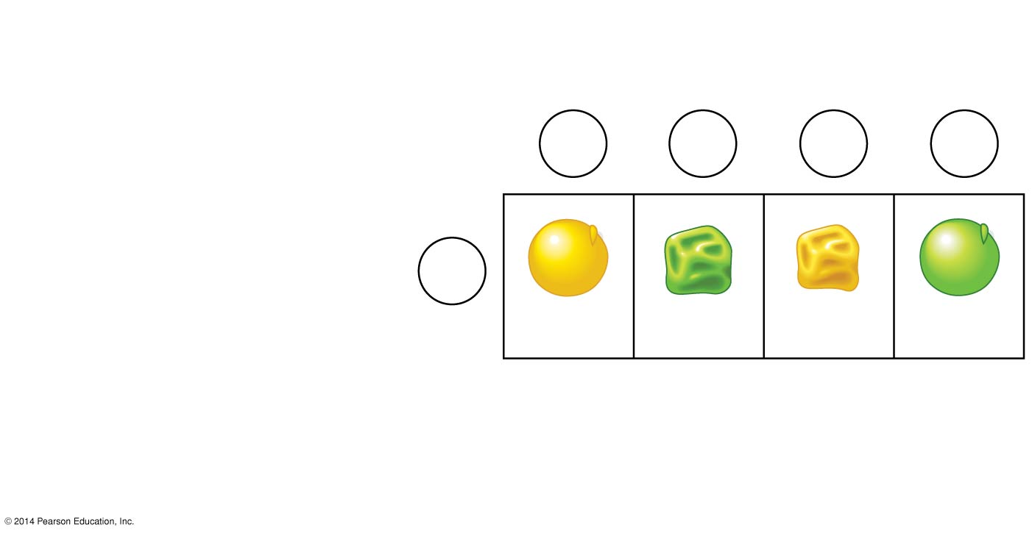
Figure 12.UN02
Gametes from yellow-round
dihybrid parent (YyRr)
YR
yr
Yr
yR
Gametes from green-
wrinkled homozygous
recessive parent (yyrr)
yr
YyRr
yyrr
Yyrr
yyRr
Parental-
type
offspring
Recombinant
offspring
Notes:
41
Figure 12.UN02 In-text figure, Punnett square, p. 236

Slide 42
Recombination of Linked Genes: Crossing Over
Morgan discovered that even when two genes were on the same chromosome, some recombinant phenotypes were observed
He proposed that some process must occasionally break the physical connection between genes on the same chromosome
That mechanism was the crossing over between homologous chromosomes
Animation: Crossing Over
Notes:
42

Slide 43
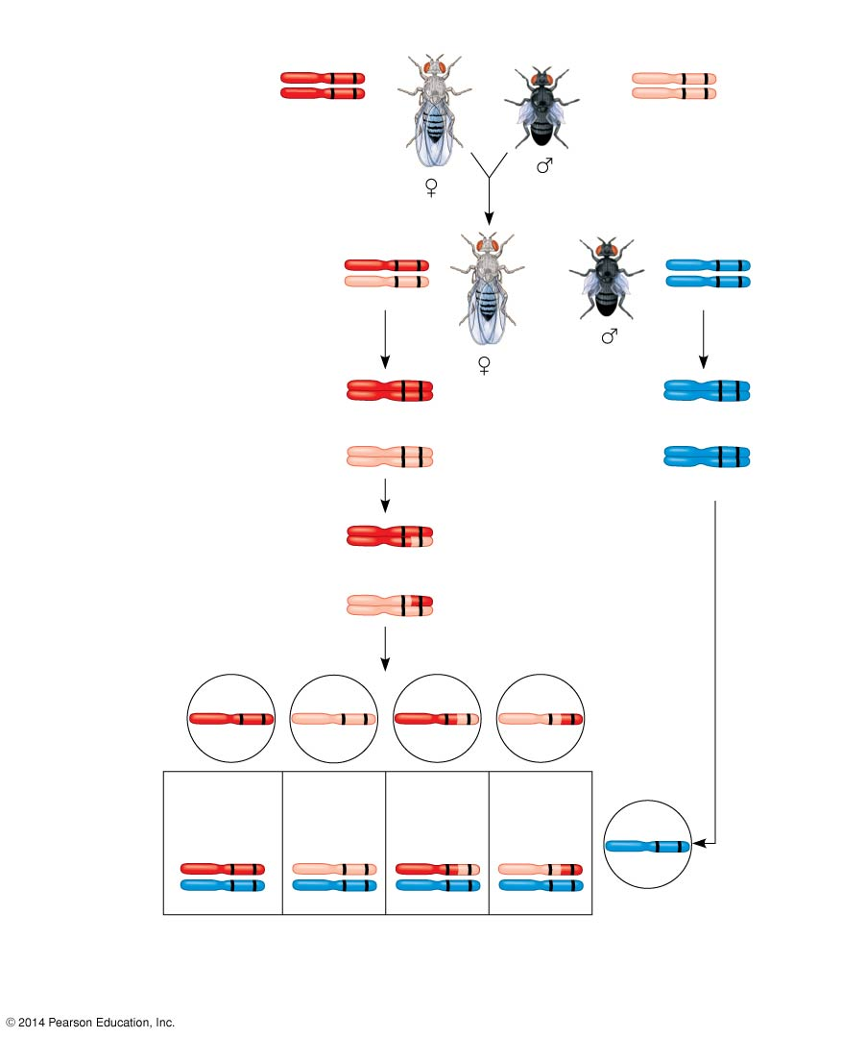
Figure 12.10
P generation
(homozygous)
Wild type (gray body,
normal wings)
Double mutant (black body,
vestigial wings)
b⁺ vg⁺
b vg
b⁺ vg⁺
b vg
F₁ dihybrid testcross
Wild-type F₁ dihybrid
(gray body, normal wings)
Homozygous recessive
(black body, vestigial wings)
b⁺ vg⁺
b vg
b vg
b vg
Replication
of chromosomes
Replication
of chromosomes
b⁺ vg⁺
b vg
b⁺ vg⁺
b vg
b vg
b vg
Meiosis I
b vg
b vg
b⁺ vg⁺
Meiosis I and II
b⁺ vg
b vg⁺
Meiosis II
b vg
Recombinant
chromosomes
Eggs
b⁺ vg⁺
b vg
b⁺ vg
b vg⁺
Testcross
offspring
965
Wild type
(gray-normal)
944
Black-
vestigial
206
Gray-
vestigial
185
Black-
normal
b vg
b⁺ vg⁺
b vg
b⁺ vg
b vg⁺
b vg
b vg
b vg
b vg
Sperm
Parental-type offspring
Recombinant offspring
Recombination
frequency
=
391 recombinants
× 100 = 17%
2,300 total offspring
Notes:
43
Figure 12.10 Chromosomal basis for recombination of linked genes

Slide 44
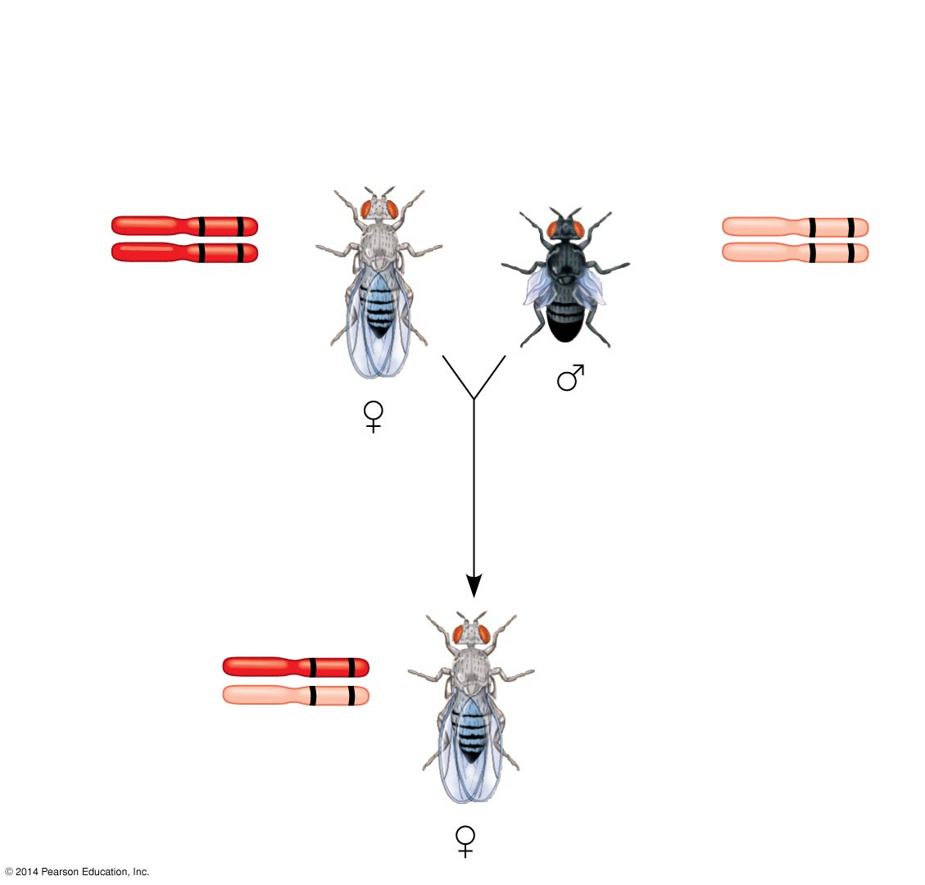
Figure 12.10a
P generation (homozygous)
Wild type
(gray body,
normal wings)
Double mutant
(black body,
vestigial wings)
b⁺ vg⁺
b vg
b⁺ vg⁺
b vg
Wild-type F₁ dihybrid
(gray body,
normal wings)
b⁺ vg⁺
b vg
Notes:
44
Figure 12.10a Chromosomal basis for recombination of linked genes (part 1: F₁ dihybrid)

Slide 45
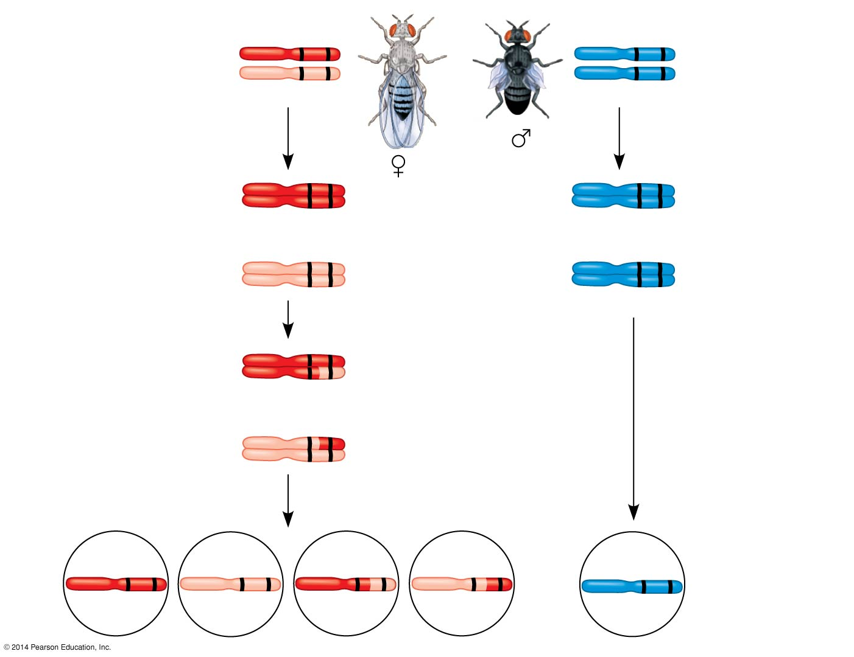
Figure 12.10b
F₁ dihybrid testcross
b⁺ vg⁺
b vg
Wild-type F₁
dihybrid
(gray body,
normal wings)
Homozygous
recessive
(black body,
vestigial wings)
b vg
b vg
b⁺ vg⁺
b vg
b⁺ vg⁺
b vg
b vg
b vg
Meiosis I
b vg
b vg
b⁺ vg⁺
Meiosis I and II
b⁺ vg
b vg⁺
b vg
Recombinant
chromosomes
Meiosis II
b⁺ vg⁺
b vg
b⁺ vg
b vg⁺
b vg
Eggs
Sperm
Notes:
45
Figure 12.10b Chromosomal basis for recombination of linked genes (part 2: testcross)

Slide 46
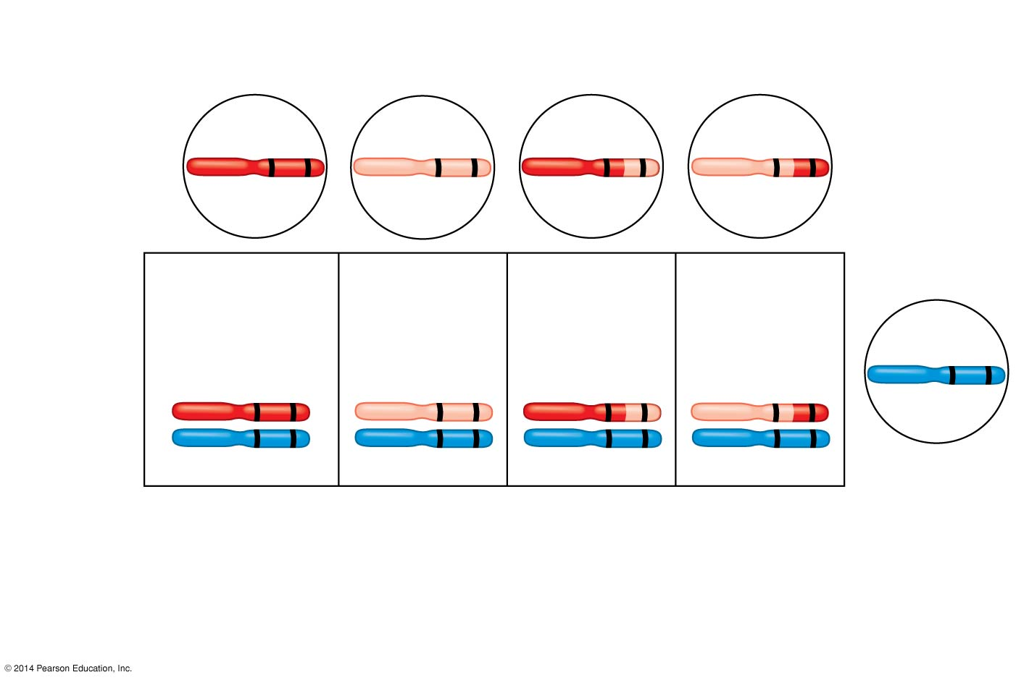
Figure 12.10c
Recombinant
chromosomes
b⁺ vg⁺
b vg
b⁺ vg
b vg⁺
Eggs
Testcross
offspring
965
Wild type
(gray-normal)
944
Black-
vestigial
206
Gray-
vestigial
185
Black-
normal
b vg
b⁺ vg⁺
b vg
b⁺ vg
b vg⁺
b vg
b vg
b vg
b vg
Sperm
Parental-type offspring
Recombinant offspring
Recombination
frequency
391 recombinants
× 100 = 17%
=
2,300 total offspring
Notes:
46
Figure 12.10c Chromosomal basis for recombination of linked genes (part 3: testcross offspring)

Slide 47
New Combinations of Alleles: Variation for Normal Selection
Recombinant chromosomes bring alleles together in new combinations in gametes
Random fertilization increases even further the number of variant combinations that can be produced
This abundance of genetic variation is the raw material upon which natural selection works
Notes:
47

Slide 48
Mapping the Distance Between Genes Using Recombination Data: Scientific Inquiry
Alfred Sturtevant, one of Morgan’s students, constructed a genetic map, an ordered list of the genetic loci along a particular chromosome
Sturtevant predicted that the farther apart two genes are, the higher the probability that a crossover will occur between them and therefore the higher the recombination frequency
Notes:
48

Slide 49
A linkage map is a genetic map of a chromosome based on recombination frequencies
Distances between genes can be expressed as map units; one map unit represents a 1% recombination frequency
Notes:
49

Slide 50
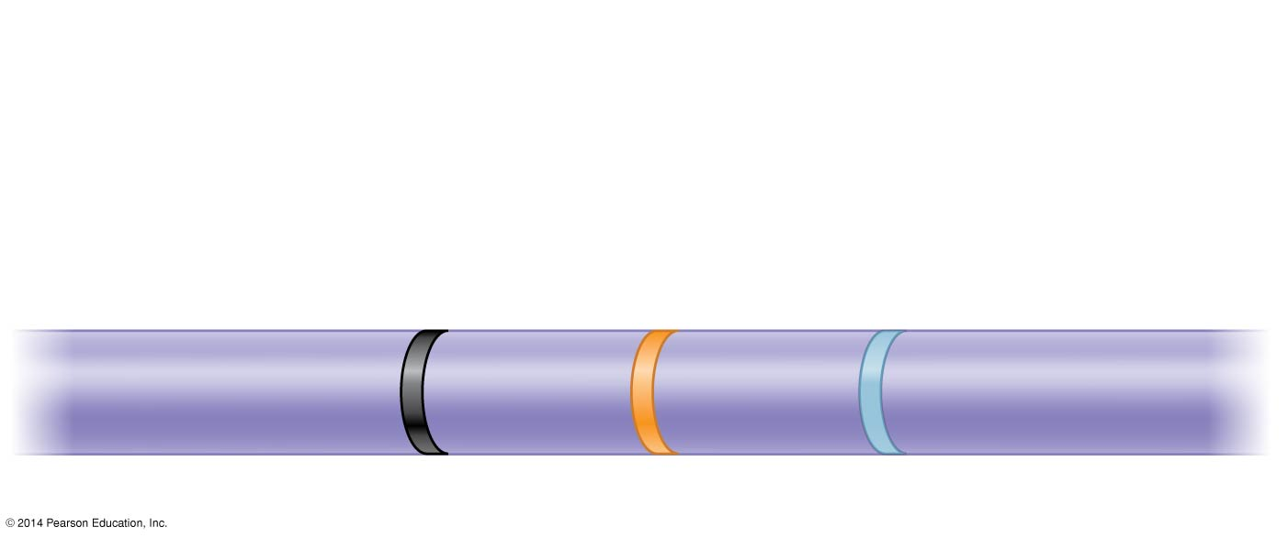
Figure 12.11
Results
Recombination
frequencies
9%
9.5%
Chromosome
17%
b
cn
vg
Notes:
50
Figure 12.11 Research method: constructing a linkage map

Slide 51
Genes that are far apart on the same chromosome can have a recombination frequency near 50%
Such genes are physically linked, but genetically unlinked, and behave as if found on different chromosomes
Notes:
51

Slide 52
Sturtevant used recombination frequencies to make linkage maps of fruit fly genes
Using methods like chromosomal banding, geneticists can develop cytogenetic maps of chromosomes
Cytogenetic maps indicate the positions of genes with respect to chromosomal features
Notes:
52

Slide 53
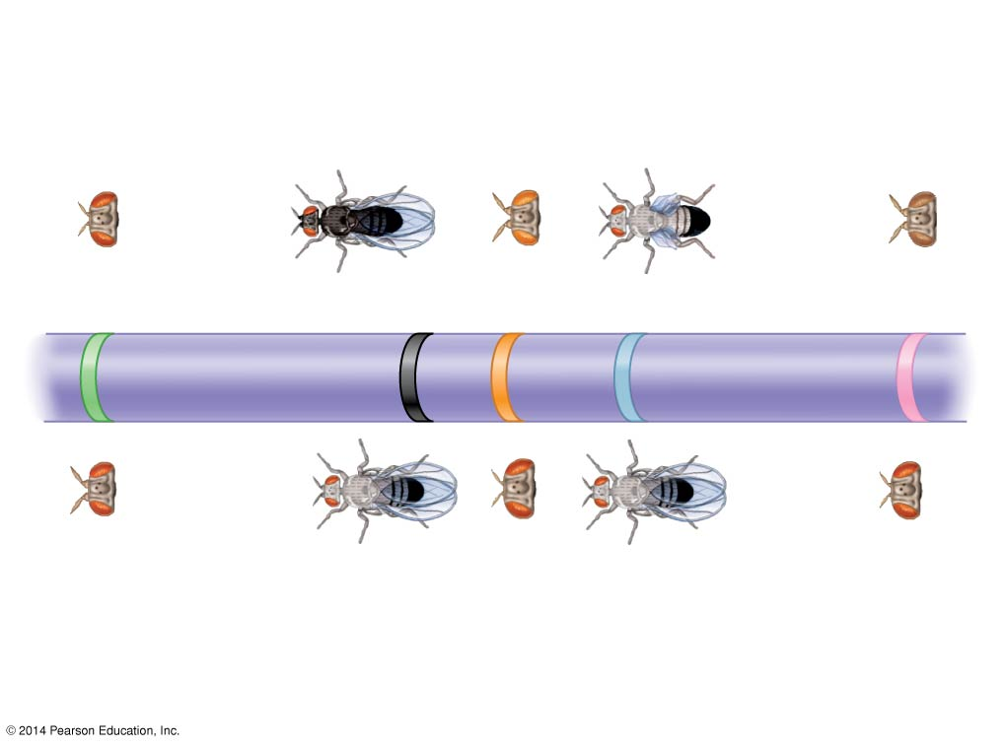
Figure 12.12
Mutant phenotypes
Short
aristae
Black
body
Cinnabar
eyes
Vestigial
wings
Brown
eyes
0
48.5
57.5
67.0
104.5
Long aristae
(appendages
on head)
Gray
body
Red
eyes
Normal
wings
Red
eyes
Wild-type phenotypes
Notes:
53
Figure 12.12 A partial genetic (linkage) map of a Drosophila chromosome

Slide 54
Concept 12.4: Alterations of chromosome number or structure cause some genetic disorders
Large-scale chromosomal alterations in humans and other mammals often lead to spontaneous abortions (miscarriages) or cause a variety of developmental disorders
Plants tolerate such genetic changes better than animals do
Notes:
54

Slide 55
Abnormal Chromosome Number
In nondisjunction, pairs of homologous chromosomes do not separate normally during meiosis
As a result, one gamete receives two of the same type of chromosome, and another gamete receives no copy
Video: Nondisjunction
Notes:
55

Slide 56
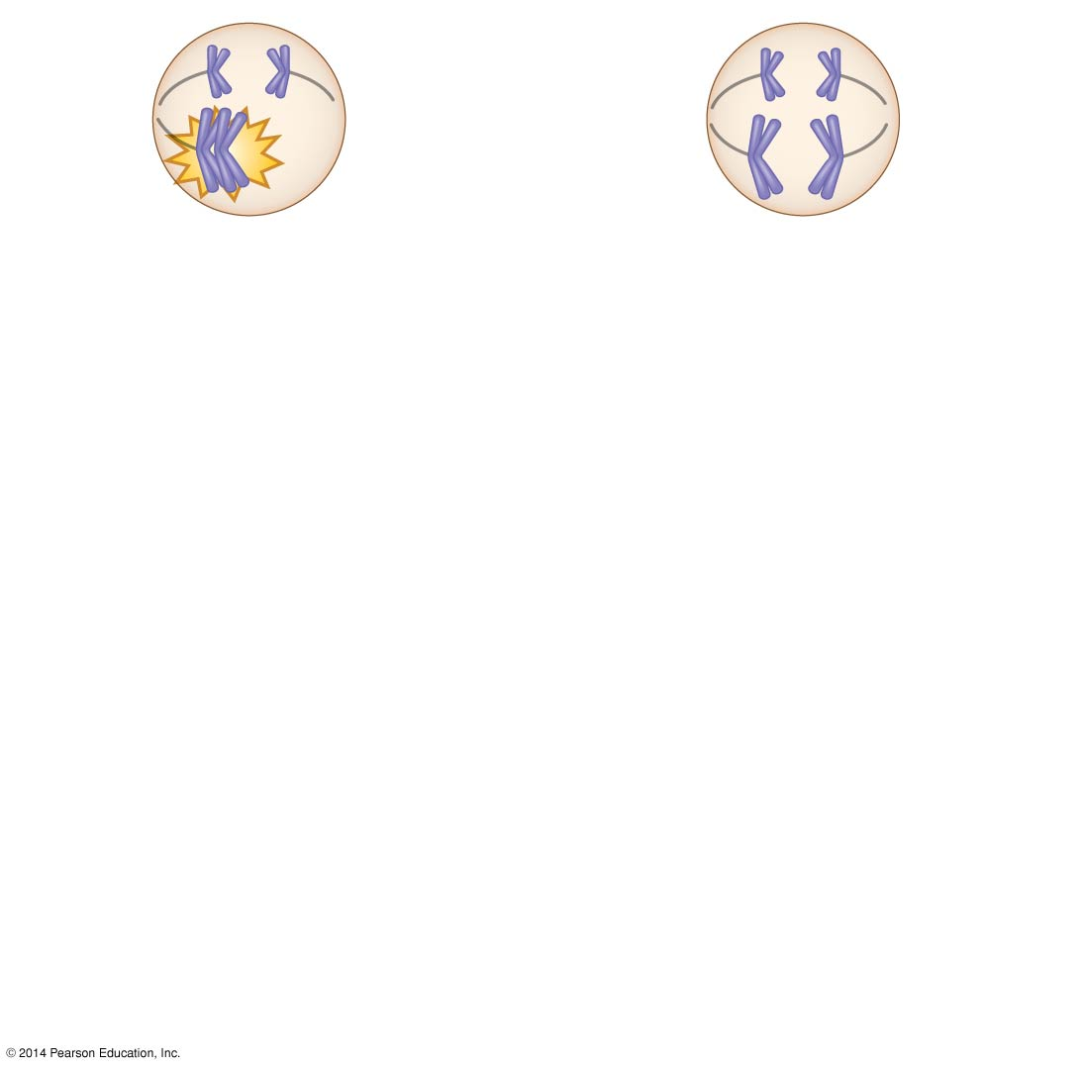
Figure 12.13-1
Meiosis I
Nondisjunction
Notes:
56
Figure 12.13-1 Meiotic nondisjunction (step 1)

Slide 57
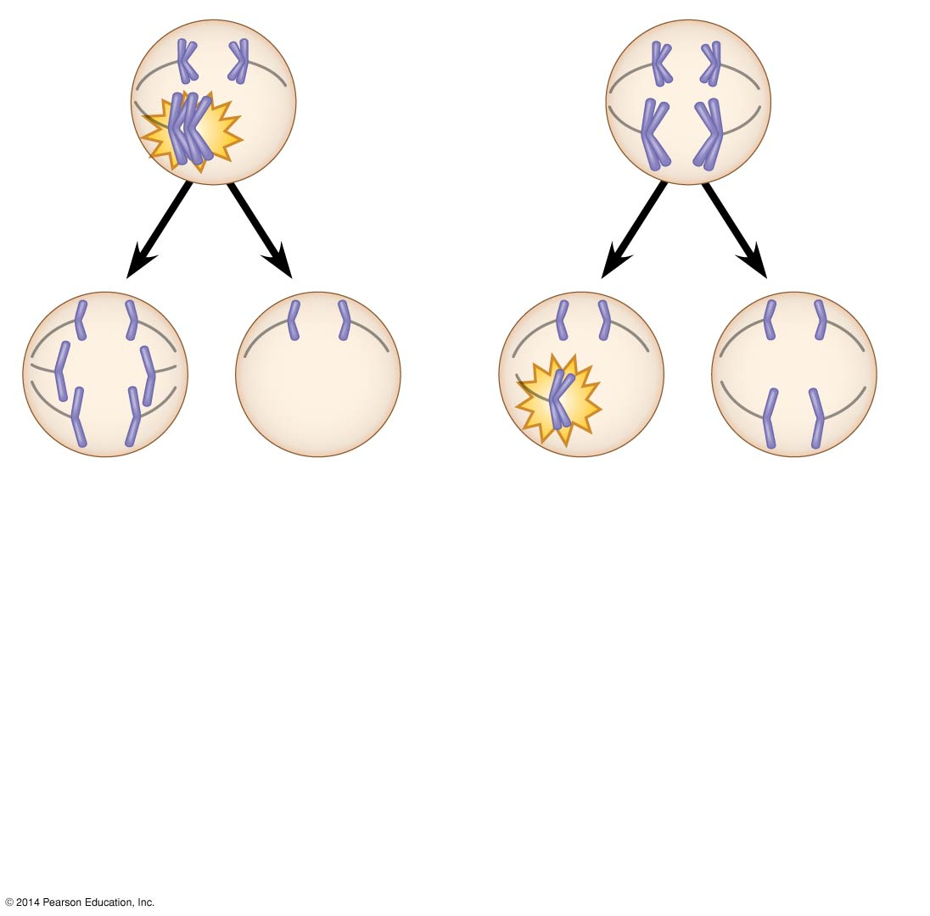
Figure 12.13-2
Meiosis I
Nondisjunction
Meiosis II
Non-
disjunction
Notes:
57
Figure 12.13-2 Meiotic nondisjunction (step 2)

Slide 58
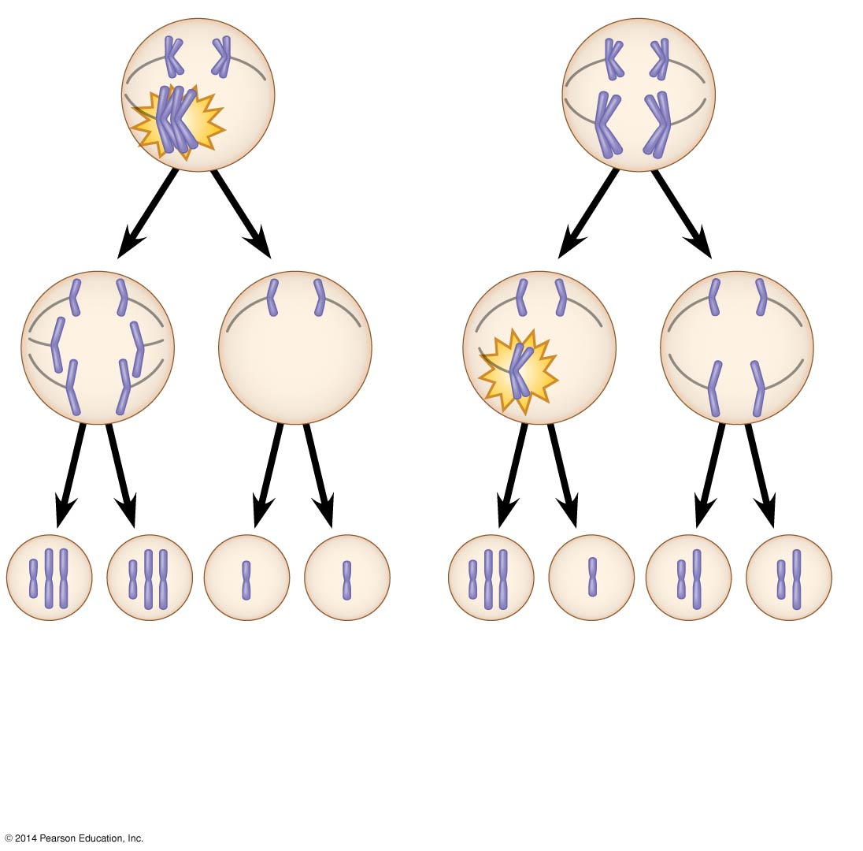
Figure 12.13-3
Meiosis I
Nondisjunction
Meiosis II
Non-
disjunction
Gametes
n + 1
n + 1
n − 1
n − 1
n + 1
n − 1
n
n
Number of chromosomes
(a)
Nondisjunction of homo-
logous chromosomes in
meiosis I
(b)
Nondisjunction of sister
chromatids in meiosis II
Notes:
58
Figure 12.13-3 Meiotic nondisjunction (step 3)

Slide 59
Aneuploidy results from the fertilization of gametes in which nondisjunction occurred
Offspring with this condition have an abnormal number of a particular chromosome
Notes:
59

Slide 60
A monosomic zygote has only one copy of a particular chromosome
A trisomic zygote has three copies of a particular chromosome
Notes:
60

Slide 61
Polyploidy is a condition in which an organism has more than two complete sets of chromosomes
Triploidy (3n) is three sets of chromosomes
Tetraploidy (4n) is four sets of chromosomes
Polyploidy is common in plants, but not animals
Polyploids are more normal in appearance than aneuploids
Notes:
61

Slide 62
Alterations of Chromosome Structure
Breakage of a chromosome can lead to four types of changes in chromosome structure
Deletion removes a chromosomal segment
Duplication repeats a segment
Inversion reverses orientation of a segment within a chromosome
Translocation moves a segment from one chromosome to another
Notes:
62

Slide 63
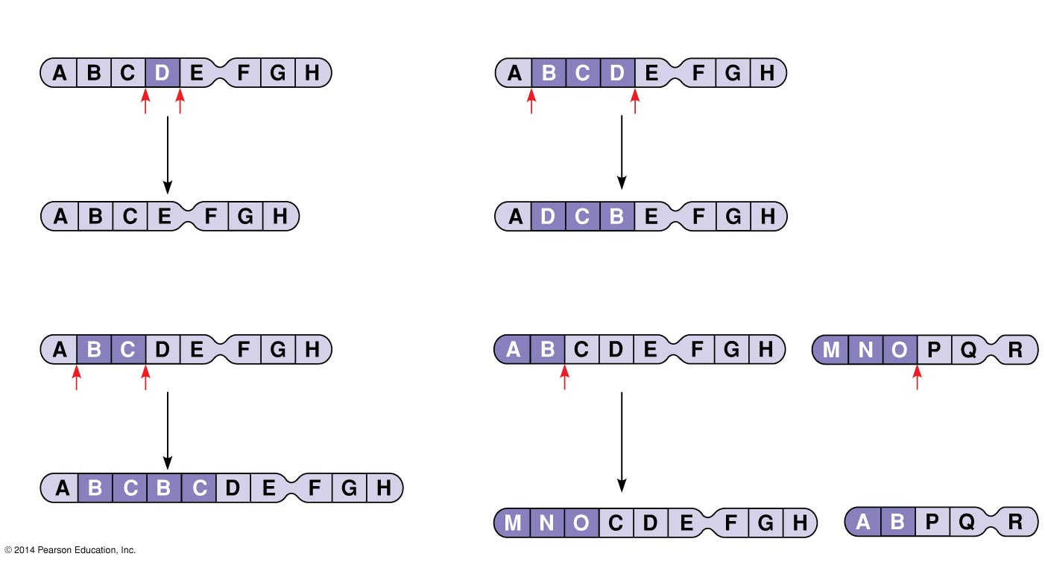
Figure 12.14
(a) Deletion
(c) Inversion
A deletion removes a
chromosomal segment.
An inversion reverses a segment
within a chromosome.
(b) Duplication
(d) Translocation
A duplication repeats
a segment.
A translocation moves a segment
from one chromosome to a
nonhomologous chromosome.
Notes:
63
Figure 12.14 Alterations of chromosome structure

Slide 64
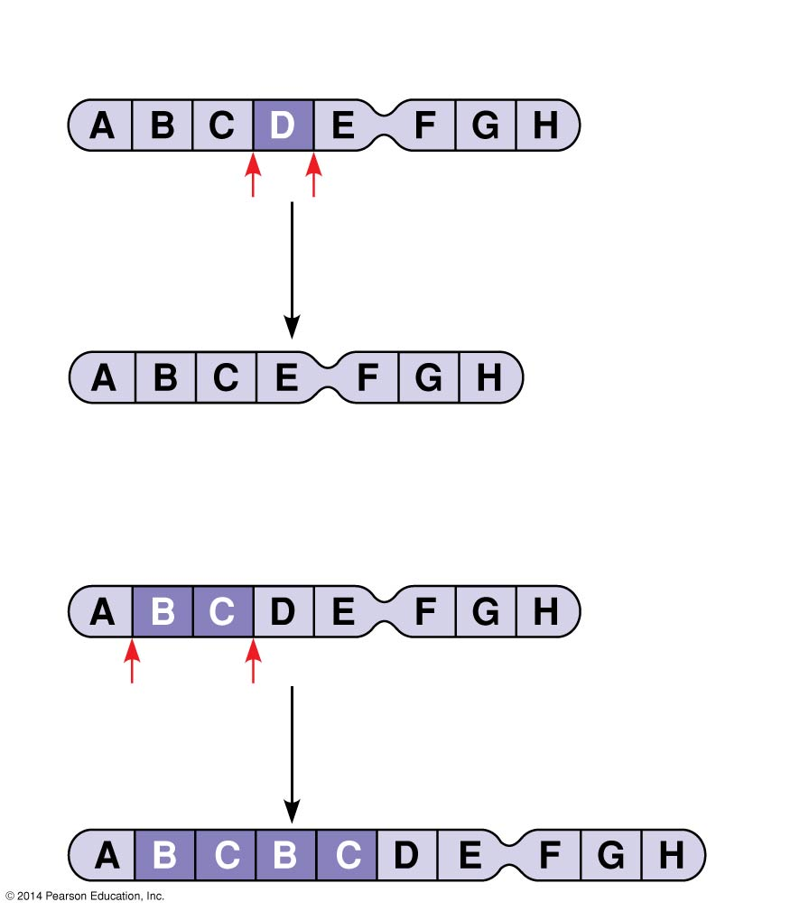
Figure 12.14a
(a) Deletion
A deletion removes a
chromosomal segment.
(b) Duplication
A duplication repeats
a segment.
Notes:
64
Figure 12.14a Alterations of chromosome structure (part 1: deletion and duplication)

Slide 65
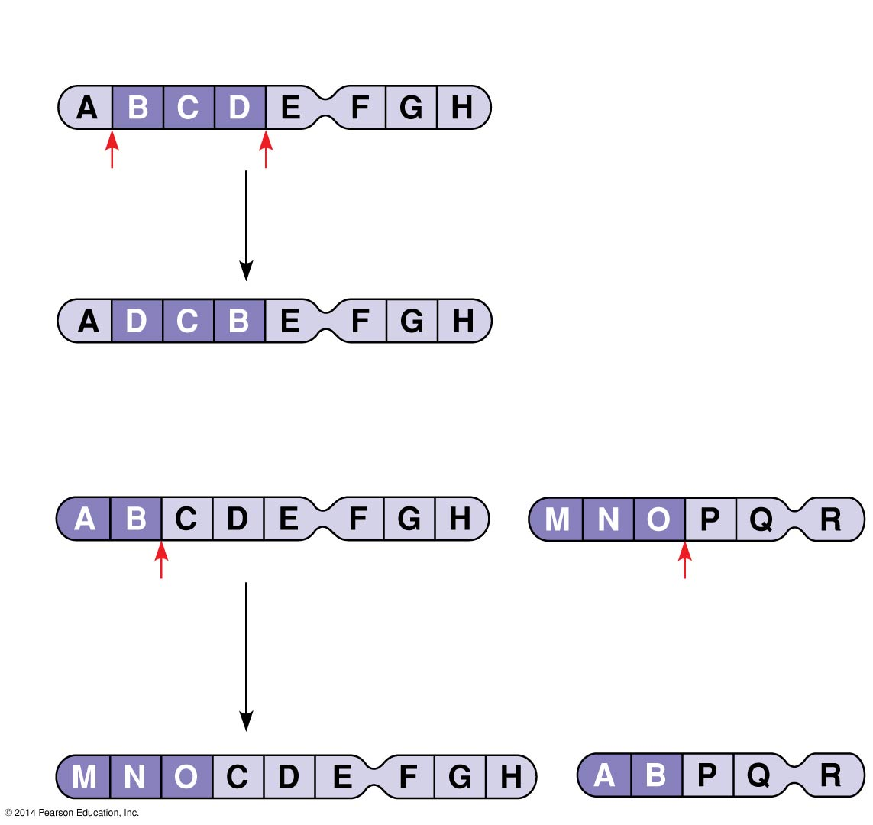
Figure 12.14b
(c) Inversion
An inversion reverses a segment
within a chromosome.
(d) Translocation
A translocation moves a segment
from one chromosome to a
nonhomologous chromosome.
Notes:
65
Figure 12.14b Alterations of chromosome structure (part 2: inversion and translocation)

Slide 66
A diploid embryo that is homozygous for a large deletion is likely missing a number of essential genes; such a condition is generally lethal
Duplications and translocations also tend to be harmful
In inversions, the balance of genes is normal but phenotype may be influenced if the expression of genes is altered
Notes:
66

Slide 67
Human Disorders Due to Chromosomal Alterations
Alterations of chromosome number and structure are associated with some serious disorders
Some types of aneuploidy upset the genetic balance less than others, resulting in individuals surviving to birth and beyond
These surviving individuals have a set of symptoms, or syndrome, characteristic of the type of aneuploidy
Notes:
67

Slide 68
Down Syndrome (Trisomy 21)
Down syndrome is an aneuploid condition that results from three copies of chromosome 21
It affects about one out of every 700 children born in the United States
The frequency of Down syndrome increases with the age of the mother, a correlation that has not been explained
Notes:
68

Slide 69
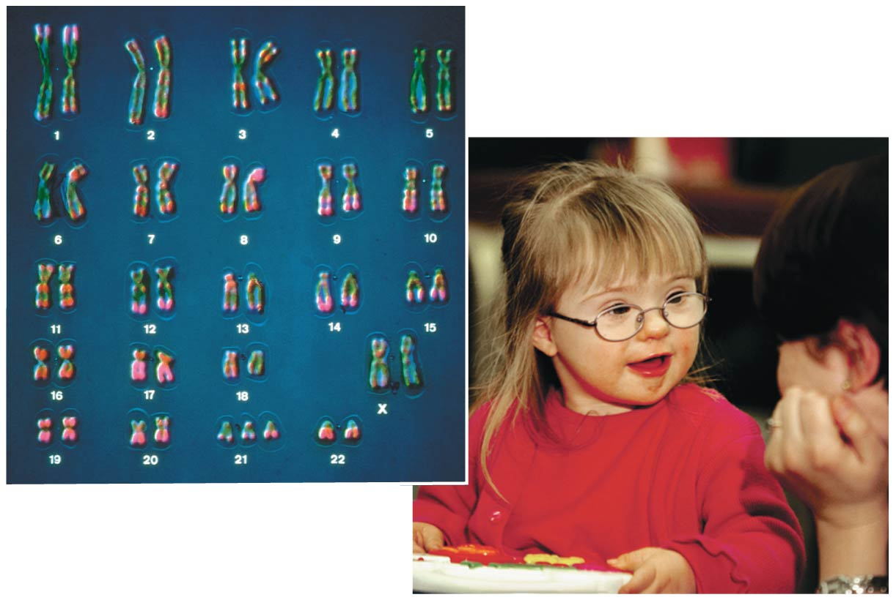
Figure 12.15
Notes:
69
Figure 12.15 Down syndrome

Slide 70
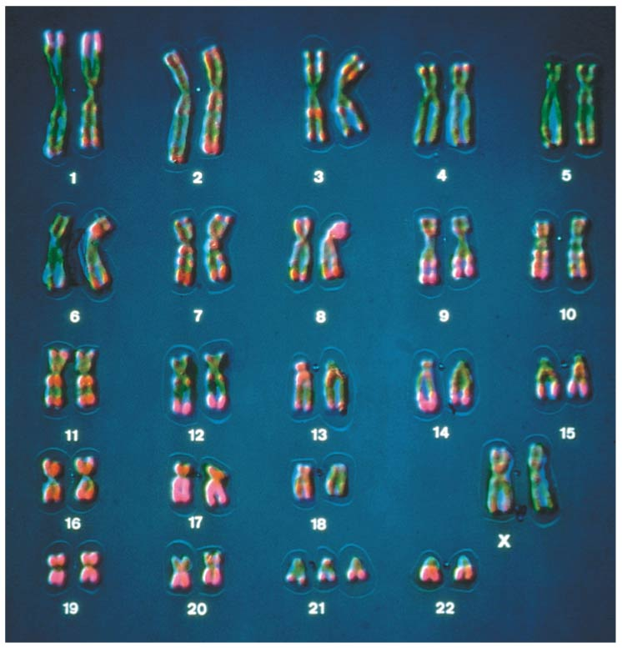
Figure 12.15a
Notes:
70
Figure 12.15a Down syndrome (part 1: karotype)

Slide 71
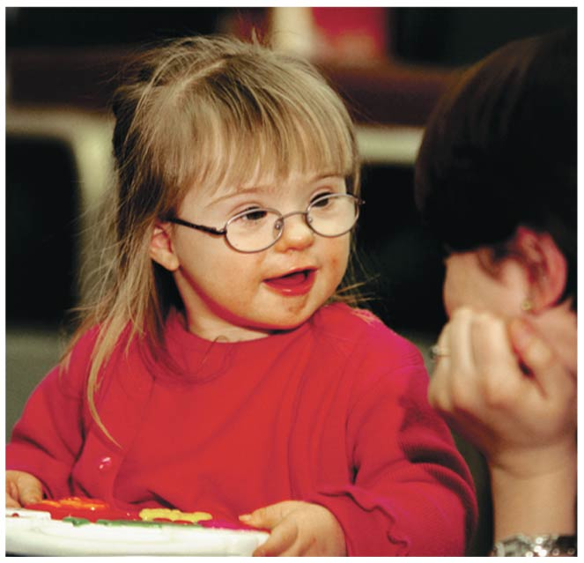
Figure 12.15b
Notes:
71
Figure 12.15b Down syndrome (part 2: photo)

Slide 72
Aneuploidy of Sex Chromosomes
Nondisjunction of sex chromosomes produces a variety of aneuploid conditions
Klinefelter syndrome is the result of an extra chromosome in a male, producing XXY individuals
Females with trisomy X (XXX) have no unusual physical features except being slightly taller than average
Notes:
72

Slide 73
Monosomy X, called Turner syndrome, produces X0 females, who are sterile
It is the only known viable monosomy in humans
Notes:
73

Slide 74
Disorders Caused by Structurally Altered Chromosomes
The syndrome cri du chat (“cry of the cat”) results from a specific deletion in chromosome 5
A child born with this syndrome is mentally retarded and has a catlike cry; individuals usually die in infancy or early childhood
Certain cancers, including chronic myelogenous leukemia (CML), are caused by translocations of chromosomes
Notes:
74

Slide 75
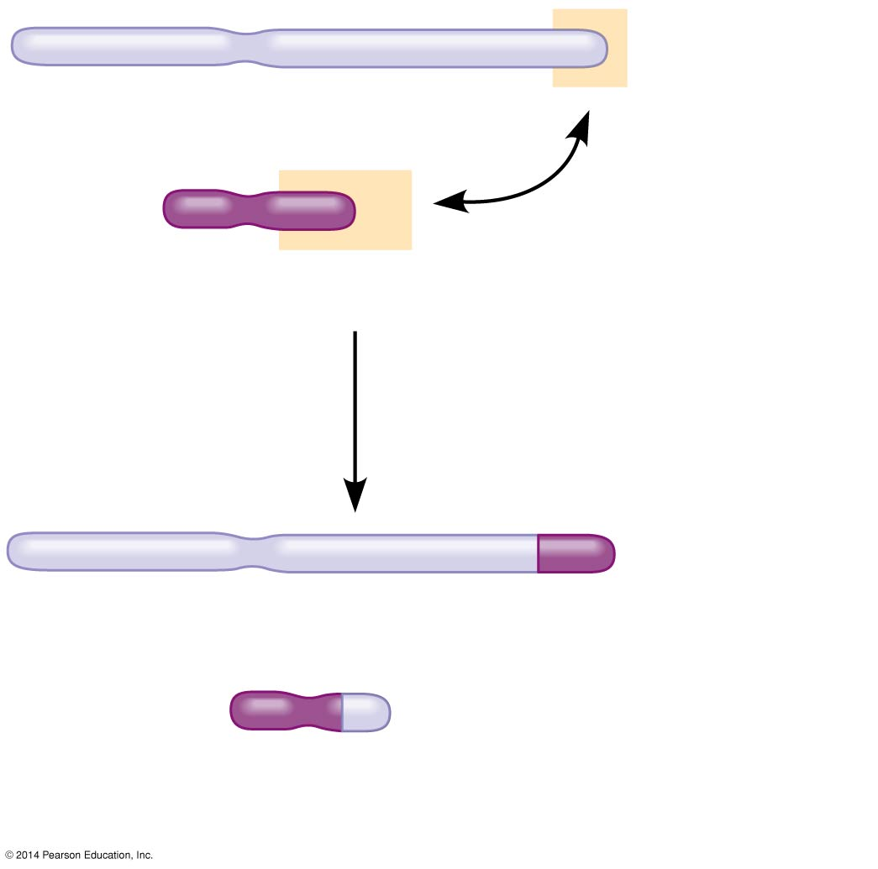
Figure 12.16
Normal chromosome 9
Normal chromosome 22
Reciprocal translocation
Translocated chromosome 9
Translocated chromosome 22
(Philadelphia chromosome)
Notes:
75
Figure 12.16 Translocation associated with chronic myelogenous leukemia (CML)

Slide 76
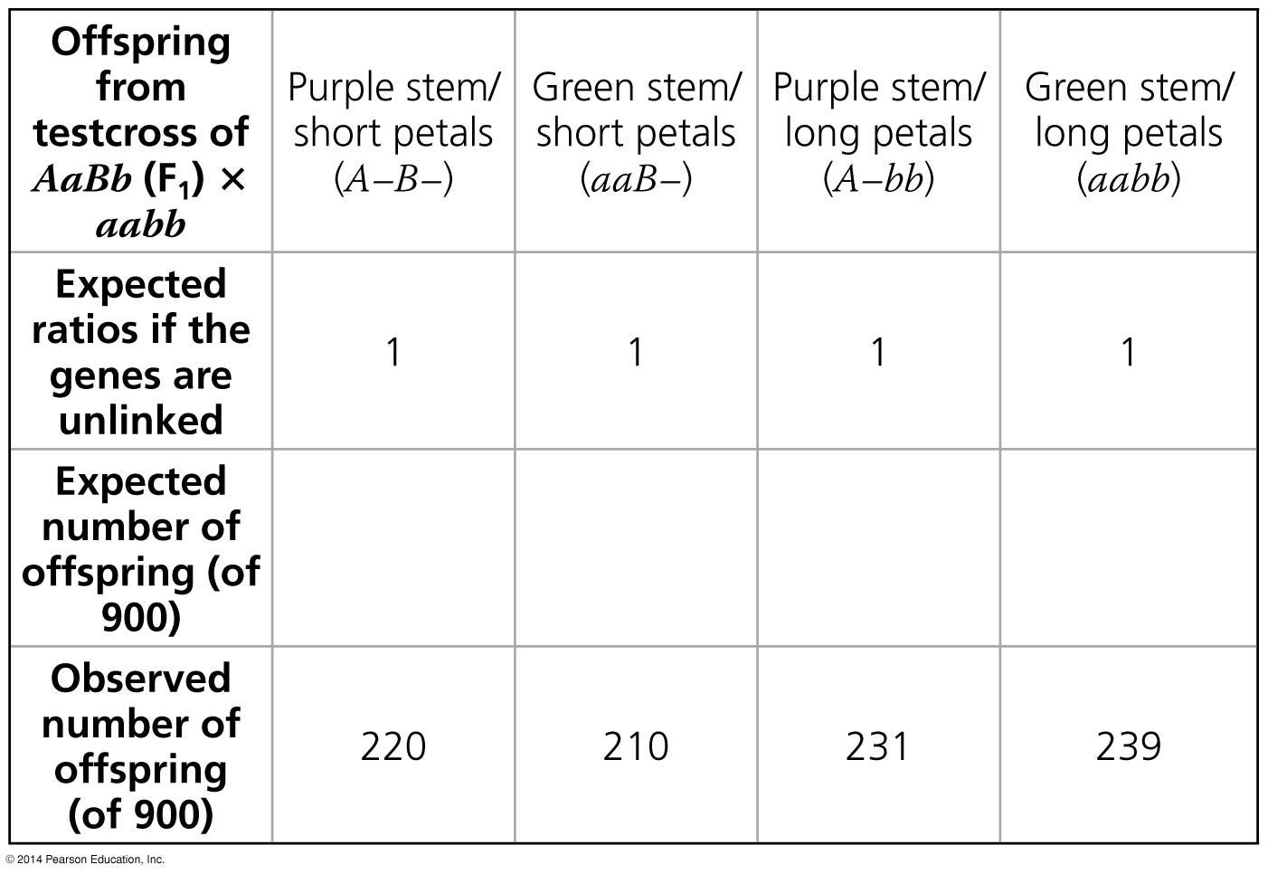
Figure 12.UN03a
Notes:
76
Figure 12.UN03a Skills exercise: using the chi-square test (part 1)

Slide 77
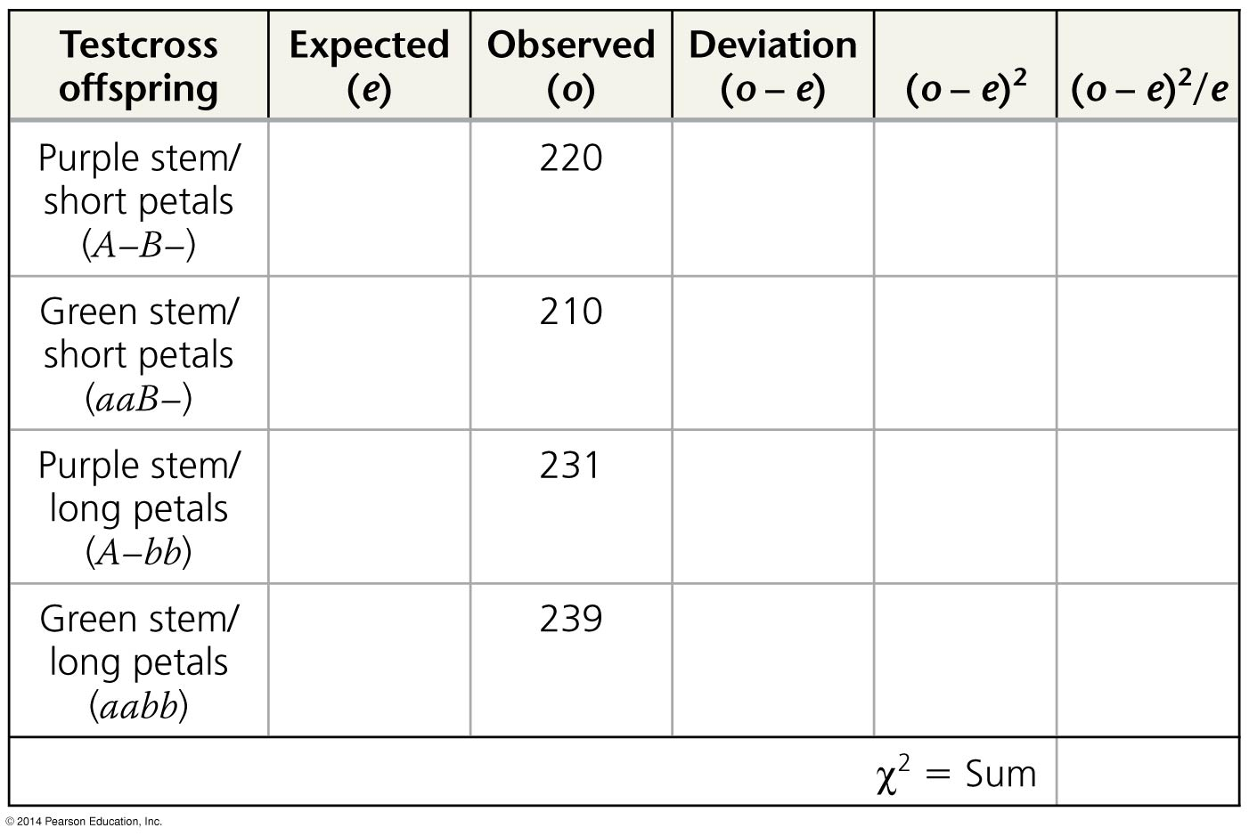
Figure 12.UN03b
Notes:
77
Figure 12.UN03b Skills exercise: using the chi-square test (part 2)

Slide 78
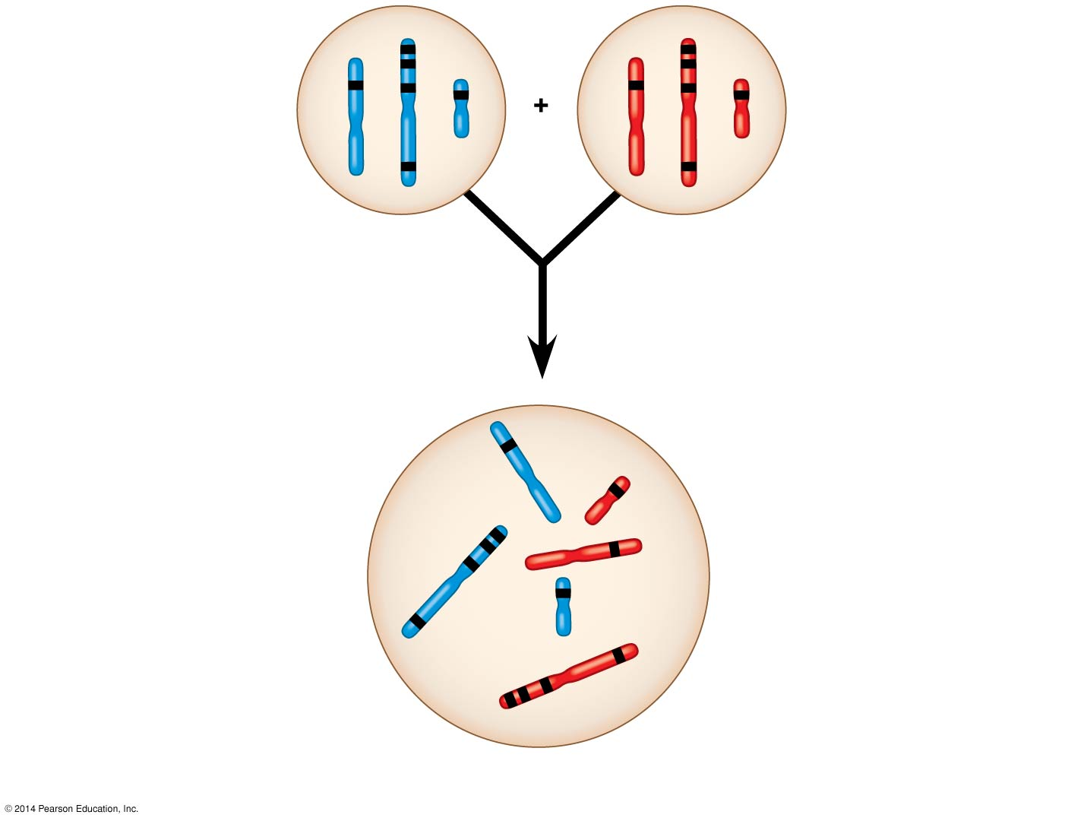
Figure 12.UN04
Sperm
Egg
C
c
B
b
P generation
gametes
D
A
E
d
a
e
F
f
This F₁ cell has 2n = 6 chromo-
somes and is heterozygous
for all six genes shown
(AaBbCcDdEeFf).
The alleles of unlinked
genes are either on
separate chromosomes
(such as d and e)
or so far apart on the
same chromosome
(c and f) that they
assort independently.
Red = maternal; blue = paternal.
D
e
C
d
B
A
Genes on the same
chromosome whose
alleles are so close to-
gether that they do not
assort independently
(such as a, b, and c) are
said to be genetically
linked.
F
E
Each chromosome has
hundreds or thousands
of genes. Four (A, B, C,
F) are shown on this one.
c
b
a
Notes:
78
Figure 12.UN04 Summary of key concepts: linkage

Slide 79
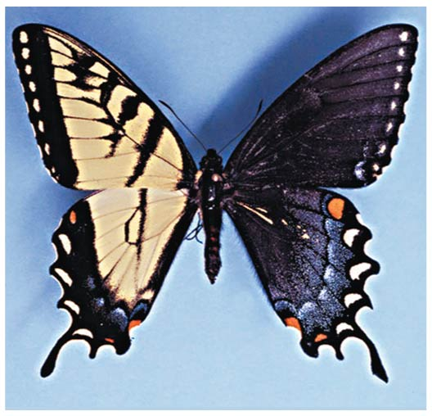
Figure 12.UN05
Notes:
79
Figure 12.UN05 Test your understanding, question 10 (tiger swallowtail gynandromorph)

