Slide 1
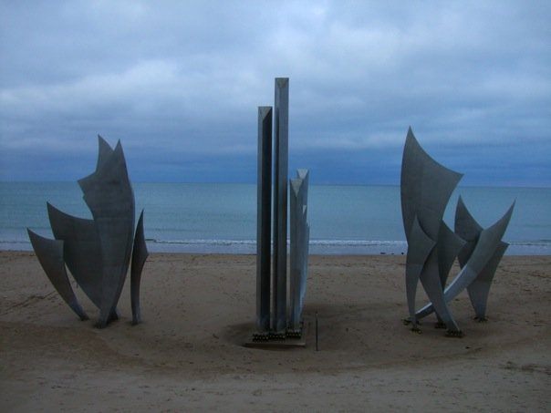
INVASION!!!
OPERATION OVERLORD:
D-DAY

Slide 2
Move Toward Allied Invasion
British, Americans, and Germans all knew an invasion was coming in 1944
Hitler did not know where it would come or where it would start
Knew was most likely to come across English Channel
Germans were fighting losing battle on two fronts

Slide 3
Axis Problems
Red Army continuing its drive west
In Italy, Allies continuing their drive north
Japan contributed nothing to war effort beyond diverting American forces to Pacific
Losses on both fronts had degraded quality and quantity of Germany’s men and equipment
Shift significant amounts of both on anticipation of invasion

Slide 4
The Atlantic Wall
Hitler orders the building of the Atlantic Wall in preparation of coming invasion
Located along the English Channel & Atlantic coasts of Western Europe – stretched 3,000 miles of coastline
Envisioned as an unbreakable barrier
Put up mines, barbed wire, and various obstacles on the beaches

Slide 5
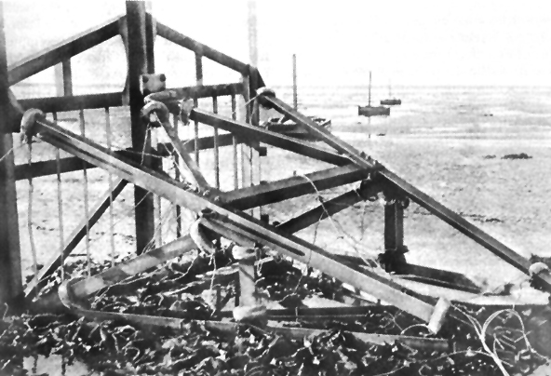
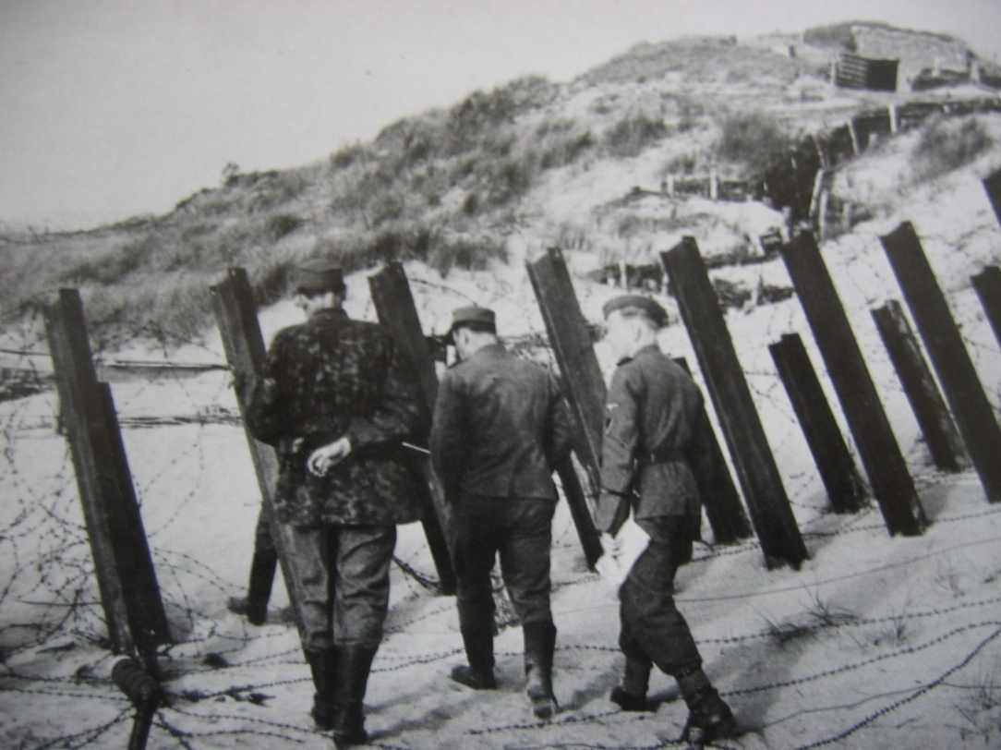
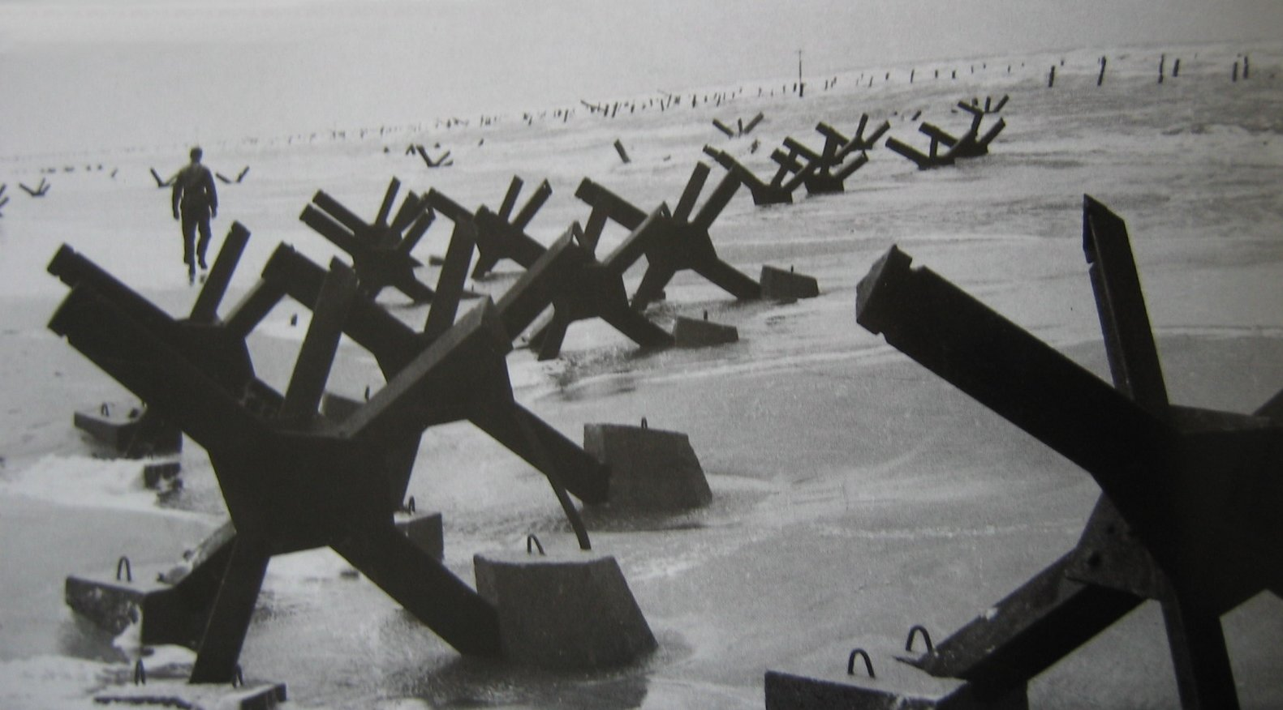
Belgian Gate
Stakes and Barbed Wire
Czech
Hedgehog

Slide 6
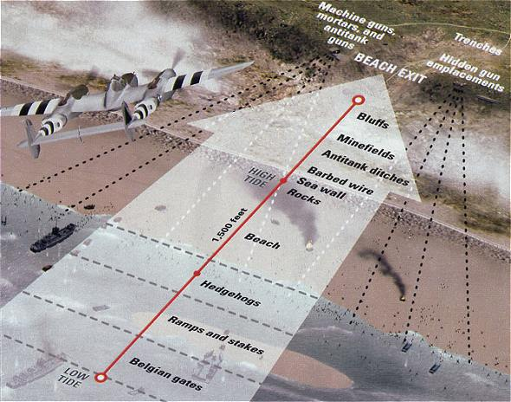

Slide 7
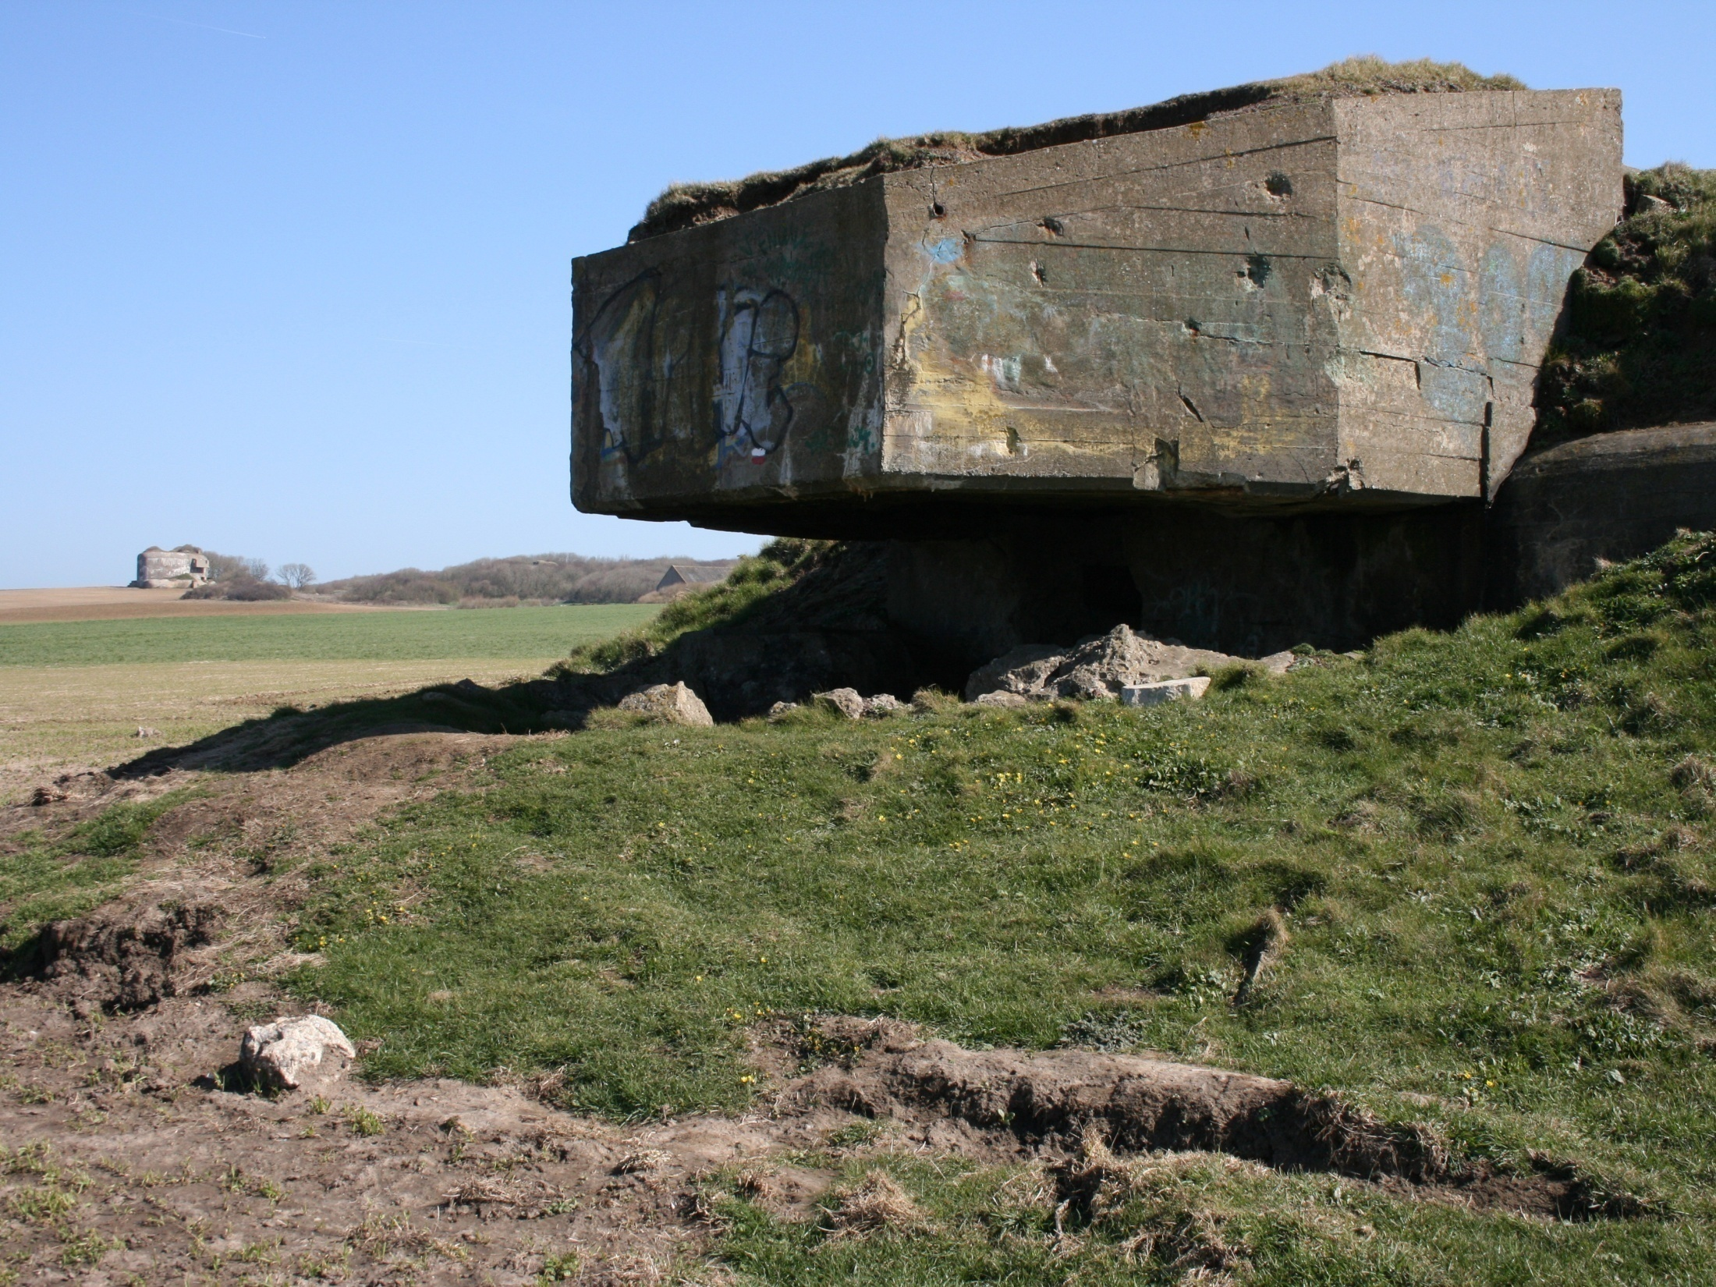

Slide 8
Phantom Army
Planners knew key to success was to trick Hitler into believing invasion would be mounted far from where the landing would actually come
Main objective to convince Germany that an invasion would indeed take place – not at Normandy
Choice of phantom invasion – Calais

Slide 9
General Patton
Create phony army force by Gen. Patton
Hitler believed would play major role in any invasion
Sent fake messages - Hitler convinced

Slide 10
Why Normandy?
Most beaches were unacceptable because of surrounding cliffs, depth of inlets, or some other logistical or geographical reason
Assault area close enough to Britain to allow adequate air cover
Could not be heavily defended
Large & flat enough to enable Allies to move large numbers of troops & supplies ashore

Slide 12
Temporary Landing
Normandy's major deficiency – no port
Planners decided to build temporary, mobile ports – Mulberries

Slide 13
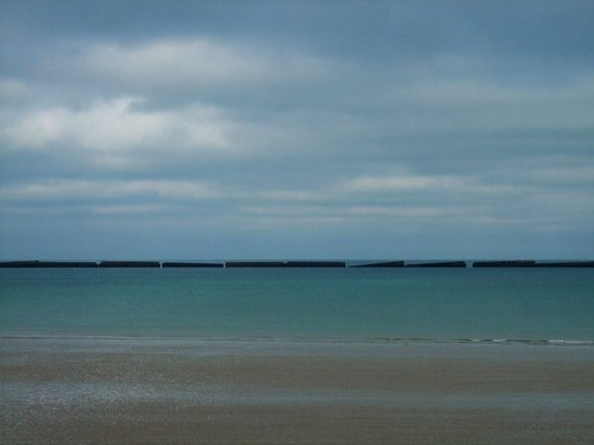

Slide 14
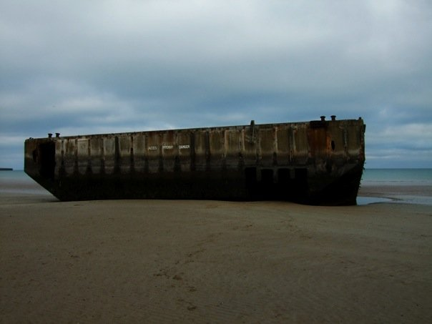
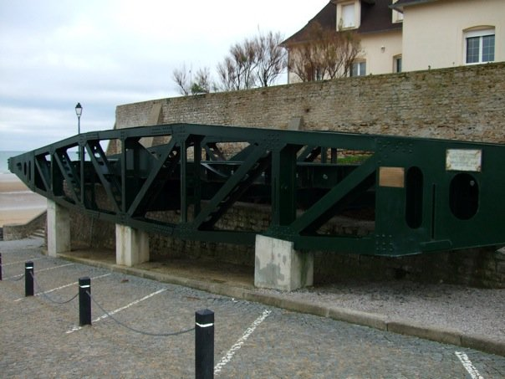

Slide 15
Massing the Troops
All land forces were to travel across the English Channel in transports
Board amphibious landing craft that would take them onto the beaches in waves
Supported by naval bombardment & umbrella of fighter planes

Slide 16
Massing the Troops
America:
6,000 ships
American, British , Canadian troops
3 million men in 47 divisions were deployed
21 American

Slide 17
The Date is Chosen
Early May, Eisenhower decided that June 5th would be D-Day
Poor weather conditions the day before forced to postpone invasion until June 6th
Germans did not think would happen in early June because of weather conditions

Slide 18
D-Day
Eisenhower conferred with leaders
Army Generals wanted to go ahead
Air force and Navy wanted to wait
Eisenhower said three words “Okay, let’s go.”

Slide 19
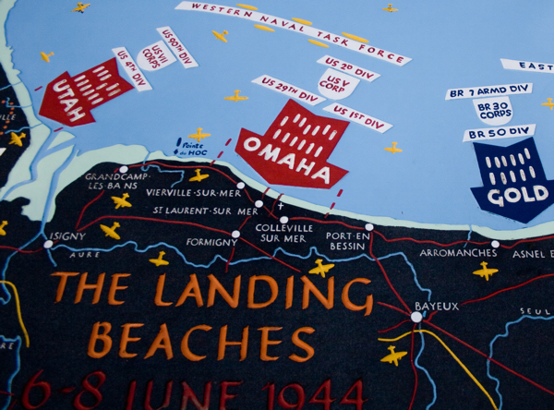

Slide 20
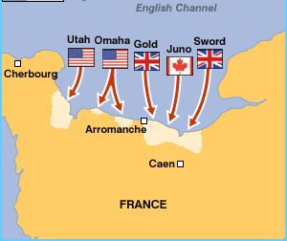

Slide 21
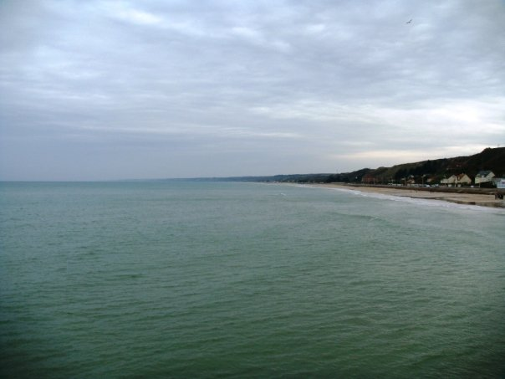

Slide 22
Attack Begins
British Military:
1,000 Royal Air Force bombers attacked coastal targets
18,000 paratroopers dropped inland to capture key bridges and roads & cut German communications
Suffered few casualties and succeed in capturing bridges

Slide 23
Americans Have Harder Time
101st & 82nd Airborne Divisions missed drop zones and were scattered
Many men drowned when landed in water
Isolated troops easier to kill or capture
Dummy paratroopers – dolls dressed like soldiers – dropped away from Normandy to deceive Germans of location of attack

Slide 24
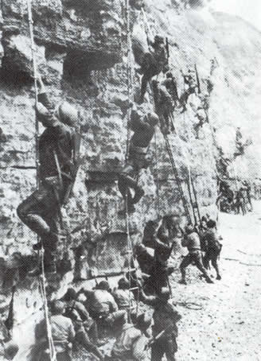
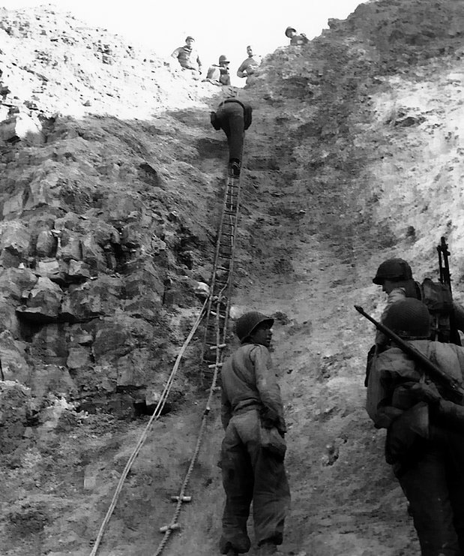

Slide 25
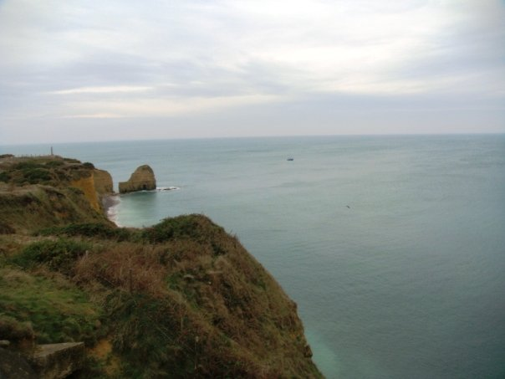

Slide 26
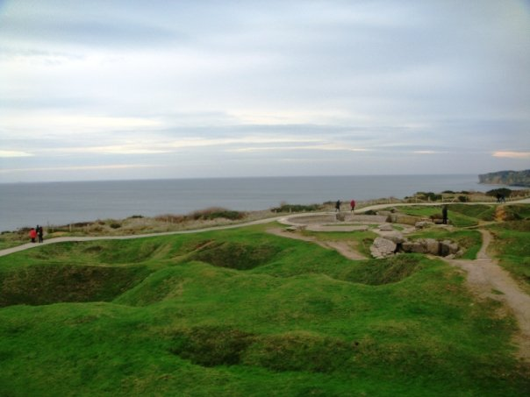

Slide 27
No Day at the Beach
First troops hit beaches at 6:30 a.m., with 23,000 men rushing onto Utah Beach
Quickly secured area against light opposition
Another large force landed on Omaha Beach
Largest landing area (6 miles)
Most vulnerable: 100-foot cliffs overlooked the beach

Slide 28
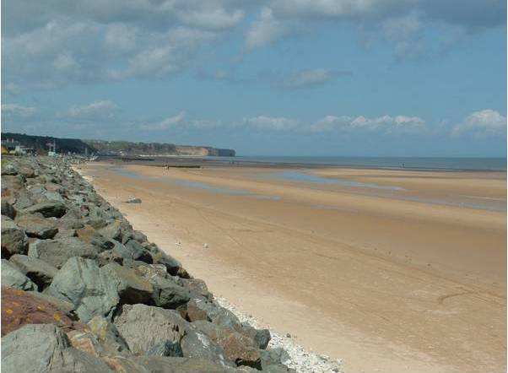

Slide 29
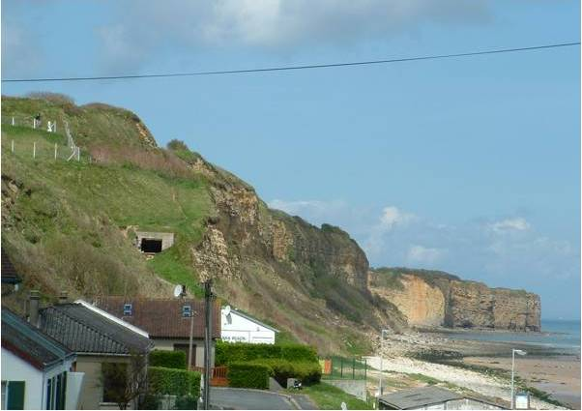

Slide 30
Hellish Battle at Omaha
Americans confronted by elite German infantry division
Poor weather & visibility protected Germans from Allied bombers
27 of special amphibious tanks sank upon debarking the transports – taking their crews to the bottom

Slide 31
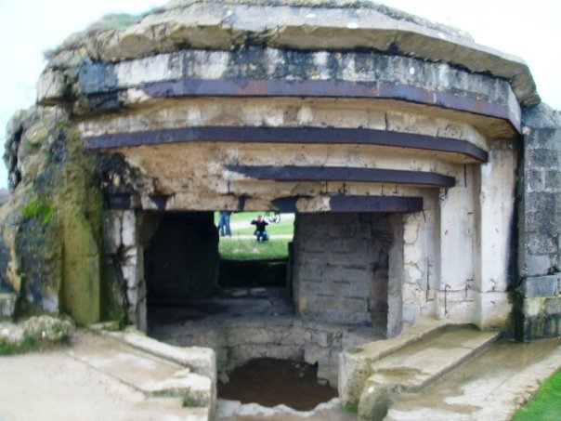
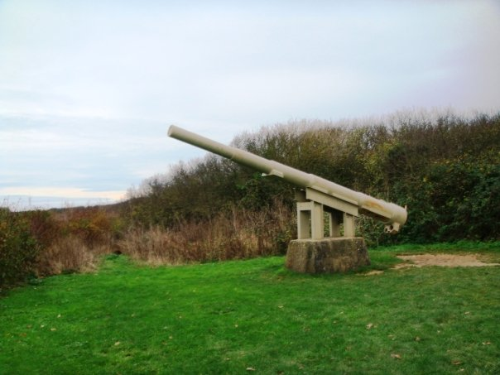
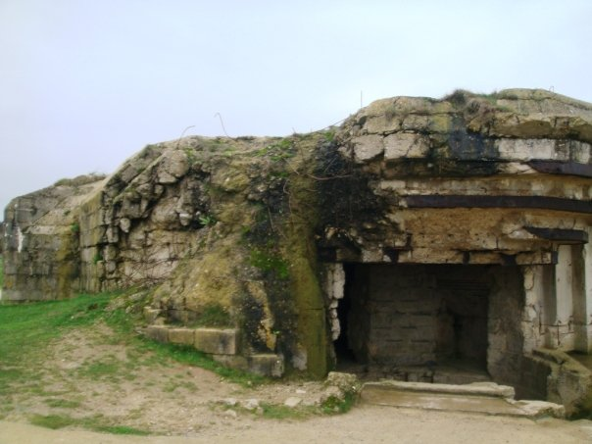
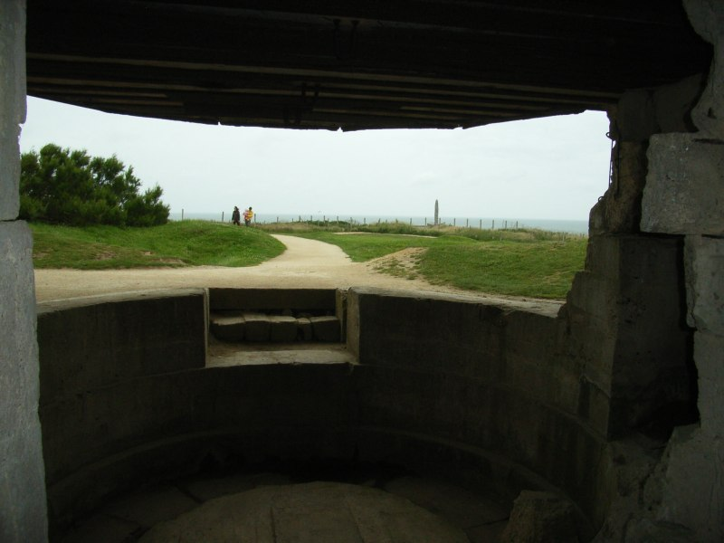

Slide 32
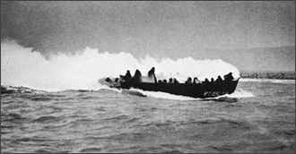
Landing Craft As It Approaches

Slide 33
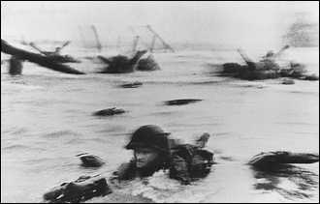
Infantry Kicks Through Water on First Assault of Omaha

Slide 34
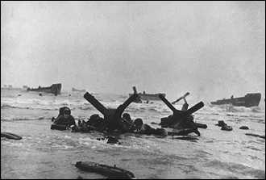
Beach Obstacles

Slide 35
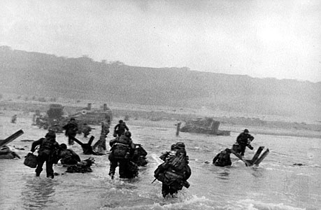
Men Rushing Towards the Beach

Slide 36
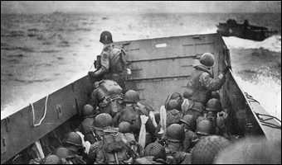
Omaha Beach Nightmare
First landing parties
Seasick from rough crossing
Literally ripped apart by mines, artillery and machine-gun crossfire
Soldiers drowned in deep water before their craft was close enough to the beach
Killed before could stagger ashore
Beach offered no cover – only could move forward

Slide 37
Battle Moves Forward
Isolated groups and individuals with no choice gradually fought their way forward and eventually took key points at each end of beach
Took several hours & heavy navy bombardment to secure beachhead
Army Rangers scaled surrounding cliffs with rope ladders to take out guns guarding coast

Slide 38
Saving Private Ryan
Steven Spielberg’s film probably comes closest to any film by capturing what it was like at Omaha Beach on D-Day
Even the vivid portrayal cannot fully depict the gore, fear, noise, or smells of that day

Slide 39
Normandy Casualties
Total casualties suffered during the entire Normandy invasion will never be known
Nations involved have different record-keeping methods and different ideas of the duration of the battle
29,000 U.S. killed/106,000 wounded
11,000 British killed/54,000 wounded
30,000 Germans killed/190,000 wounded

Slide 40
By end of June . . .
Allies put roughly 1,000,000 men
177,000 vehicles
500,000 tons of supplies ashore in France
Germans continued to believe Normandy was diversion, that major invasion was still to come from Calais

Slide 41
Eisenhower's Statement
Speech prepared on event D-Day landings failed:
“Our landings in the Cherbourg – Harve area have failed to gain a satisfactory foothold and I have withdrawn the troops. My decision to attack at this time and place was based upon the best information available. The troops, the air and the navy did all that Bravery and devotion to duty could do. If any blame or fault attaches to the attempt it is mine alone”.

Slide 42
What Does the “D” in “D-Day” Mean?
Many people think it means: designated day, decision day, doomsday, or even death day
The “D” in D-Day merely stands for DAY
Coded designation used for day of any important invasion or military operation
Days before and after D-Day indicated using plus and minus signs: D-4 meant four days before D-Day; D+7 meant 7 days after D-Day

