Slide 1
Google Apps for Education
Account Overview for High School and Middle School Students

Slide 2
Your Login
Go to www.google.com
Click on blue Sign In, in the upper right corner
Type in your school login, followed by @mayfieldstudents.org
20anjiannetti@mayfieldstudents.org
Use password 123Wildcats

Slide 3
What is Google Apps for Education?
A cloud based group of programs that provide real-time editing, powerful sharing controls, and seamless compatibility – an ideal environment for learning in the 21st century.
IT IS NOT JUST AN EMAIL ACCOUNT, but a Google account that grants students access to technology essential to modern classrooms, while being completely monitored and managed by the school.
Google Apps can be used anywhere and at anytime provided there is an Internet connection available.

Slide 4
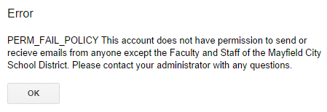
GMAIL
Student Email will be restricted so that:
Students cannot contact email addresses outside the school domain.
Students cannot email each other.
Students can only email teachers or other Mayfield City Schools employees.
Accounts ending with @mayfieldschools.org
If you attempt to email anyone not allowed by the district, you will receive the following error message.

Slide 5
Drive
Users can create documents, presentations, and spreadsheets just like they would using Microsoft Office.
Users will be able to collaborate and simultaneously work on the same document.
Users can also create online forms or surveys, and it will automatically collect the data.
Users are given up to 15GB of storage to store their work.

Slide 6
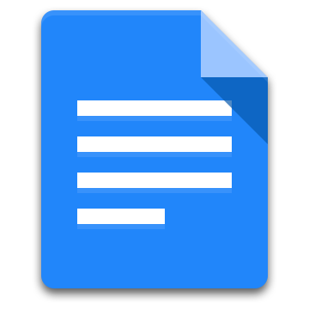
Drive
Microsoft Word
Google Docs
Microsoft Excel
Google Sheets
Microsoft Powerpoint
Google Slides
Survey Monkey
Google Forms

