Slide 1
MATHEMATICAL MODELING:HARDY-WEINBERG
INVESTIGATION 2
BIG IDEA 1

Slide 2
Hardy-Weinberg Equilibrium
How can mathematical models be used to investigate the relationship between the allele frequencies in populations of organisms and evolutionary change?

Slide 3
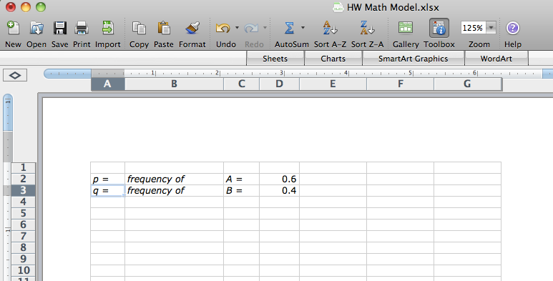
Using Excel to Model H-W
Insert values for the A and B alleles. Adjust the width of the columns.

Slide 4
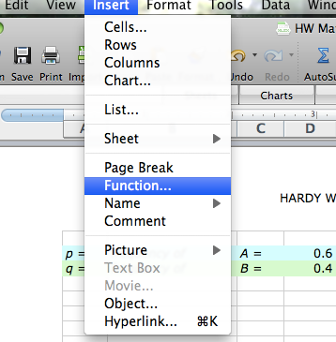
Using Excel to Model H-W
Click on the E5 cell and type in the following function:
=IF(RAND()<=$D$2, “A”, “B”)
Copy this formula to cell F5

Slide 5
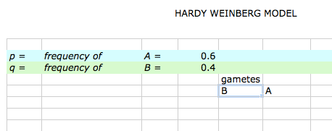
Using Excel to Model H-W
Your spreadsheet should look like this.

Slide 6
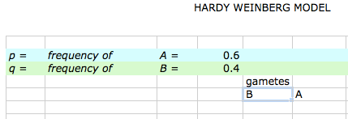
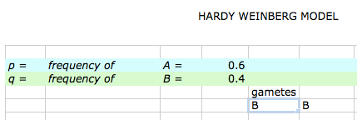
Using Excel to Model H-W
Try recalculating 10-20 times. This is what should happen.
The gametes change.

Slide 7
Using Excel to Model H-W
Copy the 2 formulas in E5 and F5 down to row 20 to represent gametes that will form offspring for the next generation.

Slide 8
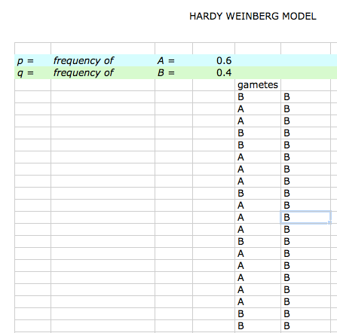
Using Excel to Model H-W
It should
look like
this.

Slide 9
Using Excel to Model H-W
The next step is to put the zygote in cell G5.
In cell G5, enter the function
= CONCATENATE(E5,F5)
and then copy this formula down as far as you have gametes.

Slide 10
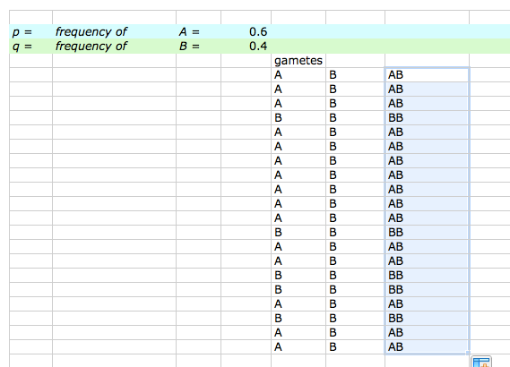
Using Excel to Model H-W
It should look like this.

Slide 11
Using Excel to Model H-W
You will now keep track of the numbers of each zygote’s genotype. You will enter the following functions for each column.
The function in cell H5 is =IF(G5=”AA”,1.0,0)
In cell I5, enter this function: =IF(G5=”AB”,1,(IF(G5=”BA”,1.0,0)))
The function in cell J5 is =IF(G5=”BB”,1.0,0)
Copy these formulas down as far as you have gametes.
Enter the labels for the columns you have been working on. Cell E4 gametes
Cell G4 Zygotes
Cell H4 AA
Cell I4 AB
Cell J4 BB

Slide 12
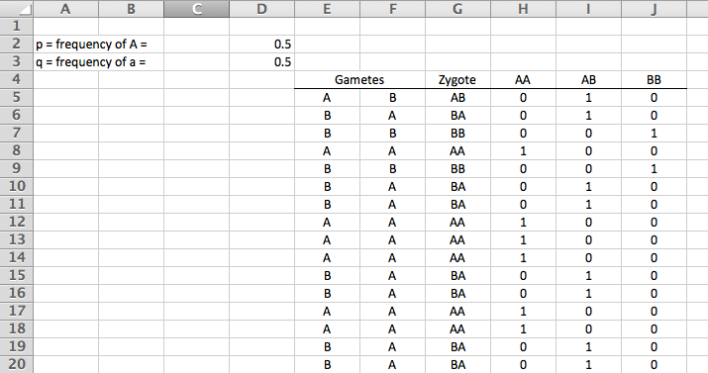
Using Excel to Model H-W
It should look like this.

Slide 13
Using Excel to Model H-W
You will now add calculations to:
Find the number of each genotype
Find the number of each allele
Find the allele frequencies (p & q)

Slide 14
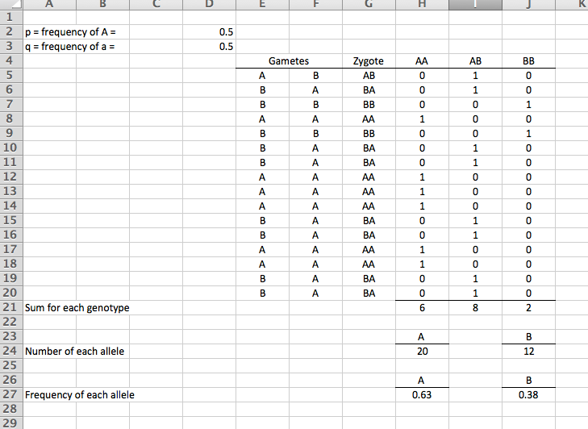
Calculating the number of genotypes
In cell H21
=Sum(H5:H20)
In cell I21
=Sum(I5:I20)
In cell J22
=Sum(J5:J20)

Slide 15
Calculating the number of alleles
In cell H25
=(H21*2)+I21
In cell J25
=(J21*2)+I21

Slide 16
Calculating the allele frequency (p &q)
In cell H27
=H24/(H24+J24)
In cell J27
=1-H27

Slide 17
Using Excel to Model H-W
Try recalculating a number of times to make sure everything is working as expected.
Don’t go on until you are sure the spreadsheet is making correct calculations.
Try different values for p.
Make sure the number of zygotes adds up.

Slide 18
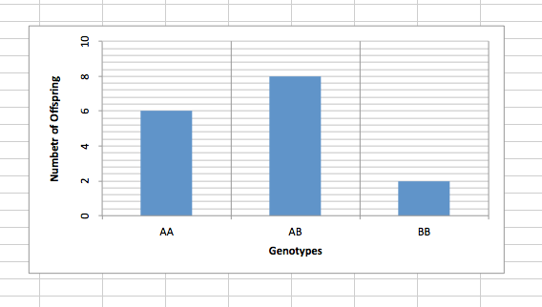
Using Excel to Model H-W
Make a bar graph of the genotypes using the chart tool.
Select the three cells with number of genotypes (cells H21, I21, J21) and create a bar graph.
All you need to do is add the title and label the X and Y axes.

Slide 19
Your Task:
You will run the model at least 3 times
Vary a condition on each of the 3 trials
For example: Use different p / q values
Add or subtract the number of individuals
Keep track of the p & q values you started with for each trial
Keep track of the allele frequencies you ended with on each trial
Run a Chi Square analysis for each of your 3 trials

