Slide 1
Identifying Icons

Slide 2
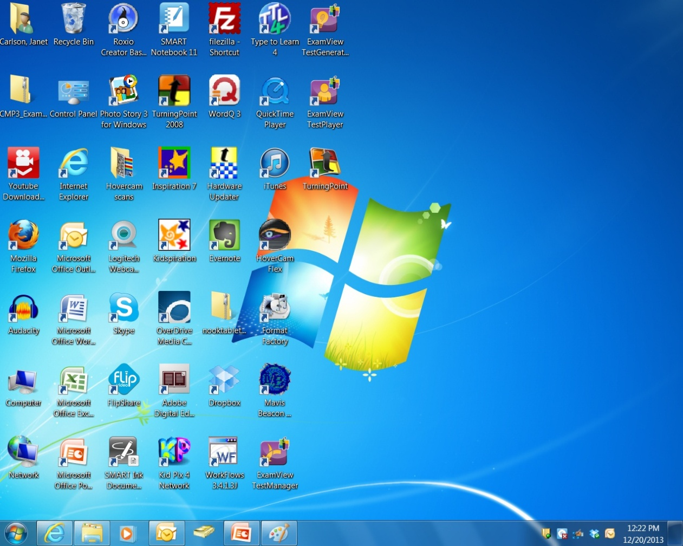
Look at the following icons that are
found on the desktop. What do they open?

Slide 9
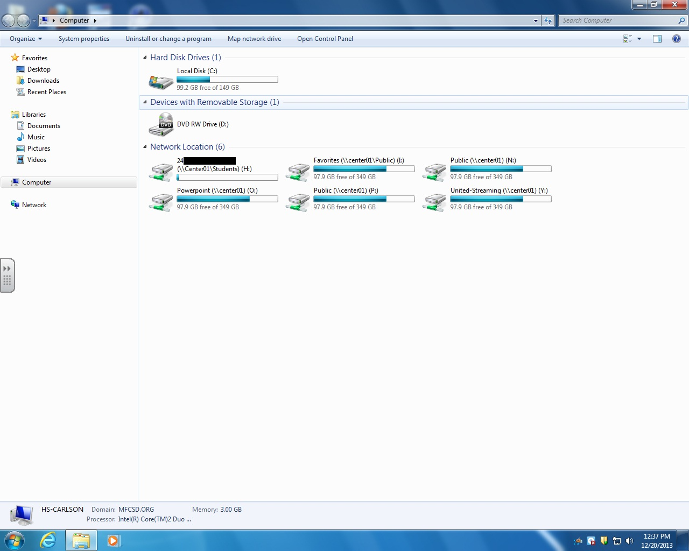
When you open Computer, you see all of the drives, including your H: drive.
Notice the drives have icons too.
T This is the icon for your
H: drive.

Slide 10
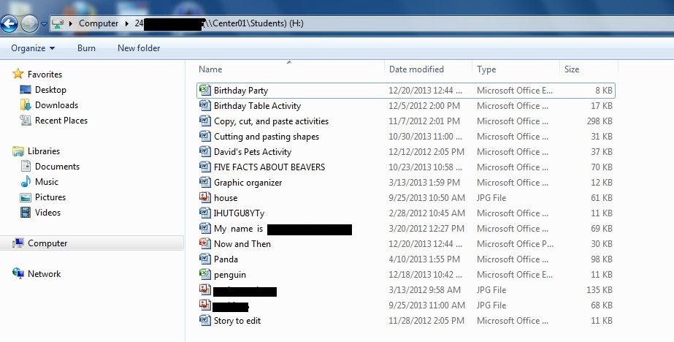
When you open your H: drive, you can see all of your files.
Your files have icons too.

Slide 11
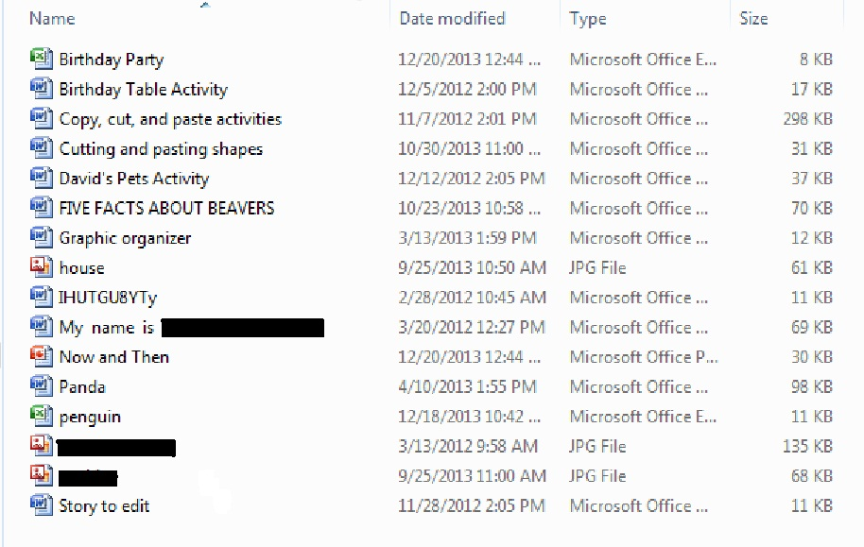
The icon helps identify the type of file. You can also use the Type column.

Slide 12
What kind of file has this icon?

Slide 13
What kind of file has this icon?

Slide 14
What kind of file has this icon?

Slide 15
What kind of file has this icon?

Slide 16
Try to remember these icons.
Recognizing them will help you find your files.
Word document
Excel spreadsheet
PowerPoint presentation
Jpeg image

