Slide 1
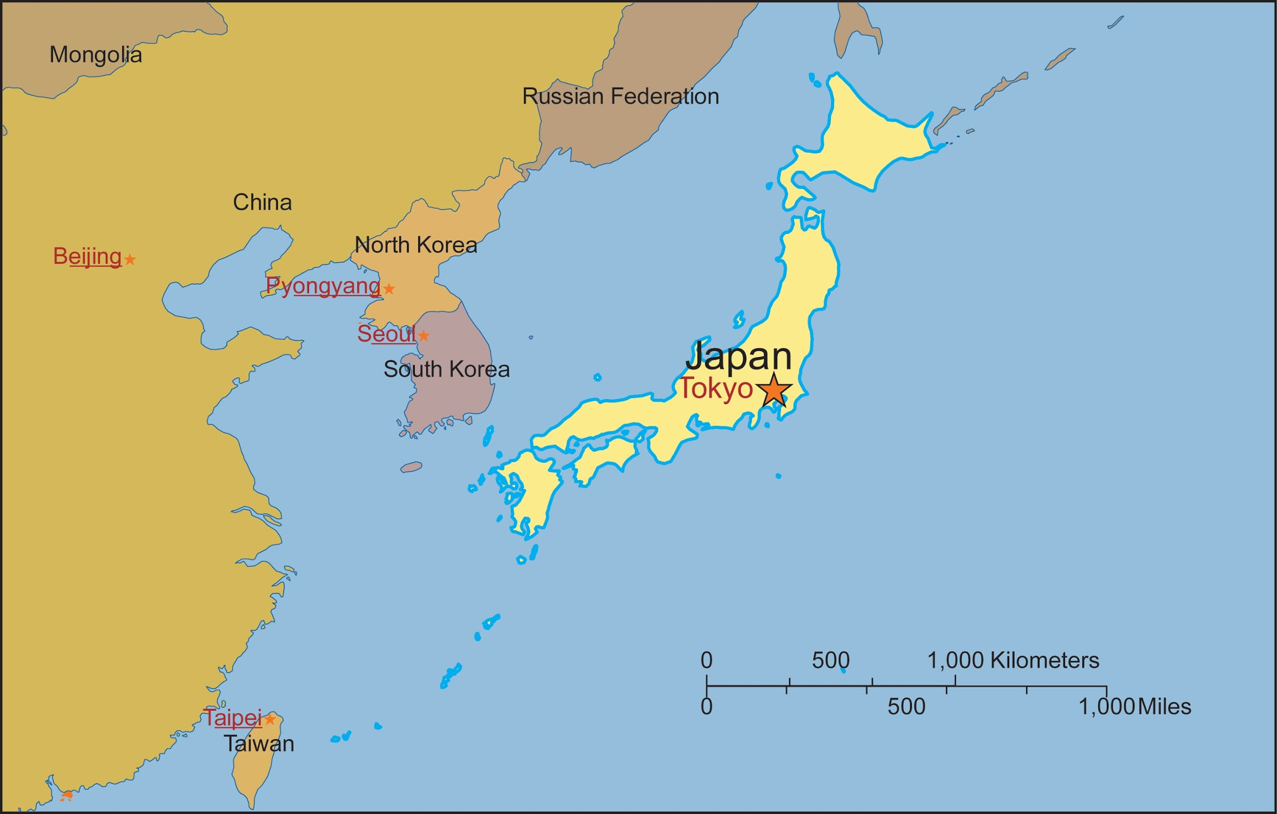
Japan
Government, Economy and Culture

Slide 2
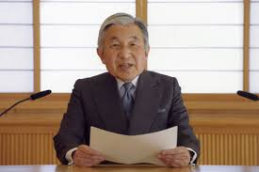
Japan’s Government
Type of Government: Constitutional Monarchy
Parliamentary government (parliament makes laws etc)
Head of state is an emperor (ceremonial)
Emperor: Akihito (since 1989) ceremonial
Prime Minister: Shinzo Abe (elected in 2012)
Type of Leader: Prime Minister (like our president) who is elected
Parliament is like our Congress
People have high rights and full liberties like us

Slide 3
Challenge!!!!!
1: Use google to help you find one right that Japanese citizens have or are allowed to do
First 2 teams to find an example of a right without repeating wins tickets!
2: BONUS- find one law in Japan that citizens cannot break

Slide 4
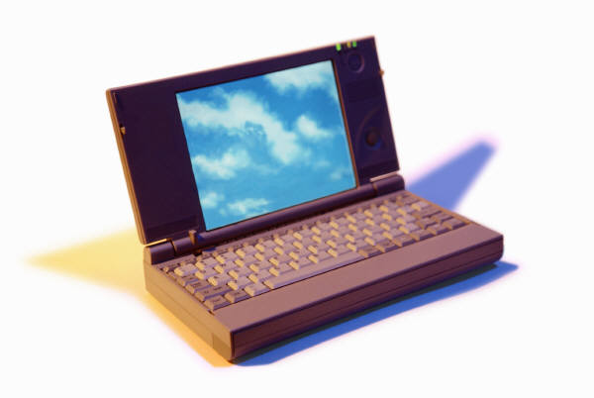
Japan’s Economy
The Japanese economy = 3rd largest in the world. (USA = #1, China = #2) *GNP
Type of Economic System: Capitalism
Exports: Car's, electronic devices, computers
Most important trade partners = China & USA,
followed by South Korea, Taiwan, Hong Kong, Singapore, Thailand & Germany
Imports: Raw materials such as oil and wood.
Major supplier = China, followed by the USA, Australia, Saudi Arabia, South Korea, Indonesia and the United Arab Emirates.
Industries: Manufacturing, construction, distribution, real estate, services, and communication are Japan's major industries today.
Agriculture = only 2% of the GNP. Most important agricultural product = RICE Resources of raw materials are very limited and the mining industry rather small
2011 earthquake and tsunami damage caused an economic setback for Japan

Slide 5
PIE CHART CHALLENGE
Japan’s Top 10 Exports
Vehicles excluding trains and streetcars: $148,516,005,000 (20.8% of total exports)
Machinery: $135,170,603,000 (18.9%)
Electronic equipment: $108,196,915,000 (15.1%)
Optical, technical and medical apparatus: $40,098,608,000 (5.6%)
Iron and steel: $35,354,109,000 (4.9%)
Organic chemicals: $26,338,964,000 (3.7%)
Plastics: $25,687,461,000 (3.6%)
Mineral fuels including oil: $16,620,425,000 (2.3%)
Ships, boats and other floating structures: $15,559,127,000 (2.2%)
Articles of iron or steel: $13,464,169,000 (1.9%)
Other=19%
Here is a list of the top 10 exports of Japan. Create a pie chart to show Japan's total exports (using percentages)
hint: make the pieces proportionate to how large or small the percentage is
How much money total does Japan make from its exports? (use your calculator!)

Slide 6
Cool Electronics Made in Japan
Asimo
Nissan Factory

Slide 7
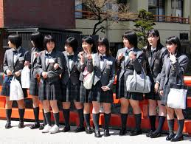
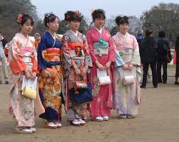
JAPANESE CULTURE
Culture Shock with Nick Cheadle- cool show
100% literacy rate
Most of the 127.3 million people live in urban areas
4 major cities: Tokyo, Yokohama, Nagoya & Osaka = VERY modern
Religions are Shinto and Buddhism
Life expectancy - 83 years
Per capita income = $36,000
Family is center of life, respect for elders is huge.
Art & Entertainment: Haiku (short poems)Judo & Karate, Sumo Wrestling, baseball, Japanimation, Kabuki Theatre

