Slide 1
Jeopardy
Types
of
Mixtures
Understanding
Solutions
Concentration
and Solubility
Acid
and
Bases
Variety
$100
$100
$100
$100
$100
$200
$200
$200
$200
$200
$300
$300
$300
$300
$300
$400
$400
$400
$400
$400
$500
$500
$500
$500
$500
Final Jeopardy

Slide 2
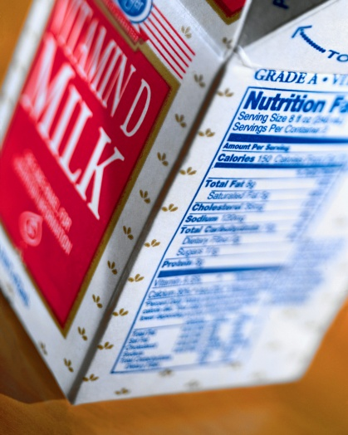
1 - $100
This type of mixture has tiny particles that can be seen with a microscope.
Colloid

Slide 3
1 - $200
This simple process can be used to separate a suspension.
Filtration

Slide 4
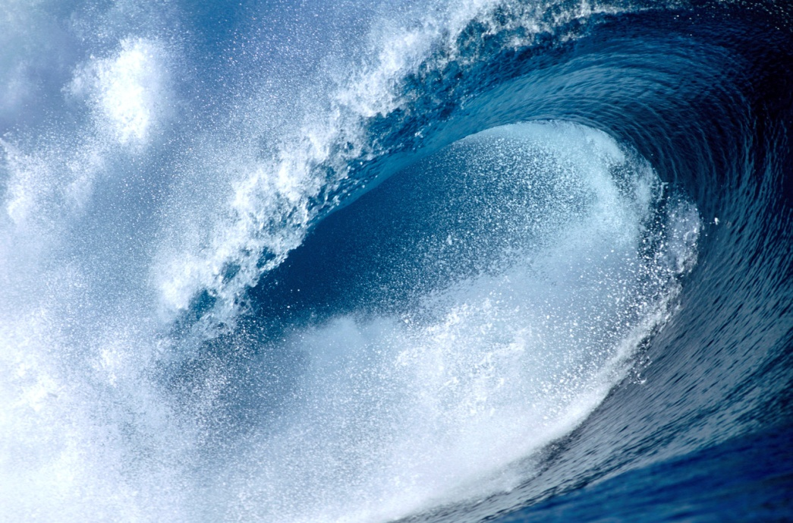
1 - $300
What type of mixture would exist if you combined salt and water and all of the salt crystals were dissolved?
Solution

Slide 5
1 - $400
What determines whether a substance in a suspension floats or sinks?
density

Slide 6

1 - $500
This solvent is found in blood and saliva.
water

Slide 7
2 - $100
What type of mixture can be separated by the process of evaporation?
solution

Slide 8
2 - $200
Do more gas molecules dissolve in low or high pressure systems?
high pressure systems

Slide 9
2 - $300
What does adding ethylene alcohol do to the freezing point of water?
It lowers it

Slide 10

2 - $400
Which type of solution would be able to conduct electricity? (Think back to last unit)
One that includes an ionic compound

Slide 11
2 - $500
Describe what happens to the ions in an ionic compound when they dissolve in a solvent.
The ions separate and they individually become surrounded by the solvent and dissolved.

Slide 12
3 - $100
Strong lemonade is highly ________________.
concentrated

Slide 13
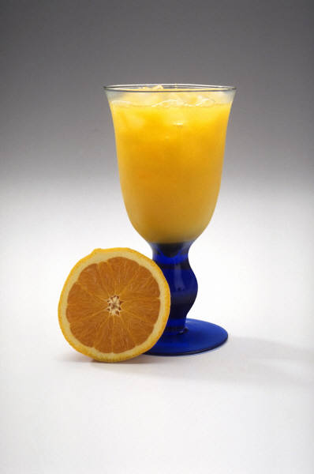
3 - $200
Hotels __________ their orange juice so they can have a larger amount to provide to their customers.
dilute

Slide 14
3 - $300
You can see the particles in a solution that is _____________________.
saturated

Slide 15
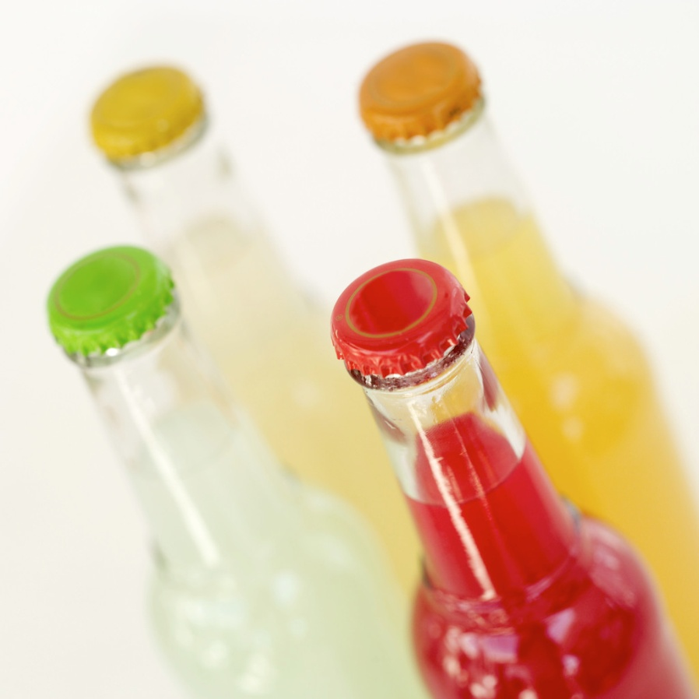
3 - $400
Calculate the concentration of a solution that has 40 mL of food coloring in 200 mL of water. (Round to the nearest hundredth)
16.67%

Slide 16

3 - $500
If the solubility of sugar is 4 g to every 100 mL of water, how many grams of sugar would settle if you placed 9 grams in 200 mL?
1 mL

Slide 17
4 - $100
A(n) _________ turns red litmus paper blue.
base

Slide 18

4 - $200
An acid is _____________ because it causes metals to wear away.
corrosive

Slide 19
4 - $300
Identify a way to neutralize heartburn.
Take a base such as Tums, Rolaids, Nexium, or drink a base like milk

Slide 20
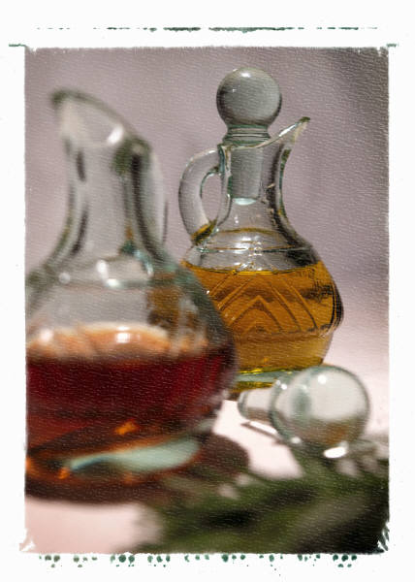
4 - $400
How would vinegar react with blue and red litmus paper?
Red litmus paper would stay red and blue litmus paper would turn red

Slide 21
4 - $500
Eating fruit increases the ____________ of acid in your stomach. (Use a current science term…not AMOUNT)
concentration

Slide 22
5 - $100
How would you separate the pulp from 100% concentrated Florida Orange Juice?
Filtration

Slide 23
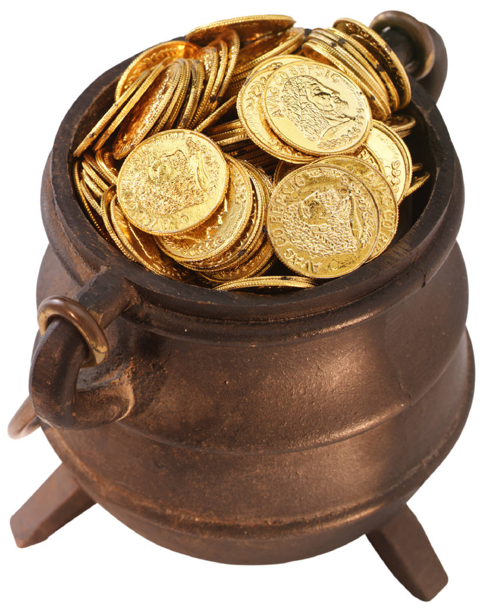
5 - $200
When divers use a vacuum to locate gold at the bottom of the Bering Strait they end up with a ________________ .
suspension

Slide 24
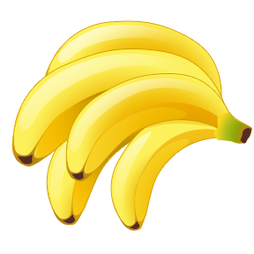
5 - $300
What would you do to increase the amount of potassium nitrate that could dissolve in water?
Heat the solution

Slide 25
5 - $400
Describe the solute and solvent used to power your two cycle lawn mower.
Oil = solute Gasoline = solvent

Slide 26
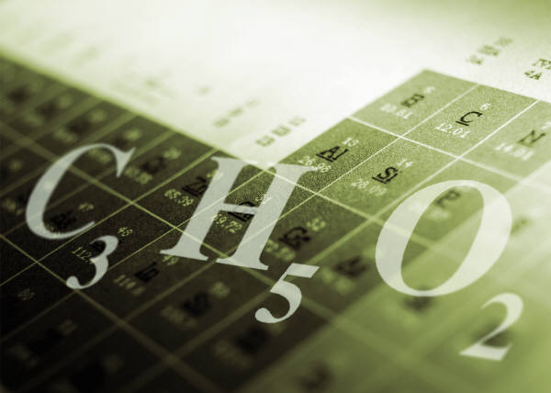
5 - $500
Describe what happens to molecular compounds when they enter water.
The individual molecules within the compound separate and become surrounded by water molecules. Then they dissolve.

Slide 27
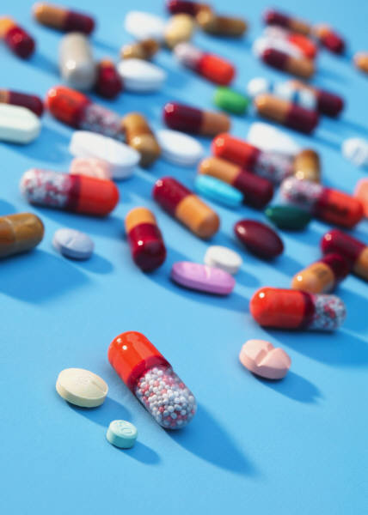
Final Jeopardy
Identify the name of the medication that Mr. Rapposelli takes to reduce the wearing away of his esophagus.
Nexium

