Slide 1
Meiosis

Slide 2
II. What is meiosis?
Meiosis is a process in which the number of chromosomes per cell is cut in half through the separation of homologous chromosomes in a diploid (2n) cell.
This will form 4 genetically different sex cells (gametes) that are haploid (n).
This means that it increases the differences between people’s DNA so that every person is genetically different.

Slide 3
II. What is meiosis?
46
46
46

Slide 4
III. Why does meiosis happen?
Meiosis happens so that sperm and egg cells can be produced so that sexual reproduction can occur.
Sexual reproduction is when two organisms combine their genetic information to produce genetically different offspring (babies).
Do animals reproduce sexually?
Yes
Do plants reproduce sexually?
Yes
Do bacteria reproduce sexually?
No! Bacteria reproduce asexually!

Slide 5
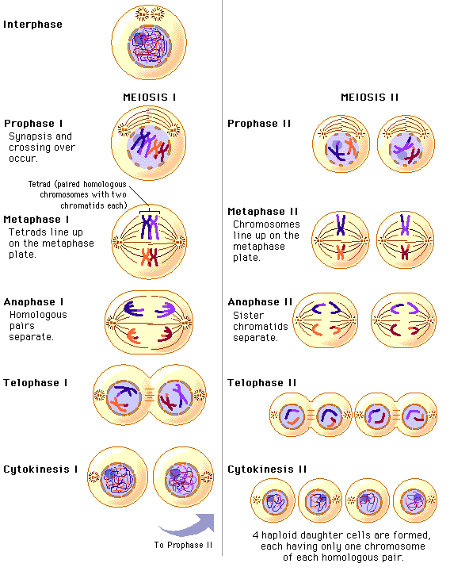

Slide 6
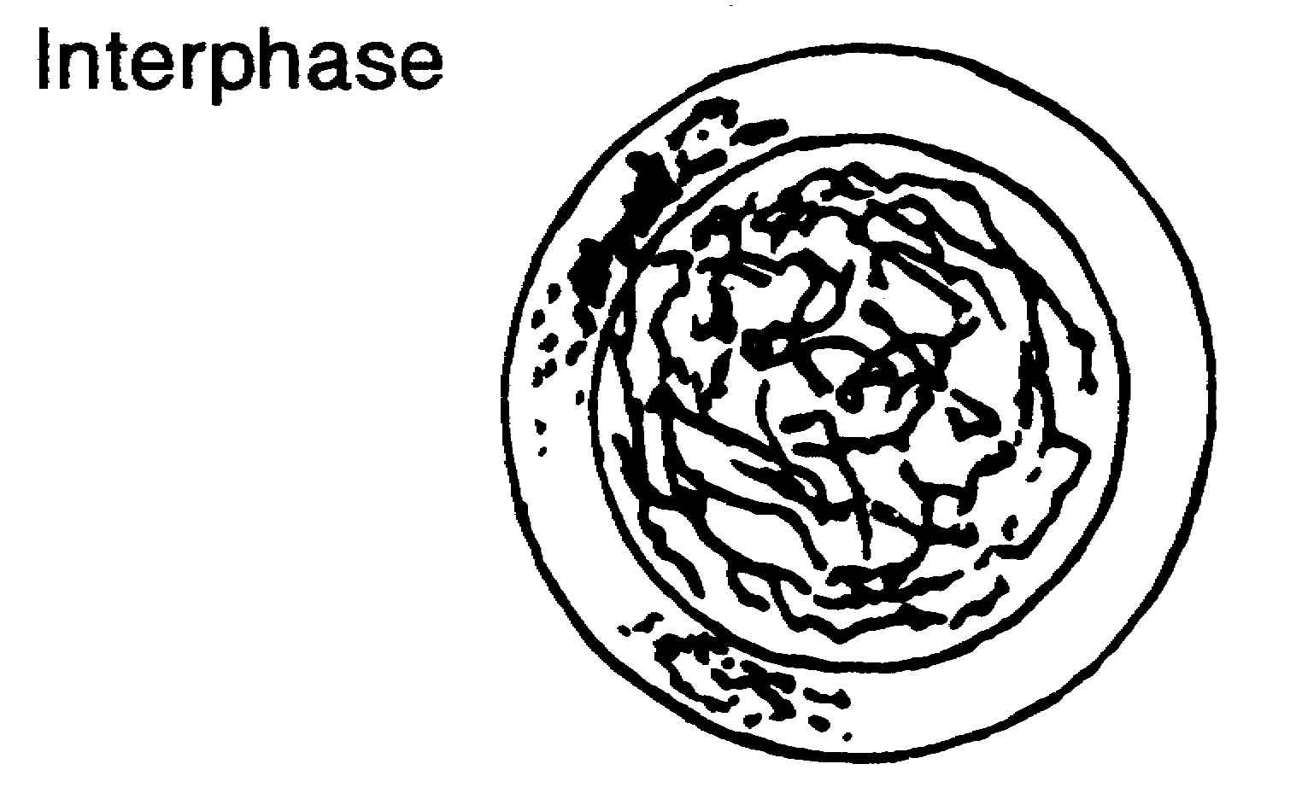
VI. What Happens During Meiosis?
Before meiosis, our sex cells go through interphase, where the DNA replicates and the cell grows.
DNA replication only occurs once in meiosis, but there are two divisions!!! (Meiosis I and Meiosis II)

Slide 7
VI. What happens during meiosis?
Meiosis I:
There are four parts of Meiosis I;
Prophase I, Metaphase I, Anaphase I and Telophase I.

Slide 8
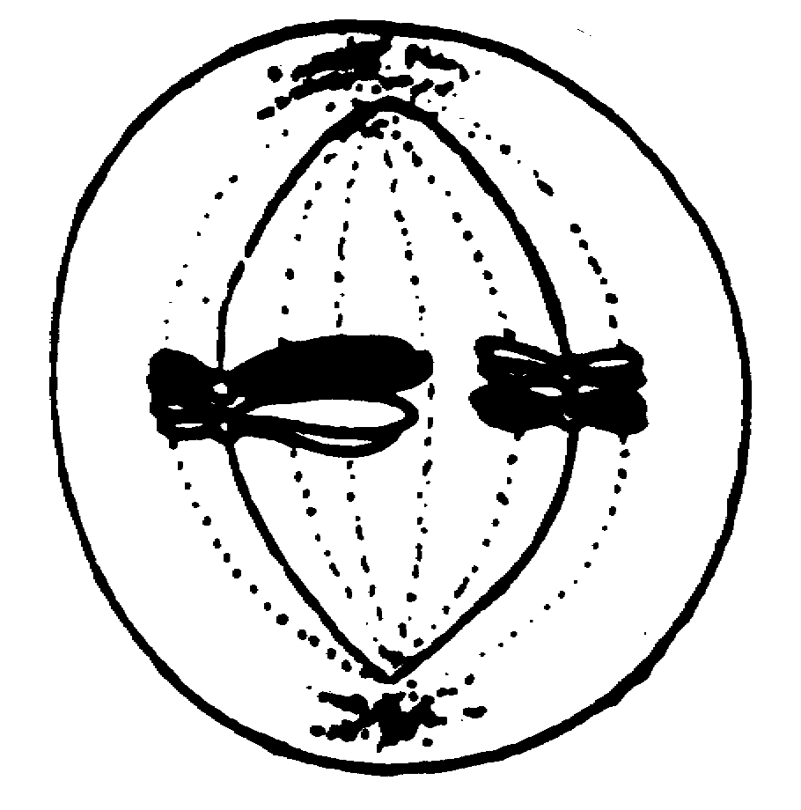
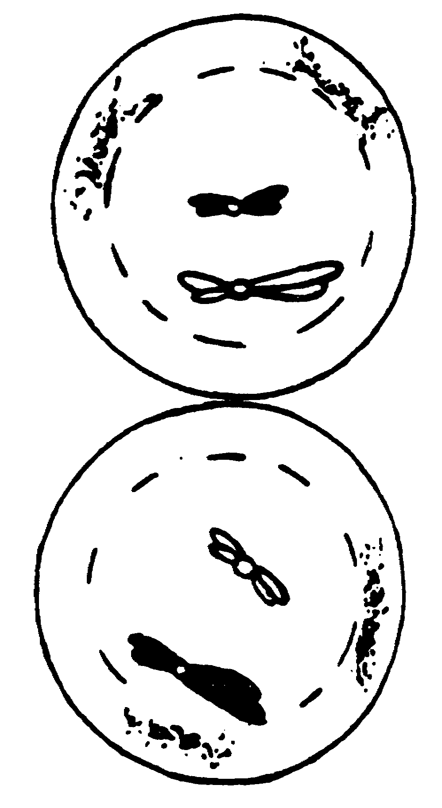
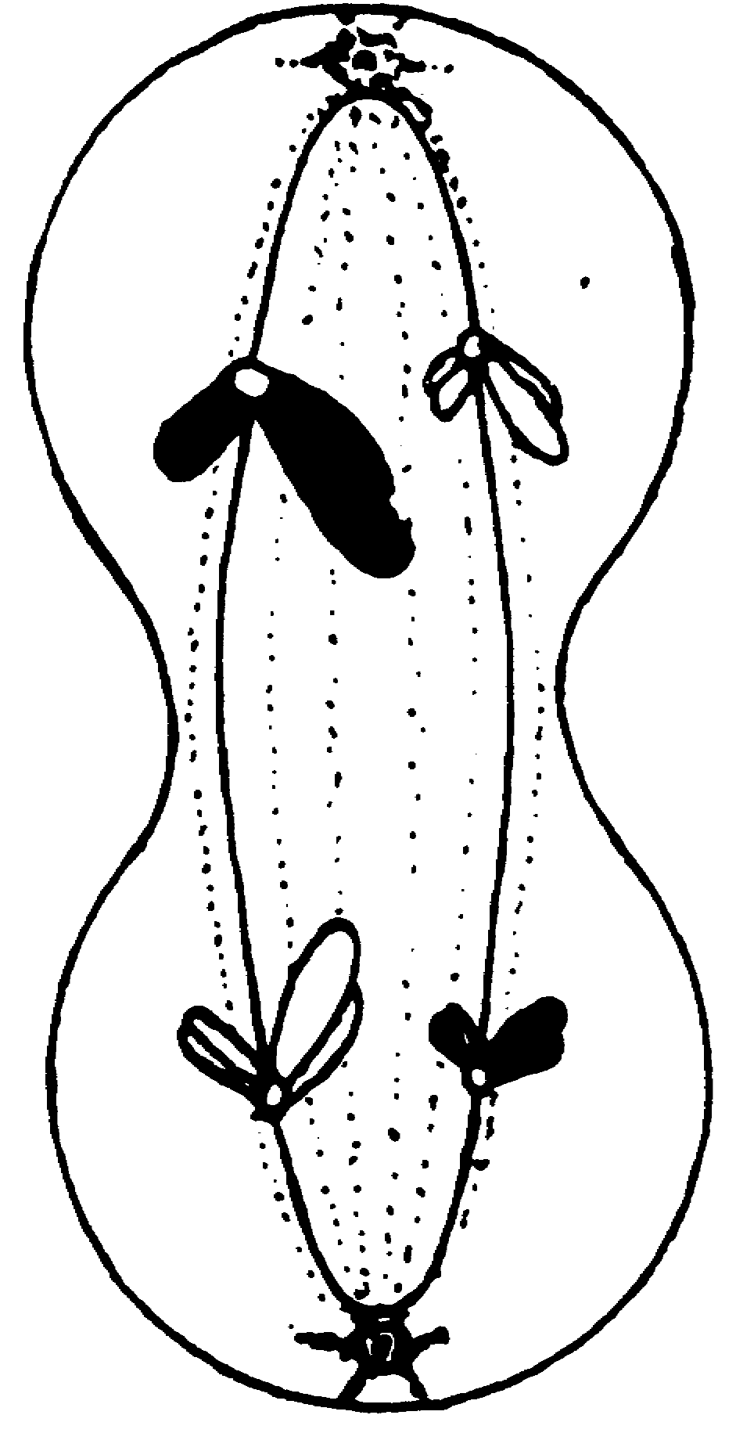
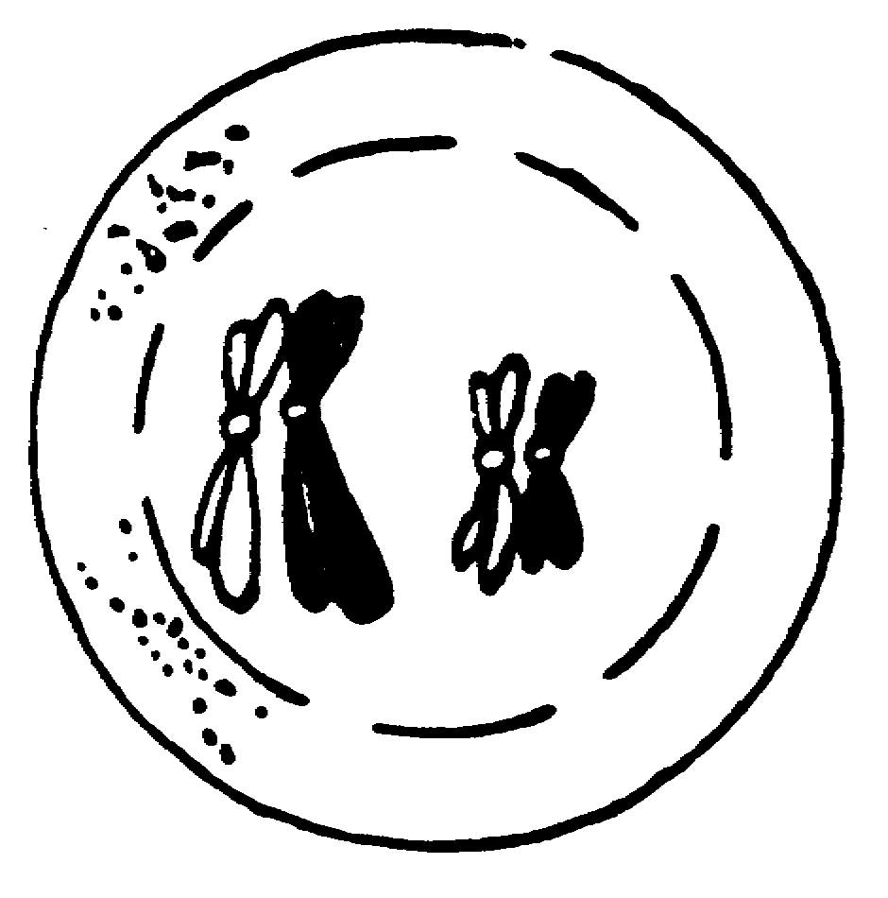
VI. What happens during meiosis?

Slide 9
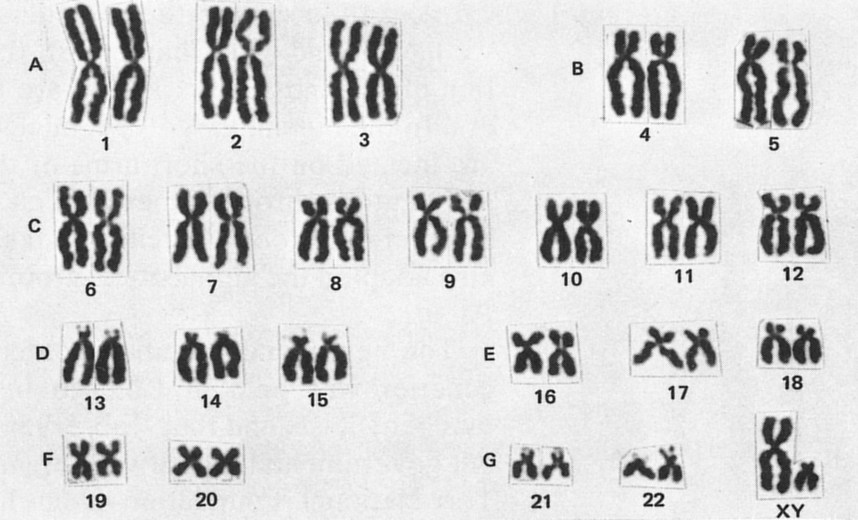
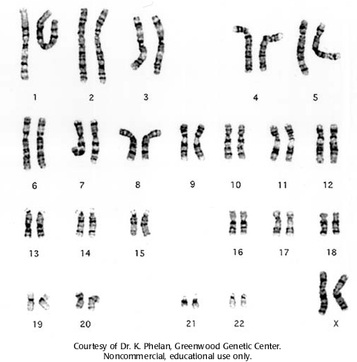
Karyotype
Shows 23 pairs of homologous chromosomes
Which karyotype shows replicated chromosomes?

Slide 10
VI. What happens during meiosis?
The most important part of Meiosis I is Prophase I. During Prophase I, tetrads form and crossing over occurs.
Tetrads are a pair of homologous chromosomes and consist of 4 chromatids.
Crossing over is when parts of a chromosome (non-sister chromatids) exchange with another chromosome. This occurs within each homologous pair of chromosomes. This is important because it increases genetic variation.

Slide 11
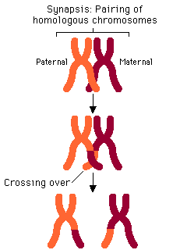

Slide 12
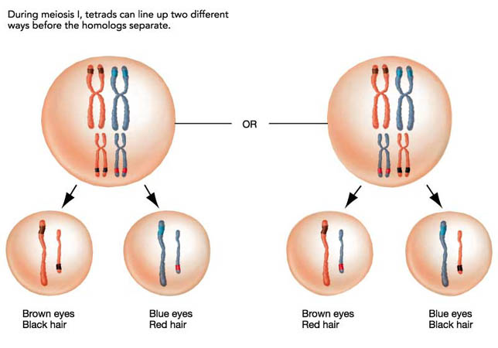
Independent Assortment
Independent Assortment occurs during metaphase I.
Creates genetic variation between gametes
Homologous pairs of chromosomes line up in the middle of the cell in a random order each time.

Slide 13
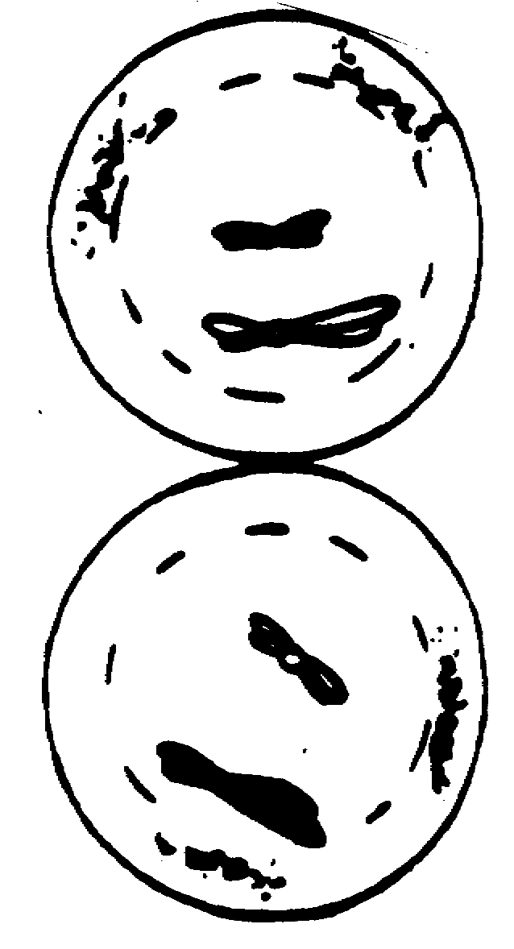
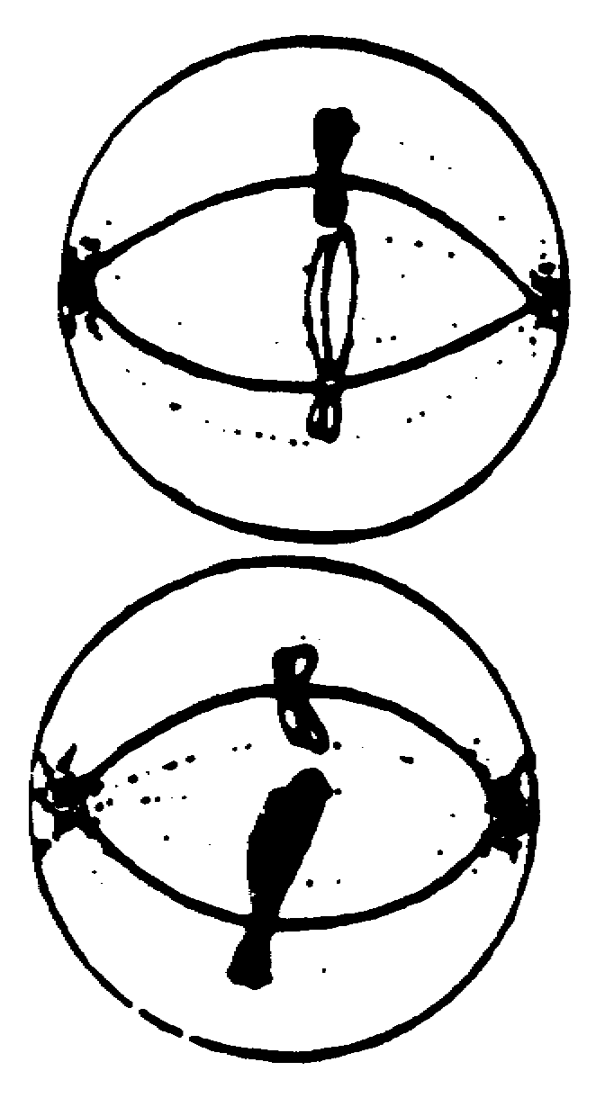
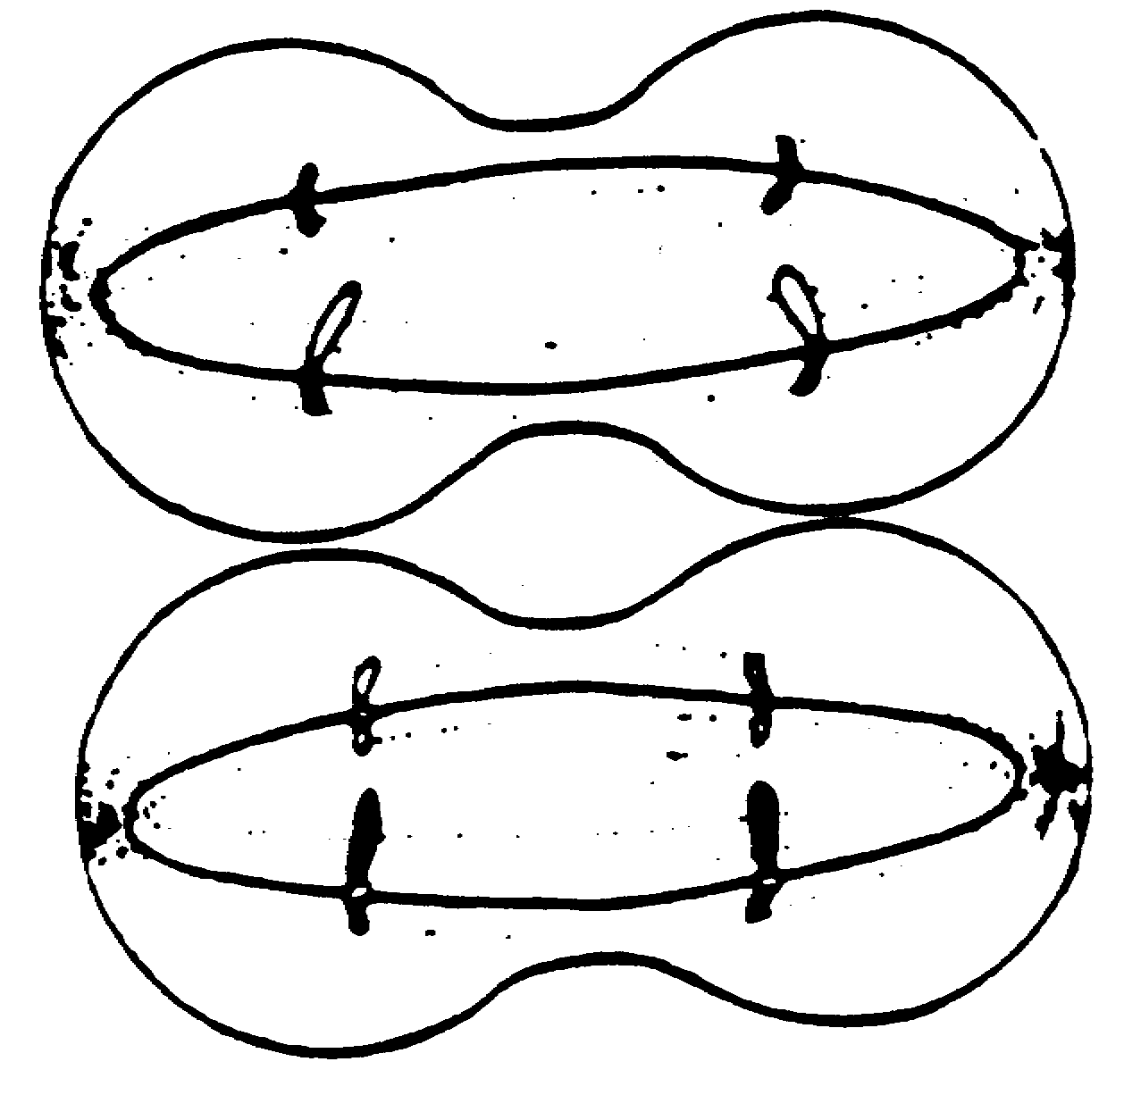
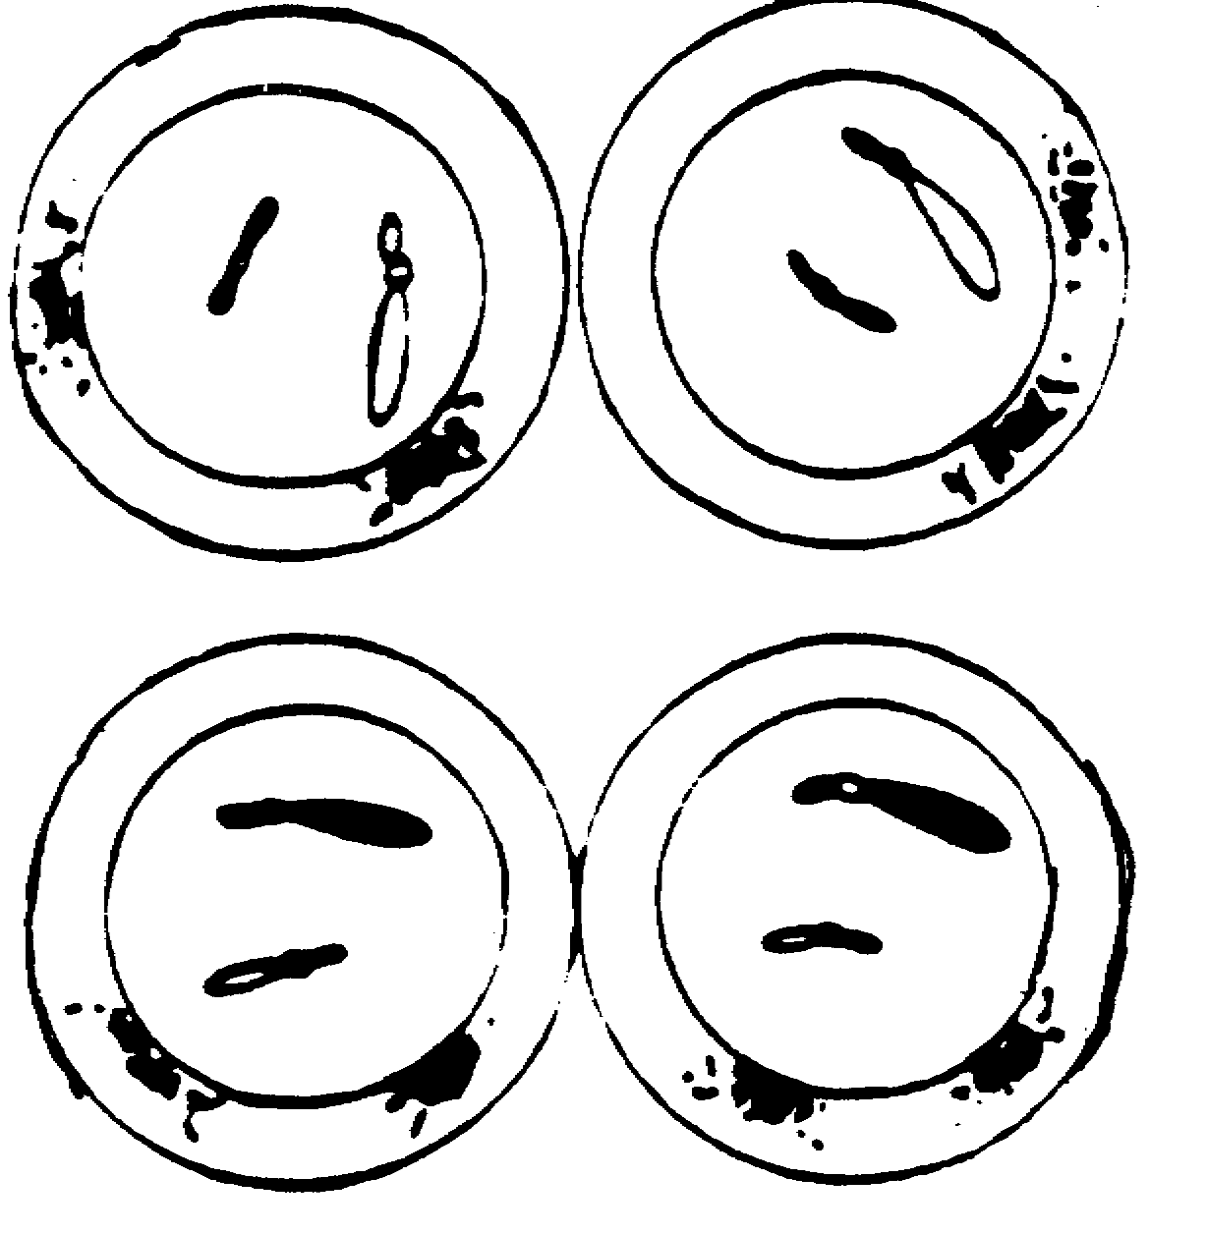
VI. What happens during meiosis?
Meiosis II:
There are four parts of Meiosis II;
Prophase II, Metaphase II, Anaphase II and Telophase II.

Slide 14
VI. What happens during meiosis?
At the end of Meiosis II, cytokinesis occurs.
Meiosis II resembles Mitosis.
The end result of the entire process of Meiosis (all 8 steps) is four haploid cells that are genetically different. .

Slide 15
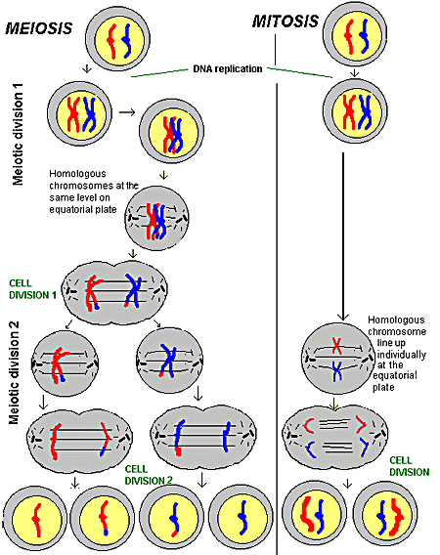
Mitosis vs. Meiosis
Let’s Compare and contrast!!
http://www.pbs.org/wgbh/nova/miracle/divi_flash.html

