Slide 1
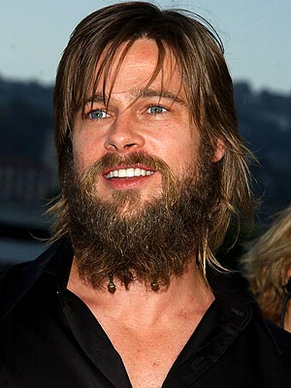
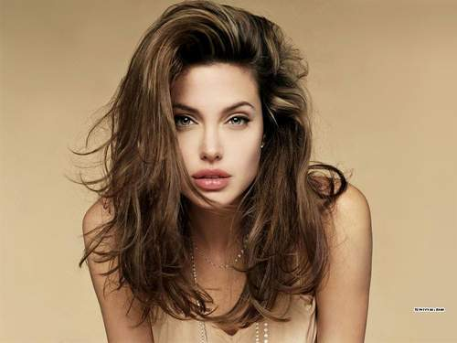
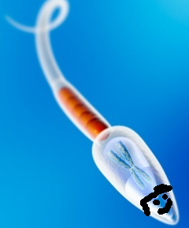
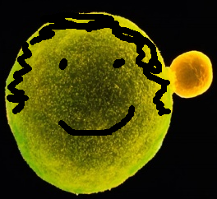
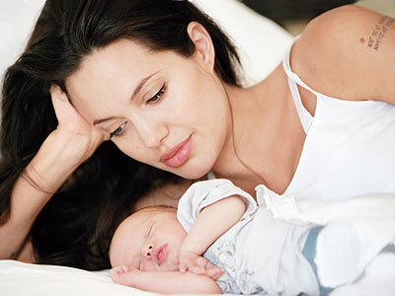
Chapter 11 Meiosis & Genetics
What do you think meiosis makes?

Slide 2
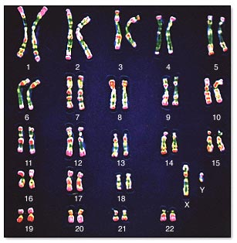
Chromosome Number
Sexually reproducing organisms receive a set of chromosomes from each parent. (half your inheritance from mom half from dad)

Slide 3
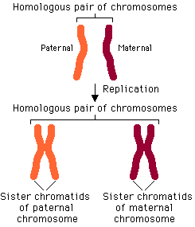
Humans get 1 set from sperm (23) 1 set from the egg (23).
Matching pairs of chromosomes are called homologous chromosomes.
23+23=?

Slide 5
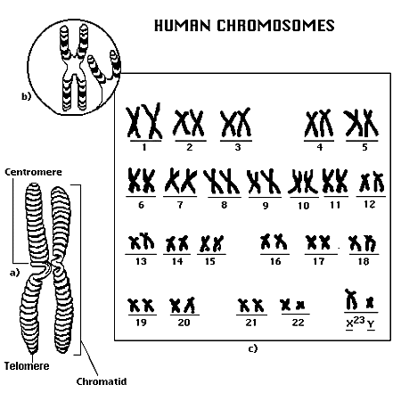
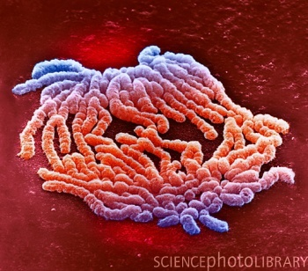
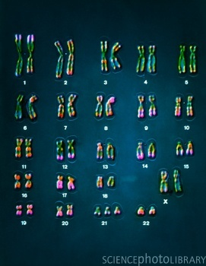
Human Chromosomes

Slide 7
Autosomes
Sex Chromosomes

Slide 8
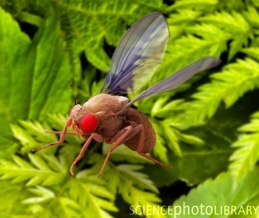
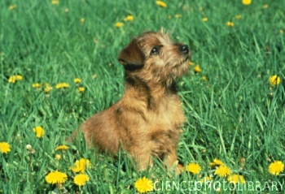
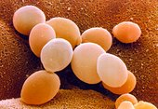
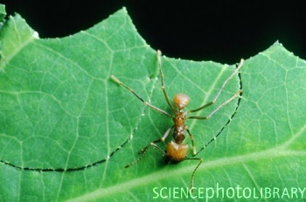
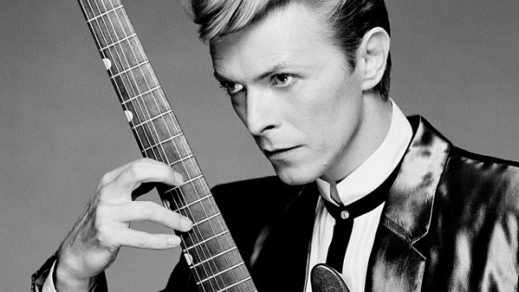
Diploid Numbers of Some Commonly Studied Organisms:
Homo sapiens (human)46
Mus musculus (house mouse)40
Drosophila melanogaster (fruit fly)8
Caenorhabditis elegans (microscopic roundworm)12
Saccharomyces cerevisiae (budding yeast)32
Arabidopsis thaliana (plant in the mustard family)10
Canis familiaris (domestic dog)78
Gallus gallus (chicken)78
Zea mays (corn or maize)20
Myrmecia pilosula (an ant)2

Slide 9
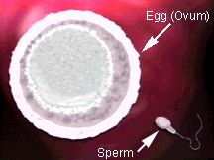
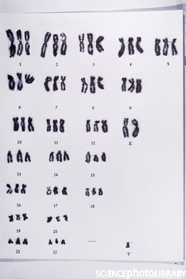
Ploidy
If a cell has two sets of chromosomes (2N) it is called diploid (all body cells except for gametes).
A cell with one set (N) is called haploid (gametes).
Gametes are sex cells (sperm or egg).
Triploidy

Slide 10
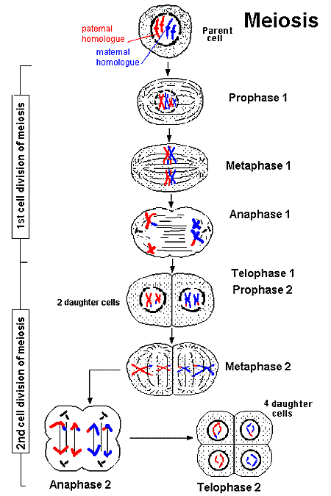
Meiosis
Meiosis is the process that produces gametes.
Two stages of Meiosis: I & II.
Meiosis I similar to Mitosis with the following exceptions:

Slide 11
TWO DIVISIONs

Slide 12
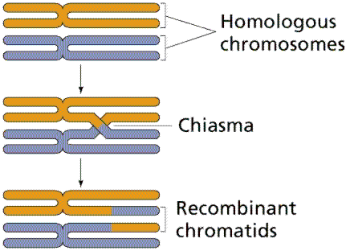
Prophase I
Chromosomes line up side by side next to their homologous chromosomes forming a tetrad.
Crossing-Over results in an exchage of genetic information.

Slide 13
Meiosis vs. Mitosis
The parent divides twice resulting in 4 daughter cells
The parent cell has a diploid number of chromosomes and the daughter cells have a haploid number.
The daughter cells are not genetically identical

Slide 14
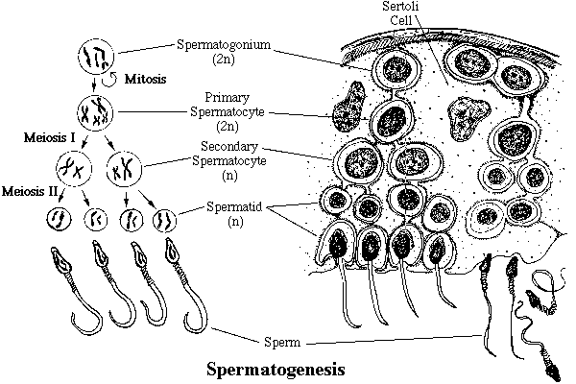
Some Physiology

Slide 15
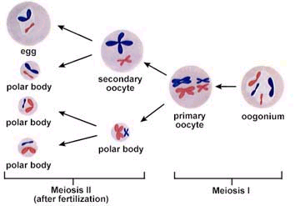
Oogenesis

Slide 16
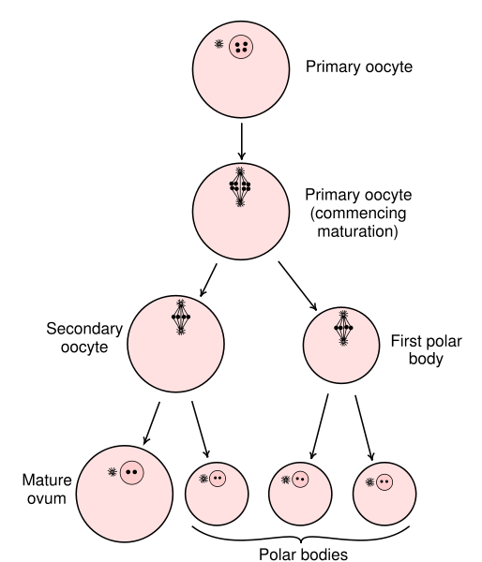

Slide 17
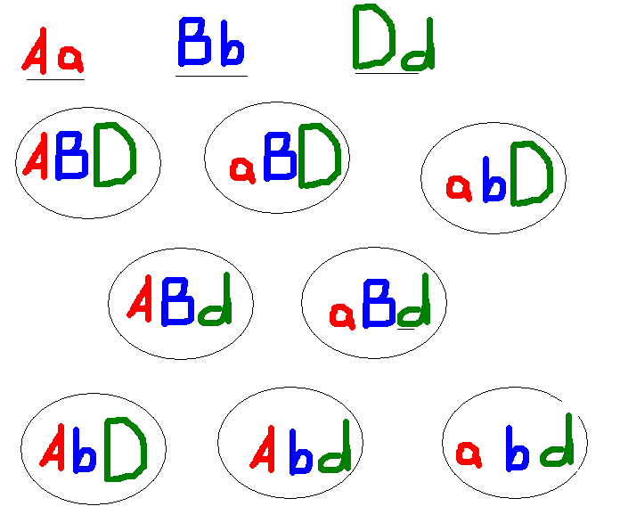
Meiosis is animals maintain genetic variability

Slide 18
Meiosis is animals maintain genetic variability

Slide 19
Some math

Slide 20
Some math

Slide 21
Odds of making you from just your parents
8,388,608 x 8,338,608
=
6.99493138 × 10¹³
But Wait! That is conservative

Slide 22
