Slide 1
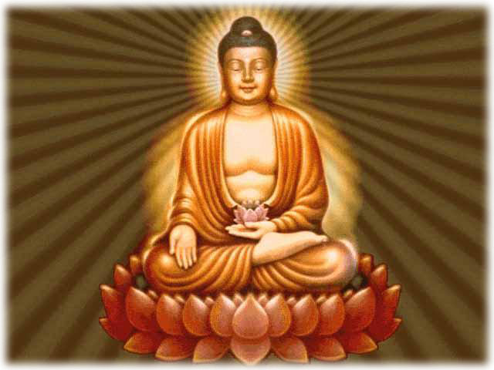
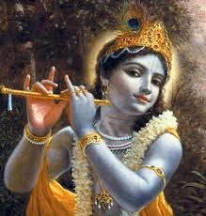
Religions of Asia
How they spread and Modern Influence

Slide 2
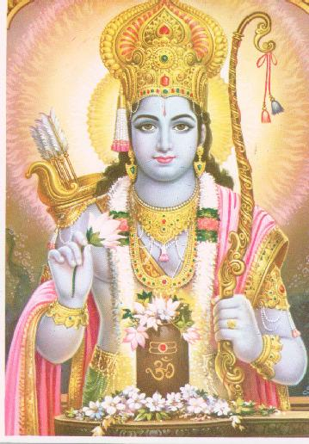
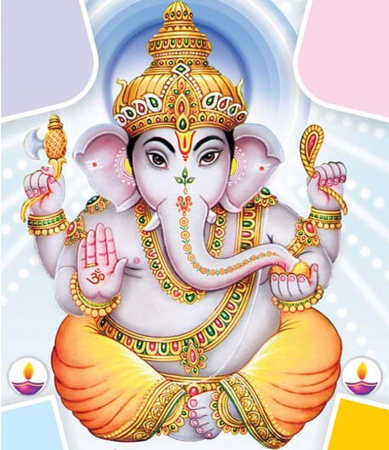
Hinduism
Major religion of India
It is polytheistic but each god represents a piece of Brahma, one great spirit or force
Believe that after the body dies the soul is reborn (reincarnation) and continues to be reborn until your soul reaches perfection
Once your soul is perfect it joins Brahma
Ideas originated from Aryan practices passed down and written in the Vedas: books of knowledge that contain prayers, religious practices etc.
Believe in karma:
If you do good things, good things will happen to you
If you do bad things, bad things will happen to you

Slide 3
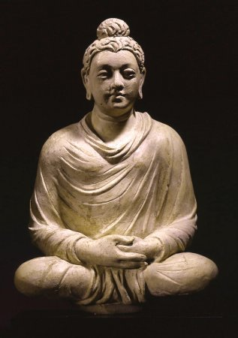
Buddhism
Started in India around 500 BC by a prince named Siddhartha Gautama
He saw the suffering of people in India and gave up his prince title to be a holy man and find the cause and end to suffering
He was later called the Buddha which means “enlightened one”
Basic belief: you can find peace from life’s troubles by praying (meditating) and doing good deeds
Shared ideas with Hinduism like reincarnation but rejected caste system
Spread to east and southern Asia through trade around 100AD
No central holy book. Some holy books are:
Tipitaka, Sutras and the Tibetan Book of the Dead

Slide 4
The Four Noble Truths
The Buddha's Teaching is based on the Four Noble Truths.
To realize these Truths is to realize and enter into the true nature of existence.
True and lasting happiness cannot be found in material possessions and worldly achievement
true happiness must be looked for only through mental clarity and the development of wisdom.
Continuous reincarnation happens because we fail to understand the Four Noble Truths.

Slide 5
Four Noble Truths
Life is full of pain
Suffering comes from desire for possessions
Stop desiring and you will no longer suffer
Escape suffering by following the 8 fold path
5

Slide 6
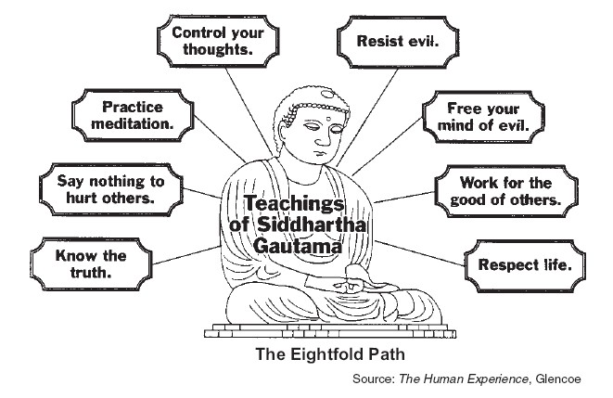

Slide 7
Eightfold path challenge
Each team will choose a part of the path.
Then, your team will create a charade (acting without talking) to try and get the rest of the class to guess what part of the path you are acting out

Slide 8
Maps of religions spreading
Spread of Christianity map
Spread of Islam map
Religions like Buddhism spread through trade

Slide 9
Ways religion spread
Trade:
to exchange ideas or items for something you need
Missionary: people who go to a new place to spread their religion

Slide 10
Ways religions spread
Conquest: to take over land outside of your country and make it part of your country
Migration: to move to a new place

Slide 11
Examples of how religion spreads
Trade:
Silk Road, Mediterranean trade, Arab Trade
This route passes through the middle east and India to china so Islam, Christianity and Buddhism start to spread
Mission Work:
Buddhist monks leaving India and bringing their religion to China and other Asian countries.
Christian missionaries traveling through Europe (ex. St. Patrick, St. Paul)
Conquering/ Colonization:
Muslim Empires spreading from Middle East to other parts of Asia and even Europe ( starting in the 600-700AD). As they conquered new places, they brought their religion with them.
Britain colonizing India in the 1800s bringing Christianity with them.
Migration:
After WWII here was a large migration of countries who were recovering from war.
After WWII large migration from India to other western nations.
Jews leaving Israel because of persecution, then returning after WWII
Pilgrims leaving England because of religious persecution, to go to the “New World”.( thank you Bobby for this example)

Slide 12
Trade
Check out this website
The Silk Road was a trade route that ran from China through the Middle East. This helped spread religions

Slide 13
Modern Influence
How ideas, practices and beliefs of Buddhism & Hinduism influence modern culture
Create a spider web in your notebook like the one you see below.
Modern Influence of Hinduism and Buddhism

Slide 14
Non- violence
Idea of using peaceful ways/methods to bring about change
Used first in India by Mahatma Gandhi who ended up freeing India from British rule/colonization
Later used by Martin Luther King Jr. (30 sec.) when during the American Civil Rights Movement

Slide 15
Music
Lyrical content reflects influence of Hindu and Buddhist ideas
DIRECT INFLUENCES
“Tomorrow Never Knows”-The Beatles (1966)
“Bodhisattva Vow”- The Beastie Boys (1994)
“Within You and Without You”- The Beatles (1967)
“Shanti/ Ashtangi”- Madonna
INDIRECT INFLUENCES
“Karma”- Alicia Keys (2004)
“What goes around Comes around”- Justin Timberlake (2006)
Sound of music reflects influence as well
“Paint it Black”-the Rolling Stones (1966)
“Jimmy” M.I.A. (2007)
“Wherever I May Roam”- Metallica (1991)
“Come and Get It”-Selena Gomez (2013)

Slide 16
Musical Artists heavily influenced by Hinduism and Buddhism
The Beatles:
Particularly George Harrison
Became interested in the teachings of Swami Vishnu-Devananda who started Sivandana Yoga
Went to India in 1966 to study, which would influence both sound and lyrics of the group
The Beastie Boys:
Particularly Adam Yauch
Traveled to Tibet several times and became interested in the religion through meeting various monks
Officially became Buddhist in 1996
Buddhist teachings would inspire lyrics and sound of groups music. They would also host Free Tibet Concerts to raise awareness.

Slide 17
Yoga
Originally only practiced by priests now used as a type of exercise.
Check out how many yoga studios are near Chesterland alone!
As of 2012: 20.4 million Americans practice yoga, compared to 15.8 million from the previous 2008 study*, an increase of 29 percent.
In addition, practitioners spend $10.3 billion a year on yoga classes and products, including equipment, clothing, vacations, and media.
Statistics taken from: http://www.yogajournal.com/press/yoga_in_america

