Slide 1
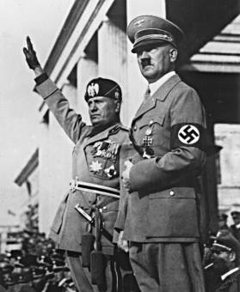
RISE OF DICTATORS

Slide 2
PRE WORLD WAR II ITALY
Unhappy victor after World War I
Received few awards
Galloping inflation
Unemployment
Labor unrest
Resort to Fascist State

Slide 3
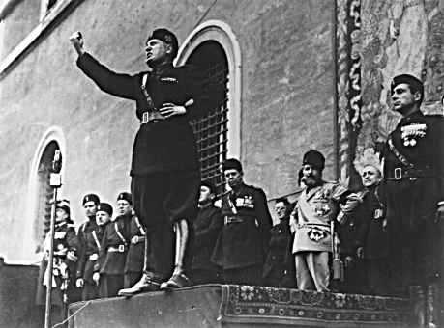
ITALY: BENITO MUSSOLINI
1922-1943
Makes radical turn towards extreme Nationalism
Formed dictatorship – strong government headed by one individual
Government seen as more important than the individual
State has duty to limit or destroy all opposition
Rejected democracy for strong central government

Slide 4
MUSSOLINI CONTROLS ITALY
Fascist party made the decisions and government carried them out
All newspapers, radio, and movies came under Fascist control
Schools textbooks taught glories of Mussolini’s regime
Italy became the first western European state to fall victim to totalitarianism

Slide 5
TOTALITARIANISM IN ITALY
Opposition to Mussolini beat up and sent to prison
Italians were grateful that discipline returned to the cities and felt it was worth the loss of civil liberties
In order to distract from problems – attempt to build an overseas empire
Formed Rome-Berlin Axis – alliance with Germany
1935: Attacks Ethiopia

Slide 6
QUICK CHECK - WHAT FACTORS LED TO THE RISE OF FASCISM IN ITALY?
Italian pride was wounded from WWI
Rising inflation
Unemployment
Social unrest

Slide 7
PRE WORLD WAR II SOVIET UNION
1921 – Soviet Union becomes communist under Vladimir Lenin & Bolshevik Party
State becomes the most totalitarian nation in all of Europe
Purge – search out dissenters – mass executions, imprisonment & flight of millions
Similar policies of Italy – all Soviet life came under the management of the state
Privately owned industry ceased to exist

Slide 8
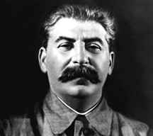
SOVIET UNION: JOSEF STALIN
1922-1953
Stalin gained support after Lenin suffered a stroke
Five-Year Plans imposed to industrialize the manufacturing sector & to form collective agriculture

Slide 9
SOVIET UNION UNDER STALIN
Landowning peasants killed or deported to labor camps after refusing to give up land
Famine ravaged the land – Stalin made no concessions
Had complete control over army & secret police
Needed to industrialize quickly – exports sent out in despite of needs of country
Established labor camps

Slide 10
PACT OF STEEL
Germans want to avoid 2 front war - Signed Pact of Steel with Soviet Union
Created an alliance that agreed would go to war against rest of Europe
Allowed him to expand the Soviet empire in exchange for providing vital resources to Germany
Didn’t realize Hitler’s ultimate plan to destroy Soviet Union

Slide 11
PRE WORLD WAR II GERMANY
Germany hit by the Great Depression
Weimer Government blamed
6 million unemployed for a nation of 60 million people
Fiscal instability
Raw materials in foreign hands
Alsace-Lorraine & Saar lost during aftermath of WWI
Allies seized large numbers of merchant vessels & railroads to make up for war losses
Reparation payments – gold reserves depleted
Value of paper money went into a tailspin
Signed a nonaggression treaty to join League of Nations

Slide 12
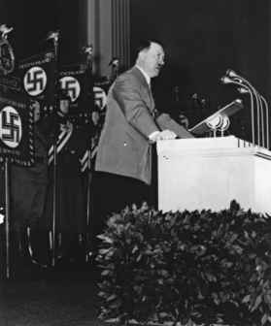
GERMANY: ADOLF HITLER
Wrote Mein Kampf (My Struggle) while in jail in 1920s
Laid out views on the centrality of Aryan purity
Danger of Jews and international Communism
Necessity of rebuilding German power
Importance of expanding Germany’s borders
Decided to try and gain power using democratic system

Slide 13
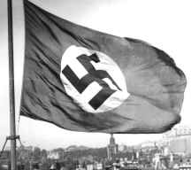
NATIONAL SOCIALIST PARTY – THE NAZIS
Between 1924 and 1928 Hitler reorganized the German Government
Used Wall Street Crash & world-wide economic depression of 1929 to begin campaign across Germany

Slide 14
HITLER’S CAMPAIGN
Promised hope
Promised jobs to unemployed
Told wealthy & upper class that he would suppress communism
Promised to get rid of Treaty of Versailles
Offered a program of law & order
Promised re-armament
Blamed Jews for everything wrong with Germany
Used propaganda to show that Weimar government had stabbed Germany in the back

Slide 15
QUICK CHECK - WHAT FACTORS LED TO NAZI TAKEOVER OF GERMANY?
Failure of Treaty of Versailles
Germany humiliated
Lost natural resources, gold in Treaty
Very high unemployment
Blamed Weimar Republic
German people were desperate

Slide 16
HITLER’S ACCOMPLISHMENTS
Passes Nuremberg Laws – deprived Jews of German citizenship
Prevent Jews from holding jobs in most occupations
Set out to destroy opposition – promised opposition certain things that he never intended to keep
Provided massive public works & rearmament program to provide jobs
Took control of press, theaters, & radio – propaganda used
Anyone who opposed regime branded a traitor

Slide 17
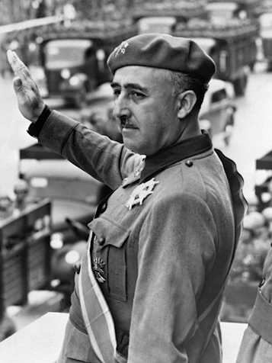
SPAIN: FRANCISCO FRANCO
1939-1975
Starts rebellion in Spanish Morocco in 1936
Hitler and Mussolini send weapons to support revolt
Able to overthrow republic government

Slide 18
PRE WORLD WAR II JAPAN
Only country to emerge from WWI stronger that it had been before
Leaders were interested in using their muscle to build their own empire
Believed the Depression as well as other ills were due to the influence of the West
Resented U.S. because of their dependence on U.S. oil

Slide 19
PRE WORLD WAR II JAPAN
Agreed with Germany that needed to expand in order to provide living space
Completely depended on other countries for all vital resources
Invaded Manchuria in 1931
Threatens to oppose any Western assistance given to China
By 1937, control richest portions of the country

Slide 20
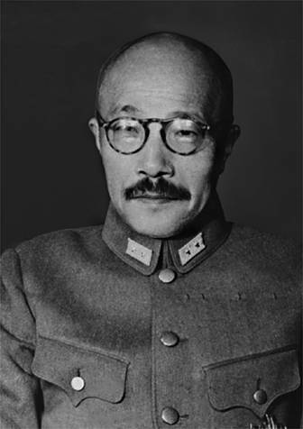
JAPAN: GENERAL TOJO
Japanese army general who served as country’s prime minister from 1941-1944
Known as The Razor – tough disciplinary policies
Never became a dictator but assumed more authority as war progresses

Slide 21
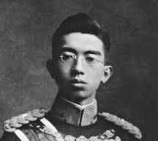
JAPAN: EMPEROR HIROHITO
Emperor 1926-1989
Hirohito gained considerable political influence
Privately concerned about growing power of military
Did little to stop aggressive attacks

Slide 22
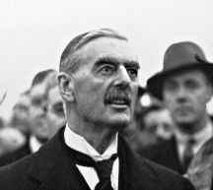
GREAT BRITAIN: NEVILLE CHAMBERLAIN
British Prime Minister from 1937-1940
Known for his policy of appeasement in the pre-World War II period
Major aim to avoid a European war at all cost
Proclaimed “peace in our time” after Munich Conference
Forced to resign in May 1940 & was succeeded by Winston Churchill

Slide 23
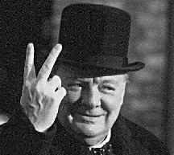
GREAT BRITAIN: WINSTON CHURCHILL
1940 – Churchill named prime minister after Chamberlain resigned
Prior warning about Hitler went unheeded
Denounces appeasement
Supervises every aspect of war effort
Set up policy of armament with help of United States

Slide 24
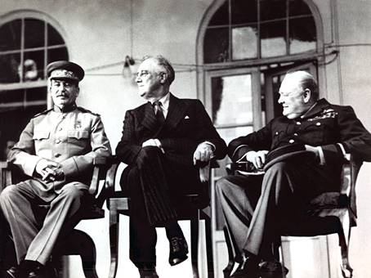
UNITED STATES: FRANKLIN DELANO ROOSEVELT
1933-1945
Tried to maintain balance between stopping aggression & keeping U.S.out of war
Continued to support Americans’ call for isolationism & improving U.S. economy

Slide 25
U.S. POLICY – NEUTRALITY ACT
Prohibited the shipment of arms to warring nations
Required warring nations that bought goods from America to transport these goods in their own ships
Forbade Americans to travel on the vessels of warring nations

Slide 26
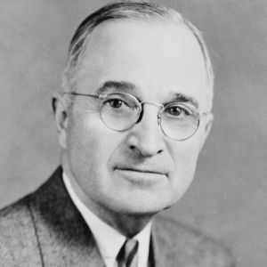
UNITED STATES: HARRY TRUMAN
1945-1953
Took over office after FDR’s death
Made the decision to drop the atomic bomb on Japan

