Slide 1
Bell work: Create the chart below and fill it out in your notebook.
 | Capitalism | Socialism | Communism
Good- Advantage
Bad- Disadvantage
Example Countries

Slide 2
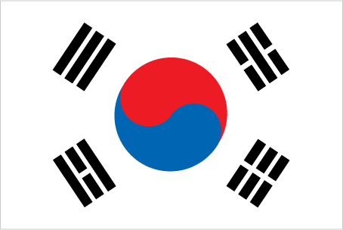
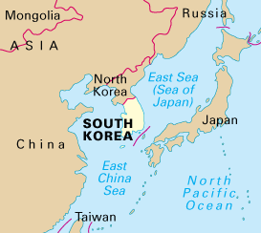
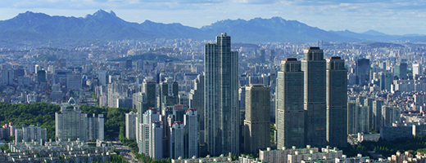
South Korea

Slide 3
History
1948
The Republic of Korea is proclaimed.
1950
South Korea declares independence, which sparks a North Korean invasion.
1953
North Korea and South Korea sign a truce, ending fighting that has lasted three years.
1987
Adopted their constitution
1998
"Kim Dae-jung becomes president and pursues a ""sunshine policy"", which aims to provide unconditional economic and humanitarian aid to North Korea."
2007
South Korea and the United States reach a free-trade agreement.
2007
Prime ministers from North and South Korea meet for the first time in 15 years.
2010
South Korea breaks off all trade with North Korea after investigators discover that a South Korean naval ship was sunk by a North Korean torpedo.

Slide 4
Sunshine Policy
The main aim of the policy was to soften North Korea's attitudes towards the South by encouraging interaction and economic assistance.
The national security policy had three basic beliefs:
No armed provocation by the North will be tolerated
The South will not attempt to take over the North in any way
The South actively seek cooperation
This went on from 1998 until 2007 when there was a change in leadership

Slide 5
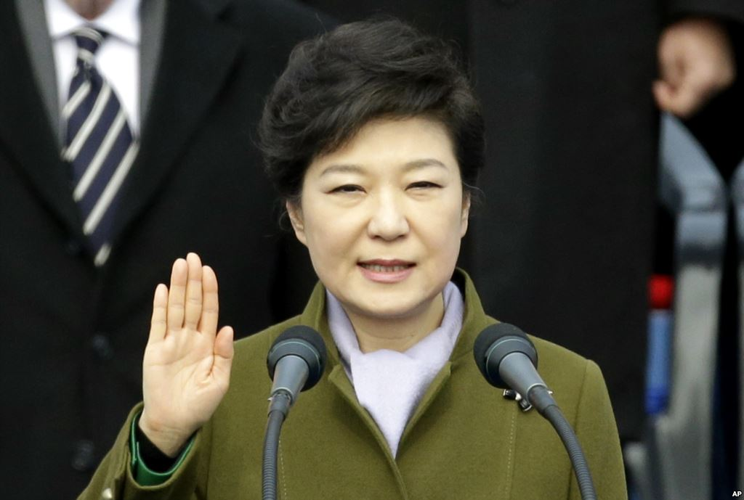
Government
Type of Government: Democracy
Citizens Rights: All liberties, freedom of speech, press, assembly
Internet free choice
Type of Leader: President
Citizens elect leader
President- Park Geun-hye
Has a fair court system for law breakers
TV stations and news is not limited by the government

Slide 6
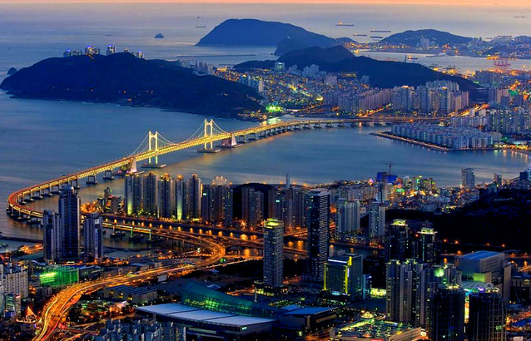
Rights and Responsibilities
High rights and liberties
Elect the leader
Can get rich
Competition between citizens
Follow fair laws
No brutal punishment
Voluntary military service
Any religion is allowed
Citizens can travel out of South Korea

Slide 7
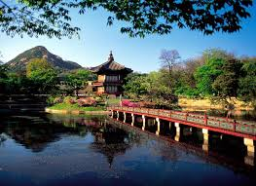
Economy
Type of Economy: Capitalist
Citizens own businesses and make economic decisions based on supply and demand
Citizens can get wealthy
Citizens can go bankrupt too
GDP Per Capita= $33, 140

Slide 8
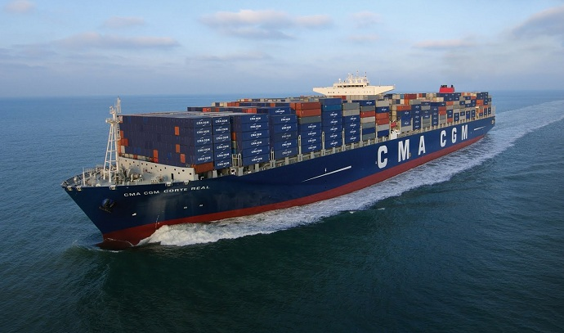
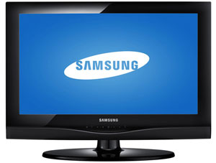
Trading
Export: ships, memory cards, TVs (Samsung), cars (Hyundai and Kia)
Import: industrial machinery, electronics, oil, steel
Trading Partners: China, Japan, U.S., Singapore

Slide 9
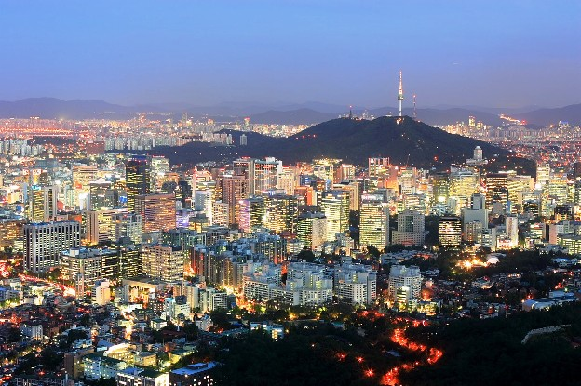
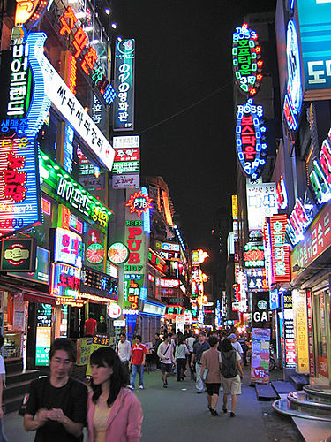
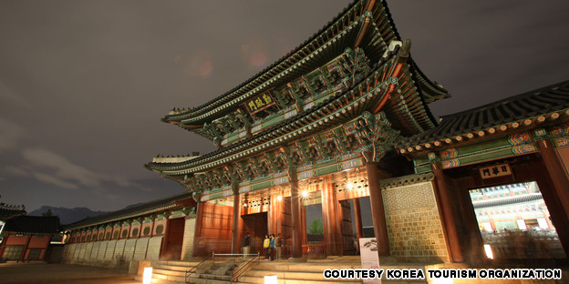
Seoul

Slide 10
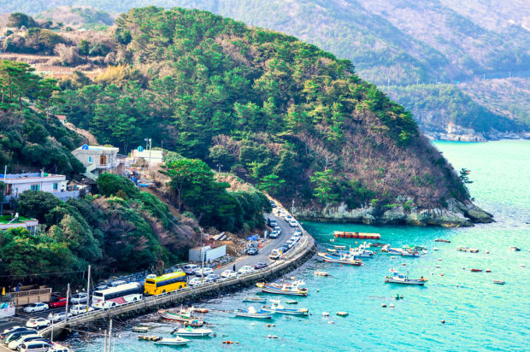
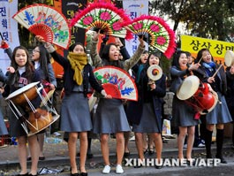
Lifestyle
Korean kids love being with their families or playing with friends
Free time = schoolwork because
parents are often very competitive and want them to study at a top Korean university to get a good job
Korean kids learn how to use computers when they are very young
When with adults, children must show respect by speaking with more polite language than they would with friends
They are expected to always obey their parents.

Slide 11
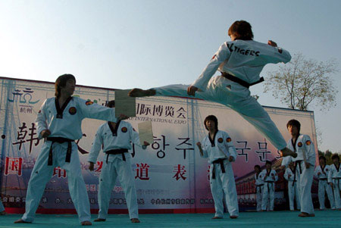
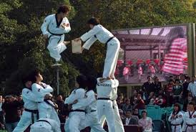
Sports
Kids play soccer, basketball, baseball and swimming.
Hiking in the mountains is popular
Almost all young children learn tae kwon do (a Korean martial art, like karate) after school
Most kids love to play computer games.

Slide 12
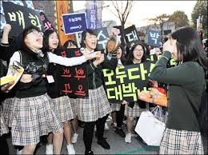
Schools
School is Monday – Friday
large amounts of homework in all grades
In elementary school, 8:20 am - 2 / 3:00pm
After school, most Korean kids (even young ones) go to a hokwon, a study or “cram” school, often until 10 or 11 p.m.
Many also attend summer school and hire private tutors.
Students must bow when they meet their teachers
School vacations usually go from January to February and July to August

Slide 13
Videos about the schools
Student Life
High school in South Korea (stop at 2:55)
American Exchange students video diary
Additional Questions Answered

Slide 14
Korean Words
Hello… Annyong haseyo(ahn-NYONG hah-say-YOH)
Good-bye… Annyonghee kasipsio
(ahn-NYONG-hee kah-ship-SHEEOH)
Please… Put'ak hamnida(POOT-ahk hahm-nee-dah)
Thank you… Kamsahamnida(kahm-SAHM-knee-dah)
Yes… Ne(neh)
No… Animnida(ah-neem-knee-DAH)

Slide 15
Webquest Links
http://www.timeforkids.com/destination/south-korea
http://kids.nationalgeographic.com/explore/countries/south-korea/#south-korea-market.jpg

