Slide 1
THE CIVIL RIGHTS MOVEMENT
1952-1968

Slide 2
RACISM
The belief that one group of people is superior to others solely on the basis of race

Slide 3
DISCRIMINATION
Excluding or restricting members of one group from opportunities that are available to other groups
Ex- not giving a job to someone because they are black, elderly, disabled

Slide 4
PREJUDICE
A preconceived judgment toward a people or a person because of race, social class, gender, ethnicity, age, disability, political beliefs, religion, sexual orientation or other personal characteristics.

Slide 5
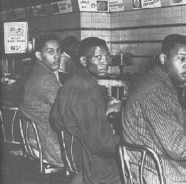
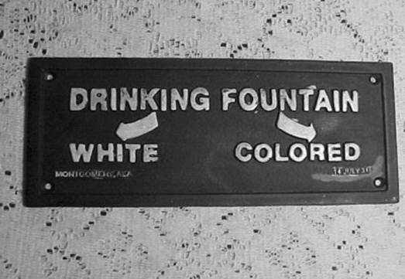

Slide 6
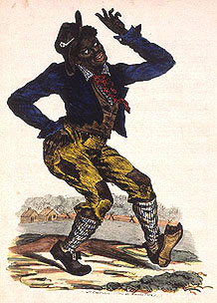
JIM CROW LAWS
Segregation laws in the United States from the 1880s until the 1960s
Named for a black minstrel character Jim Crow
Only 10% of eligible blacks voted
Required to pay poll taxes
White primaries
Discriminatory registration procedures
http://www.youtube.com/watch?v=ChWXyeUTKg8

Slide 7
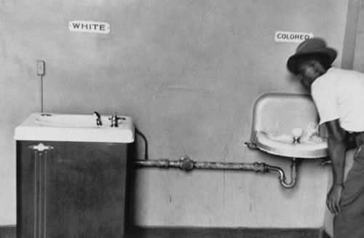
SEGREGATION
Separated groups of people based on race, gender, age, sexual preference etc.

Slide 8
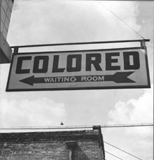
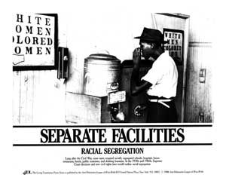
SEGREGATION

Slide 9
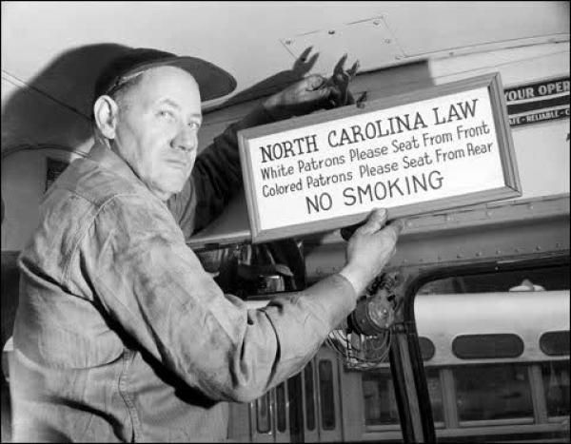
INTEGRATION
The process of ending racial segregation in places such as schools, public facilities and public transportation

Slide 10
PLESSY v. FERGUSON
1896 Supreme Court case
Held that segregation of blacks and whites was acceptable as long as the facilities were “separate but equal”
http://www.pbslearningmedia.org/resource/bf09.socst.us.const.plessy/plessy-v-ferguson/

Slide 11
BROWN v BOARD OF EDUCATION
Topeka, Kansas
1954 Supreme Court case that ruled separate but equal was inherently unequal
Violated the equal protection clause of the 14th Amendment for black school children
Ruled that schools needed to be integrated
http://www.youtube.com/watch?v=TTGHLdr-iak

Slide 12
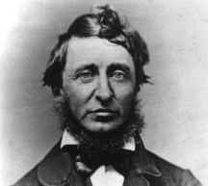
CIVIL DISOBEDIENCE
Refusing to obey unjust laws by following these rules:
The disobedience must be public, not secret, because the purpose of the disobedience is to show the law is unjust
Even though the law is unjust, the person who practices civil disobedience must accept the penalty for disobeying it

Slide 13
THEORY OF CIVIL DISOBEDIENCE
Refusing to obey unjust laws by following these rules:
Only an unjust rule or law may be disobeyed
The disobedience must be public, not secret, because the purpose of the disobedience is to show the law is unjust
Even though the law is unjust, the person who practices civil disobedience must accept the penalty for disobeying it

Slide 14
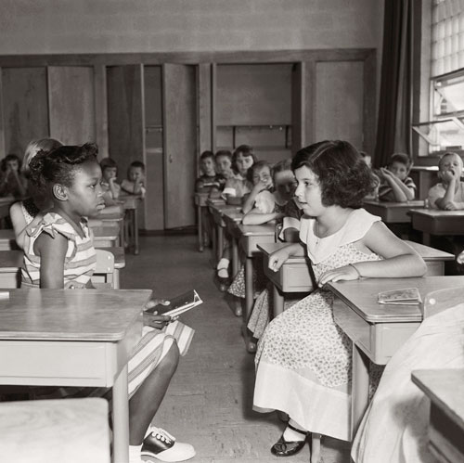
KEY ISSUES OF THE CIVIL RIGHTS MOVEMENT
Desegregation
Schools
Work
Businesses
Travel
Voting Rights

Slide 15
PRINCIPLES OF CIVIL RIGHTS MOVEMENT
Nonviolence
Christian love
Unity among the people
Protest unjust laws without overturning the fundamental principles of law and order

Slide 16
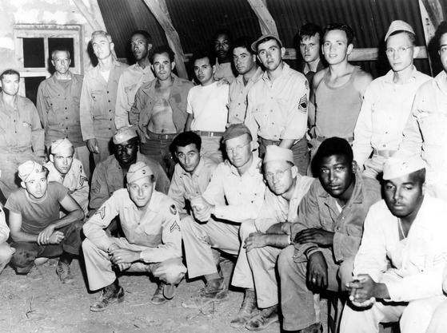
ORIGINS OF THE MOVEMENT
WWII
1 million black men and women served in military services
Discrepancy between fighting totalitarianism while enduring segregation and other racism

Slide 17
ORIGINS OF THE MOVEMENT
Migration to the North
Greater economic opportunities & political freedom
Gained political influence
Biracial unity in unions

Slide 18
POST WWII POLITICS
1946 – Truman creates Presidential Commission on Civil Rights
Report set up program to end racial inequality
Permanent civil rights division of Justice Department
Voting rights protection
Anti-lynching legislation
Legal attack on segregated housing
No legislation ever introduced
1948 – Truman issues Executive Order 9981 – desegregated U.S. armed forces

Slide 19
ROSA PARKS
Born in 1913 – Tuskegee, Alabama
Attended Alabama State College
Discrimination prevented her from finding a job that matched her education – worked as a seamstress
Became involved in civil rights movement – held office in local chapter of NAACP

Slide 20
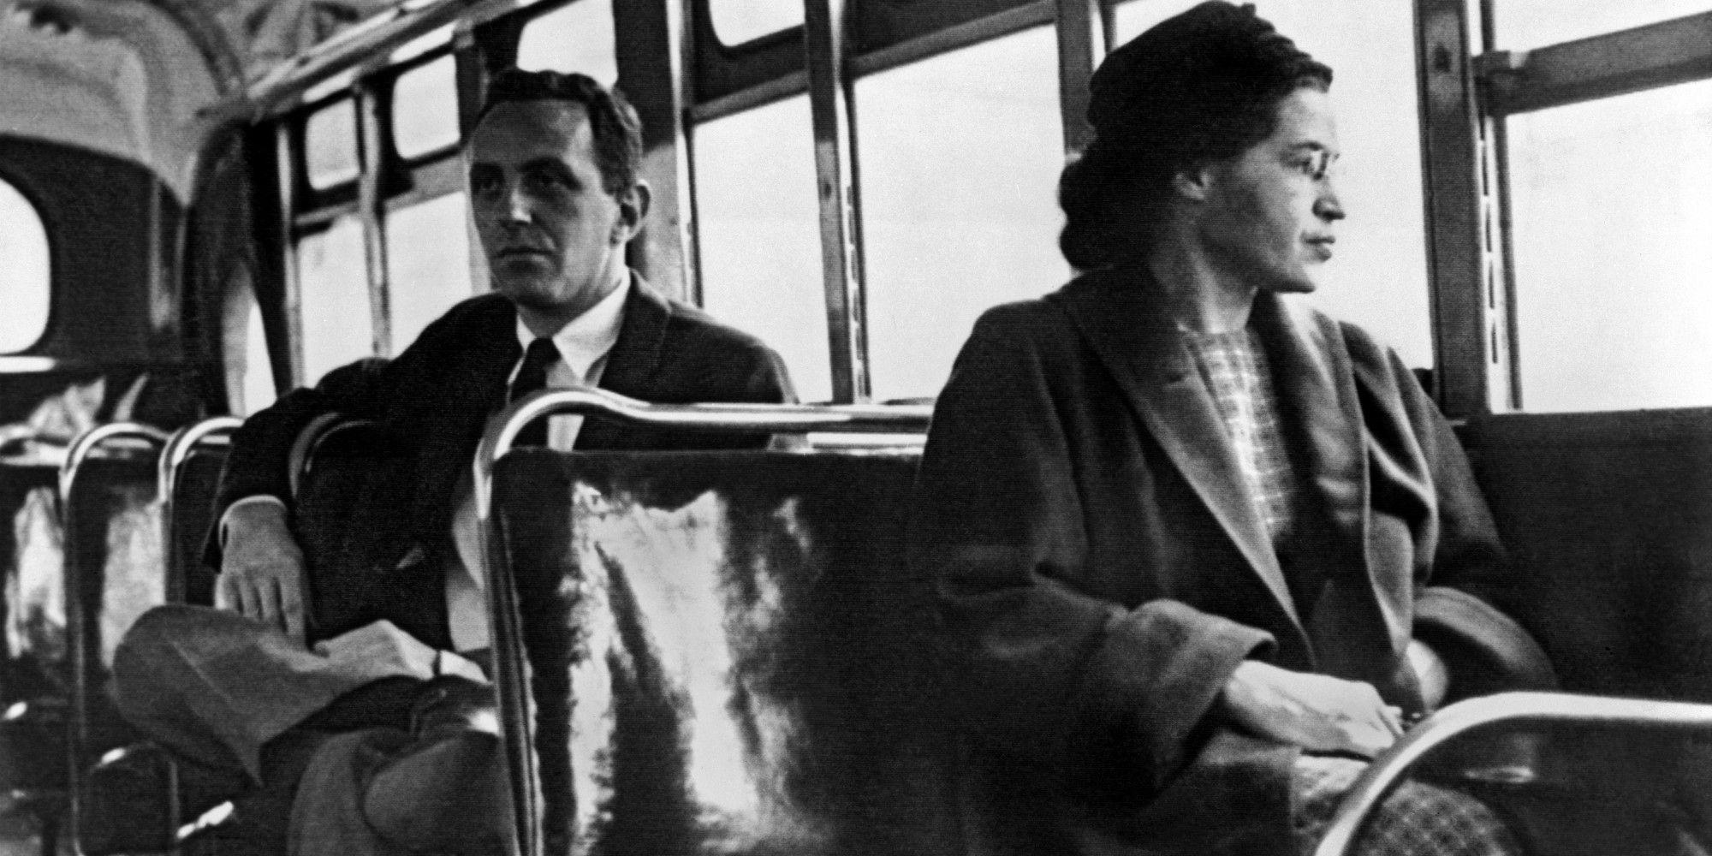
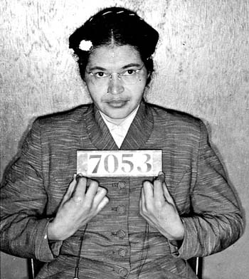
ROSA PARKS
December 1, 1955
Montgomery, Alabama
Refused to obey bus driver’s order that she give up her seat to make room for a white passenger
Arrested, and this helped lead to the Montgomery Bus Boycott

Slide 21
MONTGOMERY BUS BOYCOTT
NAACP planned test to challenge practice of forcing black citizens to ride on the back of the bus
Martin Luther King Jr. chosen as spokesman
December 5, 1955 – December 20, 1956
http://www.history.com/topics/black-history/montgomery-bus-boycott

Slide 22
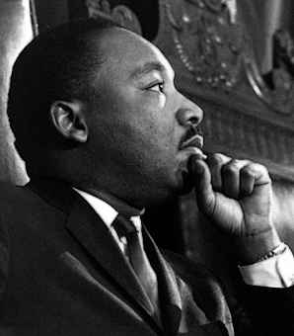
MARTIN LUTHER KING JR.
Born in Atlanta, Georgia in 1929
Lived in middle-class family
Attended Morehouse College
Studied theology
Particularly believed in Ghandi’s nonviolent resistance – expose injustice and force it to end

Slide 23
BUS BOYCOTT GIVES RISE TO A LEADER
Boycott led to violence
Vigilantes beat and attack boycotters and bombed the home of MLK and other MIA leaders
MLK and Rosa Parks lost their jobs
King urged black community not to respond with violence
1956 – Supreme Court declares Montgomery and the Alabama segregation laws unconstitutional
By the end of the year, desegregated bus system

Slide 24
MLK’s SUPPORTERS
Montgomery Bus Boycott is what made MLK famous
1957 – brought together 100 black ministers to found SCLC (Southern Christian Leadership Committee)
Southern black church leaders of the Civil Rights Movement

Slide 25
NAACP MEMBERSHIP
Membership grew from 50,000 → 500,000
Thurgood Marshall mounted legal campaign challenging segregation laws
Demonstrated potential for using federal courts to attack segregation

Slide 26
BROWN v. BOARD OF EDUCATION
NAACP – series of lawsuits seeking complete equality of segregated facilities
1951 – Thurgood Marshall begins direct action on “separate but equal” laws

Slide 27
THE HISTORIC CASE
8 year old Linda Brown had to travel by bus to her school, but lived 3 blocks from an all white school
1954 – Justice Warren issues unanimous report stating that “separate but equal” is not true – must end
Marshall claims all segregated schools would end within 5 years
No plan for implementation was included

Slide 28
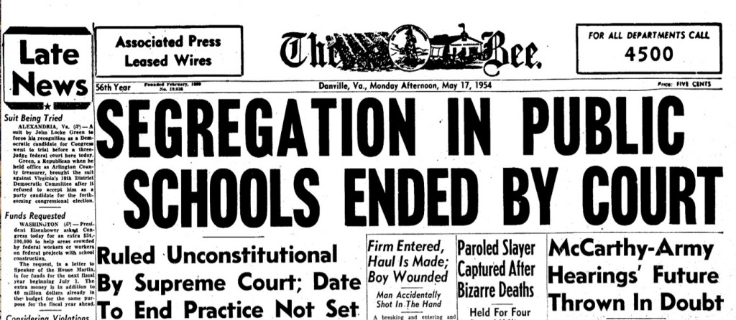
BROWN v. BOARD con’t
1955 – Justices assign responsibility of desegregating schools to school boards “with all deliberate speed”

Slide 29
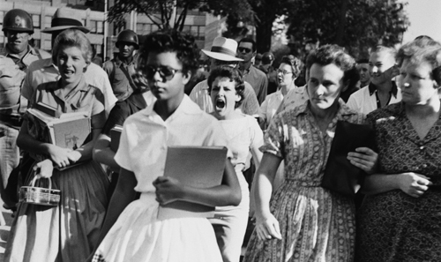
IMPLEMENTING BROWN: LITTLE ROCK 9
September 1957 – schools ordered to begin desegregation
Gov Faubus (AK) – campaigning for reelection
Defied court order
National Guard troops sent to Central High to prevent desegregation

Slide 30
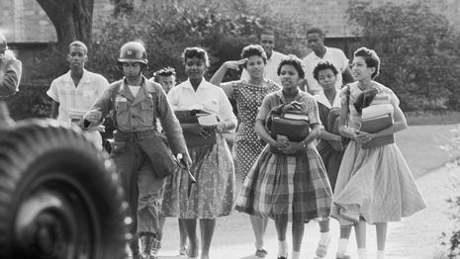
IMPLEMENTING BROWN: LITTLE ROCK 9
Eisenhower agrees to intervene quietly
Faubus withdrew the troops, students left to white mob
National Guard sent in under federal control
101st Airborne protected students
http://www.history.com/topics/black-history/central-high-school-integration

Slide 31
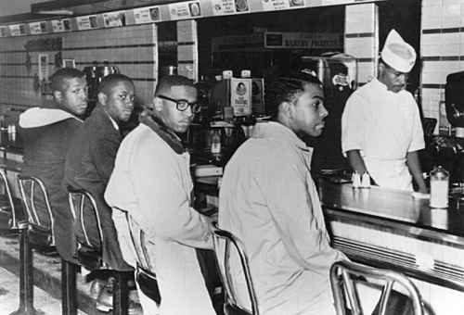
NONVIOLENT MOVEMENT: SIT INS
February 1960 – 4 black students sat down at white only lunch counter at Woolworths
Ordered but were refused service
Stayed at the counter
Hundreds came to support
Sit in leads to start of an economic boycott
Businesses will be forced to give in
Within 18 months, 70,000 people participated in sit ins (3,000 arrested)

Slide 32
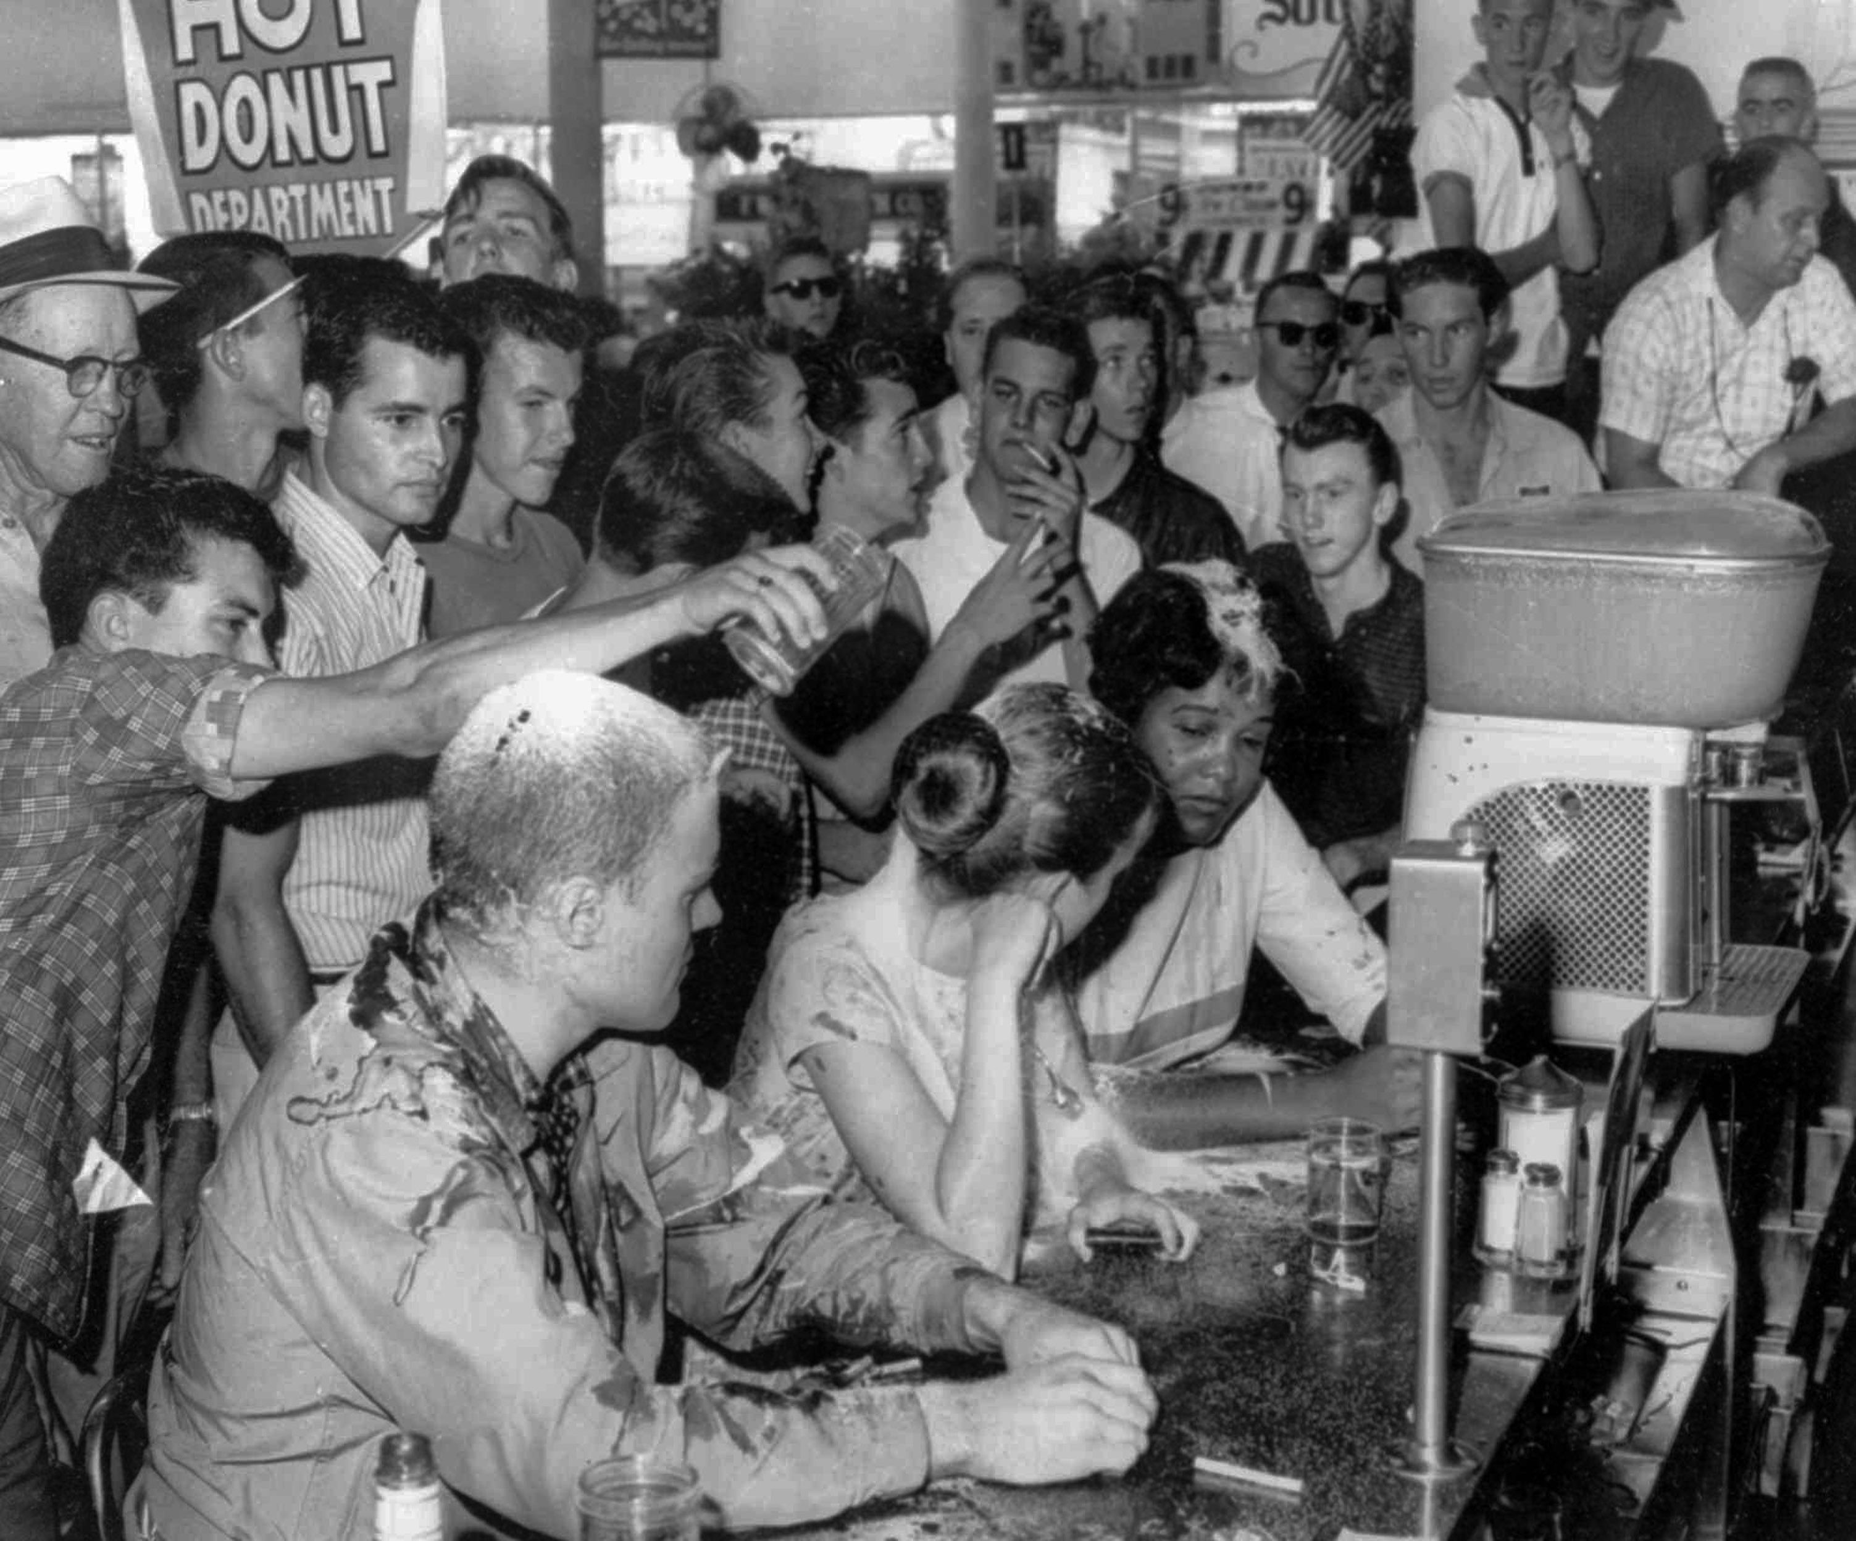

Slide 33
SNCC (STUDENT NONVIOLENT COORDINATING COMMITTEE)
1960 – Student centered leadership organized civil rights movement without adult control
Fight segregation through direct confrontation, mass action, civil disobedience
Forefront of nearly every civil rights battle

Slide 34
1960 ELECTION
Kennedy v Nixon
Kennedy praised Civil Rights Movement
Won 70% of the black vote
Kennedy’s work on Civil Rights Movement
Appoints 40 African Americans to federal positions
Thurgood Marshall appointed to federal court
Established Equal Employment Opportunity – fight discrimination in federal civil service
Careful not to alienate southern Democrats

Slide 35
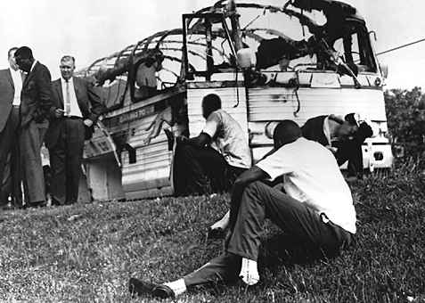
FREEDOM RIDES
1961 – led by CORE (Congress on Racial Equality)
Series of bus trips through South to protest segregation in interstate bus terminals
Mob violence erupted – FBI did nothing
Exposed ugly face of southern racism
Reinforced white resistance to desegregation
http://www.investigationdiscovery.com/tv-shows/march-to-justice/march-to-justice-videos/the-freedom-riders
http://www.pbslearningmedia.org/resource/fr11.soc.civil.tactics.frgoals/freedom-riders-freedom-riders-challenge-segregation/

Slide 36
BIRMINGHAM CAMPAIGN
1963 – most segregated big city and deep history of racial violence
Organized by SCLC
Strategy: fill city jails and boycott stores
MLK arrives with manifest demanding end to racist practices and segregation
Creation of biracial committee to oversee desegregation

Slide 37
MLK DECLARES VICTORY
Protest marches shut down city
Student march
Children’s crusade
http://www.biography.com/news/black-history-birmingham-childrens-crusade-1963-video

Slide 38
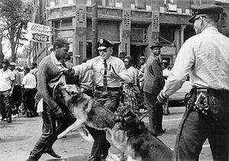
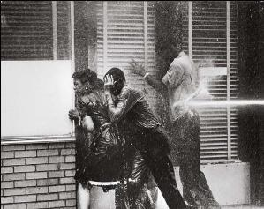
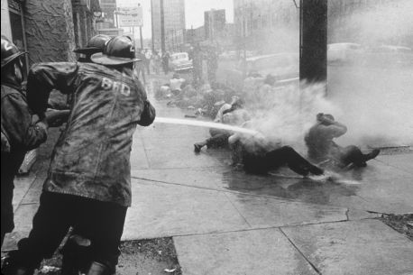

Slide 39
BIRMINGHAM
King declares victory – business leaders agree to most demands
KKK burned cross in city park after MLK left
Bomb set off at MLK’s brother’s house
Kennedy orders 3,000 troops into Birmingham
Violence receded
September 1963 – church bombing, 4 girls killed
http://www.history.com/topics/black-history/birmingham-church-bombing

Slide 40
MARCH ON WASHINGTON
June 11, 1963 – Kennedy goes on TV to personally endorse the Civil Rights Movement
Following week – Congress passes law for voting rights
Outlaw segregation
Bolster federal authority
Few hours after Congress passes law, Mississippi NAACP leader Medger Evers killed

Slide 41
MARCH ON WASHINGTON
Planned march – Kennedy reluctantly approves
Leaders of Civil Rights organizations put aside differences in philosophy to come together for march
August 28, 1963 – 250,000 people gathered
MLK gives “I Have a Dream” speech
http://www.youtube.com/watch?v=3vDWWy4CMhE

Slide 42
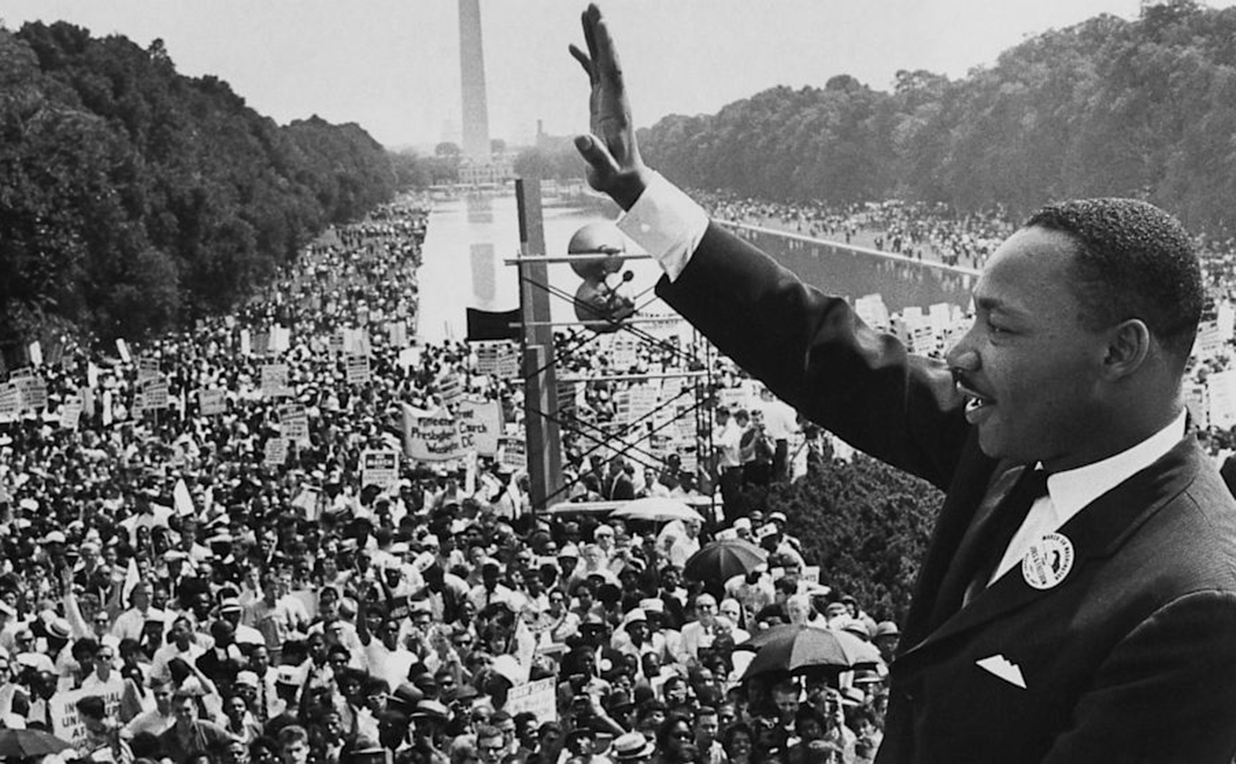
MARCH ON WASHINGTON

Slide 43
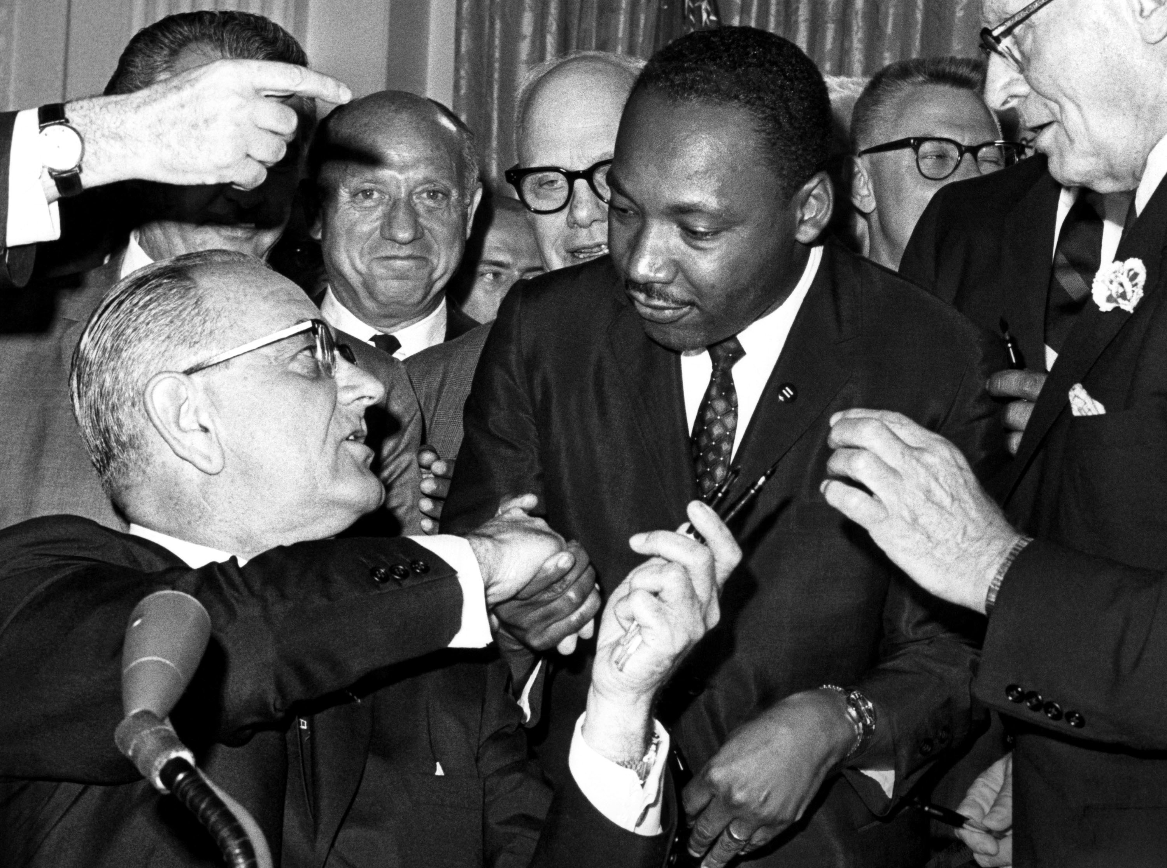
NEW PRESIDENT
November 1963 – JFK assassinated
Lyndon B. Johnson becomes president
Not a friend to Civil Rights Movement
Agrees to continue Kennedy’s lead
June 2, 1964 – LBJ passes Civil Rights Act

Slide 44
CIVIL RIGHTS ACT 1964
Prohibited discrimination in most public places
Outlawed discriminatory employment
Outlawed bias in federally assisted programs
Justice Department begins desegregating schools
Equal Employment Opportunity Commission established
Technical and financial aid to communities working to end discrimination

Slide 45
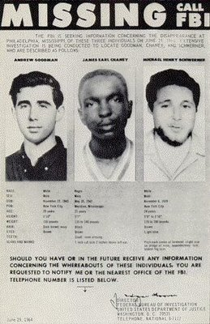
MISSISSIPPI FREEDOM SUMMER
SNCC – work to register black voters
Mississippi was poorest, most backward state
900 volunteers from white colleges begin to travel in order to get African Americans to register to vote
June 1964 – 3 activists murdered
Six weeks later, FBI finds 3 more bodies
3 more died, 1,000 arrested, 80 beatings, 35 shootings, 30 bombings
60,000 voters signed up

Slide 46
MISSING ACTIVISTS
http://www.history.com/this-day-in-history/slain-civil-rights-workers-found
http://www.cbsnews.com/news/mississippi-burning-murders-resonate-50-years-later/

Slide 47
MALCOLM X
Born in 1925 – Malcolm Little
Preacher father was murdered by whites
Drifts into life of crime – sent to jail – finds Nation of Islam in jail
Nation of Islam – create a self-reliant, highly disciplined, separate “nation” for blacks
Used “X” to symbolize loss of slave name
Ridiculed integrationist goals
Time for nonviolence had passed
Separated himself from Nation of Islam after pilgrimage to Mecca
Assassinated February 1965

Slide 48
BLACK POWER
Argued for right to use violence for self-defense
African American mobilization for control of economic and political power
Separation of societies
Black Panthers established
Citizen patrols because African Americans could not trust white police force

Slide 49
VOTING RIGHTS ACT OF 1965
August 1965 – LBJ signs law
Authorizes federal supervision of voting registration processes
Outlawed literacy and other discriminatory tests

Slide 50
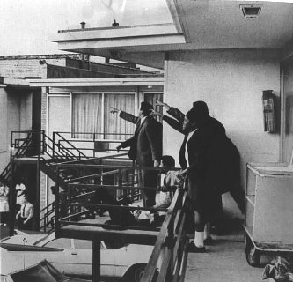
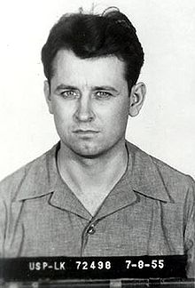
ASSASSINATION OF MLK JR.
April 4, 1968 in Memphis, TN by James Earl Ray at the Loraine Motel
http://www.youtube.com/watch?v=cmOBbxgxKvo

Slide 51
AFFIRMATIVE ACTION
Action taken to increase the representation of women and minorities in areas of employment, education and business from which they have historically been excluded

Slide 52
BAKKE v THE REGENTS OF CALIFORNIA
Allan Bakke was refused admission to medical school even though he scored higher on admissions tests than some minority applicants
Supreme Court ruled that his 14th Amendment rights were violated

Slide 53
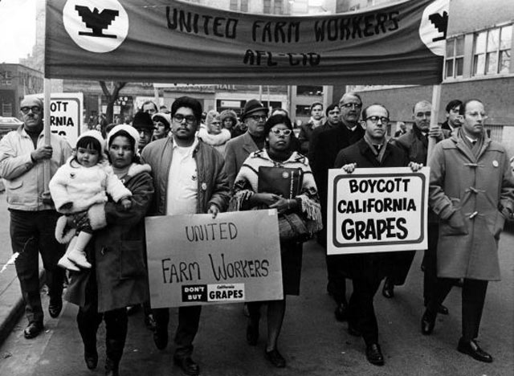
CESAR CHAVEZ
Mexican American civil rights leader
UFW – United Farm Workers – organized grape farmers to strike and led to better conditions for migrant farmers

Slide 54
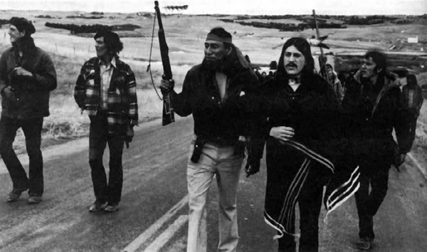
AIM (AMERICAN INDIAN MOVEMENT)
Movement to gain rights for Native Americans
Regain lost land and revise treaties that were hurtful to tribes
Fight for representation in Congress

Slide 55
NOW (NATIONAL ORGANIZATION FOR WOMEN)
Feminist group attempting to achieve full equality for women through education and litigation
Pay equity, women’s health and body image, reproductive rights

