Slide 1
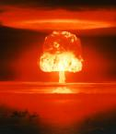
THE ATOMIC BOMB AND END OF WWII

Slide 2
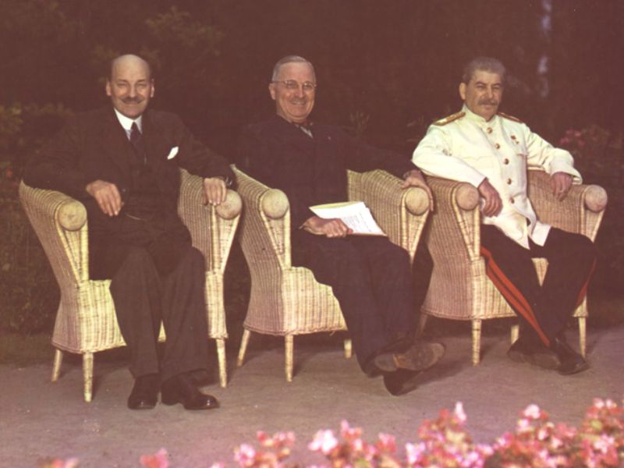
POTSDAM DECLARATION
Allies ordered the Japanese to surrender
Japan refused----Truman gave approval to use atomic weapons

Slide 3
TRINITY TEST SITE
http://www.youtube.com/watch?v=Ru2PWmGIoB8&feature=related

Slide 4
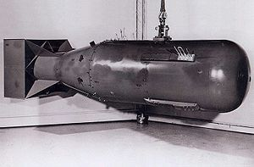
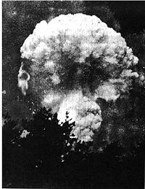
HIROSHIMA, JAPAN
Monday August 6, 1945
The Enola Gay B-29 Bomber dropped the bomb piloted by Paul Tibbets killing 70,000 immediately
“Little Boy”
Over 200,000 deaths

Slide 5
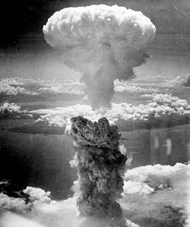
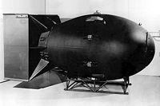
NAGASAKI, JAPAN
August 9, 1945
B 29 Bomber Bockscar dropped the A-Bomb “Fat Man”
70,000 dead immediately
140,000 total deaths

Slide 6
EFFECTS OF THE BOMBINGS
Immediate explosion and “flash burning”
Radiation Sickness
Leukemia and other cancers
Nuclear Fallout

Slide 7
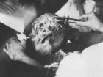

Slide 8
JUSTIFICATION?
The US believed that invading Japan would kill hundreds of thousands of people
The bombings would be a quick solution with less American casualties and would force the Japanese to surrender

Slide 9
HIROSHIMA AND NAGASAKI
https://www.youtube.com/watch?v=2Pxk4zy_SQw

Slide 10
AFTERMATH FOOTAGE
http://www.youtube.com/watch?v=xYQ88GB4zBA&NR=1

Slide 11
JAPANESE SURRENDER
Surrendered on August 15, 1945
VJ Day
Signed an unconditional surrender on September 2, 1945 on the USS Missouri in Tokyo Bay

Slide 12
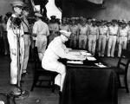
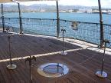
USS MISSOURI SURRENDER

Slide 13
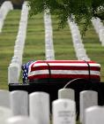
WAR DEATHS
Estimated 60 million killed during the war
20 million were soldiers and 40 million civilians

