Slide 1
BIOLOGICAL BASES OF BEHAVIOR: THE BRAIN
UNIT 3B

Slide 2
UNIT OVERVIEW
The Tools of Discovery: Having our Head Examined
Older Brain Structures
The Cerebral Cortex
Our Divided Brain
Right-Left Differences in the Intact Brain
The Brain and Consciousness
Notes:
The brain enables the mind—seeing hearing, smelling, feeling, remembering, thinking, speaking & dreaming.
When we’re thinking about our brain, we’re thinking with our brain—by firing countless millions of synapses and releasing billions of neurotransmitter molecules
Brain + body = mind (the brain enables the mind)
**Many of the now-outdated ideas about the brain—brain size equaling intelligence, phrenology—were debunked thanks to neuroimaging techniques. The ability to see the inner working of the brain in action has revolutionized the way we think about psychology.

Slide 3
THE TOOLS OF DISCOVERY: HAVING OUR HEAD EXAMINED
Notes:
Brain + Body=Mind

Slide 4
Evolutionary
Endocrine System
Building Blocks
Genetics
Biological Psychology
Neurons
Neurotransmitters
Nervous System
Central Nervous System
Peripheral Nervous System
Motor
Sensory
Brain
Spinal Cord
Autonomic
Somatic
We are here
Brain Imaging
Sympathetic
Parasympathetic

Slide 5
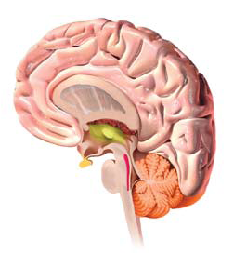
STUDYING THE BRAIN
Lesion
Stimulate (electronically, chemically or magnetically)
Very small electrodes inserted into individual neurons
Used to study activity of a single neuron
Notes:
How do neuroscientists study the brain’s connections to behavior and mind?
Neural cartographers can selectively lesion (destroy) tiny clusters of normal or defective brain cells, leaving the surrounding tissue unharmed
Scientists can also electrically, chemically or magnetically stimulate various parts of the brain and note the effects, observe the communication between neurons and see color representations of the brain’s energy-consuming activity

Slide 6
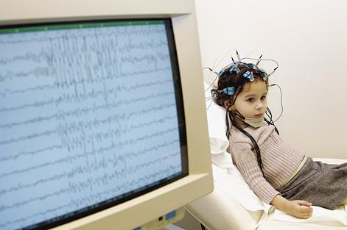
RECORDING THE BRAIN’S ELECTRICAL ACTIVITY
Electroencephalograph (EEG)
Used to get a picture of overall activity in the brain
electrodes placed on a person’s scalp to measure an amplified recording of the electrical waves sweeping across the brain’s surface.
Notes:
Electrical activity in the brain’s billions of neurons sweeps in regular waves across its surface
An electroencephalogram (EEG) is an amplified readout of such waves (like studying a car engine by listening to its hum)
A computer filters out brain activity unrelated to the stimulus and the scientist can identify the electrical wave evoked by the stimulus

Slide 7
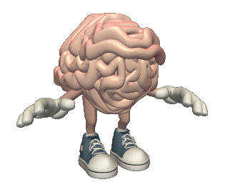
BRAIN IMAGING
Structural Imaging
Functional Imaging
CT(CAT) Scan
MRI
PET Scan
fMRI
Notes:
**Neuroimaging Techniques are used to diagnose psychological disorders, determine how drugs affect the brain and body, assess the usefulness of hypnosis, examine whether unconscious processes affect behavior, explore the interaction of sensation and perception

Slide 8
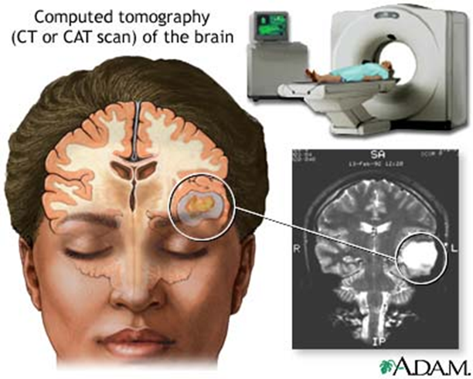
CT SCANS
Computerized Axial Tomography (CAT-scan)
Uses X-rays to create a 3-dimensional image of the brain
CT scans can often show the size and locations of brain abnormalities caused by tumors, blood vessel defects, blood clots, strokes and other problems.
Notes:
CT (computed tomography) scan ----The CT scan is the modern name for the CAT scan- this examines the brain by taking X-ray photographs that can reveal brain damage

Slide 9
**THIS IS NOT A CAT SCAN**

Slide 10
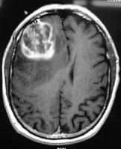
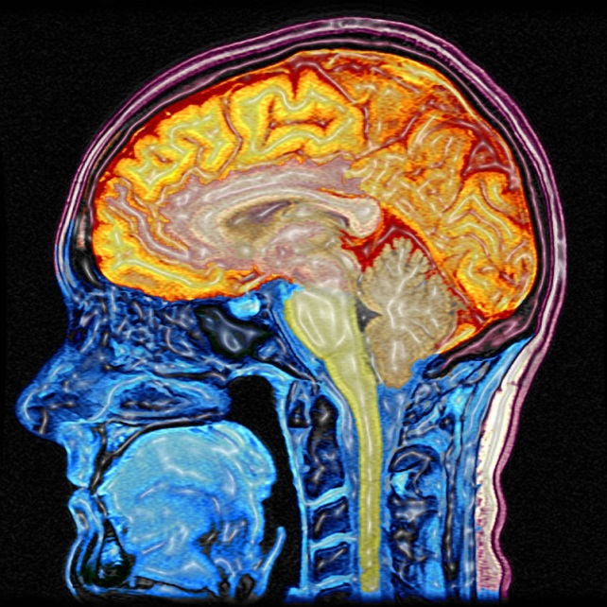
MRI SCANS
Magnetic Resonance Imaging (MRI)
Uses a magnetic field and radio waves to produce computer-generated images
They distinguish among different types of brain tissue.
Notes:
MRI (magnetic resonance imaging)—scan
where the head is put in a strong magnetic field which aligns the spinning atoms of brain molecules
Then a radio-wave pulse momentarily disorients the atoms
When the atoms return to their normal spins, they release signals that provide a detailed picture of the brain’s soft tissues
Useful to scan other body parts—my ankle
Can reveal enlarged, fluid filled brains in some patients who have schizophrenia

Slide 11
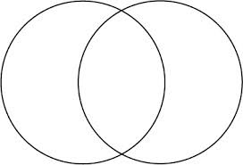
CT vs. MRI
MRI
CT scan
Less expensive than MRI
MRI contrast materials used for image enhancement have very low incidence of side effects
Less sensitive to patient movement
Give you the structure of the brain
CT can be performed if you have an implanted medical device of any kind
More sensitive to patient movement

Slide 12
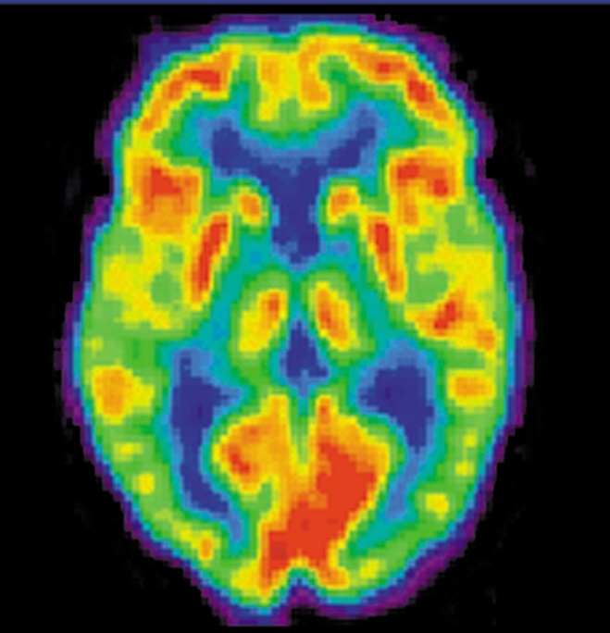
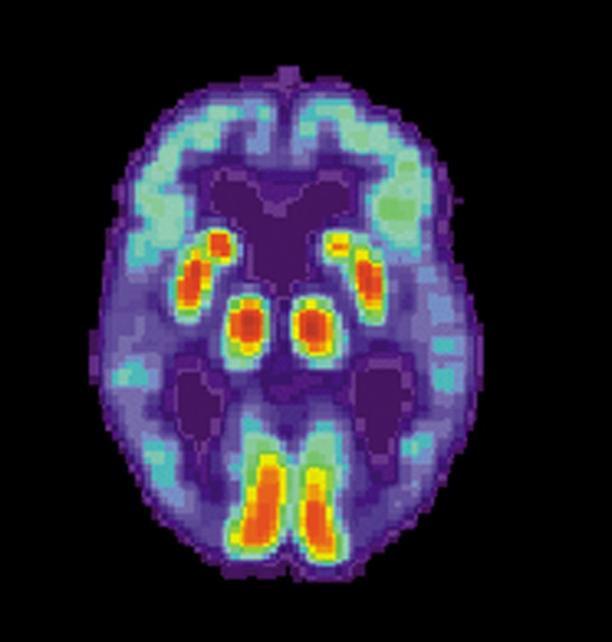
PET SCANS
Positron Emission Tomography (PET)
Use radioactive glucose to determine location of greatest brain activity
PET Scan of Normal Brain
PET Scan of Alzheimer's Disease Brain
Notes:
More dramatic = PET (positron emission tomography) scan—depicts brain activity by showing each brain area’s consumption of its chemical fuel (sugar glucose)
Active neurons are glucose hogs
After a person receives temporarily radioactive glucose, the PET scan detects where the glucose goes by locating the radioactivity.
PET scans look for “hot spots” which show what brain areas are most active as the person performs mathematical calculations, looks at images of faces, or daydreams

Slide 13
fMRIs
Functional Magnetic Resonance Imaging (fMRI)
Shows function and structure by measuring movement of blood molecules within the brain
Notes:
fMRI (functional MRI)- can reveal the brain’s functioning as well as its structure
Where the brain is especially active, blood goes
By comparing MRI scans taken less than a second apart, researchers can watch the brain “light up” (with increased oxygen-laden bloodflow) as a person performs different mental functions.
As a person looks at a scene, the fMRI machine detects blood rushing to the back of the brain (which processes visual information)

Slide 14
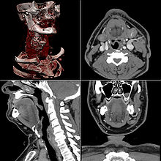
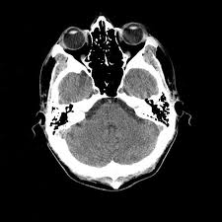
WHICH TYPE OF SCAN?
Notes:
CT (Modern name for the Cat scan---Xray photographs that can reveal brain damage

Slide 15
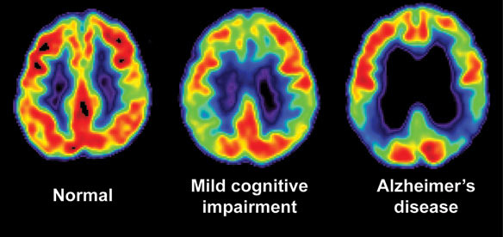
WHICH TYPE OF SCAN
Notes:
PET (Depicts brain activity by showing each brains area of consumption of its chemical fuel (sugar glucose)
Looks for hot spots during activities

Slide 16
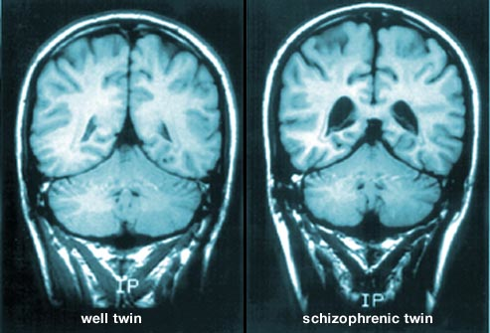
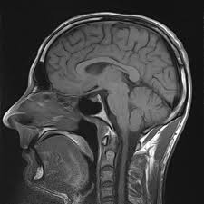
WHICH TYPE OF SCAN?
Notes:
MRI: Head is put in a strong magnetic field which aligns the spinning atoms of the brain molecules
-Radio wave pulse momentarily disrupts the atoms
-When the atoms return to their normal spins, they release signals that provide a detailed picture of the brain’s soft tissues
-Useful to scan other body parts

Slide 17
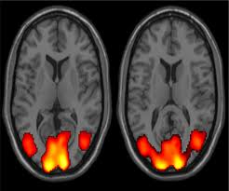
WHICH TYPE OF SCAN?
Notes:
fMRI (can reveal the brains functions as well as its structure
--Where the brain is active---blood goes
Compare to MRI scans taken less than a second apart.

Slide 18
OLDER BRAIN STRUCTURES

Slide 19
Evolutionary
Endocrine System
Building Blocks
Genetics
Biological Psychology
Neurons
Neurotransmitters
Nervous System
Central Nervous System
Peripheral Nervous System
Motor
Sensory
Brain
Spinal Cord
Autonomic
Somatic
We are here
Brain Imaging
Sympathetic
Parasympathetic

Slide 20
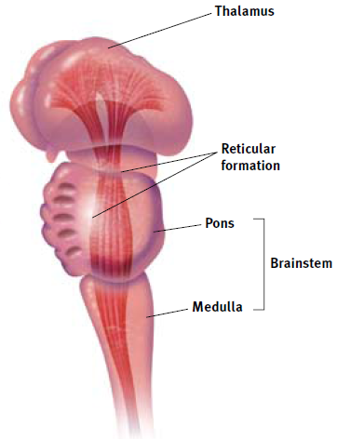
THE BRAINSTEM
Brainstem
crossover point
Medulla
control for heartbeat/breathing
Pons
coordinate movement
Reticular formation
netlike – acts as a filter
sensory arousal
Notes:
Brains are 1/45th of the body’s weight
Brain’s oldest and innermost region = brainstem (it begins where the spinal cord swells slightly after entering the skull)
The brainstem is the crossover point—where most nerves to and from each side of the brain connect with the body’s opposite side—(the right side of the brain controls the left side of the body and vice versa)

Slide 21
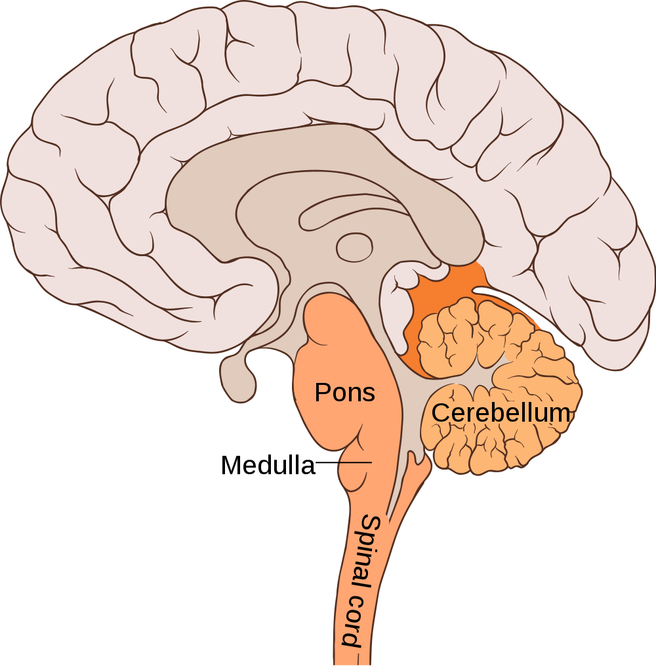
MEDULLA
The medulla is a part of the brainstem that controls survival functions. This includes breathing, blood pressure, heart rate, blinking, and vomiting.
Notes:
This slight swelling is the medulla (the control for your heartbeat and breathing)

Slide 22
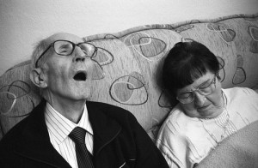
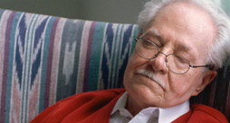
PONS
Pons:
The function of the pons is to put you to sleep by producing specific chemicals that help maintain the sleep/wake cycle. Aside from this main function, the pons also has a role in respiratory function.
Notes:
Just above the medulla sits the pons (helps to coordinate movements)
If a cat’s brainstem is severed from the rest of the brain above it, the animal will still breathe and live—and even run, climb and groom; but with the brainstem cut off from the brain’s higher regions, the cat won’t purposefully run or climb to get food

Slide 23
RETICULAR FORMATION
Reticular Formation:
The main function is to wake you up. This is made of neurons networking together through different parts of the brain to alert and “wake up” higher parts of the brain. A secondary function is that it helps decide what we should pay attention to.
Notes:
Inside the brainstem, between your ears, lies the reticular formation (netlike)—a finger-shaped network of neurons that extends from the spinal cord right up to the thalamus (involved in arousal with the sensory neurons)
May be responsible for our ability to attend to new stimuli in the environment
May play a role in dreaming
The activation synthesis theory of dreams proposes that dream signals originate in the brainstem, and perhaps more specifically the reticular formation. The cortex then takes those signals and reorganizes them into the dream story as best it can.
As the spinal cord’s sensory input travels up to the thalamus, some of it travels through the reticular formations, which filters incoming stimuli and relays important information to other areas of the brain

Slide 24
THE THALAMUS - MIDBRAIN
Thalamus
Receives sensory information from all the senses EXCEPT smell
Notes:
Sensory switchboard
Routes to the higher brain regions that deal with seeing, hearing, taste, and touch
**Typically the thalamus, cerebellum & limbic system are a part of the midbrain rather than the brainstem. They are mainly divided this way due to the functions they have. Brainstem sections control basic functions like heartbeat and breathing. Midbrain sections govern hormones, memory processing, and sensory input.
Thalamus
Top of the brainstem (joined pair of egg-shaped structures)
Acts as the brain’s sensory switchboard
Receives information from all the senses except smell and routes it to the higher brain regions that deal with seeing, hearing, tasting and touching
Smell travels to the olfactory cortex and then to the thalamus for processing. It seems that our brains adapted other senses after smell, causing them to be processed differently.
Receives some of the higher brain’s replies—then directs to the medulla and to the cerebellum

Slide 25
THALAMUS
Functions:
The mailman of the brain
Sends information to where it needs to go in the brain
Consciousness
Notes:
Brain’s oldest and innermost region = brainstem (it begins where the spinal cord swells slightly after entering the skull)
The brainstem is the crossover point—where most nerves to and from each side of the brain connect with the body’s opposite side—(the right side of the brain controls the left side of the body and vice versa)

Slide 26
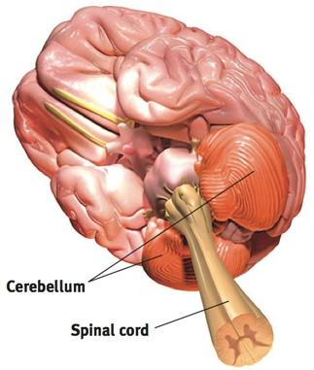
THE CEREBELLUM - MIDBRAIN
Cerebellum
“little brain”
Notes:
Enables one type of nonverbal learning and memory (skill memory)
Judge time, control our emotions, and discriminate sounds and textures
Coordinates voluntary movement (assistance from pons)
Extends from the rear of the brainstem (baseball sized)—“little brain”—two wrinkled halves
Enables one type of nonverbal learning and memory
Helps us judge time, control our emotions, and discriminate sounds and textures
Also coordinates voluntary movement (with assistance from the pons)
If you injured your cerebellum, you would have difficulty walking, keeping your balance, or shaking hands
Your movements would be jerky & exaggerated
**The older brain functions above occur almost without any conscious effort
Our brain processes most information outside of our own awareness.
We are aware of the results of our brain’s labor (current visual experience), but not of how we construct the visual image.
Whether we are asleep or awake, our brainstem manages its life-sustaining functions, freeing our newer brain regions to think, talk, dream and savor a memory

Slide 27
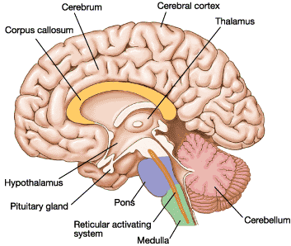
CEREBELLUM
The cerebellum is located at the butt of the brain stem and is responsible for controlling balance, coordination, and movement. Procedural memories are also stored here as a secondary function.

Slide 28
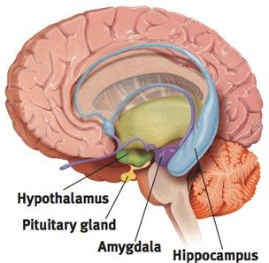
THE LIMBIC SYSTEM - MIDBRAIN
Limbic system
Notes:
At the border (limbus)
At the border (limbus) between the brain’s older parts & the cerebral hemispheres (two halves of the brain) is the limbic system

Slide 29
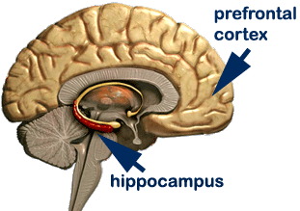
HIPPOCAMPUS
Hippocampus-
Located in the limbic system, it’s primary function is to convert short-term memory into long-term memory. A secondary function of the hippocampus is it helps navigate spatial reasoning.

Slide 30
THE LIMBIC SYSTEM THE AMYGDALA
Amygdala
Aggression, fear
Notes:
Amygdala and frontal lobes work together to regulate emotional responses---Amygdala supplies the emotional feeling while the frontal lobe makes the judgment regarding the appropriate expression of the emotion.
Amygdala (two lima bean sized clusters) influence aggression and fear, and the perception and processing of these emotions
If you cut of the brain that included the amygdala, animals that are usually on edge will be more mellow
The amygdala and the frontal lobes work together to regulate emotional responses. The amygdala supplies the emotional feelings while the frontal lobe makes the judgment regarding the appropriate expression of the emotion.

Slide 31
AMYGDALA
The amygdala is a small section of nervous tissue located in the temporal lobes. It is a structure of the limbic system involved in emotion and movements, especially for survival. The primary functions of the amygdala are fear, fight and flight. Stimulation of the amygdala will cause intense emotion. It also is involved with learning and reward-processing.

Slide 32
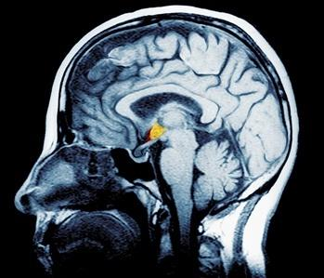
THE LIMBIC SYSTEM THE HYPOTHALAMUS
Hypothalamus
Influence on the pituitary gland
Reward centers
Reward deficiency
syndrome
Notes:
Type of scan? MRI
Reward center (Hunger, thirst, sex)
Hypothalamus (just below the thalamus)—some neural clusters regulate thirst, body temperature, sexual behavior and influence hunger—all behaviors that are regulated by hormones
Monitors blood chemistry and takes orders from other parts of the brain
Controls the function of the pituitary gland (“master gland”) which directs the hormonal system in its functioning
Ex: When you are hungry you think about food (in your brain’s cerebral cortex) can stimulate your hypothalamus to secrete saliva from your salivary glands in your exocrine system, these then trigger the “master gland”—pituitary gland to influence secretions by other glands.
Animals and humans have a general reward system that triggers the release of neurotransmitter dopamine and has specific centers associated with the pleasures of eating, drinking, and sex.
Our bodies come equipped with built-in systems that reward activities essential to survival.
If behaviors such as eating, drinking, and sex are pleasurable, they are more likely to be repeated, thus leading to survival
But in some addictive disorders (alcohol dependence, drug abuse and binge eating, may stem from a reward deficiency syndrome)—a genetically disposed deficiency in the natural brain systems for pleasure and well-being that leads people to crave whatever provides that missing pleasure or relieves negative feelings

Slide 33
HYPOTHALAMUS
The hypothalamus links the nervous system and endocrine system. It is part of the limbic system and is located directly above the thalamus. The hypothalamus is responsible for a person’s sex, hunger, and thirst drives. It also regulates body temperatures and releases hormones in the body.

Slide 34
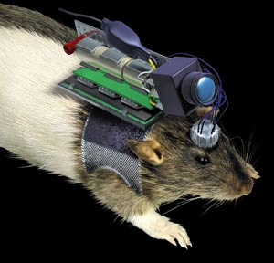
ROBO RAT
http://www.youtube.com/watch?v=G-jTkqHSWlg

Slide 35
THE CEREBRAL CORTEX
Notes:
What functions are served by the various cerebral cortex regions?

Slide 36
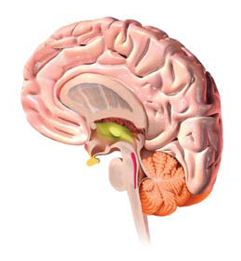
INTRODUCTION
Cerebrum
Cerebral cortex
Notes:
Cerebrum=2 large hemispheres(85% of brain weight)
Covering=cerebral cortex
20-23 billions nerve cells (neurons)
300 trillion synaptic connections
Newer neural networks within the cerebrum (the two large hemispheres that contribute to 85% of the brain’s weight) form specialized working teams that enable our perceiving, thinking and speaking
Covering those hemispheres is the cerebral cortex (a thin surface layer of interconnected neural cells)
It is your brain’s thinking crown (your body’s ultimate control and information processing center)—complex functions
Contains 20-23 billion nerve cells (neurons) and 300 trillion synaptic connections (between neurons)
Structure of the Cortex
Looks like a wrinkled organ—if it wasn’t wrinkled, it would be as big as a large pizza--**Demo using 2-11x17” pieces of paper taped together—show/tell the students “This sheet represents the approximate surface area of that thin sheet of neural tissue that we call the cerebral cortex. How can we fit it inside a skull small enough, along with the rest of the fetus, to be delivered through the mother’s birth canal”—Then crumble it up—it now fits in the skull

Slide 37
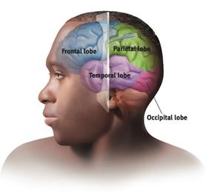
STRUCTURE OF THE CORTEX
Glial cells (“glue cells”)
Lobes
Frontal lobes
Parietal lobes
Occipital lobes
Temporal lobes
Notes:
Glial cells support, nourish and protect neurons, insulate myelin, guide neural connections, etc
Frontal: Involved in speaking and muscle movements, personality, emotions, making plans and judgments )motor cortex)
Parietal lobes (Sensory cortex and Gustatory Cortex)---sensation of taste
Occipital: Primary visual cortex
Temporal: Auditory cortex and Olfactory Cortex
Supporting the neurons are glial cells that support, nourish and protect neurons, insulate myelin, guide neural connections and mop up ions and neurotransmitters
The left and right hemispheres are filled mainly with axons connecting the cortex to the brain’s other regions
Each hemisphere is divided into four lobes (subdivisions separated by fissures (folds) called gyri (grooves in the brain) and sulci (humps in between the groves in the brain). There are two lobes of each (one in each hemisphere)

Slide 38
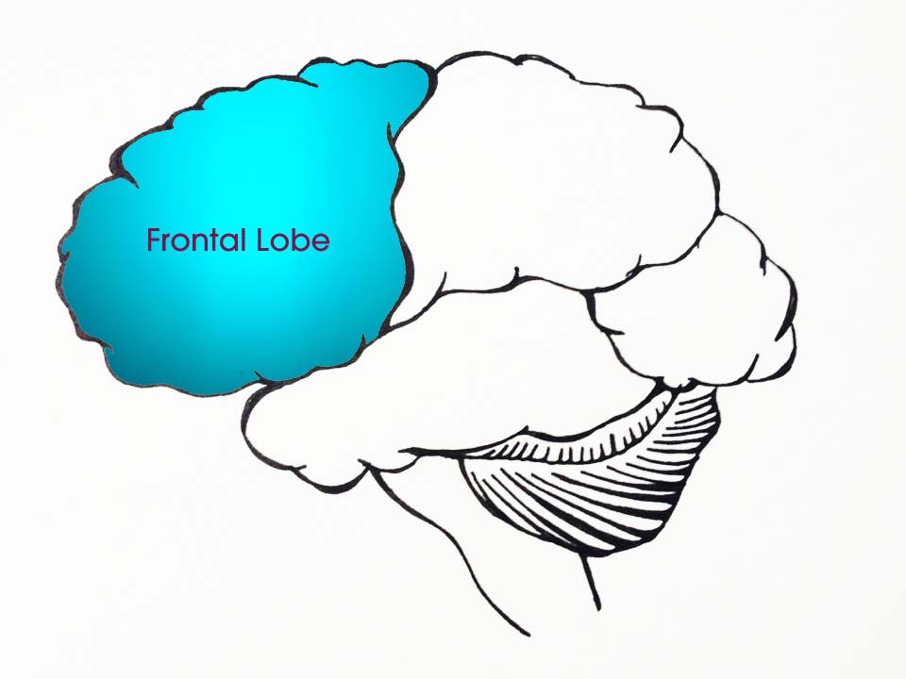
FRONTAL LOBES
Speaking, motor movements, personality, emotions, making plans & judgments
Frontal Lobe Cortical Sections:
Primary Motor Cortex
Broca’s Area
Broca’s Aphasia
Orbitofrontal Cortex
Olfactory Bulb
Notes:
The left and right hemispheres are filled mainly with axons connecting the cortex to the brain’s other regions
Each hemisphere is divided into four lobes (subdivisions separated by fissures (folds) called gyri (grooves in the brain) and sulci (humps in between the groves in the brain). There are two lobes of each (one in each hemisphere)
Frontal lobes (behind your forehead)
Involved in speaking and muscle movements, personality, emotions, making plans & judgments
Frontal lobe: Cortical regions:
Primary Motor Cortex (Precentral Gyrus) – Cortical site involved with controlling movements of the body.
Broca’s Area – Controls facial neurons, speech, and language comprehension. Located on Left Frontal Lobe.
Broca’s Aphasia (an impaired use of language) – Results in the ability to comprehend speech, but the decreased motor ability (or inability) to speak and form words.
* Possible Side Effects:
- Epilepsy
- Poor Emotional Responses
Perseveration (Uncontrolled, repetitive actions, gestures, or words)

Slide 39
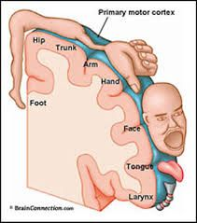
PRIMARY MOTOR CORTEX
Primary Motor Cortex - Located in the frontal lobe and a part of the Cerebral Cortex, the Primary Motor Cortex is critical for motor movements.
Specific areas of the cortex correspond with moving specific areas of the body.

Slide 40
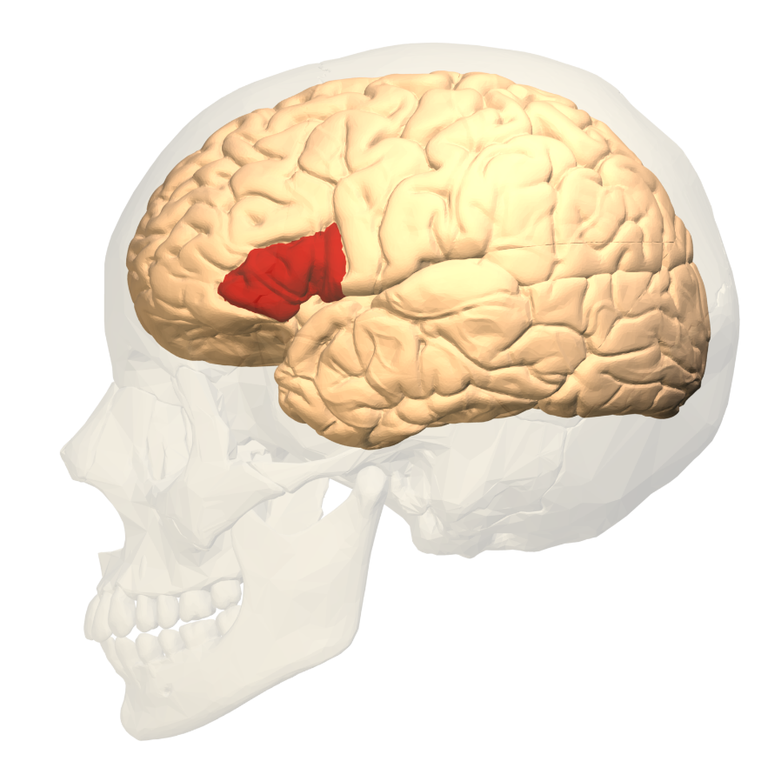
BROCA’S AREA
Broca’s area is located in the left frontal lobe of the left hemisphere of the brain and is connected to Wernicke’s area by a large bundle of fibers; involved in the control of speech, loss of speech or a speech disorder can result in Broca’s aphasia
Notes:
Broca’s Area – Controls facial neurons, speech, and language comprehension. Located on Left Frontal Lobe.
Broca’s Aphasia (an impaired use of language) – Results in the ability to comprehend speech, but the decreased motor ability (or inability) to speak and form words.

Slide 41
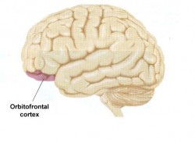
ORBITOFRONTAL CORTEX
Orbitofrontal Cortex
Site of Frontal Lobotomies
Desired Effects:
Diminished Rage
Decreased Aggression
Poor Emotional Responses

Slide 42
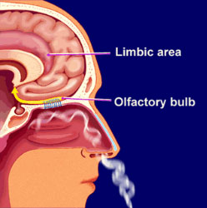
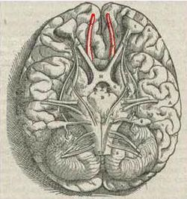
OLFACTORY BULB
Olfactory Bulb - responsible for sensation of smell

Slide 43
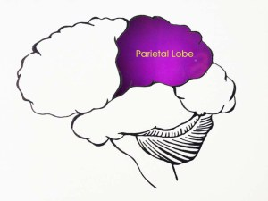
PARIETAL LOBES
Sensory input for touch and body position
Parietal Lobe Cortical Sections:
Sensory Cortex
Somatosensory Association Cortex
Primary Gustatory Cortex
Notes:
Parietal lobes (at the top and to the rear of your head)
Receives sensory input for touch and body position
Parietal lobe cortical sections:
Primary Sensory Cortex – Site involved with processing of tactile information (Did someone touch you?)
Somatosensory Association Cortex - Assists with the integration and interpretation of sensations relative to body position and orientation in space. May assist with visuo-motor coordination.
Primary Gustatory Cortex – Primary site involved with the interpretation of the sensation of taste.

Slide 44
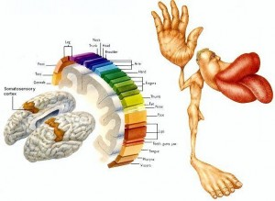
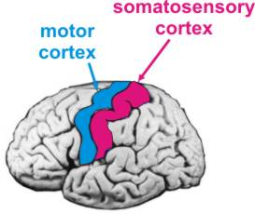
SENSORY CORTEX
Primary Sensory Cortex – processing of tactile information
Notes:
Primary Sensory Cortex – Site involved with processing of tactile information (Did someone touch you?)
This is how we would look if our body parts were proportionate to the amount of brain tissue devoted to them in the somatosensory cortex.

Slide 45
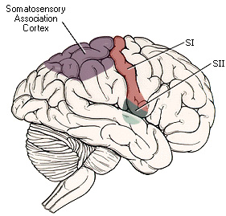
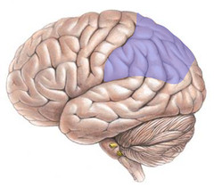
SOMATOSENSORY ASSOCIATION AREA
Somatosensory Association Cortex – integration and interpretation of sensations relative to body position and orientation in space
Draws upon stored memories of past sensory experiences
Notes:
Somatosensory Association Cortex - Assists with the integration and interpretation of sensations relative to body position and orientation in space. May assist with visuo-motor coordination.

Slide 46
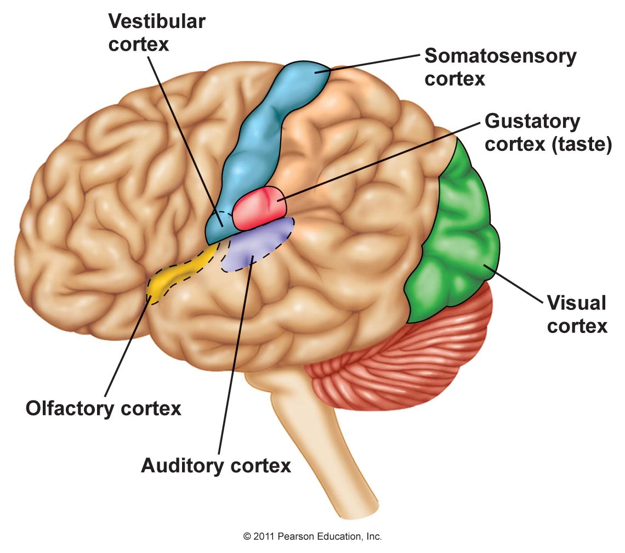
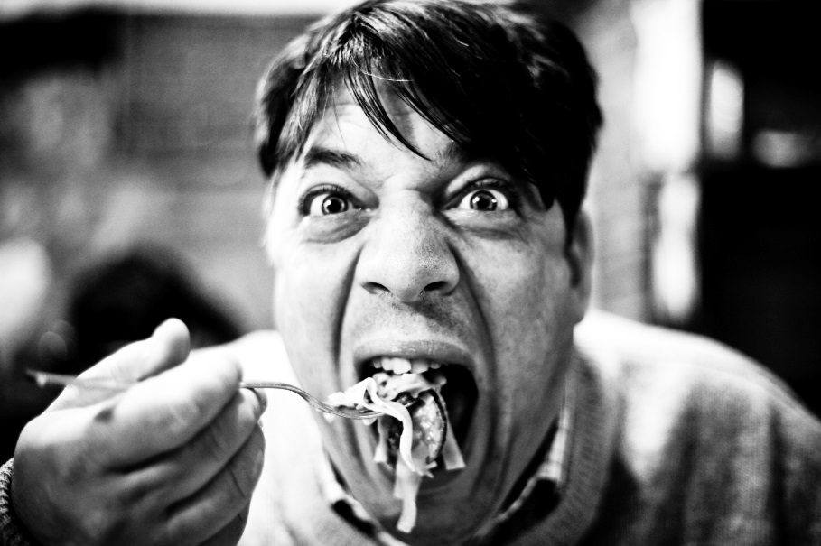
PRIMARY GUSTATORY CORTEX
Gustatory Cortex – primary site involved with the interpretation of the sensation of taste
Notes:
Primary Gustatory Cortex – Primary site involved with the interpretation of the sensation of taste.

Slide 47
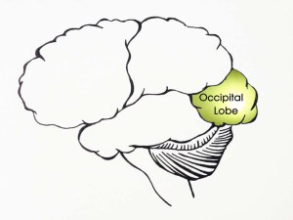
OCCIPITAL LOBES
Includes areas that receive information from the visual fields
Occipital Lobe Cortical Sections:
Primary Visual Cortex
Visual Association Areas
Notes:
Occipital lobes (at the back of your head)
Includes areas that receive information from the visual fields
Occipital lobe cortical sections:
Primary Visual Cortex – This is the primary area of the brain responsible for sight -recognition of size, color, light, motion, dimensions, etc.
Visual Association Area – Interprets information acquired through the primary visual cortex.

Slide 48
PRIMARY VISUAL CORTEX
Primary Visual Cortex – This is the primary area of the brain responsible for sight -recognition of size, color, light, motion, dimensions, etc.
ENCODES COLOR, ORIENTATION, AND MOTION.
DAMAGE COULD LEAD TO BLINDNESS/HALLUCINATIONS

Slide 49
VISUAL ASSOCIATION AREAS
Visual Association Area – Interprets information acquired through the primary visual cortex.
Notes:
Surrounds the primary visual cortex
Basically vision is the sensation of bars of light on our retinal cells (rods and cones). The primary visual cortex tells which cells are being stimulated and how

Slide 50
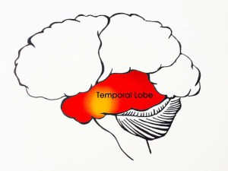
TEMPORAL LOBES
Includes auditory areas, each receiving information primarily from the opposite ear
Temporal Lobe Cortical Sections:
Primary Auditory Cortex
Primary Olfactory Cortex
Wernicke’s Area
Wernicke’s Aphasia
Notes:
Temporal lobes (just above your ear)
Includes auditory areas, each receiving information primarily from the opposite ear
Temporal lobe cortical sections:
Structure located in the Cerebral Cortex, in front of the occipital lobe and behind the temples that is responsible for auditory processing and understanding language. It also plays a strong role in allowing humans to recognize faces.

Slide 51
PRIMARY AUDITORY CORTEX
Notes:
Primary Auditory Cortex – Responsible for hearing

Slide 52
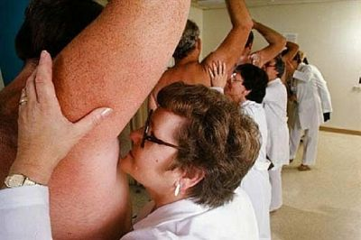
PRIMARY OLFACTORY CORTEX
Notes:
Primary Olfactory Cortex – Interprets the sense of smell once it reaches the cortex via the olfactory bulbs. (Not visible on the superficial cortex)

Slide 53
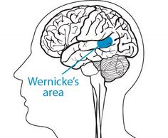
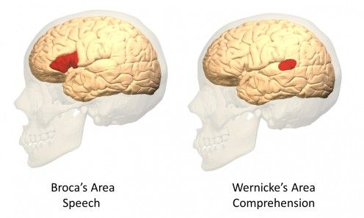
WERNICKE’S AREA
Wernicke’s Area – Processing and understanding speech. Damage leads to difficulty understanding language.
Notes:
Wernicke’s Area – Language comprehension. Located on the Left Temporal Lobe.
1874: German investigator Carl Wernicke discovered that after damage to a specific area of the left temporal lobe (Wernicke’s area) people could speak only meaningless words
Wernicke’s area: interprets auditory code/controls language reception/expression
- Wernicke’s Aphasia – Language comprehension is inhibited. Words and sentences are not clearly understood, and sentence formation may be inhibited or non-sensical.

Slide 54
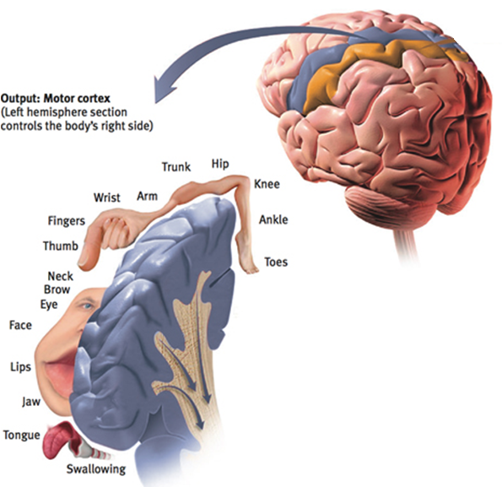
FUNCTIONS OF THE CORTEX MOTOR FUNCTIONS
Motor cortex
Mapping the
motor cortex
Neural
prosthetics
Notes:
Brain has no sensory receptors
Body parts needing precise control (more cortical space)---fingers and mouth
---Artificial body part replacements
Motor Functions
Primary Motor cortex: stimulating parts of frontal lobe in the left or right hemisphere caused movements of specific body parts on the OPPOSITE side of the body
The frontal lobe’s decision making function works with the motor cortex to create purposeful movement (OUTPUT)
Physicians have discovered the body areas requiring precise control (fingers & mouth) occupied the greatest amount of cortical space
This has paved the way for prosthetics (artificial body replacements) and neural prosthetics (researchers implant electrodes in speech areas of paralyzed humans and observe how the cells fire in different ways. Then take this information and connect it to a speech synthesizer---this is similar to what humans do for motor control)

Slide 55
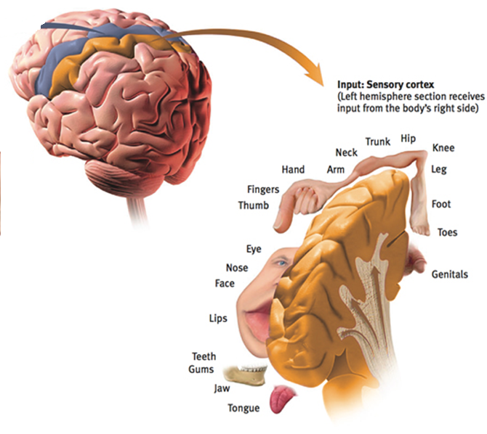
FUNCTIONS OF THE CORTEX SENSORY FUNCTIONS
Sensory cortex
Notes:
Front of the parietal lobe
-The more sensitive an area, the larger the sensory cortex are devoted to it. (Lips are more sensitive than our nose)

Slide 56
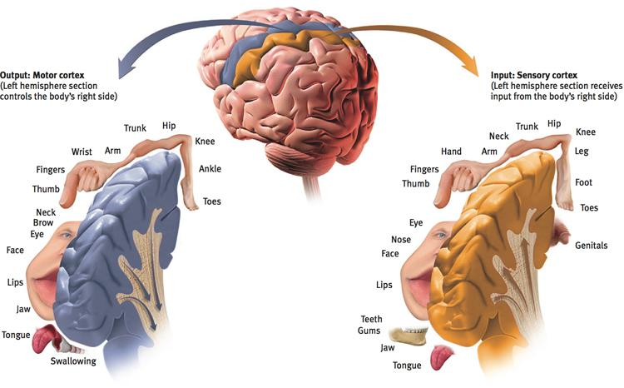
FUNCTIONS OF THE CORTEX
Notes:
Info from the eyes: visual cortex in the occipital lobe
Info from the ears: Auditory cortex in the temporal lobe
Somatosensory cortex: area at the front of the parietal lobes, parallel to and just behind the motor cortex.
Touch: This area specializes in receiving information (INPUT) from the skin senses and sensory signals and from the movement of body parts for accurate perception
The more sensitive the body region, the larger the sensory cortex area devoted to it
Ex: Our lips are more sensitive than our toes—which is why we kiss with our lips rather than our toes
You receive information from your eyes in the visual cortex in your occipital lobes
You receive information from your ears in the auditory cortex in your temporal lobe
Most of the auditory information travels in a twisting route from one ear to the auditory receiving area of your opposite ear

Slide 57
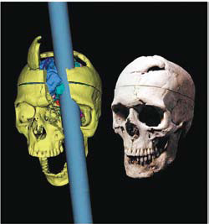
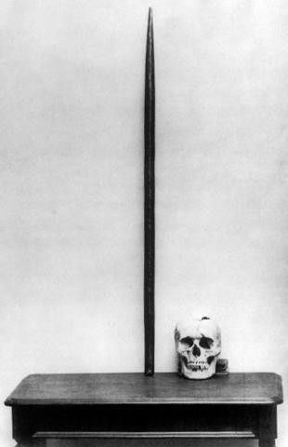
FUNCTIONS OF THE CORTEX ASSOCIATION AREAS
Association areas
Frontal lobes
Phineas Gage
Parietal lobes
Mathematical and
spatial reasoning
Temporal lobes
Recognize faces
Notes:
Association areas: link sensory inputs with stored memories (3/4 of human brain)—not sensory or muscular activity
---Found in all 4 lobes: Frontal-judgment, planning, and processing new memories
---Damage===not able to plan ahead////Alter personality=remove a persons inhibitions
Parietal: Mathematical and spatial reasoning
Temporal: faces
¾ of the human brain is uncommitted to sensory or muscular activity (association areas)
Neurons in these areas interpret, integrate and act or link information from sensory inputs with stored memories
Association areas are found in all four lobes
Frontal lobe damage can prevent a person from planning a meeting or a party and can alter personality
In the parietal lobes, they enable math & spatial reasoning. An area on the underside of the right temporal lobe enables us to recognize faces.
If a stroke or head injury destroyed this area of the brain, you would still be able to describe facial features and to recognize someone’s gender and approximate age, yet be unable to identify the person as your grandmother for example

Slide 58
CASE STUDIES: Phineas Gage
Notes:
EX: Phineas Gage
1848 Railroad worker, 25 years old, was packing gun powder into a rock with a tamping iron. A spark ignited the gunpowder, shooting the rod up through his left cheek and out the top of his skull, leaving his frontal lobes massively damaged
After this he immediately was able to sit up and speak
After the wound healed, he was able to return to work
Although his mental abilities and memories were intact, his personality changed—he was irritable, profane and dishonest—he eventually lost his job
**His moral compass had disconnected from his behavior

Slide 59
PHINEAS GAGE
Notes:
Q: It is suggested that Gage’s injury inspired the development of what at one time was a widely used medical procedure. What might this procedure be, and how does it relate to Gage’s injury?
A: The frontal lobotomy. This has been used with the intention to diminish aggression and rage in mental patients, but generally results in drastic personality changes, and an inability to relate socially. This procedure is largely frowned upon today, with the development of neurological drugs as treatments.

Slide 60
LANGUAGE
Aphasia
Broca’s area
Wernicke’s area
Notes:
Aphasia: an impaired use of language (usually to left hemisphere)
Broca’s area: (impairing speaking)
Wernickes area: (impairing understanding)
Language
What brain areas are involved in language processing?
Aphasia: an impaired use of language—can result from damage to any one of several cortical areas. Usually caused by left hemisphere damage either to Broca’s area (impairing speaking) or to Wernicke’s area (impairing understanding)
Ex: Some with aphasia can speak but can’t read; some can understand what they are reading, but can’t speak

Slide 61
LABEL AND PUT IN ORDER 1-5
Notes:
Step by Step
How do we use language? Clues…

Slide 62
LANGUAGE
Notes:
1. Register in the visual area (Visual cortex)---Seeing words
In other words, when you read aloud, the words…
Register in the visual area (seeing words)…

Slide 63
LANGUAGE
Damage to the angular gyrus leaves a person able to speak and understand, but unable to read aloud
Notes:
Involved with reading aloud---recodes visual info into auditory form---Wernickes area uses to derive its meaning
Damage to this area: Leaves a person able to speak and understand, but unable to read aloud.
Are relayed to a second brain area (angular gyrus) which transforms the word into an auditory code…
The angular gyrus is involved with reading aloud. It receives visual information from the visual area and recodes it into an auditory form—which Wernicke’s areas uses to derive its meaning.
Angular gyrus: Transforms visual representations into an auditory code
Damage to the angular gyrus leaves a person able to speak and understand, but unable to read aloud.

Slide 64
LANGUAGE
Damage to the Wernicke’s area disrupts understanding
Notes:
Controls language reception/comprehension/expression
Damage to this area disrupts understanding
This is received and understood in the nearby Wernicke’s area (hearing words) and…
Wernicke’s area: interprets auditory code/controls language reception/comprehension/expression
Damage to Wernicke’s areas disrupts understanding

Slide 65
LANGUAGE
Damage to Broca’s area disrupts speaking
Notes:
Controls speech muscles via motor cortex/language expression via motor cortex in the left frontal lobe (where the word is pronounced)
Damage to this area: Disrupts speaking
Is sent to Broca’s area (speaking words) which…
Broca’s area: controls speech muscles/language expression via the motor cortex in the left frontal lobe (where the word is pronounced)
Damage to Broca’s area disrupts speaking

Slide 66
LANGUAGE
Notes:
Apahasia occurs when one link in the chain is damaged
Controls the motor cortex as it creates the pronounced word.
**Nerve fibers interconnect these three brain areas
**In processing language, the brain operates by dividing its mental functions—speaking, perceiving, thinking, remembering—into subfunctions and subtasks—separating color, depth, movement and form
Each specialized neural network then feeds its information to higher-level networks that combine the atoms of experience and relay them to progressively higher level association areas
Using specialization and integration—involves the coordination of many brain areas to act as a whole to function

Slide 67
THE BRAIN’S PLASTICITY
Brain damage
Plasticity
Ability to modify itself after some type of damage
Neurogenesis
Formation of new neurons – form connections with neighboring neurons
https://www.youtube.com/watch?v=mGgtRG2da1c
Notes:
Plasticity: Ability to modify itself after some type of damage
Blindness or Deafness
Neurogenesis: formation of new neurons
Brain Plasticity
**To what extent can a damaged brain reorganize itself?
Plasticity: Its ability to modify itself after some type of damage
The brain’s neural tissue can reorganize in response to damage
Our brains are mostly plastic when we are young children—very resilient, figuring out ways to compensate for injury…the younger one is when the injury occurs, the more functioning can be regained
In a 6 year old child, an entire hemisphere can be removed (to eliminate seizures). The existing hemisphere will compensate by putting other areas to work
Blindness or deafness makes unused brain areas available for other uses
If a blind person uses one finger to read Braille, the brain area dedicated to that finger expands as the sense of touch invades the visual cortex that normally helps people see
If a slow-growing left hemisphere tumor disrupts language, the right hemisphere may compensate
Adult mice & humans can generate new brain cells → neurogenesis (by forming thousands of new neurons each day)
These baby neurons originate deep in the brain and may then migrate elsewhere and form connections with neighboring neurons
EX: Christopher Reeve devoted his later life to spinal cord research in an effort to find effective treatments for spinal cord injuries. Through intensive physical therapy, Reeve was able to regain some functioning in his lungs and his finger. His work showed that there is some hope for those with spinal cord damage to regain functioning, either through plasticity or neurogenesis

Slide 68
OUR DIVIDED BRAIN
Notes:
What do split brains reveal about the functions of our two brain hemispheres?

Slide 69
SPLITTING THE BRAIN
Corpus-callosum
Thick band of neural axon fibers which connect the left and right hemispheres
Sits under the cortex
The corpus callosum allows for the left and right hemispheres to communicate and send messages to each other
Notes:
The brain is divided into two sections (left & right hemispheres)
Accidents, strokes, and tumors in the left hemisphere can impair reading, writing, speaking, arithmetic reasoning, and understanding
1960s—psychologists termed the left hemisphere the “dominant” or “major” hemisphere and the right hemisphere the “minor” or “subordinate”
Similar lesions in the right hemisphere have effect that are less visibly drastic
The corpus callosum is a large band of neural axon fibers which connect the left and right hemisphere

Slide 70
SPLIT BRAIN SURGERY
Split brain
Myers and Gazzaniga
Notes:
Patients with split brains (resulting from a surgery that isolates the brain’s two hemispheres by cutting the fibers (mainly those of the corpus callosum) connecting them
Used to treat severe epilepsy
Disables communication between left and right hemispheres
Information from the left half of your field of vision goes to your right hemisphere, and information from your right half of your visual field goes to your left hemisphere (which usually controls speech). In a person with a severed (split) corpus callosum, this information sharing does not happen.
**Visual information directed to each side of the brain comes from visual fields, not from each eye. However, each eye receives sensory information from both the right and left visual fields. Data received by either hemisphere are quickly transmitted to the other across the corpus callosum.

Slide 82
Notes:
Split brain patient is asked to look at the word heart on two different pages, she reports seeing the portion of the word transmitted to her left hemisphere (ART).

Slide 83
Notes:
However, if asked to indicate with her left hand what she saw, she points (identifies) to the portion of the word transmitted to her right hemisphere (HE).
As time passes, “two separate minds” begin to figure out how to work together after split brain surgery—most often done with patients suffering from severe epilepsy
**Split brain patients do not experience problems in everyday life because the optic chiasm is not severed in the surgery. The optic chiasm is the place where the nerves connecting the eyes and the brain cross—leading to cross-hemispheric processing.
Left hemisphere: more active when a person deliberates over decisions, rationalizes
Right hemisphere: understands simple requests, easily perceives objects, and is more engaged when quick, intuitive responses are needed
The right is better than the left of copying drawings and recognizing faces, skilled at perceiving emotion and at portraying emotions through the more expressive left side of the face
Right hemisphere damage greatly disrupts emotion processing and social conduct

Slide 84
LEFT-RIGHT DIFFERENCES IN THE INTACT BRAIN

Slide 85
LEFT-RIGHT BRAIN DIFFERENCES
Hemispheric specialization
Perceptual tasks
Language (left or right?)
Sense of self (left or right?)
Inferences (left or right?)
Notes:
Left hemisphere
Person speaks or calculates, activity increases
Basic language processing (whether it is spoken or sign language)
Quick, literal interpretations of language
Right hemisphere
Brain waves, blood flow and glucose consumption, activity increases
Visual/spatial superiority
Excels in making inferences (what word goes with boot, summer and ground)—camp
Complex understandings and interpretations of language
Modifies our speech to make meaning of sentences or questions clear
Helps to orchestrate our sense of self

Slide 86
LEFT-RIGHT BRAIN DIFFERENCES

Slide 87
FUN FACTS ABOUT HANDEDNESS
Brain Organization and Handedness
How does handedness relate to brain organization?
90% of us are right-handed
96% process speech primarily in their left hemisphere
10% of us are left-handed—more males than females typically
More common among musicians, mathematicians, professional baseball and cricket players, architects and artists
Righthandness prevails in all human cultures
Genes or some prenatal factors influence handedness

Slide 88
THE BRAIN AND CONSCIOUSNESS

Slide 89
CONSCIOUSNESS
Consciousness
Notes:
Consciousness is the tip of the information-processing iceberg. Beneath the surface, unconscious information processing occurs simultaneously on many parallel tracks
Consciousness sometimes arrives late to the decision making party (brain acts ahead of the mind)
Consciousness-Our awareness of ourselves and our environment
Evolutionary psychologists speculate that consciousness helps us act in our long-term interests (by considering consequences) rather than merely seeking short-term pleasure and avoiding pain.
Cognitive neuroscience (the interdisciplinary study of brain activity linked with our mental processes)—the first step by relating specific brain states to conscious experiences
Researchers have concluded that even in a motionless body, the brain and the mind may still be active
Cognitive neuroscientists are exploring and mapping the conscious functions of the cortex (read your mind)

Slide 90
DUAL PROCESSING
Dual processing
Conscious left brain
Intuitive right brain
Notes:
Serial conscious processing through slower than parallel processing, is skilled at solving new problems, which require our focused attention.
What is the “dual processing” being revealed by today’s cognitive neuroscience?
Consciousness-Our awareness of ourselves and our environment
Evolutionary psychologists speculate that consciousness helps us act in our long-term interests (by considering consequences) rather than merely seeking short-term pleasure and avoiding pain.
Cognitive neuroscience (the interdisciplinary study of brain activity linked with our mental processes)—the first step by relating specific brain states to conscious experiences
Researchers have concluded that even in a motionless body, the brain and the mind may still be active
Cognitive neuroscientists are exploring and mapping the conscious functions of the cortex (read your mind)
**Brains related to computers??
Computers cannot process more than one piece of information at a time. Computers run on serial processing, in which one task is accomplished before another one is tackled.
Brains run on parallel processing, in which several tasks can be tackled at once. This ability of the brain to process multiple pieces of information at once makes it superior to computers, no matter how fast computers may be. Dual processing
Perception, memory, thinking, language, and attitudes all operate on two levels—a conscious, deliberate “high road” and an unconscious, automatic “low road”.
We process memory both consciously (explicitly) and unconsciously (implicitly). These two ways of remembering information are stored in different parts of the brain.
The Two-Track Mind
The eye sends information simultaneously to different brain areas, which have different tasks
Dual processing system:
A visual perception track—enables us “to create the mental furniture that allows us to think about the world”—to recognize things and to plan future actions
A visual action track—guides our moment-to-moment actions
**On rare occasions, the two conflict—the hollow face illusion (mistakenly perceive the inside of a mask as a protruding face)—seeing one thing, but processing another

Slide 91
HOLLOW FACE ILLUSION
https://www.youtube.com/watch?v=ORoTCBrCKIQ
**On rare occasions, the two conflict—the hollow face illusion (mistakenly perceive the inside of a mask as a protruding face)—seeing one thing, but processing another
**Brain Games – Seeing is Believing – Hollow Face**

