Slide 1
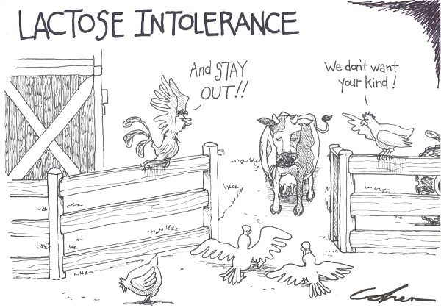
The Lac Operon An inducible operon

Slide 2
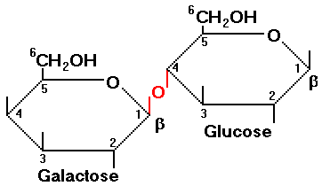
The Lac Operon
Keep in mind → most prokaryotes will prefer glucose as an energy source
When it is not present prokaryotes will look to other sources

Slide 3
Lac Structural Genes
Genes that code for enzymes that aid in digestion of lactose!
How are these different than Trp operon?

Slide 4
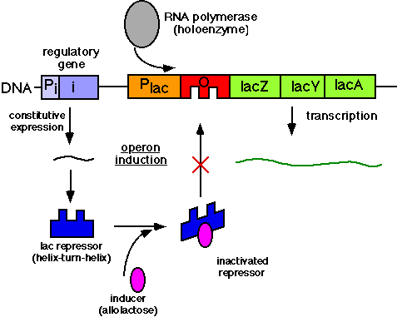

Slide 5
Lac operon
Repressor gene codes for an active repressor
Remember active repressor binds to operator → no transcription
Lactose can bind to this repressor and DEACTIVATE IT
Lactose bound to repressor means transcription can be promoted!

Slide 6
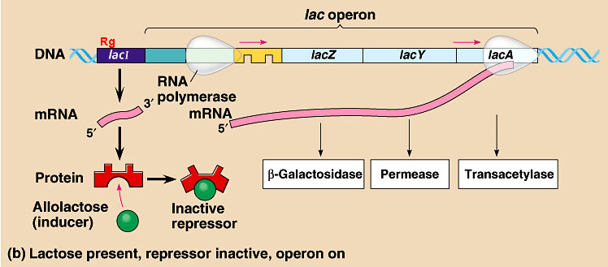

Slide 7
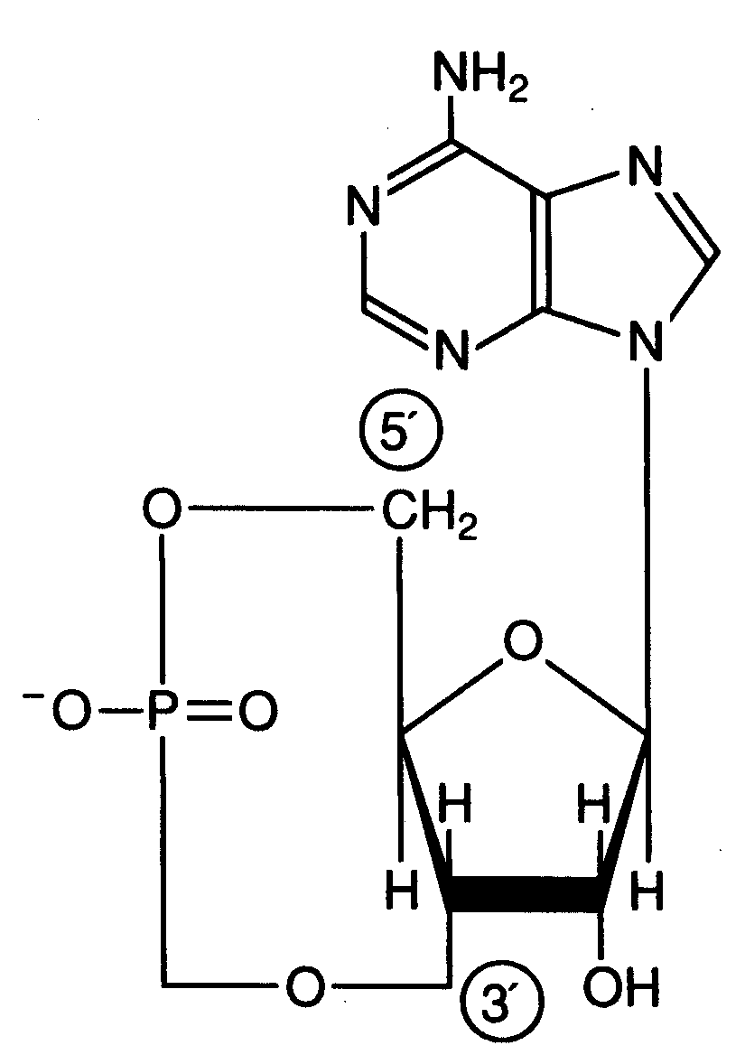
Meet cAMP
What is ATP broken down into?
Having an AMP around likely means what?
No Gluclose means less ATP

Slide 8
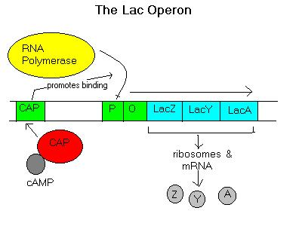
cAMP le gusta CAP
CAP = catabolite activator protein
cAMP binds with CAP
This complex attaches to CAP binding site next to lac promoter
Bends DNA so promoter easier for RNA polymerase to find

Slide 9
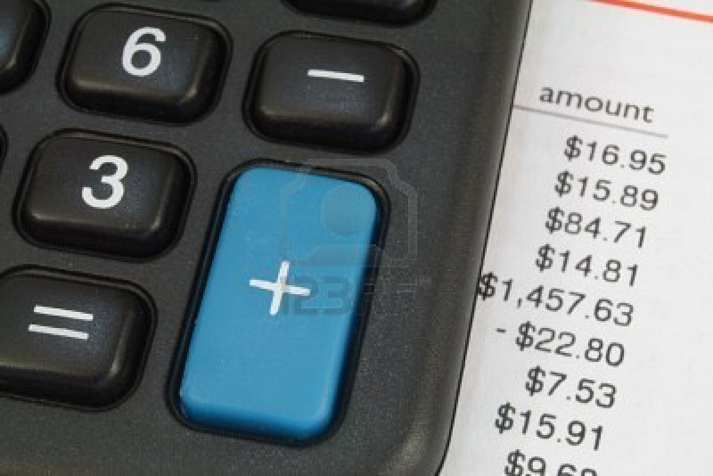
Lets sum it up
What does cAMP tell the cell?
What does an inactive repressor tell the cell

Slide 10
The rest of class
Discuss this stuff…
In writing Personify these two operons!
Share with your classmates

