Slide 1
THE US CONSTITUTION the Supreme law of the Land

Slide 2
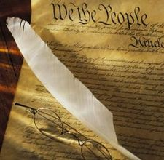
POPULAR SOVREIGNTY
Government authority is derived from the people
Government governs with the consent of the governed

Slide 3
FEDERALISM
US federalism is the division of governing authority between Federal and State governments

Slide 4
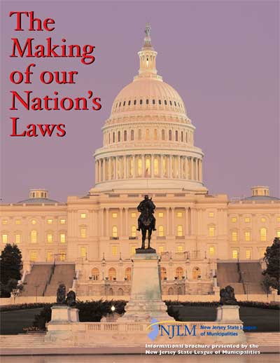
ARTICLE I
House of Representatives
Representation based on states population
Elected every 2 Years
25 yrs. old, citizen for 7 yrs., must live in state

Slide 5
ARTICLE I con’t
Senate (2 per state)
Representation is equal
Elected every 6 years
30 yrs. old, citizen for 9 yrs., must live in state

Slide 6
ARTICLE II
The President - Enforce Laws
Natural Born Citizen, 35 yrs. old, 14 year resident of USA
Two, 4 year terms, not to exceed 10 years (22th amendment)

Slide 7
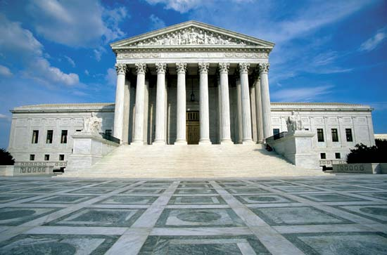
ARTICLE III
Federal District Court Downtown Cleveland
Supreme Court, Court of Appeals, Federal District Court- Interpret Laws
Serve for life
Appointed by the President
Supreme Court Holds the position of “Highest Court in the Land”
6th Circuit Court of Appeals Cincinnati, Ohio
U.S. Supreme Court Building Washington D.C.

Slide 8
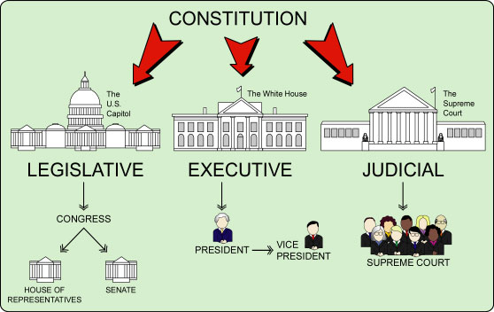
SEPARATION OF POWERS
Distribution of governmental powers among independent branches
- Each branch has specific authority and a unique set of responsibilities within the operation of the government

Slide 9
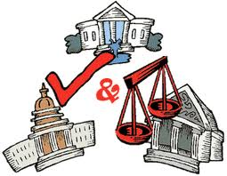
CHECKS AND BALANCES
Branches of government possess the ability to restrain certain actions of other branches

Slide 10
Congress approves all presidential nominations, controls the budget, can override a veto, and can remove a president from office
Executive
President, Vice Pres. , and Cabinet
(Enforce Laws)
Legislative
House and Senate
(Make Laws)
President can veto legislation
President Nominates Judges
Courts can declare laws unconstitutional
Courts can declare presidents acts unconstitutional
Senate confirms Justice nominations, Congress can impeach judges
Judicial
Supreme Court
Court of Appeals;
District Courts
(Interpret Laws)

Slide 11
FEDERALISTS
The Federalists supported the Constitution as it was. After all, it was decided upon by representatives from each state
The Constitution had a strong sense of CHECKS AND BALANCES
James Madison, Alexander Hamilton, John Jay
wrote the “Federalist Papers” to encourage states to approve the Constitution

Slide 12
ANTI-FEDERALISTS
Thought the Constitution gave the government too much power
Argued that states should have more power because they were closer to the people…what could a national government possibly know about state and city problems?
No Bill of Rights – nothing that said what people can and cannot do
Argued that it would create a government with so much power, it would just be like having a king again.
George Mason, James Monroe, Patrick Henry

Slide 13
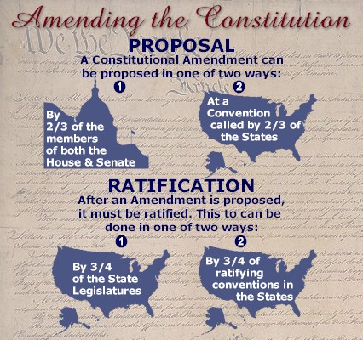
ARTICLE V

