Slide 1

1772766PU

Slide 2

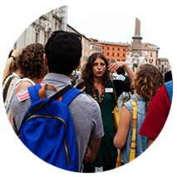


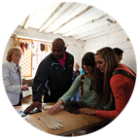

OUR MEETING WILL COVER:
Why travel is important
Where we’re going
Our travel partner
The safety approach
What’s included and
what’s not
How to reserve your spot

Slide 3
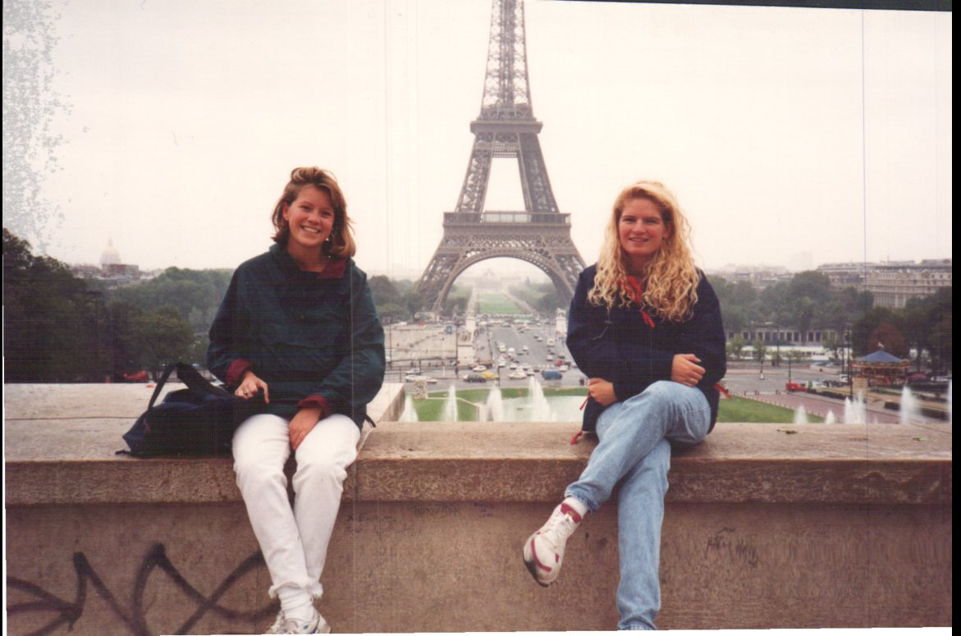
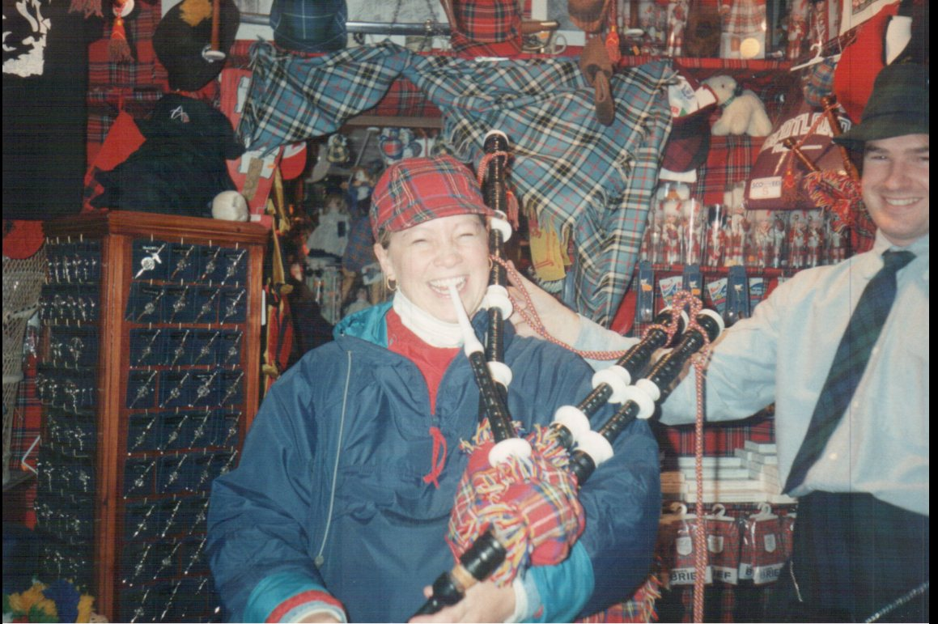
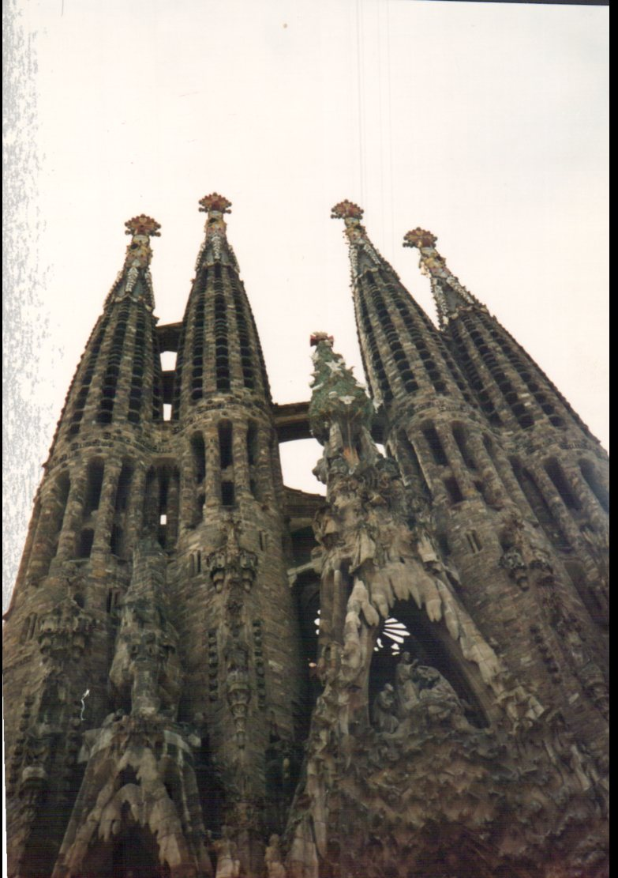

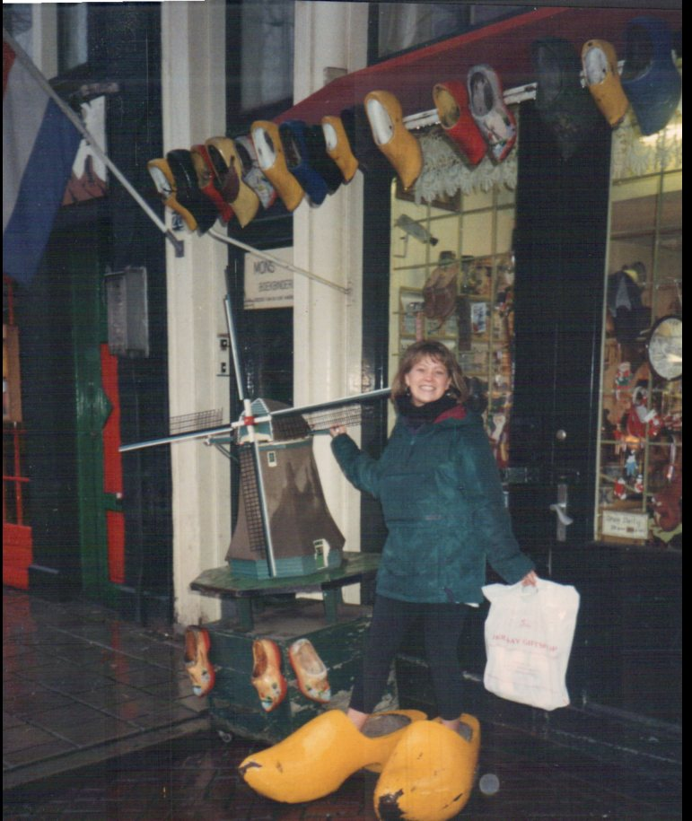
Why do I travel? I am passionate about seeing the world.
During my junior year of college I studied abroad in England. During those five months I also traveled to Spain, France, Holland, Ireland, & Scotland.

Slide 4


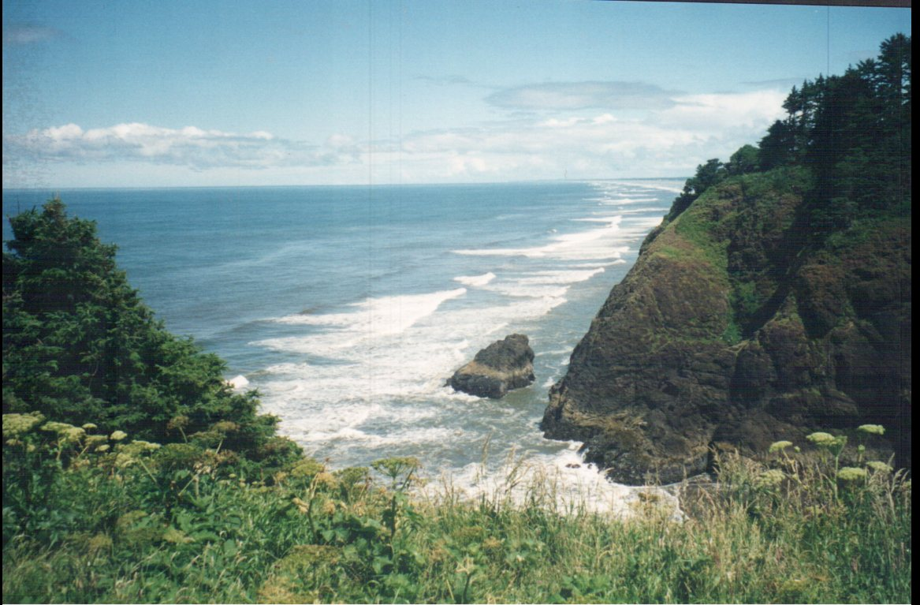
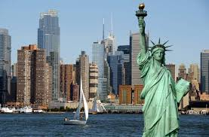
Why do I travel? To be a life-long learner
After graduating from Wittenberg, I moved to Anchorage, Alaska, Portland, Oregon and New York City, New York.

Slide 5
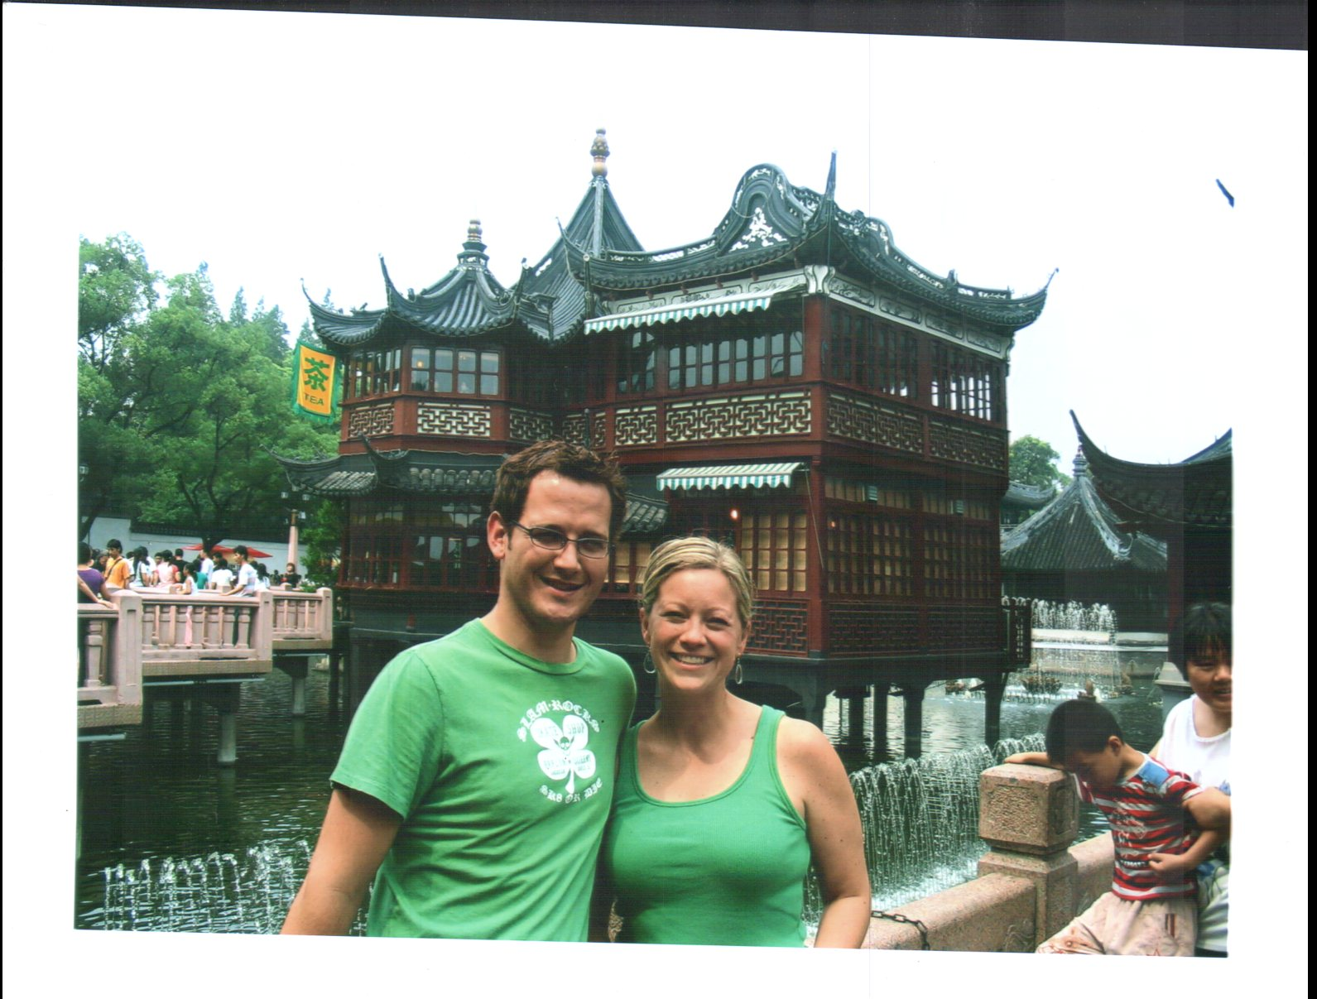



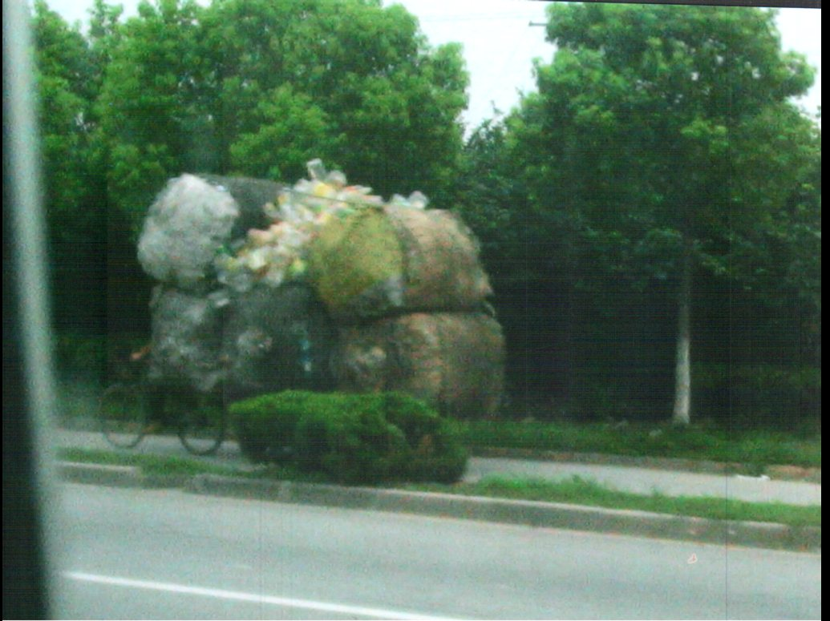
Why do I travel?
To be more compassionate and connected to others in this world.
After traveling to Mexico and China my heart has grown!

Slide 6
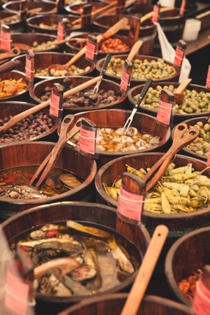


WHY TRAVEL?
Why this tour is great for our group
Helping students become global citizens
http://www.eftours.com/videos/global-classroom
My tour was an absolutely life-changing experience and inspired me to continue to travel the world.”
— Alivia L., Student
“

Slide 7
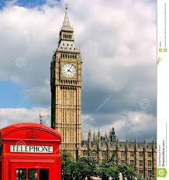

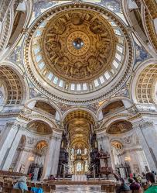
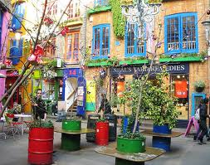
TOUR HIGHLIGHTS
hand out the day-by-days before this slide so everyone can follow along as you review the itinerary!
London: London Bridge, St. Paul’s Cathedral, Piccadilly Circus, Hyde Park, Changing of the Guard at Buckingham Palace, Big Ben, Trafalgar Square, Leicester Square and Covent Garden.

Slide 8
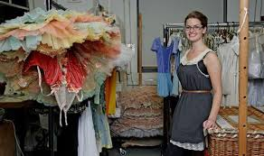
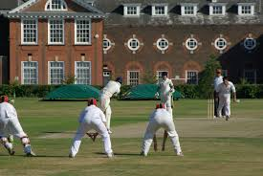
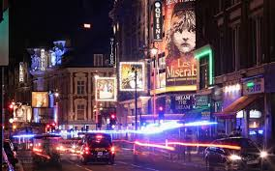

Tour Highlights in London

Slide 9
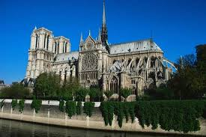
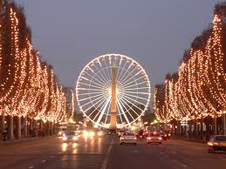
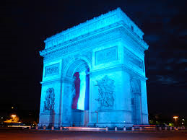

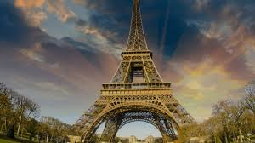
Paris

Slide 10





Tour Highlights in Paris

Slide 11
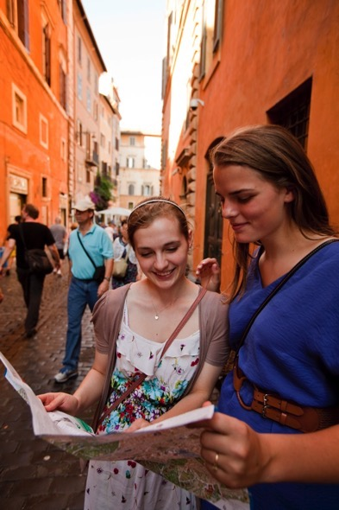
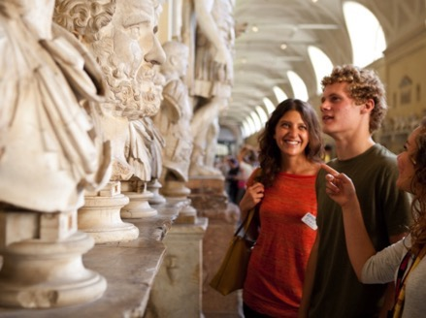
A MORE ENGAGING
LEARNING EXPERIENCE
Bring classroom subjects, people and
places to vivid life.
Help students become global citizens.
Develop new perspectives that will give students an edge on their college applications (and in the college lecture hall).
Spark a lifelong ability to take on any new experience with confidence.
Insert Video
“This was truly the trip of a lifetime, and I will forever be grateful to my parents who made
it possible.”
— Jessica S., Student

Slide 12
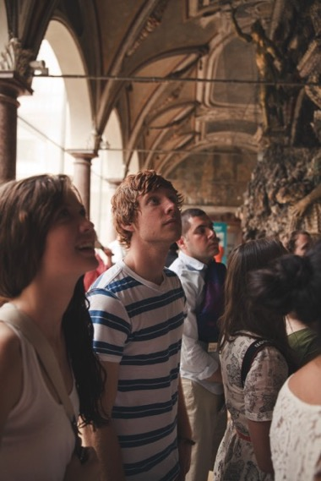
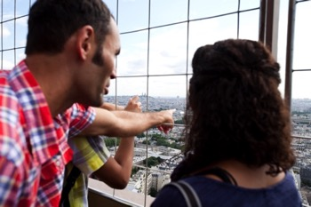
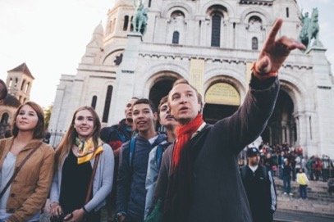
WHY EF?
50 years of experience
Global and local presence
  Over 500 schools and offices in over 53 countries, including San Jose
Educational value
  Accredited, just like our school
  Earn high school and college credit
Incredible travel experiences at the guaranteed lowest price
“My department has
been traveling with EF for over 20 years!”
— Heather V., Group Leader

Slide 13
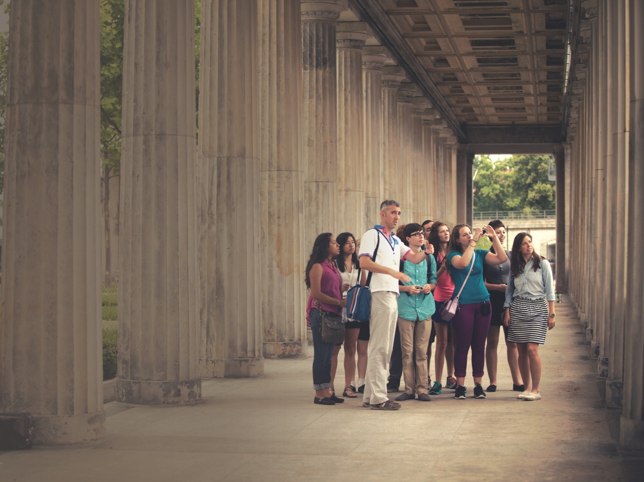
EF’S COMMITMENT TO
OUR SAFETY
24/7 Tour Director
Chaperones
24-Hour emergency on-call service
Peace of Mind policy
My approach to safety

Slide 14

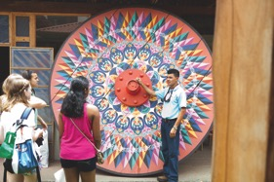
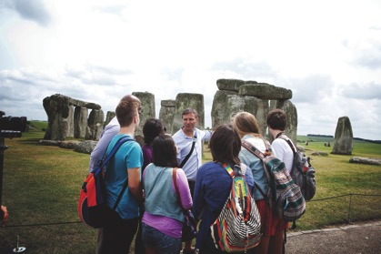
WHY GROUP TRAVEL?
Group travel keeps tours affordable, allowing more students to see the world
“Couldn't have asked for a better senior trip! Our tour guide, Andrés, was very kind and worked so hard to make everything perfect.”
— Lynsey M., Student
Combined groups get the best value.
Tour choice and departure date flexibility to match with other groups.
Meet other students from around the country.
Our departure date window is:
07/07/2016 – 07/15/2016

Slide 15

THE GLOBAL
TRAVEL PROTECTION
PLAN COVERS:
Tour cancellation and interruption
Illness and accident
Baggage and property
Flight delay
24-hour access to an English-
speaking representative

Slide 16
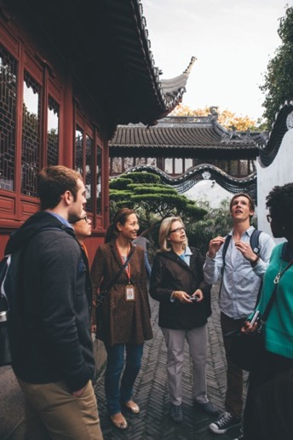


WESHARE
ENHANCES EVERY TOUR
weShare is EF’s online platform that takes every tour to a deeper, more engaging level
Before tour students research destination-related topics that they feel passionate about.
On tour students continue to explore these topics and engage in more in-depth learning.
After tour students reflect through a creative project. This project is eligible for high school or college credit—and is a great asset for college applications.
“My daughter toured France and Italy. It sparked a worldview beyond the classroom. The journey is just beginning!”
—Carol B., Parent

Slide 17


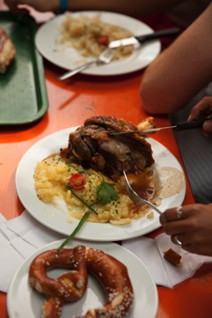
WHAT ARE YOU
RESPONSIBLE FOR?
These are all necessities each traveler will be responsible for.
Spending Money
For additional tour experiences, free time activities, souvenirs, beverages and snacks ($30–$65 per day)
Tips
For your Tour Director, bus driver and local guides (around $10 per day)
Passport and/or visa fees
“

Slide 18
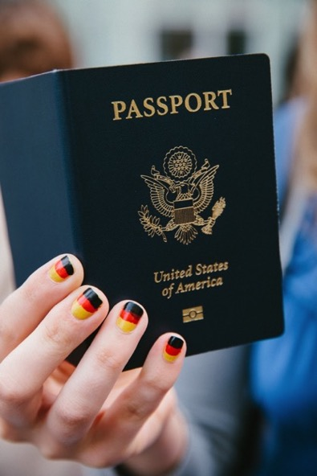

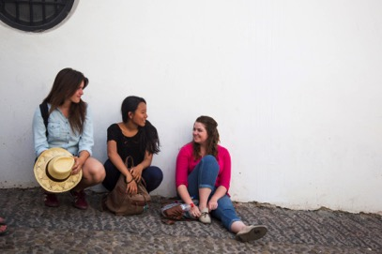
PASSPORTS AND VISAS
All travelers are responsible for securing necessary documentation
Passports
Valid passports are required for all travelers. Passports may take up to 14 weeks to process.
Important Note: Passports must be valid for at least six months after our return date.
Visas
Non-U.S. citizens may require special visas or other travel documents.

Slide 19

EVERYTHING YOU GET
Program price includes:
Round-trip flights on major carriers
Hotels with private bathrooms
Breakfast and dinner daily
Comfortable motorcoach
Global Travel Protection Plan
Full-time, bilingual Tour Director
Educational itinerary
Sightseeing led by licensed local guides
Entrance fees to select attractions
weShare, EF’s online platform for a deeper
learning experience
Notes:
Make sure All Inclusive Insurance is mandatory in price already!

Slide 20
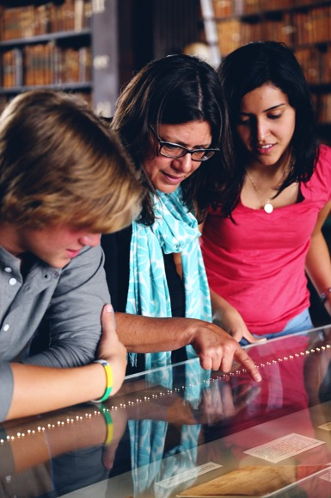
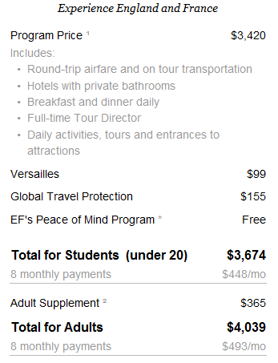

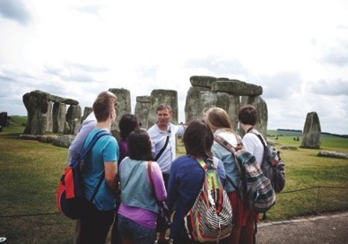
PAYING FOR YOUR TOUR
EF Price Guarantee—your guaranteed lowest price will never change once you enroll
Just $95 to enroll and claim your spot!

Slide 21
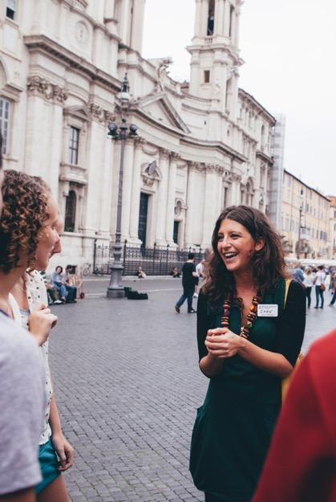

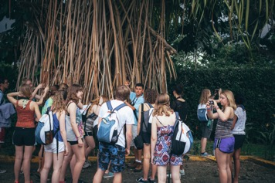
PAYMENT OPTIONS
Pay in Full at Enrollment
Automatic Payment Plan—Free
Manual Payment Plan—$50 Plan Fee
Call Customer Service to choose your perfect plan: 800-665-5364
“EF really knows how to make student tours not only so much fun, but really educational.”
— Andrea X., Group Leader

Slide 22
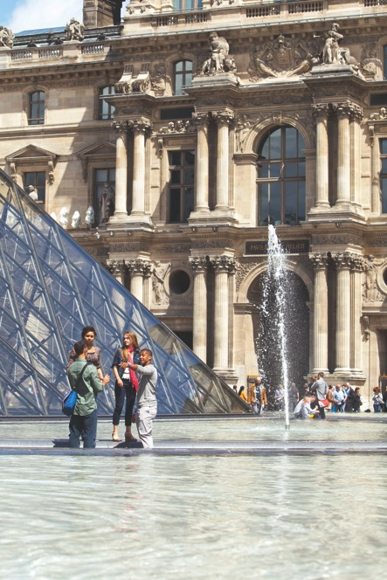
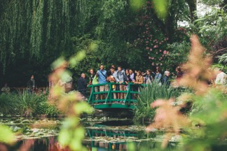
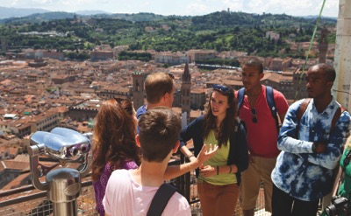
WHO’S IN?
Reserve your spot now!
Online:
www.eftours.com/1772766PU
Phone: 800-665-5364
Tour Number
1772766PU
Application Deadline
October 30th, 2015
“It’s the best gift a parent can give to their child.”
—Barbara B., Group Leader

