Slide 1
COGNITION: THINKING, PROBLEM SOLVING, CREATIVITY AND LANGUAGE
UNIT 7B

Slide 2
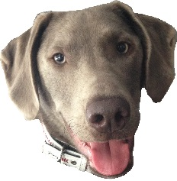
Algorithms
Heuristics
Compensatory Models
Representativeness Heuristic
We are here
Problem Solving Techniques
Decision Making Techniques
Availability Heuristic
Unit 7:
Cognition
Obstacles to Problem Solving
Obstacles to Decision Making
Biological Factors
Acquisition and use of Language
Memory
Information Processing Model
Encoding
Storage
Retrieval
Cognitive Factors
Cultural Factors

Slide 3
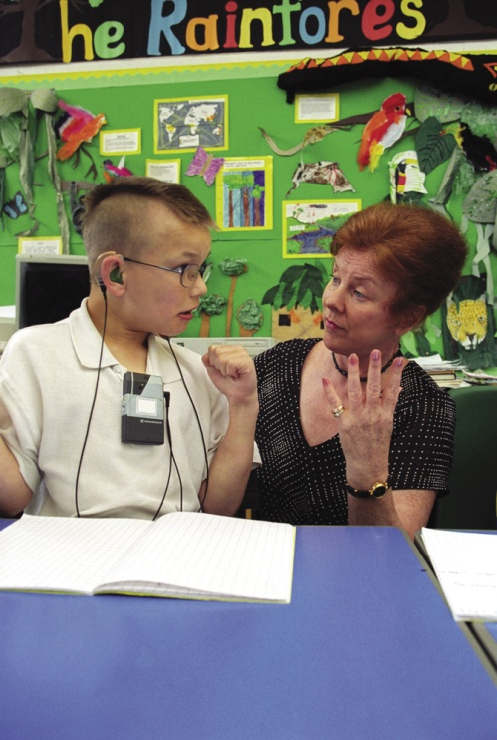
UNIT OVERIVEW
Thinking
Language
Thinking and Language

Slide 4
Algorithms
Heuristics
Compensatory Models
Representativeness Heuristic
We are here
Problem Solving Techniques
Decision Making Techniques
Availability Heuristic
Unit 7:
Cognition
Obstacles to Problem Solving
Obstacles to Decision Making
Biological Factors
Acquisition and use of Language
Memory
Information Processing Model
Encoding
Storage
Retrieval
Cognitive Factors
Cultural Factors

Slide 5
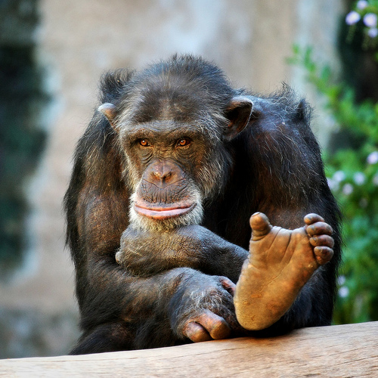
THINKING
Thinking, or cognition, refers to a process that involves knowing, understanding, remembering, and communicating.

Slide 6
COGNITIVE PSYCHOLOGY
Cognition involves a number of mental activities, which are listed below
Concepts
Problem solving
Decision making
Judgment formation
Language
Memory

Slide 7

THINKING
Notes:
Thinking
Thinking, or cognition, refers to all the mental activities associated with thinking, knowing, remembering and communicating
Cognitive psychologists study all of these activities above including the logical and sometimes illogical ways in which we created concepts, solve problems, make decisions and form judgments.

Slide 8
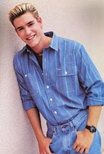
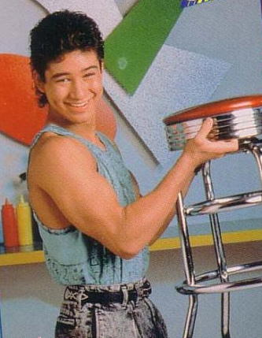
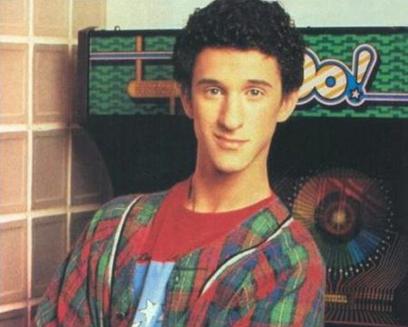
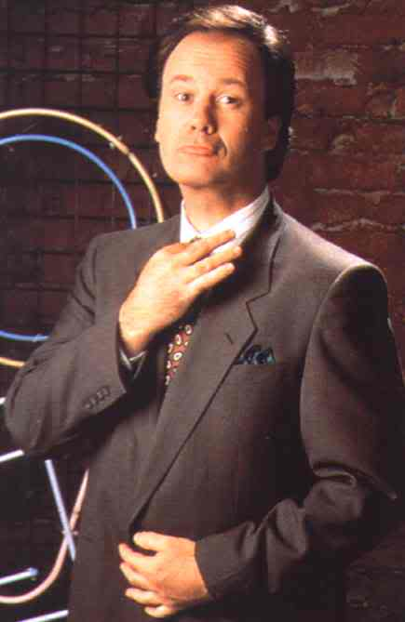
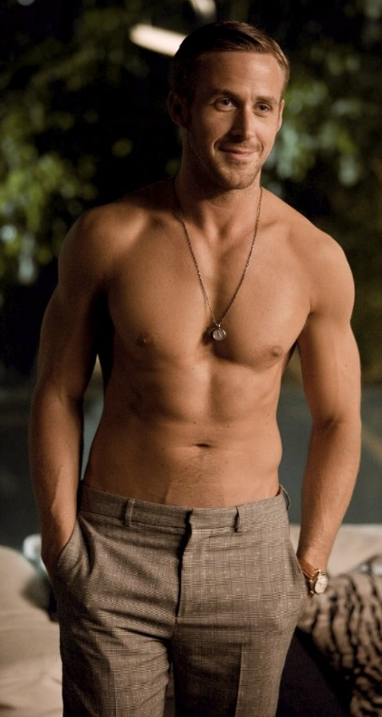
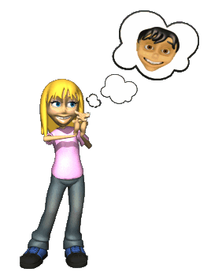
What is thought?
Our concept of men may include all of the following guys….
There are basically two types of thought…
Concepts (schemas)…usually based on prototypes.
Images
But they are based on our prototype (ideal) male…..

Slide 9
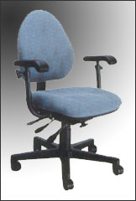
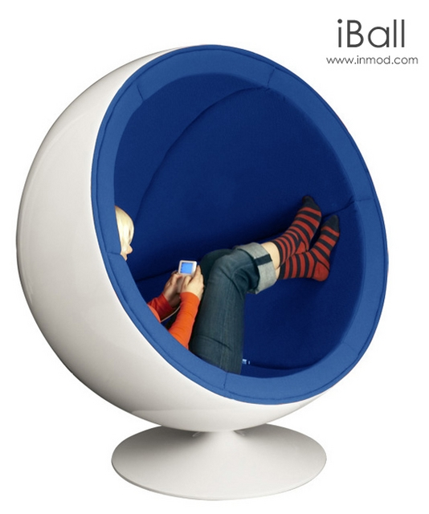
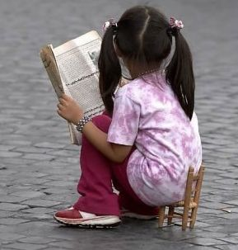
SCHEMA OR CONCEPT
The mental grouping of similar objects, events, ideas, or people. There are a variety of chairs but their common features make up your CHAIR schema
Notes:
OBJECTIVE 2| Describe the roles of categories, hierarchies, definitions, and prototypes in concept formation.

Slide 10
CHAIR SCHEMA CHARACTERISTICS
Furniture
Seat
Four Legs
Back
Arms
Sits one person
Cushioned
Made of wood

Slide 11
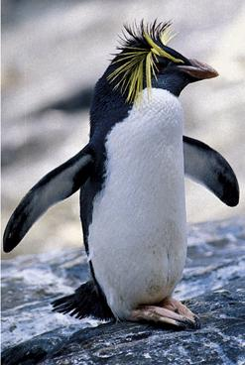
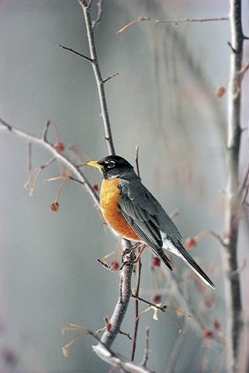
CONCEPTS
Concepts
  Category hierarchies
  prototype
Notes:
Concepts
To think about countless events, objects and people in our world, we form concepts (mental groupings of similar objects, events, ideas and people)—There are a variety of puppies, but their common features define the concept of a Puppy
To simplify things, we organize concepts into category hierarchies—see chart on slide
We form some concepts by definition→ by prototypes (a mental image or best example that incorporates all the features we associate with a category
A Triangle has three sides = definition
Robin and penguin = bird because both have two feet, wings and feathers and hatches from an egg, but a robin more closely resembles our bird prototype
Once we put an item in a category, our memory of it later shifts toward the category prototype

Slide 12
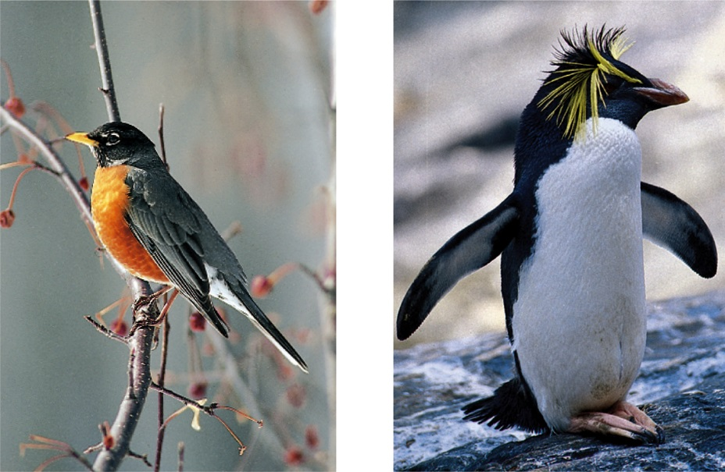
DEVELOPMENT OF CONCEPTS
We form some concepts with definitions. For example, a triangle has three sides. Mostly, we form concepts with mental images or typical examples (prototypes). For example, a robin is a prototype of a bird, but a penguin is not.
J. Messerschmidt/ The Picture Cube
Daniel J. Cox/ Getty Images
Triangle (definition)
Bird (mental image)
Notes:
Concepts
To think about countless events, objects and people in our world, we form concepts (mental groupings of similar objects, events, ideas and people)—There are a variety of puppies, but their common features define the concept of a Puppy
To simplify things, we organize concepts into category hierarchies—see chart on slide
We form some concepts by definition→ by prototypes (a mental image or best example that incorporates all the features we associate with a category
A Triangle has three sides = definition
Robin and penguin = bird because both have two feet, wings and feathers and hatches from an egg, but a robin more closely resembles our bird prototype
Once we put an item in a category, our memory of it later shifts toward the category prototype

Slide 13
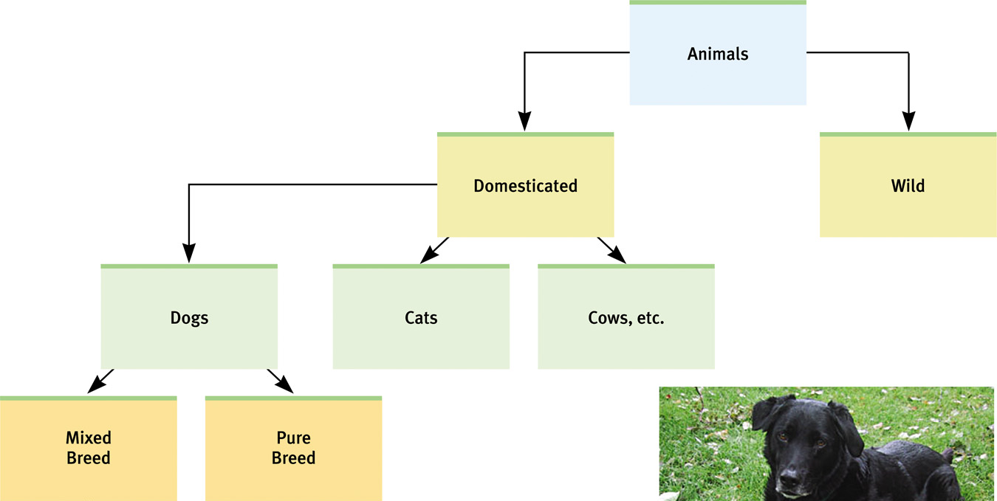
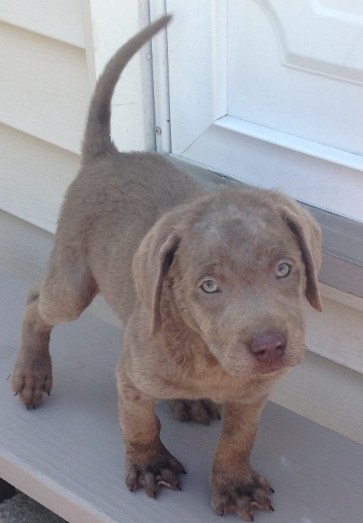
CATEGORY HIERARCHIES
We organize concepts into category hierarchies.
Courtesy of Christine Brune
Silver Lab named BILL!!!
Notes:
Concepts
To think about countless events, objects and people in our world, we form concepts (mental groupings of similar objects, events, ideas and people)—There are a variety of puppies, but their common features define the concept of a Puppy
To simplify things, we organize concepts into category hierarchies—see chart on slide
We form some concepts by definition→ by prototypes (a mental image or best example that incorporates all the features we associate with a category
A Triangle has three sides = definition
Robin and penguin = bird because both have two feet, wings and feathers and hatches from an egg, but a robin more closely resembles our bird prototype
Once we put an item in a category, our memory of it later shifts toward the category prototype

Slide 14
PROTOTYPES
A prototype is the BEST example or cognitive representation of something within a certain schema or concept.
Schema
List characteristics that make a place a college or university.
Prototype
Now list a specific college that BEST represents or embodies those characteristics.

Slide 15
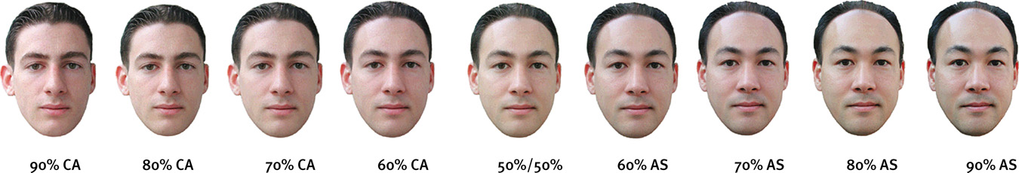
CATEGORIES
Once we place an item in a category, our memory shifts toward the category prototype.
Courtesy of Oliver Corneille
A computer generated face that was 70 percent
Caucasian led people to classify it as Caucasian.

Slide 16
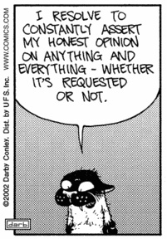
SCHEMATA CAN GET FUZZY…
Is a whale a mammal?
Are penguins and kiwis birds?
Are 17 year old people children or adults
People more easily detect male prejudice against females than female against males or female against female

Slide 17
Algorithms
Heuristics
Compensatory Models
Representativeness Heuristic
Problem Solving Techniques
Decision Making Techniques
Availability Heuristic
We are here
Unit 7:
Cognition
Obstacles to Problem Solving
Obstacles to Decision Making
Biological Factors
Acquisition and use of Language
Memory
Information Processing Model
Encoding
Storage
Retrieval
Cognitive Factors
Cultural Factors

Slide 18
Algorithms
Heuristics
Compensatory Models
Representativeness Heuristic
We are here
Problem Solving Techniques
Decision Making Techniques
Availability Heuristic
Unit 7:
Cognition
Obstacles to Problem Solving
Obstacles to Decision Making
Biological Factors
Acquisition and use of Language
Memory
Information Processing Model
Encoding
Storage
Retrieval
Cognitive Factors
Cultural Factors

Slide 19
ALGORITHMS
Algorithms, which are very time consuming, exhaust all possibilities before arriving at a solution. Computers use algorithms.
S P L O Y O C H Y G
If we were to unscramble these letters to form a word
using an algorithmic approach, we would face
907,208 possibilities.

Slide 20
Algorithms
Heuristics
Compensatory Models
Representativeness Heuristic
We are here
Problem Solving Techniques
Decision Making Techniques
Availability Heuristic
Unit 7:
Cognition
Obstacles to Problem Solving
Obstacles to Decision Making
Biological Factors
Acquisition and use of Language
Memory
Information Processing Model
Encoding
Storage
Retrieval
Cognitive Factors
Cultural Factors

Slide 21
HEURISTICS
In psychology, heuristics are simple, efficient rules, learned from experience, that people use to make decisions, come to judgments, and solve problems typically when facing complex problems or incomplete information.

Slide 22
HEURISTICS
Heuristics make it easier for us to use simple principles to arrive at solutions to problems.
S P L O Y O C H Y G
P S L O Y O C H G Y
S P L O Y O C H G Y
P S Y C H O L O G Y
Heuristic at work: Y’s usually go at the end of a word.

Slide 23
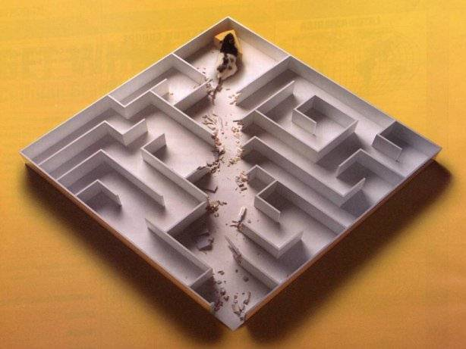
HEURISTICS
A rule of thumb that generally, but not always, can be used to make a judgment to solve a problem.
It is fast, but is prone to errors

Slide 24
Algorithms
Heuristics
Compensatory Models
Representativeness Heuristic
We are here
Problem Solving Techniques
Decision Making Techniques
Availability Heuristic
Unit 7:
Cognition
Obstacles to Problem Solving
Obstacles to Decision Making
Biological Factors
Acquisition and use of Language
Memory
Information Processing Model
Encoding
Storage
Retrieval
Cognitive Factors
Cultural Factors

Slide 25


REPRESENTATIVENESS HEURISTIC
Flo is a smart gal, but did not go to Harvard (but she looks like she might have).
Who went to Harvard?
Judging a situation based on how similar the aspects are to the prototypes the person holds in their mind.
Like thinking someone with glasses is nerdy, or a blonde is not smart.
Sonia Dara is a Sports Illustrated swimsuit model, you would make certain quick judgments (heuristics) about her…like about her interests or intelligence.
She is an economics major at Harvard University.
Notes:
Making Decisions and Forming Judgments
Each day we make hundreds of judgments and decisions, and we rarely take the time and effort to reason systematically. We just follow our intuition.
Using and Misusing Heuristics
Cognitive psychologists-Amos Tversky and Daniel Kahneman (1974) suggested representative and availability heuristics generally are helpful shortcuts, but can lead smart people to make poor decisions.
Representative Heuristics—to judge the likelihood of things in terms of how well they represent particular prototypes
When describing a short, slim person who likes to read poetry –you would be likely to choose a professor at an Ivy League school over a truck driver (make a snap judgment)
But there are higher odds that a person matches the description is a truck driver because there is more truck driver’s than Ivy League professors who like to read poetry (50-1 odds instead of 10 to 1)

Slide 26
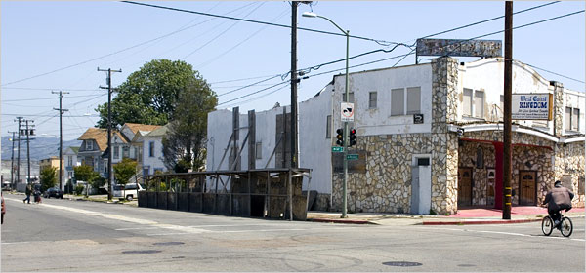
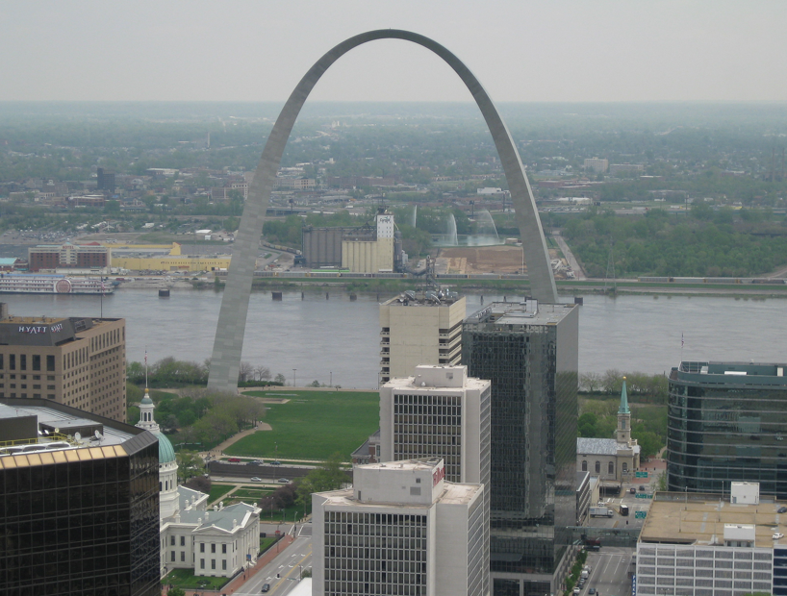
AVAILABILITY HEURISTIC
Which place would you be more scared of getting mugged or even murdered?
Judging a situation based on examples of similar situations that initially come to mind.
Vivid examples in the news often cause an availability heuristic.
Oakland, CA
The crime rate of St. Louis, Missouri is MUCH higher than Oakland. But when you think of crime, which town comes to mind?
St. Louis, MO
Notes:
248 vs 191 violent crimes per 10,000 residents

Slide 27
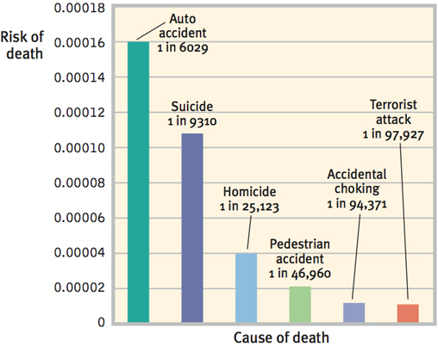
MAKING DECISIONS AND FORMING JUDGMENTS: USING AND MISUSING HEURISTICS
The Availability Heuristic
Notes:
Availability Heuristic—operates when we base our judgments on how mentally available information is
Anything that enables information to “pop into our head” quickly and without much effort—make the judgment more readily available
People began to fear flying after the 9/11 attacks (even though the risk of death from a terrorist attack is 1 in 97,927 compared to 1 in 6,029 of auto accidents)
People began to discriminate against Muslim-Americans after 9/11 because of our readily available memory of the dramatic event may shape our impression of the whole ethnic group
We overfeel and underthink
How is retrieval facilitated?
How recently we have heard about the event?
How distinct it is?
How correct it is?

Slide 28
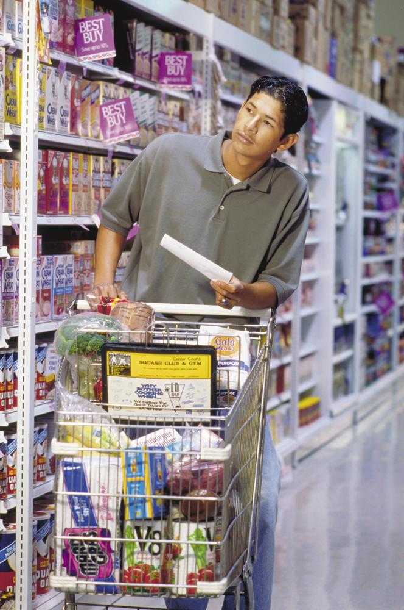
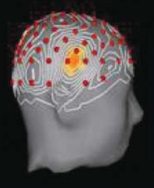
SOLVING PROBLEMS: STRATEGIES
Algorithms
  Step-by-step
Heuristic
Insight
Notes:
Problem Solving
We solve problems through trial and error
Other problems we use algorithms (step-by-step procedures that guarantee a solution)—can be quite difficult and time consuming—computers use algorithms to find all possible solutions
Or use simpler strategies called heuristics to arrive at a solution, less time consuming, but more error filled than algorithms
Sometimes no problem-solving strategy seems to be working at all and we arrive at a solution to a problem with insight
Humans and animals use insight
Jung-Beeman and others have identified brain activity associated with sudden flashes of insight about a word grouping or phrase. The researchers mapped the problem solver’s brain activity, using fMRIs (functional MRIs) or EEGs. Half of the solutions were by a sudden Aha! Insight, which typically was preceded by frontal lobe activity involved in focusing attention and was accompanied by a burst of activity in the right temporal lobe, just above the ear (see figure on slide)
There is more learning than conditioning with animal cognition

Slide 29
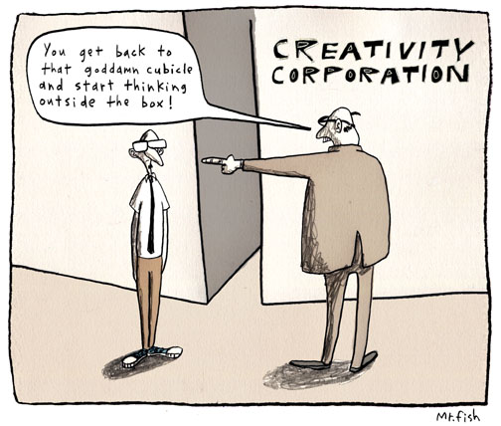
CREATIVITY
Almost impossible to define.
Little correlation between creativity and intelligence.
Convergent Thinking versus Divergent Thinking

Slide 30
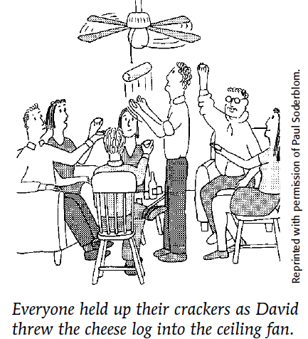
SOLVING PROBLEMS: CREATIVITY
Creativity
Strernberg’s five components
  Expertise
  Imaginative thinking skills
  A venturesome personality
  Intrinsic motivation
  A creative environment

Slide 31
Algorithms
Heuristics
Compensatory Models
Representativeness Heuristic
Problem Solving Techniques
Decision Making Techniques
Availability Heuristic
Unit 7:
Cognition
We are here
Obstacles to Problem Solving
Obstacles to Decision Making
Biological Factors
Acquisition and use of Language
Memory
Information Processing Model
Encoding
Storage
Retrieval
Cognitive Factors
Cultural Factors

Slide 32

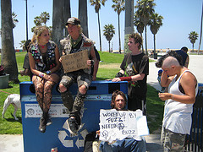
CONFIRMATION BIAS
We look for evidence to confirm our beliefs and ignore evidence that contradicts them.
For example, if one believes that everyone in LA is rich and beautiful and then turns on the E! Network and sees the Kardashians
Look…I knew it was true!!!
But is it really?
http://www.socialpsychology.org/teach/wason.htm
Notes:
Obstacles in Solving Problems: Confirmation Bias
We seek evidence verifying our ideas more eagerly than we seek evidence that might refute them = confirmation bias
Major obstacle to problem solving
Peter Wason (1960) gave British university students a three number sequence 2-4-6 and were asked to guess the rule use to devise the series. Once they felt they were certain they had the rule, they were to announce it
Most students formed the wrong idea and then searched only for evidence confirming the wrong rule
We went to war against Iraq in 2003 on the assumption that Saddam Hussein possessed WMD that posed an immediate threat. When the assumptions turned out to be false, confirmation bias was one of the flaws in the judgment process identified by the U.S. Senate Select Committee on Intelligence (2004)

Slide 33
OVERCONFIDENCE
Heuristics, confirmation of beliefs, and the inclination to explain failures increase our overconfidence. Overconfidence is a tendency to overestimate the accuracy of our beliefs and judgments.
In the stock market, both the seller and the buyer may be confident about their decisions on a stock.
Notes:
Overconfidence
A tendency to overestimate the accuracy of our knowledge and judgments (people overestimate what their performance is, will, be or was)
Ex: Lyndon Johnson was overconfident marching into North Vietnam, George Bush overconfident invading Iraq for WMD
Ex: Stockbrokers who are overconfident about the market, students who are overconfident they can finish a project in an hour, takes multiple hours
Positives—the more a person error’s about their estimates allows them to more precisely estimate in the future

Slide 34
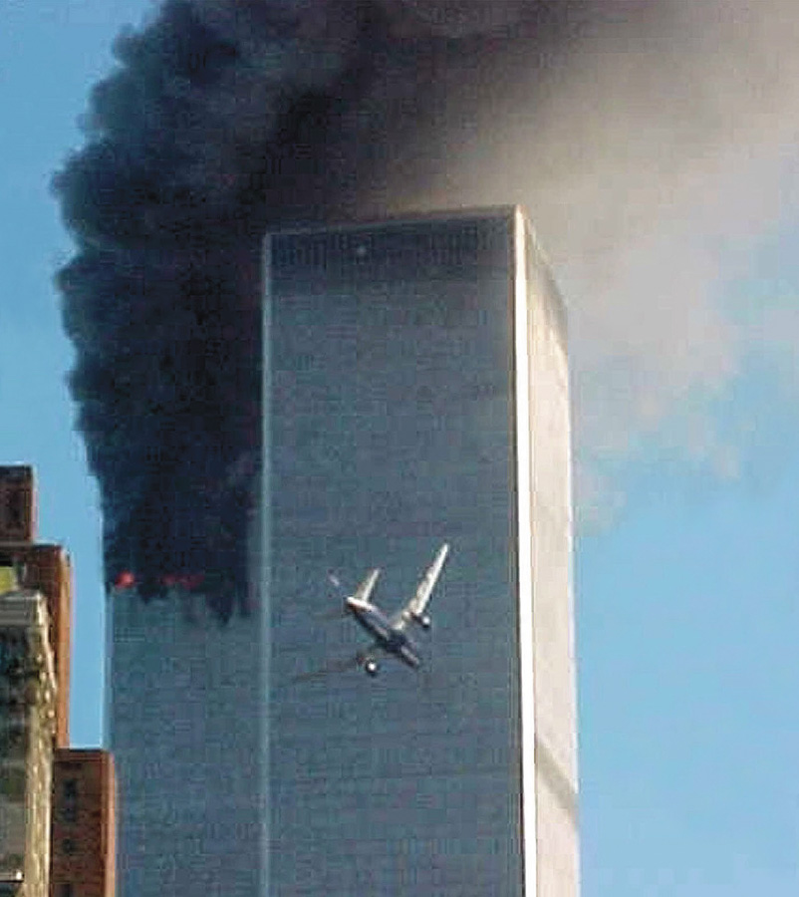
EXAGGERATED FEAR
The opposite of having overconfidence is having an exaggerated fear about what may happen. Such fears may be unfounded.
The 9/11 attacks led to a decline in air travel due to fear.
AP/ Wide World Photos
Notes:
Exaggerated Fear
The opposite of having overconfidence is having an exaggerated fear about what may happen. Such fears may be unfounded.
The 9/11 attacks led to a 20% decline in air travel due to fear and an increase in driving. However, between 2003-2005, Americans were 230 times more likely to die in a car crash than plane crash.

Slide 35
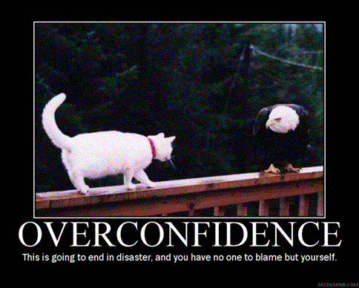
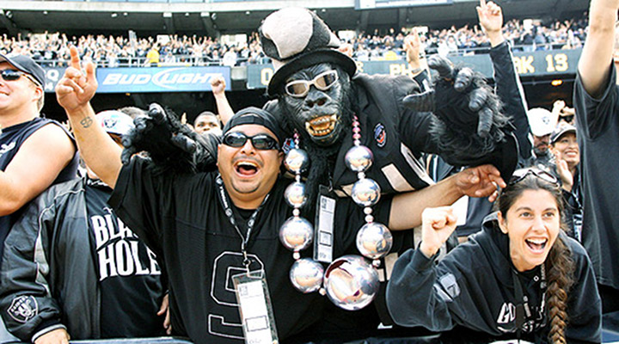
HEURISTICS CAN LEAD TO OVERCONFIDENCE
Our confidence is not a good indicator of how right we are.
Belief Perseverance- maintaining a belief even after it has been proven wrong.
  Obstacle to problem solving – must consider the opposite!
Notes:
Belief Perseverance Phenomenon
Our tendency to cling to our beliefs in the face of differing evidence (belief perseverance)
Fuels social conflict
Always consider the opposite (often allows people to be much less biased in their evaluations of the evidence and situation)
Once the beliefs are formed and get justified, it takes more compelling evidence to change these beliefs than it did to create them
Pygmalion effect (teachers who expect students to succeed, will succeed and vice versa)
Belief Bias: The tendency of one’s preexisting beliefs to distort logical reasoning by making invalid conclusions.
Premise = Bias

Slide 36
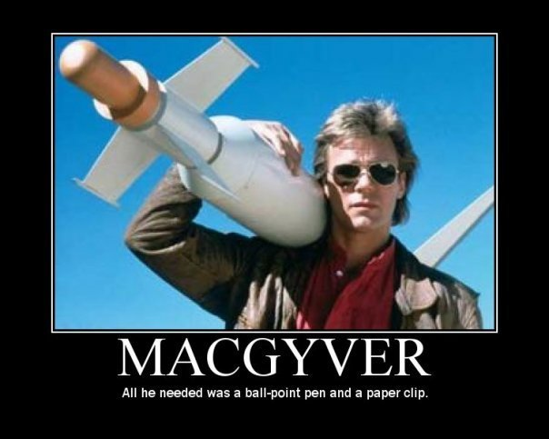
FUNCTIONAL FIXEDNESS
The inability to see a new use for an object.
"Many people might see this AP Psychology book as a source of information ... but it can also serve as a source of kindling."
Notes:
Fixation
Once we incorrectly represent a problem, it’s hard to restructure how we approach it
(hard to see the problem from a new perspective) = Fixation
Ex: The matchstick problem—To solve this problem , you must view it from a new perspective, breaking the fixation of limiting the solutions to two dimensions
Two examples of fixation
Mental Set—predisposes how we think—tendencies to approach a problem with how we have solved it in the past
Functional Fixedness—Our tendency to think of only the familiar functions for objects, without imagining alternative uses
Ex: Candle mounting problem—Solving this problem requires recognizing that a matchbox can have other functions besides holding matches

Slide 37
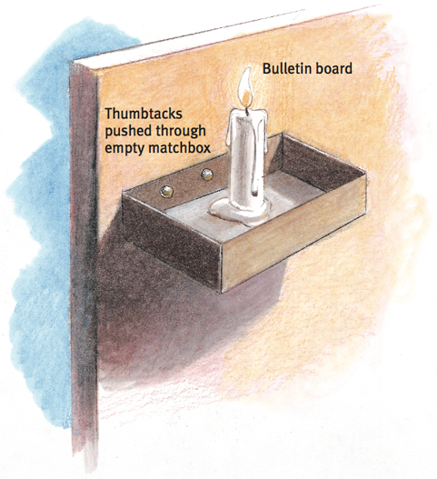
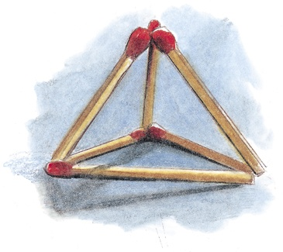
SOLVING PROBLEMS:
OBSTACLES TO PROBLEM SOLVING
Confirmation bias
Fixation
  Mental set
  Functional fixedness
  https://www.youtube.com/watch?v=gaI7N6J3rAc

Slide 38
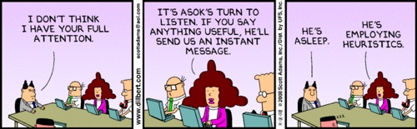
HEURISTICS IN ACTION
Notes:
Making Decisions and Forming Judgments
Each day we make hundreds of judgments and decisions, and we rarely take the time and effort to reason systematically. We just follow our intuition.
Using and Misusing Heuristics
Cognitive psychologists-Amos Tversky and Daniel Kahneman (1974) suggested representative and availability heuristics generally are helpful shortcuts, but can lead smart people to make poor decisions.
Representative Heuristics—to judge the likelihood of things in terms of how well they represent particular prototypes
When describing a short, slim person who likes to read poetry –you would be likely to choose a professor at an Ivy League school over a truck driver (make a snap judgment)
But there are higher odds that a person matches the description is a truck driver because there is more truck driver’s than Ivy League professors who like to read poetry (50-1 odds instead of 10 to 1)

Slide 39
Algorithms
Heuristics
Compensatory Models
Representativeness Heuristic
Problem Solving Techniques
Decision Making Techniques
Availability Heuristic
Unit 7:
Cognition
Obstacles to Problem Solving
Obstacles to Decision Making
We are here
Biological Factors
Acquisition and use of Language
Memory
Information Processing Model
Encoding
Storage
Retrieval
Cognitive Factors
Cultural Factors

Slide 40
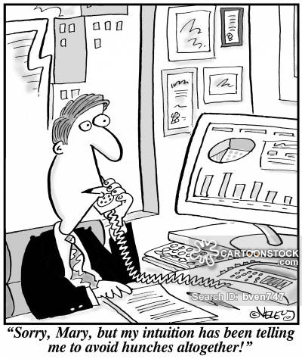

MAKING DECISIONS AND FORMING JUDGMENTS: THE PERILS AND POWERS OF INTUITION
Intuition
  Unconscious intuition
Notes:
The Perils and Powers of Intuition
Intuition also feeds our gut feelings, fears and prejudices-often effortless, immediate, automatic feeling and reaction
If a stranger looks like someone who previously harmed or harassed us, we may—without consciousness—react warily
Intuition is adaptive—it feeds our expertise, our creativity, our love and our spirituality—born of experience
Nurses, firefighters, athletes size up a situation and react instantaneously
Psychological science reminds us to check our intuition with reality—two track mind (parallel processing)
See chart on page 310 in book (Intuition’s perils and powers)

Slide 41

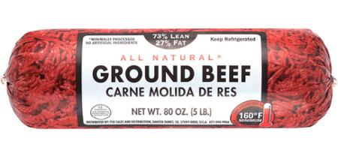

MAKING DECISIONS and JUDGMENTS
THE EFFECTS OF FRAMING
90% of the population will be saved with this medication…..or
10% of the population will die despite this medication.
You should not drink more than two alcoholic drinks per day….or
You should not drink more than 730 drinks a year.
The way a problem is presented can drastically affect the way we view it.
Notes:
Effects of Framing
The effects of framing (the way we present an issue) are sometimes surprising
Merchants mark up their prices to appear to have a big sale
Ground beef describes as 75% lean is more appealing than 25% fat
Those who understand the power of framing can use it to influence our decisions

Slide 42
LANGUAGE

Slide 43
Algorithms
Heuristics
Compensatory Models
Representativeness Heuristic
Problem Solving Techniques
Decision Making Techniques
Availability Heuristic
Unit 7:
Cognition
Obstacles to Problem Solving
Obstacles to Decision Making
Biological Factors
Acquisition and use of Language
We are here
Memory
Information Processing Model
Encoding
Storage
Retrieval
Cognitive Factors
Cultural Factors

Slide 44
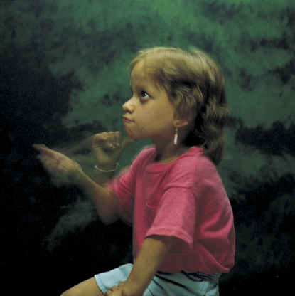
LANGUAGE: INTRODUCTION
Language
Spoken, written or
signed words and the
ways we combine
them as we think
and communicate
Notes:
Language
Our spoken, written, or signed words and they ways we combine them as we think and communicate
Linguist—Noam Chomsky—the qualities of the mind are unique to humans
Language transmits culture
How do we go about inventing a language?

Slide 45
LANGUAGE STRUCTURE: PHONEME
Phoneme
  Basic sounds of language
    B-A-T (3), CH-A-T (3)
  English about 40 phonemes
  Learning another language’s phonemes
Notes:
Language Structure
Three building blocks:
Phonemes—basic sounds
Ex: B-A-T = 3 phonemes, CH-A-T has 3 phonemes
In 500 languages, there are 869 different phonemes in human speech—no one language uses all of them; English uses about 40
Consonant phonemes carry more information than do vowel phonemes (see ex on slide)
Learning the phonemes of one culture makes it challenging to learn another culture (German→ English)

Slide 46
LANGUAGE STRUCTURE
Phonemes: The smallest distinct sound unit in a spoken language. For example:
bat, has three phonemes b · a · t
chat, has three phonemes ch · a · t
How many meanings can you make by varying the vowel phoneme between B and T?
Generally _____________ phonemes carry more information.
Notes:
OBJECTIVE 11| Describe the basic structural units of language.

Slide 47
ANSWERS
Bait, bat, beat/beet, bet bit, bite, boat, boot, bought, bout, and but.
Generally consonant phonemes carry more information.
**The treth ef thes stetement shed be evedent frem thes bref demenstretien.**

Slide 48
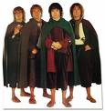
LANGUAGE STRUCTURE
Morpheme: The smallest unit that carries a meaning. It may be a word or part of a word. For example:
Milk = milk
Pumpkin = pump . kin
Unforgettable = un · for · get · table

Slide 49
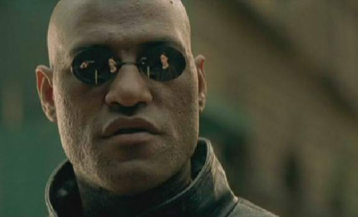
LANGUAGE STRUCTURE: MORPHEMES
Morpheme
  Typically words, but also word-like chunks that convey meaning on their own
    prefixes and suffixes
  Created by stringing together phonemes
  Some morphemes are also phonemes
    S (indicate plural), I (personal pronoun)
Notes:
Morphemes
The smallest unit of language that carries meaning (about 100,000)
Most are a combination of two or more phonemes, or prefixes/suffixes (pre in preview or ed in watched)
Ex: Milk = Milk, Pumpkin = Pump-kin, Unforgettable = Un-For-Get-Table

Slide 50
STRUCTURING LANGUAGE
Phonemes
Basic sounds (about 40) … ea, sh.
Morphemes
Smallest meaningful units (100,000) … un, for.
Words
Meaningful units (290,500) … meat, pumpkin.
Phrase
Composed of two or more words (326,000) … meat eater.
Sentence
Composed of many words (infinite) … She opened the jewelry box.

Slide 51
GRAMMAR
Grammar is the system of rules in a language that enable us to communicate with and understand others.
Grammar
Semantics
Syntax

Slide 52
SEMANTICS
Semantics is the set of rules by which we derive meaning from morphemes, words, and sentences. For example:
Semantic rule tells us that adding –ed to the word laugh means that it happened in the past.
Notes:
Grammar
A system of rules (semantics and syntax) in a given language that enables us to communicate with and understand others
Grammar is extremely complex in different societies with 6,000 other languages spoken
Semantics is the set of rules we use to derive meaning from morphemes, words and even sentences
Adding –ed to any word tells us that the action happened in the past

Slide 53
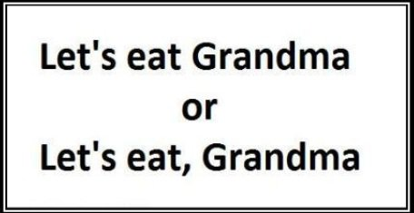
SYNTAX
Syntax consists of the rules for combining words into grammatically sensible sentences. For example:
In English, syntactical rule says that adjectives come before nouns; white house. In Spanish, it is reversed; casa blanca.
Notes:
Grammar
A system of rules (semantics and syntax) in a given language that enables us to communicate with and understand others
Grammar is extremely complex in different societies with 6,000 other languages spoken
Syntax refers to the rules we use to other words into sentences
Grammatical rules of language related to word ordering
Adjectives come before nouns (white house) in English
In Spanish adjectives come after (casa blanca)

Slide 54
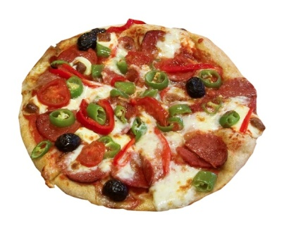
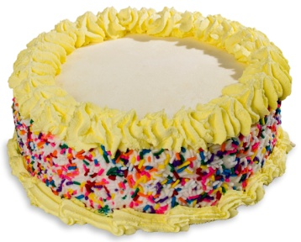
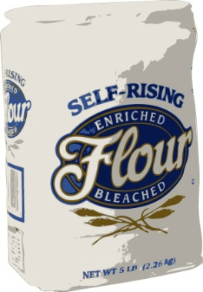
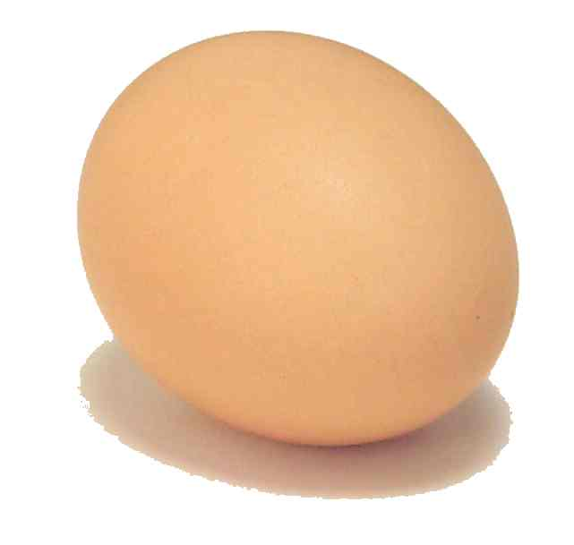
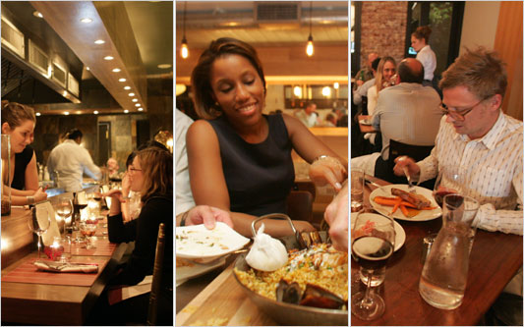
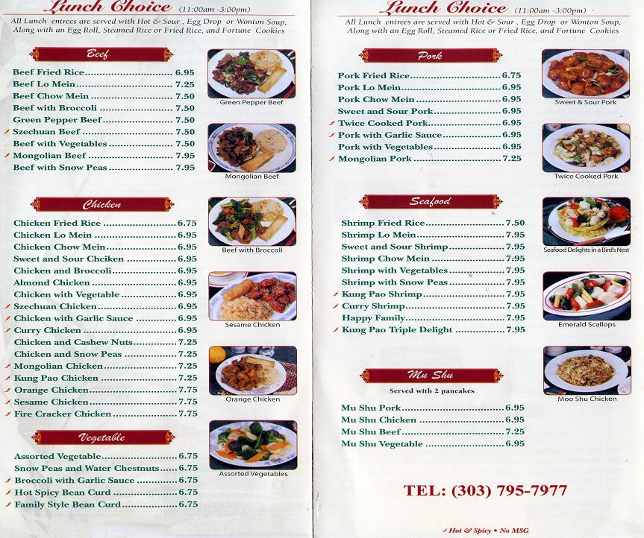
BECAUSE EVERYONE LOVES FOOD
Phonemes:
Ingredients
Morphemes:
Foods
Syntax:
Menu /
Courses
Extralinguistic Info:
Dining Experience
Notes:
beyond the words → The tone of voice and/or facial expression we use when speaking can convey a more powerful message than our actual words
helps us make sense of ambiguous statements or implied understandings
Failure to recognize this extralinguistic information can result in serious misunderstandings and bring about conflict

Slide 55
Algorithms
Heuristics
Compensatory Models
Representativeness Heuristic
Problem Solving Techniques
Decision Making Techniques
Availability Heuristic
Unit 7:
Cognition
Obstacles to Problem Solving
Obstacles to Decision Making
Biological Factors
Acquisition and use of Language
Memory
Information Processing Model
We are here
Encoding
Storage
Retrieval
Cognitive Factors
Cultural Factors

Slide 56
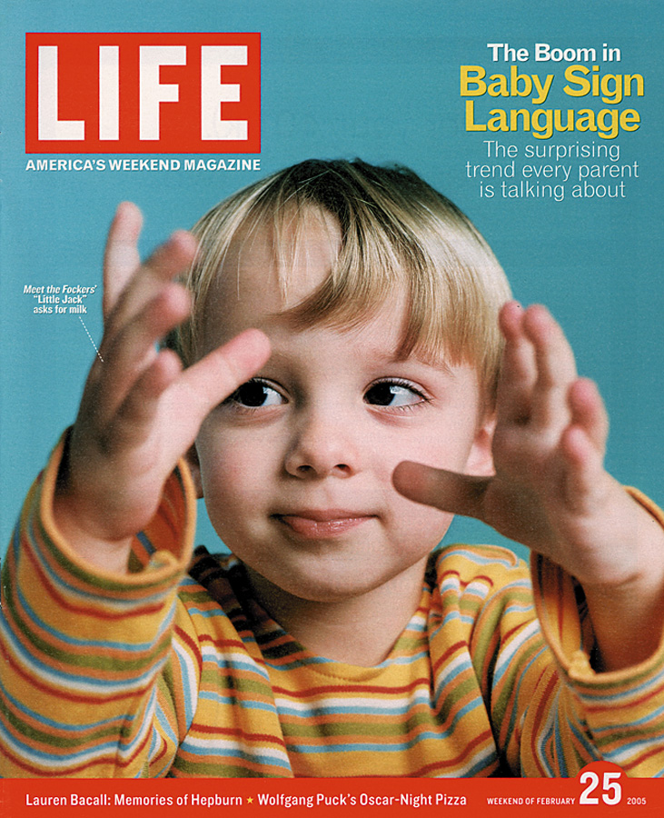
LANGUAGE DEVELOPMENT
Children learn their native languages much before learning to add 2+2.
We learn, on average (after age 1), 3,500 words a year, amassing 60,000 words by the time we graduate from high school.
Time Life Pictures/ Getty Images

Slide 57
LANGUAGE DEVELOPMENT
Receptive language is the child’s ability to comprehend speech. Begins to mature before their productive language, which is their ability to produce words.
Productive Language is a child’s ability to produce words. (improves with improvement of receptive language)
Notes:
Receptive language is the child’s ability to comprehend speech. Begins to mature before their productive language, which is their ability to produce words.
Productive Language is a child’s ability to produce words. (improves with improvement of receptive language)
Babbling Stage: (3- 6months after birth) A stage in speech development where the infant utters sounds unlike the family language.
One-word stage: (1-2 years old) A stage in speech development where the infant speaks single words
Two-word stage: (2 years old) Infants speak in two-word phrases that resemble Telegraphic speech – speech like a “telegram” I.e. Want candy, me play, no eat…etc

Slide 58
LANGUAGE DEVELOPMENT:
WHEN DO WE LEARN LANGUAGE?
Receptive language
Productive language
  Babbling stage
  One-word stage
  Two-word stage
  Telegraphic speech
Notes:
Language Development
You have learned 60,000 words between your 1st birthday and high school graduation (nearly 3,500 words per year, 10 words a day!)
Before you were able to add 2 +2, you were creating your own grammatically correct sentences
We selectively sample tens of thousands of words in memory, effortlessly assemble them with near-perfect syntax and spew them out at rate of 3 words per second.
We also adapt our behavior to our social and cultural context, following rules for speaking and listening (How far apart should I stand? Is it OK to interrupt?

Slide 59
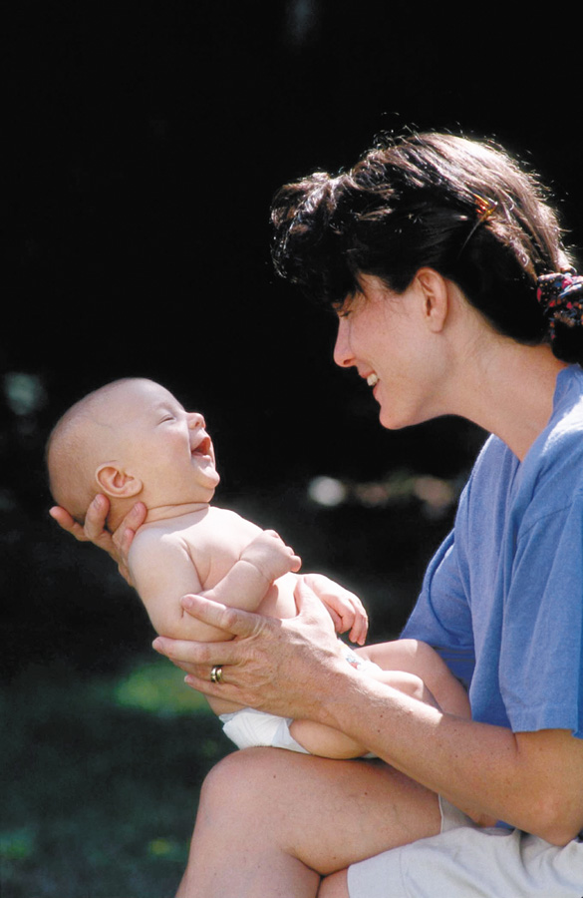
WHEN DO WE LEARN LANGUAGE?
Babbling Stage: Beginning at 4 months, the infant spontaneously utters various sounds, like ah-goo. Babbling is not imitation of adult speech.
Notes:
OBJECTIVE 12| Trace the course of language acquisition from the babbling stage through two-word stage.

Slide 60
WHEN DO WE LEARN LANGUAGE?
One-Word Stage: Beginning at or around his first birthday, a child starts to speak one word at a time and is able to make family members understand him. The word doggy may mean look at the dog out there.
Notes:
Language Development
You have learned 60,000 words between your 1st birthday and high school graduation (nearly 3,500 words per year, 10 words a day!)
Before you were able to add 2 +2, you were creating your own grammatically correct sentences
We selectively sample tens of thousands of words in memory, effortlessly assemble them with near-perfect syntax and spew them out at rate of 3 words per second.
We also adapt our behavior to our social and cultural context, following rules for speaking and listening (How far apart should I stand? Is it OK to interrupt?

Slide 61
WHEN DO WE LEARN LANGUAGE?
Two-Word Stage: Before the 2nd year a child starts to speak in two-word sentences. This form of speech is called telegraphic speech because the child speaks like a telegram: “Go car,” means I would like to go for a ride in the car.
Notes:
Language Development
You have learned 60,000 words between your 1st birthday and high school graduation (nearly 3,500 words per year, 10 words a day!)
Before you were able to add 2 +2, you were creating your own grammatically correct sentences
We selectively sample tens of thousands of words in memory, effortlessly assemble them with near-perfect syntax and spew them out at rate of 3 words per second.
We also adapt our behavior to our social and cultural context, following rules for speaking and listening (How far apart should I stand? Is it OK to interrupt?

Slide 62
WHEN DO WE LEARN LANGUAGE?
Longer phrases: After telegraphic speech, children begin uttering longer phrases (Mommy get ball) with syntactical sense, and by early elementary school they are employing humor.
You never starve in the desert because of all the sand-which-is there.
Notes:
Language Development
You have learned 60,000 words between your 1st birthday and high school graduation (nearly 3,500 words per year, 10 words a day!)
Before you were able to add 2 +2, you were creating your own grammatically correct sentences
We selectively sample tens of thousands of words in memory, effortlessly assemble them with near-perfect syntax and spew them out at rate of 3 words per second.
We also adapt our behavior to our social and cultural context, following rules for speaking and listening (How far apart should I stand? Is it OK to interrupt?

Slide 63
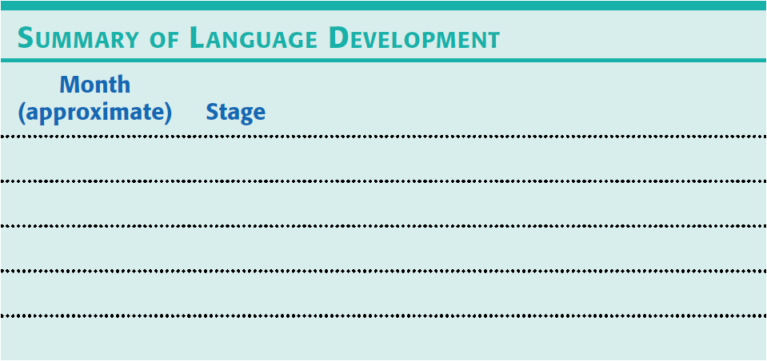
LANGUAGE DEVELOPMENT: WHEN DO WE LEARN LANGUAGE?

Slide 64

LANGUAGE DEVELOPMENT: WHEN DO WE LEARN LANGUAGE?
Notes:
Infants start without language, but by 4 months of age, babies can discriminate speech sounds→ this marks the beginning of babies’ receptive language (their ability to comprehend speech)
At 7 months and beyond, babies grow in their power to do what you and I find difficult when listening to an unfamiliar language
Babies productive language (their ability to produce words) matures after their receptive language
Around 4 months of age, babies enter the babbling stage (randomly utter a variety of sounds—ah-goo)
Not an imitation of adult speech
Many of these natural babbling sounds are consonant-vowel pairs formed by simply bunching the tongue in the front of the mouth (da-da, na-na) or by opening and closing the lips (ma-ma)—both of which babies do naturally for feeding

Slide 65

LANGUAGE DEVELOPMENT: WHEN DO WE LEARN LANGUAGE?
Notes:
By 10 months old, a trained ear can identify the language of the household
Without exposure to other languages, babies become functionally deaf to speech sound outside their native language

Slide 66

LANGUAGE DEVELOPMENT: WHEN DO WE LEARN LANGUAGE?
Notes:
Around their 1st birthday (exact age varies from child to child) most children enter the one-word stage—they have learned that sounds carry meanings and if repeatedly trained to associate fish with a picture of a fish, so when they see a fish again, they will recognize it
Babies are able to make family members understand him. The word doggy may mean look at the dog out there.

Slide 67

LANGUAGE DEVELOPMENT: WHEN DO WE LEARN LANGUAGE?
Notes:
About 18 months, children learn a word a week→ a word per day
2nd birthday = two-word stage they start uttering two-word sentences in telegraphic speech (speaking like a telegram—nouns and verbs—want juice
English speaking children place the adjectives before the noun (big doggie)

Slide 68

LANGUAGE DEVELOPMENT: WHEN DO WE LEARN LANGUAGE?
https://www.youtube.com/watch?v=s9shPouRWCs&index=16&list=PL8dPuuaLjXtOPRKzVLY0jJY-uHOH9KVU6
Crash Course - Language
Notes:
After 2 years old—develop Longer phrases: After telegraphic speech, children begin uttering longer phrases (i.e. Mommy get ball) with syntactical sense, and by early elementary school they are employing humor.
You never starve in the desert because of all the sand-which-is there.

Slide 69

LANGUAGE DEVELOPMENT:
EXPLAINING LANGUAGE DEVELOPMENT
Skinner: Operant Learning
  Learning principles
    Association
    Imitation
    Reinforcement
“It sure didn’t pay to increase my vocabulary that time!”
Notes:
Explaining Language Development
Operant Learning: B.F. Skinner (Behaviorist)
Believed we can explain language development with familiar learning principles (association—of the sight of things with the sounds of words, imitation—of the words and syntax modeled by others, and reinforcement—with smiles and hugs when the child says something right)
Children learn words similar to how animals learn to peck keys and press bars for sounds/food/rewards

Slide 70
OPERANT LEARNING
Language acquisition is governed by operant learning principles.
Association of the sight of things with sounds of words
Imitation of the words/syntax modeled by others
Reinforcement by the caregiver
This assumes that children are being constantly reinforced for using good grammar and corrected when they use bad grammar. (Seldom occurs)
Cute mistakes?

Slide 71

LANGUAGE DEVELOPMENT:
EXPLAINING LANGUAGE DEVELOPMENT
We learn language too quickly for it to be through reinforcement and punishment.
Inborn universal language acquisition device
Notes:
Inborn Universal Grammar: Noam Chomsky
Opposed Skinner’s theory, said that children acquire untaught words and grammar at a rate too extraordinary to be explained solely by learning principles (most if it is inborn and developed on their own)
Some children add to many –eds to words (I holded my bunny rabbit)
Given adequate nurturing, the language will grow—language acquisition, universal grammar (all languages have subject/verbs/nouns/questions, etc…)
Most psychologists believe children benefit from a combination of Skinner’s and Chomsky’s theories

Slide 72
Algorithms
Heuristics
Compensatory Models
Representativeness Heuristic
Problem Solving Techniques
Decision Making Techniques
Availability Heuristic
Unit 7:
Cognition
Obstacles to Problem Solving
Obstacles to Decision Making
Biological Factors
Acquisition and use of Language
Memory
Information Processing Model
We are here
Encoding
Storage
Retrieval
Cognitive Factors
Cultural Factors

Slide 73
INBORN UNIVERSAL GRAMMAR
Linguist Noam Chomsky
Language is almost entirely inborn
Language will naturally occur
We are hard wired to learn language
Children acquire untaught words and grammar at a rate too high to be explained through learning
Productivity? “I hate you daddy”
Many of the mistakes children make are from overgeneralizing grammar rules they picked up on
Universal Grammar
But children do learn their environment’s language
Notes:
Inborn Universal Grammar: Noam Chomsky
Opposed Skinner’s theory, said that children acquire untaught words and grammar at a rate too extraordinary to be explained solely by learning principles (most if it is inborn and developed on their own)
Some children add to many –eds to words (I holded my bunny rabbit)
Given adequate nurturing, the language will grow—language acquisition, universal grammar (all languages have subject/verbs/nouns/questions, etc…)
Most psychologists believe children benefit from a combination of Skinner’s and Chomsky’s theories

Slide 74



UNIVERSAL GRAMMAR
All human languages have the same grammatical building blocks, such as nouns and verbs, subjects and objects, negations and questions.
We all start speaking mostly in nouns
We all follow language development stages

Slide 75
CRITICAL PERIOD
Language Machines - A one year old’s brain is statistically analyzing which syllables most often go together to discern word breaks
Can we keep it up?
No, childhood seems to represent a critical period for mastering certain aspects of language
Once the critical period is over mastering the grammar of another language is very difficult
Notes:
Babies come with a built-in readiness to learn grammatical rules--Genes design the mechanisms for a language, and experience modifies the brain.
Childhood represents a critical period for mastering certain aspects of language
Children who have not been spoken to or signed language during the first 7 years of life gradually lose their ability to master any language (Genie/feral children)
People who learn a second language as an adult usually speak it with their accent of their first language (learning a second language early is better than later)

Slide 76


CRITICAL PERIOD –
FERAL CHILDREN
When a young brain does not learn language its language-learning capacity never develops.
https://vimeo.com/65190917 - Secret of the Wild Child (NOVA)
https://www.youtube.com/watch?v=cymZq1VblU0 – Wild Child (TLC)
Notes:
Genie Wiley
Not discovered until age 13 – Los Angeles, November 1970
Extreme neglect and deprivation – father would not permit anyone to leave/enter except son (with multiple verifications) and would sit in living room with a shotgun to discourage any disobedience
Physical abuse
Chained to a potty chair during the day, caged off crib at night
Language never developed
Became ward of the state – mother sued for custody when Genie turned 18
Underwent extensive testing – found to be extremely right-hemisphere skewed
No linguistic exposure – stimulation only visual and tactile
Mental age between 5 and 8 years old
Oksana
Born in 1983 Soviet Ukraine
Normal child at birth – neglected by alcoholic parents
Lived surrounded by dogs
Found at age 7 ½
Could not talk
Lacked many basic skills
Behaved like a dog
Barking, running like a dog
Slept on floor with the pack
Ate, and hygiene like a dog
Put in foster home for intellectually impaired children, underwent extensive therapy to address cognitive, emotional and social development issues
Learned to speak fluently, intelligently
Works on a farm

Slide 77
THINKING AND LANGUAGE
Notes:
Thinking & Language
Thinking & Language intricately intertwine…language determines the way we think (think before your speak)
Linguist Benjamin Lee Whorf believed this (1956)
Linguistic determinism hypothesis: different languages impose different conceptions of reality: “Language itself shapes a man’s basic ideas.”
For example, he noted that the Hopi people do not have the past tense for verbs. Therefore, the Hopi cannot think readily about the past.
You may think different if you speak different languages (ex: words may influence our thinking with English vs. Japanese based on the cultural communicative values with each, different concepts of self with each language)

Slide 78
Algorithms
Heuristics
Compensatory Models
Representativeness Heuristic
Problem Solving Techniques
Decision Making Techniques
Availability Heuristic
Unit 7:
Cognition
Obstacles to Problem Solving
Obstacles to Decision Making
Biological Factors
Acquisition and use of Language
Memory
Information Processing Model
We are here
Encoding
Storage
Retrieval
Cognitive Factors
Cultural Factors

Slide 79


LANGUAGE INFLUENCES THINKING
Linguistic Determinism: Whorf (1956) suggested that language determines the way we think.
American Inuit tribe has over 50 words for types of snow and 70 words for types of ice
**All languages find a way to say what they need**
Notes:
Need to know whether ice is safe to walk on, ice filled with holes, ice that lasts year after year, etc.

Slide 80

WHORF’S LINGUISTIC RELATIVITY
The idea that language determines the way we think.
The Hopi tribe has no past tense in their language, so Whorf says they rarely think of the past.
Notes:
Hopi Tribe?
Whorf argued that Hopi has "no words, grammatical forms, construction or expressions that refer directly to what we call 'time'", and concluded that the Hopi had "no general notion or intuition of time as a smooth flowing continuum in which everything in the universe proceeds at equal rate, out of a future, through the present, into a past".
Whorf used the Hopi concept of time as a primary example of his concept of linguistic relativity, which posits that the way in which individual languages encode information about the world, influences and correlates with the cultural world view of the speakers.

Slide 81

LANGUAGE INFLUENCES THINKING
When a language provides words for objects or events, we can think about these objects more clearly and remember them. It is easier to think about two colors with two different names (A) than colors with the same name (B) (Özgen, 2004).

Slide 82




(n) a face badly in need of a fist
(n) pre-fun, the sense of enjoyment before a party or event takes place
(n) a person who is always late because they think they have more time than they do
(n) a joke so poorly told and unfunny you can’t help but laughing
l‘esprit de l’escalier
(n.) lit. “the spirit of the staircase”
the feeling you get after leaving a conversation, when you think of all the things you should have said

Slide 83
WORD POWER
Increasing word power pays its dividends. It helps explain the bilingual advantage of bilingual children to inhibit one language while using another.
https://www.youtube.com/watch?v=Tuhs2GWrnXc
Notes:
Bilinguals have less vocabulary in ONE language than a monolingual, but more vocabulary overall
Also showed better results in cognitive tasks requiring executive functions:
Mental flexibility
Problem solving
Attentional control
Inhibitory control
Task switching
Less cognitive decline when older

Slide 84



THINKING IN IMAGES
To a large extent cognition is language-based. When alone, we may talk to ourselves. However, we also think in images.
Notes:
OBJECTIVE 15| Discuss the value of thinking in images.
Thinking in Images
Implicit memory (nondeclarative, procedural memory)—a mental picture of how you do something
When we are alone, we may talk to ourselves, but we often think in images
For someone who has learned a skill, even watching the activity will activate the brain’s internal simulation of it—noted a British research team after collecting fMRIs as people watched videos, this also applies if a person is imagining an activity or a painful memory (see visual on slides of fMRI)
Mental practice of a sport/skill is a part of the training sessions for Olympic athletes or any athlete/musician/dancer, etc…
It is best to imagine planning how to accomplish something/get somewhere than to dwell on a certain score or the imagined destination **Thinking affects our language which then affects our thoughts.

Slide 85
THINKING IN IMAGES
Images
Thinking in images is very useful especially for mentally practicing upcoming events and can actually increase our skills.
Visualization can improve skills and/or performance
https://www.youtube.com/watch?v=3gQwY5Np4FA
Procedural Memory is our unconscious memory system for motor and cognitive skills and conditioned associations.

Slide 86

IMAGES AND BRAIN
Watching a physical activity activates the same brain regions as when actually performing the activity.
Notes:
Thinking in Images
Implicit memory (nondeclarative, procedural memory)—a mental picture of how you do something
When we are alone, we may talk to ourselves, but we often think in images
For someone who has learned a skill, even watching the activity will activate the brain’s internal simulation of it—noted a British research team after collecting fMRIs as people watched videos, this also applies if a person is imagining an activity or a painful memory (see visual on slides of fMRI)
Mental practice of a sport/skill is a part of the training sessions for Olympic athletes or any athlete/musician/dancer, etc…
It is best to imagine planning how to accomplish something/get somewhere than to dwell on a certain score or the imagined destination **Thinking affects our language which then affects our thoughts.

