Slide 1
UNIT 9: DEVELOPMENTAL PSYCHOLOGY

Slide 2
We are here
Adulthood
Types of Studies
Adolescence
Late Adulthood
Childhood
Prenatal
Development
Unit 9
Developmental
Psych
Aging
Cognitive
Development
Moral
Development
Piaget’s
Stages
Vygotsky’s
Theory
Kohlberg
Gilligan
Social
Development
Erikson
Parenting
Styles
Gender

Slide 3
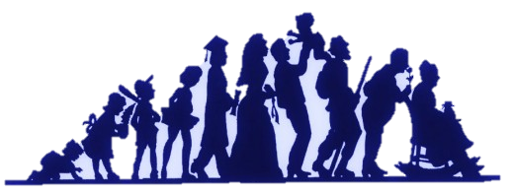
DEVELOPMENTAL PSYCHOLOGY
Study of humans from womb to tomb.

Slide 4
DEVELOPMENTAL PSYCHOLOGY
Issue | Details
Nature/Nurture | How do genetic inheritance (our nature) and experience (the nurture we receive) influence our behavior?
Stability/Change | Do our early personality traits persist through life, or do we become different persons as we age.
Continuity/Stages | Is developmental a gradual, continuous process or a sequence of separate stages?
Notes:
OBJECTIVE 1| State the three areas of change that developmental psychologists study, and identify the three major issues in developmental psychology.
Continuity and stages: Gradual continuous process or stages? (Escalator vs. Ladder)
Personality same throughout life?
Developmental psychology—examines how people are continually developing—physically, cognitively, and socially from infancy through old age
Developmental psychology research focuses on three major issues:
Nature and nurture: How do genetic inheritance (our nature) and experience (the nurture we receive) influence our development?
Continuity and stages: Is development a gradual, continuous process or does it proceed through a sequence of separate stages, like climbing the rungs of a ladder?
Stability and change: Do our early personality traits persist through life, or do we become different persons as we age?

Slide 5
PRENATAL DEVELOPMENT AND THE NEWBORN

Slide 6
Adulthood
We are here
Types of Studies
Adolescence
Late Adulthood
Childhood
Prenatal
Development
Unit 9
Developmental
Psych
Aging
Cognitive
Development
Moral
Development
Piaget’s
Stages
Vygotsky’s
Theory
Kohlberg
Gilligan
Social
Development
Erikson
Parenting
Styles
Gender

Slide 7
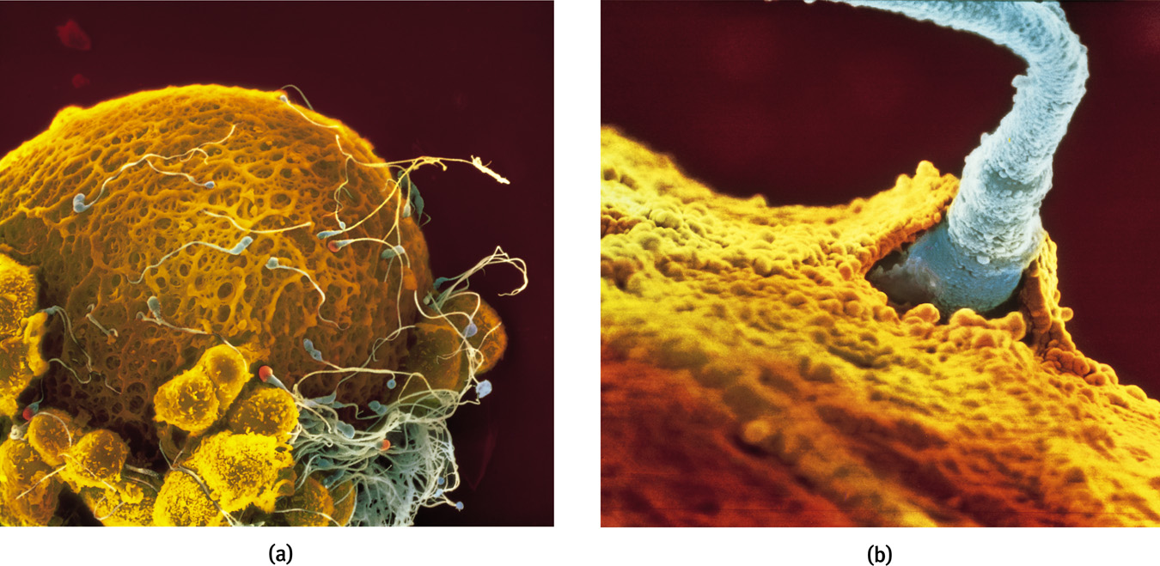
CONCEPTION
A single sperm cell (male) penetrates the outer coating of the egg (female) and fuses to form one fertilized cell.
Your most fortunate of moments!
Out of the 200 million sperm and 5000 eggs ‘you’ won the race.
Notes:
1/200 million sperm/one particular egg: your most fortunate moment
Conception
The process starts when a woman’s ovary releases a mature egg—a woman is born with all the immature eggs would ever have
After puberty, men produce 1000 sperm per second. With each ejaculation, men deposit 200 million sperm which travel through the vagina into the uterus and a few reach the egg which releases digestive enzymes that eat away its protective coating
As soon as one sperm is penetrated into the egg, the egg’s surface begins to block out other sperm
½ a day later, the sperm and egg fuse together to form a nucleus

Slide 8
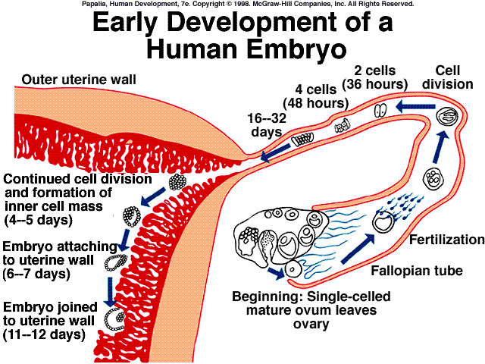
Outline

Slide 9
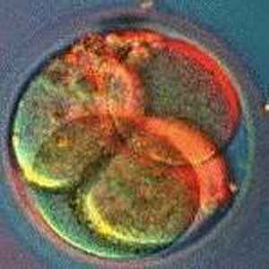
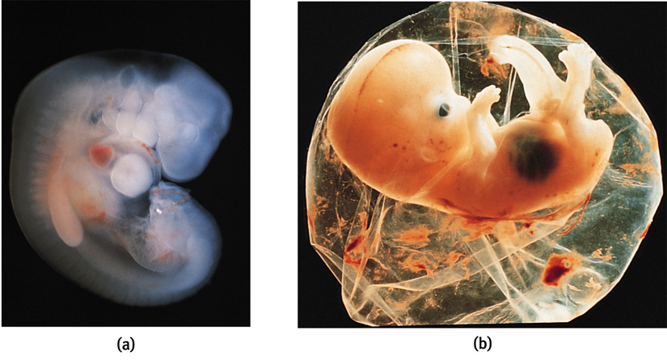
PRENATAL DEVELOPMENT
A zygote is a fertilized cell with cells that become increasingly diverse.
At about 14 days the zygote turns into an embryo (a and b).
Embryo at 40 Days
Embryo at 45 Days
Notes:
Zygote: Fertilized egg
Prenatal Development
Fertilized eggs = zygotes
One cell becomes 2, 4 and continues to divide of some 100 cells by the first week
About 10 days after conception, the zygote attaches to the mother’s uterine wall and the placenta forms which transfers nutrients and oxygen from the mother to the fetus
Also helps to screen out many potentially harmful substances
Some substances (teratogens)—like harmful agents like viruses and drugs slip through and affect the fetus
The zygote’s inner cells become the embryo (from 2 weeks after fertilization to 8 weeks)
Over the next 6 weeks, organs begin to form and function. The heart begins to beat.

Slide 10
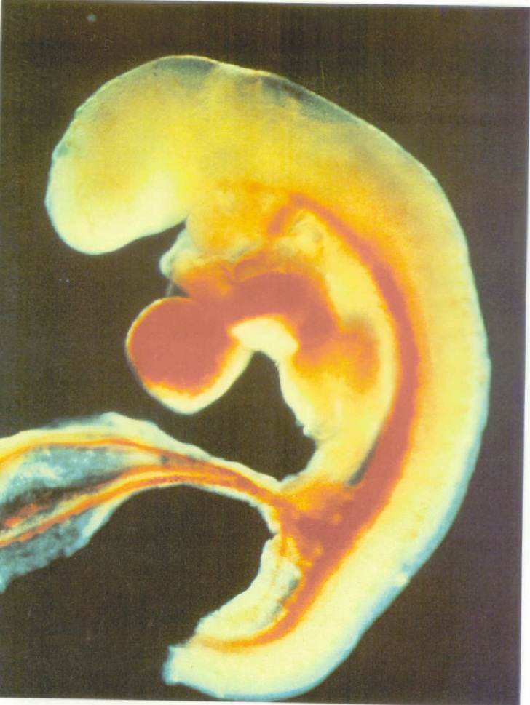
EMBRYO: 6 WEEKS
Notice the large neural tube and the formation of the heart and other internal organs.
Notes:
The zygote’s inner cells become the embryo (from 2 weeks after fertilization to 8 weeks)
Over the next 6 weeks, organs begin to form and function. The heart begins to beat.

Slide 11
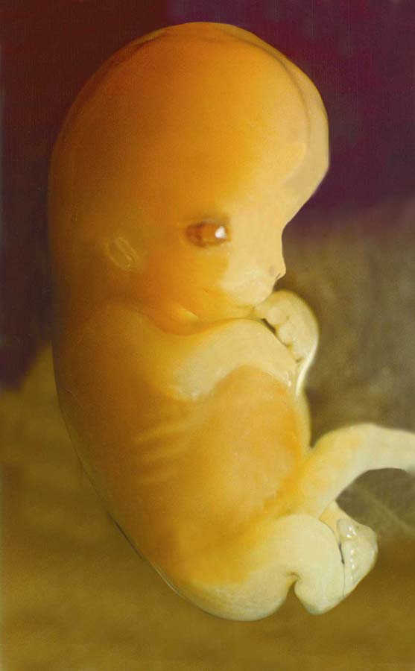
EMBRYO: 7 WEEKS
Eyes, fingers, toes and most internal organs have formed, but are not yet fully functional

Slide 12
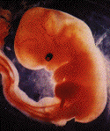
EMBRYO: 7 WEEKS
Facial features are visible, including a mouth and tongue.
The eyes have a retina and lens.
The major muscle system is developed and the unborn child moves as if practicing.
The child has its own blood type, distinct from the mother's.
These blood cells are produced by the liver now instead of the yolk sac.

Slide 13
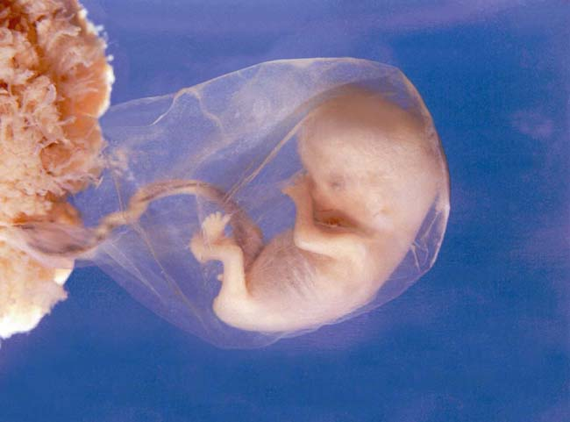
EMBRYO: 8 WEEKS
Amniotic Sac
Placenta

Slide 14
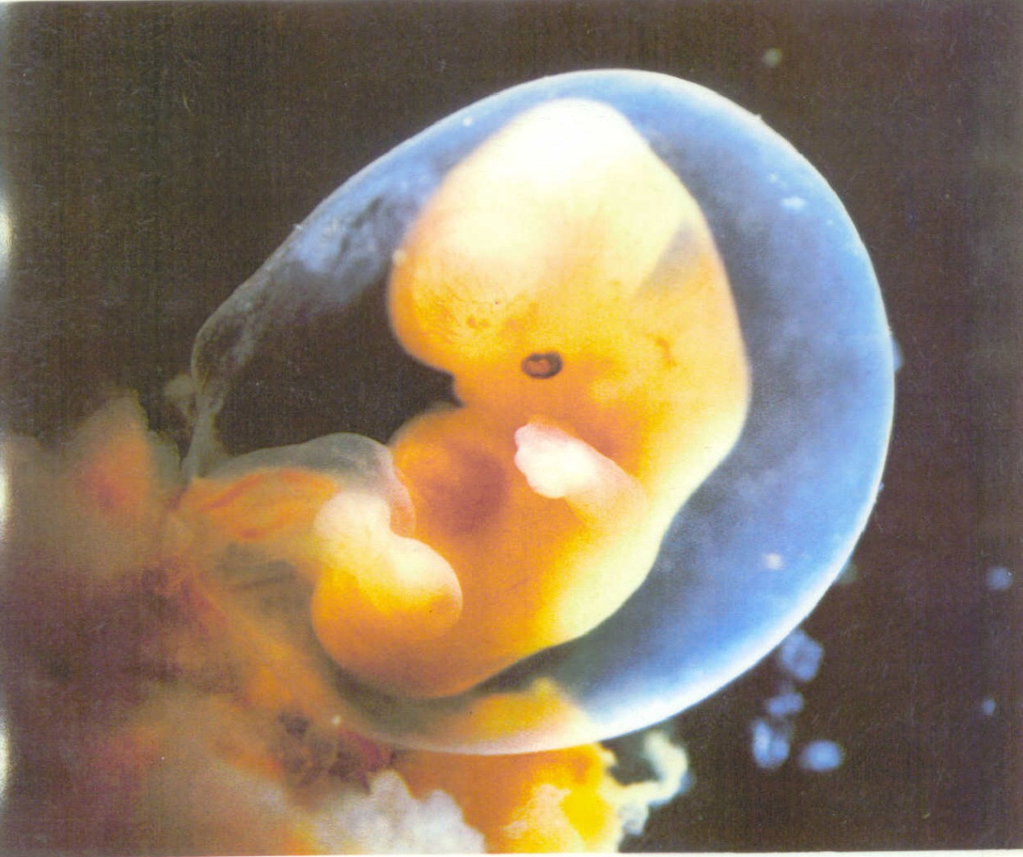
EMBRYO: 8 WEEKS
Embryo in Amniotic sac

Slide 15
FETUS: 8-9 WEEKS
The unborn child, called a fetus at this stage, is about half an inch long.
The tiny baby is protected by the amniotic sac, filled with fluid.
Inside, the child swims and moves gracefully.
The arms and legs have lengthened, and fingers can be seen.
The toes will develop in the next few days.
Brain waves can now be measured.
Notes:
By 9 weeks after conception, the embryo looks human (hands, fingers, toes, eye sockets) and becomes a fetus

Slide 16
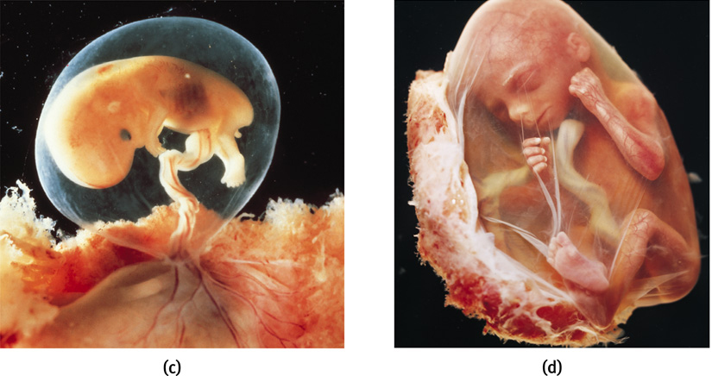
PRENATAL DEVELOPMENT
At 9 weeks, an embryo turns into a fetus (c and d).

Slide 17
10 WEEKS
The heart is almost completely developed and very much resembles that of a newborn baby.
An opening the atrium of the heart and the presence of a bypass valve divert much of the blood away from the lungs, as the child's blood is oxygenated through the placenta.
Twenty tiny baby teeth are forming in the gums; some babies are even born with teeth emerging from the gums.

Slide 18
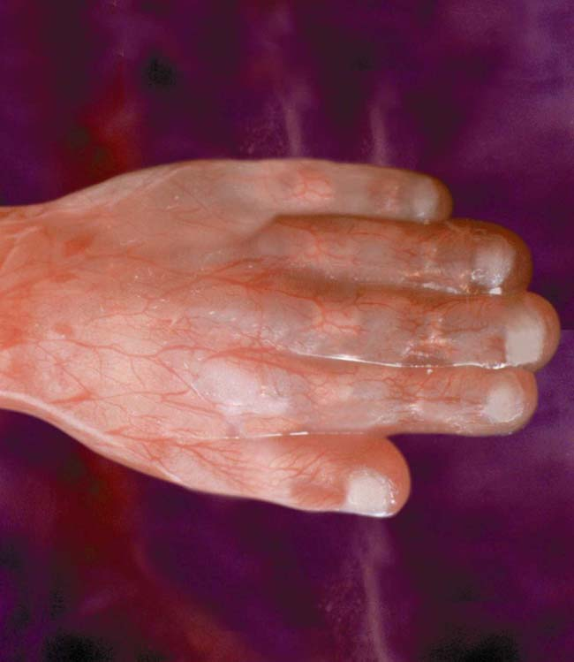
12 WEEKS
The baby at 12 weeks:
notice the webbing
on the fingers, with
the digits still fused

Slide 19
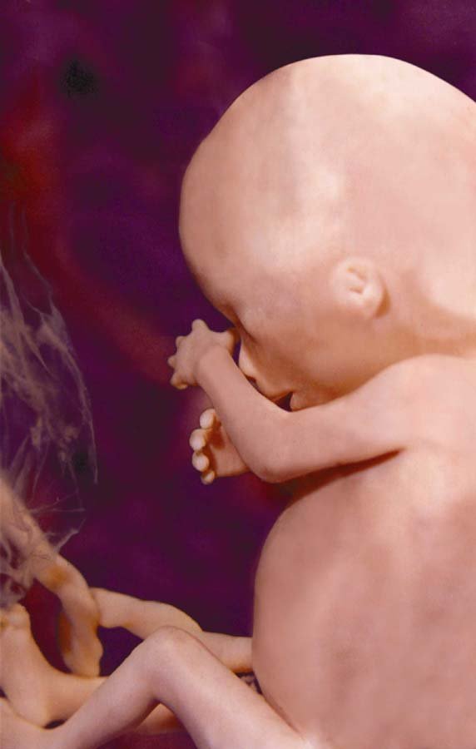
FETUS: 12 WEEKS
Vocal chords are complete, and the child can and does sometimes cry silently.
The brain is fully formed, and the child can feel pain.
The fetus may even suck his thumb.
The eyelids now cover the eyes, and will remain shut until the seventh month to protect the delicate optical nerve fibers.
Notice head size and chest size in comparison to an adult

Slide 20
FETUS AT 14-15 WEEKS:
14 weeks—
Muscles lengthen and become organized.
The mother will soon start feeling the first flutters of the unborn child kicking and moving within
15 weeks—
The fetus has an adult's taste buds and may be able to savor the mother's meals.
Foods the mother eats can affect movement of the baby

Slide 21
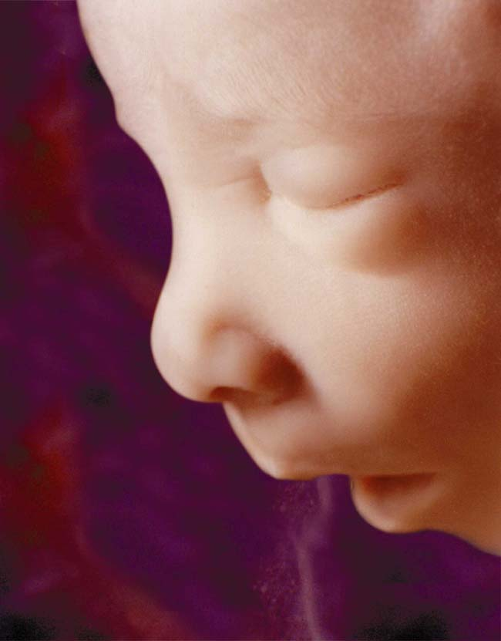
FETUS AT 4 MONTHS (~16 WEEKS)
Face is fully developed and
A downy hair covers the skin.
Face is fully formed.
Eyes are fully formed but not yet functional.

Slide 22
16 WEEKS
Five and a half inches tall and only six to 10 ounces in weight
Eyebrows, eyelashes and fine hair appear.
The child can grasp with his hands, suck her thumb, kick, or even somersault

Slide 23
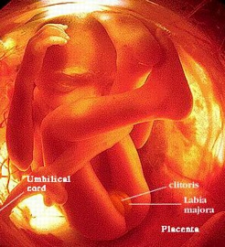
20 WEEKS
The child can hear and recognize her mother's voice.
Though still small and fragile, the baby is growing rapidly and could possibly survive if born at this stage.
Fingernails and fingerprints appear.
Sex organs are visible.
Using an ultrasound device, the doctor can tell if the child is a girl or a boy. This is a baby girl.

Slide 24
5 MONTHS
Beginning to form hair on all body parts
Definite sleep/awake cycles now.
REM sleep occurs.

Slide 25
5 MONTHS
Approximately 8-10 inches long and 1 to 2 pounds
Body position is often still “head up”
Baby is viable at this point with at least a 50/50 chance of survival outside the womb.

Slide 26
24 WEEKS
Seen here at six months, the unborn child is covered with a fine, downy hair called lanugo.
Its tender skin is protected by a waxy substance called vernix.
Some of this substance may still be on the child's skin at birth at which time it will be quickly absorbed.
The child practices breathing by inhaling amnionic fluid into developing lungs.
Notes:
By 6 months the stomach has developed enough to be able to survive on its own if born prematurely, fetus is responsive for sound (babies are more comforted by their mother’s voice than another woman’s or their father’s)

Slide 27
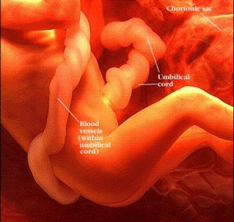
30 WEEKS
For several months, the umbilical cord has been the baby's lifeline to the mother.
Nourishment is transferred from the mother's blood, through the placenta, and into the umbilical cord to the fetus.
If the mother ingests any toxic substances, such as drugs or alcohol, the baby receives these as well.

Slide 28
7 MONTHS
Room is getting tight at this point.
The baby is less able to move, squirms and pushes more than flutters and kicks.
Most babies begins to get into a head down position getting ready for birth.

Slide 29
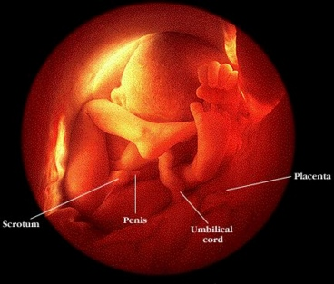
32 WEEKS
The fetus sleeps 90-95% of the day with REM sleep dominating the sleep cycle, an indication of dreaming.
The baby is very viable at this point, with a 75% or higher chance of survival.
If the baby is born, the concerns are with adequate lung development. Final lung development does not occur until about 37 weeks.

Slide 30
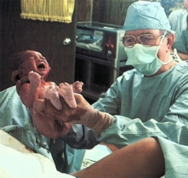
BIRTH: 38-42 WEEKS
40 weeks is normal gestation
The baby weighs on average 7 lbs. and is 20 inches long.
At birth the baby can see, hear, move and recognizes the voices of her parents or others who have been near the mother.

Slide 31
PRENATAL DEVELOPMENT
Zygote – conception to 2 weeks
Embryo – 2 weeks through 8 weeks
Fetus – 9 weeks to birth
Placenta
Connects fetus to mother
Brings oxygen and nutrients
Takes away waste
Critical period
A time during development when influences have major effect
Teratogens
Substances that can damage an embryo or fetus
Notes:
Prenatal influences on development
Nutrition
Mother’s general health and anxiety
HIV—if the mother carries the virus, the baby may also
Heroin addict---if the mother is an addict, the baby will be born a heroin addict
Smoking—the fetus experience reduced oxygen and a shot of nicotine
***According to the National Center for Health Statistics in 2001, about 50 more males than females are born per 1,000 babies each year. More babies are born in August and on Tuesdays, regardless of race.

Slide 32
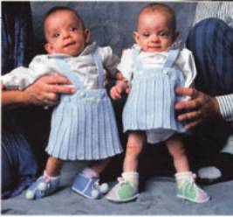
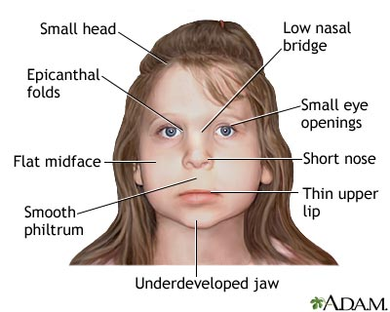
FETAL ALCOHOL SYNDROME
Occurs in children of women who consume large amounts of alcohol during pregnancy
Symptoms include facial deformities, heart defects, stunted growth, and cognitive impairments
Notes:
Alcoholism (fetal alcohol syndrome)—alcohol depresses both the mother’s and baby’s central nervous systems
Persistent heavy drinking will put the fetus at risk for birth defects and intellectual disability (1 in 800 infants FAS symptoms are marked by small, disproportioned head and lifelong bran abnormalities
A pregnant mother’s alcoholism may prime their child to like alcohol or the odor

Slide 33
REFLEXES
Rooting
Baby turns its head toward something that brushes its cheek and gropes around with mouth
Sucking
Newborn’s tendency to suck on objects placed in the mouth
Swallowing
Enables newborn babies to swallow liquids without choking
Grasping
Close fist around anything placed in their hand
Stepping
Stepping motions made by an infant when held upright
Notes:
Competent Newborn
Newborns are born with the basic survival skills (withdraw limbs to escape pain)
When something touches their cheeks, babies turn toward the touch, open their mouth and vigorously seek a nipple of a bottle or breast. When they find one, they automatically close on it and begin sucking which requires reflexive tonguing, swallowing and breathing
If a child fails at this, they may cry because they’re hungry
Researchers have used habituation (a decrease in responding with repeated stimulation)—the more often a stimulus is presented, the weaker the response becomes
Infants focus on the face first (eyes), not the body to remember items
Infants can remember smell within days after birth

Slide 34
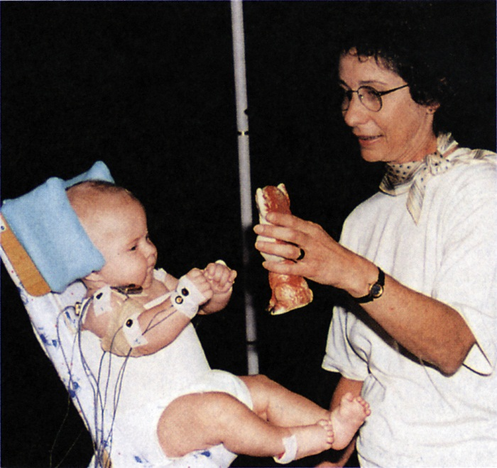
HABITUATION
Investigators study infants becoming habituated to objects over a period of time. Infants pay more attention to new objects than habituated ones, which shows they are learning
Notes:
Researchers have used habituation (a decrease in responding with repeated stimulation)—the more often a stimulus is presented, the weaker the response becomes
Infants focus on the face first (eyes), not the body to remember items
Infants can remember smell within days after birth

Slide 35
INFANCY AND CHILDHOOD
Notes:
Infancy = newborn → toddler
Childhood = toddler → teenager

Slide 36
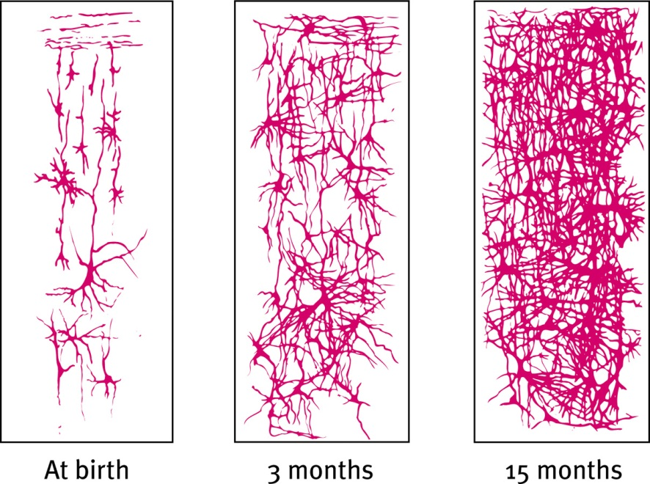
PHYSICAL DEVELOPMENT: BRAIN DEVELOPMENT
The developing brain overproduces neurons. Peaking around 28 billion at 7 months, these neurons are pruned to 23 billion at birth. The greatest neuronal spurt is in the frontal lobe enabling the individual to think rationally.
Notes:
Physical Development
Brain Development
The infant’s brain overproduces neurons as high as 23 billion at birth (the most you would ever need)—but not your nervous system
The branching neural network have wild growth spurts as you learn how to eat, walk, talk, and remember (from birth→3 months→15 months)
Ages 3-6-most rapid growth is in your frontal lobe
The association areas (linked with thinking, memory and language) are the last cortical areas to develop
The orderly sequence of biological growth = maturation (standing → walking, using nouns before adjectives)—basic course of development
Genetic growth tendencies are inborn; experience adjusts our maturation

Slide 37
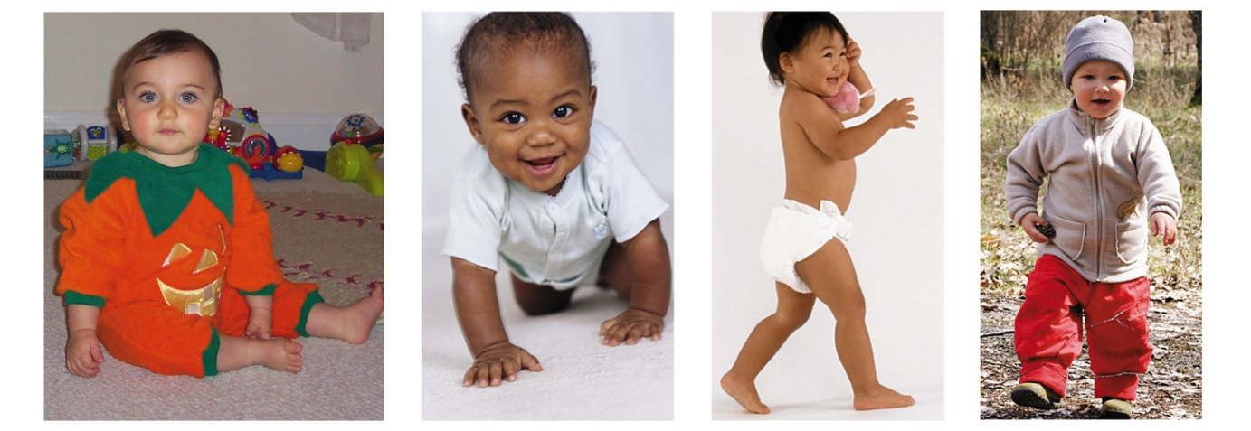
PHYSICAL DEVELOPMENT: MOTOR DEVELOPMENT
Developmental Norms
Ages by which an average child achieves various developmental milestones
First, infants begin to roll over. Next, they sit unsupported, crawl, and finally walk.
Experience has little effect on this sequence.
Notes:
Motor Development
Brain development = physical coordination
Motor development sequence is universal (reflect a growing nervous system)
1. Babies roll over before they sit unsupported
2. Babies crawl on all fours before they walk (about age 1)
Genes play a role in development
Identical twins typically begin sitting up and walking nearly on the same day
Sitting Unsupported – 6 months
Crawling – 8-9 months
Beginning to walk – 12 months
Walking independently – 15 months

Slide 38
PHYSICAL DEVELOPMENT: MATURATION AND INFANT MEMORY
The earliest age of conscious memory is around 3½ years . A 5-year-old has a sense of self and an increased long-term memory, thus organization of memory is different from 3-4 years.
Infantile amnesia!!
Notes:
Maturation and Infant Memory
Infantile amnesia—most memories before the age of 3.5 we don’t recall either at all or clearly
Our memories do process thinking during the first 4 years though—babies are capable of learning (kicking = moving the crib mobile—but needs to be the same mobile because babies recognize the original mobile and note the different between them)

Slide 39
Adulthood
Types of Studies
Adolescence
Late Adulthood
Childhood
Prenatal
Development
Unit 9
Developmental
Psych
Aging
Cognitive
Development
Moral
Development
Piaget’s
Stages
Vygotsky’s
Theory
Kohlberg
Gilligan
Social
Development
We are here
Erikson
Parenting
Styles
Gender

Slide 40
COGNITIVE DEVELOPMENT
Piaget believed that the driving force behind cognitive development is our biological development (maturation)
As we get older we enter into new cognitive stages.
Notes:
OBJECTIVE 8| State Piaget’s understanding of how the mind develops, and discuss the importance of assimilation and accommodation in this process.
Cognitive Development
Cognition = all the mental activities associated with thinking, knowing, remembering and communicating
Jean Piaget = developmental psychologist—started in 1920
Became intrigued by children’s wrong answers when given an intelligence test
His studies led him to believe that the child’s mind develops through a series of stages—in an upward march from newborn’s simple reflexes to the adult’s abstract reasoning power
Children realize that a mini slide is too small to slide down and a mini car is too small to get into (scale errors)

Slide 41
SCHEMAS
Schemas are mental molds that we use to organize our world and are formed from experiences.
Star Wars according to a 3 year old
https://www.youtube.com/watch?v=O1iqdHgIAig
Notes:
Children’s active minds build schemas (concepts or mental molds which we pour our experiences
Disney movie Bambi: When Bambi is sniffing the flowers with Thumper (rabbit) a little skunk pokes his head up through the flowers to say hello. Bambi, having just learned the word “flower,” immediately calls the skunk “Flower” mistaking him for what he was smelling. Bambi didn’t accommodate his schema for flowers after meeting the skunk

Slide 42
ASSIMILATION AND ACCOMMODATION
The process of assimilation involves incorporating new experiences into our current understanding (schema). The process of adjusting a schema and modifying it is called accommodation.
Bill Anderson/ Photo Researchers, Inc.
Jean Piaget with a subject
Notes:
Disney movie Bambi: When Bambi is sniffing the flowers with Thumper (rabbit) a little skunk pokes his head up through the flowers to say hello. Bambi, having just learned the word “flower,” immediately calls the skunk “Flower” mistaking him for what he was smelling. Bambi didn’t accommodate his schema for flowers after meeting the skunk
To explain how we use and adjust our schemas we assimilate new experiences (we interpret them in terms of our current understandings (schemas).
As we interact with the world, we also adjust (accommodate) our schemas to incorporate information provided by new experiences
Children experience spurts of change and stability as they move from one cognitive challenge to another. These challenges are Piaget’s four stages of children’s cognitive development

Slide 43
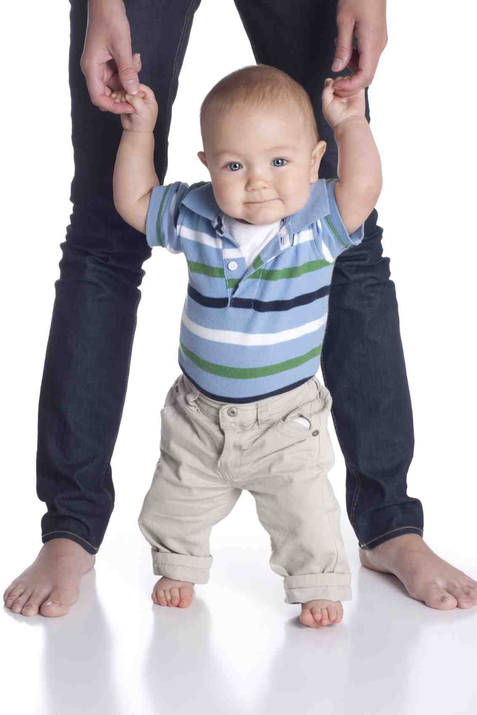
SENSIORMOTOR STAGE: 0-2
In the sensorimotor stage, babies take in the world by looking, hearing, touching, mouthing, and grasping.
They are learning to sense
They are learning to move
Notes:
Piaget’s Stages
1. Sensorimotor stage (birth -2 years)
Babies take in the world through their senses and actions (looking, hearing, touching, mouthing and grasping)

Slide 44
OBJECT PERMANENCE
THE major cognitive ability gained at this stage.
Definition - objects that are out of sight still exist. Drop the mic and walk away.
Children younger than 6 months of age do not grasp object permanence
https://www.youtube.com/watch?v=NCdLNuP7OA8
Notes:
Lack object permanence—things out of sight still exist even when out of sight
Babies =out of sight, out of mind
After 8-10 months, the infant will momentarily look for it
Researchers believe object permanence develops gradually

Slide 45
Other cognitive power-ups during the sensorimotor stage…
Stranger Anxiety
Separation Anxiety (depends on attachment to the parent)
Sense of Self
Notes:
Occurs once object perm is established
After object permanence emerges, children become mobile and by 8 months develop stranger anxiety (greet strangers by crying and reaching for familiar caregivers)
Have schemas for familiar faces; when they can’t assimilate the new faces into these remembered schemas, they become distressed
Separation anxiety from parents:
By 13 months a child’s separation from parents peaks, then gradually declines
The power of early attachment does gradually relax, allowing us to move out into exploration phases more easily and freely

Slide 46
Other cognitive power-ups during the sensorimotor stage…
Stranger anxiety: The fear of strangers that develops at around 8 months. This is the age at which infants form schemas for familiar faces and cannot assimilate a new face.
Notes:
OBJECTIVE 11| Define stranger anxiety.
Occurs once object perm is established
After object permanence emerges, children become mobile and by 8 months develop stranger anxiety (greet strangers by crying and reaching for familiar caregivers)
Have schemas for familiar faces; when they can’t assimilate the new faces into these remembered schemas, they become distressed

Slide 47
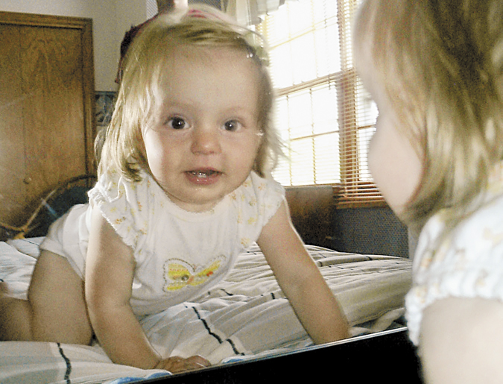
SOCIAL DEVELOPMENT: SELF-CONCEPT
Self-concept
Self-esteem
How they feel about who they are
Self-awareness
Begins when recognize self in mirror
Notes:
Self concept : 12
Self awareness: 15-18 months (schema on how their face looks)
Self-Concept
By the end of childhood, (age 12), most children have developed a self-concept—an understanding and assessment of who they are
Self-awareness begins when we recognize ourselves in a mirror (Charles Darwin-1877), by 15-18 months, children recognize their face-self recognition reflection in their mirror
Adoptive children often display resilience and researchers did not find any difference in self-esteem by a lack of parental involvement early in life

Slide 48
Other cognitive power-ups during the sensorimotor stage…
Separation anxiety peaks at 13 months of age, regardless of whether the children are home or sent to day care.

Slide 49
SENSIORMOTOR STAGE: CRITICISMS
Piaget believed children in the sensorimotor stage could not think —they do not have any abstract concepts or ideas.
However, recent research shows that children in the sensorimotor stage can think and count.
Children understand the basic laws of physics. They are amazed at how a ball can stop in midair or disappear.
Notes:
Criticism of Piaget’s conclusions:
Researchers believe Piaget underestimated young children’s competence
Infants stare longer at unbelievable tricks, impossible images longer than adults—babies have more of an intuitive grasp of simple laws of physics than Piaget realized
Infants sometimes do a double take, staring longer when shown a wrong number of objects
Babies number sense extends to larger numbers and such things as drumbeats and motions

Slide 50
SENSIORMOTOR STAGE: CRITICISMS
2. Children can also count. Wynn (1992, 2000) showed that children stared longer at the wrong number of objects than the right ones.

Slide 51
PREOPERATIONAL STAGE: 2 - 6/7
Piaget suggested that from 2 years old to about 6-7 years old, children are in the preoperational stage—too young to perform mental operations.
Notes:
2. Preoperational Stage (2 yrs-6 or 7 years old)
Too young to perform mental operations

Slide 52
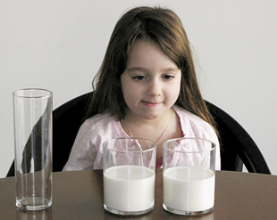
LACK OF CONSERVATION
Conservation: (lack this) the principle that quantity remains the same despite changes in shape
Notes:
2. Preoperational Stage (2 yrs-6 or 7 years old)
Too young to perform mental operations
Children at this age lack the concept of conservation—the principle that quantity remains the same despite changes in shape (pouring a short glass of milk into a tall skinny glass)
Judy DeLoache (1987) counters Piaget’s view that children do use symbolic thinking through models to be able to locate a stuffed animal in a real room

Slide 53
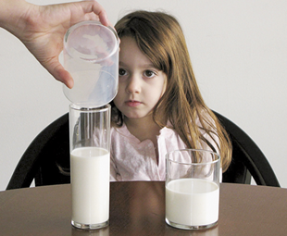
LACK OF CONSERVATION
Preoperational Stage
Conservation
Notes:
2. Preoperational Stage (2 yrs-6 or 7 years old)
Too young to perform mental operations
Children at this age lack the concept of conservation—the principle that quantity remains the same despite changes in shape (pouring a short glass of milk into a tall skinny glass)
Judy DeLoache (1987) counters Piaget’s view that children do use symbolic thinking through models to be able to locate a stuffed animal in a real room

Slide 54
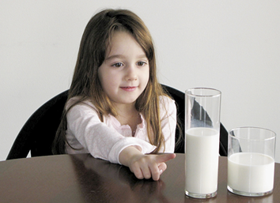
LACK OF CONSERVATION
Preoperational Stage
Conservation
https://www.youtube.com/watch?v=gnArvcWaH6I
Notes:
2. Preoperational Stage (2 yrs-6 or 7 years old)
Too young to perform mental operations
Children at this age lack the concept of conservation—the principle that quantity remains the same despite changes in shape (pouring a short glass of milk into a tall skinny glass)
Judy DeLoache (1987) counters Piaget’s view that children do use symbolic thinking through models to be able to locate a stuffed animal in a real room

Slide 55
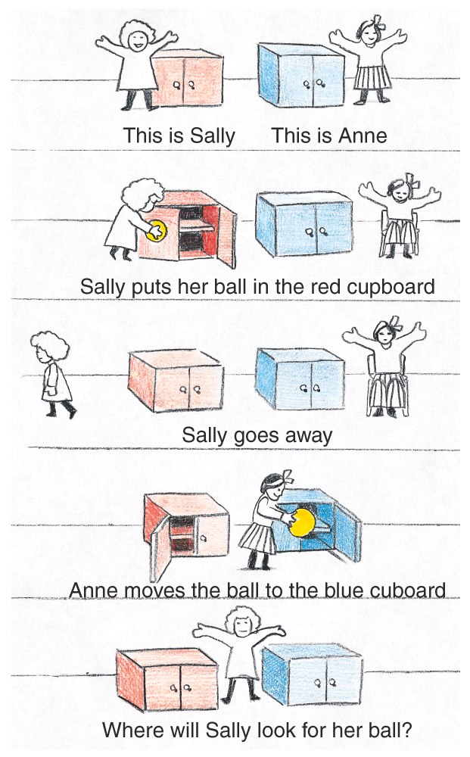
DEVELOPMENT OF A THEORY OF MIND
Preschoolers, although still egocentric, develop the ability to understand another’s mental state when they begin forming a theory of mind.
The problem on the right tests such ability in children.
Notes:
Piaget concluded that preschool children are egocentric (difficulty perceiving things from another’s point of view)
Children form a theory of mind (ability to read intentions)
Understand what made a playmate angry, what may make a parent buy a toy
They begin to tease, empathize and persuade
Children with Autism have a difficult time trying to reflect on their own mental states (using I and me)
By age 7, children become capable of thinking in words and using words to work out solutions to problems
Children who talk to themselves helps to control their behavior and emotions and master new skills

Slide 56
LANGUAGE DEVELOPMENT
Holographic Speech
Telegraphic Speech
1 year old
“Ball”
2 years old
“Want Ball”/”Where Ball”
Notes:
Children move through two stages of language development
Holographic speech –appears around 1 year old involves using single words to stand for a whole sentence of meaning
“Ball” could mean I want the ball or where is the ball
Telegraphic speech—appears around 2 years old involves two word phrases that communicate more meaning
“Want ball” and “where ball”

Slide 57
CONCRETE OPERATIONAL: 6/7 - 12
In concrete operational stage, given concrete materials, 6- to 7-year-olds grasp conservation problems and mentally pour liquids back and forth into glasses of different shapes conserving their quantities.
Children in this stage are also able to transform mathematical functions. So, if 4 + 8 = 12, then a transformation, 12 – 4 = 8, is also easily doable.
Notes:
3. Concrete Operational Stage (by 6-7 years old-12)
Given concrete objects, children begin to grasp conservation (they understand that change in form does not mean change in quantity)
Children fully gain the mental ability to comprehend math transformations and conservation
Answering reverse simple math (8 +4=12, 12-4 = 8)

Slide 58
FORMAL OPERATIONAL STAGE: 12+
Around age 12, our reasoning ability expands from concrete thinking to abstract thinking. We can now use symbols and imagined realities to systematically reason. Piaget called this formal operational thinking.
Abstract concepts (If this, then that)
Notes:
4. Formal Operational Stage (12-adult)
Our reasoning expands to abstract thinking (involving imagined realities and symbols)
Adolescence can solve hypothetical propositions and consequences (if this, then that)
Systematic reasoning = formal operational thinking
Abstract thinking starts around 7 years old:
“If John is in school, then Mary is in school. John is in school. What can you say about Mary?
Not necessarily the ultimate end stage of cognitive thinking. Some studies have shown that even college students have trouble with some of Piaget’s formal operational problems, while young children solved some of those same problems—some people will never reach the Formal Operational Stage

Slide 59
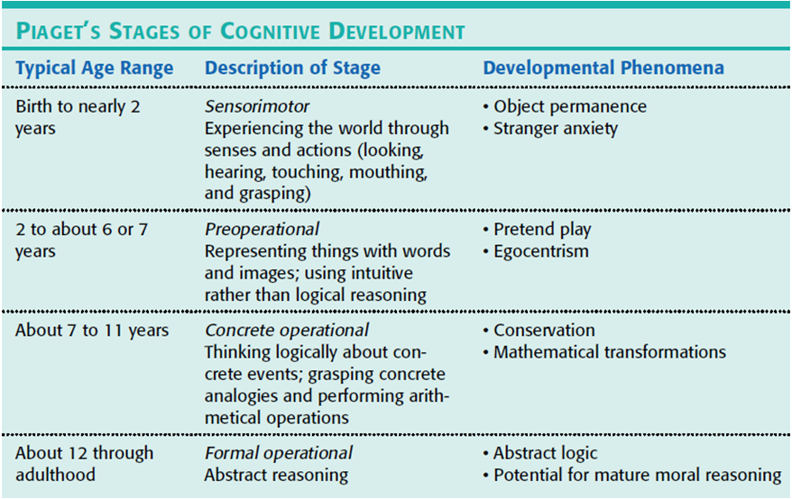

Slide 60
REFLECTING ON PIAGET’S THEORY
Piaget’s stage theory has been influential globally, validating a number of ideas regarding growth and development in many cultures and societies. However, today’s researchers believe the following:
Development is a continuous process.
Children express their mental abilities and operations at an earlier age.
Formal logic is a smaller part of cognition.
Notes:
OBJECTIVE 10| Discuss psychologists’ current views on Piaget’s theory of cognitive development.

Slide 61
Adulthood
Types of Studies
Adolescence
Late Adulthood
Childhood
Prenatal
Development
Unit 9
Developmental
Psych
Aging
We are here
Cognitive
Development
Moral
Development
Piaget’s
Stages
Vygotsky’s
Theory
Kohlberg
Gilligan
Social
Development
Erikson
Parenting
Styles
Gender

Slide 62
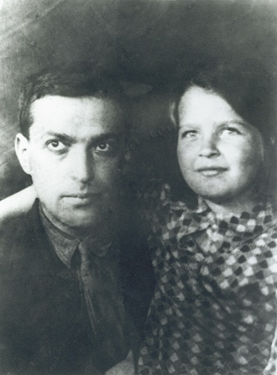
LEV VYGOTSKY
“It is through others that we become ourselves”
All learning is social
“What a child can do in co-operation today he can do alone tomorrow”
Guided participation, ZPD, scaffolding

Slide 63
VYGOTSKY’S IDEAS
Different than Piaget’s image of the individual constructing understanding alone
Everything is social
Vygotsky saw cognitive development as depending more on interactions with people & tools in the child’s world.
Tools are real: pens, paper, computers;
or Tools are symbols: language, math systems, signs

Slide 64
THE BIG IDEAS…
Vygotsky developed the theory of the Zone of proximal development (ZPD)
The distance between where a learner is at developmentally on their own & where a learner could be with the help of a more knowledgeable other.
A more knowledgeable other can be an adult or a peer, helping a learner in this way is to scaffold their learning. Scaffolding occurs through the process of internalization… mediated by language and though (see youtube).

Slide 65
THE BIG IDEAS…
Explained complex learning through Guided Participation.
Explained things that are taught rather than discovered (reading, writing etc.)
a way to “share the thinking load”
Helping a novice accomplish a complex task
Assistance can be physical or mental & come from adults or peers
Scaffolding: where the more knowledgeable other provides some type of structure.

Slide 66
GUIDED PARTICIPATION
A mother sitting with her toddler singing, “Baa, baa black sheep have you any wool, yes sir, yes sir ….” at this point the mother pauses and the child sings loudly,
“THREE BAGS FULL!”
How is this guided participation?

Slide 67
SOCIAL DEVELOPMENT

Slide 68
Adulthood
Types of Studies
Adolescence
Late Adulthood
Childhood
Prenatal
Development
Unit 9
Developmental
Psych
Aging
We are here
Cognitive
Development
Moral
Development
Piaget’s
Stages
Vygotsky’s
Theory
Kohlberg
Gilligan
Social
Development
Erikson
Parenting
Styles
Gender

Slide 69
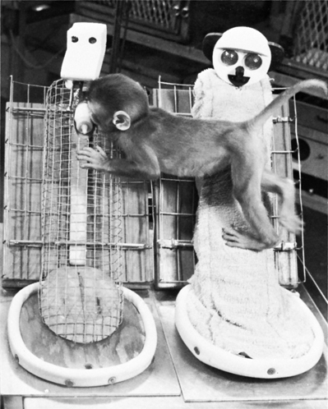
SOCIAL DEVELOPMENT: ORIGINS OF ATTACHMENTS
Familiarity
Critical period
Imprinting
Sensitive period
https://www.youtube.com/watch?v=_O60TYAIgC4
https://www.youtube.com/watch?v=hsA5Sec6dAI
Notes:
Familiarity
Attachment based on familiarity forms during a critical period (an optimal period when certain events must take place to facilitate proper development
Familiarity = safety and breeds content of the child or animal
For goslings, ducklings and chicks = hours shortly after hatching; first moving object they see = mother—the young follow her and her alone
Konrad Lorenz (1937) explored imprinting—what would happen if ducklings were first exposed to a human instead of their mother? They would follow the human around
Baby birds imprint best to their own species, but will imprint to a variety of moving objects
Once formed, this attachment is difficult to reverse
Children do not imprint, but do become attached during a sensitive period to what they’ve known
Mere exposure to things and people fosters fondness (children like to reread the same books, rewatch the same movies, eat familiar foods)
(Being around an object long enough will cause one to develop an affection for the object)

Slide 70
Psychologists Harry Harlow and Margaret Harlow raised monkeys with two artificial mothers—one a bare wire cylinder with a wooden head and an attached feeding bottle, the other a cylinder with no bottle but covered with foam rubber and wrapped with terry cloth. The Harlows’ discovery surprised many psychologists: The infants much preferred contact with the comfortable cloth mother, even while feeding from the nourishing mother.
Monkeys raised with artificial mothers were terror-stricken when placed in strange situations without their surrogate mothers.

Slide 71
ORIGINS OF ATTACHMENT
Harlow (1971) showed that infants bond with surrogate mothers because of bodily contact and not because of nourishment.
Harlow Primate Laboratory, University of Wisconsin
Notes:
OBJECTIVE 12| Discuss the effects of nourishment, body contact, and familiarity on infant social attachment.
Body Contact
1950s: University of Wisconsin psychologists Harry Harlow and Margaret Harlow bred monkeys for their learning studies
Monkey babies were separated from their mothers at birth and raised them in sanitary individual cages to equalize the monkeys’ experience & isolate them from disease
Slept with a cheesecloth baby blanket; when they removed it, the monkeys were distressed (challenged the theory that monkeys/humans were attached to those who nourished them)
They created two artificial mothers—one was a bare wire cylinder with a wooden head and an attached feeding bottle, the other a cylinder wrapped with terry cloth (no bottle)
When raised with both, the baby monkey preferred the comfy cloth mother over the nourishing fake mother
Other qualities (rocking, warmth, and feeding) made the cloth mother even more appealing
Touch is important—snuggles or tickling no matter if the child is a baby or an older adult with their spouse

Slide 72
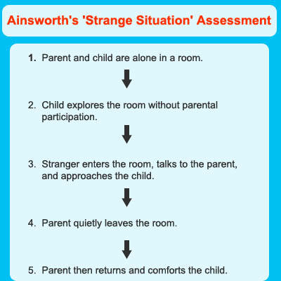
SOCIAL DEVELOPMENT: ATTACHMENT DIFFERENCES: TEMPERAMENT AND PARENTING
https://www.youtube.com/watch?v=DH1m_ZMO7GU
Notes:
Attachment Differences: Temperament and Parenting
Placed in a strange situation (a laboratory playroom), about 60% of infants will display secure attachment
In their mother’s presence, children will play happily and explore their new environment. When she leaves, they are distressed (sad she left—does not indicate a weak relationship with mom). When she returns, they seek comfort with her.
Other infant avoid attachment or show insecure attachment (less likely to explore their surroundings or may cling to their mother). When the mother leaves, the infants cry or remain upset until she returns
Mary Ainsworth (1979) designed strange situation experiments and studied attachment differences by observing mother-infant pairs at home during their first 6 months
Later she observed the 1 year old infants in a strange situation without their mothers
Mother who were sensitive (who noticed what their babies were doing and responded appropriately) had infants who exhibited secure attachment
Insensitive, unresponsive mothers (who ignored their babies at times) had infants who became insecurely attached (Harlow’s monkeys with the cloth v. wire mothers in the strange room)

Slide 73
ATTACHMENT DIFFERENCES
Placed in a strange situation, 60% of children express secure attachment, i.e., they explore their environment happily in the presence of their mothers. When their mother leave, they show distress.
The other 30% show insecure attachment. These children cling to their mothers or caregivers and are less likely to explore the environment.
Notes:
OBJECTIVE 13| Contrast secure and insecure attachment, and discuss the roles of parents and infants in the development of attachment and an infant’s feelings of basic trust.
Attachment Differences: Temperament and Parenting
Placed in a strange situation (a laboratory playroom), about 60% of infants will display secure attachment
In their mother’s presence, children will play happily and explore their new environment. When she leaves, they are distressed (sad she left—does not indicate a weak relationship with mom). When she returns, they seek comfort with her.
Other infant avoid attachment or show insecure attachment (less likely to explore their surroundings or may cling to their mother). When the mother leaves, the infants cry or remain upset until she returns
Mary Ainsworth (1979) designed strange situation experiments and studied attachment differences by observing mother-infant pairs at home during their first 6 months
Later she observed the 1 year old infants in a strange situation without their mothers
Mother who were sensitive (who noticed what their babies were doing and responded appropriately) had infants who exhibited secure attachment
Insensitive, unresponsive mothers (who ignored their babies at times) had infants who became insecurely attached (Harlow’s monkeys with the cloth v. wire mothers in the strange room)

Slide 74
SECURE ATTACHMENT
Relaxed and attentive caregiving becomes the backbone of secure attachment.
Berry Hewlett
Notes:
Placed in a strange situation (a laboratory playroom), about 60% of infants will display secure attachment
In their mother’s presence, children will play happily and explore their new environment. When she leaves, they are distressed (sad she left—does not indicate a weak relationship with mom). When she returns, they seek comfort with her.

Slide 75
INSECURE ATTACHMENT
Harlow’s studies showed that monkeys experience great anxiety if their terry-cloth mother is removed.
Harlow Primate Laboratory, University of Wisconsin
Notes:
Other infant avoid attachment or show insecure attachment (less likely to explore their surroundings or may cling to their mother). When the mother leaves, the infants cry or remain upset until she returns
Mary Ainsworth (1979) designed strange situation experiments and studied attachment differences by observing mother-infant pairs at home during their first 6 months
Later she observed the 1 year old infants in a strange situation without their mothers
Mother who were sensitive (who noticed what their babies were doing and responded appropriately) had infants who exhibited secure attachment
Insensitive, unresponsive mothers (who ignored their babies at times) had infants who became insecurely attached (Harlow’s monkeys with the cloth v. wire mothers in the strange room)

Slide 76
DEPRIVATION OF ATTACHMENT
What happens when circumstances prevent a child from forming attachments?
In such circumstances children become:
Withdrawn
Frightened
Unable to develop speech
Notes:
OBJECTIVE 14| Assess the impact of parental neglect, family disruption, and day care on attachment patterns and development.
Deprivation of Attachment
Babied raised in institutions without the stimulation and attention of a regular caregiver, or locked away at home under conditions of abuse or extreme neglect, are often withdrawn, frightened, even speechless
Some humans who were abused as a child do not become violent criminals or abusive parents
30% however who have been abused do abuse their children
These children have changed levels of serotonin which calms aggressive impulses—these children become aggressive teens and adults
Young children who are terrorized through physical abuse or wartime atrocities may suffer long-term depression, nightmares and an adolescence troubled by substance abuse, binge eating or aggression

Slide 77
PROLONGED DEPRIVATION
If parental or caregiving support is deprived for an extended period of time, children are at risk for physical, psychological, and social problems, including alterations in brain serotonin levels.
Notes:
Disruption of Attachment
Separated from their families, infants and monkeys become upset and withdrawn
If placed in a more positive and stable environment, most infants recover from the separation distress
Children moving in and out of foster families can be disruptive, have deep sadness

Slide 78
TEMPERAMENT
Temperament refers to characteristic patterns of emotional reactions and emotional self-regulation
Three basic types of babies
Easy
Good-natured, easy to care for, adaptable
Difficult
Moody and intense, react to new situations and people negatively and strongly
Slow-to-warm-up
Inactive and slow to respond to new things, and when they do react, it is mild
Notes:
Sensitive mothers & fathers tend to have securely attached infants
Infants temperament can vary from one baby to another and you can tell by the first few weeks of life:
Difficult babies are more irritable, intense and unpredictable
Easy babies are cheerful, relaxed and predictable in feeding and sleeping
Slow-to-warm-up infants tend to resist or withdraw from new people and situations
Heredity predisposes temperament differences → neurotransmitter serotonin predisposes a fearful temperament and (in combination with unsupportive caregiving) a fearful, edgy child
Temperament differences:
Infants who lack a caring mother suffer from “maternal deprivation”; those lacking a father’s care experience “father absence”
A father’s love and acceptance have been comparable to a mother’s love in predicting their offspring’s health and well-being

Slide 79
TEMPERAMENT
Kagan has added a fourth type
Shy child
Timid and inhibited, fearful of anything new or strange
Temperament may predict later disposition
Notes:
Temperament differences:
Infants who lack a caring mother suffer from “maternal deprivation”; those lacking a father’s care experience “father absence”
A father’s love and acceptance have been comparable to a mother’s love in predicting their offspring’s health and well-being

Slide 80
Adulthood
Types of Studies
Adolescence
Late Adulthood
Childhood
Prenatal
Development
Unit 9
Developmental
Psych
Aging
Cognitive
Development
Moral
Development
Piaget’s
Stages
We are here
Gilligan
Vygotsky’s
Theory
Kohlberg
Social
Development
Erikson
Parenting
Styles
Gender

Slide 81
CHILD-REARING PRACTICES
Practice | Description
Authoritarian | Parents impose rules and expect obedience.
Permissive | Parents submit to children’s demands.
Authoritative | Parents are demanding but responsive to their children.
Notes:
OBJECTIVE 16| Describe three parenting styles, and offer three potential explanations for the link between authoritative parenting and social competence.
Parenting Styles
Three parenting styles by Diana Baumrind (1996):
1. Authoritarian parents impose rules and expect obedience (“Don’t stay out too late or you’ll be grounded. Why? Because I said so”
Oppressive dictator : Adolf Hitler, Saddam Hussein
Children tend to have less social skills and self-esteem
Low responsiveness/high demandingness
2. Permissive parents submit to their children’s desires. They make few demands and use little punishment.
“Laissez Faire” type of government in the 1920s
Children tend to be more aggressive and immature
High responsivess/low demandingless
3. Authoritative parents are both demanding and responsive. They exert control by setting rules and enforcing them, but they also explain the reason for rules. Older children = encourage open discussion when making rules and allowing for exceptions
U.S. President—symbol of democracy, where individuals are expected to be rational and law-abiding
High responsiveness & High demandingness
Researchers reveal that children with the highest self-esteem, self-reliance, and social competence usually have warm, concerned, authoritative parents

Slide 82
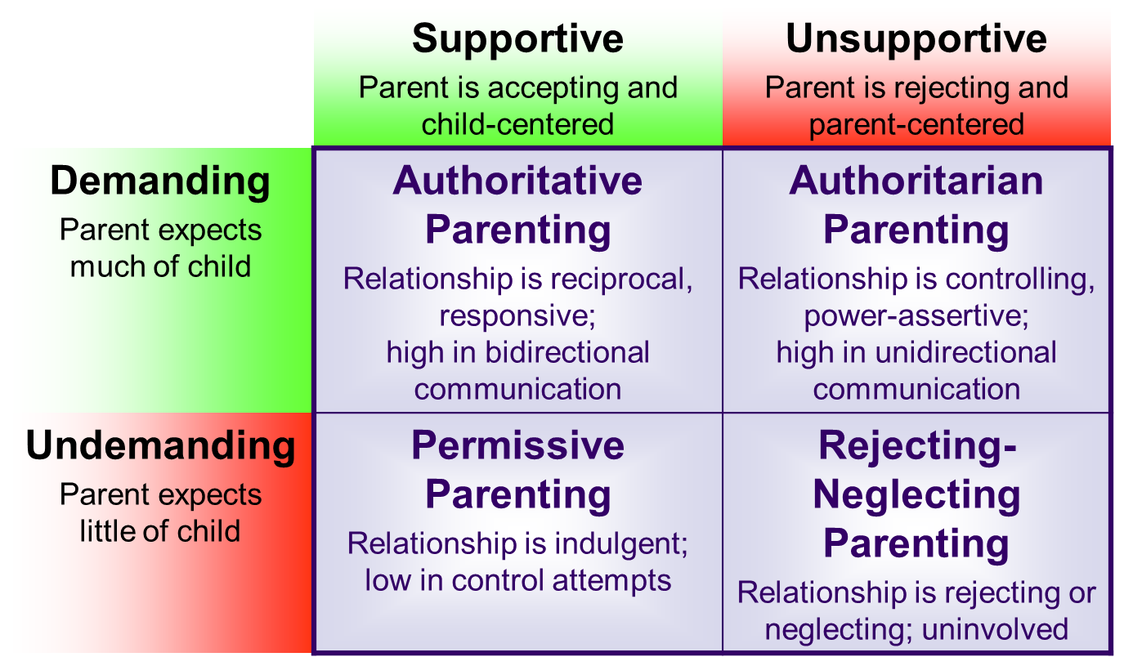

Slide 83
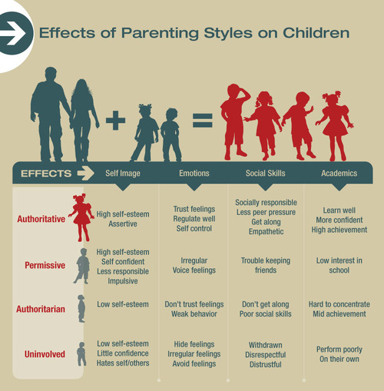

Slide 84
AUTHORATATIVE PARENTING
Authoritative parenting correlates with social competence — other factors like common genes may lead to an easy-going temperament and may invoke an authoritative parenting style.

Slide 85
SOCIAL DEVELOPMENT: CULTURE AND CHILD-REARING
Differences in child-rearing from culture to culture
Independence vs. family self
Notes:
*These are correlational studies –no causation
Culture and a child’s personality traits can impact the effectiveness of parenting
Some cultures strive for independence (Western hemisphere) of children or having a family self (Asian, Africans)—what brings honor to the family brings honor to the self

Slide 86
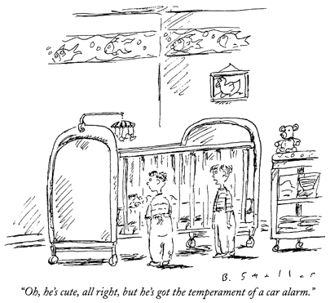
SOCIAL DEVELOPMENT: ATTACHMENT DIFFERENCES: TEMPERAMENT AND PARENTING
Erik Erikson’s Basic trust
A sense that the world is predictable and reliable
Attributed to early parenting
Notes:
Separation anxiety from parents:
By 13 months a child’s separation from parents peaks, then gradually declines
The power of early attachment does gradually relax, allowing us to move out into exploration phases more easily and freely
Erik Erikson (developmental theorist) said that securely attached children approach life with a sense of basic trust (a sense that the world is predictable and reliable)—attributed to early parenting

Slide 87
Adulthood
Types of Studies
Adolescence
Late Adulthood
Childhood
Prenatal
Development
Unit 9
Developmental
Psych
Aging
Cognitive
Development
Moral
Development
Piaget’s
Stages
Vygotsky’s
Theory
Kohlberg
Gilligan
Social
Development
We are here
Erikson
Parenting
Styles
Gender

Slide 88
GENDER
a socially constructed notion of what is feminine and what is masculine

Slide 89
GENDER DEVELOPMENT: GENDER SIMILARITIES AND DIFFERENCES
Gender
Biological and social characteristics by which people define male/female
45 out of 46 chromosomes are unisex
Gender and aggression
Males more physically aggressive
Gender and Social Power
Men more socially dominant, powerful in most societies
Gender and Social Connectedness
Females more interdependent – spend more time with others than alone
Notes:
Gender Development
Gender = biological and social characteristics by which people define male or female
Males and females are a similar sex—out of the 46 chromosomes, 45 of them are unisex
Men tend to behave more physically aggressively
In most societies, men are socially dominant, powerful and focus on achievement
Females are concerned with social connectedness (surface in early years as children play) in smaller groups with one friend, less competitive
Females are more interdependent—spend time with others instead of alone
Gender differences may be influenced by our differing sex chromosomes and physiologically from our differing concentrations of the sex hormones
23rd pair of chromosomes—two sex chromosomes
From your mother = X chromosome
From your father you either received another X chromosome (girl) or a Y chromosome (boy)—includes the master switch triggering the testes to develop and produce the principal male hormone (testosterone)
Females also have testosterone, but less of it

Slide 90
GENDER DEVELOPMENT: THE NATURE OF GENDER
Gender differences influenced by differing sex chromosomes and sex hormones
X chromosome – from mother
X or Y chromosome – from father
Females also have testosterone, just less

Slide 91
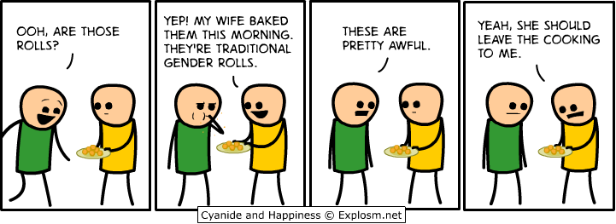
GENDER DEVELOPMENT: THE NURTURE OF GENDER
Gender Roles
Shaped by cultural standards and generational influences
Expectations how men/women behave
In and out of the home
Does culture construct gender roles?
Notes:
Gender roles are shaped by a person’s cultural standards and generational (family) influences

Slide 92
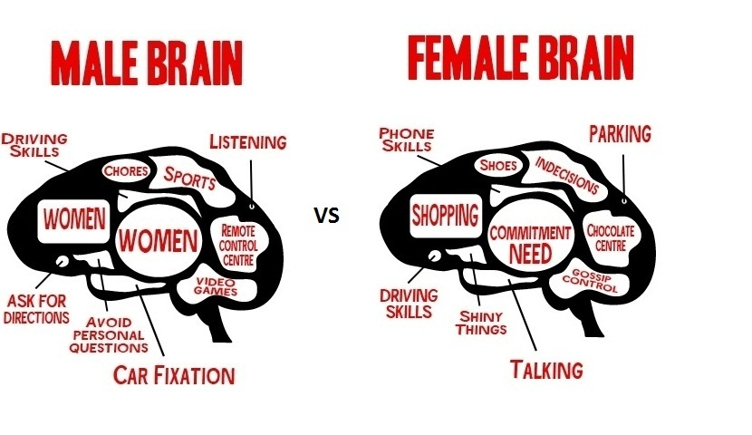
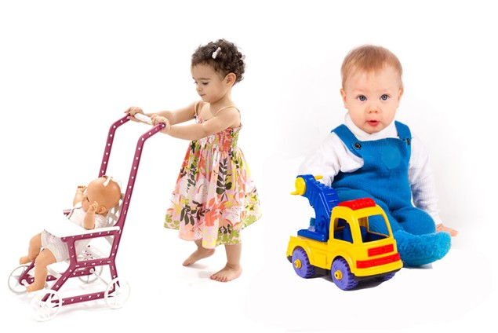
GENDER DEVELOPMENT: THE NURTURE OF GENDER
Gender and Child Rearing – influence of parents
Gender Identity
Sense of being male or female
Social Learning Theory
Gender typing
Gender Schema
Notes:
Gender identity: our sense of being male or female (masculinity or femininity)
Social learning theory: assumes that children learn gender linked behaviors by observing and imitating and by being rewarded or punished
Gender typing: Some males exert overly masculine traits—Boy world: (Boys don’t cry) or overly feminine traits—Girl world: (Sarah you are such a great Mommy to your dolls)
Your gender schema is a lens through which you view your experiences and take your gender identity through development

Slide 93
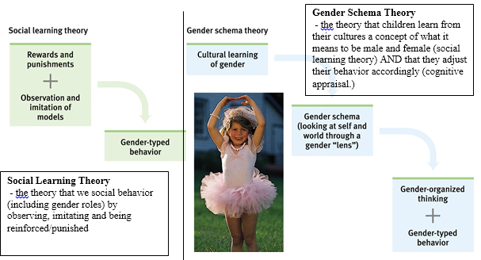
GENDER TYPING THEORIES

Slide 94
PARENTS AND PEERS

Slide 95
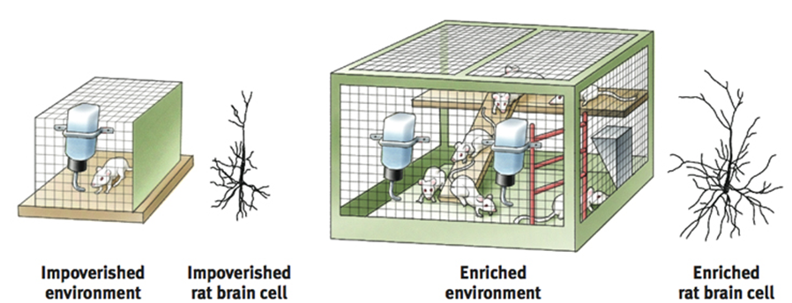
PARENTS AND EARLY EXPERIENCE
Experience and brain development
Notes:
Parents & Peers
Experience (stimulation by touch or massage) affects brain development
Both nature & nurture sculpt our synapses (after brain maturation provides us with an abundance of neural connections, our experiences trigger a pruning process)—sights, smells, touches and tugs activate connections and strengthen them
We perform with increasing skill as our brain incorporates the new learning (brain’s plasticity and neural tissue always changing)—always learn as you grow older

Slide 96
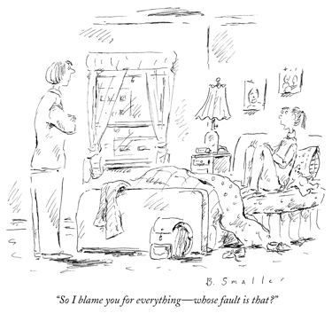
PARENTS AND EARLY EXPERIENCE
How much credit (or blame) do parents deserve?
political attitudes,
religious beliefs,
personal matters
Notes:
Society blames parents for a child’s behavioral or learning problems and praise parents of children who have good morals and are well behaved
Parents do matter—the power of the family environment shows up in children’s political attitudes, religious beliefs and personal manners
Parents are more important when it comes to education, discipline, responsibility, orderliness, charitableness and ways of interacting with authority figures

Slide 97
PEER INFLUENCE
Peer influence
Notes:
Peer Power: Children get their culture from their peers---slang words, accents because they have peer similarity (similar peers with similar interests and attitudes)
Peers are more important for learning cooperation, for finding the road to popularity, for inventing styles of interaction among people of the same age

Slide 98
ADOLESCENCE

Slide 99
We are here
Adulthood
Types of Studies
Adolescence
Late Adulthood
Childhood
Prenatal
Development
Unit 9
Developmental
Psych
Aging
Cognitive
Development
Moral
Development
Piaget’s
Stages
Vygotsky’s
Theory
Kohlberg
Gilligan
Social
Development
Erikson
Parenting
Styles
Gender

Slide 100
INTRODUCTION
Adolescence
Notes:
Adolescence
As we know adolescence today did not evolve until the early 20th century when child-labor laws and compulsory education delayed the social onset of adulthood = a time of storm and stress (G. Stanley Hall—Father of American psychology; studied under Wilhelm Wundt and founded the APA—learning the new science of psychology in the first experimental lab in Germany)
Adolescence = the years spent morphing from child to adult—starts with the physical beginnings of sexual maturity and ends with the social achievement of independent adult status
A time of rewarding friendships, heightened idealism & a growing sense of life’s exciting possibilities
In some cultures, adolescence never hits if they are self-supporting as children

Slide 101
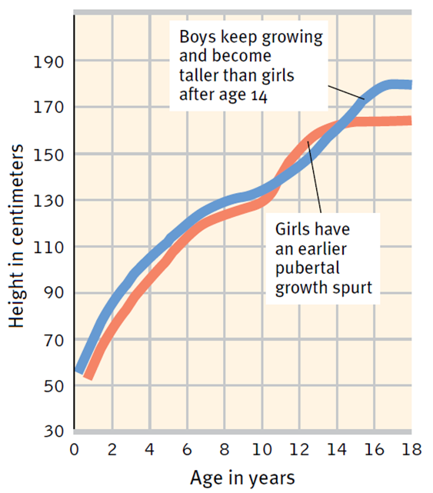
PHYSICAL DEVELOPMENT
Notes:
Physical Development
Adolescence begins with puberty (the time when teens sexually mature)
Puberty follows a surge of hormones which may intensify moods and trigger a 2 year period of rapid physical development
Begins around age 11 for girls, 13 for boys
Boys growth is longer usually than girls—girls growth spurt from 11-13
During this growth spurt, the primary sex characteristics (the reproductive organs and external genitalia) develop dramatically
So do secondary sex characteristics (the nonproductive traits –breasts, hips in girls and facial hair and deepened voice for boys; pubic hair and underarm hair for both sexes
First menstrual period (menarche)=puberty’s landmarks for females and first ejaculation in boys (spermarche)—often in their sleep

Slide 102
COGNITIVE DEVELOPMENT: DEVELOPING REASONING POWER
Piaget’s formal operations
Frontal lobe develops
Limbic system lags frontal lobe
Notes:
Brain Development
Until puberty, brain cells increase their connections. Then during adolescence, comes a selective pruning (weeding out) of unused neurons and connections
As teens mature, their frontal lobes continue to develop
The growth of myelin (myelin sheath)—the fatty tissue that forms around axons and speeds neurotransmission, enables better communication with other brain regions
These developments bring improved judgment, impulse control and the ability to plan for the long term—adulthood
Frontal lobe maturation lags the emotional limbic system
Puberty’s hormonal surge and limbic system development help explain teens’ occasional impulsiveness, risky behaviors, emotional storms (slamming doors, turning up the music)
Your frontal lobe will continue maturing until about age 25

Slide 103
Adulthood
Types of Studies
Adolescence
Late Adulthood
Childhood
Prenatal
Development
Unit 9
Developmental
Psych
Aging
We are here
Cognitive
Development
Moral
Development
Piaget’s
Stages
Vygotsky’s
Theory
Kohlberg
Gilligan
Social
Development
Erikson
Parenting
Styles
Gender

Slide 104
COGNITIVE DEVELOPMENT: DEVELOPING MORALITY
Lawrence Kohlberg
Posed moral dilemmas to children, adolescents and adults
Morality involves doing the right thing, which can be influenced by social influences
Notes:
Developing Morality –Morality = Kohlberg
Two crucial tasks of childhood & adolescence = differentiating between right & wrong and developing character
To be moral we must think morally and act accordingly
Lawrence Kohlberg sought to describe the development of moral reasoning (the thinking that occurs as we consider right and wrong)
Kohlberg posed moral dilemmas (whether a person should steal medicine to save a loved one’s life?)
Asked children, adolescents & adults
Morality
The mind makes moral judgments quickly & automatically—gut feeling
If we see generosity, compassion, courage, we feel joy, elevation for their actions
Morality involves doing the right thing, which can be influenced by social influences
As our thinking matures, our behavior becomes less selfish and more caring
Learn empathy for others’ feelings and self-discipline to restraint one’s own impulses

Slide 105
KOHLBERG’S MORALITY
Level I: Pre-conventional: Egocentric orientation focusing on moral consequences for the self; reasoning found until about 10 years of age
Level II: Conventional: Moral reasoning linked to perspectives of, and concerns for, others (i.e. loyalty, obeying the law, family obligation); typical of 10 to 20 yr olds.
Level III: Post-conventional: Reasoning transcends society’s rules; reflects an understanding that rules sometimes need to be changed/ignored.
Notes:
Identified three basic levels of moral thinking to form a moral ladder
1. Preconventional morality: Before age 9, most children’s morality focuses on self-interest. They obey rules either to avoid punishment or to gain concrete rewards
Found in people before they joined society as “adults”
2. Conventional morality: By early adolescence, morality focuses on caring for others and on upholding law & social rules, simply because they are laws and rules
Most prevalent among people in general society
3. Postconventional morality: Abstract reasoning = Actions are judged “right” because they flow from people’s rights or from self-defined, basic ethical principles.
Occurs mostly in European & North American educated middle class which strive for individualism
Kohlberg believes it exists, but was not able to find enough people to study over a long period of time to validate it

Slide 106
Adulthood
Types of Studies
Adolescence
Late Adulthood
Childhood
Prenatal
Development
Unit 9
Developmental
Psych
Aging
Cognitive
Development
Moral
Development
Piaget’s
Stages
Vygotsky’s
Theory
Kohlberg
Gilligan
Social
Development
We are here
Erikson
Parenting
Styles
Gender

Slide 107
GENDER DIFFERENCES IN MORALITY AND CRITICISMS OF KOHLBERB
Are there gender differences? Do men and women approach moral dilemmas differently?
Some suggest:
Men: judgment on abstract concepts (justice, rules, individual rights)
Women: Interpersonal connections and attention to human needs
Ultimately, findings mixed
Kohlberg focused exclusively on cognitive aspects of moral reasoning/development
Critics of Kohlberg’s theory say he is biased against moral reasoning in collectivist societies
Notes:
Critics of Kohlberg’s theory says he is biased against the moral reasoning in collectivist (conformist) type of societies (China, India)

Slide 108
GILLIGAN’S VIEW OF MORAL DEVELOPMENT
Student of Kohlberg and later became critical of some of his ideas (Kohlberg only studied boys)
Females develop along different path
Preconventional: Care is egocentric
Conventional: Care results from internalized focus on others, while neglecting oneself
Postconventional: Critical of approach in Conventional stage; Learn to balance caring for self with caring for others.

Slide 109
Adulthood
Types of Studies
Adolescence
Late Adulthood
Childhood
Prenatal
Development
Unit 9
Developmental
Psych
Aging
Cognitive
Development
Moral
Development
Piaget’s
Stages
Vygotsky’s
Theory
Kohlberg
Gilligan
Social
Development
We are here
Erikson
Parenting
Styles
Gender

Slide 110
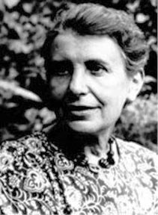
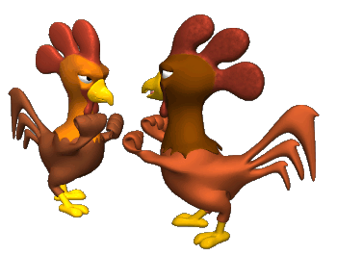
ERIK ERIKSON
A neo-Freudian
Worked with Anna Freud
Thought our personality was influenced by our experiences with others.
Stages of Psychosocial Development.
Each stage centers on a social conflict.

Slide 111
ERIKSON’S PSYCHOSOCIAL STAGES OF DEVELOPMENT
8 successive stages over the lifespan
Crisis: must adaptively or maladaptively cope with task in each developmental stage
Respond adaptively: acquire strengths needed for next developmental stage
Respond maladaptively: less likely to be able to adapt to later problems
Basic strengths: Motivating characteristics and beliefs that derive from successful resolution of crisis in each stage
Notes:
Social Development
Erik Erikson contended that each stage of life has its own psychosocial task (a crisis that needs resolution)
Young children have a difficult time with trust, autonomy (independence) & initiative
School age children strive for competence (feeling productive & able)
Adolescence take the past, present & future and shape it into your sense of self (Who am I?) = search for identity
Chart on page 451 in book—8 stages of psychosocial development

Slide 112
STAGE 1: BASIC TRUST vs. MISTRUST
Birth to age 1
Totally dependent on others
Caregiver meets needs: child develops trust
Caregiver does not meet needs: child develops mistrust
Basic strength: Hope
Belief our desires will be satisfied
Feeling of confidence

Slide 113
TRUST vs. MISTRUST = HOPE

Slide 114
STAGE 2: AUTONOMY vs. SHAME/DOUBT
Ages 1-3
Child able to exercise some degree of choice
Child’s independence is thwarted: child develops feelings of self-doubt, shame in dealing with others
Basic Strength: Will
Determination to exercise freedom of choice in face of society’s demands

Slide 115
AUTONOMY vs. SHAME/DOUBT = WILL

Slide 116
STAGE 3: INITIATIVE vs. GUILT
Ages 3-5
Child expresses desire to take initiative in activities
Parents punish child for initiative: child develops feelings of guilt that will affect self-directed activity throughout life
Basic strength: Purpose
Courage to envision and pursue goals

Slide 117
INITIATIVE vs. GUILT = PURPOSE

Slide 118
STAGE 4: INDUSTRIOUSNESS vs. INFERIORITY
Ages 6-11
Child develops cognitive abilities to enable in task completion (school work, play)
Parents/teachers do not support child’s efforts: child develops feelings of inferiority and inadequacy
Basci strength: Competence
Exertion of skill and intelligence in pursuing and completing tasks

Slide 119
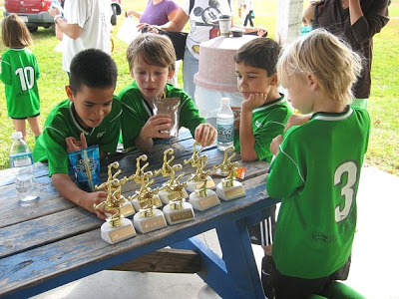
INDUSTRIOUSNESS vs. INFERIORITY = COMPETENCE

Slide 120
Stages 1-4
Largely determined by others (parents, teachers)
Stages 5-8
Individual has more control over environment
Individual responsibility for crisis resolution in each stage

Slide 121
STAGE 5: IDENTITY vs. ROLE CONFUSION
Ages 12-18
Form ego identity: self-image
Strong sense of identity: face adulthood with certainty and confidence
Identity crisis: confusion of ego identity
Basic strength: Fidelity
Emerges from cohesive ego identity
Sincerity, genuineness, sense of duty in relationships with others

Slide 122
IDENTITY vs. ROLE CONFUSION = FIDELITY

Slide 123
STAGE 6: INTIMACY vs. ISOLATION
Ages 18-35 (approximately)
Undertake productive work and establish intimate relationships
Inability to establish intimacy leads to social isolation
Basic strength: Love
Mutual devotion in a shared identity
Fusing of oneself with another person

Slide 124
INTIMACY vs. ISOLATION = LOVE

Slide 125
STAGE 7: GENERATIVITY vs. STAGNATION
Ages 35-55 (approximately)
Generativity: Active involvement in teaching/guiding the next generation
Stagnation involves not seeking outlets for generativity
Basic strength: Care
Broad concern for others
Need to teach others

Slide 126
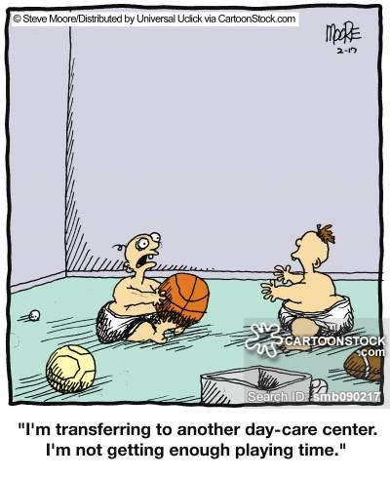
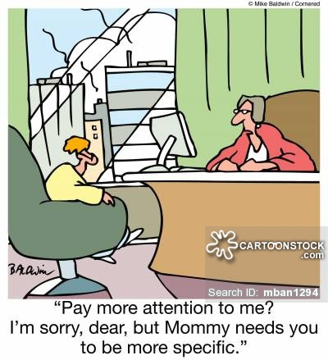
GENERATIVITY vs. STAGNATION = CARE

Slide 127
STAGE 8: EGO INTEGRITY vs. DESPAIR
Ages 55+
Evaluation of entire life
Integrity: Look back with satisfaction
Despair: Review with anger, frustration
Basic strength: Wisdom
Detached concern with the whole of life

Slide 128
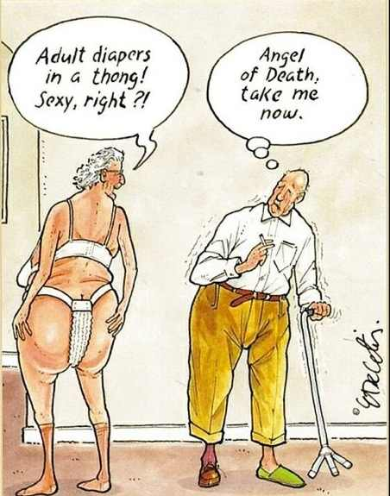
EGO INTEGRITY vs. DESPAIR = WISDOM

Slide 129
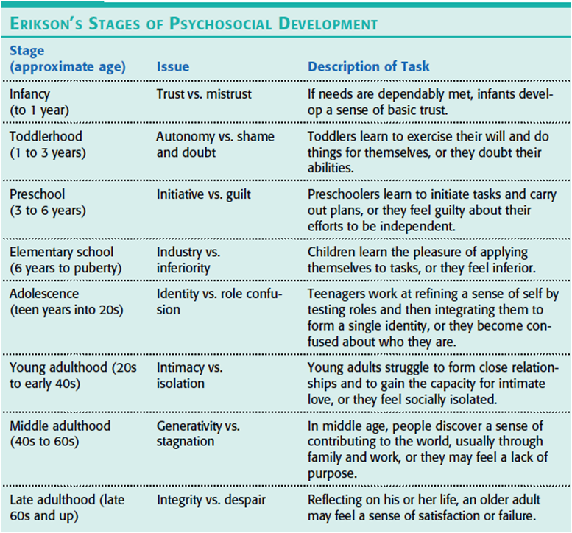

Slide 131
SOCIAL DEVELOPMENT
Forming an identity
Identity
Social identity
Intimacy
Parent and peer relationships
Notes:
Forming an Identity
In individualized societies, adolescents “try out” different selves to shape their identity
Facebook vs. friends vs. family vs. athlete
For adults & adolescents, group identities often form around how we differ from those around us (social identity)---around a group of females, men will experience their gender identity
Some adolescents form their identity early (maturely) by adopting their parents values and expectations
Key task of adolescent development is to achieve a purpose (a desire to accomplish something personally meaningful that makes a difference to the world beyond oneself)
Parent & Peer Relationships
As adolescents in Western cultures form their own identities, they pull away from their parents—transition occurs gradually throughout childhood
Parent-child conflict during adolescence tends to be greater with the first-born than with the second-born children
Can lead to real divisions & great stress
Misbehaving in class or poor social relationships = difficulty at home & vice versa
Peer pressure to conform to the group’s standards (clothing, actions, slang language)

Slide 132
EMERGING ADULTHOOD
Emerging adulthood
Notes:
Emerging Adulthood (18-25 years old)
Early 20s—still lean on parents
Late 20s –most are comfortably independent and better able to empathize with parents as fellow adults
Today, more adolescents are taking more time to finish college, leave the nest, establish careers & get married
Average age for men to get married = 27, women =25
Ease their way into these new statuses

Slide 133
ADULTHOOD
Notes:
Adulthood
It is more difficult to generalize about adulthood stages than about early developmental stages
Young adulthood through older adulthood
Developmental changes continue throughout adulthood: not a single phase of life
Taking on adult responsibilities in work and social relationships
Challenges: love, work, play continue changing
Physical development
Our physical abilities—muscular strength, reaction time, sensory keenness and cardiac output all peak by mid-twenties
Most adults who do not require top physical performance hardly notice any early signs of physical decline

Slide 134
We are here
Adulthood
Types of Studies
Adolescence
Late Adulthood
Childhood
Prenatal
Development
Unit 9
Developmental
Psych
Aging
Cognitive
Development
Moral
Development
Piaget’s
Stages
Vygotsky’s
Theory
Kohlberg
Gilligan
Social
Development
Erikson
Parenting
Styles
Gender

Slide 135
PHYSICAL DEVELOPMENT
Physical changes in middle adulthood
Menopause
Exercise and health more to do with physical ability than age
Midlife crisis
Not as common as popularly believed
Notes:
Middle Adulthood
As people enter their forties (middle adulthood)—they realize that life soon will be mostly behind them instead of ahead = midlife crisis (a time of great struggle, regret or even feeling struck down by life)
Not as common as society says—unhappiness, job dissatisfaction, marital dissatisfaction, divorce, anxiety, etc… does NOT peak in their forties
Divorce is more common in the twenties
Trigger of stress and “midlife” crises is more from a major event (illness, divorce, job loss, etc…)
Levinson – four brief stages
Midlife transition (early 40s)
Entry to middle adulthood stage (45 to 50)
Age 50 transition
Culmination of middle adulthood
Climactic –
Female sexual ability to reproduce declines
Not all adult development timed by social clock rather than biological clock
Social clock = “the right time” to leave home ,marry, get a job, have children and retire
Varies from era to era (50s to 2000s) and culture to culture (some value women staying home, marrying earlier)
Physical Changes in Middle Adulthood
Exercise and a person’s health will have more to do with a person’s physical abilities than age
Aging does bring a gradual decline in fertility
Women’s sign of aging = menopause (ends her menstrual cycles—within a few years of 50)
Men have no equivalent to menopause—just experience a gradual decline in sperm count, testosterone level and speed of erection and ejaculation

Slide 136
PHYSICAL DEVELOPMENT
Physical changes in later life
Life expectancy
Lower for males than females
Sensory abilities
Diminish with age
Health
Immune system weakens as we age
Dementia and Alzheimer’s Disease
Notes:
Physical Changes in Later Life
People have misconceptions that as people age, they will lose their memory and have failing health
Life expectancy for male is lower than for females (4-6 years more for females)
With age (especially when accentuated by smoking, obesity or stress), people’s chromosome tips (telomeres) wear down, much the tip of a shoelace frays
Causes for Aging/Why do we age?
Evolutionary biologists speculate the answer relates to our survival as a species---we pass on our genes most successfully when we raise our young and the stop consuming resources. Once we’ve fulfilled our gene-producing and nurturing tasks, there are no natural selection pressures against genes that cause degeneration in later life
Human spirit (chronic anger and depression increase health risks and premature death)
Sensory Abilities:
Visual sharpness diminishes, distance perception and adaption to changes in light level are less acute
Muscle strength, reaction time, stamina, vision (the eye’s pupil shrinks and its lens becomes less transparent), sense of smell and hearing diminish
Mosquito ring tones activity—older adults can’t hear ringtones of faint sound
Emotional and social development
Many aspects of personality are fairly stable over time, and changes are predictable
On average, adults become less anxious and emotional, socially outgoing, and creative
People become more dependable, agreeable, and accepting of life’s hardships
Gender differences lessen over time
Emotional and social development
Much disagreement about when and how changes occur during aging – differences between stages of infant/child development and adult development
Not all adults go through every stage
Order of stages can vary for individuals
Timing of stages not controlled by biological maturation
Health/Motor Abilities
Body’s disease-fighting immune system weakens, making older people more susceptible to life-threatening ailments such as cancer and pneumonia
But, because of a lifetime accumulation of antibodies, those over 65 are less likely to have short-term ailments (cold, flu)
Neural processing slows, making it difficult to process information, remember names, solve problems, etc…
How to prevent?
Exercise feeds the brain and helps compensate for brain cell loss and promotes neurogenesis (the birth of new nerve cells) in the hippocampus
Fatal accident rates per mile driven increase after age 75, but are similar to the accident rate of teenagers (teens are bad drivers too!)—cross-sectional researc
Cognitive Development
Are cognitive abilities (memory, intelligence, and creativity) similar to the physical decline of abilities?

Slide 137
COGNITIVE DEVELOPMENT: AGING AND MEMORY
Recall versus recognition
Prospective memory
Notes:
Prospective memory refers to remembering to perform intended actions in the future, or simply, remembering to remember. Examples of prospective memory include: remembering to take medicine at night before going to bed, remembering to deliver a message to a friend, and remembering to pick up flowers for a significant other on an anniversary. Because a great deal of each day is spent forming intentions and acting on those intentions, it is no surprise that at least half of everyday forgetting is due to prospective memory failures
Aging & Memory
During early adulthood (20s) many “firsts” occur—career, marriage, children, house, love, etc…
We also remember significant events in our lifetime (9/11, Iraq War, Obama’s election, Columbine)
Recalling names (memory) becomes more difficult with age (see chart)
Older generations have a better time recognizing a list of words (in a multiple choice format) than recalling them (without clues) compared to younger generations (cross-sectional research)
Prospective memory (memory with clues which trigger the task)---passing a grocery store and remembering to get milk remains strong
Time-based tasks (3:00 appointment) and habitual tasks (taking certain medications every day at a specific time) can be difficult
Older generations rely on reminder cues (sticky notes)
Aging & Memory
Difficult to remember meaningless information as people get older

Slide 138
COGNITIVE DEVELOPMENT: AGING AND MEMORY
Recall versus recognition
Prospective memory
Notes:
Dementia & Alzheimer’s Disease
From age 60-95, the incidence of mental disintegration doubles every 5 years
A series of small strokes, a brain tumor, or alcohol dependence can progressively damage the brain , causing mental erosion = dementia
What is AD?
Memory deteriorates first, then reasoning for Alzheimer’s disease patients (not normal aging)
Patients have a diminishing sense of smell
A person becomes emotionally flat, then disorientated and eventually mentally vacant
What is AD?/Statistics
Strikes 3% of the world’s population by 75, even the brightest of minds
AD is the most common cause of dementia among people age 65 and older.
Scientists estimate that around 4.5 million people now have AD.
For every 5-year age group beyond 65, the percentage of people with AD doubles.
By 2050, 13.2 million older Americans are expected to have AD if the current numbers hold and no preventive treatments become available
Where are people with AD cared for?
home
assisted living facilities (those in the early stages)
nursing homes (special care units
The national cost of caring for people with AD is about $100 billion every year.
Plaques & Tangles
Patients have a loss of brain cells and deterioration of neurons that produce the neurotransmitter acetylcholine (vital chemical messenger)
Deprived of this—memory and thinking suffer
The brains of people with AD have an abundance of two abnormal structures:
beta-amyloid plaques, which are dense deposits of protein and cellular material that accumulate outside and around nerve cells
neurofibrillary tangles, which are twisted fibers that build up inside the nerve cell
The Changing Brain in Alzheimer’s Disease
No one knows what causes AD to begin, but we do know a lot about what happens in the brain once AD takes hold.
Vivid on PET brain scans = shriveled protein filaments in the cell body and plaque (globs of degenerating tissue) at the tips of neuron branches
Severe AD
In severe AD, extreme shrinkage occurs in the brain. Patients are completely dependent on others for care.
Symptoms can include weight loss, seizures, skin infections, groaning, moaning, or grunting, increased sleeping, loss of bladder and bowel control.
Death usually occurs from aspiration pneumonia or other infections. Caregivers can turn to a hospice for help and palliative care.
AD Develops
the levels of the protein filaments AD develops when genetic, lifestyle, and environmental factors work together to cause the disease process to start.
In recent years, scientists have discovered genetic links to AD. They are also investigating other factors that may play a role in causing AD
Scientists are working to develop drugs that will block proteins from aggregating into plaques or that will lower

Slide 139
CROSS-SECTIONAL STUDY
Study people of different ages at the same point in time
Advantages
Inexpensive
Can be completed quickly
Low attrition
Disadvantages
Different age groups are not necessarily much alike
Differences may be due to cohort differences rather than age

Slide 140
LONGITUDINAL STUDY
Study the same group of people over time
Advantages
Detailed information about subjects
Developmental changes can be studied in detail
Eliminates cohort differences
Disadvantages
Expensive and time consuming
Potential for high attrition
Differences over time may be due to assessment tools and not age

Slide 141
COGNITIVE DEVELOPMENT: AGING AND INTELLIGENCE
It all depends
Crystallized intelligence
Accumulated knowledge
Increases up to old age
Fluid intelligence
Ability to reason speedily and abstractly
Better when younger
Notes:
Aging & Intelligence
Intelligence is not a single trait, but several distinct abilities
Intelligence tests that assess the speed of thinking may place older adults at a disadvantage because of their slower neural mechanisms processing the information
German researcher Paul Baltes developed “wisdom” tests that assess “expert knowledge about life in general and good judgment and advice about how to conduct oneself in the face of complex, uncertain circumstances
Older adults did better than younger adults
Crystallized intelligence (our accumulated knowledge as reflected in vocabulary and analogies tests) increases up to old age
Verbal scores hold relatively steady from ages 20-74
Involved in Learning skills (riding a bike)—once you learn the skill, you can still perform it after many years of no practice
Fluid intelligence (our ability to reason speedily and abstractly—solving logic problems) decreases slowly up to age 75, then more rapidly after age 85
Nonverbal ,puzzle-solving intelligence declined
We lose recall memory and processing speed, but gain vocabulary and knowledge
Age is only a predictor of memory and intelligence abilities
Mental ability more strongly correlates with proximity to death (if a person is 8 months or 8 years to death, this is a better measure for their mental ability)
Terminal decline (in the last 3-4 years of life, cognitive decline typically accelerates

Slide 143
SOCIAL DEVELOPMENT: WELL-BEING ACROSS THE LIFE SPAN
Well-being across the life span
Adulthood’s Commitments
Love/Marriage
Divorce vs stable marriage
Work
Happiness about work that fits interests
Sense of competence and accomplishment
Attitude about occupation can affect satisfactions
Notes:
Social Development
Life events bring new relationships, new expectations and new demands (becoming a parent, getting a new job, buying your first house)
Adulthood’s Ages & Stages
Mid-life crisis (talked about earlier)—more like to occur from major life events (divorce, job loss) than just by being in your 40s
Chance events = romantic encounters can change our lives
Adulthood’s Commitments
Two basic aspects of our lives dominate adulthood (Erik Erikson)
Intimacy (Forming close relationships)
Generativity (being productive and supporting future generations)
Other researchers have chosen other terms:
Affiliation and Achievement
Attachment and productivity
Commitment and competence
Sigmund Freud (1935): The healthy adult is the one who can love and work.
Love
Helen Fisher (1993) said we typically flirt, fall in love and commit—one person at a time
From an evolutionary perspective, relatively monogamous pairing makes sense—parents who cooperated to nurture their children to maturity were more likely to have their genes passed along to further generations than were parents who did not
Adult bonds of love are most satisfying and enduring when the couple has similar interests & values and intimate self-disclosure
Those couples who seal their commitment of love with marriage or civil unions more often last—especially if they are educated and after age 20
Marriage is a predictor of happiness, health, sexual satisfaction and income (think of human faces—three women)
Neighborhoods with higher marriage rates typically have low rates of crime, childhood emotional disorders and delinqency
Divorce rate is 50% in US—reflects women’s economic independence and less reliance on men
Higher for people who have children with just cohabitation and not married
How to have a stable marriage?
5 to 1 ratio—5 positive interactions (smiling, hugging, laughing, touching, complimenting) to one negative one (sarcasm, criticism, insults)
Work
Happiness is about having work that fits your interests and provides you with a sense of competence and accomplishment
One’s attitude about an occupation can determine how positively one views that work
Three types of works (job, career, calling)

Slide 144
SOCIAL DEVELOPMENT: WELL-BEING ACROSS THE LIFE SPAN
Well-being across the life span
Grow older
Look back with satisfaction or or regret
Happiness higher among young and older rather than middle-age
Notes:
Well-Being Across the Life Span
To live is to grow older so you can look back with satisfaction or regret and forward with hope or dread
Happiness tends to be higher among both young and older adults than among those middle-aged
Positive feelings grow and negative feelings subside after midlife
Although as one approaches the terminal decline phase (3-4 years before death), feeling mellow, highs become less high, lows less low
Often find themselves to feel less often excited, intensely proud

Slide 145
BIOPSYCHOSOCIAL INFLUENCES ON SUCCESSFUL AGING
Notes:
Summarizing aging
More and more people flourish into later life knowing positive emotions are coming
Biological, psychological and social-cultural influences

Slide 146
DEATH AND DYING
Death of a spouse most difficult to deal with
Facing death with dignity and opennes helps people complete life cycle with a sense of meaninfulness
Elizabeth Kubler-Ross’s theory of the stages of dying
Denial, Anger, Bargaining, Depression, Acceptance (DABDA)
Notes:
Death & Dying
Most difficult to cope with = death of a spouse
5X more women will experience this than men
Usually—death comes at an expected late-life time, where the grieving may be relatively short-lived where others may take a longer time if the death is unexpected (whether it is spouse, child or close loved one)
Depending on the culture—the reaction to a loved one can vary
Some cultures encourage public weeping and wailing, where others hide their grief
Facing death with dignity and openness helps people complete the life cycle with a sense of life’s meaningfulness and unity (the sense that their existence has been good & that life and death are parts of an ongoing cycle)
Erik Erikson’s called this a sense of integrity (a feeling that one’s life has been meaningful and worthwhile)
Elizabeth Kubler-Ross’s theory of the stages of dying
Denial, Anger, Bargaining, Depression, Acceptance (giraffe dying to bring to life a description of the stages)
DABDA

Slide 147
ELIZABETH KUBLER-ROSS’S THEORY OF THE STAGES OF DYING
Denial, Anger, Bargaining, Depression, Acceptance (DABDA)

Slide 148
REFLECTIONS ON TWO MAJOR DEVELOPMENTAL ISSUES

Slide 149
THREE MAJOR DEVELOPMENTAL ISSUES
Nature versus nurture
Continuity and stages
Stability and change
Notes:
Reflections on Three Major Developmental Issues/Questions
How development is steered by our genes & experiences
Whether development is a gradual, continuous process or a series of discrete stages
Whether development is characterized by stability over time or by change
Nature and Nurture
Studies of the inheritance of temperament and of twins & adopted children (in Unit 3C) confirm that nature and nurture influence development
Genes & environment, biological and social factors direct our life courses, and their effects intertwine
Stability & Change
There is continuity to personality and life is a process of becoming (the struggles of the present, may be laying the foundation for the future)
Older children & adolescents do change (even with a disturbing teen life of substance abuse & crime, many can become mature, successful adults)
As people grow older, personality gradually stabilizes
Some characteristics (temperament) are more stable than others (social attitudes)
In some ways, we all change with age
Most shy, fearful toddlers will open up by age 4
Most people become self-disciplined, stable, agreeable and self-confident in the years after adolescence
Life requires stability & change
Stability enables us to depend on others, provides our identity, and motivates our concern for the healthy development of children
Change motivates our concerns about present influences, sustains our hope for a brighter future and lets us adapt and grow with experience

Slide 150
CONTINUITY AND STAGES
Criticisms of each model of development: Piaget – young children have some abilities attributed to later stages
Kohlberg – worldview only of educated, individualistic cultures
Erikson – does not progress through reliable, fixed stages
Notes:
Continuity & Stages
Researchers who emphasize experience and learning see development as a slow, continuous shaping process
Those who emphasize biological maturation tend to see development as a sequence of genetically predisposed stages or steps (everyone passes through them in the same order-some quicker than others)—Piaget (psychological), Kohlberg (moral), Erikson (psychsocial)
The concept of stages remains useful
The human brain does experience growth spurts during childhood and puberty that correspond roughly to Piaget’s stages
Stage theories contribute a developmental perspective on the whole life span
**The sequence is set in developmental stages, but the timing is not. The timing will be different from one person to another.

