Slide 1
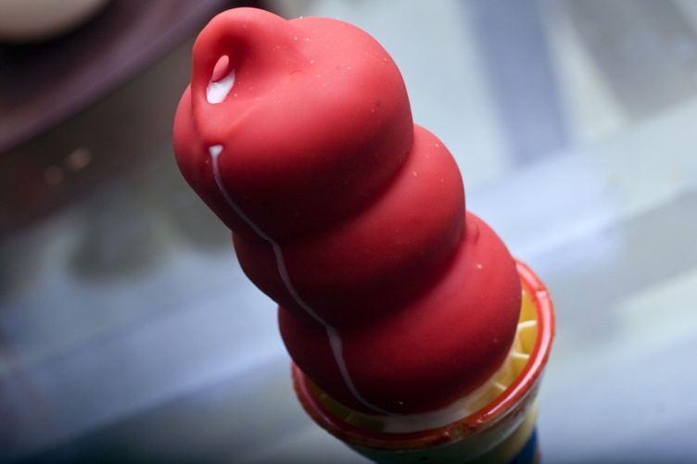
Dairy Queen
By Sadie Gerber

Slide 2
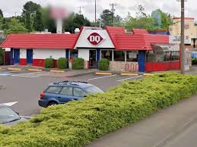
Location
My favorite restaurant is Dairy Queen. It is in Mayfield Heights.

Slide 3
Hours
Everyday it’s the same hours 11:00 a.m.- 10:00 p.m.

Slide 4
Outside Appearance
It’s very colorful in the outside. You can eat outside when it’s warm.

Slide 5
Inside Appearance
It’s not too big or too small.
It has tables to eat your food.
There’s a place to pay for your food.

Slide 6
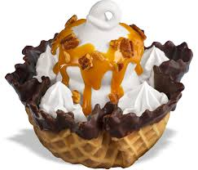
Children’s Menu
The children’s menu has lots of good ice cream.
I like vanilla ice cream in a cone.

Slide 7
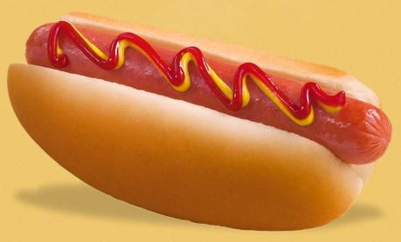
Carry Out or Delivery
You can take your food home with you.
They don’t have delivery.

Slide 8
Service
They’re nice and make sure you get your food.
They’re very quick to.

Slide 9
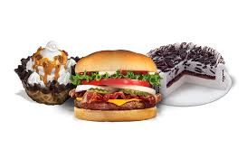
Website
I like the website. It tells you what they have on the menu.
It’s very colorful.

Slide 10
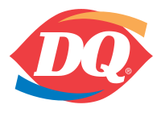
Logo
For Dairy Queen it’s a D and a Q.
The orange on their symbol is for the hot foods.
The blue on their symbol is for the cold foods.

Slide 11
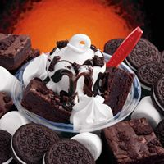
Slogan
Fan food not fast food.

Slide 12
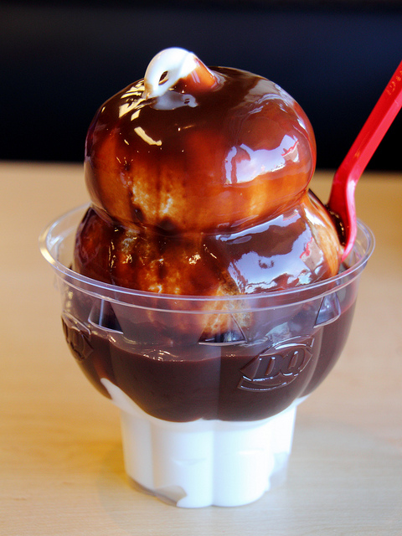
Conclusion
Dairy Queen is my favorite restaurant.
I like the ice cream the best.
I wish it was closer to my house.
Even if they aren’t closer to my house I still like Dairy Queen!!

