Slide 1
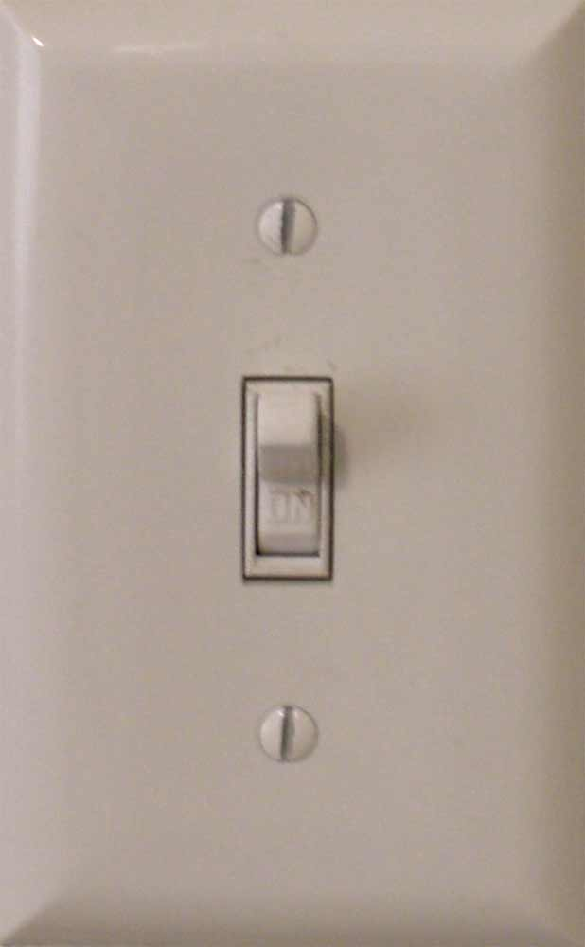
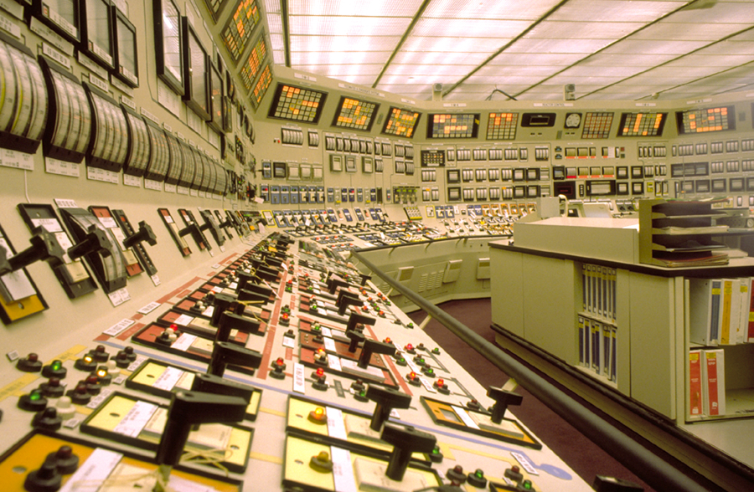
Reproduction
Male Reproductive System
Female Reproductive system
This is about to make a whole lot more sense!

Slide 2
The Tentative Plan:
1.5 days describing female anatomy Quiz
2-3 days: Life inside the Ovary and Follice development! Quiz
2 days on Hormones… Much more detailed information to come here than in the male Quiz
1.5-2 days on the menstrual cycle and uterus
Big Test
3 Days on Pregnancy
Little Test

Slide 3
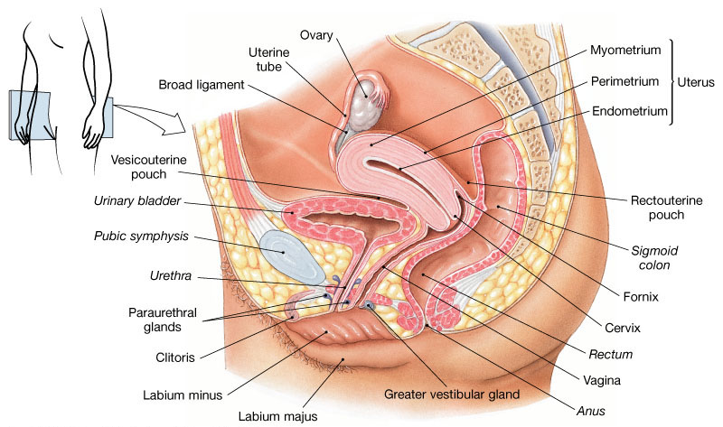

Slide 4
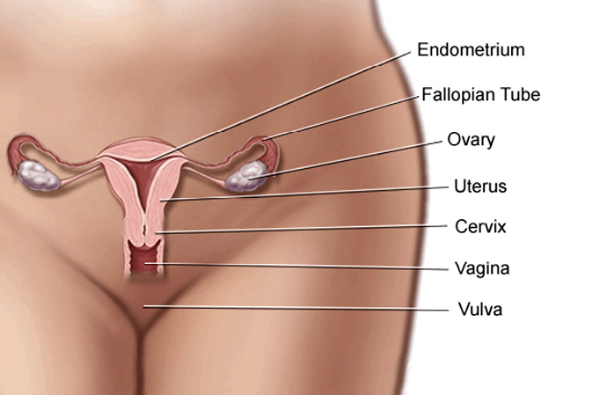
Primary Sex Organs: Ovaries
Inner Female Genatalia
Uterus
Fallopian Tubes
Vagina
Cervix

Slide 5
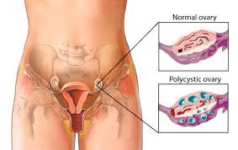
Ovaries and their Function
Oogenesis
Maturation of oogenesis
Expulsion of oocyte
Secretion of the female sex (steroidal) hormones
Progesterone (P) and Estrogen (E)
Protein hormone inhibin

Slide 6
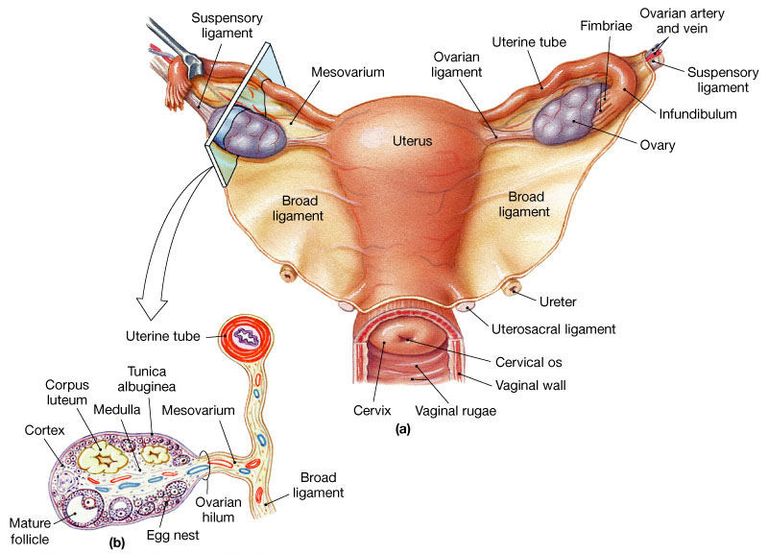

Slide 7
The Follicle (Real quick to be visited later)
The main functional unit of the ovary is the follicle.
Follicles are composed of the oocyte, surrounded by granulosa cells, and theca cells.
Granulosa – generate E
Mature theca cells generate P

Slide 8
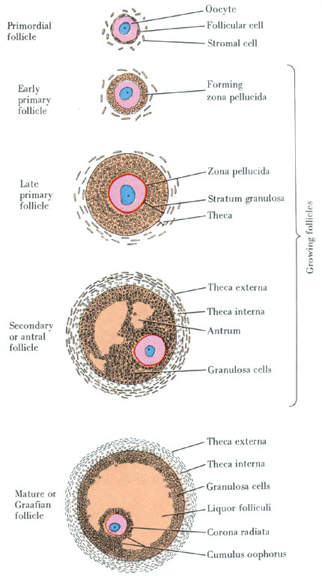

Slide 9
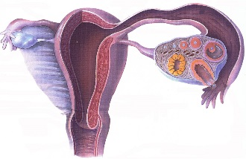
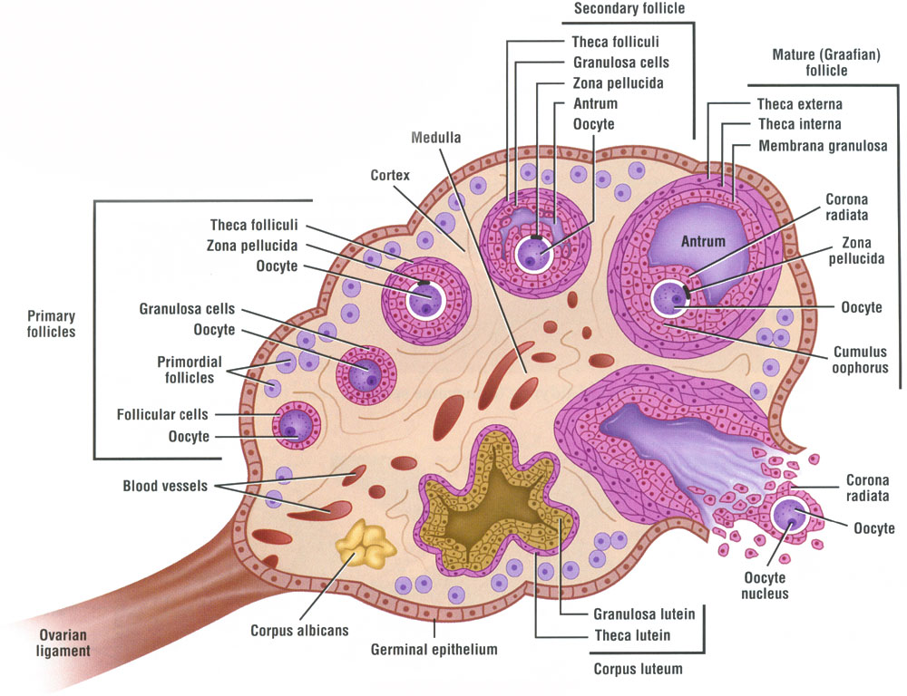
FEMALE REPRODUCTIVE SYSTEM The Ovarian Cycle
• OVARY
3 to 5 million OOGONIA differentiate into PRIMARY OOCYTES during early development
OOCYTES becomes surrounded by squamous (follicular) cells to become PRIMORDIAL FOLLICLES
most PRIMORDIAL FOLLICLES undergo atresia leaving 400,000 at birth
oocytes at birth arrested at Meiosis I (prophase)

Slide 11
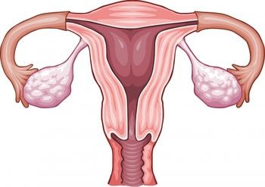
The Uterus
Hollow
Thick walled
Muscluar
Between bladder and rectum
Where my kid currently hangs out
(More formally) where fetus development takes place
Source of menstrual flow

Slide 12
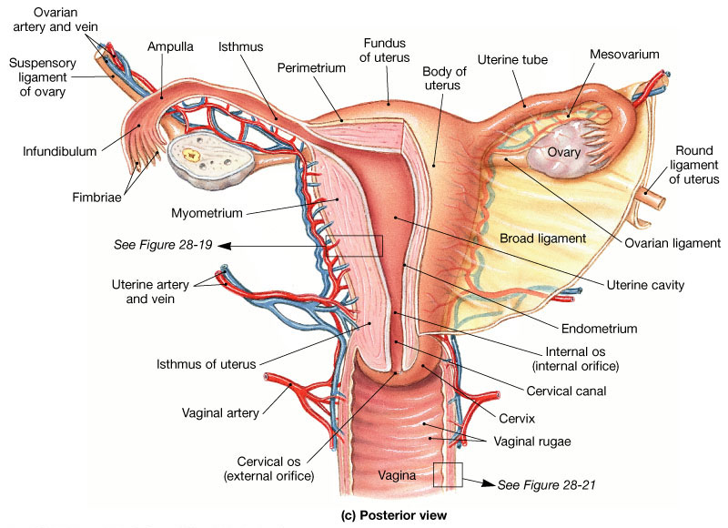
The Uterus
Figure 28.18c

Slide 13
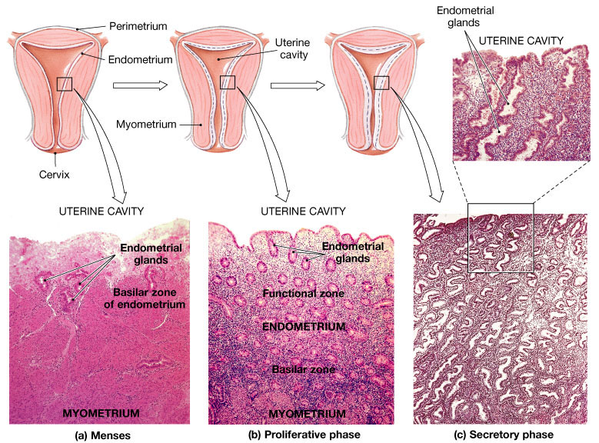
The Uterine Cycle To be discussed below
Figure 28.20

Slide 14
Fallopian Tubes
One end attach to uterus
Other end DOES NOT attach to ovaries
Rather ends in fimbrae
Finger like projections,
cilia on their epithelium!
http://www.youtube.com/watch?v=nLmg4wSHdxQ

Slide 15
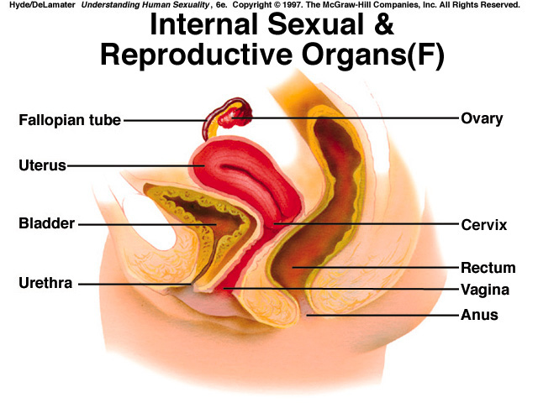
Vagina
Canal from uterus to the outside

Slide 16
Cervix

