Slide 1
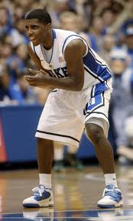
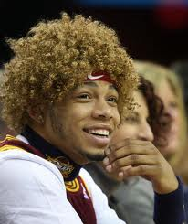
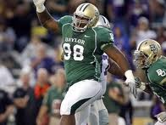
To celebrate
Start in the L pulmonary artery. Where does blood go until it gets back to the pulmonary arteries?

Slide 2
Cardiac Muscle Contraction
Depolarization of the heart is rhythmic and spontaneous
About 1% of cardiac cells have automaticity— (are self-excitable)
Gap junctions ensure the heart contracts as a unit
Long absolute refractory period (250 ms)

Slide 3
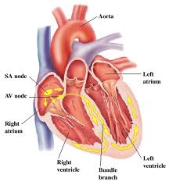
Heart Physiology: Sequence of Excitation
Sinoatrial (SA) node (pacemaker)
Generates impulses
Depolarizes faster than any other part of the myocardium

Slide 4
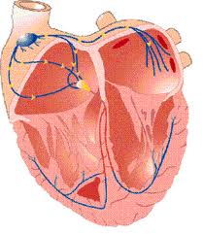
Heart Physiology: Sequence of Excitation
Atrioventricular (AV) node
Smaller diameter fibers; fewer gap junctions
This Delays impulses approximately 0.1 second
Depolarizes slower in absence of SA node input

Slide 5
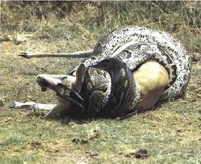
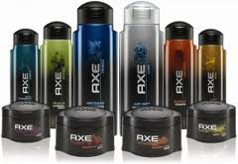
Heart Physiology: Sequence of Excitation
Atrioventricular (AV) bundle (bundle of His)
Only electrical connection between the atria and ventricles

Slide 6
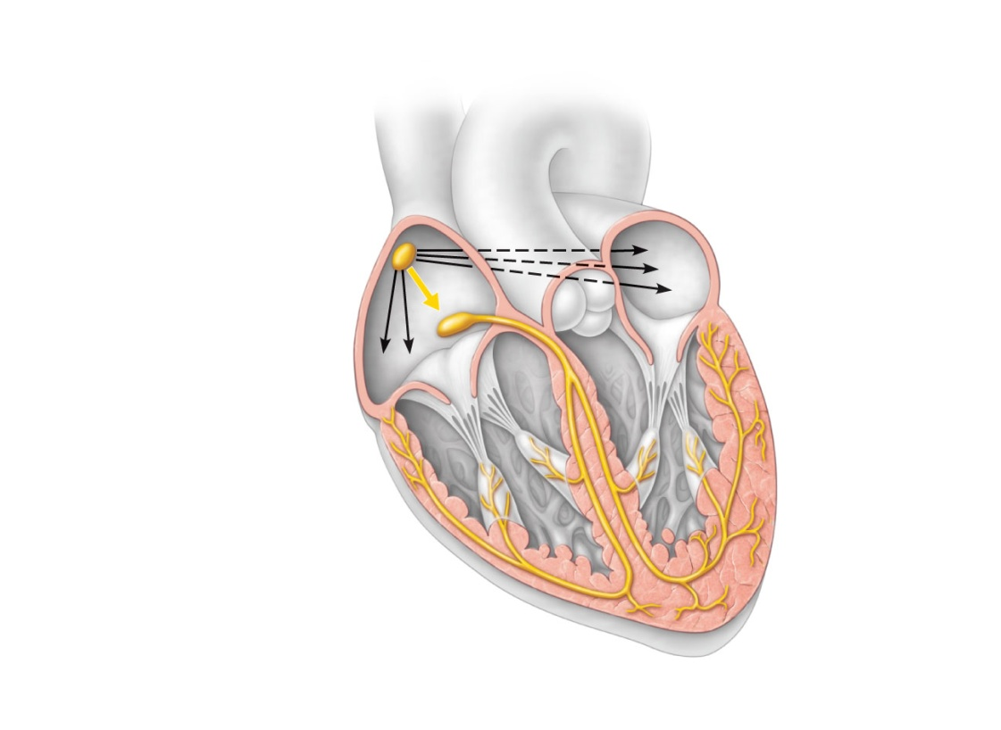
Heart Physiology: Sequence of Excitation
Right and left bundle branches
Two pathways in the interventricular septum that carry the impulses toward the apex of the heart

Slide 8
Heart Physiology: Sequence of Excitation
Purkinje fibers
Complete the pathway into the apex and ventricular walls
AV bundle and Purkinje fibers depolarize only 30 times per minute in absence of AV node input

Slide 9
Superior vena cava
Right atrium
The sinoatrial (SA)
node (pacemaker)
generates impulses.
1
Internodal pathway
2
Left atrium
The impulses
pause (0.1 s) at the
atrioventricular
(AV) node.
The atrioventricular
(AV) bundle
connects the atria
to the ventricles.
Purkinje
fibers
3
The bundle branches
conduct the impulses
through the
interventricular septum.
4
Inter-
ventricular
septum
The Purkinje fibers
depolarize the contractile
cells of both ventricles.
5
(a) Anatomy of the intrinsic conduction system showing the
sequence of electrical excitation
Figure 18.14a

Slide 10
Homeostatic Imbalances
Defects in the intrinsic conduction system may result in
Arrhythmias: irregular heart rhythms
Uncoordinated atrial and ventricular contractions
Fibrillation: rapid, irregular contractions; useless for pumping blood

Slide 11
Electrocardiography
Electrocardiogram (ECG or EKG): a combination of all the APs generated by nodal and contractile cells at a given time
3 waves
P wave: depolarization of SA node
QRS complex: ventricular depolarization
T wave: ventricular repolarization

Slide 12
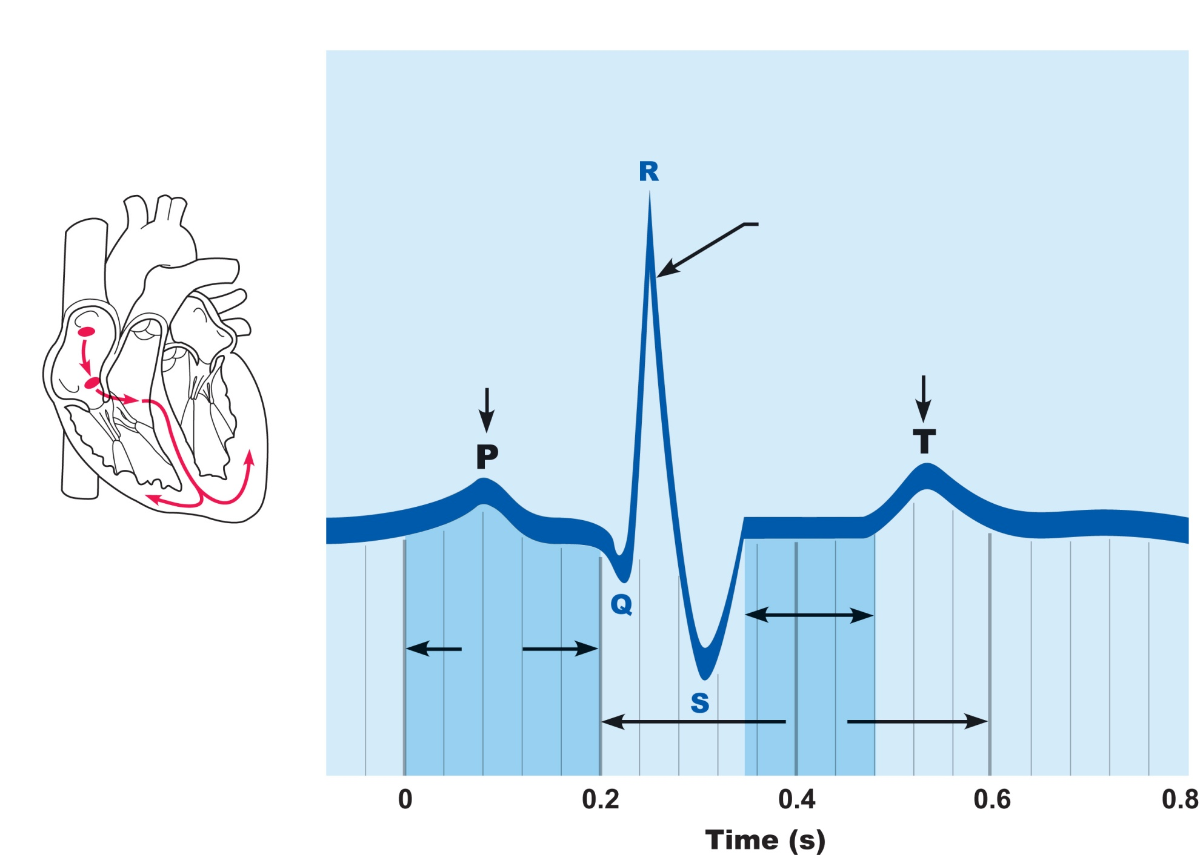
QRS complex
Sinoatrial
node
Ventricular
depolarization
Atrial
depolarization
Ventricular
repolarization
Atrioventricular
node
P-Q
Interval
S-T
Segment
Q-T
Interval
Figure 18.16

Slide 13
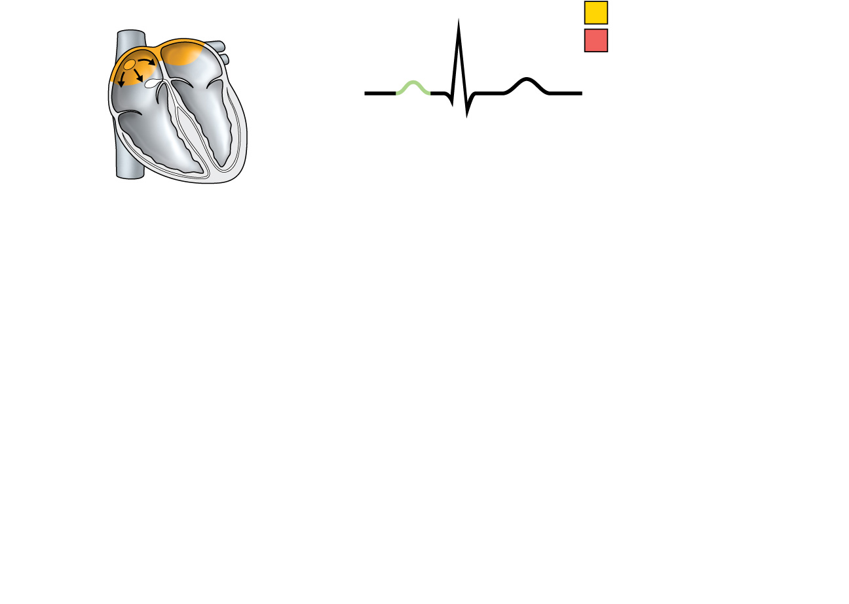
SA node
R
Depolarization
Repolarization
P
T
Q
S
1
Atrial depolarization, initiated by the SA node, causes the P wave.
Figure 18.17, step 1

Slide 14
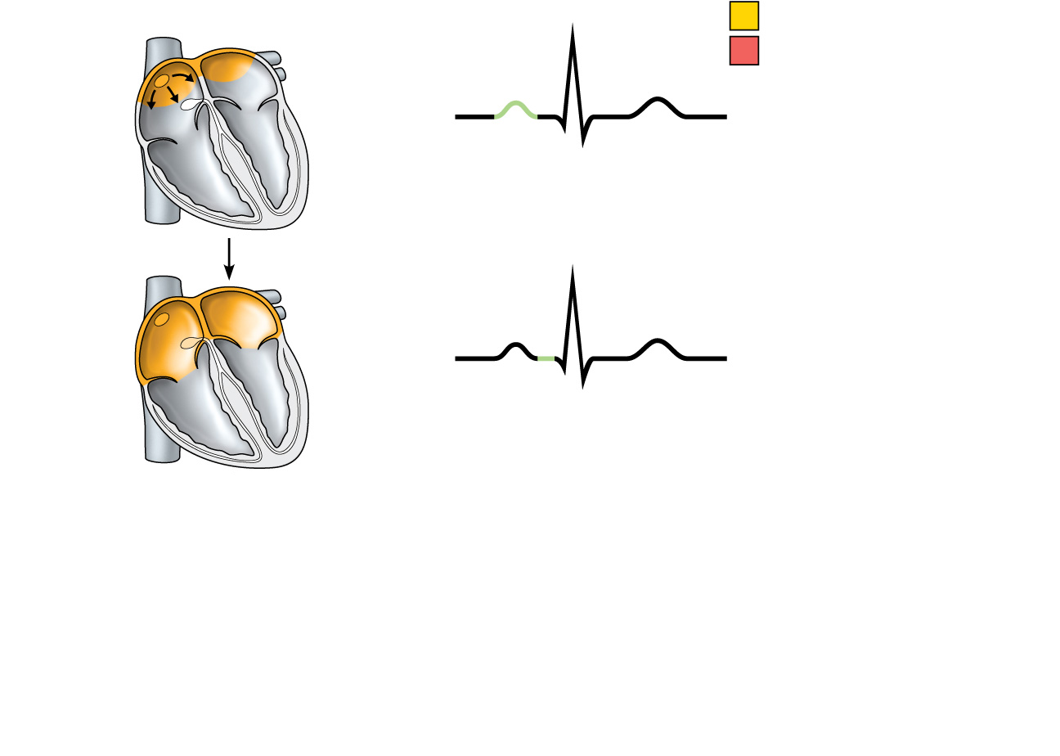
SA node
R
Depolarization
Repolarization
P
T
Q
S
1
Atrial depolarization, initiated by the SA node, causes the P wave.
R
AV node
P
T
Q
S
2
With atrial depolarization complete, the impulse is delayed at the AV node.
Figure 18.17, step 2

Slide 15
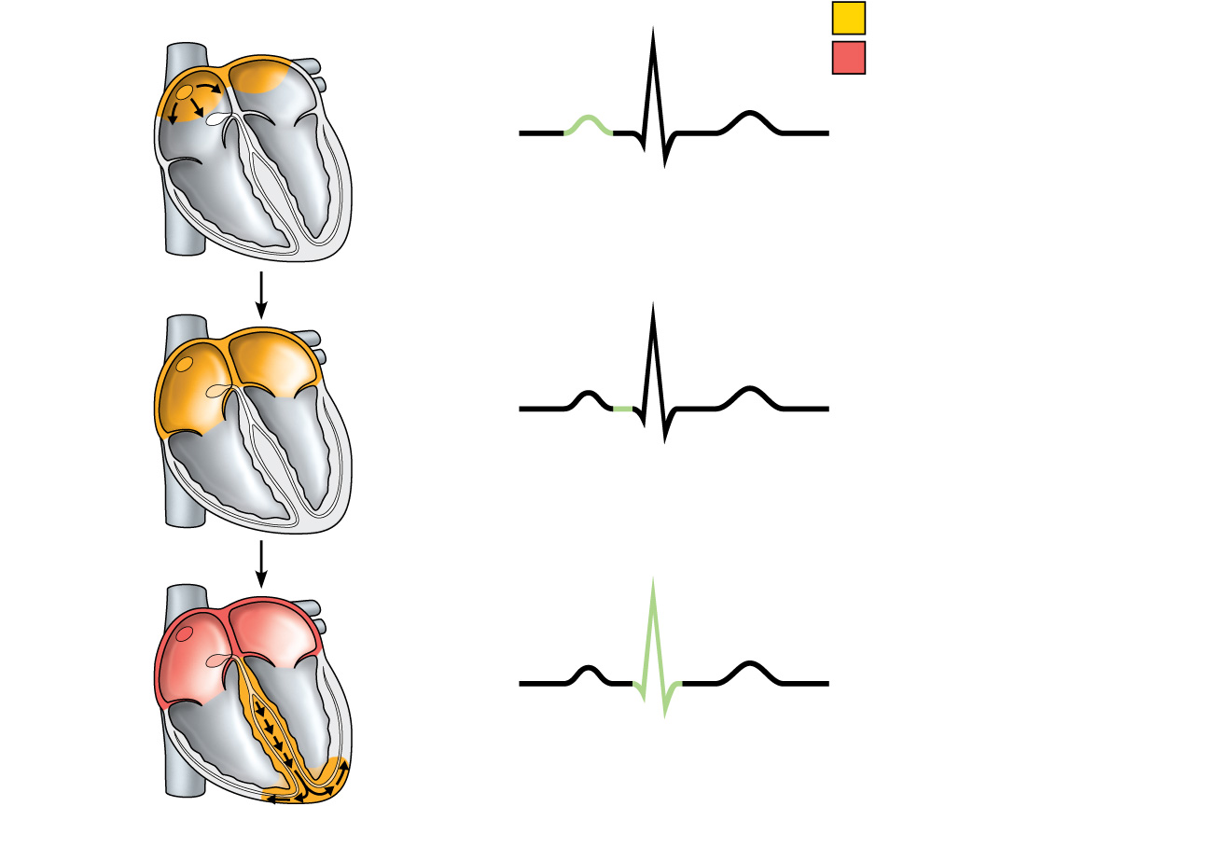
SA node
R
Depolarization
Repolarization
P
T
Q
S
1
Atrial depolarization, initiated by the SA node, causes the P wave.
R
AV node
P
T
Q
S
2
With atrial depolarization complete, the impulse is delayed at the AV node.
R
P
T
Q
S
3
Ventricular depolarization begins at apex, causing the QRS complex. Atrial repolarization occurs.
Figure 18.17, step 3

Slide 16
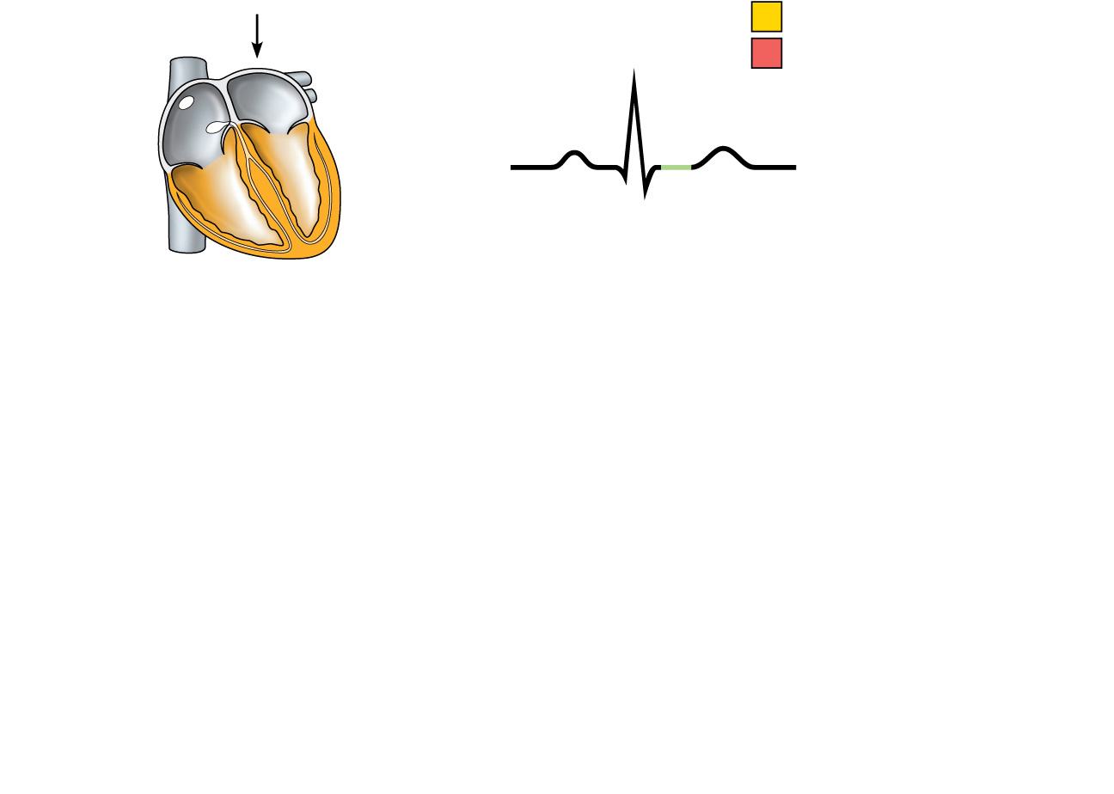
Depolarization
R
Repolarization
P
T
Q
S
4
Ventricular depolarization is complete.
Figure 18.17, step 4

Slide 17
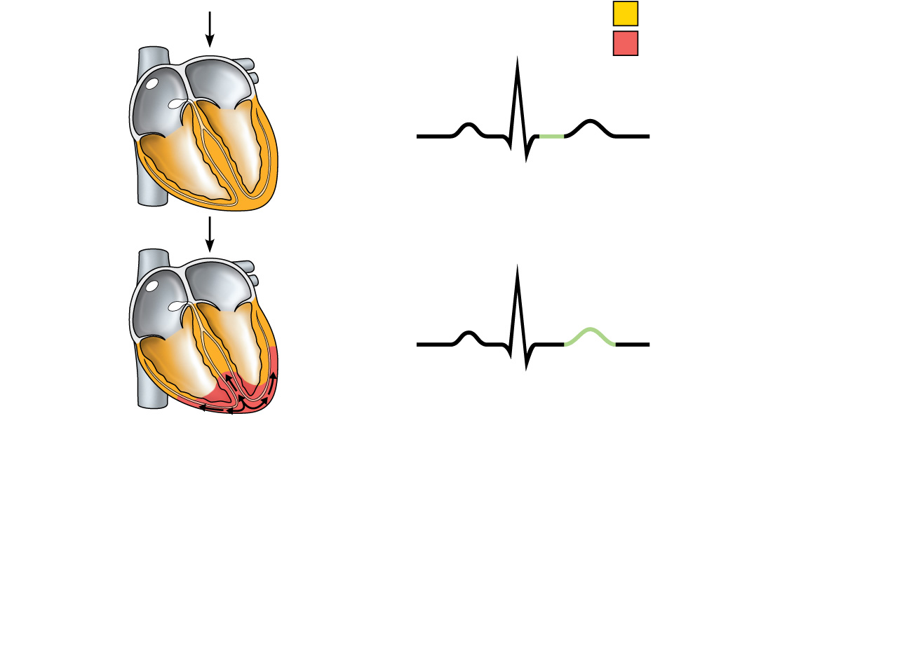
Depolarization
R
Repolarization
P
T
Q
S
4
Ventricular depolarization is complete.
R
P
T
Q
S
5
Ventricular repolarization begins at apex, causing the T wave.
Figure 18.17, step 5

Slide 18
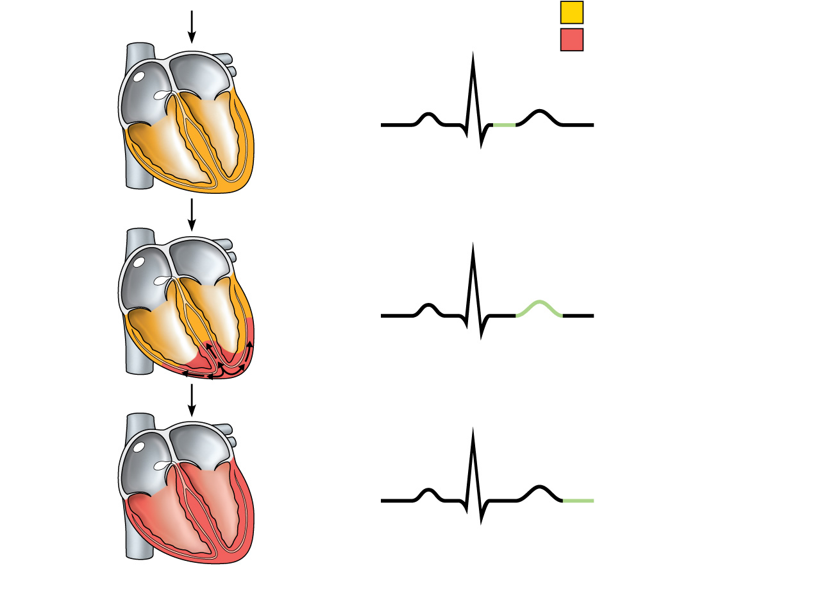
Depolarization
R
Repolarization
P
T
Q
S
4
Ventricular depolarization is complete.
R
P
T
Q
S
5
Ventricular repolarization begins at apex, causing the T wave.
R
P
T
Q
S
6
Ventricular repolarization is complete.
Figure 18.17, step 6

Slide 19
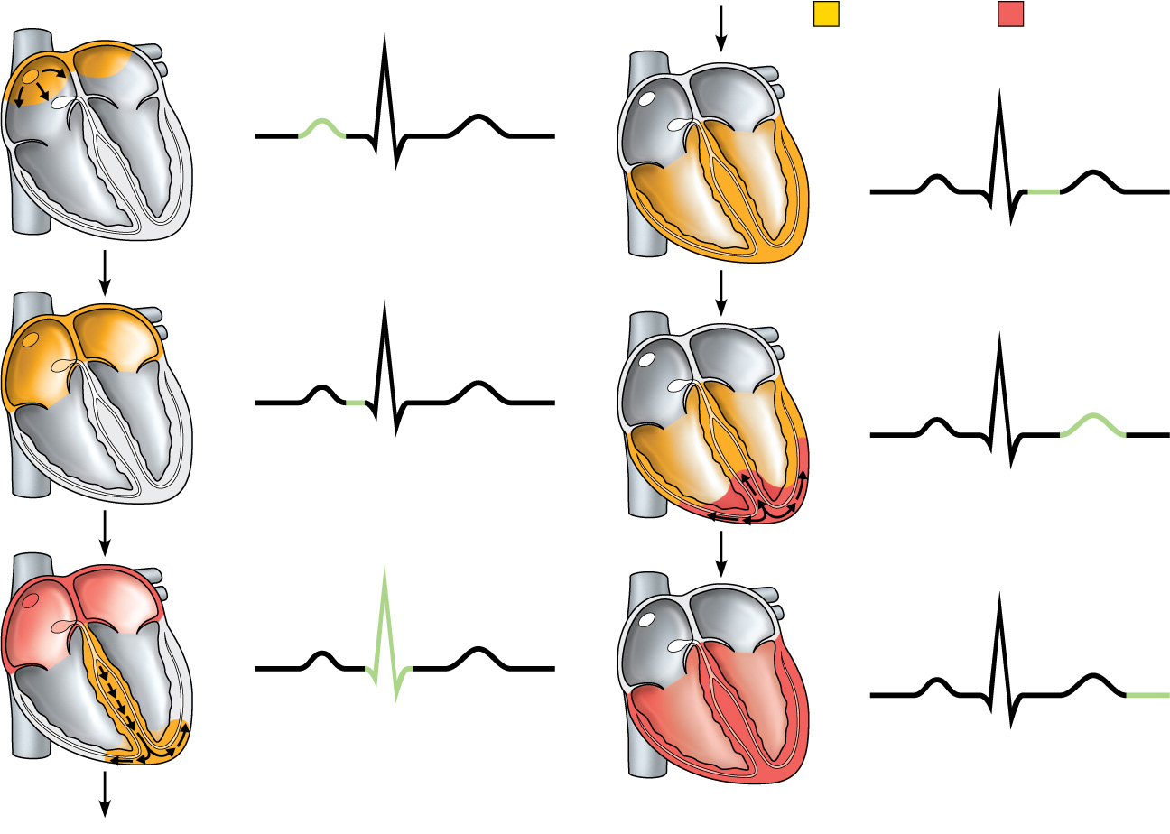
SA node
R
Depolarization
Repolarization
R
P
T
Q
P
T
S
1
Atrial depolarization, initiated by the SA node, causes the P wave.
Q
S
4
Ventricular depolarization is complete.
AV node
R
R
P
T
P
T
Q
S
2
Q
With atrial depolarization complete, the impulse is delayed at the AV node.
S
5
Ventricular repolarization begins at apex, causing the T wave.
R
R
P
T
P
T
Q
S
Q
S
3
Ventricular depolarization begins at apex, causing the QRS complex. Atrial repolarization occurs.
6
Ventricular repolarization is complete.
Figure 18.17

Slide 20
SA node
R
Depolarization
Repolarization
R
P
T
Q
P
T
S
1
Atrial depolarization, initiated by the SA node, causes the P wave.
Q
S
4
Ventricular depolarization is complete.
AV node
R
R
P
T
P
T
Q
S
2
Q
With atrial depolarization complete, the impulse is delayed at the AV node.
S
5
Ventricular repolarization begins at apex, causing the T wave.
R
R
P
T
P
T
Q
S
Q
S
3
Ventricular depolarization begins at apex, causing the QRS complex. Atrial repolarization occurs.
6
Ventricular repolarization is complete.
Figure 18.17

Slide 21
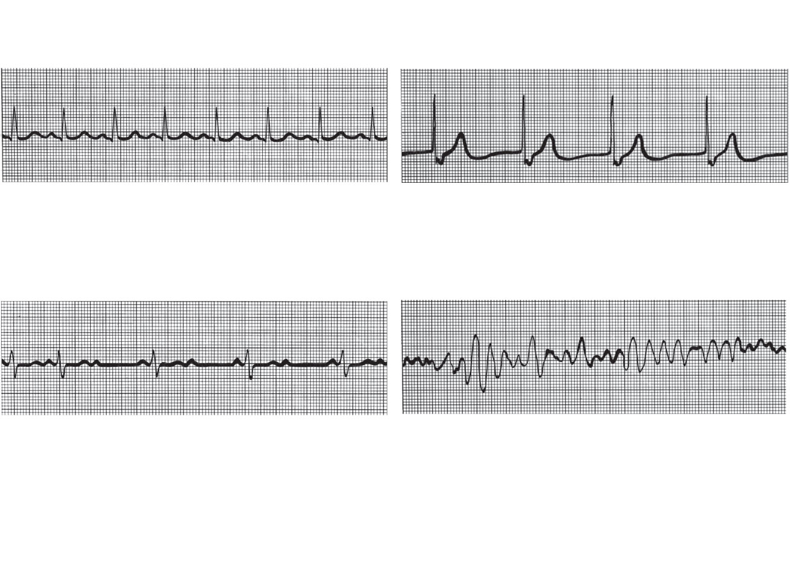
(a) Normal sinus rhythm.
(b) Junctional rhythm. The SA
node is nonfunctional, P waves
are absent, and heart is paced by
the AV node at 40 - 60 beats/min.
(c) Second-degree heart block.
Some P waves are not conducted
through the AV node; hence more
P than QRS waves are seen. In
this tracing, the ratio of P waves
to QRS waves is mostly 2:1.
(d) Ventricular fibrillation. These
chaotic, grossly irregular ECG
deflections are seen in acute
heart attack and electrical shock.
Figure 18.18

Slide 22
Heart Sounds
Two sounds (lub-dup) associated with closing of heart valves
First sound occurs as AV valves close and signifies beginning of systole
Second sound occurs when SL valves close at the beginning of ventricular diastole
Heart murmurs: abnormal heart sounds most often indicative of valve problems

Slide 23
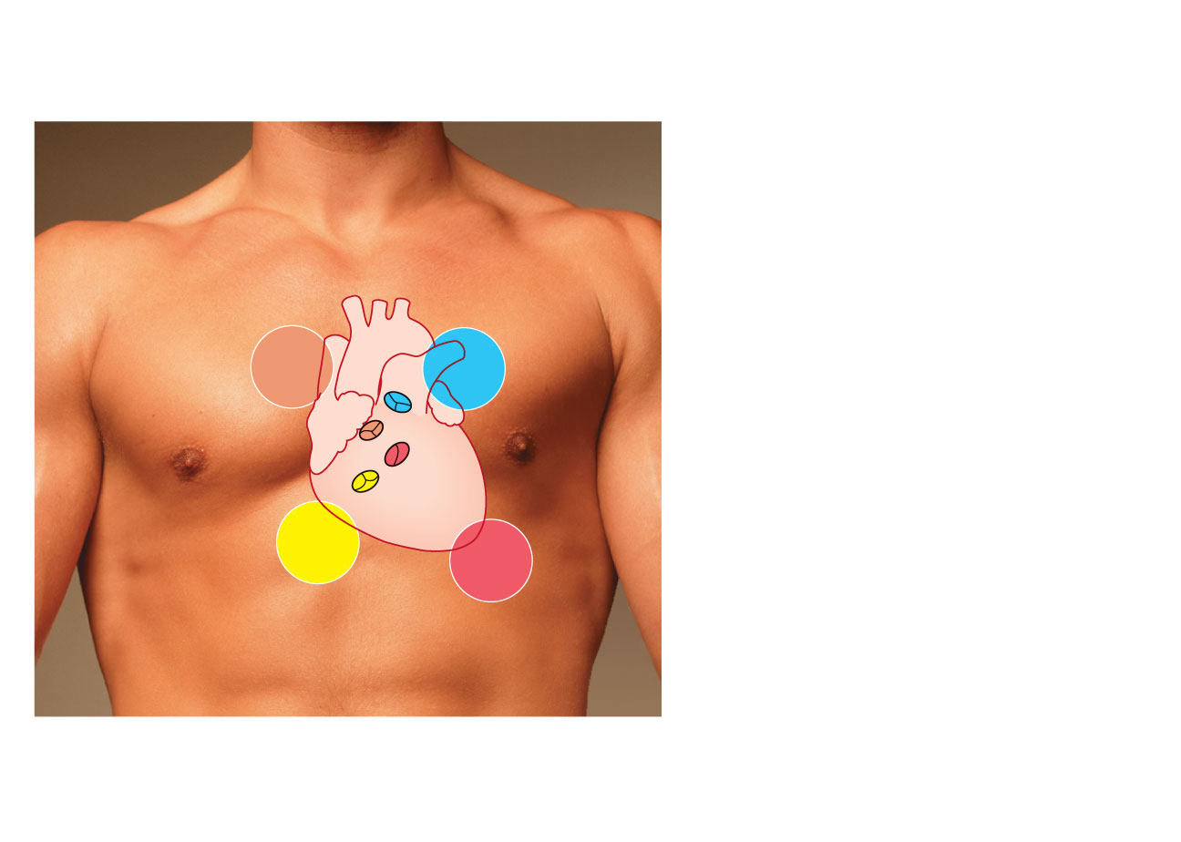
Aortic valve sounds heard
in 2nd intercostal space at
right sternal margin
Pulmonary valve
sounds heard in 2nd
intercostal space at left
sternal margin
Mitral valve sounds
heard over heart apex
(in 5th intercostal space)
in line with middle of
clavicle
Tricuspid valve sounds typically
heard in right sternal margin of
5th intercostal space
Figure 18.19

Slide 24
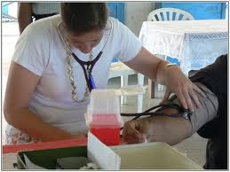
Mechanical Events: The Cardiac Cycle
Cardiac cycle: all events associated with blood flow through the heart during one complete heartbeat
Systole—contraction - maximal pressure
Diastole—relaxation - minimal pressure

Slide 25
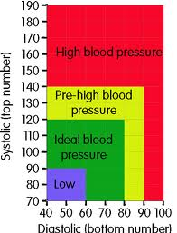

Slide 26
Phases of the Cardiac Cycle
Ventricular filling—takes place in mid-to-late diastole
AV valves are open
80% of blood passively flows into ventricles
Atrial systole occurs, delivering the remaining 20%
End diastolic volume (EDV): volume of blood in each ventricle at the end of ventricular diastole

Slide 27
Phases of the Cardiac Cycle
Ventricular systole
Atria relax and ventricles begin to contract
Rising ventricular pressure results in closing of AV valves
Isovolumetric contraction phase (all valves are closed)
In ejection phase, ventricular pressure exceeds pressure in the large arteries, forcing the SL valves open
End systolic volume (ESV): volume of blood remaining in each ventricle

Slide 28
Phases of the Cardiac Cycle
Isovolumetric relaxation occurs in early diastole
Ventricles relax
Backflow of blood in aorta and pulmonary trunk closes SL valves and causes dicrotic notch (brief rise in aortic pressure)

Slide 29
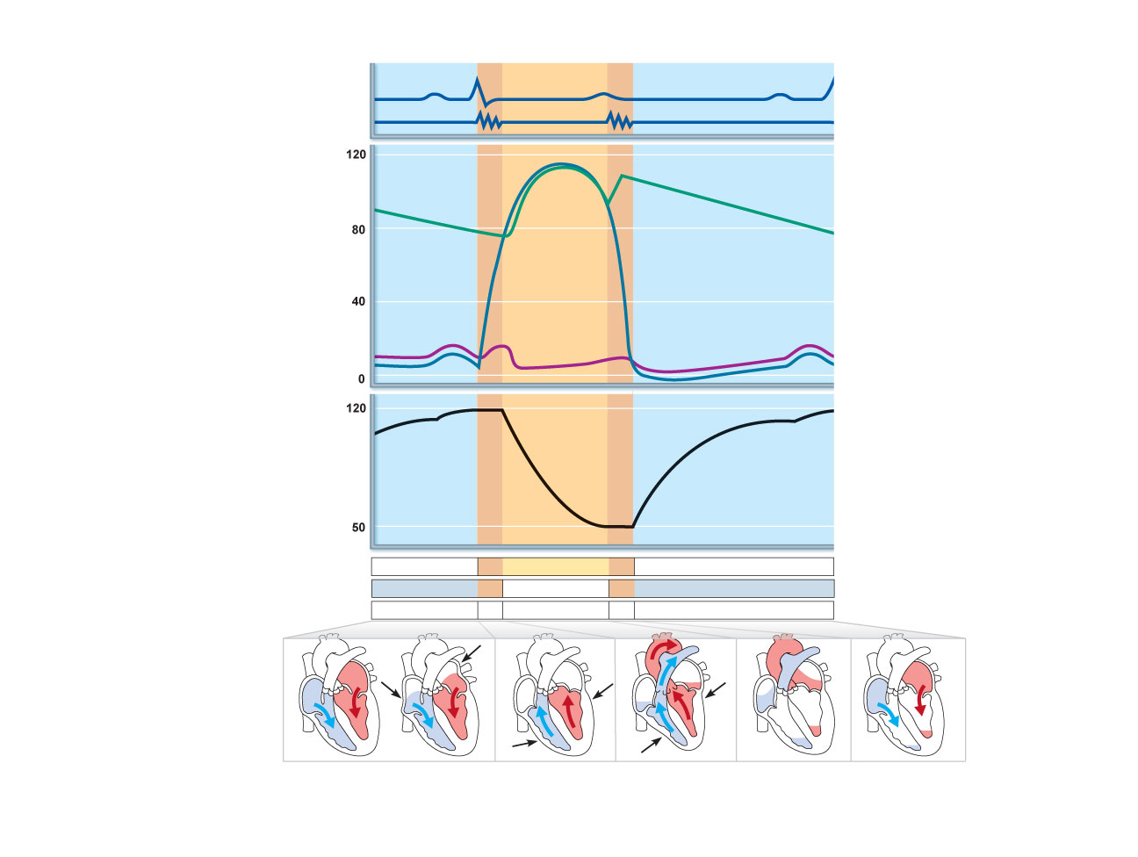
QRS
Left heart
Electrocardiogram
P
T
P
Heart sounds
1st
2nd
Dicrotic notch
Pressure (mm Hg)
Aorta
Left ventricle
Atrial systole
Left atrium
EDV
Ventricular
volume (ml)
SV
ESV
Atrioventricular valves
Open
Closed
Open
Aortic and pulmonary valves
Closed
Open
Closed
Phase
1
2a
2b
3
1
Left atrium
Right atrium
Left ventricle
Right ventricle
Ventricular
filling
Atrial
contraction
Isovolumetric
contraction phase
Ventricular
ejection phase
Isovolumetric
relaxation
Ventricular
filling
1
2a
2b
3
Ventricular filling
(mid-to-late diastole)
Ventricular systole
(atria in diastole)
Early diastole
Figure 18.20

Slide 30
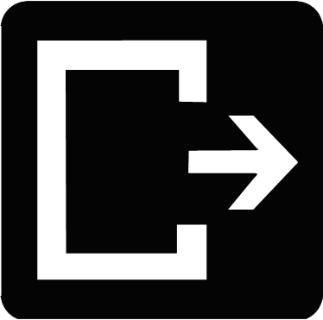
Cardiac Output (CO)
Volume of blood pumped by each ventricle in one minute
CO = heart rate (HR) x stroke volume (SV)
HR = number of beats per minute
SV = volume of blood pumped out by a ventricle with each beat

Slide 31
Cardiac Output (CO)
At rest
CO (ml/min) = HR (75 beats/min) × SV (70 ml/beat)
= 5.25 L/min
Maximal CO is 4–5 times resting CO in nonathletic people
Maximal CO may reach 35 L/min in trained athletes
Cardiac reserve: difference between resting and maximal CO

Slide 32
Regulation of Stroke Volume
SV = EDV – ESV
Three main factors affect SV
Preload
Contractility
Afterload

Slide 33
Regulation of Stroke Volume
Preload: degree of stretch of cardiac muscle cells before they contract (Frank-Starling law of the heart)
Cardiac muscle exhibits a length-tension relationship
At rest, cardiac muscle cells are shorter than optimal length
Slow heartbeat and exercise increase venous return
Increased venous return distends (stretches) the ventricles and increases contraction force

Slide 34
Regulation of Stroke Volume
Contractility: contractile strength at a given muscle length, independent of muscle stretch and EDV
Positive inotropic agents increase contractility
Increased Ca²⁺ influx due to sympathetic stimulation
Hormones (thyroxine, glucagon, and epinephrine)
Negative inotropic agents decrease contractility
Acidosis
Increased extracellular K⁺
Calcium channel blockers

Slide 35
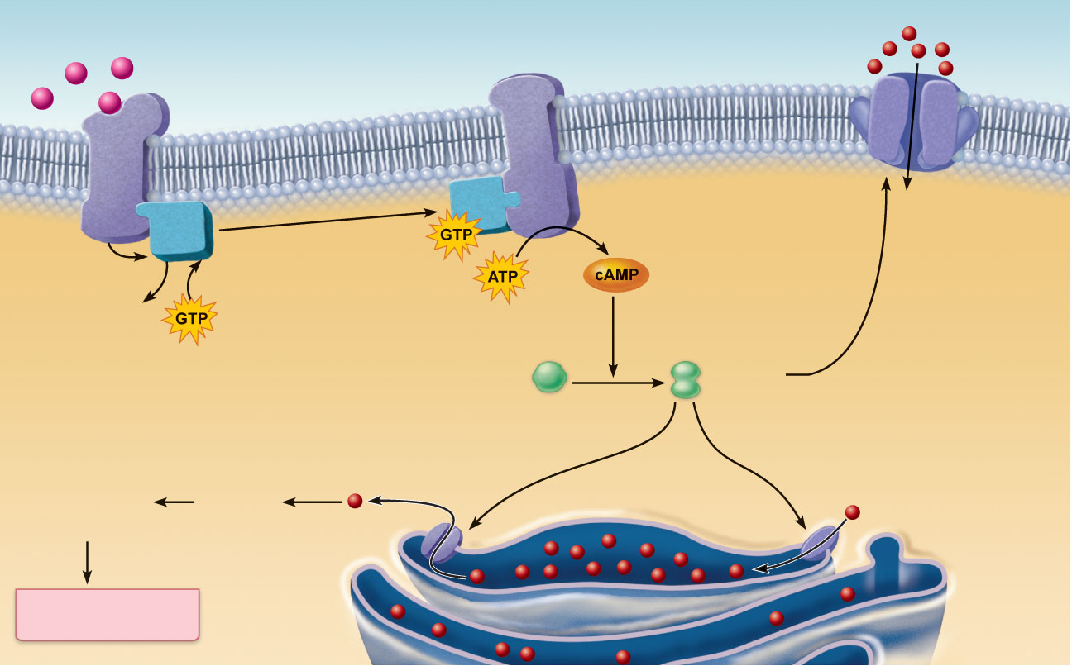
Norepinephrine
Extracellular fluid
β₁-Adrenergic
receptor
Adenylate cyclase
Ca²⁺
Ca²⁺
channel
G protein (G_{s})
ATP is converted
to cAMP
Cytoplasm
a
Phosphorylates
plasma membrane
Ca²⁺ channels,
increasing extra-
cellular Ca²⁺ entry
GDP
Inactive protein
kinase A
Active
protein
kinase A
Phosphorylates SR Ca²⁺ channels,
increasing intracellular Ca²⁺
release
Phosphorylates SR Ca²⁺
pumps, speeding Ca²⁺
removal and relaxation
b
c
Enhanced
actin-myosin
interaction
Troponin
binds
to
Ca²⁺
Ca²⁺
Ca²⁺ uptake
pump
SR Ca²⁺
channel
Cardiac muscle
force and velocity
Sarcoplasmic
reticulum (SR)
Figure 18.21

Slide 36
Regulation of Stroke Volume
Afterload: pressure that must be overcome for ventricles to eject blood
Hypertension increases afterload, resulting in increased ESV and reduced SV

Slide 37
Regulation of Heart Rate
Positive chronotropic factors increase heart rate
Negative chronotropic factors decrease heart rate

Slide 38
Autonomic Nervous System Regulation
Sympathetic nervous system is activated by emotional or physical stressors
Norepinephrine causes the pacemaker to fire more rapidly (and at the same time increases contractility)

Slide 39
Autonomic Nervous System Regulation
Parasympathetic nervous system opposes sympathetic effects
Acetylcholine hyperpolarizes pacemaker cells by opening K⁺ channels
The heart at rest exhibits vagal tone (parasympathetic)

Slide 40
Autonomic Nervous System Regulation
Atrial (Bainbridge) reflex: a sympathetic reflex initiated by increased venous return
Stretch of the atrial walls stimulates the SA node
Also stimulates atrial stretch receptors activating sympathetic reflexes

Slide 41
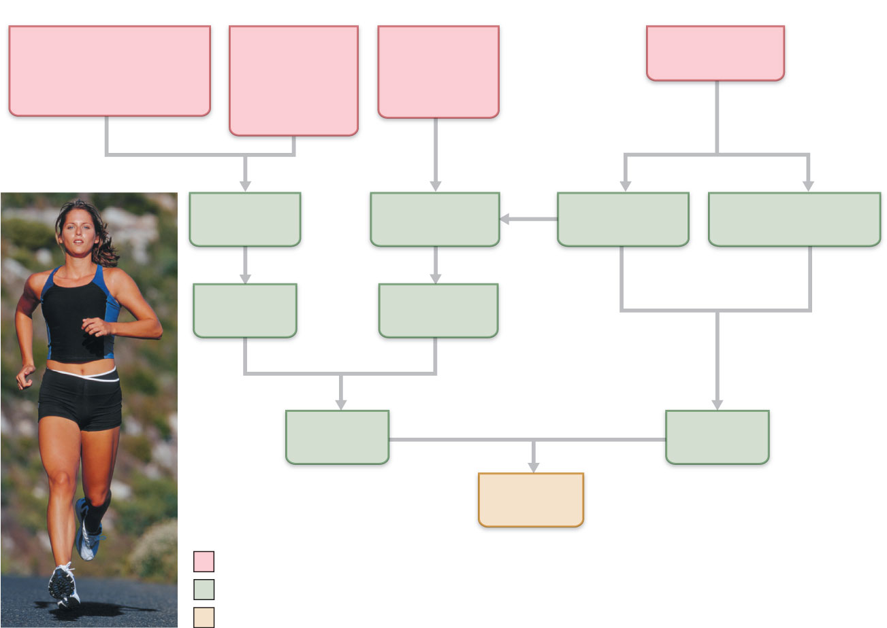
Exercise (by
skeletal muscle and
respiratory pumps;
see Chapter 19)
Heart rate
(allows more
time for
ventricular
filling)
Bloodborne
epinephrine,
thyroxine,
excess Ca²⁺
Exercise,
fright, anxiety
Venous
return
Contractility
Sympathetic
activity
Parasympathetic
activity
EDV
(preload)
ESV
Stroke
volume
Heart
rate
Cardiac
output
Initial stimulus
Physiological response
Result
Figure 18.22

Slide 42
Chemical Regulation of Heart Rate
Hormones
Epinephrine from adrenal medulla enhances heart rate and contractility
Thyroxine increases heart rate and enhances the effects of norepinephrine and epinephrine
Intra- and extracellular ion concentrations (e.g., Ca²⁺ and K⁺) must be maintained for normal heart function

Slide 43
Other Factors that Influence Heart Rate
Age
Gender
Exercise
Body temperature

Slide 44
Homeostatic Imbalances
Tachycardia: abnormally fast heart rate (>100 bpm)
If persistent, may lead to fibrillation
Bradycardia: heart rate slower than 60 bpm
May result in grossly inadequate blood circulation
May be desirable result of endurance training

Slide 45
Congestive Heart Failure (CHF)
Progressive condition where the CO is so low that blood circulation is inadequate to meet tissue needs
Caused by
Coronary atherosclerosis
Persistent high blood pressure
Multiple myocardial infarcts
Dilated cardiomyopathy (DCM)

Slide 46
Developmental Aspects of the Heart
Embryonic heart chambers
Sinus venous
Atrium
Ventricle
Bulbus cordis

Slide 47
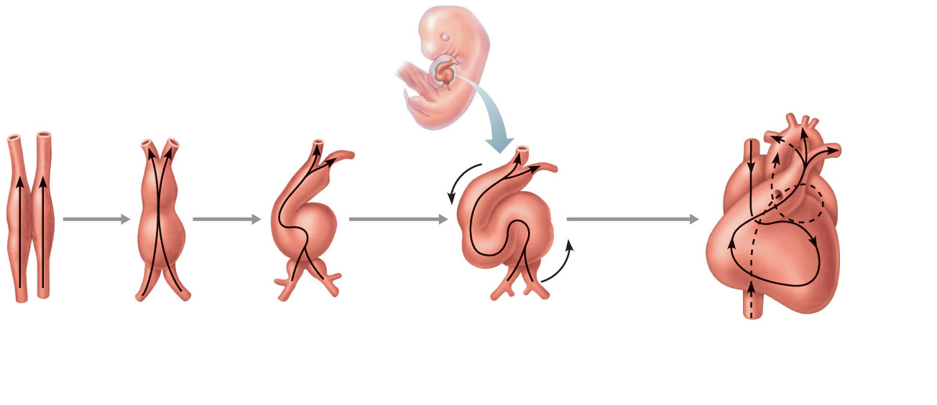
Aorta
Ductus
arteriosus
Arterial end
Arterial end
4a
Superior
vena
cava
4
Tubular
heart
Pulmonary
trunk
Ventricle
Foramen
ovale
3
Atrium
2
Ventricle
1
Inferior
vena cava
Ventricle
Venous end
Venous end
(a) Day 20:
Endothelial
tubes begin
to fuse.
(b) Day 22:
Heart
starts
pumping.
(c) Day 24: Heart
continues to
elongate and
starts to bend.
(d) Day 28: Bending
continues as ventricle
moves caudally and
atrium moves cranially.
(e) Day 35: Bending
is complete.
Figure 18.23

Slide 48
Developmental Aspects of the Heart
Fetal heart structures that bypass pulmonary circulation
Foramen ovale connects the two atria
Ductus arteriosus connects the pulmonary trunk and the aorta

Slide 49
Developmental Aspects of the Heart
Congenital heart defects
Lead to mixing of systemic and pulmonary blood
Involve narrowed valves or vessels that increase the workload on the heart

Slide 50
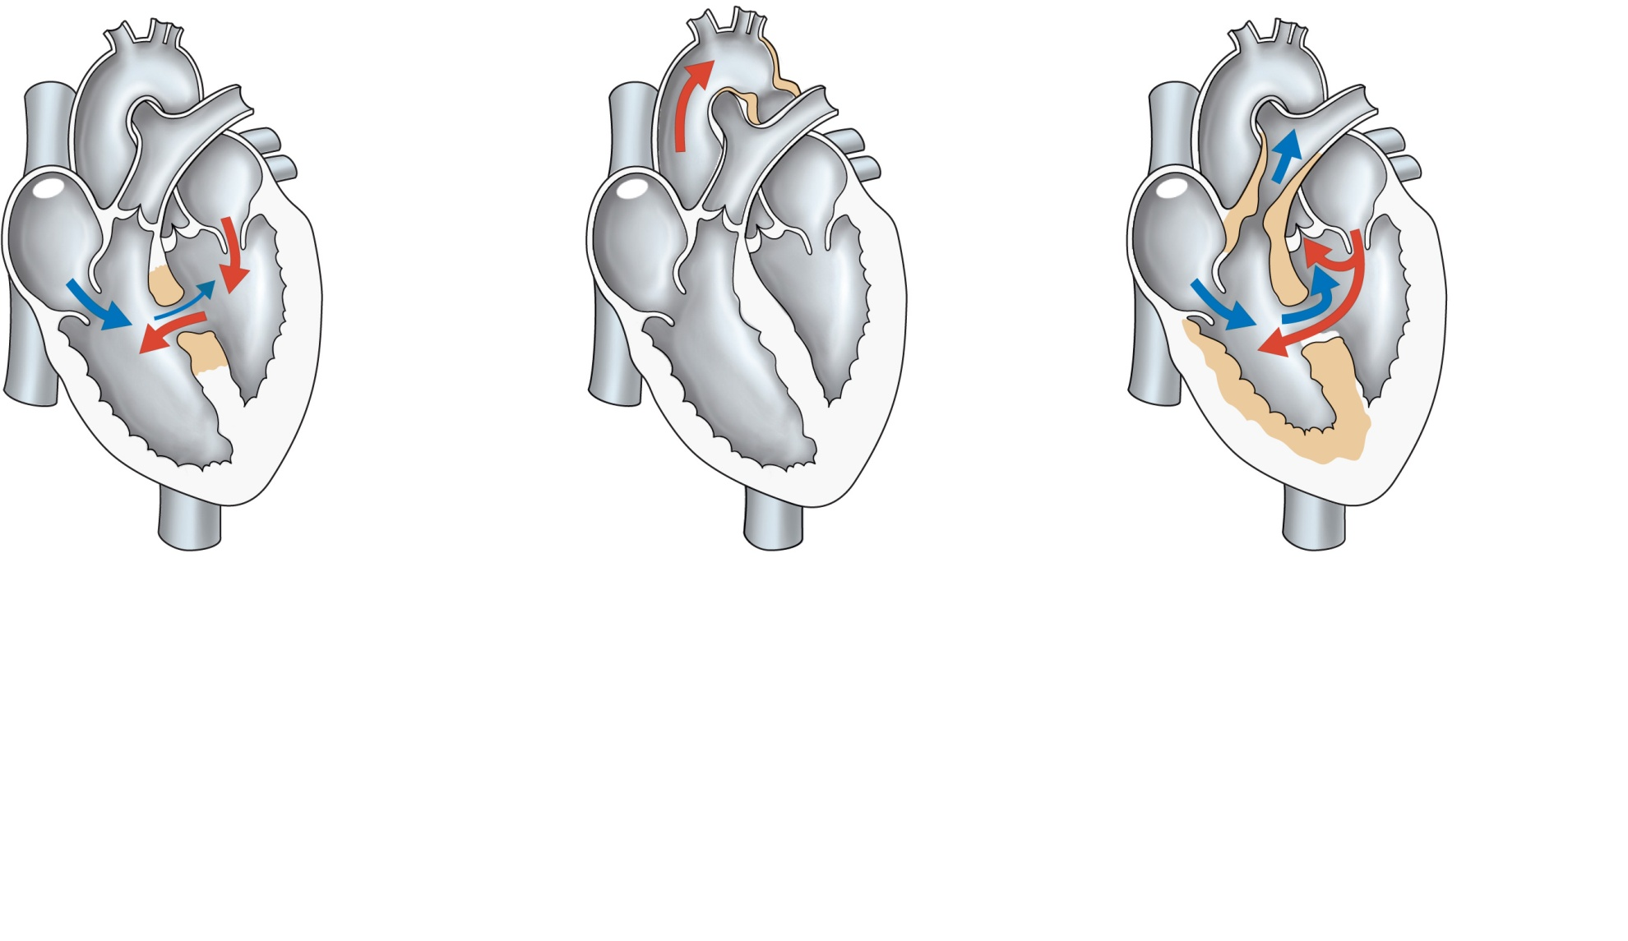
Narrowed
aorta
Occurs in
about 1 in
every
500 births
Occurs in
about 1 in
every 1500
births
Occurs in
about 1 in
every 2000
births
(a)
Ventricular septal defect.
The superior part of the inter-
ventricular septum fails to
form; thus, blood mixes
between the two ventricles.
More blood is shunted from
left to right because the left
ventricle is stronger.
(b)
Coarctation of the
aorta. A part of the
aorta is narrowed,
increasing the workload
of the left ventricle.
(c)
Tetralogy of Fallot.
Multiple defects (tetra =
four): (1) Pulmonary trunk
too narrow and pulmonary
valve stenosed, resulting
in (2) hypertrophied right
ventricle; (3) ventricular
septal defect; (4) aorta
opens from both ventricles.
Figure 18.24

Slide 51
Age-Related Changes Affecting the Heart
Sclerosis and thickening of valve flaps
Decline in cardiac reserve
Fibrosis of cardiac muscle
Atherosclerosis

Slide 52
Cardiac Muscle Contraction
Depolarization opens voltage-gated fast Na⁺ channels in the sarcolemma
Reversal of membrane potential from –90 mV to +30 mV
Depolarization wave in T tubules causes the SR to release Ca²⁺
Depolarization wave also opens slow Ca²⁺ channels in the sarcolemma
Ca²⁺ surge prolongs the depolarization phase (plateau)

Slide 53
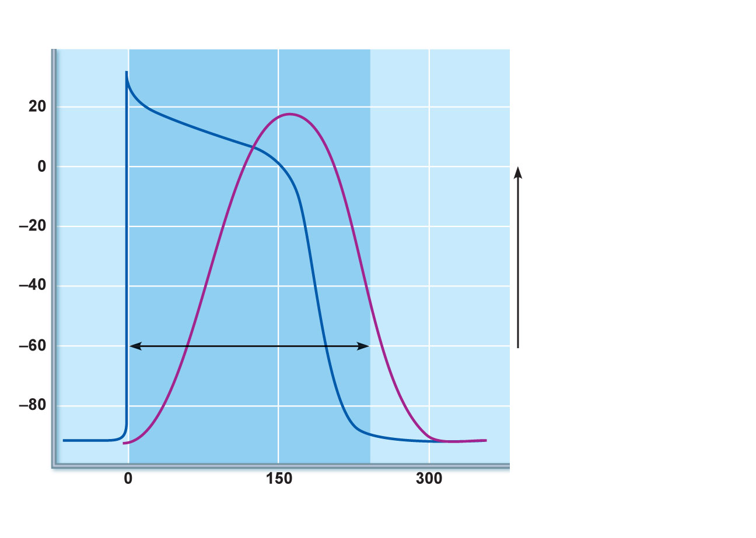
Action
potential
1
Depolarization is
due to Na⁺ influx through
fast voltage-gated Na⁺
channels. A positive
feedback cycle rapidly
opens many Na⁺
channels, reversing the
membrane potential.
Channel inactivation ends
this phase.
Plateau
2
Tension
development
(contraction)
Membrane potential (mV)
3
Tension (g)
1
2
Plateau phase is
due to Ca²⁺ influx through
slow Ca²⁺ channels. This
keeps the cell depolarized
because few K⁺ channels
are open.
Absolute
refractory
period
3
Repolarization is
due to Ca²⁺ channels
inactivating and K⁺
channels opening. This
allows K⁺ efflux, which
brings the membrane
potential back to its
resting voltage.
Time (ms)
Figure 18.12

Slide 54
Cardiac Muscle Contraction
Ca²⁺ influx triggers opening of Ca²⁺-sensitive channels in the SR, which liberates bursts of Ca²⁺
E-C coupling occurs as Ca²⁺ binds to troponin and sliding of the filaments begins
Duration of the AP and the contractile phase is much greater in cardiac muscle than in skeletal muscle
Repolarization results from inactivation of Ca²⁺ channels and opening of voltage-gated K⁺ channels

Slide 55
Heart Physiology: Electrical Events
Intrinsic cardiac conduction system
A network of noncontractile (autorhythmic) cells that initiate and distribute impulses to coordinate the depolarization and contraction of the heart

Slide 56
Autorhythmic Cells
Have unstable resting potentials (pacemaker potentials or prepotentials) due to open slow Na⁺ channels
At threshold, Ca²⁺ channels open
Explosive Ca²⁺ influx produces the rising phase of the action potential
Repolarization results from inactivation of Ca²⁺ channels and opening of voltage-gated K⁺ channels

Slide 57
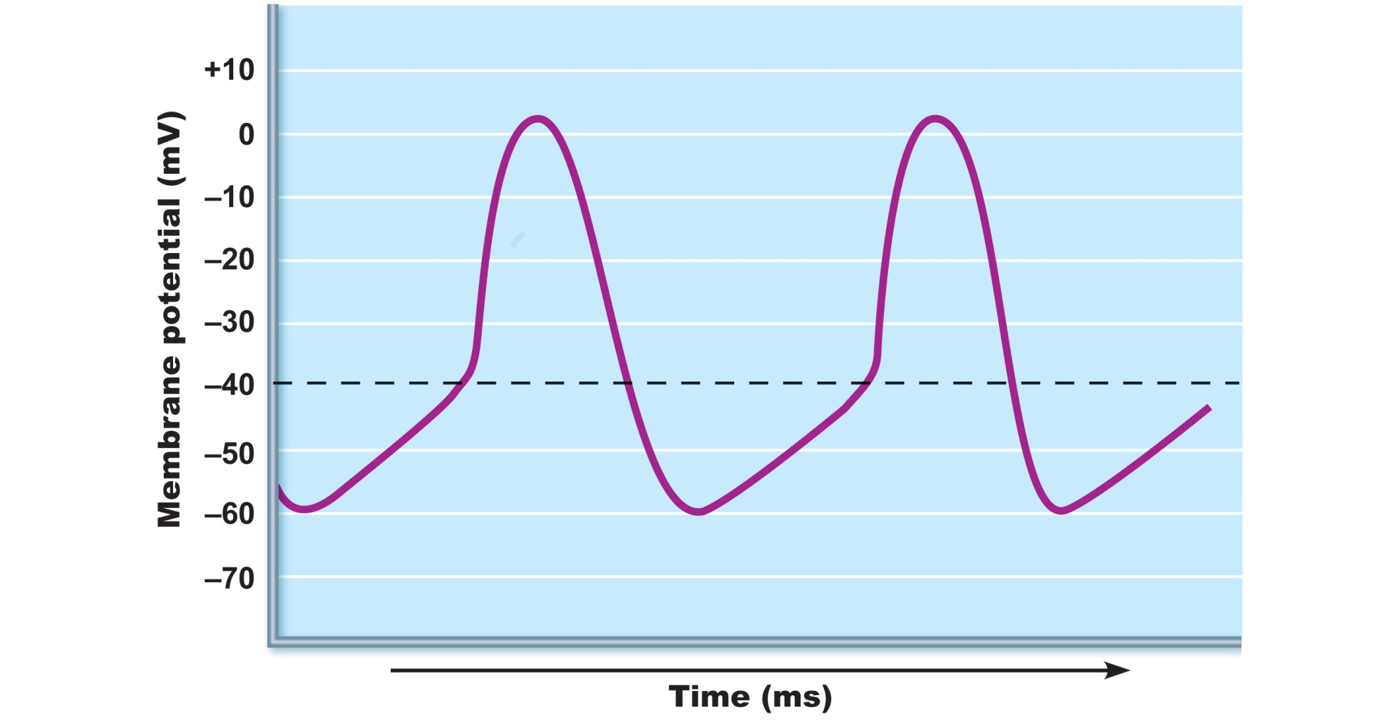
Action
potential
Threshold
2
2
3
1
1
Pacemaker
potential
1
2
3
Pacemaker potential
This slow depolarization is
due to both opening of Na⁺
channels and closing of K⁺
channels. Notice that the
membrane potential is
never a flat line.
Depolarization The
action potential begins when
the pacemaker potential
reaches threshold.
Depolarization is due to Ca²⁺
influx through Ca²⁺ channels.
Repolarization is due to
Ca²⁺ channels inactivating and
K⁺ channels opening. This
allows K⁺ efflux, which brings
the membrane potential back
to its most negative voltage.
Figure 18.13

Slide 58
Homeostatic Imbalances
Defective SA node may result in
Ectopic focus: abnormal pacemaker takes over
If AV node takes over, there will be a junctional rhythm (40–60 bpm)
Defective AV node may result in
Partial or total heart block
Few or no impulses from SA node reach the ventricles

Slide 59
Extrinsic Innervation of the Heart
Heartbeat is modified by the ANS
Cardiac centers are located in the medulla oblongata
Cardioacceleratory center innervates SA and AV nodes, heart muscle, and coronary arteries through sympathetic neurons
Cardioinhibitory center inhibits SA and AV nodes through parasympathetic fibers in the vagus nerves

Slide 60
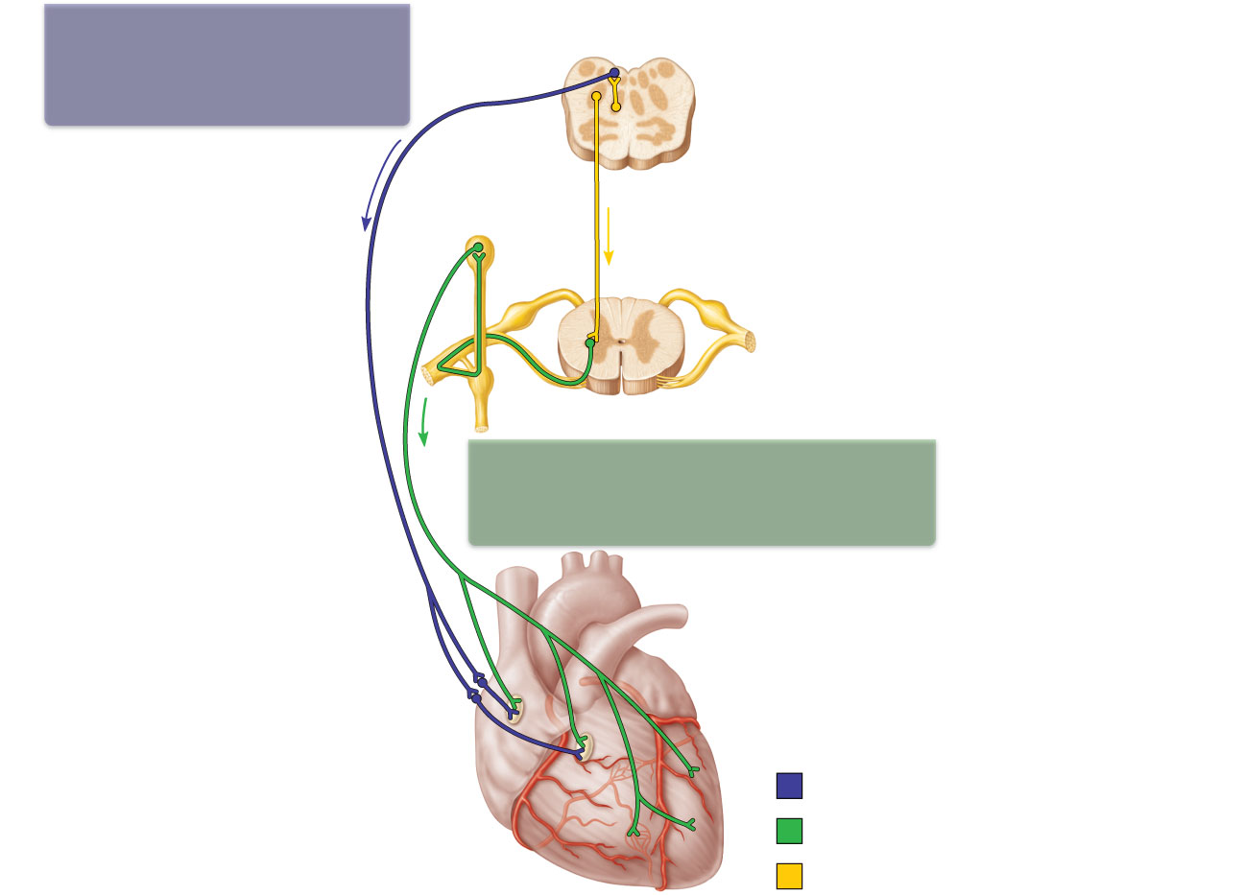
The vagus nerve
(parasympathetic)
decreases heart rate.
Dorsal motor nucleus of vagus
Cardioinhibitory center
Medulla oblongata
Cardio-
acceleratory
center
Sympathetic trunk ganglion
Thoracic spinal cord
Sympathetic trunk
Sympathetic cardiac
nerves increase heart rate
and force of contraction.
AV node
SA node
Parasympathetic fibers
Sympathetic fibers
Interneurons
Figure 18.15

