Slide 1
Ossification
Protein Shake
Contractions… Hee Hee Hee HOOOO
Sark Week!
Organelles
OSU
$100
$100
$100
$100
$100
$200
$200
$200
$200
$200
$300
$300
$300
$300
$300
$400
$400
$400
$400
$400
$500
$500
$500
$500
$500
FINAL ROUND

Slide 2
General : $100 Question
The thick protein
ANSWER
BACK TO GAME

Slide 3
General: $100 Answer
What is myosin?
BACK TO GAME

Slide 4
General : $200 Question
The protein Calcium ions bind to.
ANSWER
BACK TO GAME

Slide 5
General : $200 Answer
What is troponin?
BACK TO GAME

Slide 6
General: $300 Question
The protein myosin wants to attach to
ANSWER
BACK TO GAME

Slide 7
General : $300 Answer
What is actin?
BACK TO GAME

Slide 8
General : $400 Question
The protein that prevents myosin heads from binding to actin molecules
ANSWER
BACK TO GAME

Slide 9
General : $400 Answer
What is tropomyosin?
BACK TO GAME

Slide 10
General : $500 Question
The organelle that stores Calcium ions in a muscle cell and releases them in response to an Action Potential
ANSWER
BACK TO GAME

Slide 11
intramembanous: $500 Answer
What is the sarcoplasmic reticulum?
BACK TO GAME

Slide 12
Intramembanous $100 Question
Causes Myosin cross bridges to break between myosin and actin
ANSWER
BACK TO GAME

Slide 13
intramembranous : $100 Answer
What is ATP?
BACK TO GAME

Slide 14
intramembranous : $200 Question
When it binds to troponin, troponin changes shape.
ANSWER
BACK TO GAME

Slide 15
intramembranous : $200 Answer
What is calcium ions?
BACK TO GAME

Slide 16
intramembranous : $300 Question
This happens after myosin attaches to actin
ANSWER
BACK TO GAME

Slide 17
intramembanous : $300 Answer
What is the POWER STROKE?
BACK TO GAME

Slide 18
Division : $400 Question
After the myosin head splits ATP into ADP and Phosphate, this happens to the head.
ANSWER
BACK TO GAME

Slide 19
Division: $400 Answer
What is raised or elevated?
BACK TO GAME

Slide 20
Division: $500 Question
Daily Double!
How much would you like to wager?
ANSWER
BACK TO GAME

Slide 21
Division: $500 Answer
Rigor Mortis
BACK TO GAME

Slide 22
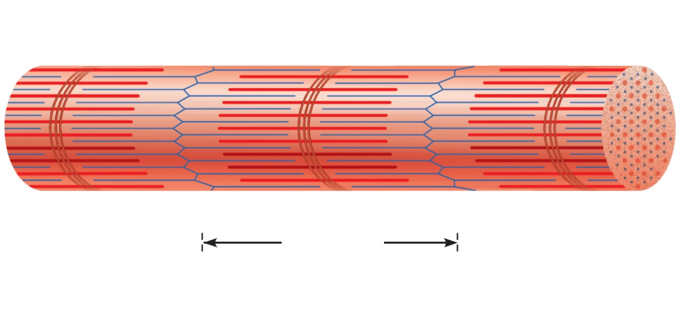
Endochondral: $100 Question
The Length of the top arrow
ANSWER
BACK TO GAME

Slide 23
endo: $100 Answer
What is the A band?
BACK TO GAME

Slide 24
Too late to apoptize : $200 Question
This stays the same length during muscle contraction?
ANSWER
BACK TO GAME

Slide 25
endo: $200 Answer
What is the A band?
BACK TO GAME

Slide 26
endo: $300 Question
The top arrow
ANSWER
BACK TO GAME

Slide 27
endo: $300 Answer
What is the I band?
BACK TO GAME

Slide 28
endo: $400 Question
These shorten during contraction
ANSWER
BACK TO GAME

Slide 29
endo: $400 Answer
What are the I band, H Zone, and sarcomere?
(check with judges if only say one)
BACK TO GAME

Slide 30
Endochondral! 500
Organization of a muscle from largest bundle to smallest
ANSWER
BACK TO GAME

Slide 31
Bone! 500
What is muscle, fascicles, fibers, myofibrils, myofilaments?
BACK TO GAME

Slide 32
Histology: $100 Question
Muscle cells contain plenty of these 2 famous organelles
ANSWER
BACK TO GAME

Slide 33
histology $100 Answer
What are mitochondria and nuclei?
BACK TO GAME

Slide 34
Characteristics of Cancer $200 Question
Network like structure that stores calcium
ANSWER
BACK TO GAME

Slide 35
Characteristics of Cancer : $200 Answer
What is the sarcoplasmic reticulum?
BACK TO GAME

Slide 36
Characteristics of Cancer $300 Question
Another the name for sarcolemma
ANSWER
BACK TO GAME

Slide 37
Characteristics of Cancer : $300 Answer
What is the cell membrane
BACK TO GAME

Slide 38
Characteristics of Cancer : $400 Question
The cell membrane invades the muscle cell at the Z disc and the structure looks like a T so it is called this.
ANSWER
BACK TO GAME

Slide 39
Characteristics of Cancer : $400 Answer
What is the T Tubule?
BACK TO GAME

Slide 40
I give this rose to : $500 Question
Activated if you do not get enough calcium
ANSWER
BACK TO GAME

Slide 41
Neurotransmitters and Integration: $500 Answer
What are osteoclasts?
BACK TO GAME

Slide 42
Mixed Bag: $100 Question
The best part of your day.
ANSWER
BACK TO GAME

Slide 43
Mixed Bag: $100 Answer
What is Right now?
BACK TO GAME

Slide 44
Mixed Bag: $200 Question
If you are not studying tonight, Hans and Franz would call you this.
ANSWER
BACK TO GAME

Slide 45
Mixed Bag: $200 Answer
What is totally flabby?
BACK TO GAME

Slide 46
Mixed Bag: $300 Question
Your favorite energy storing molecule.
ANSWER
BACK TO GAME

Slide 47
Mixed Bag: $300 Answer
What is ATP?
BACK TO GAME

Slide 48
Mixed Bag: $400 Question
Tomorrow
ANSWER
BACK TO GAME

Slide 49
Mixed Bag: $400 Answer
What is happy times?
BACK TO GAME

Slide 50
Mixed Bag: $500 Question
The steps of muscle contraction
ANSWER
BACK TO GAME

Slide 51
Mixed Bag: $500 Answer
Give em to me!
BACK TO GAME

Slide 52
FINAL ROUND Question
Describe intramembranous ossification
ANSWER
BACK TO GAME

