Slide 1
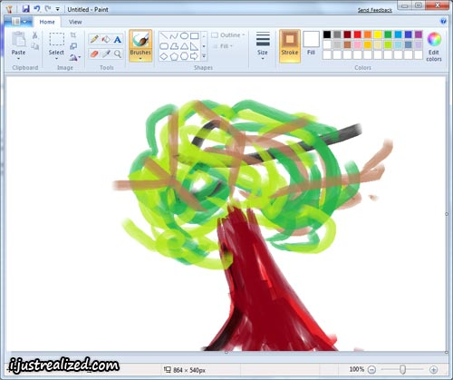
Make a graphic Organizer on organization of the nervous system
Use credible sources
provide more information than just text book
foreach division

Slide 2
Table time
6 cell types found in nervous system
Where each is found
What each does
Bonus: a pathologic condition that occurs when that cell “goes wrong”

