Slide 1
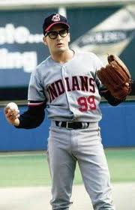
This week’s plan 2 days talking about how nerve impulse Wednesday – Brain regions Thursday Dissect Sheep Brain Friday Assess regions and neuron firing Current Event

Slide 2
The Forest
Neurons are highly irritable (touchy!)
Respond to adequate stimulus by generating an action potential (nerve impulse)
This Impulse is always the same regardless of stimulus
The Trees come next!

Slide 3
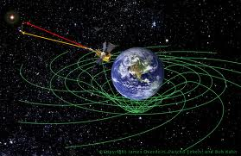
Mass ~energy
You will not have to know physics!
~
Space is not a thing
Time is not a thing
Spacetime is a thing!
Protons are made of quarks which are made of “strings!?” …vibrating in spacetime!?
But it is interesting

Slide 4
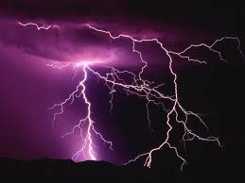
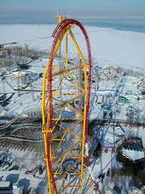
Principles of Electricity
Opposite charges attract each other
E is required to separate opposite charges across a membrane
Energy is liberated when the charges move toward one another
If opposite charges are separated, the system has potential energy

Slide 5
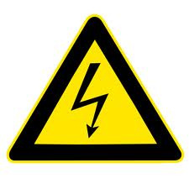
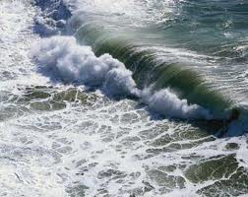
Background Definitions
Voltage (V): measure of potential energy generated by separated charge
Potential difference: voltage measured between two points
Current (I): the flow of electrical charge (ions) between two points

Slide 6
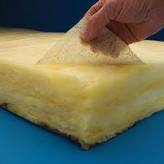
Background Definitions (that I won’t test on… but is good for any well rounded scientists)
Resistance (R): hindrance to charge flow (provided by the plasma membrane)
Insulator: substance with high electrical resistance
Conductor: substance with low electrical resistance

Slide 7
We’ll look at
Generating and maintaining the difference of charges on sides of cell membrane
Channels
Gated need a key
Leakage always open
What happens when we let those charges dissipate

Slide 8
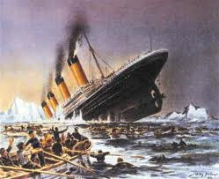
Ion Channels What is an ion again?
Proteins serve as membrane ion channels
Two main types of ion channels
Leakage (nongated) channels—always open

Slide 9
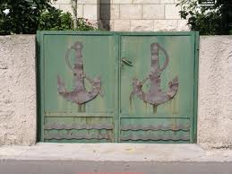
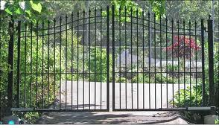
Ion Channels
Gated channels (three keys):
Chemically gated (ligand-gated) channels—open with binding of a specific neurotransmitter
Voltage-gated channels—open and close in response to changes in membrane potential
Mechanically gated channels—open and close in response to physical deformation of receptors

Slide 10
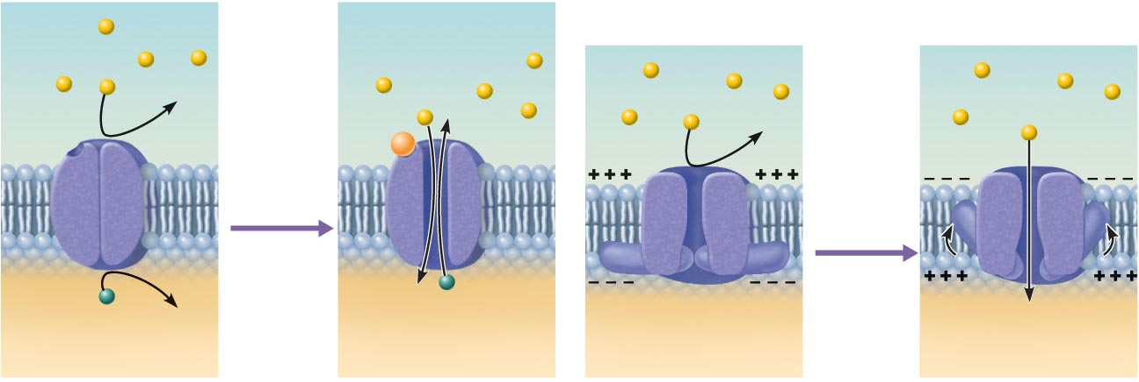
Neurotransmitter chemical
attached to receptor
Receptor
Na⁺
Na⁺
Na⁺
Na⁺
Chemical
binds
Membrane
voltage
changes
K⁺
K⁺
Closed
Open
Closed
Open
(Volt)
(Chemical)
Figure 11.6

Slide 11
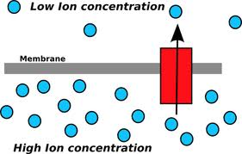
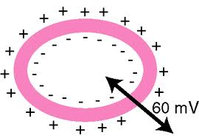
Gated Channels
When gated channels are open:
Ions diffuse quickly across the membrane along their electrochemical gradients
Along chemical concentration gradients
Along electrical gradients
*Ion flow creates an electrical current and voltage changes across the membrane

Slide 12
Resting Membrane Potential (Vr)
Potential difference across the membrane of a resting cell
Approximately –70 mV in neurons (inside -)
Generated by:
Differences in ionic makeup of ICF and ECF
Differential permeability of the plasma membrane

Slide 13
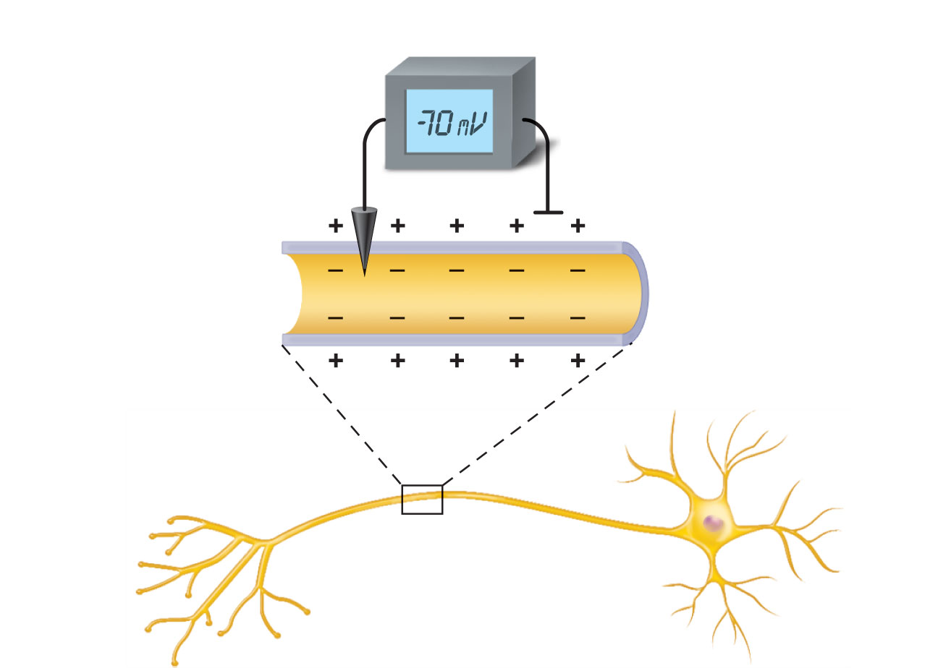
Voltmeter
Plasma
membrane
Ground electrode
outside cell
Microelectrode
inside cell
Axon
Neuron
Figure 11.7

Slide 14
Resting Membrane Potential
Differences in ionic makeup
ICF has lower concentration of Na⁺ and Cl– than ECF
ICF has higher concentration of K⁺ and negatively charged proteins (A–) than ECF

Slide 15
Resting Membrane Potential
Differential permeability of membrane
Impermeable to A^{– (anion proteins}
Slightly permeable to Na⁺ (through leakage channels)
75 times more permeable to K⁺ (more leakage channels)
Freely permeable to Cl–

Slide 16
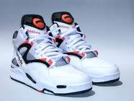
Resting Membrane Potential
Negative interior of the cell is due to much greater diffusion of K⁺ out of the cell than Na⁺ diffusion into the cell
Sodium-potassium pump stabilizes the resting membrane potential by maintaining the concentration gradients for Na⁺ and K⁺
#1 country of export potassium
Notes:
Kazakstan

Slide 17
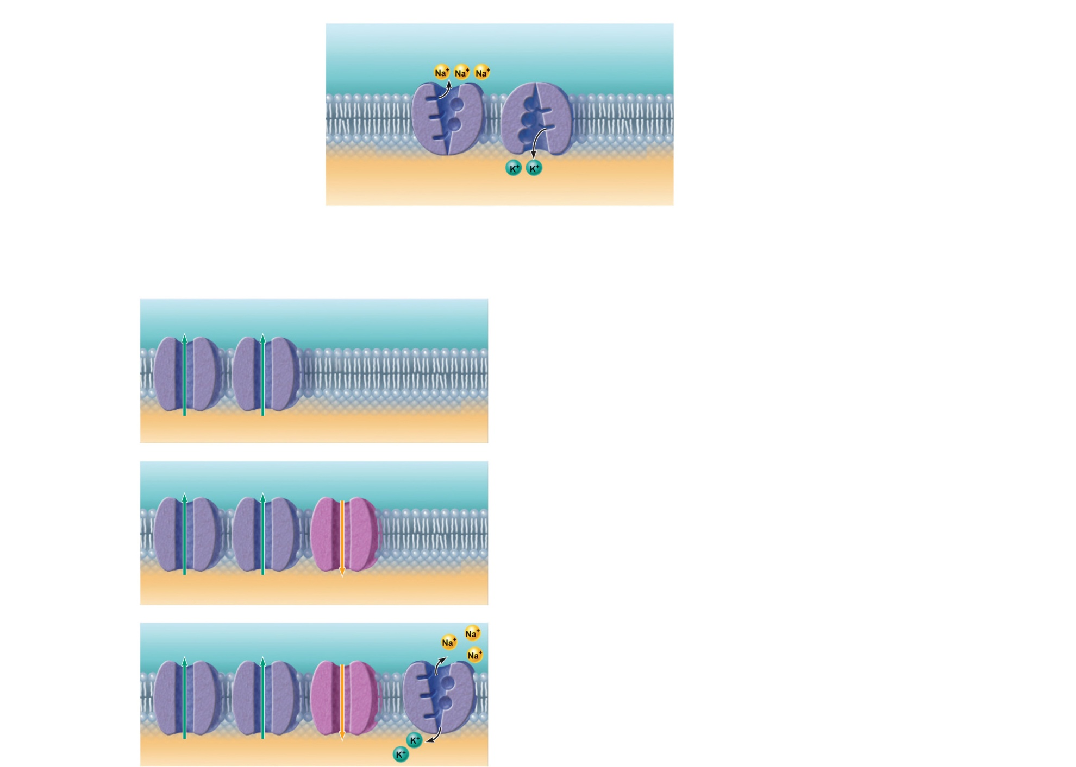
The concentrations of Na⁺ and K⁺ on each side of the membrane are different.
The Na⁺ concentration
is higher outside the
cell.
Outside cell
K⁺
(5 mM )
Na⁺
(140 mM )
The K⁺ concentration
is higher inside the
cell.
K⁺
(140 mM )
Na⁺
(15 mM )
Inside cell
Na⁺-K⁺ ATPases (pumps)
maintain the concentration
gradients of Na⁺ and K⁺
across the membrane.
The permeabilities of Na⁺ and K⁺ across the
membrane are different.
K⁺ leakage channels
Suppose a cell has only K⁺ channels...
K⁺ loss through abundant leakage
channels establishes a negative
membrane potential.
K⁺
K⁺
K⁺
K⁺
Cell interior
–90 mV
Now, let’s add some Na⁺ channels to our cell...
Na⁺ entry through leakage channels reduces
the negative membrane potential slightly.
K⁺
K⁺
Na⁺
K
K⁺
Na⁺
Cell interior
–70 mV
Na+-K+ pump
Finally, let’s add a pump to compensate
for leaking ions.
Na⁺-K⁺ ATPases (pumps) maintain the
concentration gradients, resulting in the
resting membrane potential.
K⁺
K⁺
Na⁺
K⁺
K⁺
Na⁺
Cell interior
–70 mV
Figure 11.8

Slide 18
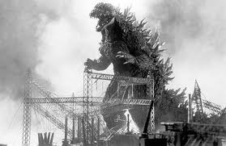
Next one is a big one

Slide 19
*Membrane Potentials That Act as Signals
Membrane potential changes when:
Concentrations of ions across the membrane change
Permeability of membrane to ions changes
Changes in membrane potential are signals used to receive, integrate and send information

Slide 20
Words we’re going to be using…

Slide 21
*Membrane Potentials That Act as Signals
Two types of signals
Graded potentials
Incoming short-distance signals
Action potentials
Long-distance signals of axons

Slide 22
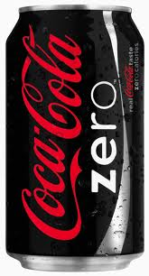
*Changes in Membrane Potential
Depolarization
A reduction in membrane potential (toward zero)
Inside of the membrane becomes less negative

Slide 23
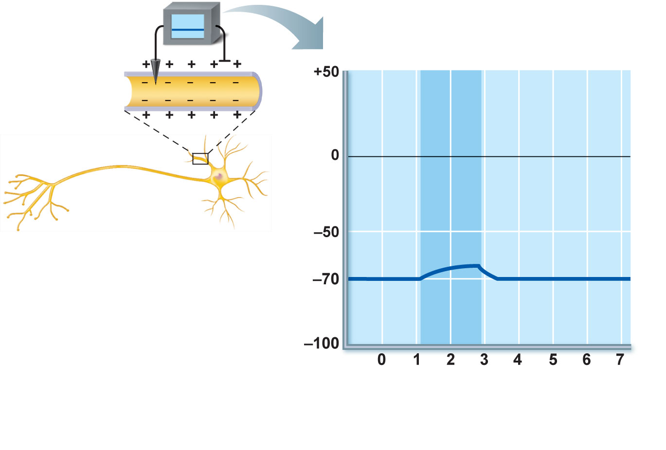
Depolarizing stimulus
Inside
positive
Inside
negative
Depolarization
Resting
potential
Time (ms)
(a) Depolarization: The membrane potential moves toward 0 mV, the inside becoming less negative (more positive).
Figure 11.9a

Slide 24
Changes in Membrane Potential
Hyperpolarization
An increase in membrane potential (away from zero)
Inside of the membrane becomes more negative than the resting potential
Reduces the probability of producing a nerve impulse

Slide 25
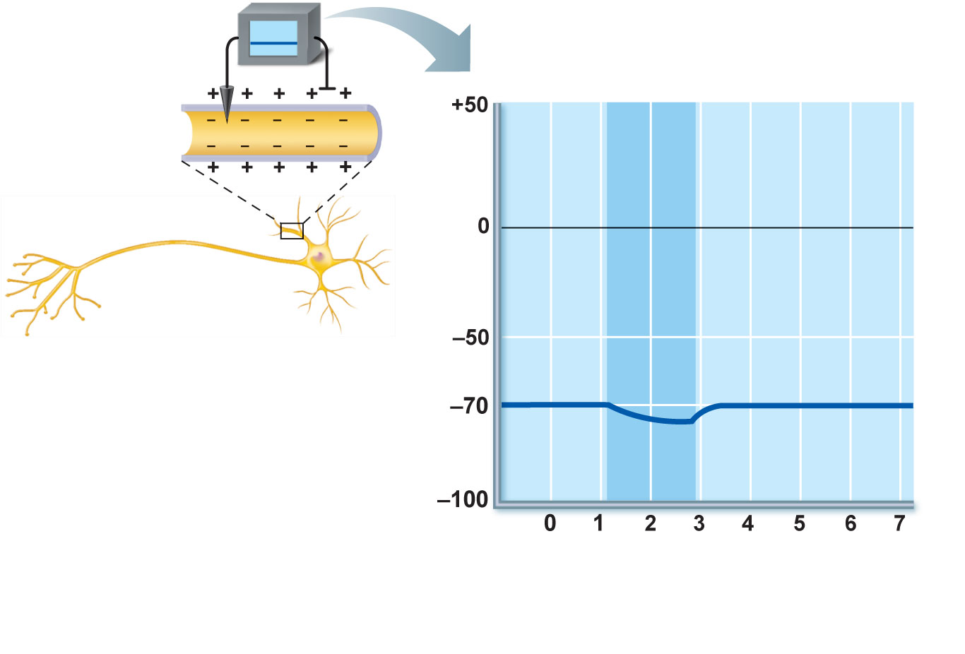
Hyperpolarizing stimulus
Resting
potential
Hyper-
polarization
Time (ms)
(b) Hyperpolarization: The membrane potential increases, the inside becoming more negative.
Figure 11.9b

Slide 26
Graded Potentials
Short-lived, localized changes in membrane potential
Depolarizations or hyperpolarizations
Graded potential spreads as local currents change the membrane potential of adjacent regions

Slide 27
Stimulus
Depolarized region
Plasma
membrane
(a) Depolarization: A small patch of the
membrane (red area) has become depolarized.
Figure 11.10a

Slide 28
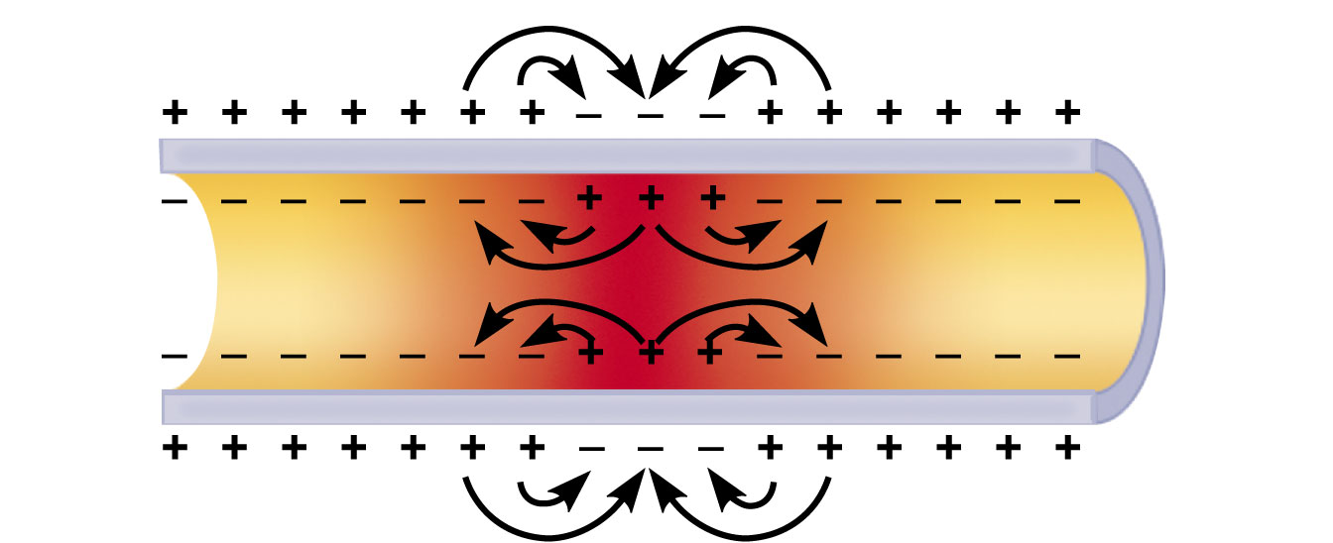
(b) Spread of depolarization: The local currents
(black arrows) that are created depolarize
adjacent membrane areas and allow the wave of
depolarization to spread.
Figure 11.10b

Slide 29
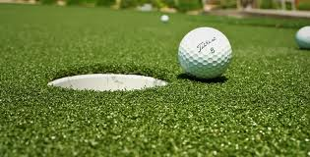
Graded Potentials (your putter)
Occur when a stimulus causes gated ion channels to open
E.g., receptor potentials, generator potentials, postsynaptic potentials
Magnitude varies directly (graded) with stimulus strength
Decrease in magnitude with distance as ions flow and diffuse through leakage channels
Short-distance signals

Slide 30
Active area
(site of initial
depolarization)
Membrane potential (mV)
–70
Resting potential
Distance (a few mm)
(c) Decay of membrane potential with distance: Because current
is lost through the “leaky” plasma membrane, the voltage declines
with distance from the stimulus (the voltage is decremental ).
Consequently, graded potentials are short-distance signals.
Figure 11.10c

Slide 31
http://outreach.mcb.harvard.edu/animations/actionpotential.swf

Slide 32
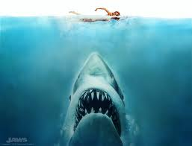
Next one is a big one

Slide 33
Action Potential (AP)
Brief reversal of membrane potential with a total amplitude of ~100 mV
Occurs in muscle cells and axons of neurons
Does not decrease in magnitude over distance
Principal means of long-distance neural communication

Slide 34
The big picture
1
Resting state
2
Depolarization
3
Repolarization
3
4
Hyperpolarization
Membrane potential (mV)
2
Action
potential
Threshold
1
1
4
Time (ms)
Figure 11.11 (1 of 5)

Slide 35
Generation of an Action Potential
Resting state
Leakage channels - open
Gated channels - Not open. Why?

Slide 36
Sodium Channels
Each Na⁺ channel has two voltage-sensitive gates
Activation gates
Closed at rest; open with depolarization
Inactivation gates
Open at rest; block channel once it is open

Slide 37
Properties of Gated Channels
Each K⁺ channel has one voltage-sensitive gate
Opens slowly with depolarization

Slide 38
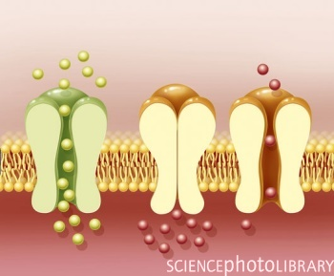
Depolarizing Phase
Depolarizing local currents open voltage-gated Na⁺ channels
Na⁺ influx causes more depolarization
At threshold (–55 to –50 mV) positive feedback leads to opening of all Na⁺ channels, and a reversal of membrane polarity to +30mV (spike of action potential)

Slide 39
Repolarizing Phase
Na⁺ channel slow inactivation gates close
Na+ back to normal permeability
Slow voltage-sensitive K⁺ gates open
K⁺ exits the cell and internal negativity is restored
Are ions concentrations restored???

Slide 40
Hyperpolarization
Hyperpolarization
Some K⁺ channels remain open, allowing excessive K⁺ efflux
This causes hyperpolarization
6th period

Slide 41
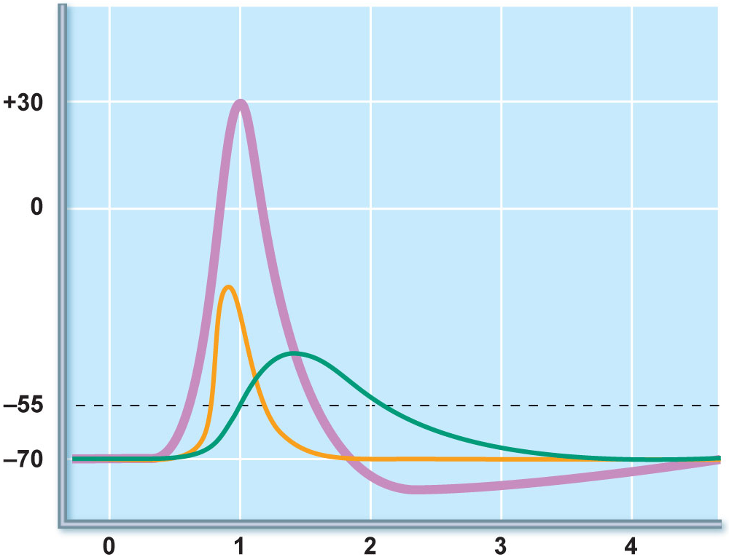
The AP is caused by permeability changes in
the plasma membrane
3
Action
potential
Membrane potential (mV)
Na⁺ permeability
2
Relative membrane permeability
K⁺ permeability
1
1
4
Time (ms)
Figure 11.11 (2 of 5)

Slide 42
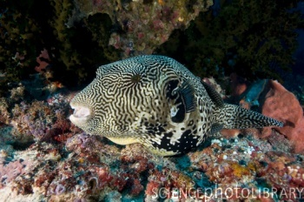
Repolarization
Restores the resting electrical conditions of the neuron
Does not restore the resting ionic conditions
Ionic redistribution back to resting conditions is restored by…
thousands of sodium-potassium pumps

Slide 43
Propagation of an Action Potential
Na⁺ influx causes a patch of the axonal membrane to depolarize
Local currents occur
Na⁺ channels toward the point of origin are inactivated and not affected by the local currents

Slide 44
Propagation of an Action Potential
Local currents affect adjacent areas in the forward direction
Depolarization opens voltage-gated channels and triggers an AP
Repolarization wave follows the depolarization wave
(Fig. 11.12 shows the propagation process in unmyelinated axons.)

Slide 45
Voltage
at 0 ms
Recording
electrode
(a) Time = 0 ms. Action
potential has not yet
reached the recording
electrode.
Resting potential
Peak of action potential
Hyperpolarization
Figure 11.12a

Slide 46
Voltage
at 2 ms
(b) Time = 2 ms. Action
potential peak is at the
recording electrode.
Figure 11.12b

Slide 47
Voltage
at 4 ms
(c) Time = 4 ms. Action
potential peak is past
the recording electrode.
Membrane at the
recording electrode is
still hyperpolarized.
Figure 11.12c

Slide 48
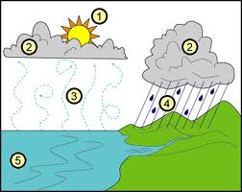
Threshold
At threshold:
Membrane is depolarized by 15 to 20 mV
Na⁺ permeability increases
Na influx exceeds K⁺ efflux
The positive feedback cycle begins

Slide 49
Threshold
Subthreshold stimulus—weak local depolarization that does not reach threshold
Threshold stimulus—strong enough to push the membrane potential toward and beyond threshold
AP is an all-or-none phenomenon—action potentials either happen completely, or not at all

Slide 50
Coding for Stimulus Intensity
All action potentials are alike and are independent of stimulus intensity
How does the CNS tell the difference between a weak stimulus and a strong one?
Strong stimuli can generate action potentials more often than weaker stimuli
The CNS determines stimulus intensity by the frequency of impulses

Slide 51
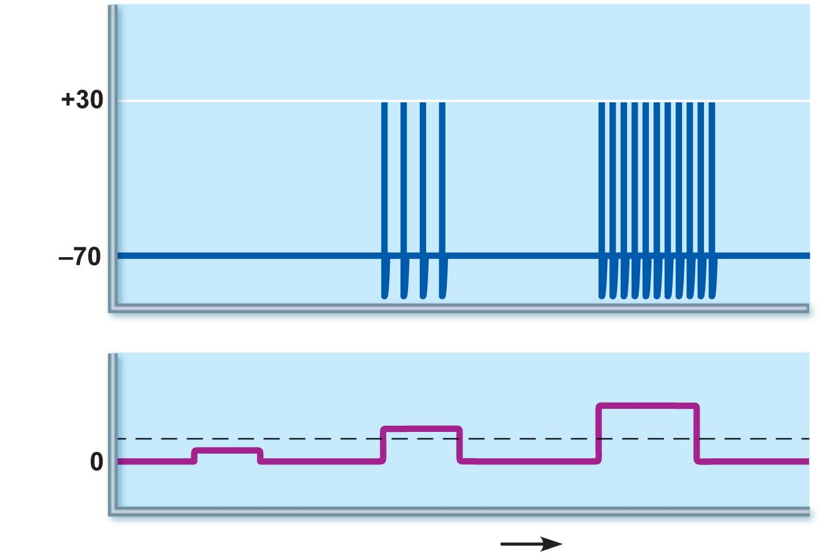
Action
potentials
Stimulus
Threshold
Time (ms)
Figure 11.13

Slide 52
Absolute Refractory Period
Time from the opening of the Na⁺ channels until the resetting of the channels
Ensures that each AP is an all-or-none event
Enforces one-way transmission of nerve impulses

Slide 53
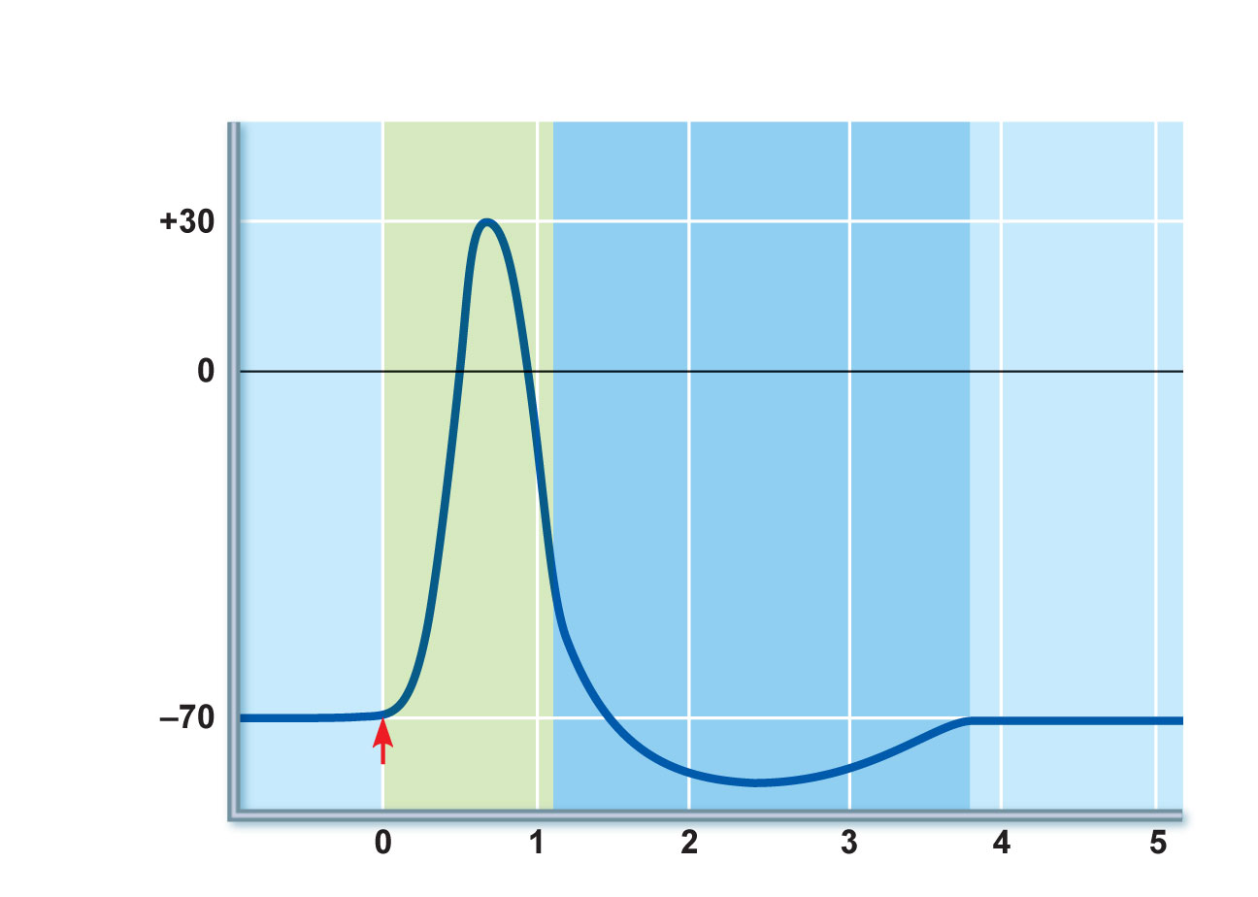
Absolute refractory
period
Relative refractory
period
Depolarization
(Na⁺ enters)
Repolarization
(K⁺ leaves)
After-hyperpolarization
Stimulus
Time (ms)
Figure 11.14

Slide 54
Relative Refractory Period
Follows the absolute refractory period
Most Na⁺ channels have returned to their resting state
Some K⁺ channels are still open
Repolarization is occurring
Threshold for AP generation is elevated
Exceptionally strong stimulus may generate an AP

Slide 56
Conduction Velocity
Conduction velocities of neurons vary widely
Effect of axon diameter
Larger diameter fibers have less resistance to local current flow and have faster impulse conduction
Effect of myelination
Continuous conduction in unmyelinated axons is slower than saltatory conduction in myelinated axons

Slide 57
Conduction Velocity
Effects of myelination
Myelin sheaths insulate and prevent leakage of charge
Saltatory conduction in myelinated axons is about 30 times faster
Voltage-gated Na⁺ channels are located at the nodes
APs appear to jump rapidly from node to node

Slide 58
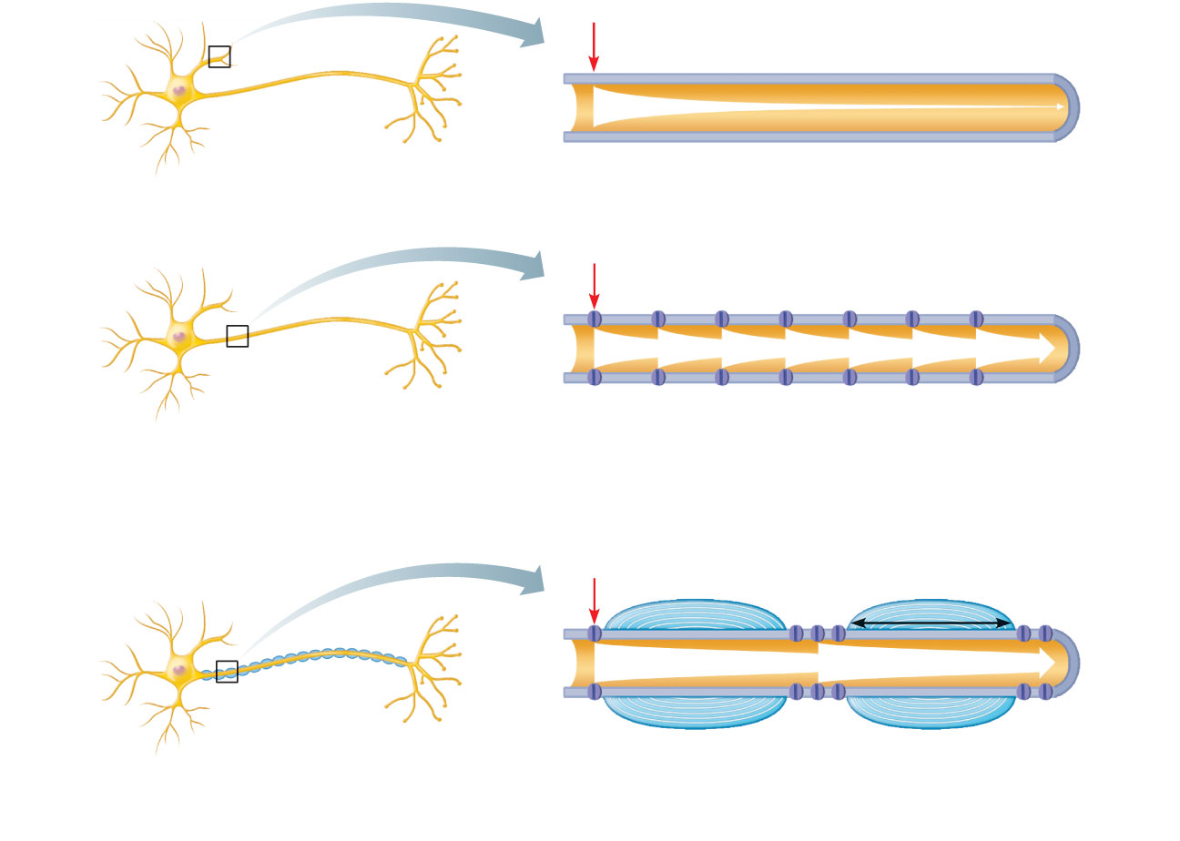
Stimulus
Size of voltage
(a) In a bare plasma membrane (without voltage-gated channels), as on a dendrite, voltage decays because current leaks across the membrane.
Stimulus
Voltage-gated
ion channel
(b) In an unmyelinated axon, voltage-gated Na⁺ and K⁺ channels regenerate the action potential at each point along the axon, so voltage does not decay. Conduction is slow because movements of ions and of the gates of channel proteins take time and must occur before voltage regeneration occurs.
Stimulus
Node of Ranvier
Myelin
sheath
1 mm
(c) In a myelinated axon, myelin keeps current in axons (voltage doesn’t decay much). APs are generated only in the nodes of Ranvier and appear to jump rapidly from node to node.
Myelin sheath
Figure 11.15

Slide 59
Multiple Sclerosis (MS)
An autoimmune disease that mainly affects young adults
Symptoms: visual disturbances, weakness, loss of muscular control, speech disturbances, and urinary incontinence
Myelin sheaths in the CNS become nonfunctional scleroses
Shunting and short-circuiting of nerve impulses occurs
Impulse conduction slows and eventually ceases

Slide 60
Multiple Sclerosis: Treatment
Some immune system–modifying drugs, including interferons and Copazone:
Hold symptoms at bay
Reduce complications
Reduce disability

Slide 61
Nerve Fiber Classification
Nerve fibers are classified according to:
Diameter
Degree of myelination
Speed of conduction

Slide 62
Nerve Fiber Classification
Group A fibers
Large diameter, myelinated somatic sensory and motor fibers
Group B fibers
Intermediate diameter, lightly myelinated ANS fibers
Group C fibers
Smallest diameter, unmyelinated ANS fibers

