Slide 1
This week:
Monday and Tuesday – Nervous System Overview (Fucntions, Histology, Cell types)
Wednesday and Thursday Nerve Firing
Friday Assess – and Read

Slide 2
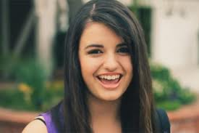
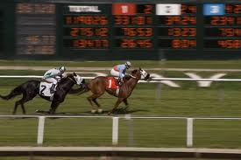
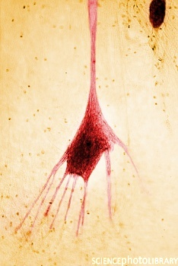
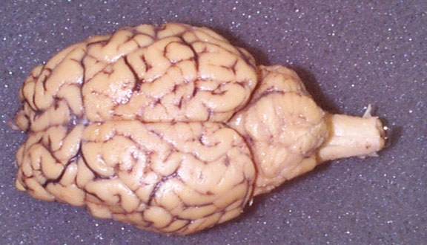
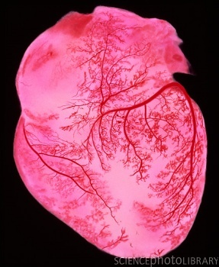
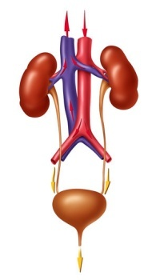
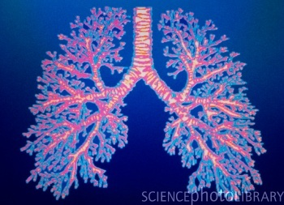
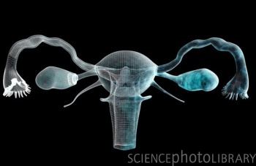
Week 7
Near The home Stretch!

Slide 3
Questions to answer by end of class
Name 2 divisions of nervous system
Name 2 divisions of peripheral nervous system
Name 2 divisions of Autonomic Nervous System
List functions of (formal) Nervous system

Slide 4
Today Nervous System Lecture 1
Functions
Input, output, Interpret!
Organization
Where cells are found, and by what they do
Cells
Neurons
Supporting Cells
6 new cells to ID

Slide 5
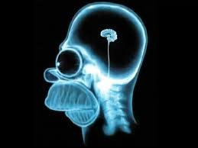
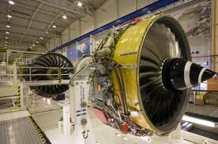
Functions of the Nervous System
Sensory input
Info gathered by sensory receptors
Integration
Interpretation of sensory input
Motor output
Activation of effector organs (muscles and glands) produces a response

Slide 6
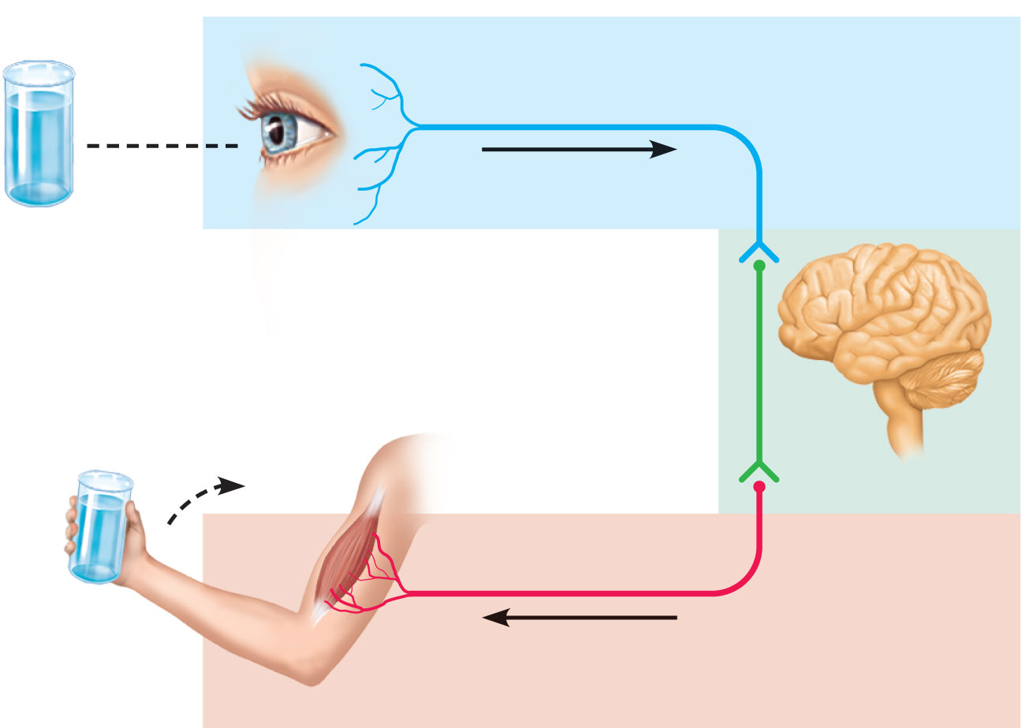
Sensory input
Integration
Motor output
Figure 11.1

Slide 7
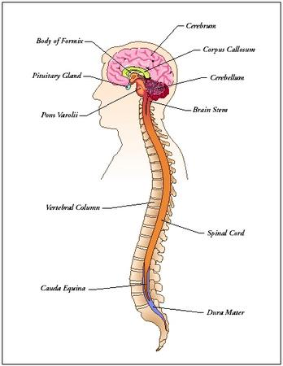
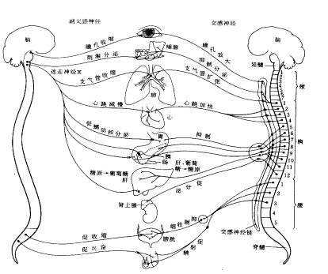
Divisions of the Nervous System
Central nervous system (CNS)
Brain and spinal cord
Integration & command center
Peripheral nervous system (PNS)
Paired spinal and cranial nerves carry messages TO and FROM the CNS

Slide 9
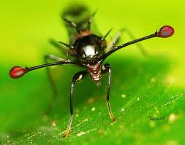
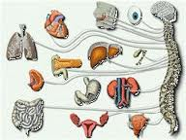
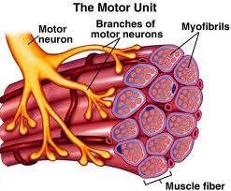
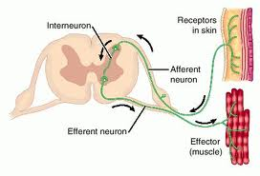
Peripheral Nervous System (PNS)
Two functional divisions
Sensory (afferent) division
Somatic afferent fibers—convey impulses from skin, skeletal muscles, and joints
Visceral afferent fibers—convey impulses from visceral organs
Motor (efferent) division
Transmits impulses from the CNS to effector organs

Slide 10
Efferent (Motor) Division of PNS
Somatic nervous system
Conscious control of skeletal muscles
(voluntary Division)

Slide 11
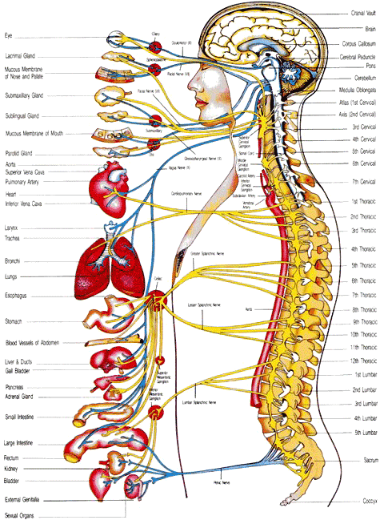
Motor Division of PNS
Autonomic nervous system (ANS)
Visceral motor nerve fibers
Regulates smooth mm, cardiac mm, and glands
Stuff you are too busy to think about
Two functional subdivisions
Sympathetic
Parasympathetic
involuntary division

Slide 12
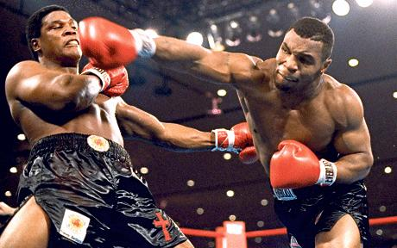
There are 2 divisions of this Autonomic system
Sympathetic – fight or flight
Parasympathetic – rest and digest

Slide 13
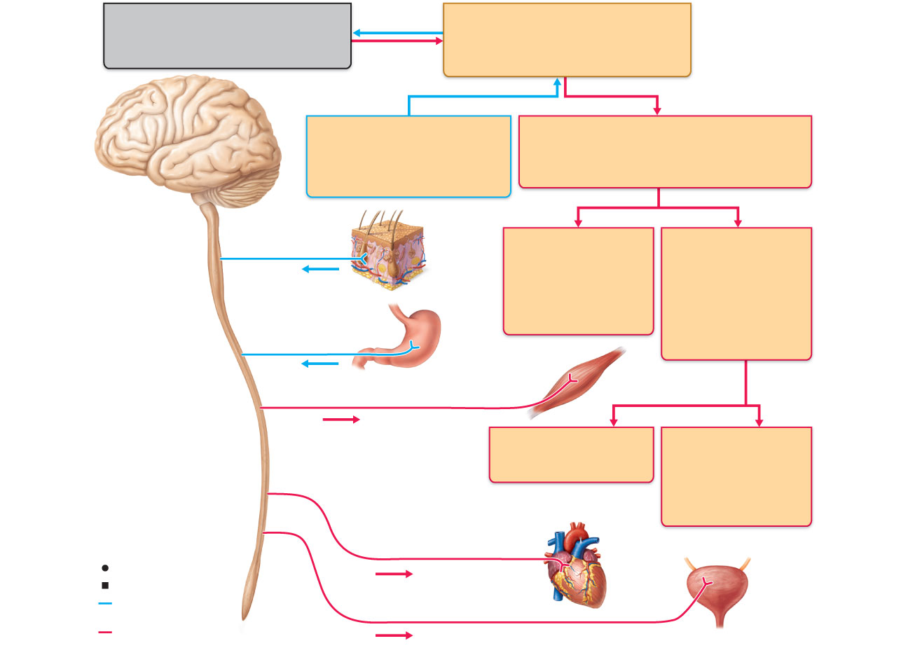
Central nervous system (CNS)
Peripheral nervous system (PNS)
Brain and spinal cord
Cranial nerves and spinal nerves
Integrative and control centers
Communication lines between the
CNS and the rest of the body
Sensory (afferent) division
Motor (efferent) division
Somatic and visceral sensory
nerve fibers
Motor nerve fibers
Conducts impulses from
receptors to the CNS
Conducts impulses from the CNS
to effectors (muscles and glands)
Somatic sensory
fiber
Somatic nervous
system
Autonomic nervous
system (ANS)
Skin
Somatic motor
(voluntary)
Visceral motor
(involuntary)
Conducts impulses
from the CNS to
skeletal muscles
Conducts impulses
from the CNS to
cardiac muscles,
smooth muscles,
and glands
Visceral sensory fiber
Stomach
Skeletal
muscle
Motor fiber of somatic nervous system
Sympathetic division
Parasympathetic
division
Mobilizes body
systems during activity
Conserves energy
Promotes house-
keeping functions
during rest
Sympathetic motor fiber of ANS
Heart
Structure
Function
Sensory (afferent)
division of PNS
Parasympathetic motor fiber of ANS
Bladder
Motor (efferent)
division of PNS
Figure 11.2

Slide 14
Histology of Nervous Tissue
Two principal cell types
Neurons—excitable cells that transmit electrical signals

Slide 15
Histology of Nervous Tissue
Neuroglia (glial cells)—supporting cells:
Astrocytes (CNS)
Microglia (CNS)
Ependymal cells (CNS)
Oligodendrocytes (CNS)
Satellite cells (PNS)
Schwann cells (PNS)

Slide 16
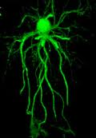
Astrocytes
Most abundant, versatile, and highly branched glial cells
Cling to neurons, synaptic endings, and capillaries
Support and brace neurons

Slide 17
Astrocytes
Help determine capillary permeability
Guide migration of young neurons
Control the chemical environment
Participate in information processing in the brain

Slide 18
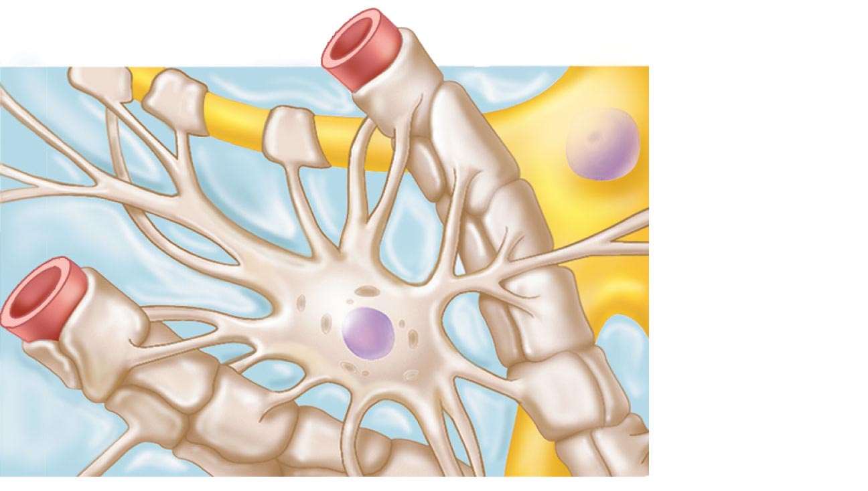
Capillary
Neuron
Astrocyte
(a) Astrocytes are the most abundant CNS neuroglia.
Figure 11.3a

Slide 19
Microglia
Small, egg shaped cells with thorny processes
Migrate toward injured neurons
Phagocytize microorganisms and neuronal debris
Closest to immune cell you’ll get in CNS

Slide 20
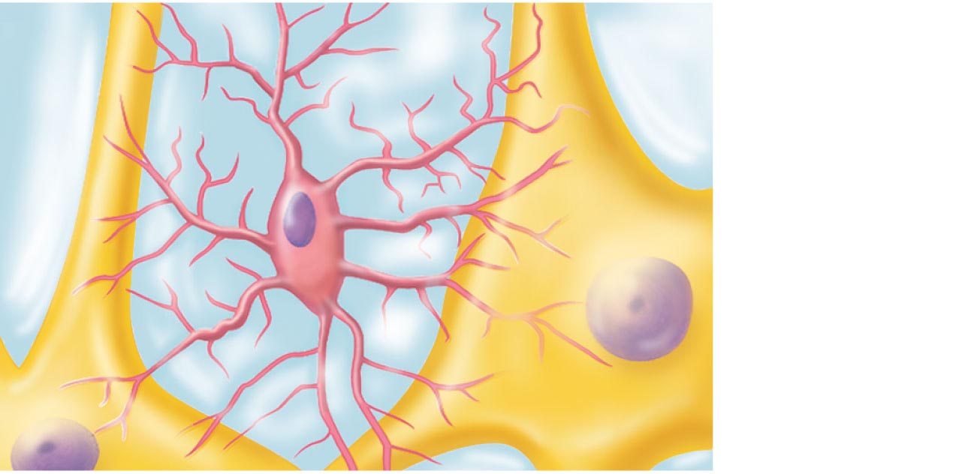
Neuron
Microglial
cell
(b) Microglial cells are defensive cells in the CNS.
Figure 11.3b

Slide 21
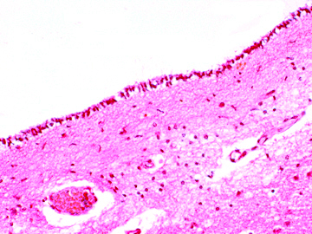
Ependymal Cells
Range in shape from squamous to columnar
May be ciliated
Line the central cavities of the brain and spinal column
Separate the CNS interstitial fluid from the cerebrospinal fluid in the cavities

Slide 22
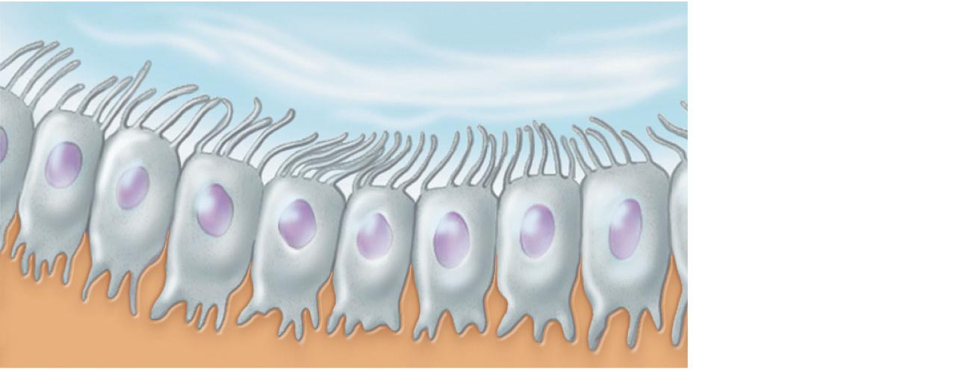
Fluid-filled cavity
Ependymal
cells
Brain or
spinal cord
tissue
(c) Ependymal cells line cerebrospinal fluid-filled cavities.
Figure 11.3c

Slide 23
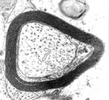
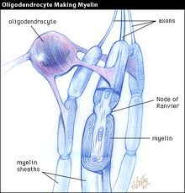
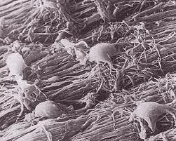
Oligodendrocytes
Branched cells
Processes wrap CNS nerve fibers, forming insulating myelin sheaths

Slide 24
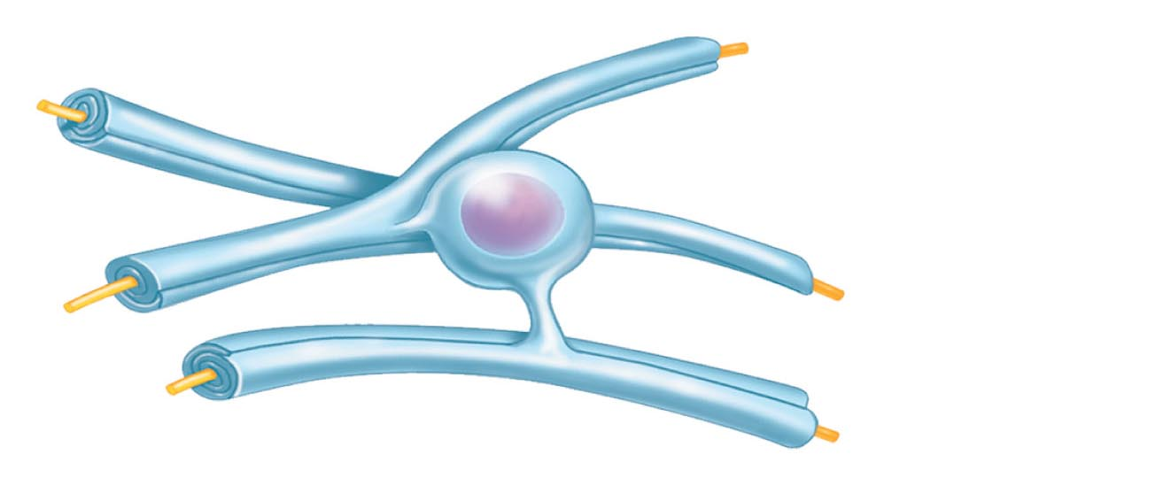
Myelin sheath
Process of
oligodendrocyte
Nerve
fibers
(d) Oligodendrocytes have processes that form myelin sheaths around CNS nerve fibers.
Figure 11.3d

Slide 25
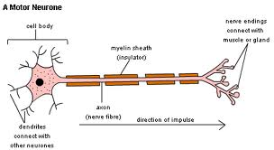
PNS Satellite Cells and Schwann Cells
Satellite cells
Surround neuron cell bodies in the PNS
Schwann cells (neurolemmocytes)
Surround peripheral nerve fibers and form myelin sheaths
Vital to regeneration of damaged peripheral nerve fibers

Slide 26
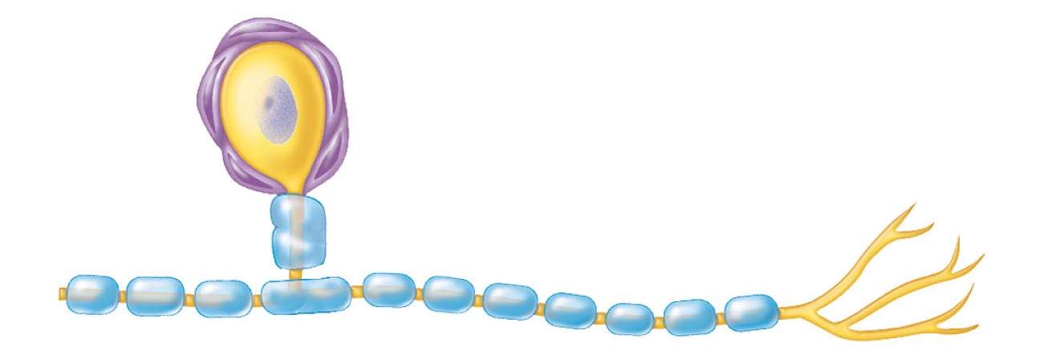
Satellite
cells
Cell body of neuron
Schwann cells
(forming myelin sheath)
Nerve fiber
(e) Satellite cells and Schwann cells (which form myelin) surround neurons in the PNS.
Figure 11.3e

Slide 27
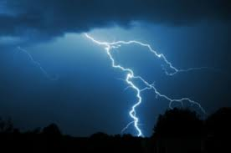
Neurons (Nerve Cells)
Special characteristics:
Long-lived (→ 100 years or more)
Amitotic—with few exceptions
High metabolic rate—constant oxygen and glucose
Plasma membrane functions in:
Electrical signaling
Cell-to-cell interactions during development

Slide 28
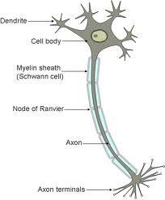
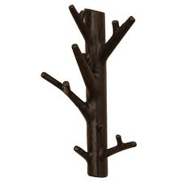
Nerve parts
Pay attention to axon, dendrites, body

Slide 29
Cell Body (Perikaryon or Soma)
Its in the middle! Nucleus
Book gets technical on us…
Biosynthetic center of a neuron
Spherical nucleus with nucleolus
Well-developed Golgi apparatus
Rough ER called Nissl bodies (chromatophilic substance)
Clusters of cell bodies are called nuclei in the CNS, ganglia in the PNS

Slide 30
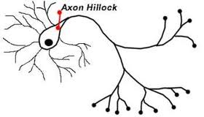
Cell Body (Perikaryon or Soma)
Network of neurofibrils (neurofilaments)
Axon hillock—cone-shaped area from which axon arises

Slide 31
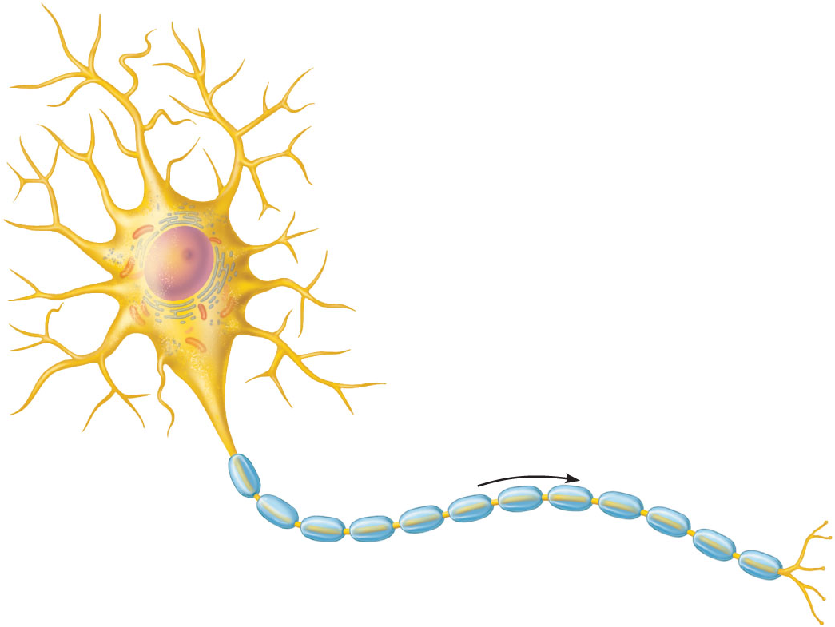
Dendrites
(receptive regions)
Cell body
(biosynthetic center
and receptive region)
Nucleolus
Axon
(impulse generating
and conducting region)
Nucleus
Impulse
direction
Nissl bodies
Node of Ranvier
Axon
terminals
(secretory
region)
Axon hillock
Schwann cell
(one inter-
node)
(b)
Neurilemma
Terminal
branches
Figure 11.4b

Slide 32
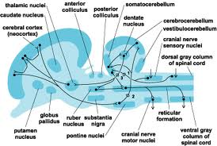
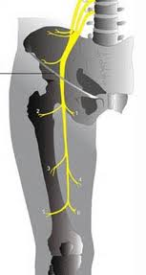
Processes
Dendrites and axons
Bundles of processes are called
Tracts in the CNS
Nerves in the PNS

Slide 33
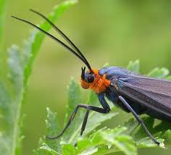
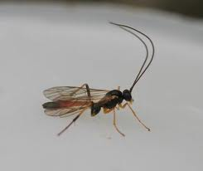
Dendrites
“Cells little feelers”
Scattered branches
Receptive (input) region of a neuron
Convey electrical signals toward the cell body as graded potentials

Slide 34
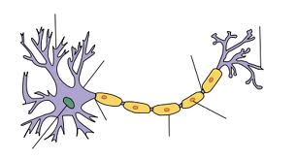
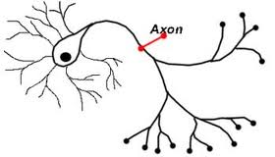
The Axon
One axon per cell arising from the axon hillock
Long axons (nerve fibers)
Occasional branches ~90 degrees (axon collaterals)

Slide 35
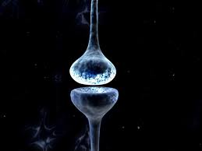
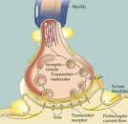
The Axon
Numerous terminal branches (telodendria)
Knoblike axon terminals (synaptic knobs or boutons)
Secretory region of neuron
Release neurotransmitters to excite or inhibit other cells

Slide 36
Axons: Function
Conducting region of a neuron
Generates and transmits nerve impulses (action potentials) away from the cell body

Slide 37
Dendrites
(receptive regions)
Cell body
(biosynthetic center
and receptive region)
Nucleolus
Axon
(impulse generating
and conducting region)
Nucleus
Impulse
direction
Nissl bodies
Node of Ranvier
Axon
terminals
(secretory
region)
Axon hillock
Schwann cell
(one inter-
node)
(b)
Neurilemma
Terminal
branches
Figure 11.4b

Slide 38
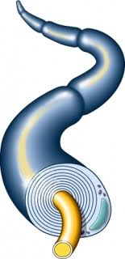
Myelin Sheath
Lipid little blankets!
It functions to:
Protect and electrically insulate the axon
Increase speed of nerve impulse transmission

Slide 39
Myelin Sheaths in the PNS
Schwann cells wraps many times around the axon
Myelin sheath—concentric layers of Schwann cell membrane
Neurilemma—peripheral bulge of Schwann cell cytoplasm

Slide 40
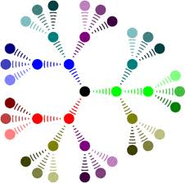
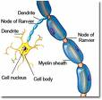
Myelin Sheaths in the PNS
Nodes of Ranvier
Myelin sheath gaps between adjacent Schwann cells
Sites where axon collaterals can emerge

Slide 41
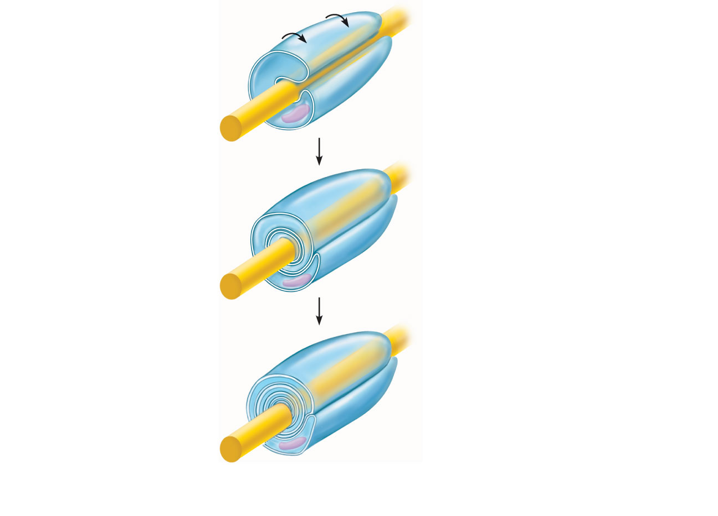
Schwann cell
plasma membrane
A Schwann cell
envelopes an axon.
Schwann cell
cytoplasm
1
Axon
Schwann cell
nucleus
2
The Schwann cell then
rotates around the axon,
wrapping its plasma
membrane loosely around
it in successive layers.
Neurilemma
The Schwann cell
cytoplasm is forced from
between the membranes.
The tight membrane
wrappings surrounding
the axon form the myelin
sheath.
3
Myelin sheath
(a) Myelination of a nerve fiber (axon)
Figure 11.5a

Slide 42
Unmyelinated Axons
Thin nerve fibers are unmyelinated
One Schwann cell may incompletely enclose 15 or more unmyelinated axons

Slide 43
Myelin Sheaths in the CNS
Formed by processes of oligodendrocytes, not the whole cells
Nodes of Ranvier are present
No neurilemma
Thinnest fibers are unmyelinated

Slide 44
Myelin sheath
Process of
oligodendrocyte
Nerve
fibers
(d) Oligodendrocytes have processes that form myelin sheaths around CNS nerve fibers.
Figure 11.3d

Slide 45
Stop here!

Slide 46
White Matter and Gray Matter
White matter
Dense collections of myelinated fibers
Gray matter
Mostly neuron cell bodies and unmyelinated fibers

Slide 47
Structural Classification of Neurons
Three types:
Multipolar—1 axon and several dendrites
Most abundant
Motor neurons and interneurons
Bipolar—1 axon and 1 dendrite
Rare, e.g., retinal neurons

Slide 48
Structural Classification of Neurons
Unipolar (pseudounipolar)—single, short process that has two branches:
Peripheral process—more distal branch, often associated with a sensory receptor
Central process—branch entering the CNS

Slide 49
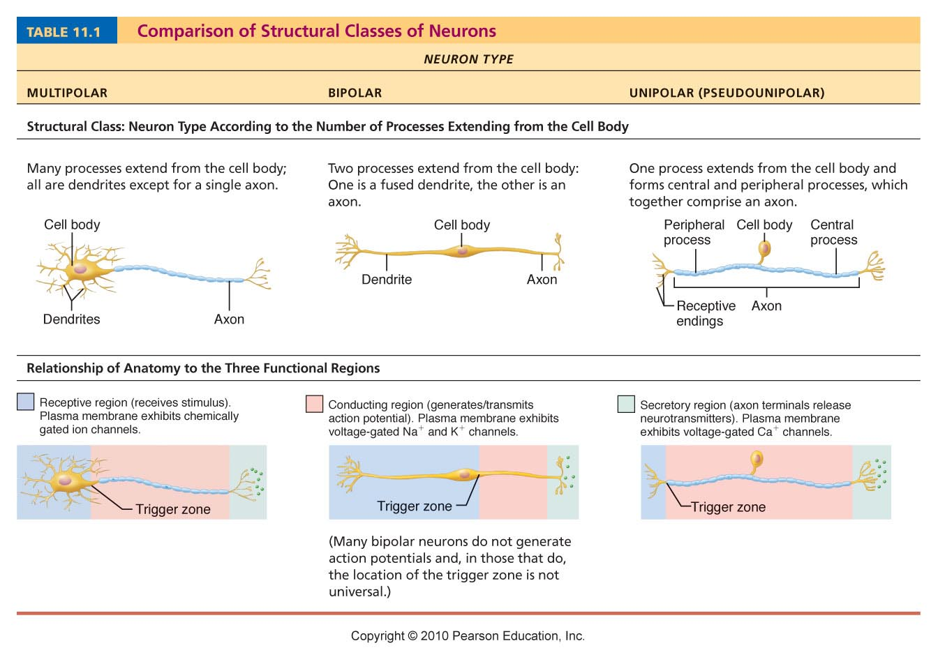
Table 11.1 (1 of 3)

Slide 50
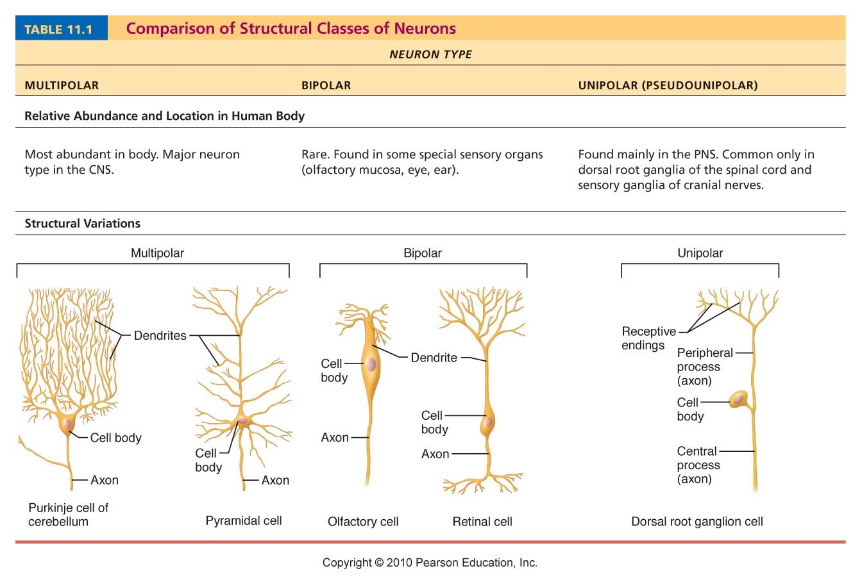
Table 11.1 (2 of 3)

Slide 51
Functional Classification of Neurons
Three types:
Sensory (afferent)
Transmit impulses from sensory receptors toward the CNS
Motor (efferent)
Carry impulses from the CNS to effectors

Slide 52
Functional Classification of Neurons
Interneurons (association neurons)
Shuttle signals through CNS pathways; most are entirely within the CNS

Slide 53
Table 11.1 (3 of 3)

