Slide 1
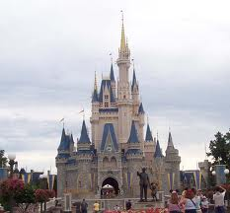

Slide 2
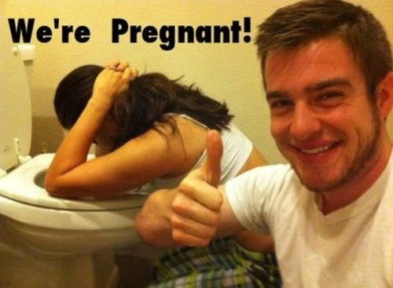
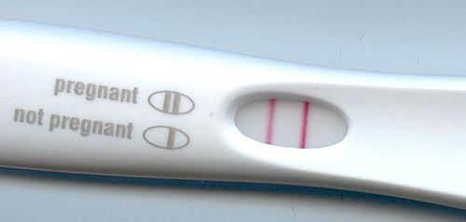
Pregnancy

Slide 3
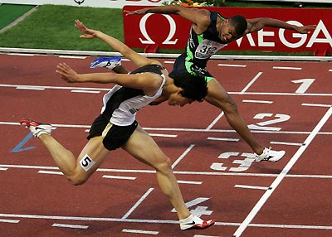
Fertilization before and after
Sperm capacitates
Swims even faster
Cell membrane changes
Fertilization
Sperm donates nucleus
Meiosis II happens in oocyte

Slide 4
Acrosome reaction
(Now we call it a) zygote becomes impenetrable to other sperm

Slide 5
Zygote’s travels
Stays in fallopian tubes ~4 days
E keeps them contracted
Undergoes division a couple times
Becomes a blastocyst
Cells in a blastocyst are differentiated

Slide 6
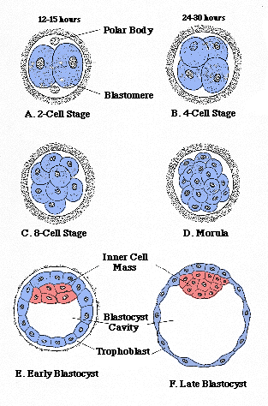

Slide 7
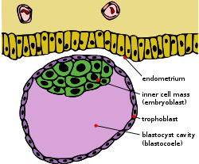
Trophoblast

Slide 8
Totipotent and differentiate
Go look this word up!

Slide 9
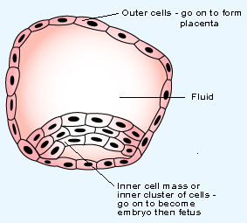
Outter cells are sticky!
Stick to endometrium

Slide 10
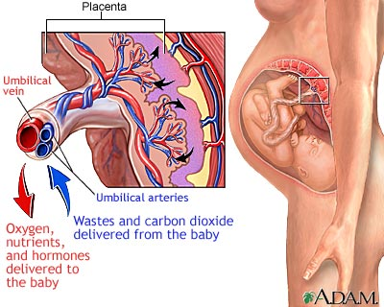
Placenta
Placenta forms
Combo of maternal and fetal tissue

Slide 11
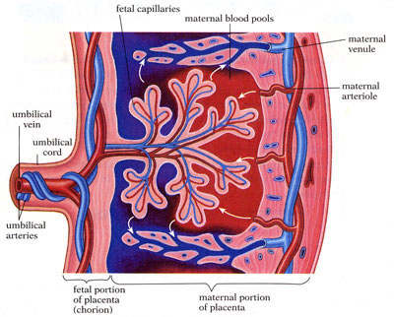

Slide 12
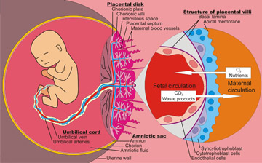

Slide 13
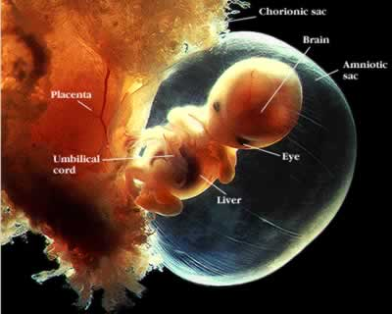

Slide 14
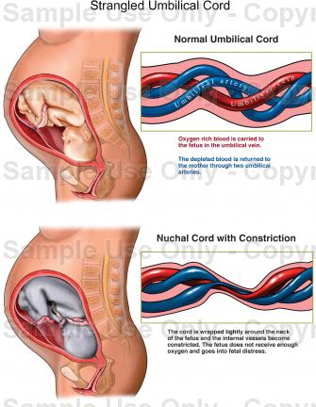

Slide 15
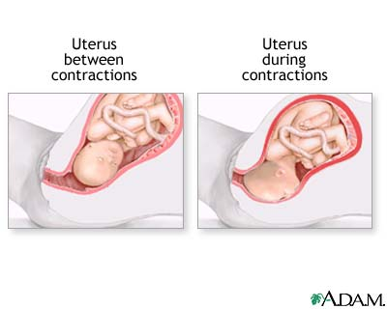
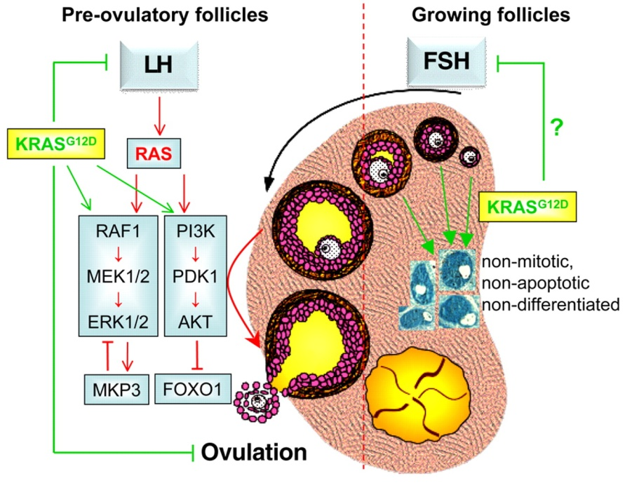
Hormones
E and P keep rising
Corpus Luteum in charge of this for 1st 2 months
E causes uterus muscle mass to keep growing
P keeps that muscle from contracting

Slide 16
But what keeps corpus luteum alive?
It normally degenerates 2 weeks after ovulation

Slide 17
The conceptus secretes human chorionic gonadotropin hCG
hCG keeps corpus luteum alive
AND tells it to keep P and E coming!

Slide 18
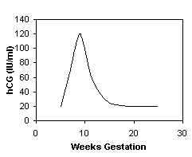
Byby hCG
End of 1st trimester placenta can make its own E and P
What effect do E and P have on LH and FSH?

Slide 19
This week
Monday – Delivering the bacon
Tuesday – Getting that baby some milk… and wrap it up
Wednesday – Review
Thursday – Big Test!
Friday – The Eye
All Bets are off if kid shows up

Slide 20
To start… quick write
What is hCG?
What makes up the placenta?
What happens right before and after fertilization?

Slide 21
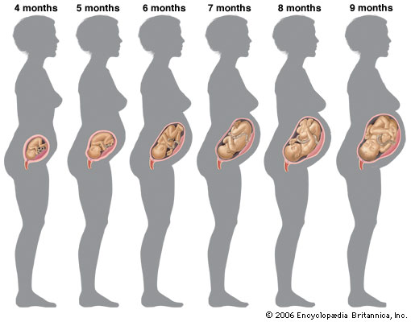
Parturition every event of pregnancy, including delivery
40 weeks since last menses
How many weeks after ovulation?

Slide 22
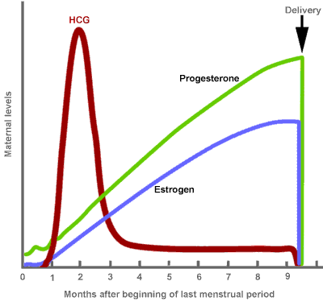

Slide 23
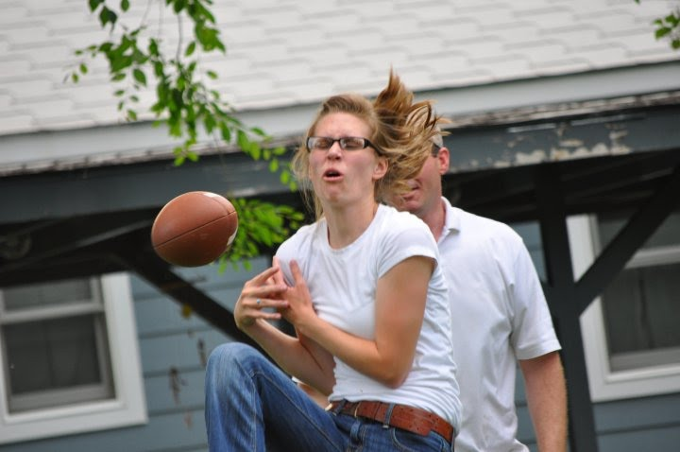
The Uterus
Progesterone keeps cervix hard and shut
In late pregnancy Estrogen – causes uterus muscle cells to connect via gap junctions
Why is it good the cells of the uterus are all connected by the time delivery comes?

Slide 24
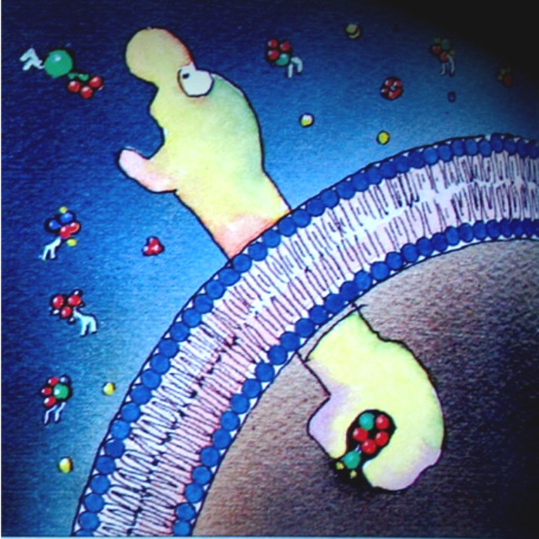
Estrogen’s other effect
Causes a rise in oxytocin receptors on uterus
What effect does oxytocin have on uterus?

Slide 25
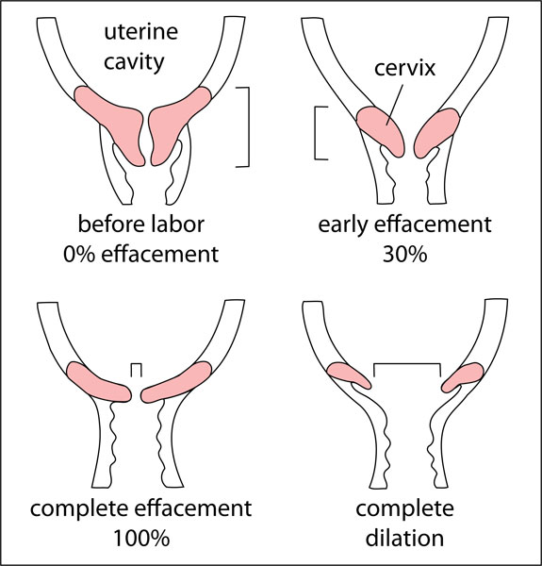
Estrogen other effects
Stimulate prostaglandins to signal enzymatic softening of cervix

Slide 26
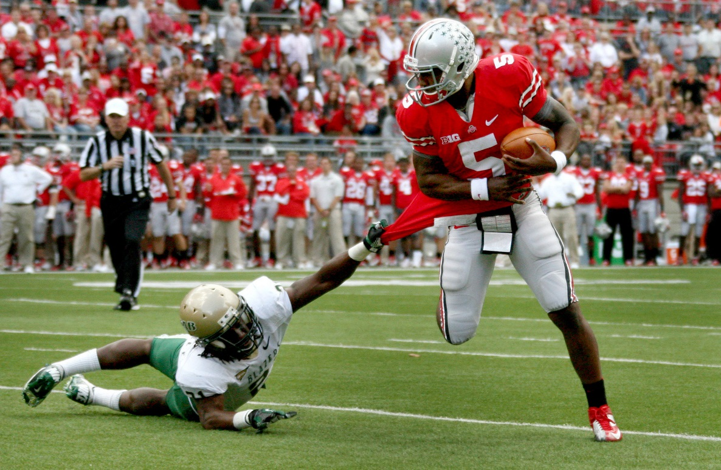
Braxton Hicks
Practice contractions → your uterus is more sensitive to oxytocin than ever

Slide 27
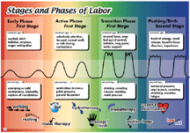
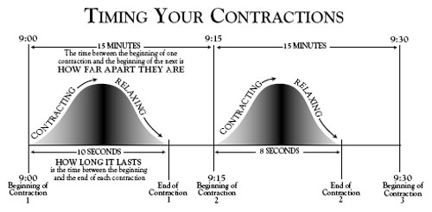
Labor
Rhythmic contractions begin!
The day is here!

Slide 28
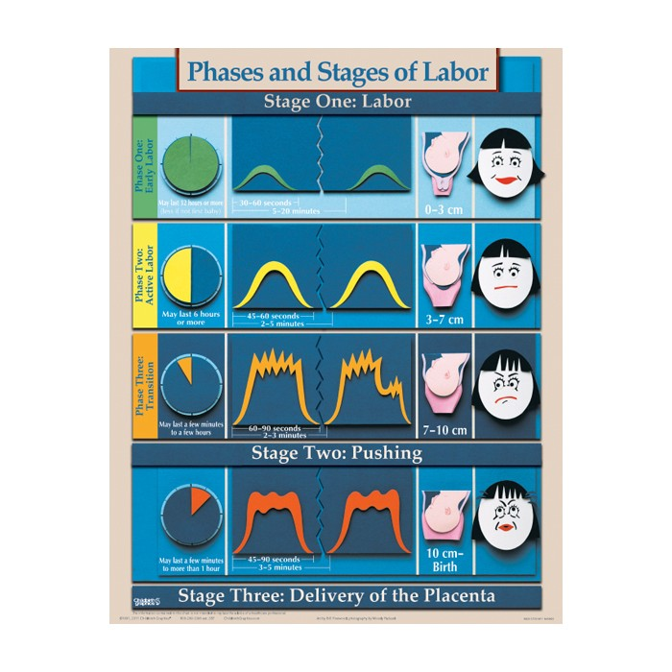

Slide 29
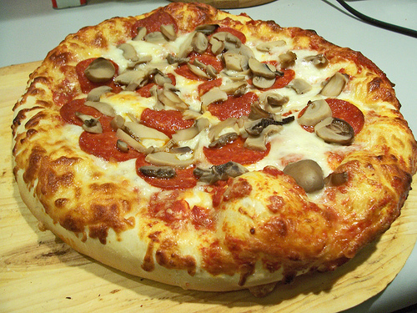
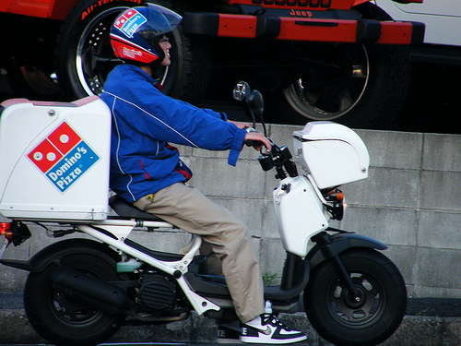
Delivery
10 cm dilated=
time to push
90% of time heads first
Placenta and umbilical cord work for few more minutes
Afterbirth

