Slide 1
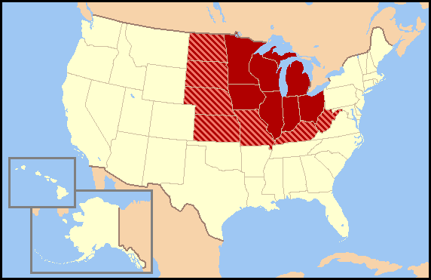
Regional Word day! Learning these words will take…
Practice!

Slide 2
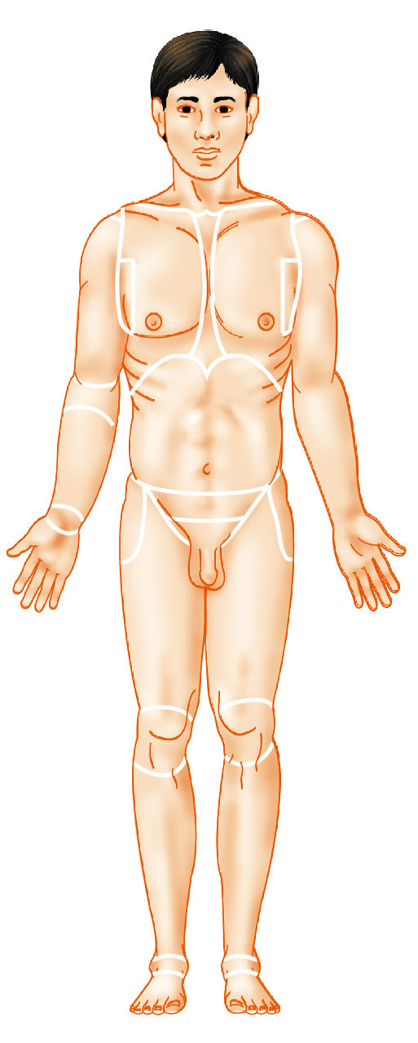
Regional Terms: Anterior View
Nasal (nose)
Frontal (forehead)
Oral (mouth)
Orbital (eye)
Cervical (neck)
Buccal (cheek)
Mental (chin)
Figure 1.7a
(a) Anterior

Slide 3
Regional Terms: Anterior View
Nasal (nose)
Frontal (forehead)
Oral (mouth)
Orbital (eye)
Cervical (neck)
Buccal (cheek)
Acromial
(point of shoulder)
Mental (chin)
Sternal
(breastbone)
Axillary (armpit)
Thoracic
(chest)
Abdominal
(abdomen)
Brachial (arm)
Mammary
(breast)
Antecubital
(front of elbow)
Antebrachial
(forearm)
Umbilical
(navel)
Pelvic (pelvis)
Carpal (wrist)
Pollex
(thumb)
Palmar
(palm)
Digital
(fingers)
Figure 1.7a
(a) Anterior

Slide 4
Regional Terms: Anterior View
Nasal (nose)
Frontal (forehead)
Oral (mouth)
Orbital (eye)
Cervical (neck)
Buccal (cheek)
Acromial
(point of shoulder)
Mental (chin)
Sternal
(breastbone)
Axillary (armpit)
Thoracic
(chest)
Abdominal
(abdomen)
Brachial (arm)
Mammary
(breast)
Antecubital
(front of elbow)
Antebrachial
(forearm)
Umbilical
(navel)
Pelvic (pelvis)
Carpal (wrist)
Pollex
(thumb)
Palmar
(palm)
Coxal
(hip)
Digital
(fingers)
Inguinal
(groin)
Pubic (genital region)
Femoral
(thigh)
Patellar
(anterior knee)
Fibular, or
peroneal
(side of leg)
Crural (leg)
Pedal
(foot)
Tarsal (ankle)
Hallux (great toe)
Digital (toes)
(a) Anterior
Figure 1.7a

Slide 5
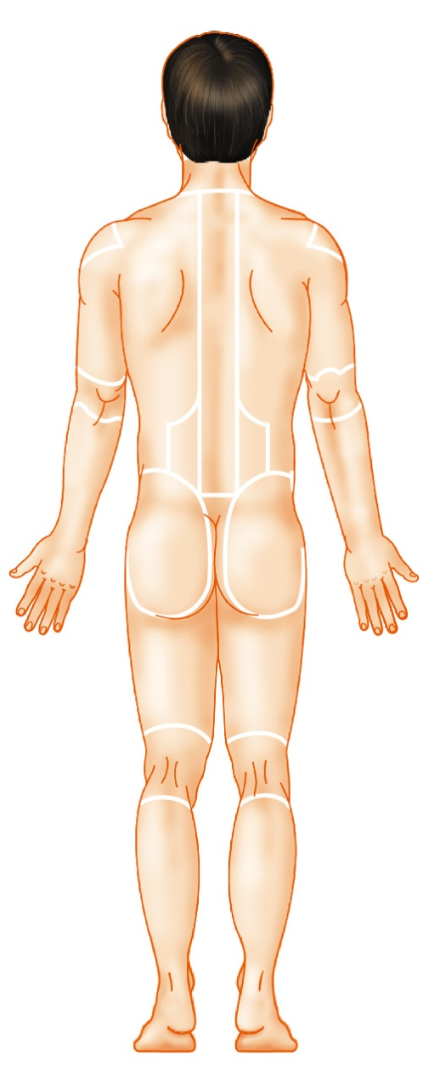
Regional Terms: Posterior View
Otic (ear)
Cephalic
(head)
Occipital (back of
head or base of skull)
(b) Posterior
Figure 1.7b

Slide 6
Regional Terms: Posterior View
Otic (ear)
Cephalic
(head)
Occipital (back of
head or base of skull)
Acromial
(point of shoulder)
Vertebral
(spinal column)
Scapular
(shoulder blade)
Upper
extremity
Brachial (arm)
Dorsum or dorsal
(back)
Olecranal
(back of elbow)
Lumbar (loin)
Manus
(hand)
Sacral
(between hips)
(b) Posterior
Figure 1.7b

Slide 7
Regional Terms: Posterior View
Otic (ear)
Cephalic
(head)
Occipital (back of
head or base of skull)
Acromial
(point of shoulder)
Vertebral
(spinal column)
Scapular
(shoulder blade)
Upper
extremity
Brachial (arm)
Dorsum or dorsal
(back)
Olecranal
(back of elbow)
Lumbar (loin)
Manus
(hand)
Sacral
(between hips)
Gluteal (buttock)
Perineal
(region between
the anus and
external genitalia)
Lower
extremity
Femoral (thigh)
Popliteal
(back of knee)
Sural (calf)
Calcaneal (heel)
Plantar (sole)
(b) Posterior
Figure 1.7b

Slide 8
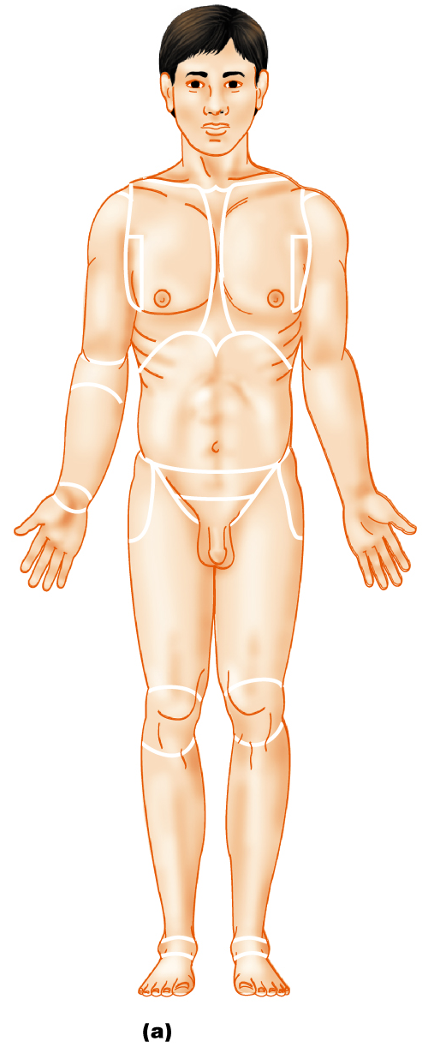
Anatomical Position
Body erect, feet slightly apart, palms facing forward, thumbs point away from body
Figure 1.7a

Slide 9
Directional Terms
Superior and inferior – toward and away from the head, respectively
Anterior and posterior – toward the front and back of the body
Medial, lateral, and intermediate – toward the midline, away from the midline, and between a more medial and lateral structure

Slide 10
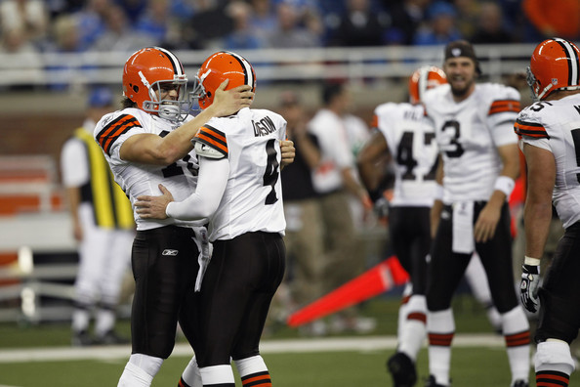
Directional Terms
Proximal and distal – closer to and farther from the origin of the body part
Superficial and deep – toward and away from the body surface

