Slide 1
Integument
Ressetar

Slide 2
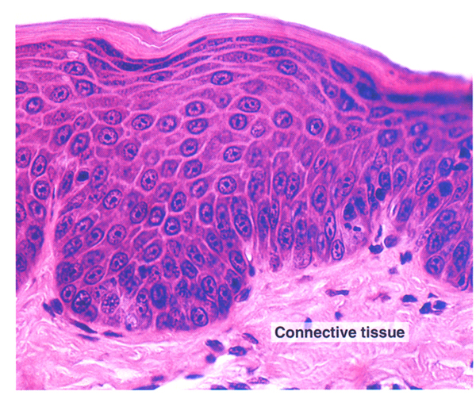
Epidermis
Dermis

Slide 3
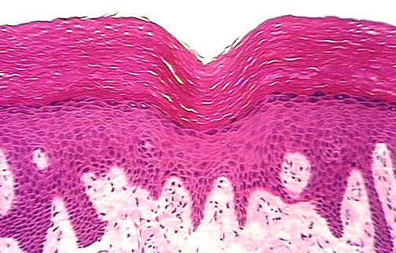
Stratum Corneum
Stratum Granulosum
Stratum Lucidum
Stratum Spinosum
Stratum Basale

Slide 4
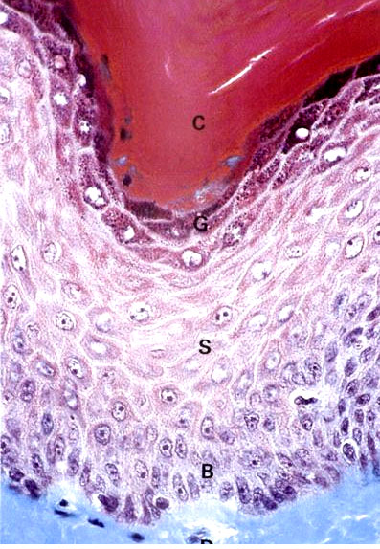
C= stratum corneum
G= stratum granulosum
S= stratum spinosum
B= stratum basale

Slide 5
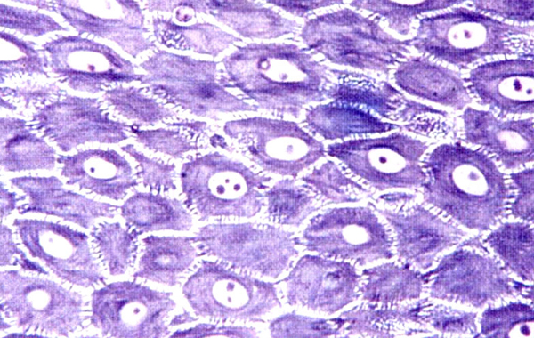
Stratum Spinosum

Slide 6
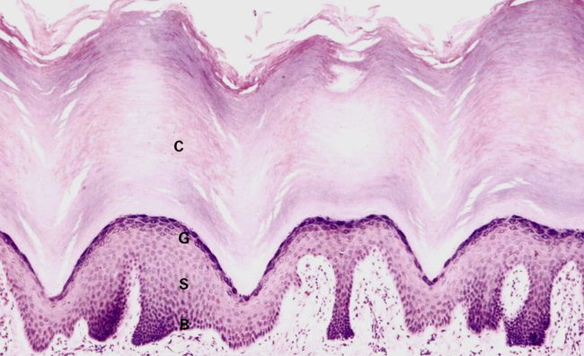
Thick Skin
C= stratum corneum, G= stratum granulosum, S= stratum spinosum,
B= stratum basale

Slide 7
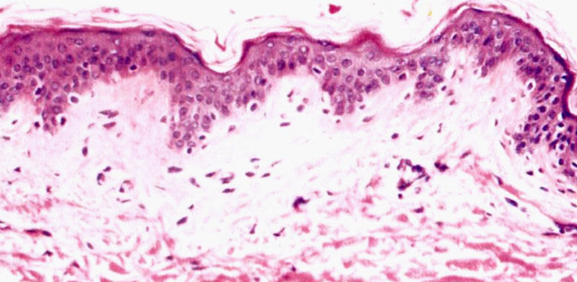
Thin Skin

Slide 8
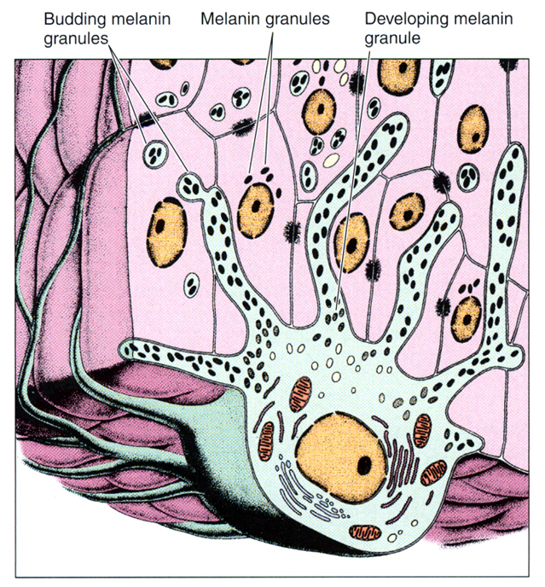
Melanocyte

Slide 9
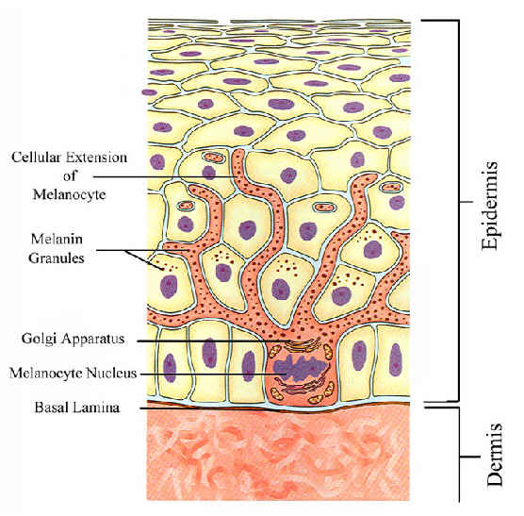

Slide 10
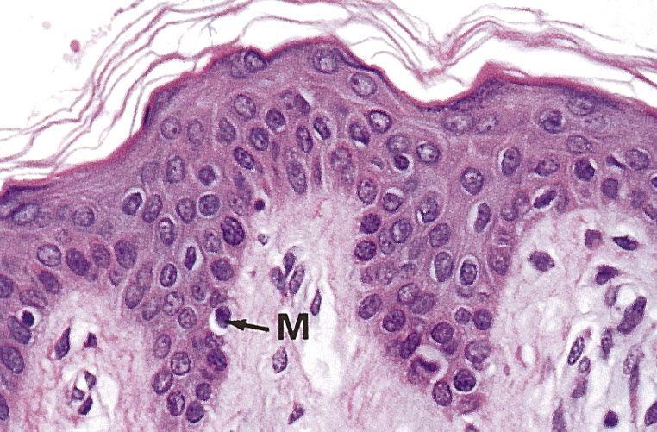
M= Melanocyte

Slide 11
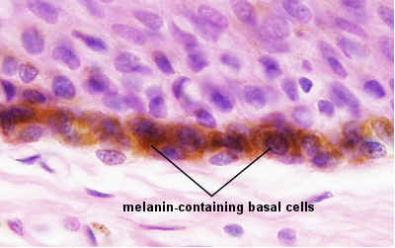

Slide 12
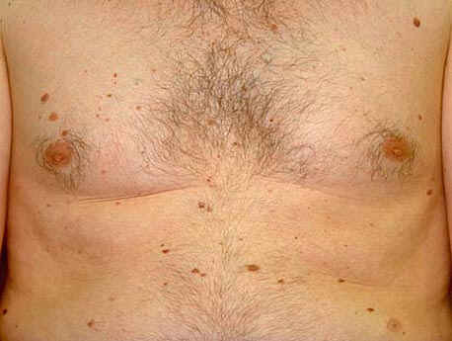
Nevi

Slide 13
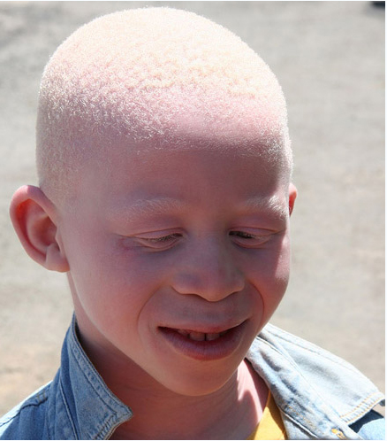
Albinism

Slide 14
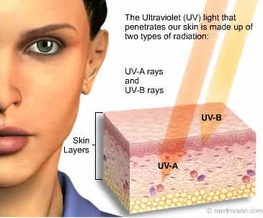

Slide 15
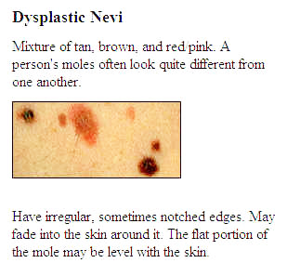

Slide 16
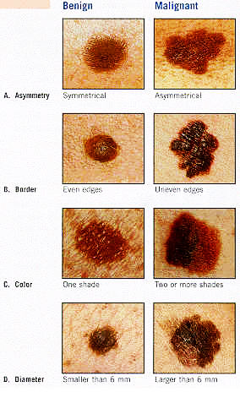

Slide 17
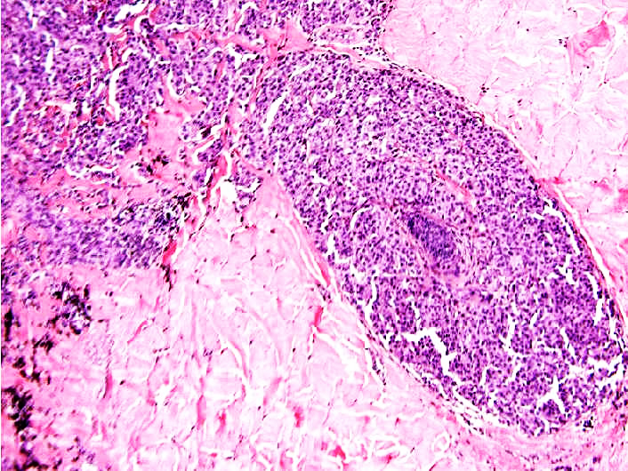
Melanoma

Slide 18
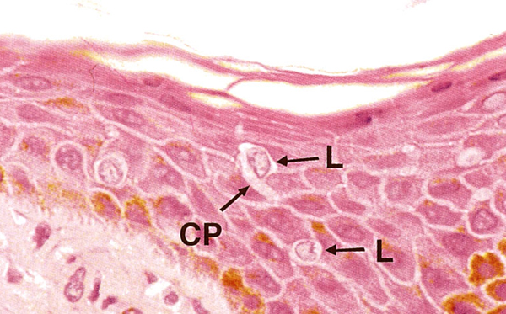
L= Langerhans cells, C=dendritic process of Langerhans cell

Slide 19
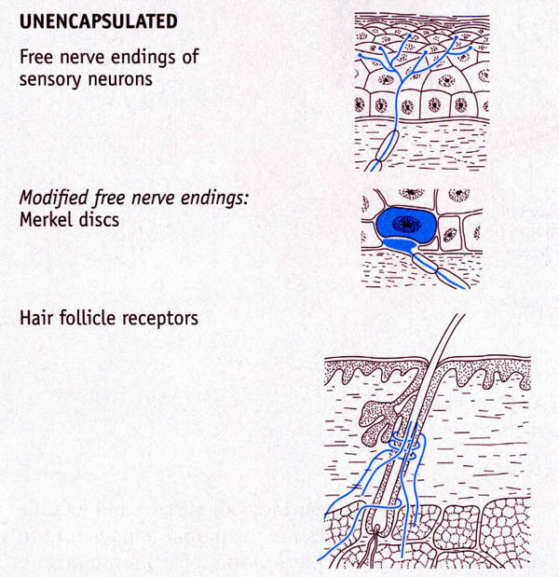

Slide 20
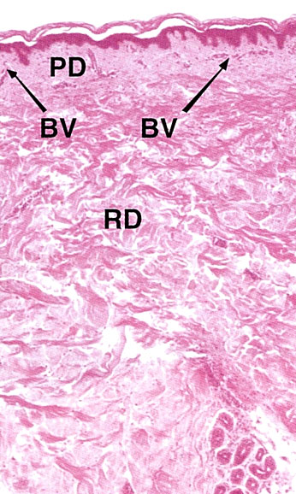
PD= papillary layer of dermis
RD= Reticular layer of dermis
BV= Blood vessels

Slide 21
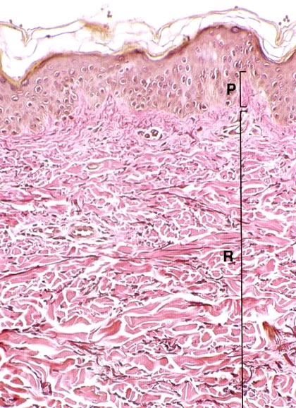
Papillary Layer of Dermis
Reticular Layer of Dermis

Slide 22
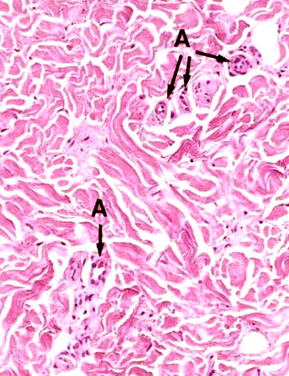
A=arterioles in dermis

Slide 23
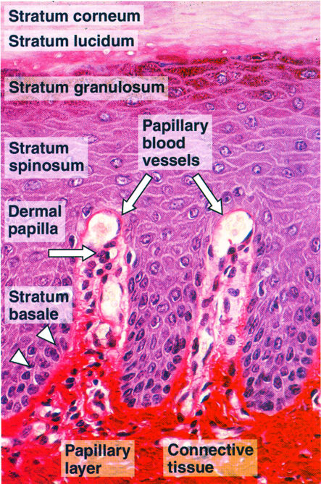

Slide 24
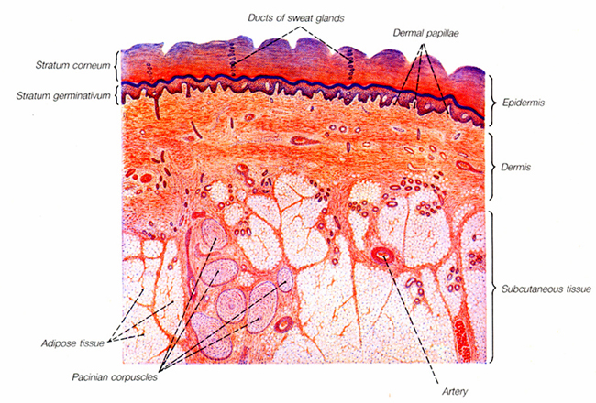

Slide 25
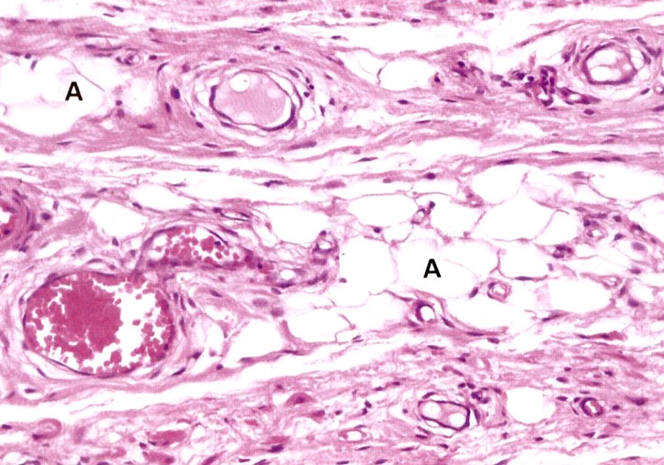
Hypodermis
Adipose
Blood vessels

Slide 26
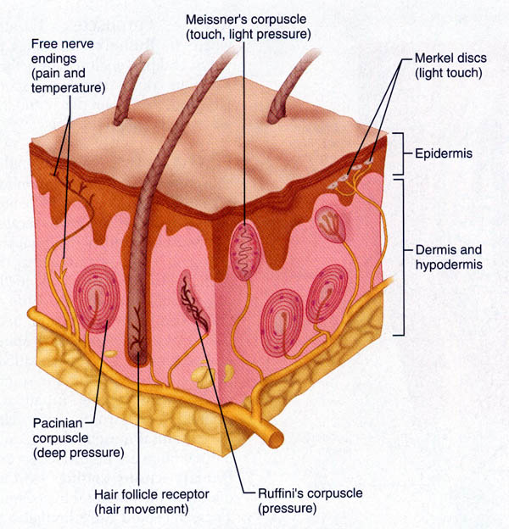

Slide 27
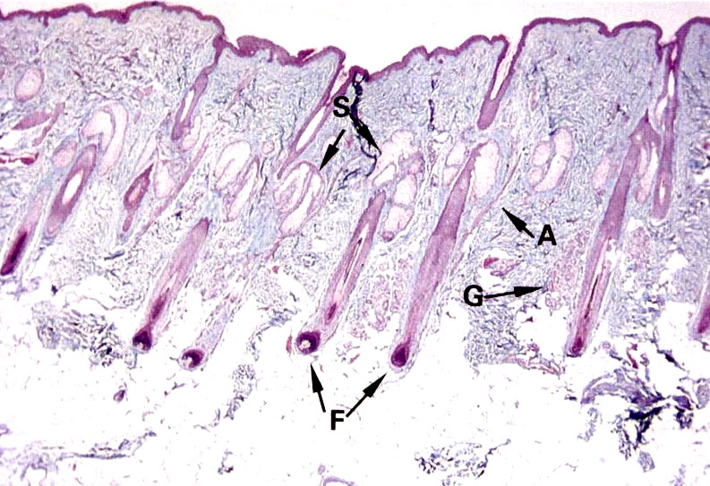
S= sebaceous gland, A= arrector pili, G= blood vessels, F= hair follicle

Slide 28
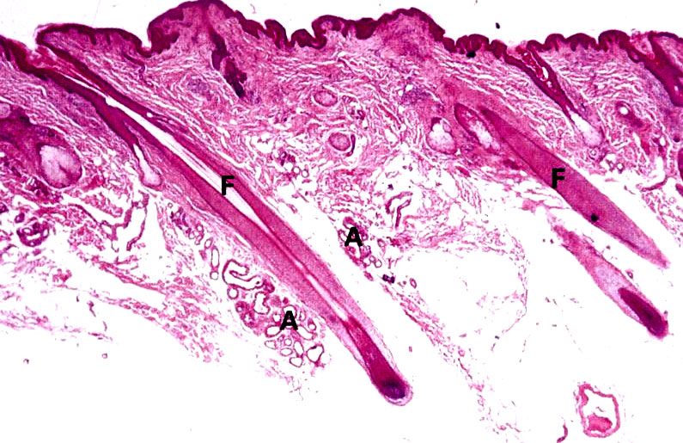
F= hair follicle, A= apocrine sweat glands

Slide 29
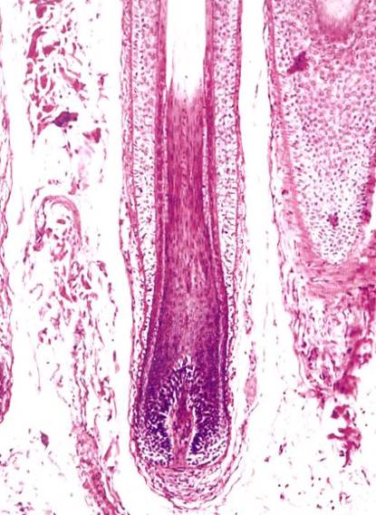
Hair Follicle

Slide 30
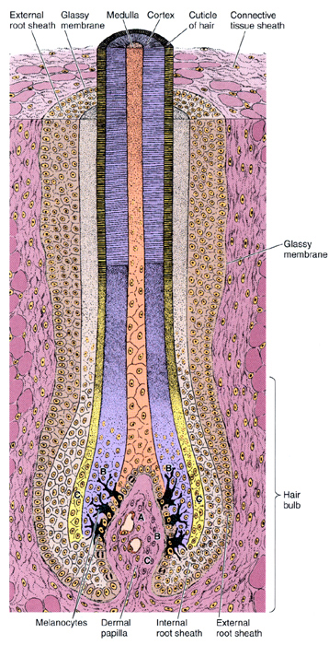

Slide 31
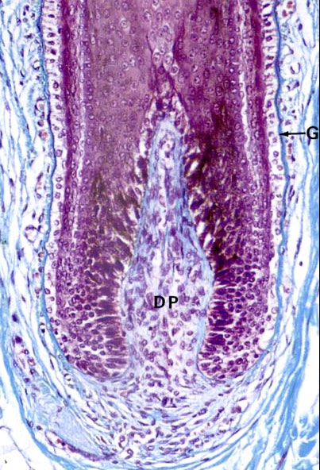
Hair Bulb
G= glassy membrane (outer BM of external root sheath)
DP= dermal papilla

Slide 32
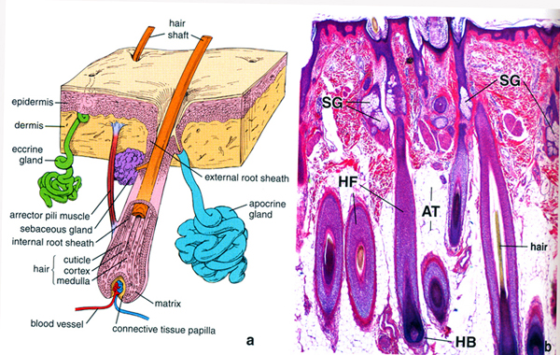
SG= sebaceous glands, HF= hair follicle, HB= hair bulb,
AT= adipose tissue

Slide 33
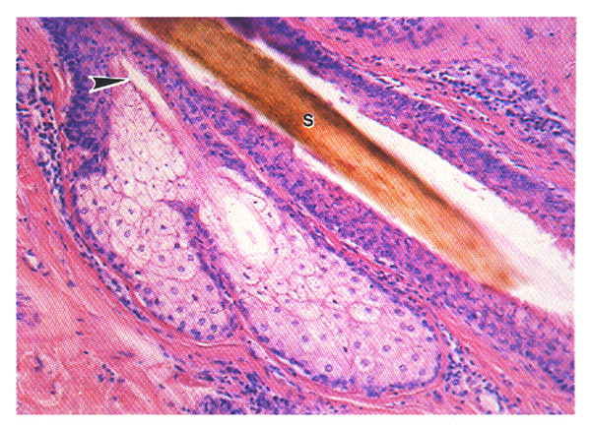
Sebaceous Gland

Slide 34
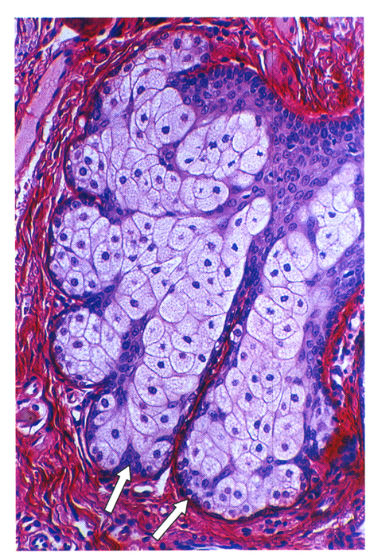
Sebaceous Gland

Slide 35
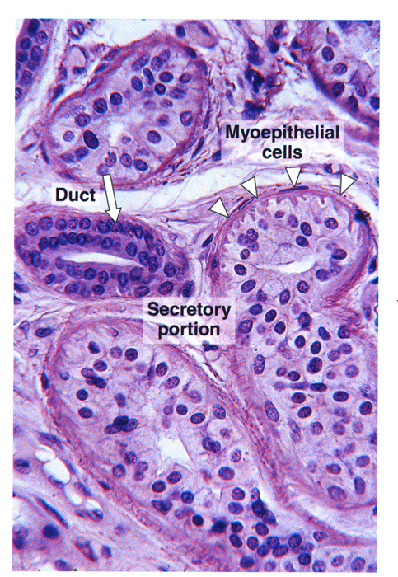
Eccrine Sweat Gland

Slide 36
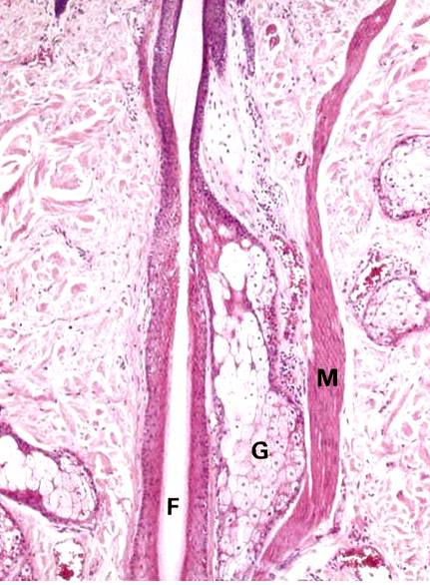
Hair Follicle
F= hair follicle
G= sebaceous gland
M= arrector pili muscle

Slide 37
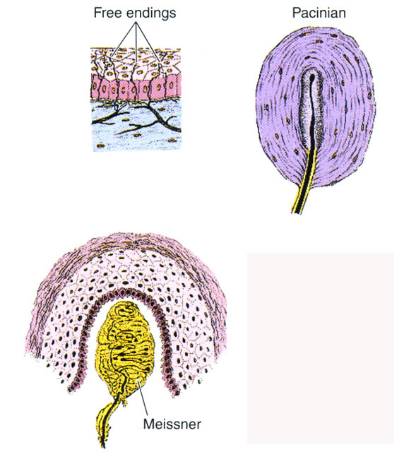

Slide 39
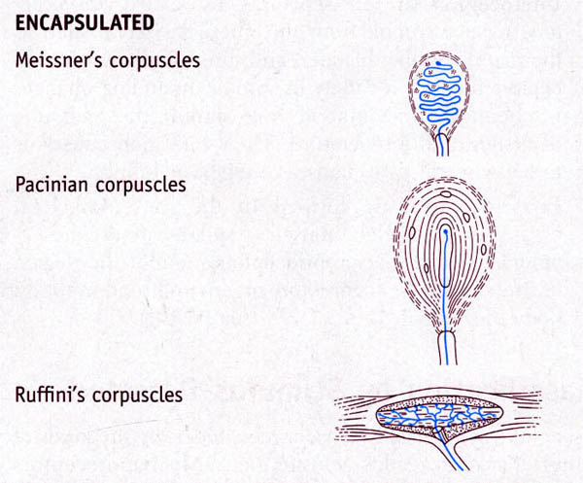

Slide 40
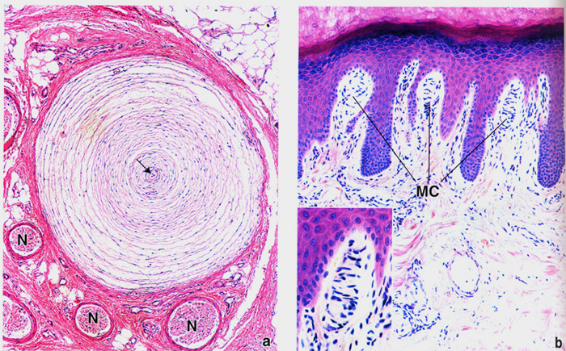
Paccinian Corpuscle
Meissner’s Corpuscles

Slide 41
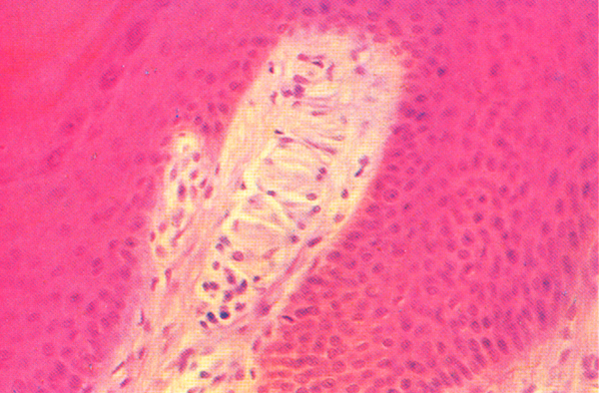
Meissner’s Corpuscle

Slide 42
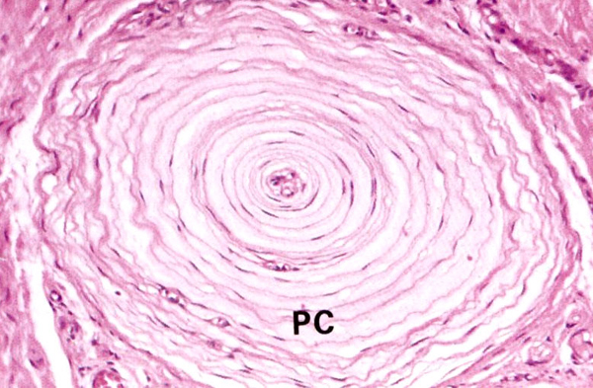
Paccinian Corpuscle

Slide 43
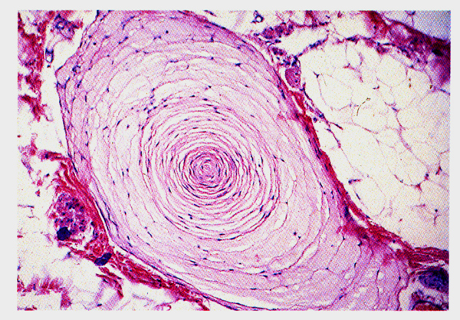
Paccinian Corpuscle

Slide 44
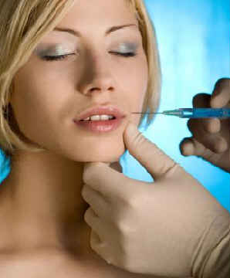
Collagen Injection

Slide 45
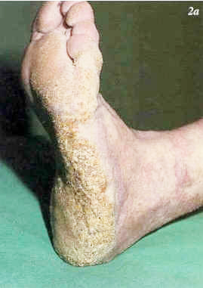
Hyperkeratosis

Slide 46
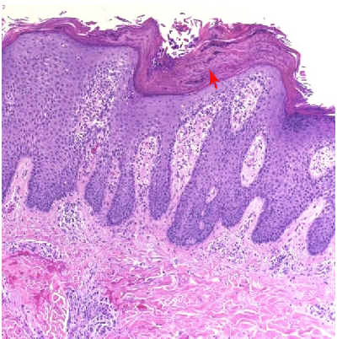
Hyperkeratosis

Slide 47
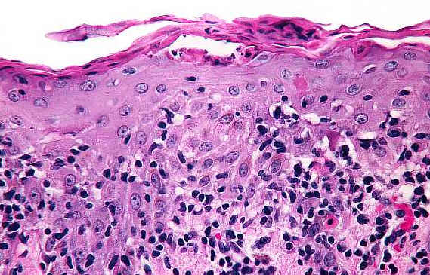
Parakeratosis

Slide 48
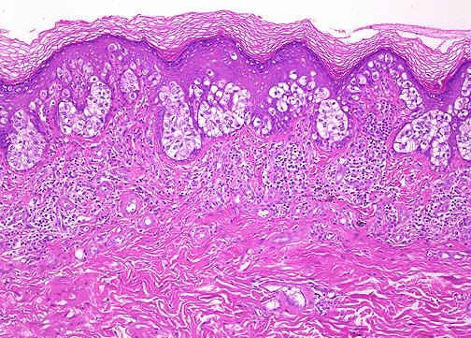
Parakeratosis
Intraepidermal edema

Slide 49
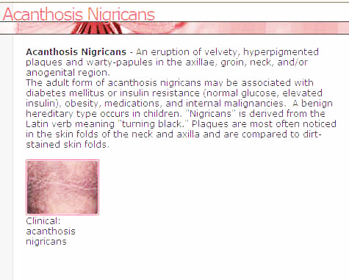

Slide 50
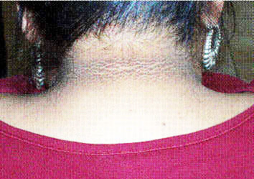
Acanthosis

Slide 51
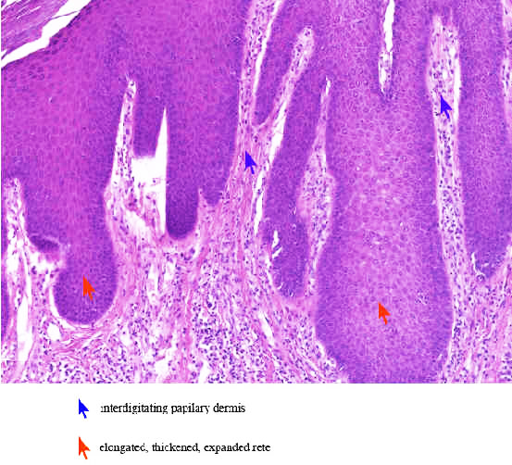
Acanthosis

Slide 52
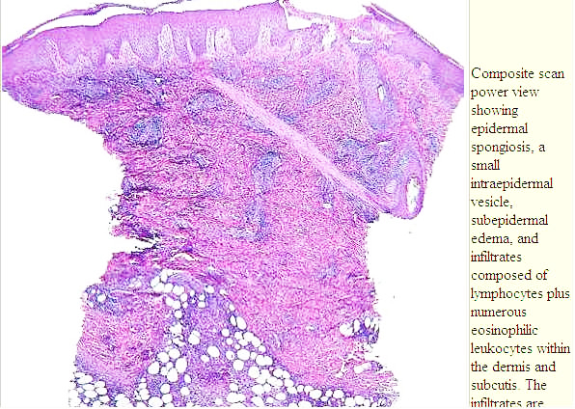
Intraepidermal Edema

Slide 53
Intraepidermal edema

Slide 54
Eczema

Slide 56
Psoriasis

Slide 57
Basal cell Carcinoma

Slide 58
Basal Cell Carcinoma

Slide 59
Squamous Cell Carcinoma

Slide 61
Last image

