Slide 1
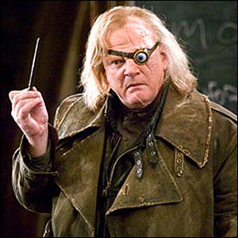
The Eye A Brief overview: Accessories & the main outfit
http://www.youtube.com/watch?v=RE1MvRmWg7I
http://www.youtube.com/watch?v=_5dEO-LRV-g

Slide 2
The Eye and Vision Fun facts
70% of all sensory receptors are in the eye…
wooooow
Nearly ½ of the cerebral cortex is involved in processing visual information!
So much for the just occipital lobe!
Most of the eye is protected by a cushion of fat and the bony orbit
(how is that different than any other American organ!?)

Slide 3
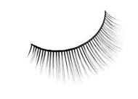
Accessory Structures of the Eye
Protect the eye and aid eye function
Eyebrows
Eyelids (palpebrae)
Fissures and commisures
Conjunctiva
Lacrimal apparatus
Extrinsic eye muscles

Slide 4
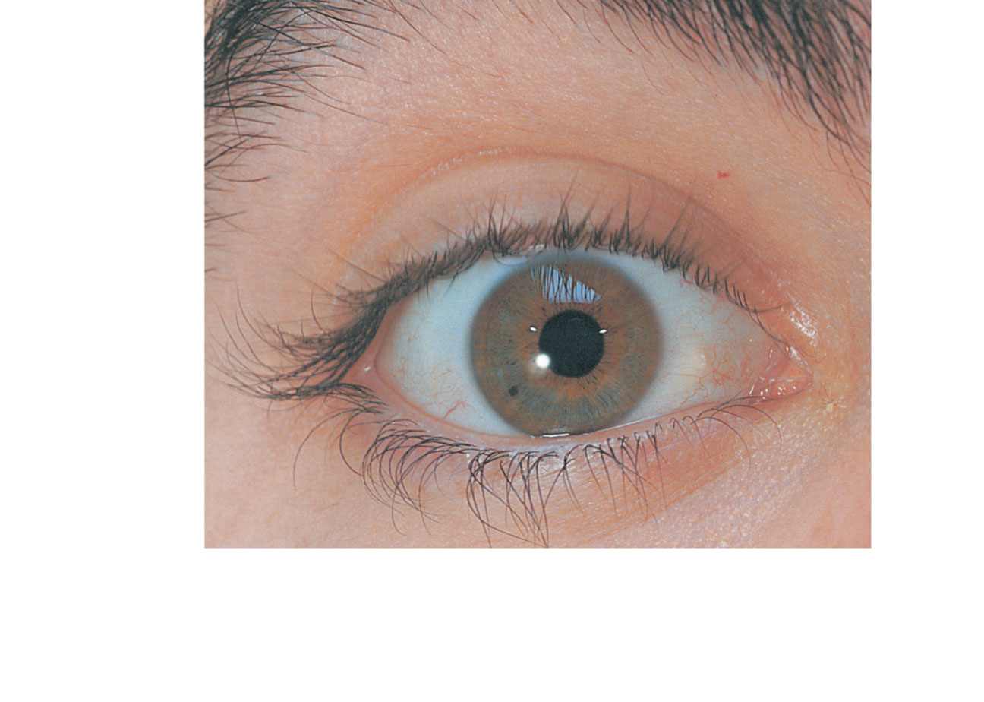
Eyebrow
Eyelid
Eyelashes
Site where
conjunctiva
merges with
cornea
Palpebral
fissure
Lateral
commissure
Iris
Eyelid
Pupil
Sclera
(covered by
conjunctiva)
Lacrimal
caruncle
Medial
commissure
(a) Surface anatomy of the right eye
Figure 15.1a

Slide 5
Eyebrows
Overlie the supraorbital margins
Two Functions we will agree on
Shading the eye
Preventing perspiration from reaching the eye

Slide 6
Eyebrows
Overlie the supraorbital margins
Two Functions we will agree on
Shading the eye
Preventing perspiration from reaching the eye

Slide 7
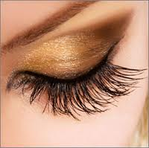
Eyelids or palbebrae
Protect the eye anteriorly… do we have to write this?
Palpebral fissure—separates eyelids
Lacrimal caruncle—elevation at medial commissure; contains oil and sweat glands

Slide 8
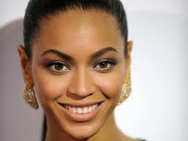
Eyelids
Eyelashes
Nerve endings of follicles initiate reflex blinking
Lubricating glands associated with the eyelids

Slide 9
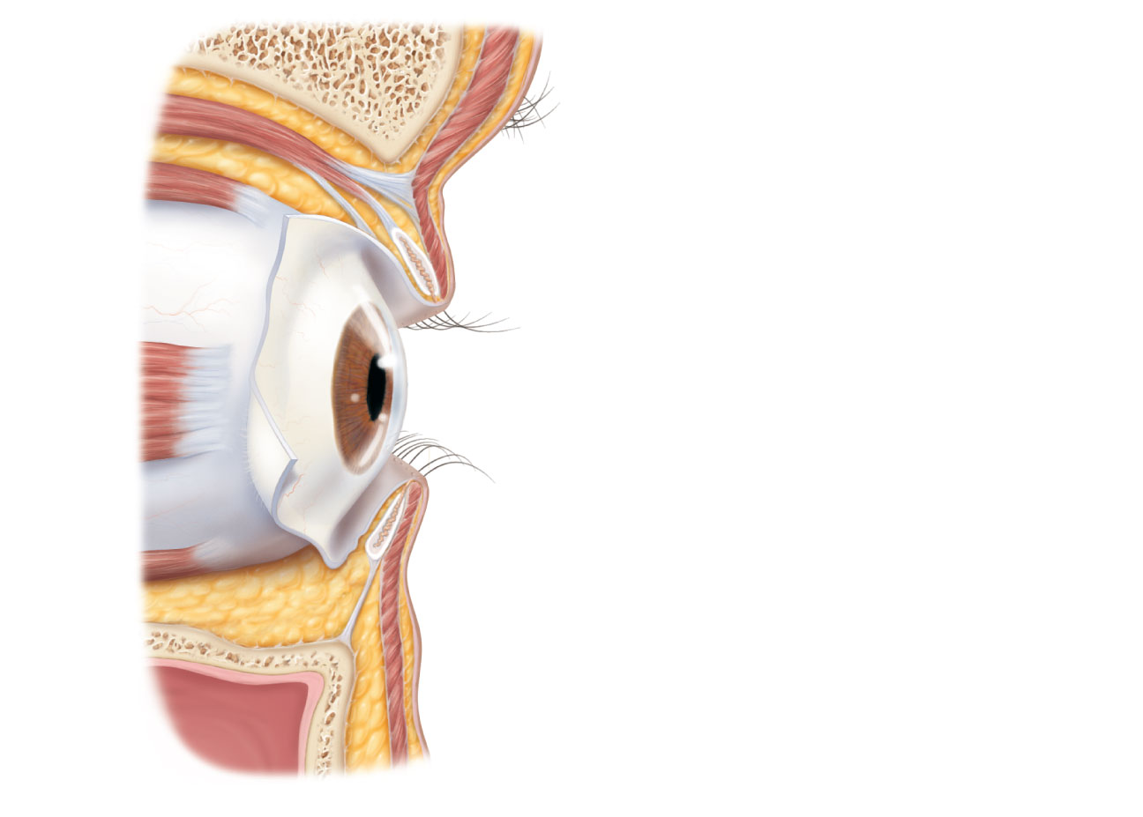
Levator palpebrae
superioris muscle
Orbicularis oculi muscle
Eyebrow
Tarsal plate
Palpebral conjunctiva
Tarsal glands
Cornea
Palpebral fissure
Eyelashes
Bulbar conjunctiva
Conjunctival sac
Orbicularis oculi muscle
(b) Lateral view; some structures shown in sagittal section
Figure 15.1b

Slide 10
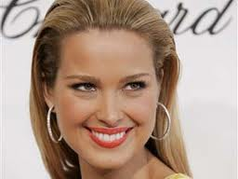
Conjunctiva
Transparent membrane
Function: Produces a lubricating mucous secretion

Slide 11
Conjunctiva
Palpebral conjunctiva lines the eyelids
Bulbar conjunctiva covers the white of the eyes

Slide 12
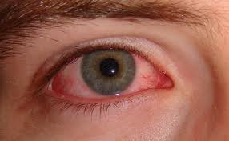
Conjunctivitis

Slide 13
Lacrimal Apparatus
Lacrimal gland and ducts that connect to nasal cavity
Lacrimal secretion (tears)
Dilute saline solution containing
mucus,
antibodies,
lysozyme
Blinking spreads the tears toward the medial commissure
No time to write… lets focus on vision – but may come into play during graduation

Slide 14
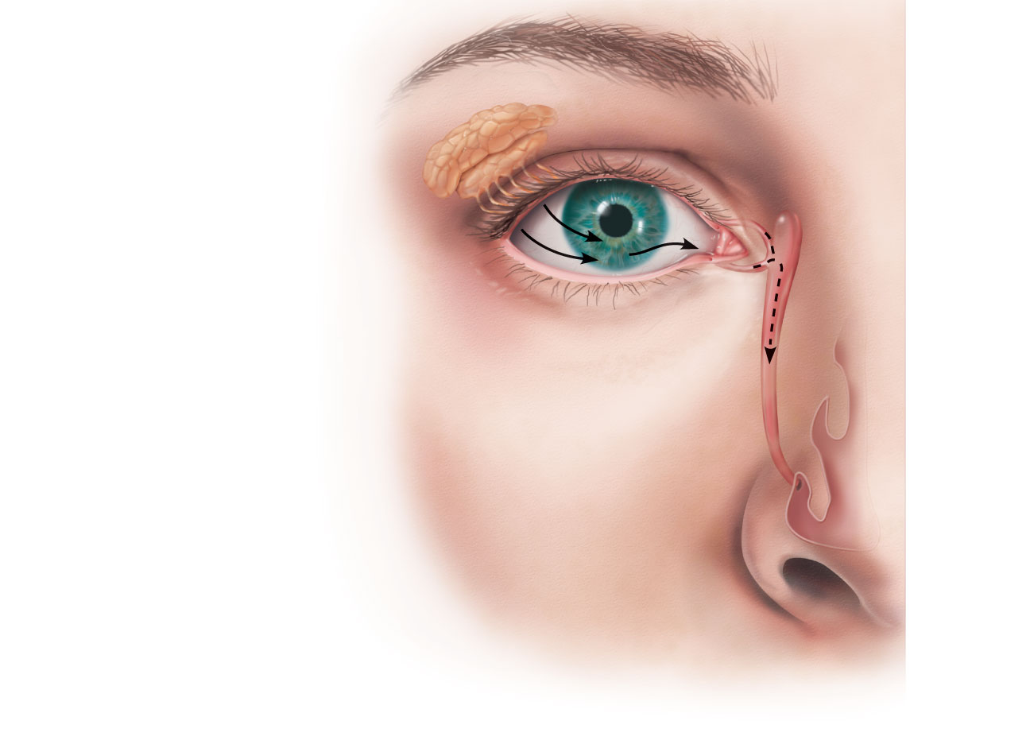
Lacrimal sac
Lacrimal gland
Excretory ducts
of lacrimal glands
Lacrimal punctum
Lacrimal canaliculus
Nasolacrimal duct
Inferior meatus
of nasal cavity
Nostril
Figure 15.2

Slide 15
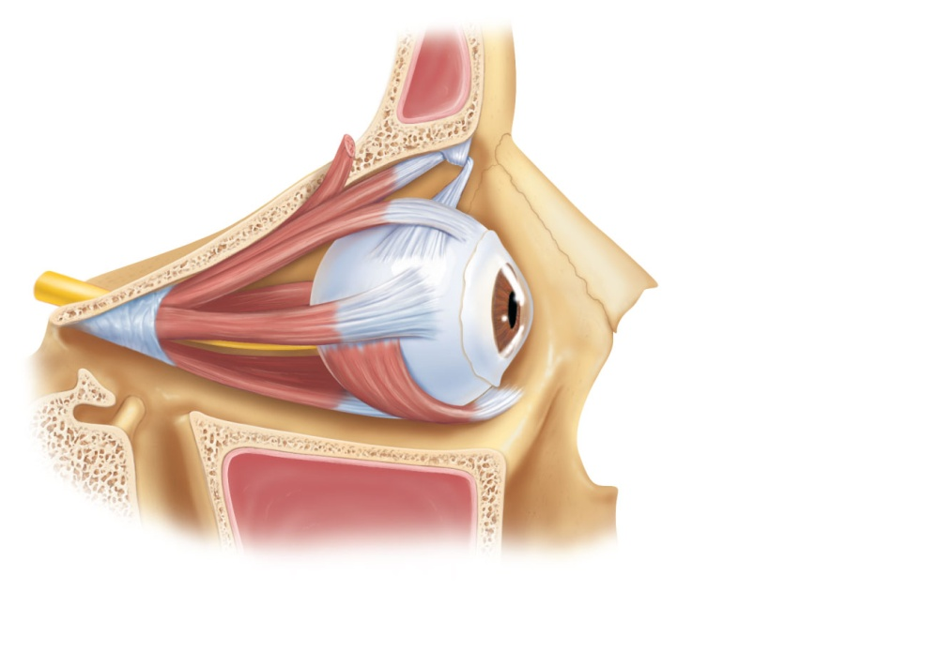
There are 6 Extrinsic Eye Muscles
4 rectus = straight
2 oblique = not straight

Slide 16
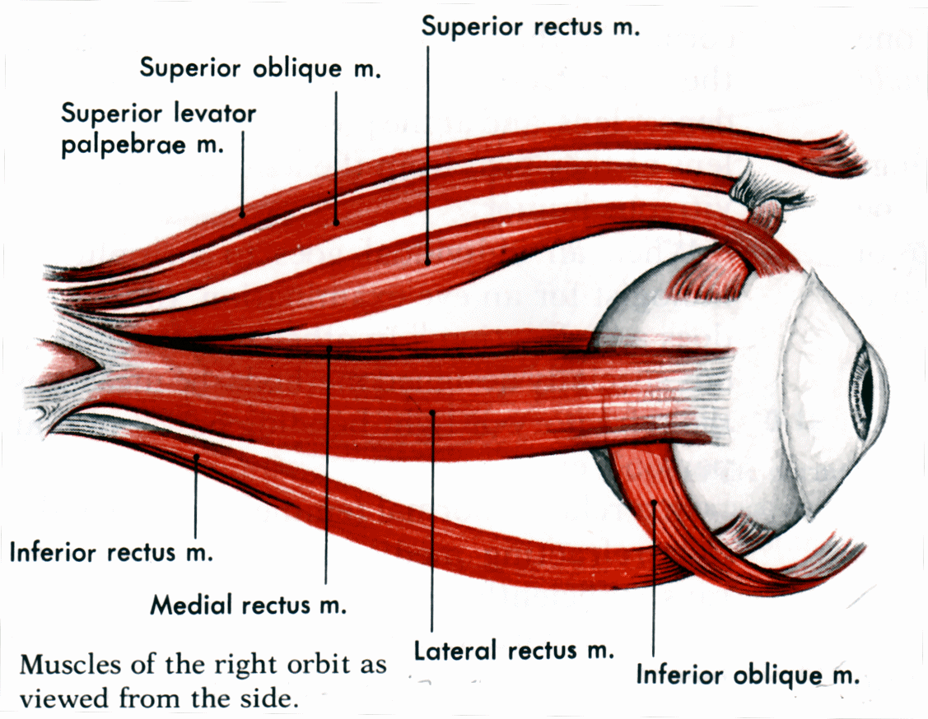

Slide 17
Superior oblique
muscle
Superior oblique
tendon
Superior rectus
muscle
Lateral rectus
muscle
Inferior rectus
muscle
Inferior oblique
muscle
(a) Lateral view of the right eye
Figure 15.3a

Slide 18
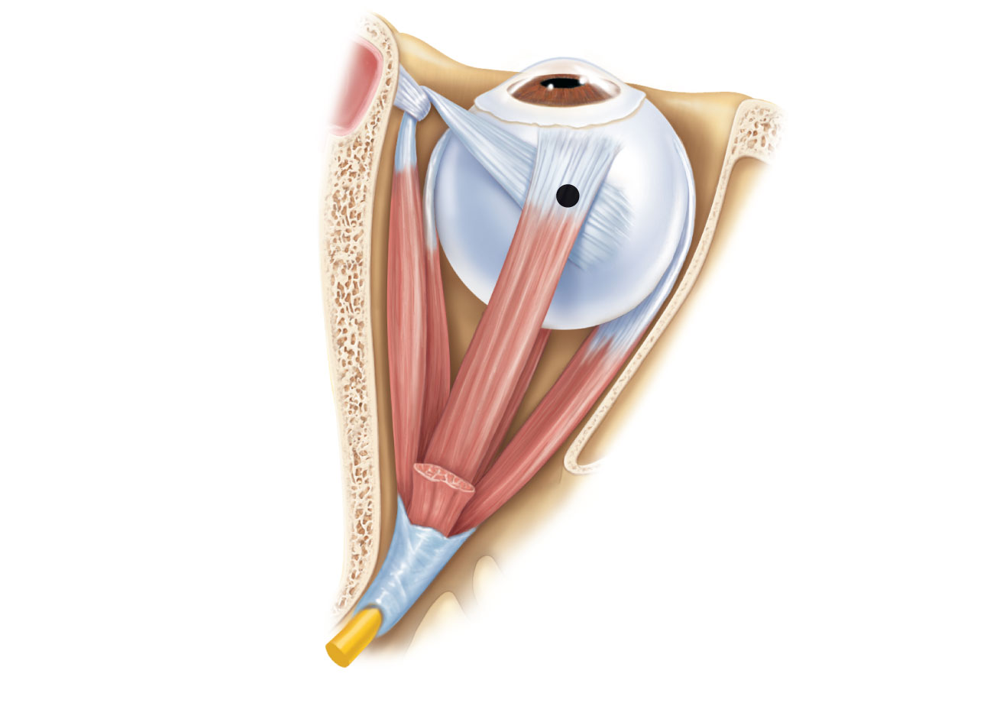
Trochlea
Superior oblique
muscle
Superior oblique
tendon
Axis at center
of eye
Superior rectus
muscle
Inferior
rectus muscle
Medial
rectus muscle
Lateral
rectus muscle
Common
tendinous ring
(b) Superior view of the right eye
Figure 15.3b

Slide 19
Muscle
Action
Controlling
cranial nerve
Lateral rectus
Medial rectus
Superior rectus
Inferior rectus
Inferior oblique
Superior oblique
Moves eye laterally
Moves eye medially
Elevates eye and turns it medially
Depresses eye and turns it medially
Elevates eye and turns it laterally
Depresses eye and turns it laterally
VI (abducens)
III (oculomotor)
III (oculomotor)
III (oculomotor)
III (oculomotor)
IV (trochlear)
(c) Summary of muscle actions and innervating cranial nerves
Figure 15.3c

Slide 20
And Now your feature presentation

Slide 21
THE GENERAL Structure of the Eyeball
Wall of eyeball contains three layers
Fibrous
Vascular
Sensory
Internal cavity is filled with fluids called humors
The lens separates the internal cavity into anterior and posterior segments (cavities)

Slide 22
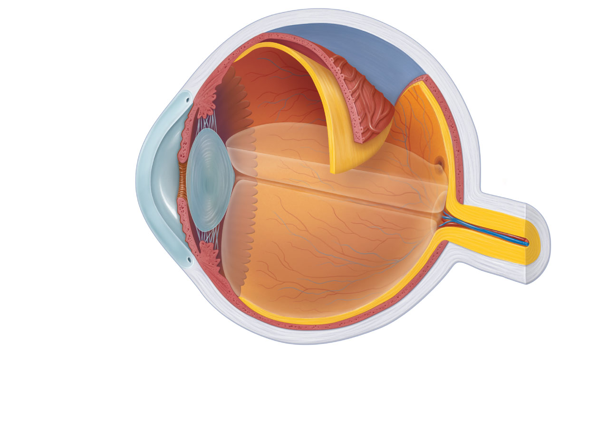
Ora serrata
Ciliary body
Ciliary zonule
(suspensory
ligament)
Sclera
Choroid
Retina
Cornea
Macula lutea
Iris
Fovea centralis
Pupil
Posterior pole
Anterior pole
Optic nerve
Anterior
segment (contains
aqueous humor)
Lens
Scleral venous
sinus
Central artery
and vein of
the retina
Posterior segment
(contains vitreous humor)
Optic disc
(blind spot)
(a) Diagrammatic view. The vitreous humor is illustrated only in the bottom part of the eyeball.
Figure 15.4a

Slide 23
Fibrous Layer
Outermost layer;
dense avascular connective tissue
Two regions: sclera and cornea

Slide 24
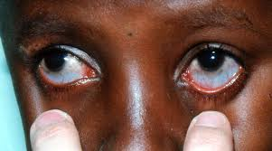
Sclera
Opaque posterior region
Protects and shapes eyeball
Anchors eye muscles
Continues to dura mater

Slide 25
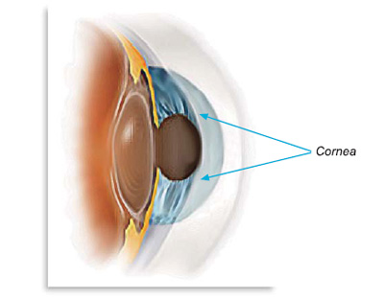
2. Cornea
Transparent anterior 1/6 of fibrous layer
Bends light as it enters the eye
Numerous pain receptors
contribute to blinking and tearing reflexes
Sodium pumps of the corneal endothelium on the inner face help maintain the clarity of the cornea

Slide 26
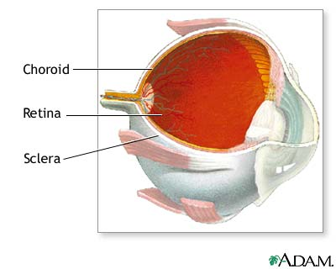
Vascular Layer (Uvea)
Middle pigmented layer
Three regions: choroid, ciliary body, and iris
Choroid region
Posterior portion of the uvea
Supplies blood to all layers of the eyeball
Brown pigment absorbs light to prevent visual confusion

Slide 27
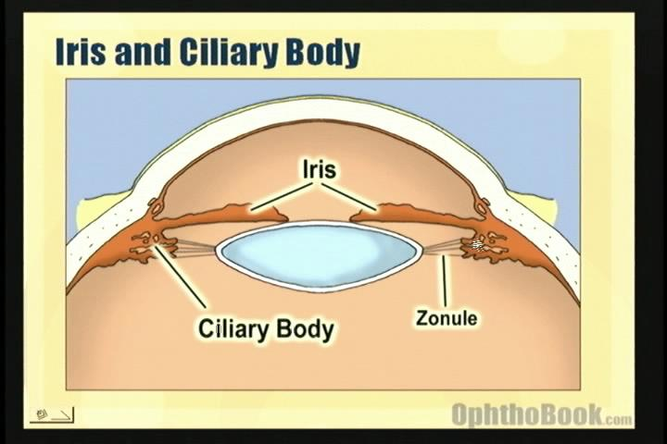
Vascular Layer
2. Ciliary body
Ring of tissue surrounding the lens
Smooth muscle bundles (ciliary muscles) control lens shape
Capillaries of ciliary processes secrete fluid
Ciliary zonule (suspensory ligament) holds lens in position

Slide 28
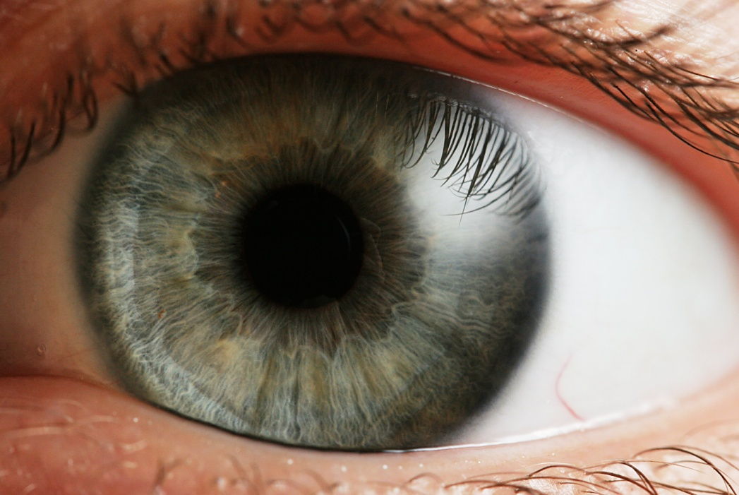
Vascular Layer
3. Iris
The colored part of the eye
Pupil—central opening
regulates the amount of light entering the eye

Slide 29
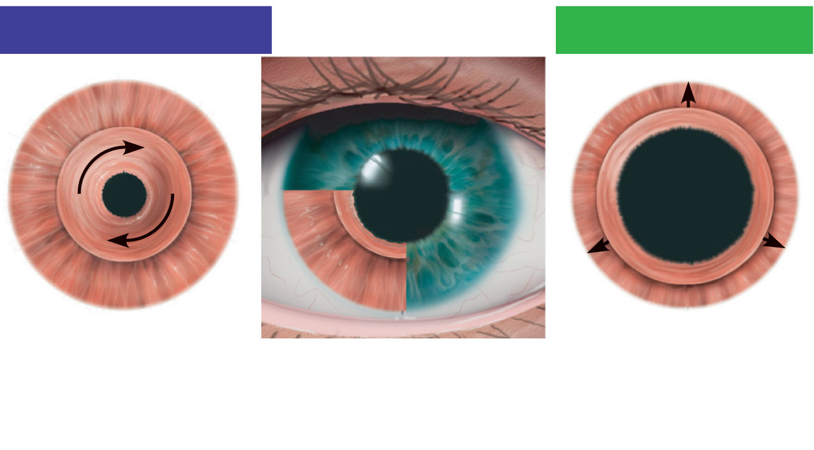
Parasympathetic +
Sympathetic +
Sphincter pupillae
muscle contraction
decreases pupil size.
Iris (two muscles)
• Sphincter pupillae
• Dilator pupillae
Dilator pupillae
muscle contraction
increases pupil size.
Figure 15.5

Slide 30
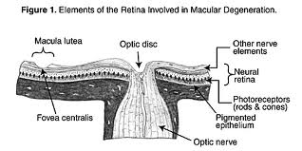
Sensory Layer: Retina
Delicate two-layered membrane
Pigmented layer
Outer layer
Absorbs light and prevents its scattering
Stores vitamin A

Slide 31
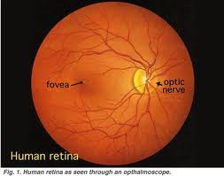
Sensory Layer: Retina
Neural layer
Photoreceptor: transduce light energy
Cells that transmit and process signals: bipolar cells, ganglion cells, amacrine cells, and horizontal cells

Slide 32
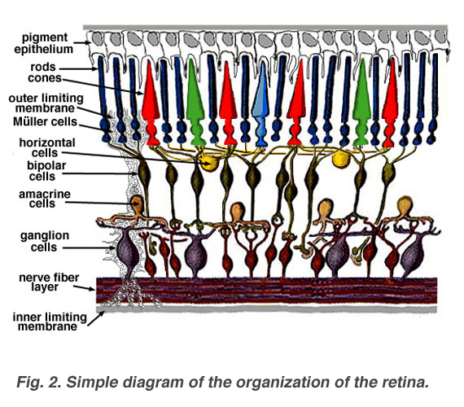

Slide 33
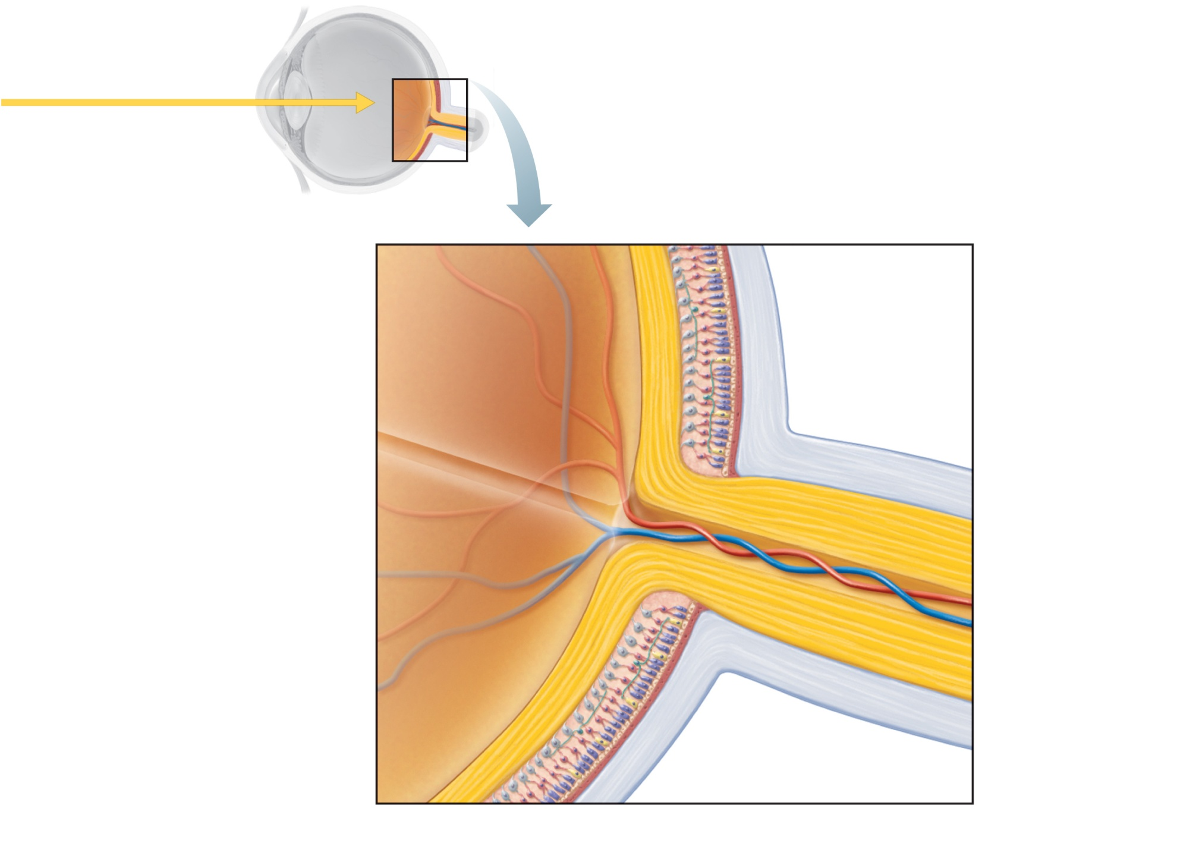
Pathway of light
Neural layer of retina
Pigmented
layer of
retina
Choroid
Sclera
Optic disc
Central artery
and vein of retina
Optic
nerve
(a) Posterior aspect of the eyeball
Figure 15.6a

Slide 34
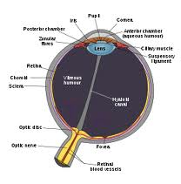
The Retina
Ganglion cell axons
Run along the inner surface of the retina
Leave the eye as the optic nerve
Optic disc (blind spot)
Site where the optic nerve leaves the eye
Lacks photoreceptors

Slide 35
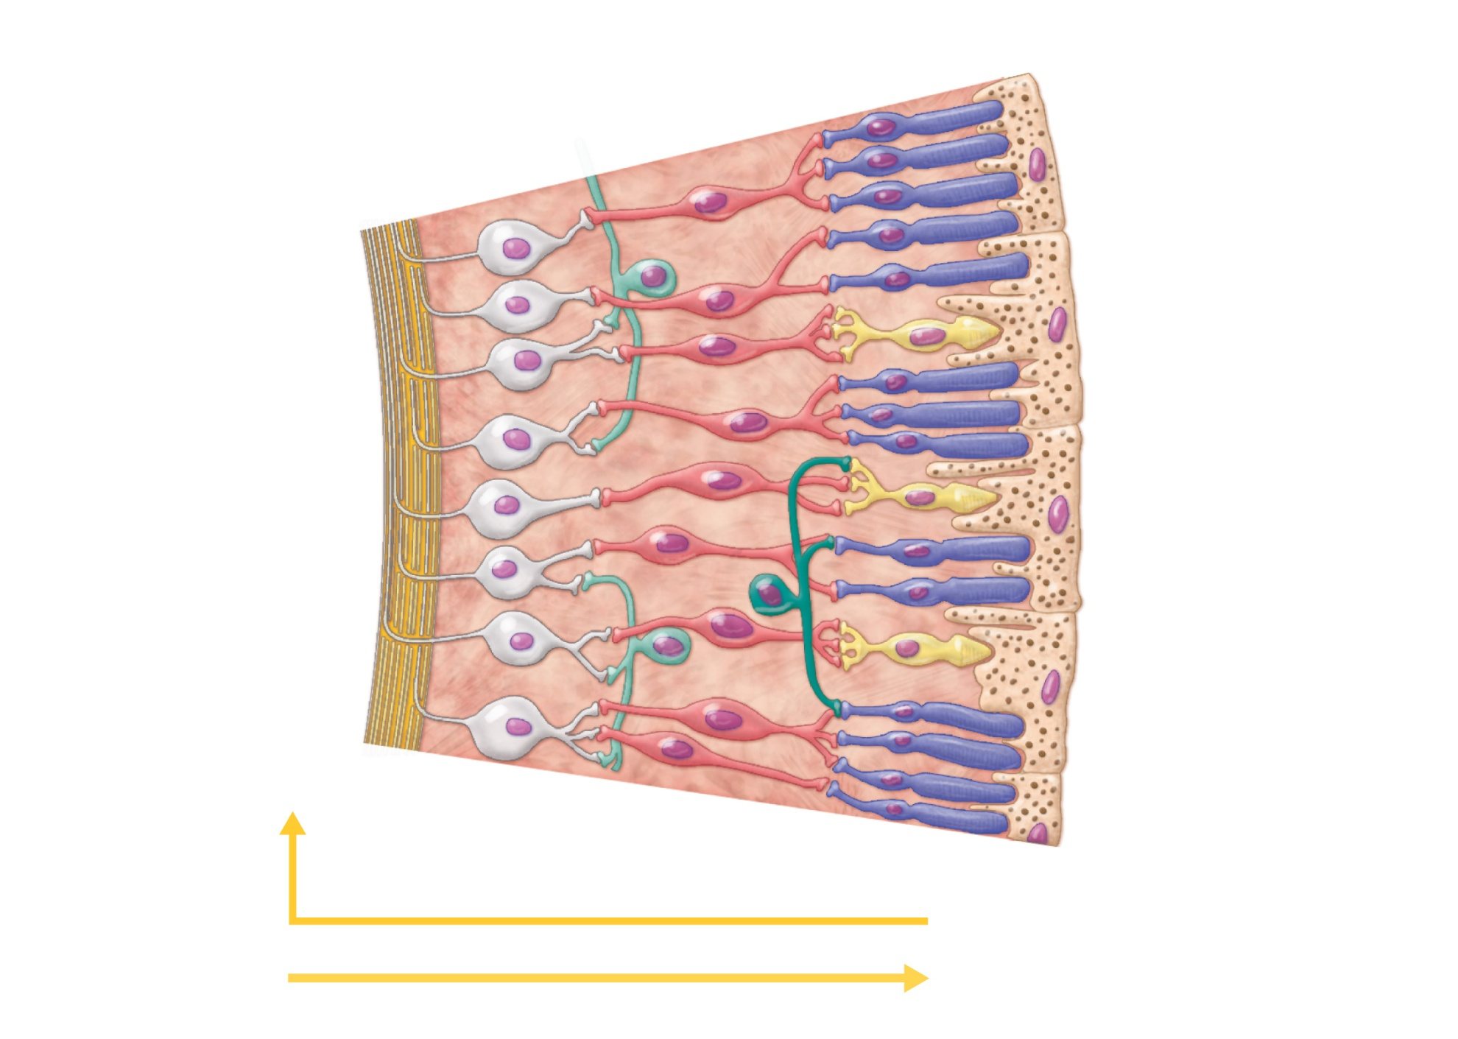
Photoreceptors
Bipolar
cells
• Rod
Ganglion
cells
• Cone
Amacrine cell
Horizontal cell
Pathway of signal output
Pigmented
layer of retina
Pathway of light
(b) Cells of the neural layer of the retina
Figure 15.6b

Slide 36
Photoreceptors
Rods
More numerous at peripheral region of retina, away from the macula lutea
Operate in dim light
Provide indistinct, fuzzy, non color peripheral vision

Slide 37
Photoreceptors
Cones
Found in the macula lutea; concentrated in the fovea centralis
Operate in bright light
Provide high-acuity color vision

Slide 38
Blood Supply to the Retina
Two sources of blood supply
Choroid supplies the outer third (photoreceptors)
Central artery and vein of the retina supply the inner two-thirds

Slide 39
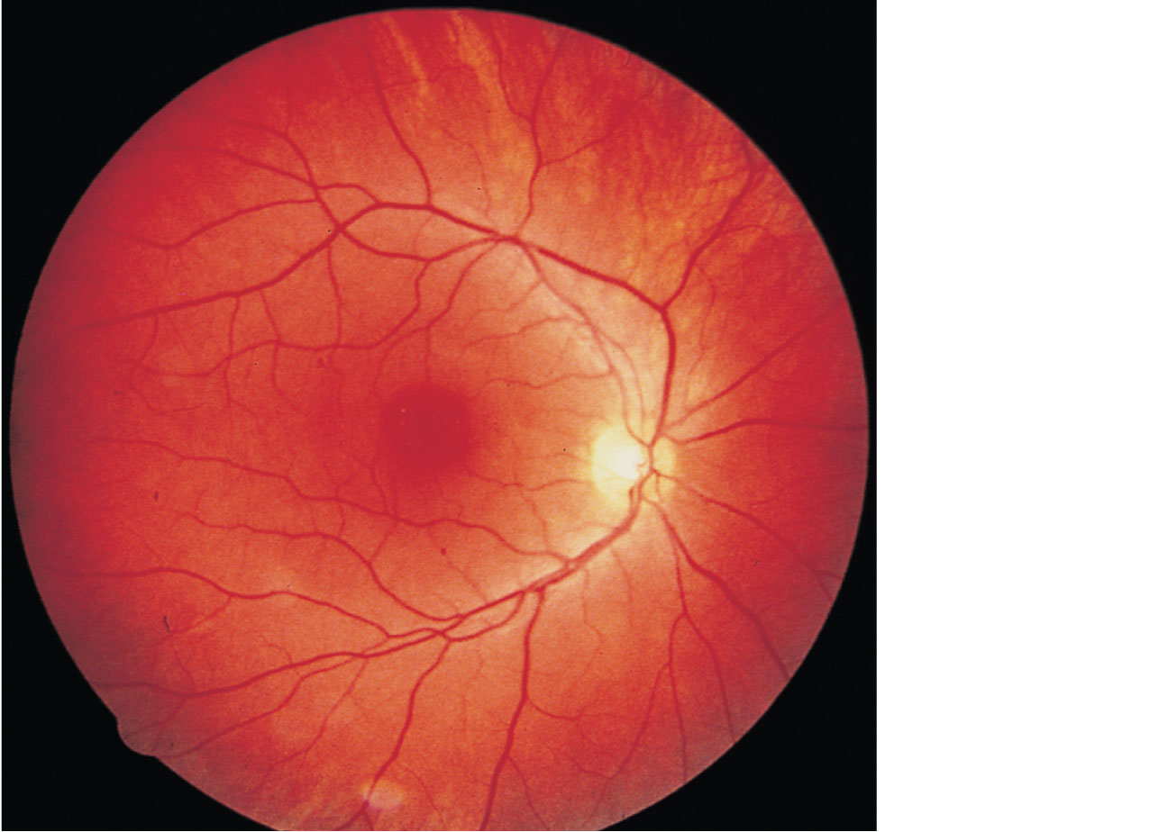
Central
artery
and vein
emerging
from the
optic disc
Macula
lutea
Optic disc
Retina
Figure 15.7

Slide 40
Internal Chambers and Fluids
The lens and ciliary zonule separate the anterior and posterior segments

Slide 41
Ora serrata
Ciliary body
Ciliary zonule
(suspensory
ligament)
Sclera
Choroid
Retina
Cornea
Macula lutea
Iris
Fovea centralis
Pupil
Posterior pole
Anterior pole
Optic nerve
Anterior
segment (contains
aqueous humor)
Lens
Scleral venous
sinus
Central artery
and vein of
the retina
Posterior segment
(contains vitreous humor)
Optic disc
(blind spot)
(a) Diagrammatic view. The vitreous humor is illustrated only in the bottom part of the eyeball.
Figure 15.4a

Slide 42
Internal Chambers and Fluids
Posterior segment contains vitreous humor that:
Transmits light
Supports the posterior surface of the lens
Holds the neural retina firmly against the pigmented layer
Contributes to intraocular pressure
Anterior segment is composed of two chambers
Anterior chamber—between the cornea and the iris
Posterior chamber—between the iris and the lens

Slide 43
Internal Chambers and Fluids
Anterior segment contains aqueous humor
Plasma like fluid continuously filtered from capillaries of the ciliary processes
Drains via the scleral venous sinus (canal of Schlemm) at the sclera-cornea junction
Supplies nutrients and oxygen mainly to the lens and cornea but also to the retina, and removes wastes
Glaucoma: compression of the retina and optic nerve if drainage of aqueous humor is blocked

Slide 44
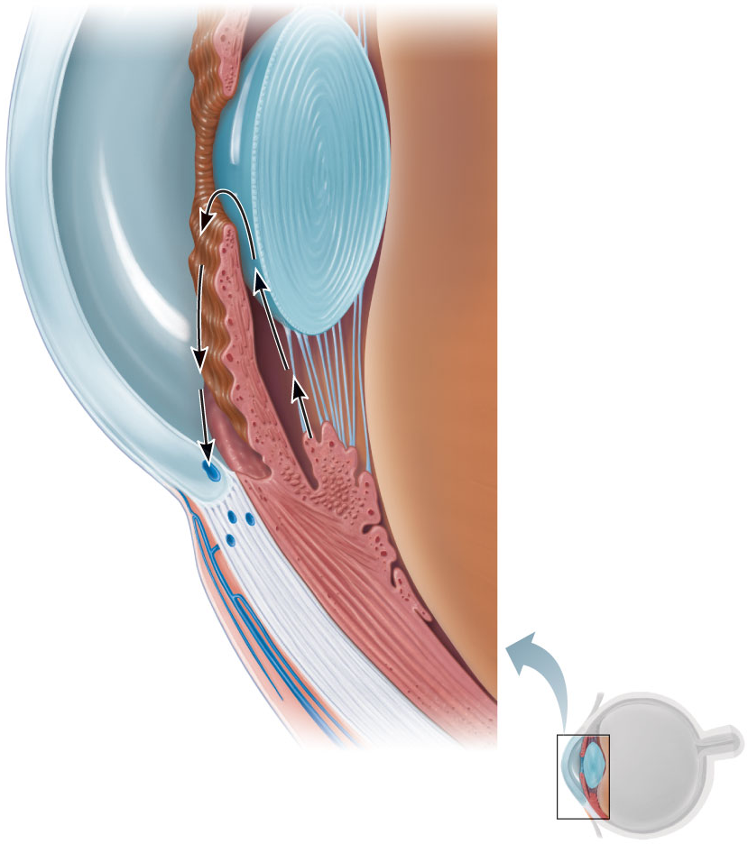
Iris
Lens epithelium
Posterior
segment
(contains
vitreous
humor)
Lens
Cornea
Corneal epithelium
2
Corneal endothelium
Aqueous humor
Ciliary zonule
(suspensory
ligament)
Anterior
segment
(contains
aqueous
humor)
Anterior
chamber
Posterior
chamber
Ciliary body
Scleral venous
sinus
3
1
Ciliary
processes
Aqueous humor is
formed by filtration
from the capillaries in
the ciliary processes.
1
Corneal-
scleral junction
Ciliary
muscle
Aqueous humor flows from the
posterior chamber through the
pupil into the anterior chamber.
Some also flows through the
vitreous humor (not shown).
Bulbar
conjunctiva
2
Sclera
Aqueous humor is reabsorbed
into the venous blood by the
scleral venous sinus.
Cornea
Lens
3
Figure 15.8

Slide 45
Lens
Biconvex, transparent, flexible, elastic, and avascular
Allows precise focusing of light on the retina
Cells of lens epithelium differentiate into lens fibers that form the bulk of the lens
Lens fibers—cells filled with the transparent protein crystallin
Lens becomes denser, more convex, and less elastic with age
Cataracts (clouding of lens) occur as a consequence of aging, diabetes mellitus, heavy smoking, and frequent exposure to intense sunlight

Slide 46
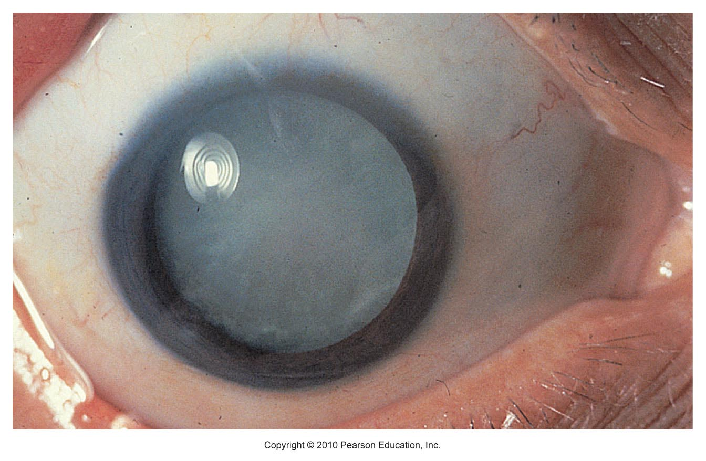
Figure 15.9

Slide 47
Close vision and bright light—sphincter papillae (circular muscles) contract; pupils constrict
Distant vision and dim light—dilator papillae (radial muscles) contract; pupils dilate
Changes in emotional state—pupils dilate when the subject matter is appealing or requires problem-solving skills

