Slide 1
Vocabulary for the day
Viable – capable of living
Labile – apt or likely to change
Dilate – to make wider; to cause to expand
Permeable – capable of letting things pass through

Slide 2
List the 3 membranes their functions Locations tissues

Slide 3
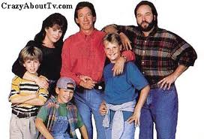
Tissue Repair

Slide 4
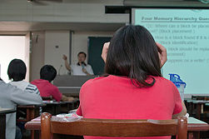
Tissue Repair: substitution of viable cells for dead cells

Slide 5
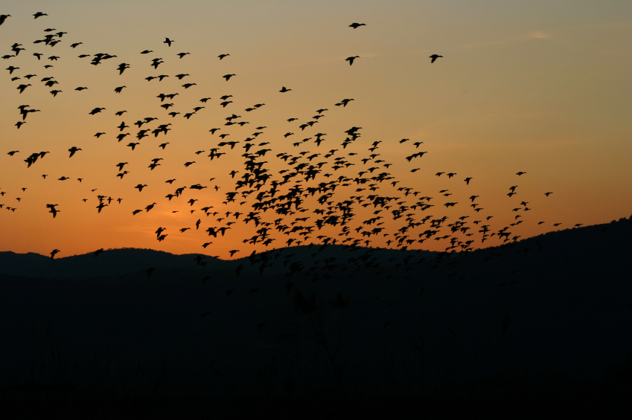
Tissue repair requires that cells DIVIDE and MIGRATE
Activities initiated by growth factors
released by injured cells

Slide 6
Cell Classification
Labile: divide throughout life
Stable: stop dividing after growth ceases (still can divide if injured) CT, pancreas, glands, liver
Permanent: limited to no ability to replicate

Slide 7
From pathology!

Slide 8
Labile Cells
Develop from a population of Stem cells
Capable of continuously dividing and dying (hence labile).
Examples:
hematopoietic cells of bone marrow
squamous epithelia of skin, oral cavity, vagina, cervix
cuboidal epithelia lining ducts of exocrine glands;
columnar epithelium of GI tract, uterus, fallopian tubes,
transitional epithelia of urinary tract

Slide 9
Stable Cells
They are quiescent (in G0 stage) with minimal replication in their normal state
They divide rapidly in response to injury
e.g. parenchymal cells of liver, kidney, pancreas; endothelial cells lining blood vessels; fibroblasts, and smooth muscle cells; have limitations to regenerate (except lever).
Permanent Cells
These cells are terminally differentiated and
nonproliferative after birth.
e.g. most neurons and cardiac cells.
Thus injury is irreversible and results only in scar.

Slide 10
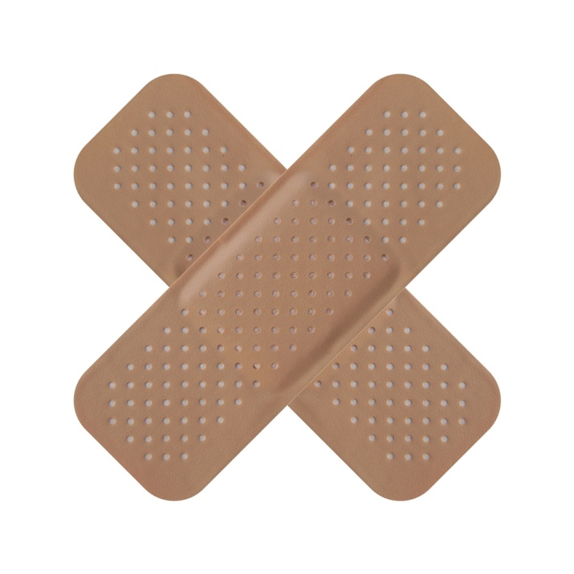
Repair occurs by two ways:
1. Regeneration
2. Fibrosis
Regeneration/replaced/ same cells
Fibrosis involves proliferation of fibrous CT called scar tissue

Slide 11
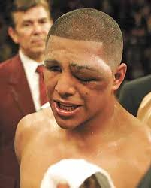
The Process
1. Inflammation
cells release inflammatory chemicals
Capillaries dilate
And become very permeable
This allows white blood cells and clotting proteins as well as antibodies to seep into injured area

Slide 12
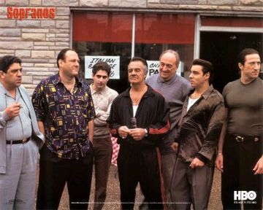
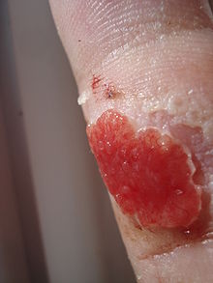
2. Organization restores the blood supply
Blood clot→replaced by granulation tissue.
Granulation tissue: delicate pink tissue composed of several elements

Slide 13
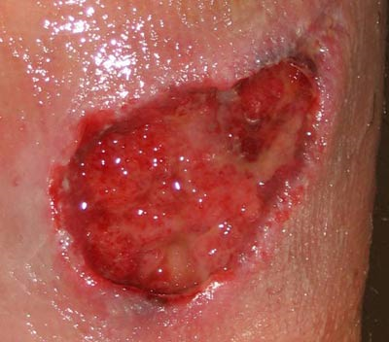
Repair By Connective Tissue (Fibrosis)
When repair cannot be accomplished by regeneration of cells alone, it involves replacement with connective tissue or by combination of both
Begins in 24 hours by fibroblasts
Granulation tissue forms by proliferation of fibroblasts with new vessels, in a loose ECM; eventually scar tissue is formed
Steps in the process:
Angiogenesis or Neovascularisation
Migration and proliferation of fibroblasts
Formation of ECM (leading to scarring)
Maturation and remodeling of scar tissue

Slide 14
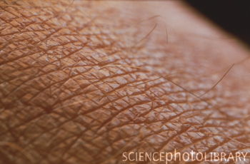
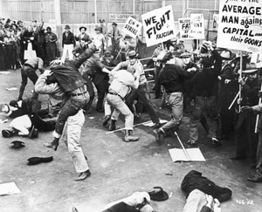
3. Regeneration and fibrous effect permanent repair
Surface epithelium repairs underneath the scab
End result: fully regenerated epithelium and scar tissue (may be seen or not)

Slide 15
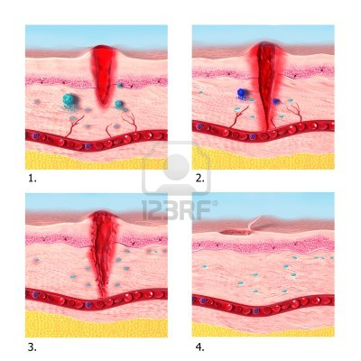

Slide 16
Healing granulation tissue Mature Scar
A, Granulation tissue showing numerous blood vessels, edema, and a loose ECM containing occasional inflammatory cells. Collagen is stained blue by the trichrome stain; minimal mature collagen can be seen at this point.
B, Trichrome stain of mature scar, showing dense collagen with only scattered vascular channels.

Slide 17
Scar Tissue….issues…
Tissue that forms in the bladder, heart or other muscular organ can greatly hamper the function of that organ.
Normal shrinking reduces the over all volume and may hinder or even block the movement of substances.

Slide 18
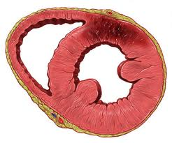

Slide 19
