Slide 2
What does calcium attach to?
Troponin
Tropomyosin
Actin
Myosin

Slide 3
What blocks myosin from binding to actin?
Troponin
Tropomyosin
Actin
Myosin

Slide 4
What step is after the cross bridge is broken?
Myosin’s head goes down
Myosin heads elevate
Myosin Heads break off
POWER STROKE

Slide 5
What organelle stores calcium ions?
T Tubule
Sarcoplasmic Reticulum
Sarcolemma
Myofribril
Mitochondria

Slide 6
Anatomy is
A Great class
The Greatest class

Slide 7
I think I will get a ____ on the quiz on Friday
A
B
C
C-
Failure is not an option

Slide 8
What substance must bind to myosin heads in order for the heads to detach from the thin filaments?
ADP
Creatine
ATP
Calcium

Slide 9
Acetabulum
Ischium
Anterior Superior Illiac Spine

Slide 10
Ischial Tuberosity
Illiac Crest
Pubic Bone

Slide 11
Pubic Symphisis
Female Hip
Sciatic Notch
Now some nerve questions

Slide 12
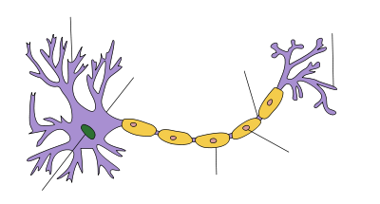

Slide 16
Ischial Spine
Head of the femur
Obturator Foramen

Slide 17
Troponin
Myosin
A Band

Slide 18
Actin
Troponin
Sarcoplasmic Reticulum

Slide 19
Calcium
POWER STROKE
Tropomyosin

Slide 20
ATP
I Band
H Zone

Slide 21
Axon
Sodium ions
Neuron

Slide 22
Voltage gated channel
Action potential
Depolarization

Slide 23
Leakage channel
Resting membrane potential

Slide 24
Negative
The femur
hyperpolarization

Slide 25
Oligodendrocytes
Parasympathetic nervous system
Efferent nervous system

Slide 26
Pns
Astrocytes
Microglial cells

Slide 27
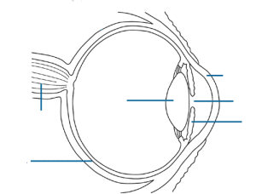
Skeletal Muscle Anatomy: $100 Question
ANSWER
BACK TO GAME

Slide 28
Skeletal Muscle Anatomy: $100 Answer
What is the cornea?
BACK TO GAME

Slide 29
Skeletal Muscle Anatomy: $200 Question
ANSWER
BACK TO GAME

Slide 30
Skeletal Muscle Anatomy: $200 Answer
What is the optic Disc/ Optic Nerve / Blind Spot?
BACK TO GAME

Slide 31
Skeletal Muscle Anatomy: $300 Question
ANSWER
BACK TO GAME

Slide 32
Skeletal Muscle Anatomy: $300 Answer
What is the Sclera?
BACK TO GAME

Slide 33
Skeletal Muscle Anatomy: $400 Question
ANSWER
BACK TO GAME

Slide 34
Skeletal Muscle Anatomy: $400 Answer
What is the iris?
BACK TO GAME

Slide 35
Skeletal Muscle Anatomy: $500 Question
Responsible for the T wave.
ANSWER
BACK TO GAME

Slide 36
Skeletal Muscle Anatomy: $500 Answer
What is the pupil?
BACK TO GAME

Slide 37
The Sliding Filament Theory: $100 Question
Cells responsible for seeing clearly
ANSWER
BACK TO GAME

Slide 38
The Sliding Filament Theory: $100 Answer
What are cones?
BACK TO GAME

Slide 39
The Sliding Filament Theory: $200 Question
Your peripheral vision relies on this type of phtooreceptor
ANSWER
BACK TO GAME

Slide 40
The Sliding Filament Theory: $200 Answer
What are rods?
BACK TO GAME

Slide 41
General : $100 Question
The Parts of the female duct system
ANSWER
BACK TO GAME

Slide 42
General: $100 Answer
What is the vagina, uterus, and fallopian tube
BACK TO GAME

Slide 43
General : $200 Question
A follicle
ANSWER
BACK TO GAME

Slide 44
General : $200 Answer
What is the egg and the cells that surround it?
BACK TO GAME

Slide 45
General: $300 Question
Gonatotropins
ANSWER
BACK TO GAME

Slide 46
General : $300 Answer
What is LH hCG and FSH?
BACK TO GAME

Slide 47
General : $400 Question
The type of tissue that makes up the inside of the uterus
ANSWER
BACK TO GAME

Slide 48
General : $400 Answer
What is the endometrium?
BACK TO GAME

Slide 49
General : $500 Question
How sperm find the egg
ANSWER
BACK TO GAME

Slide 50
intramembanous: $500 Answer
What is swimming against the current
BACK TO GAME

Slide 51
Intramembanous $100 Question
LH spike
ANSWER
BACK TO GAME

