Slide 1
Constitutional Government
Content Statement #7: Constitutional government in the United States has changed over time as a result of amendments to the U.S. Constitution, Supreme Court decisions, legislation and informal practices.

Slide 2
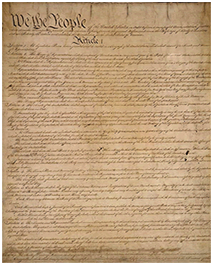
When Changes Need to be Made
The operations of the government in the U.S. take place within a framework provided by the U.S. Constitution
The U.S. Constitution has been amended, interpreted, supplemented and implemented in a variety of ways

Slide 3
Bill of Rights
Content Statement #8: The Bill of Rights was drafted in response to the national debate over the ratification of the Constitution of the United States.

Slide 4
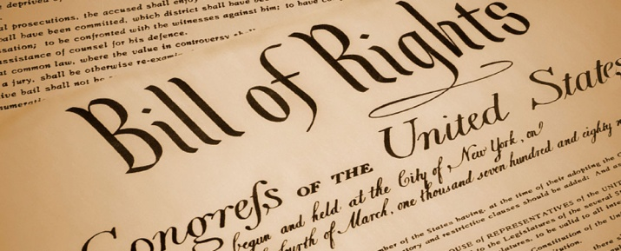
Bill of Rights History
Key argument during the course of the debate over the ratification of the U.S. Constitution concerned the need for a bill of rights
Federalists pointed to protections included in the original document but Anti-Federalists argued that those protections were inadequate
To secure sufficient votes in the state ratifying conventions, Federalists pledged to offer a bill of rights once the new government was established
Massachusetts & Virginia, in accord with Anti-Federalist sentiments, went so far as to propose amendments to the Constitution
including amendments to protect the rights of citizens

Slide 5
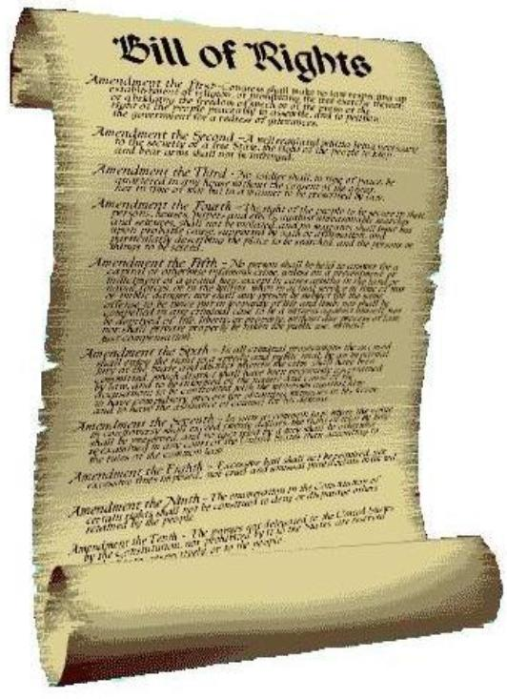
Bill of Rights
First ten amendments-ratified in 1791
Addressed protections for individual rights (Amendments 1 – 9)
These amendments reflect the principle of limited government
10th Amendment also addressed the principle of limited government as well as federalism

Slide 6
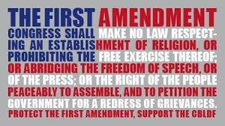
1st Amendment
Free Speech
Freedom of Religion
establishment or exercise
Assembly
Press
Petition against the government

Slide 7
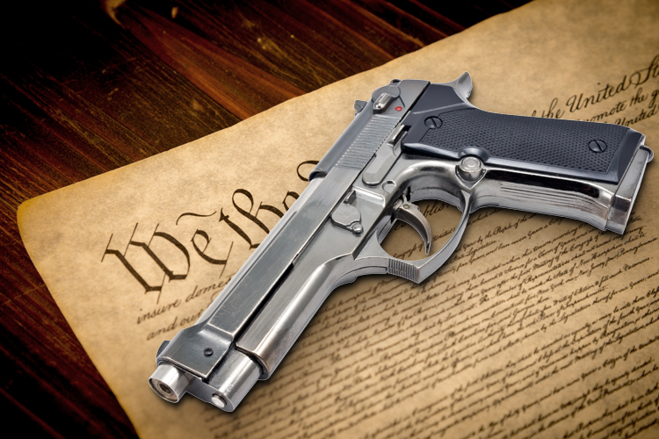
2nd Amendment
A well regulated Militia, being necessary to the security of a free State, the right of the people to keep and bear Arms, shall not be infringed

Slide 8
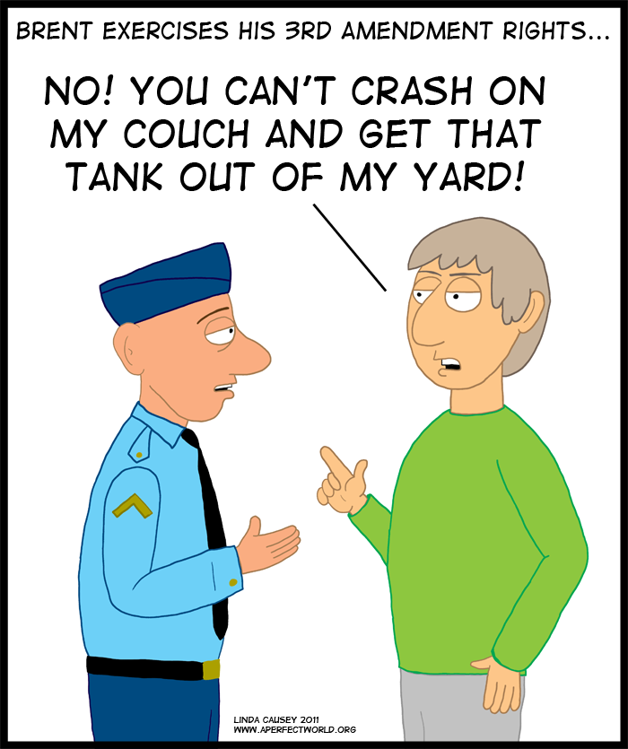
3rd Amendment
No Soldier shall, in time of peace be quartered in any house, without the consent of the Owner, nor in time of war, but in a manner to be prescribed by law.

Slide 9
4th Amendment
No unreasonable search and seizure
Requirement of a warrant for searches

Slide 10
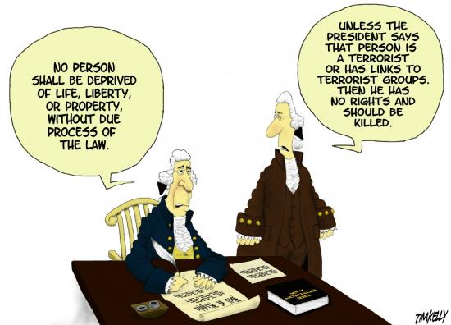
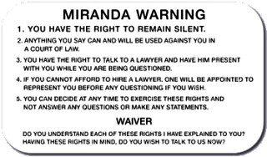
5th Amendment
No person shall be held to answer for a capital, or otherwise infamous crime, unless on a presentment or indictment of a GRAND JURY
Nor shall any person be subject for the same offence to be twice put in jeopardy (DOUBLE JEOPARDY)of life or limb
Nor shall be compelled in any criminal case to be a witness against himself (SELF INCRIMINATION)
Nor be deprived of life, liberty, or property, without DUE PROCESS of law
Nor shall private property be taken for public use, without JUST COMPENSATION
Eminent Domain

Slide 11
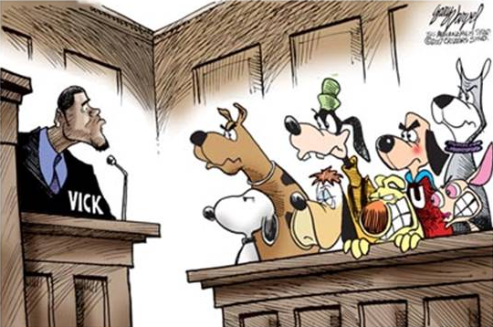
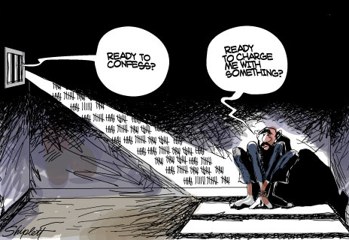
6th Amendment
Criminal Cases
The accused shall enjoy the right to a speedy and public trial
By an impartial jury
Accusation to be confronted with the witnesses against him
To have the Assistance of Counsel for his defense

Slide 12
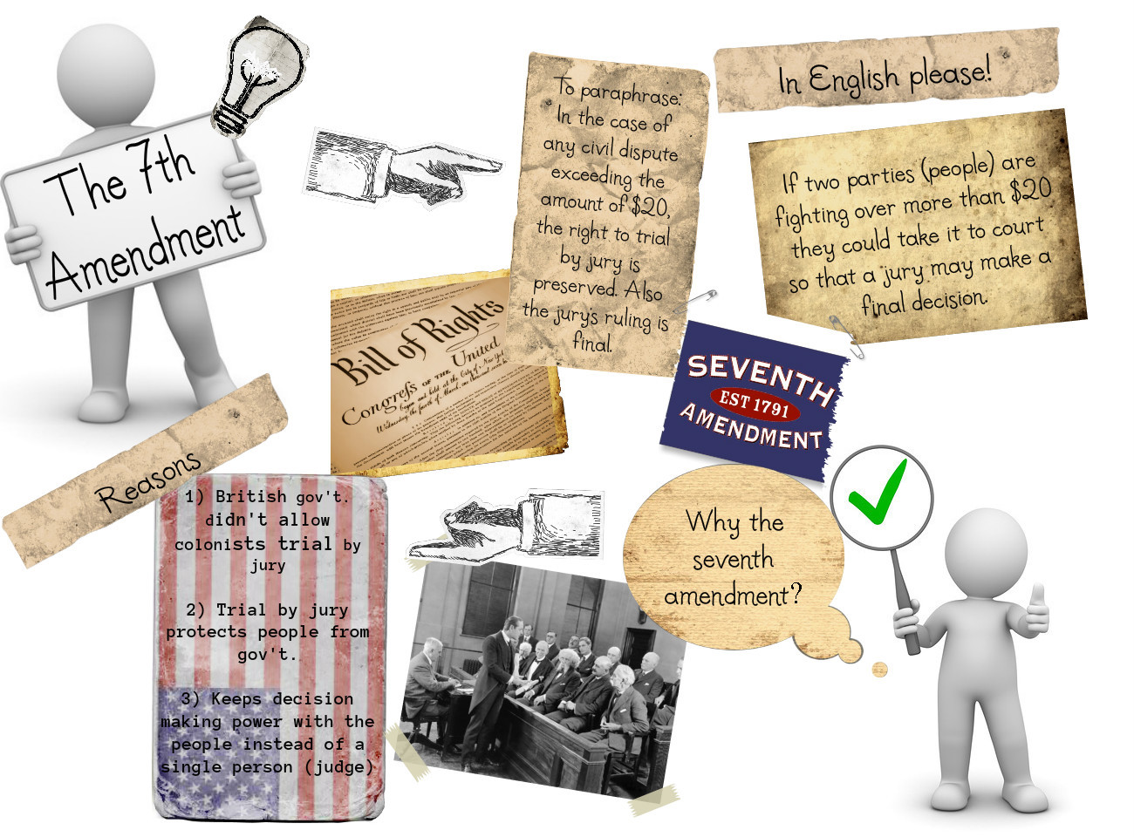
7th Amendment
Civil Cases
The right of trial by jury shall be preserved

Slide 13
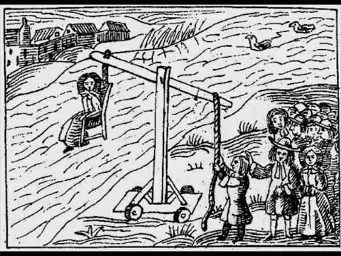
8th Amendment
Excessive bail shall not be required, nor excessive fines imposed, nor cruel and unusual punishments inflicted

Slide 14
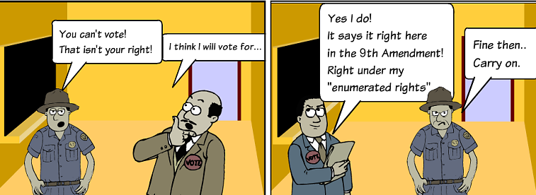
9th Amendment
The enumeration in the Constitution, of certain rights, shall not be construed to deny or disparage others retained by the people

Slide 15
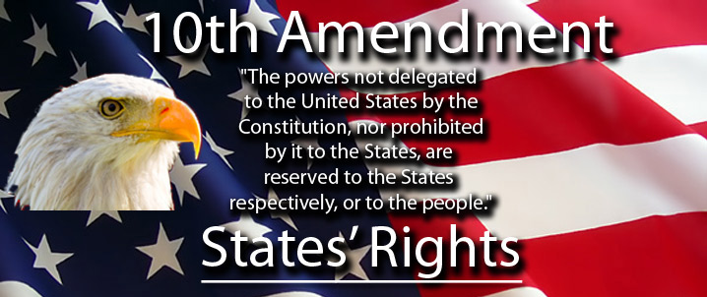
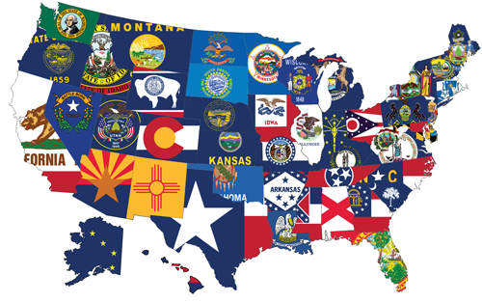
10th Amendment
Reserved Powers to the States

Slide 16
Reconstruction Amendments
Content Statement #9: The Reconstruction Era prompted Amendments 13 through 15 to address the aftermath of slavery and the Civil War.

Slide 17
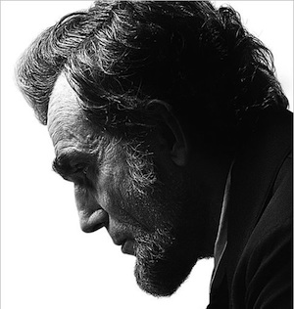
History of the Reconstruction Amendments
The conflict over slavery was a primary cause of the American Civil War
As the war came to a close, plans to “reconstruct” the rebellious states were instituted
The 13th Amendment, which abolished slavery, was not part of President Lincoln’s original plan to readmit former Confederate states to Congress
Ratification of the 13th Amendment became a requirement under President Johnson’s Reconstruction plan

Slide 18
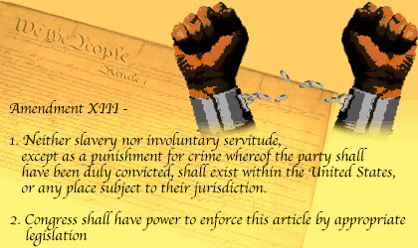
Amendment 13 (1865)
Slavery is abolished in the United States

Slide 19
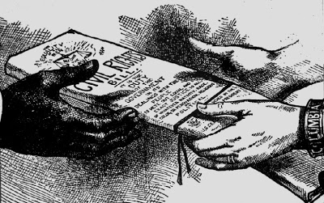
Amendment 14 (1868)
Everyone born or naturalized in U.S. are entitled to rights-EQUAL PROTECTION UNDER THE LAW
Defined what persons were citizens of the United States & offered protection from state infringements on citizens’ rights
Revised the means for determining representation in the House of Representatives & included punishments for former Confederates and their states
No one shall run for office if they are convicted of treason or uprising
All debts are valid EXCEPT those incurred to fund insurrection or losses related to slavery

Slide 20
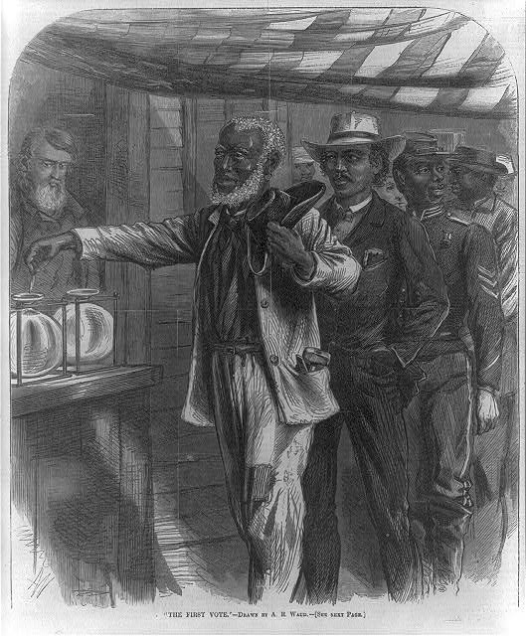
Amendment 15 (1870)
Extended the right to vote to citizens regardless of race, color or previous condition of servitude

Slide 21
Progressive Era Amendments
Content Statement #10: Amendments 16 through 19 responded to calls for reform during the Progressive Era.

Slide 22
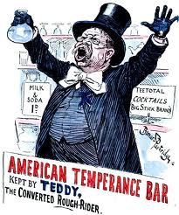
Progressive Era History
Time of political, economic, and social reform in response to problems which emerged throughout the United States in the late 1800s
Progressive reforms began at the local level and gradually spread to the national level, including four constitutional amendments
addressed issues related to taxation, representation in Congress, alcohol use and suffrage

Slide 23
Amendment 16 (1913)
Congress has the power to tax income
Background:
Concerns over the usage of tariffs by the federal government and distribution of wealth in the country had been raised by the Populist Party
Progressives took up the call for reform and the 16th Amendment was passed to allow for a federal income tax

Slide 24
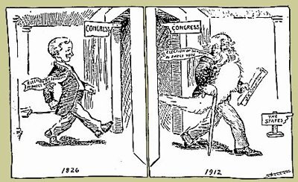
Amendment 17 (1913)
Senators elected by popular vote
If Senate seat is vacated, a replacement Senator is appointed until an election is held
Background:
Critics of state politics viewed political party bosses and business leaders as having too much influence on state legislatures and their selection of senators
Amendment 17 provides for the direct election of senators by the people
Cartoon portraying the time it took to pass the Seventeenth Amendment allowing the direct election of U.S. senators

Slide 25
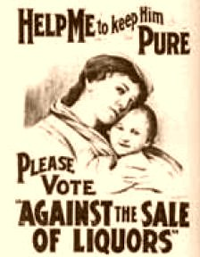
Amendment 18 (1919)
Manufacture, transportation, and sale of intoxicating liquors becomes illegal one year after ratification of the amendment
Importation and exportation of substances also illegal
Background:
Proponents of prohibition had for decades linked alcohol use to problems such as poverty & the destruction of family life
Efforts to ban the use of alcoholic beverages led to passage of the 18th Amendment.

Slide 26
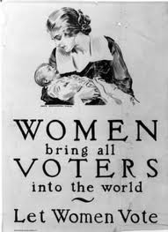
Amendment 19 (1920)
Sex cannot exclude a person from voting
Background:
Longstanding reform effort was focused on obtaining the right to vote for women
Women's suffrage in the U.S. was achieved gradually, at state and local levels during the late 19th century and early 20th century, culminating in 1920 with the passage of the Nineteenth Amendment

Slide 27
Voting Amendments
Content Statement #11: Four amendments have provided for extensions of suffrage to disenfranchised groups.

Slide 28
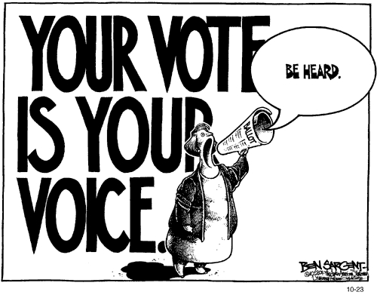
Extension of Voting Rights
A recurring theme in amending the Constitution of the United States has been the extension of voting rights to more citizens
Over time, the fundamental democratic practice of voting has been made possible for different groups of people

Slide 29
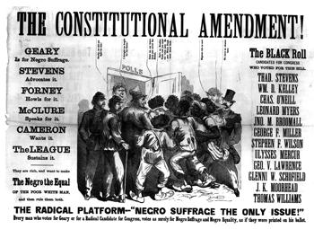
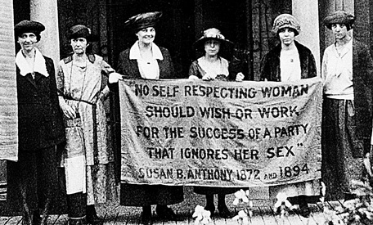
What Amendments Have We Already Covered that Would Fit in this Category?
Amendment 15 prohibits the denial of suffrage to people because of race, color or previous condition of servitude
Amendment 19 prohibits the denial of suffrage on account of sex

Slide 30
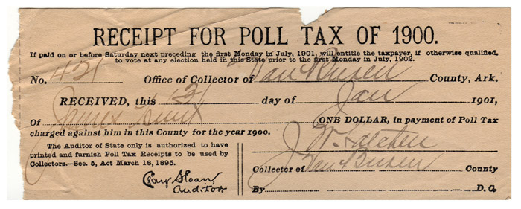
Amendment 24 (1964)
The right to vote will not be impeded upon by any poll tax
Background:
Poll taxes disenfranchised the poor and were also used as Jim Crow legislation to deny the right to vote to African Americans
Amendment 24 prohibits the use of poll taxes in federal elections

Slide 31
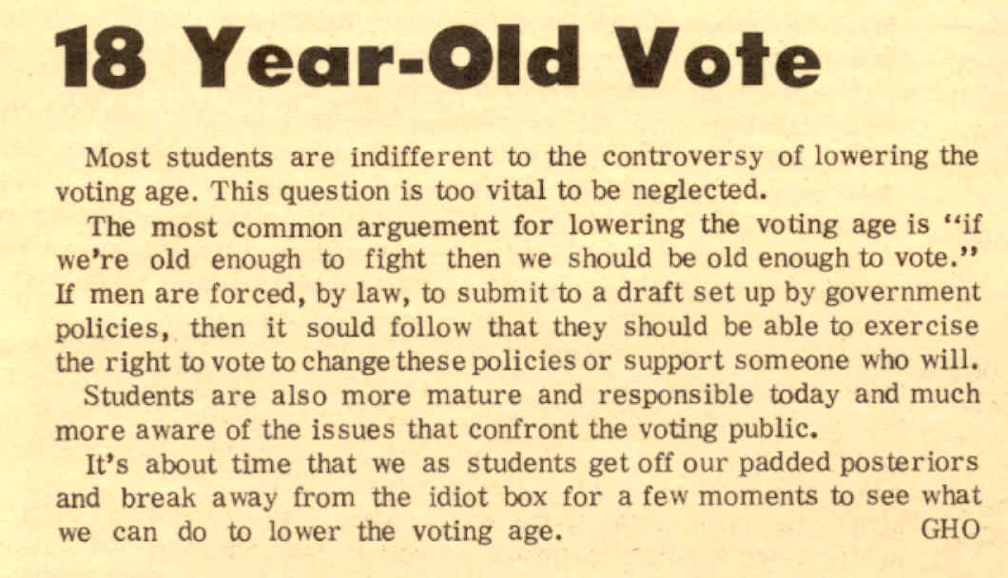
Amendment 26 (1971)
Right to vote is extended to citizens 18 years of age or older
Background:
Direct result of many young men being drafted to fight in the Vietnam War, but not being able to vote

Slide 32
Changes With the Presidency Amendments
Content Statement #12: Five amendments have altered provisions for presidential election, terms, and succession to address changing historical circumstances.

Slide 33
Changes to the Executive Branch
Constitutional provisions related to the executive branch of the federal government have been frequent subjects for amendment
The amendments have responded to events impacting presidential elections, terms and succession

Slide 34
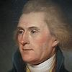
Amendment 12 (1804)
Vice President is chosen as a separate office
Defines how electoral college shall vote for Vice President
Background:
Amendment 12 altered the procedures of the Electoral College
altered the U.S. Electoral College to allow electors to vote for both a President and a Vice-President in a presidential election, instead of voting for two different presidential candidates, or the same presidential candidate twice
The change allowed separate balloting for president and vice president to avoid a tie in electoral votes
as happened in the election of 1800 (Jefferson vs. Burr)

Slide 35
Amendment 20 (1933)
January 20 ends President and Vice President term
January 3 ends congressional term
Background:
Shortened the time between elections and when presidents and members of Congress take office
These changes reflected the improvements in transportation which allowed for easier travel to Washington
Also reflected the desire to avoid “lame duck” periods in the transition from one administration or session to another

Slide 36
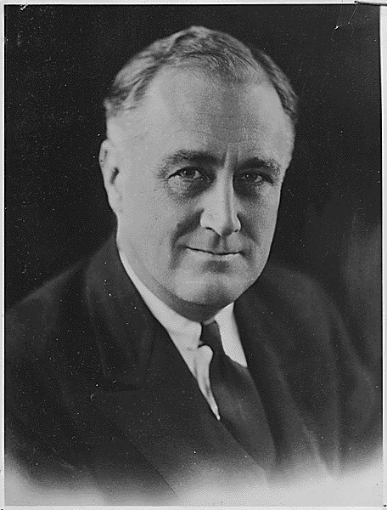
Amendment 22 (1951)
No President shall be elected for more than two terms, congruent or not
Background:
Imposed a two-term limit on presidential terms
Passed following the four-term presidency of Franklin Roosevelt to institutionalize the two-term tradition established by George Washington
FDR: President from 1933-1945

Slide 37
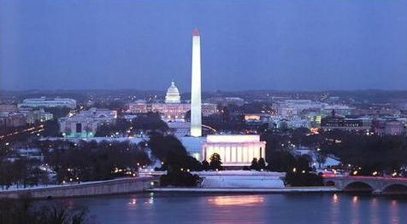
Amendment 23 (1961)
Electors appointed to District of Columbia
Background:
The Electoral College was originally based upon electors representing states
Population of the District of Columbia grew
it was decided that the residents there deserved to have the opportunity to vote for electors in presidential elections

Slide 38
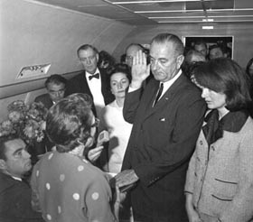
Amendment 25 (1967)
Succession of Presidency
Vice President fills office of President
If Vice President is vacated, New Vice President is appointed after approval of Senate
Background:
Presidential succession and disability were addressed
Lyndon B. Johnson (who had a history of heart problems) took office following the assassination of JFK
This left the office of vice president vacant
25th Amendment clarified that a successor to the presidency was designated as President of the United States and included provisions for filling the office of Vice President
It also outlined procedures to be used in case of presidential disability

Slide 39
Changing Historical Circumstances Amendments
Content Statement #13: Amendments 11, 21 and 27 have addressed unique historical circumstances.

Slide 40
Unique Circumstances
Three amendments to the United States Constitution have come about due to particularly unique circumstances
One amendment addresses judicial power
Another repeals a previous amendment
The most recent amendment took more than 200 years to be ratified.

Slide 41
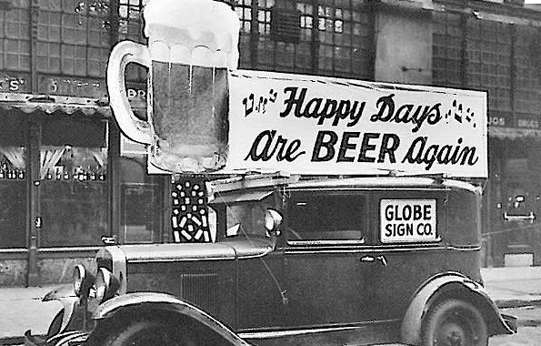
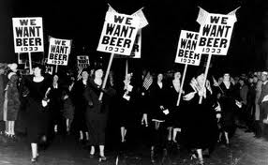
Amendment 21 (1933)
REPEALS 18th Amendment
14 years later
Background
Congress enacted the Volstead Act to implement the provisions of the 18th Amendment
Difficulties in enforcing the law led to widespread disregard for Prohibition and increased criminal activities during the 1920’s
A successful 1932 Democratic Party campaign against Prohibition led to the proposal and ratification of the 21st Amendment

Slide 42
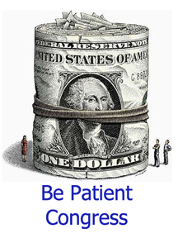
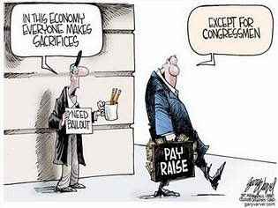
Amendment 27 (1992)
Congressional pay raises take effect after the next congressional election
Background:
Originally proposed in 1789 to limit conflicts of interest among members of Congress in determining their own compensation
Was not ratified with the 10 amendments known today as the Bill of Rights
Popular opposition to congressional pay raises in the 1980’s renewed interest in the amendment

