Slide 1
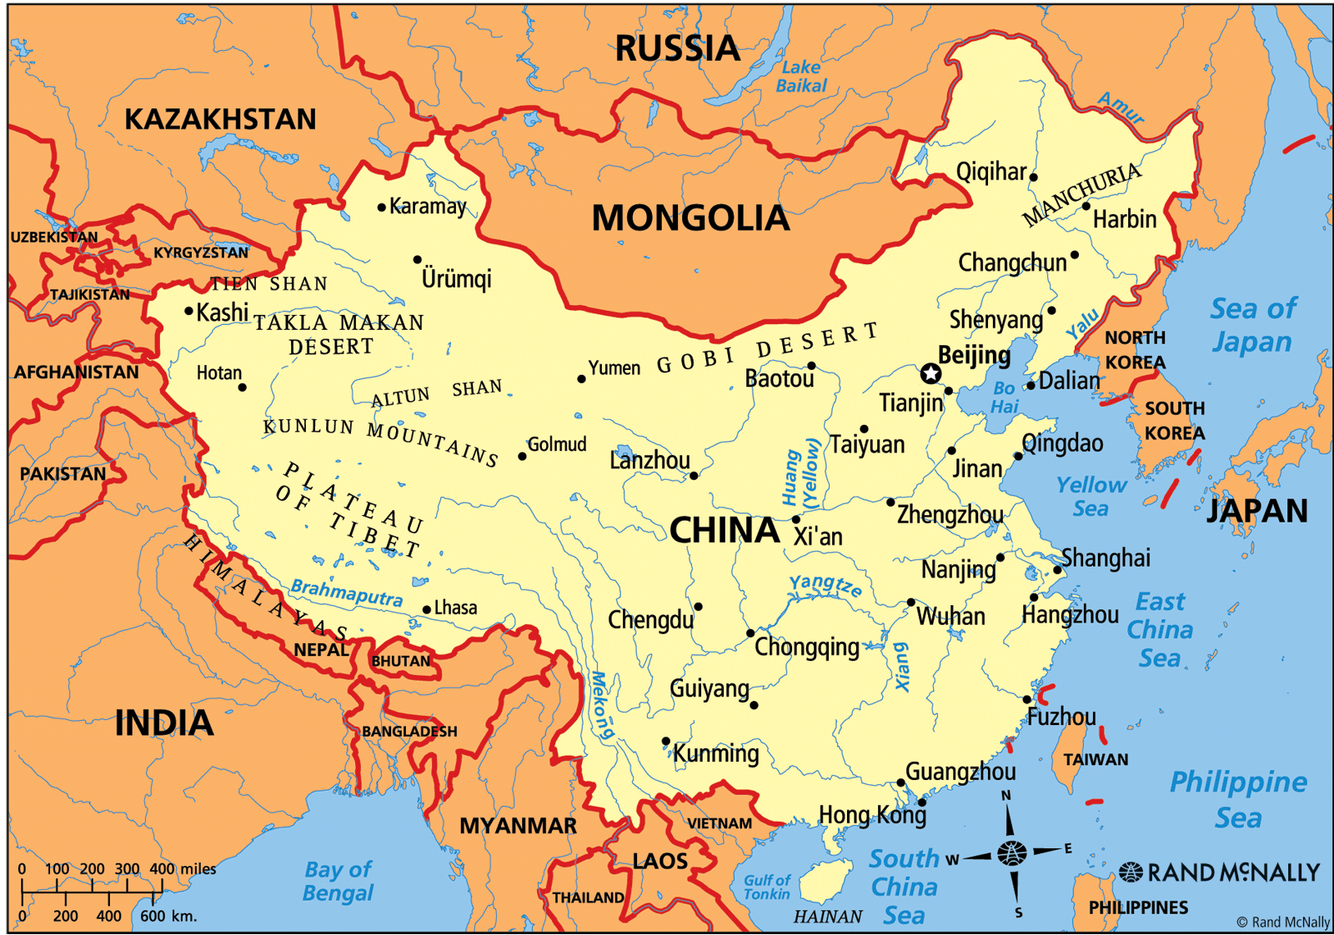
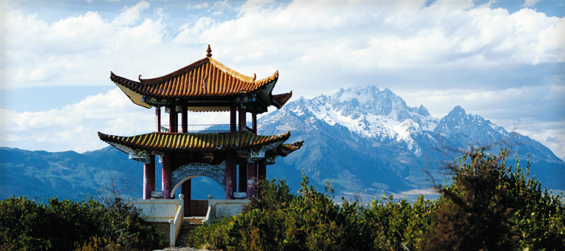
CHINA

Slide 2
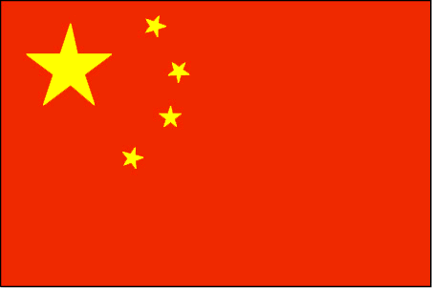
CHINA
Largest population in the world!!!
1.4 billion
55% live in rural areas, 45% live in urban areas
25% change in last 20 years (urbanization)
people moving to cities to look for jobs
China gets criticized for its strict treatment of its citizens
Notes:
La Ozi is the person who created Taoism… the ying yang.

Slide 3
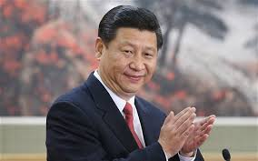
China’s Government
Type of Government: Communist ( 1 political party)
Only one political party led by a president. The party controls both political AND economic decisions
Type of Leader- President
elected by the Communist Party
Civic Participation and Rights are low because the communist party is so strong
Xi Jinping

Slide 4
Rights in China are LOW
What you CAN DO: | What you CANNOT DO:
Can now have up to 2 Children old law only allowed 1 per family and government punishments were: sterilization, taking of extra child, fines, prison ect. Freedom of clothing used to only be able to wear very conservative clothes | Internet is restricted by the Great Firewall Religion is restricted by the government. Approved places of worship are organized by official religious organizations Freedom of speech or press is very restricted Cannot have labor unions or human rights groups groups like this would help workers when it comes to working conditions or hours Judicial system is controlled by government

Slide 5
China’s Economy
Type of Economy: moving towards a Mixed Market Economy
Communist government has a large effect on the economy
Citizens are only allowed to own small businesses
citizens can own their own houses
government controls major industry, resources, production and distribution ( how wealth is divided up)

Slide 6
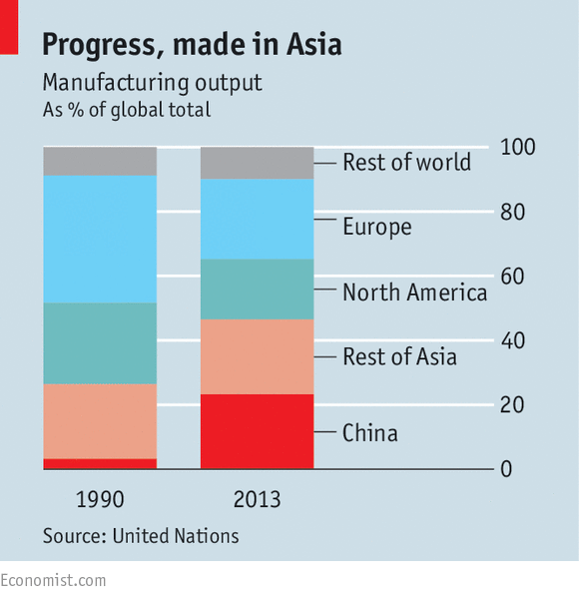
China’s Economy: Exports
In 2013 China reached 46.5% of Asia’s output… a.k.a - almost half of everything Asia sends out is from China!
China EXPORTS the most manufactured goods in the world
Why does China manufacture so much stuff?
Large population = many workers (yes...humans are resources)

Slide 7
China’s Economy: Exports
Without labor unions, there is little protection from
Long Hours
Low wages
Working Conditions
Government allowed other countries to set up businesses in China (outsourcing)
US and Europe took advantage of China’s low wages (think IPAD factory)
Pay people less, cost of making stuff is less, now you (the business owner) can charge more
World's largest producer of rice, wheat, cotton, tobacco, silk, coal, aluminum, and tea
China also has oil

Slide 8
IMPORTS
China top ten imports
electronics
machines
oil
slag (stones)
medical equipment
cars
chemicals
plastics
copper
aircraft.
China’s Top Trading Partners:
USA
Japan
Hong Kong
Vietnam
Singapore
Russia
India
United Kingdom

Slide 9
Economic Improvements
Raising wages for workers:
forces foreign investors to pay more
workers can afford to live in city and spend money
regulating supply
regulating prices (keeping them reasonable)
technology becoming a major business
President Xi Jinping is pushing for innovation. He wants China to start designing new products.
quality of education is improving

Slide 10
America has to have a good relationship with China
We depend on them for cheap labor and manufacturing
We work with China to handle things like climate change and North Korea
Hard because they are allies with nations that we are not
Iran and Syria are two examples

Slide 11
