Slide 1
Fluids
Holt Ch 8

Slide 2
Fluids and Buoyancy Forces
Holt Chapter 8 Section 1

Slide 3
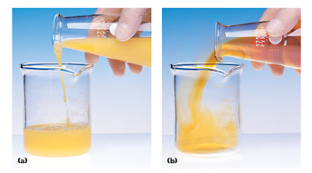
Definition of Fluids
There are three fundamental states of matter
  Solids, Liquids & Gasses
Matter whose particles can flow past one another and can take the shape of its container is a defined as a fluid:
  Liquids (a)
  Gasses (b)
Notes:
Use carbon dioxide gas to sequester a flame in a container to show gasses are fluids too.

Slide 4
Density
Density (mass density) is the mass per unit volume of a substance
  Density is represented by rho (ρ)
  The SI standard for mass density is kg/m³
  Another common unit for density is g/ml
Specific Gravity is a ratio compared to water used to express density without units
  Same scale as kg/L

Slide 5
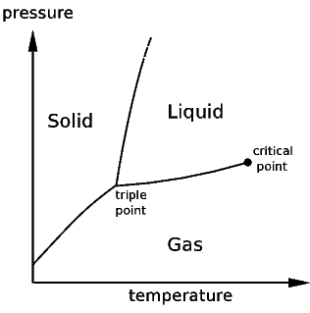
Other Properties
Viscosity is the internal resistance to flow
  Determines how the fluid will move
    (high=slow, low=fast)
Liquids have the lowest average kinetic energy of fluids, so their particles are closer together than those of gasses
  This means that (ideally) liquids cannot be compressed any further
At high enough temperature and pressure liquids and gasses become indistinguishable (supercritical)
  Furthermore, Jupiter’s center is so highly pressurized that hydrogen is compressed to a quazi-solid state
Fluids

Slide 6
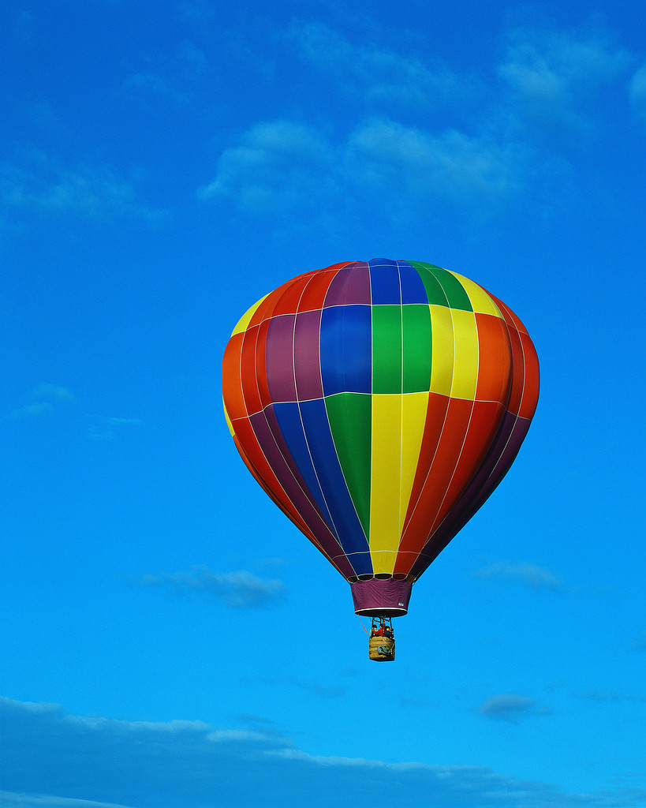
Archimedes’ Principle
Any object completely or partially submerged in a fluid experiences an upward buoyant force equal in magnitude to the weight of the fluid displaced by the object
Buoyant force of displaced air
Weight of the hot air balloon
The hot air balloon rises because of the large volume of air that it displaces

Slide 7
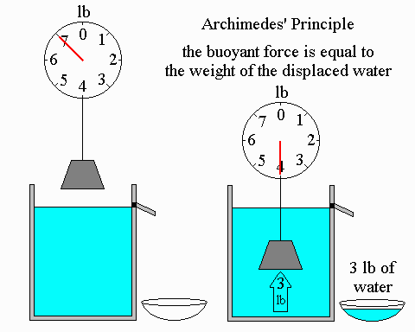
Apparent Weight
When objects are in a fluid their weight appears lower because of the buoyant force that pushes upward on the object
  This lower-than-standard measurable weight is called the “apparent weight” in the fluid
Notes:
Two Demos: Use a spring scale to submerge something that is near (but a little over) the density of water to see the apparent weight effect.

Slide 8
Organized thinking makes life better.
These problems deal with two objects and several properties of each object- that’s a lot to remember
There are two objects: the displaced water and whatever is submerged
  Make a column for each of the objects
  Make a row for each of the properties
  Look for relationships between boxes in the table
 | Object 1 | Object 2
Name
Mass
Volume
Density
Weight
Apparent Weight
Sunken Treasure
Displaced Water
Magic Box!
Why is it?
Why?

Slide 9
Apparent Weight
People train for moonwalks in spacesuits at the bottom of swimming pools. What is the apparent weight of a 100kg (when you include the suit) astronaut if they displace 81L of water?
The density of freshwater is 1kg/L.
186.2N

Slide 10
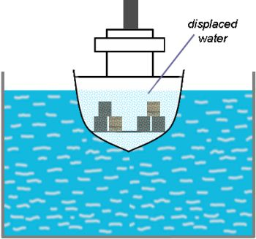
Floating Objects
If, and only if, an object is floating on the surface:
  The buoyant force exerted by the fluid that is displaced is equal in magnitude to the weight of the floating object
This is because when an object is floating, it is not moving up or down
  therefore the net force is zero and the buoyant force must equal the weight
Only if floating
Notes:
Float something, and talk about the equilibrium state that floating is. Things will bobble up and down until they are displacing just the right amount of water to balance the weight of the object.

Slide 11
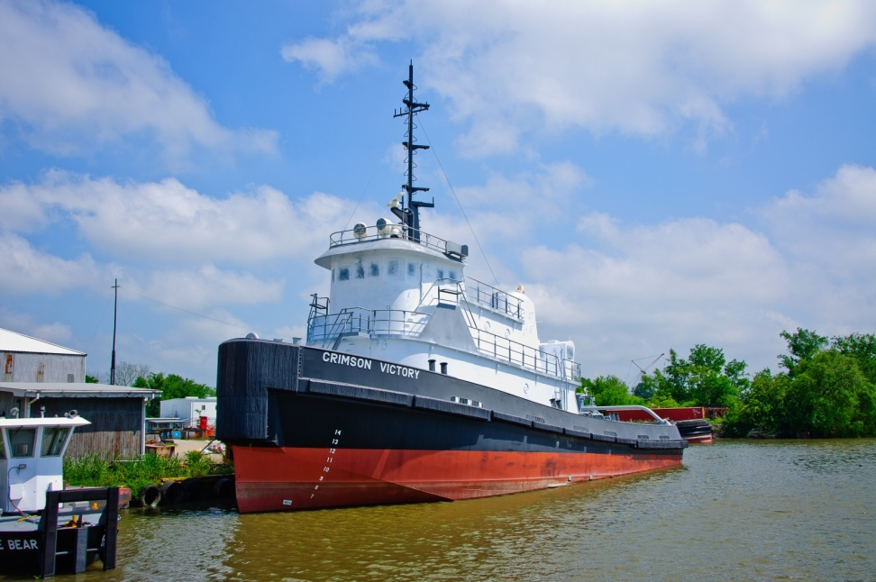
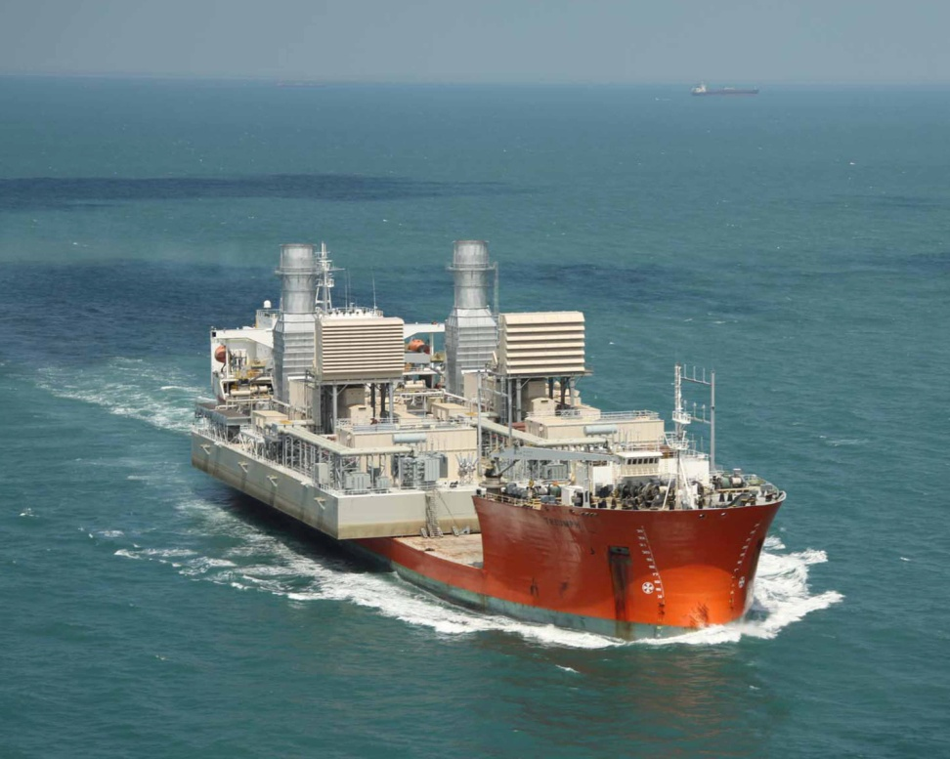
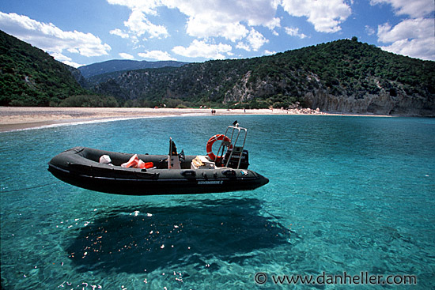
The Red line

Slide 12
Volume Displaced
A boat has a mass of 8450kg. What is the minimum volume of water it will need to displace in order to float on the surface of pure water without sinking?
This is something you will have to think about with your cardboard boats!
8450L

Slide 13
The Golden Crown
A king commissioned a golden crown made by his finest goldsmith, with gold he had just won in battle. The crown was beautiful, but soon after receiving it he heard the goldsmith had just purchased a new horse worth more than the commission. The suspicious king wanted to find out if the crown was made with his gold, or if the goldsmith made a fake crown and kept the gold for himself.
The king had no idea how to check if the crown was really made of gold, nor did any nobility in his court. Eventually, the court jester offered to help. He took the new crown and weighed it. He then weighed a bucket of water, and finally weighed the crown in the bucket of water. Once this was done the jester determined the crown was fake, and the goldsmith was put to death. How did the jester know it was fake?

Slide 14
The Golden Crown
The weight of the crown was 10.4N when out of the water. The bucket had a volume of 25L and a weight of 245N. The crown weighed 8.8N when in the water. If the density of gold is 19.3×10³ kg/m³, is the crown really made of gold?
Density is 6.5×10³ kg/m³ Not really gold
Notes:
This process can be used to very accurately measure body fat. A person is weighed, and then submerged, asked to exhale completely, and weighed underwater. By comparing the two weights the person’s density can be determined, and body fat predictably lowers a person’s density (fat floats). Therefore you can find body fat percentage to a very accurate level– although it is rather traumatizing to exhale completely underwater.

Slide 15
How large is the buoyant force?
A cannon built in 1868 in Russia could fire a cannonball with a mass of 4.80 × 10² kg and a radius of 0.250 m. When suspended from a scale and submerged in water, a cannonball of this type has an apparent weight of 4.07 × 10³ N. How large is the buoyant force acting on the cannonball? The density of fresh water is 1.00 × 10³ kg/m³

Slide 16
What is the minion’s mass?
La Belle, one of four ships that Robert La Salle used to establish a French colony late in the seventeenth century, sank off the coast of Texas. The ship’s well-preserved remains were discovered and excavated in the 1990s. Among those remains was a small bronze cannon, called a minion. Suppose the minion’s total volume is 4.14 × 10⁻² m³. What is the minion’s mass if its apparent weight in sea water is 3.115 × 10³ N? The density of sea water is 1.025 × 10³ kg/m³.

Slide 17
How deep does it float?
A 4500kg boat is coasting through brackish water, that has a density of 1015kg/m³. If it is a flat-bottom barge that has a bottom surface area of 85m², how low does the boat sit in the water?
Part A: What is the necessary buoyant force?
Part B: What volume of water is displaced?
Part C: To what depth must the boat be floating?

Slide 18
How large was the buoyant force?
The largest iceberg ever observed had an area of 3.10 × 10⁴ km², which is larger than the area of Belgium. If the top and bottom surfaces of the iceberg were flat and the thickness of the submerged part was 0.84 km, how large was the buoyant force acting on the iceberg? The density of sea water equals 1.025 × 10³ kg/m³

Slide 19
Fluid Pressure
Holt Chapter 8 section 2

Slide 20
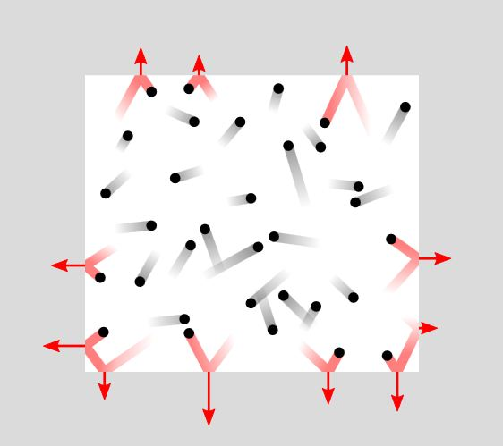
Pressure in Fluids
Pressure occurs within fluids due to the constant motion of their molecules.
As temperature increases, the average kinetic energy of the molecules increases, thus increasing the pressure inside a fluid.

Slide 21
Pressure
Pressure is a measure of how much force is applied over a given area
Pressure can be described in many units
  Pascals (Pa)- S.I. Standard
    1N/m² = 1 Pa (this is a very small unit for pressure)
    At sea level air pressure is usually 1.01×10⁵ Pa
  Atmospheres (Atm) – standardized for earth
  Millimeters Mercury (mmHg) – for easy standards
    760mmHg = 1Atm = 1.01×10⁵ Pa
Notes:
Pressure gauges

Slide 22
Common Pressure Units
Standard atmospheric pressure is:
  14.7 psi (pounds per square inch)
  1.01 x 10⁵ Pa (Pascal) = N/m²
  760 mmHg (millimeters mercury)
  1 atm (atmosphere)

Slide 23
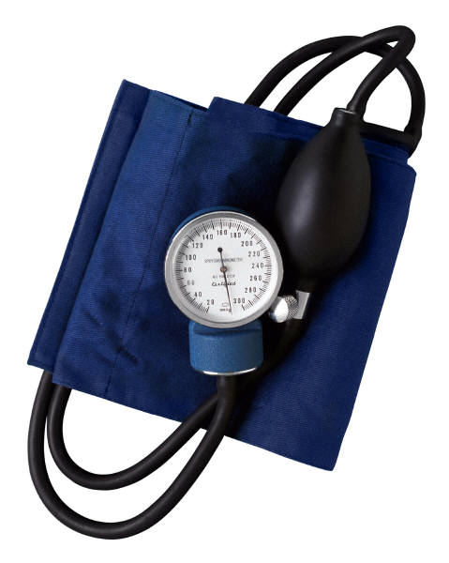
Three ways to Describe Pressure
Absolute pressure is zero-referenced against a perfect vacuum, so it is equal to gauge pressure plus atmospheric pressure.
Gauge pressure is zero-referenced against ambient air pressure, so it is equal to absolute pressure minus atmospheric pressure.
  Negative signs are usually omitted (if the pressure being measured is less than atmospheric pressure). To distinguish a negative pressure, the value may be appended with the word "vacuum" or the gauge may be labeled a "vacuum gauge."
Differential pressure is the difference in pressure between two points.

Slide 24
Compressibility of Fluids
Compressibility of fluids varies for liquids in gases.
  For gases, it is possible to compress fluids.
  Liquids, however, are not compressible.

Slide 25
Pressure of Fluids
Because force is inversely proportional to area, one can vary the cross-sectional area to provide more force.
Eg. Hydraulic brakes, car jacks, clogging of arteries

Slide 26
Bed of Nails

Slide 27
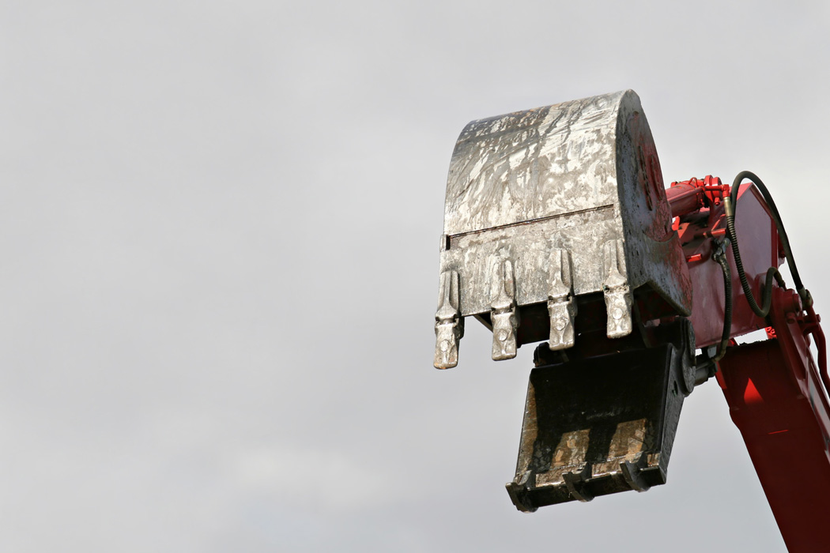
Pascal’s Principle
Pressure applied to a fluid in a closed container is transmitted equally to every point of the fluid and to the walls of the container
  This principle is the foundation for hydraulics and pneumatics
Notes:
Hydraulic examples

Slide 28
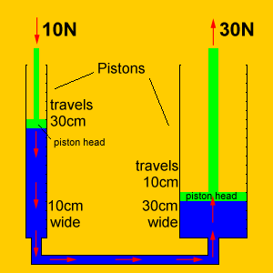
Practical Hydraulics
Hydraulics can be used to amplify a force or multiply a distance.
  In this way they operate much like a lever and the mechanical advantage can be calculated in a similar way
  The total work done on either end of the hydraulics system is the same, as with any simple machine
Notes:
The top equation comes from Pascal's principle, and subbing in the definition for pressure.
The bottom equation comes from the fact that equal amounts of work are done on both ends of the hydraulics system. (W₁=W₂ and W=Fd)

Slide 29
Ex. 2
A car weighing 12000 N sits on a hydraulic press piston with an area of 0.90 m². Compressed air exerts a force on a second piston, which has an area of 0.20m². How large must this force be to support the car?

Slide 30
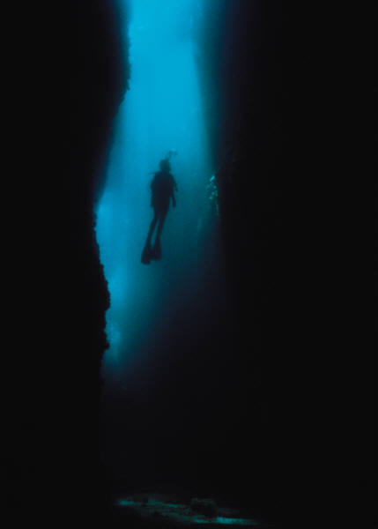
Pressure with Depth
Pressure increases as you move down in a fluid (like in the ocean or atmosphere)
  Why your ears pop when you dive underwater, fly in an airplane, or drive up a mountain
    P_{o} is the surface pressure
Notes:
Demonstration: Newspaper to break a shim- used to show that we live at the bottom of an ocean of air

Slide 31
Ex. 3
Calculate the absolute pressure at an ocean depth of 1,000m. Assume that the density of water is 1,025 kg/m³ and that
P_{o}= 1.01 x 10⁵Pa.
What is the gauge pressure as well?

Slide 32
Fluids in Motion
Holt Chapter 8 Section 3

Slide 33
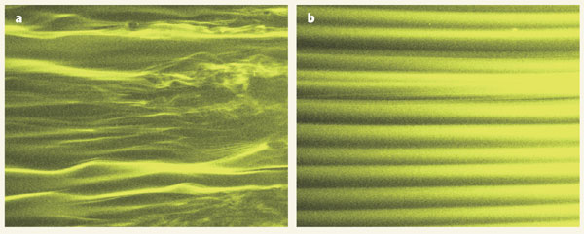
Flowing Fluids
There are two types of flow within fluids
  Turbulent flow: erratic, broken cycles
  Laminar flow: straight and even

Slide 34
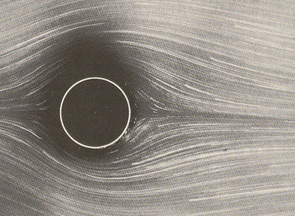
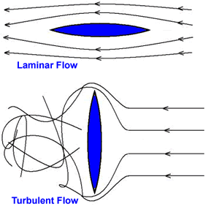
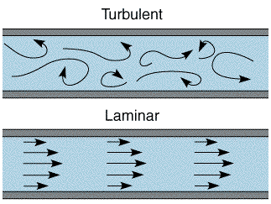
Flowing Fluids
More examples of laminar and turbulent flow

Slide 35
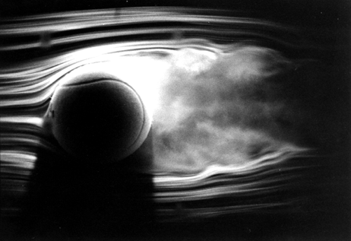
Fluid Flow
Sometimes it just looks neat-o, and can be used for (semi)practical things…

Slide 36
The ‘Ideal’ Fluid
The ideal fluid is a conceptual model of a fluid, that is both easy to think about and useful to predict the behavior of real fluids that behave similarly
  Ideal fluids are incompressible (constant ρ)
  Ideal fluids have a steady flow (non-turbulent)
  Ideal fluids are considered non-viscous
    Viscous fluids loose some kinetic energy to internal friction and heat

Slide 37
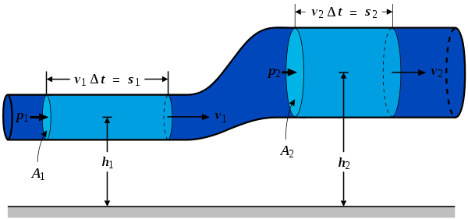
Continuity Equation
The conservation of mass leads to a way to describe the speed of a fluid in different sized channels
  Start with constant mass
  Then substitute for density
  Break down volume into parts
  Substitute volume width for velocity & time
  Cancel all equivalent values
x₂
x₁
Cross-sectional Area × Velocity = Cross-sectional Area × Velocity

Slide 38
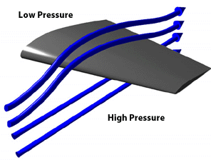
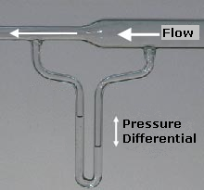
Bernoulli’s Principle
The pressure of a fluid decreases as the fluid’s velocity increases
  Helps planes fly
  Perfume spray
  Floats ping-pong balls
  Tears shingles off houses
  Laboratory sink vacuums
  Passing cars shake toward each other on 2-lane roads
Notes:
Ping-pong ball and hair dryer
Ball on a string, held over to the side by a stream of water

Slide 39
Bernoulli’s Principle
This equation of many terms can show the relationship between several ideas
  Comparative values on opposite sides
  Cancel out terms to find other equations
Pressure
Kinetic Energy
Potential Energy

