Slide 1
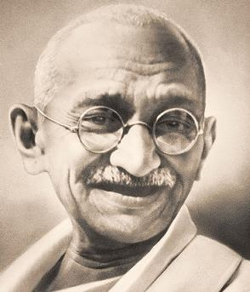
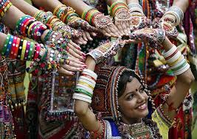
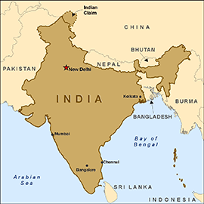
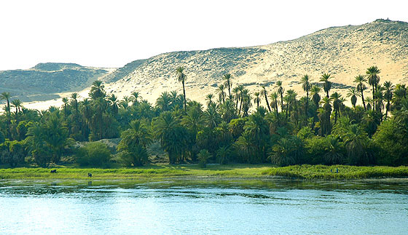
India

Slide 2
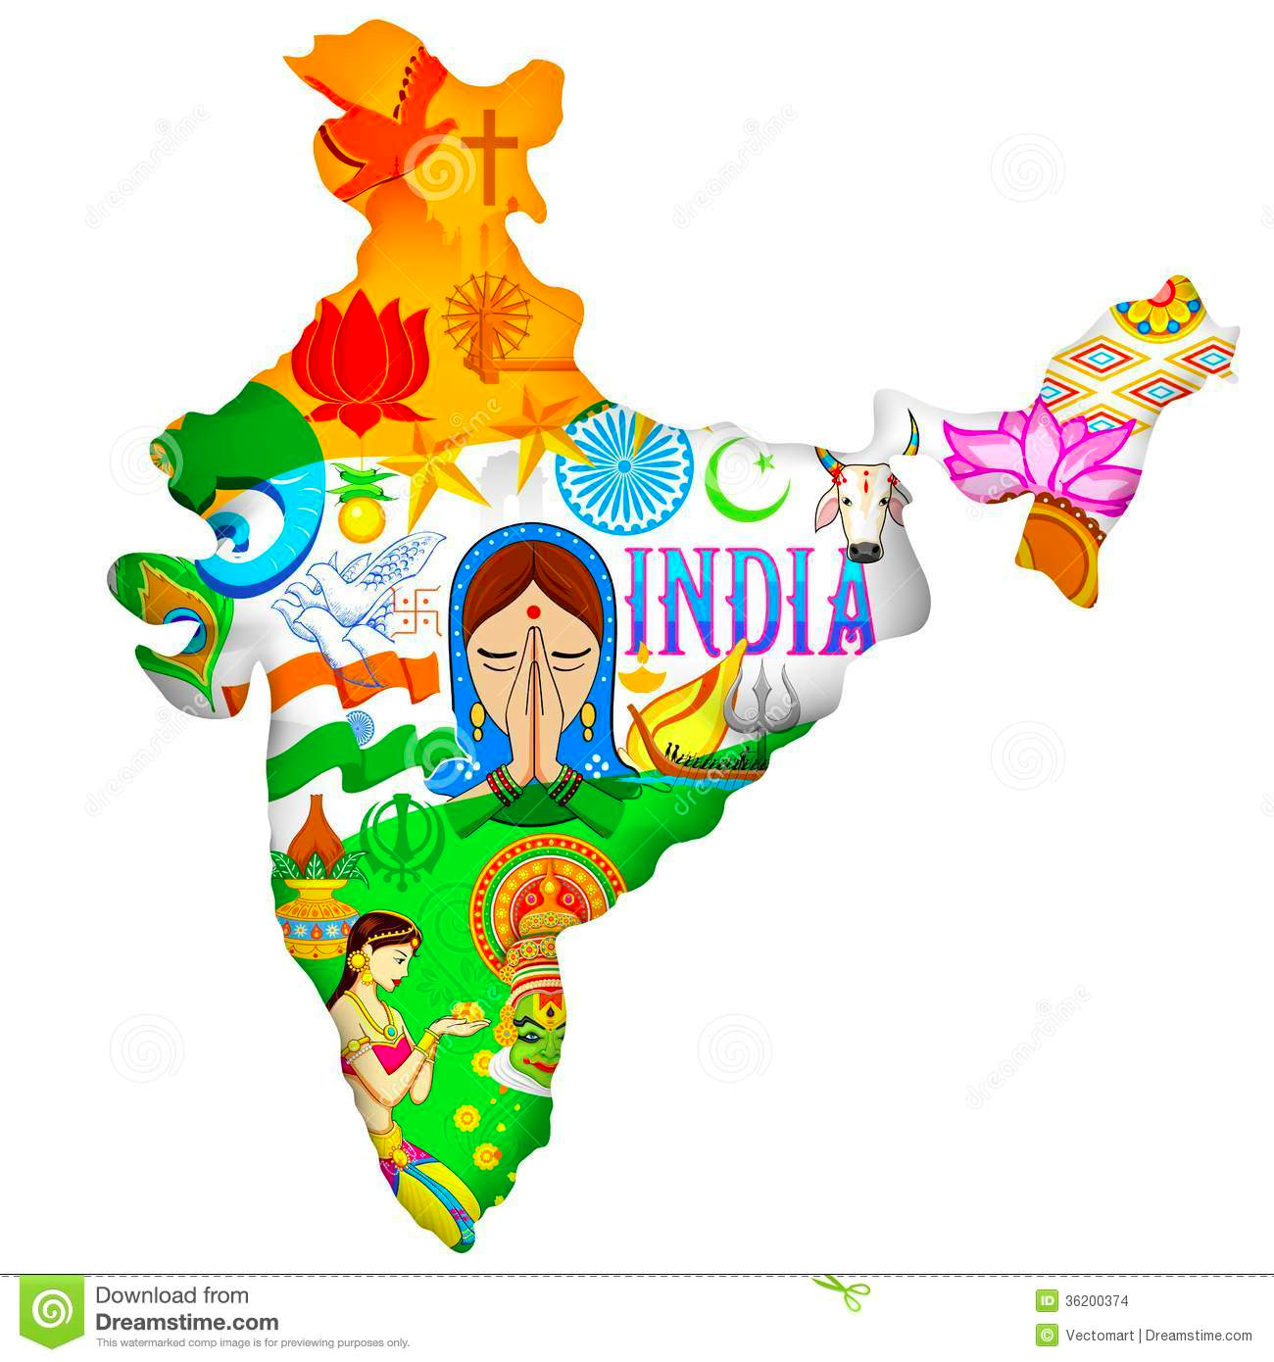
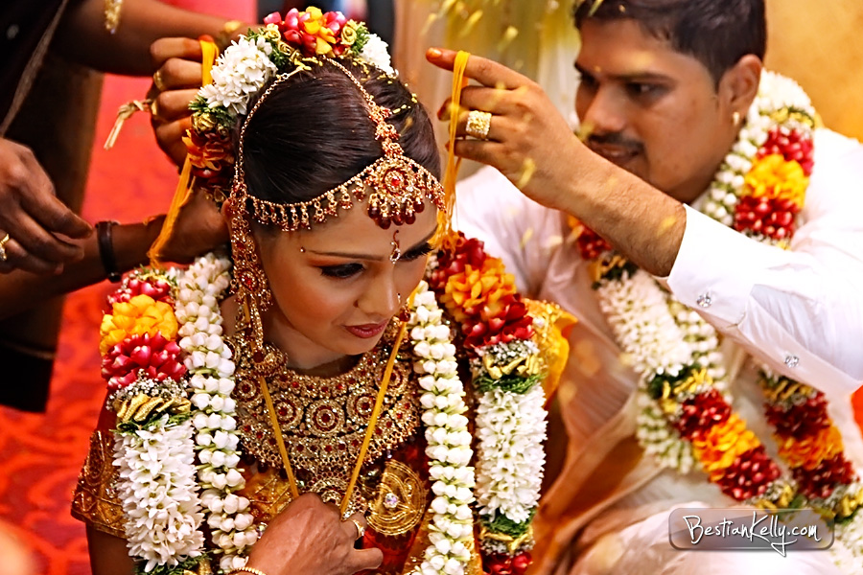
India: Colorful, Beautiful, Busy
A Subcontinent
in South Asia.
Namaste =
Hello in Hindi

Slide 3
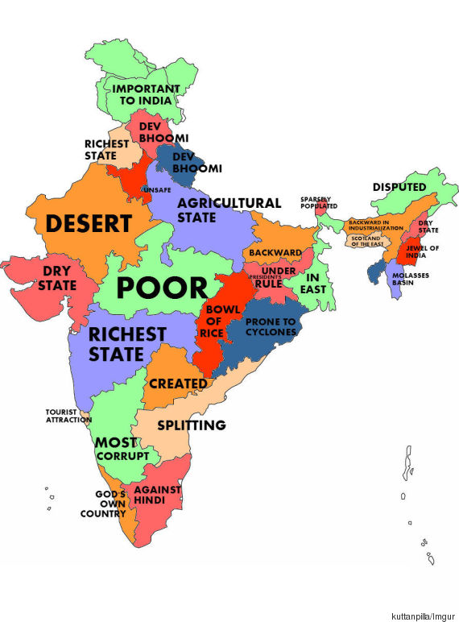
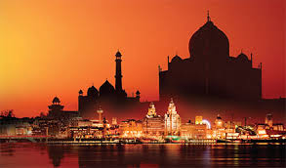

Slide 4
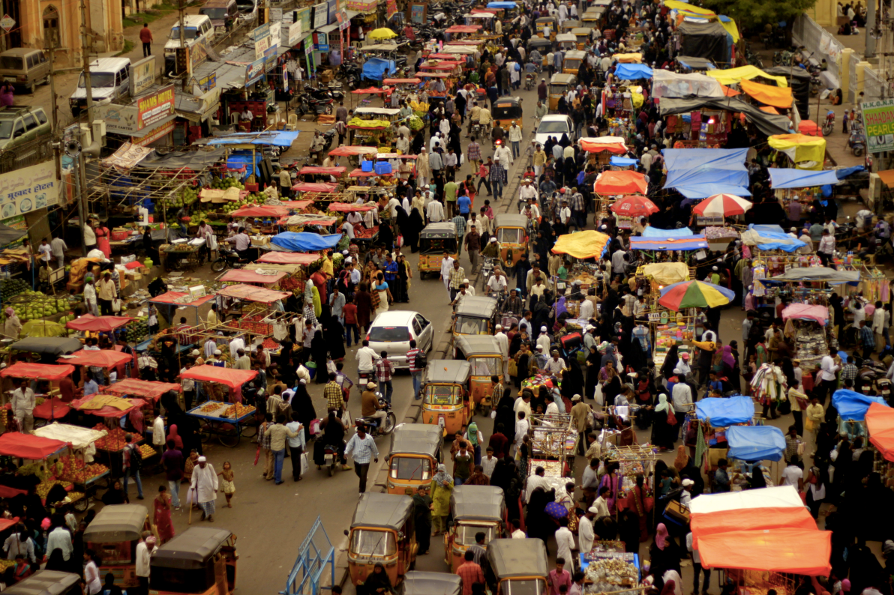
Busy and Diverse
2nd most populated nation in the world;
Over 1 billion people
Over 1,000 languages
18 major languages –
HINDI = most popular
Many religions
Hindu
Buddhism
Islam
Christianity
2 families of languages:
Indo-Aryan and Dravidian
mixed through trade & movement.
Rickshaws and cars crowd streets

Slide 5
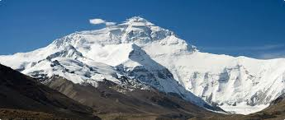
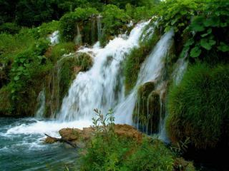
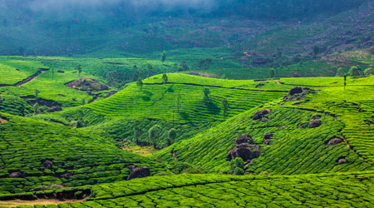
Diversity: Land of Extremes
Very rich and very poor
Very crowded & rural
Snowy mountains
Lush valleys
Arid deserts

Slide 6
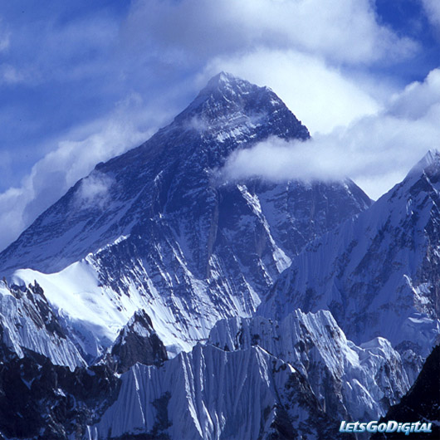
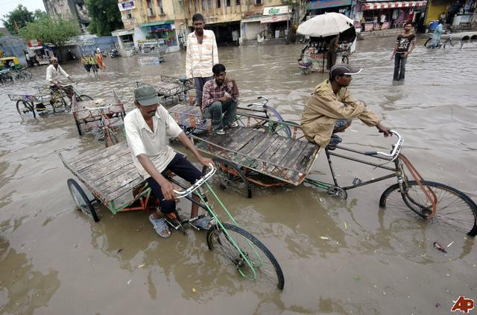
GEOGRAPHY:
Karakoram and Himalaya Mountains in North = largest in the world
Mountains block cold north winds
The Ganges and Indus Rivers flow from Himalayas = water and fertile land
Climate: HOT all year with monsoons from June-September
Monsoons = warm winds that
bring moist air from Indian Ocean
causes tons of rain
Up to 100 inches!

Slide 7
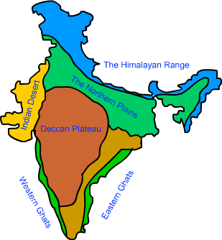
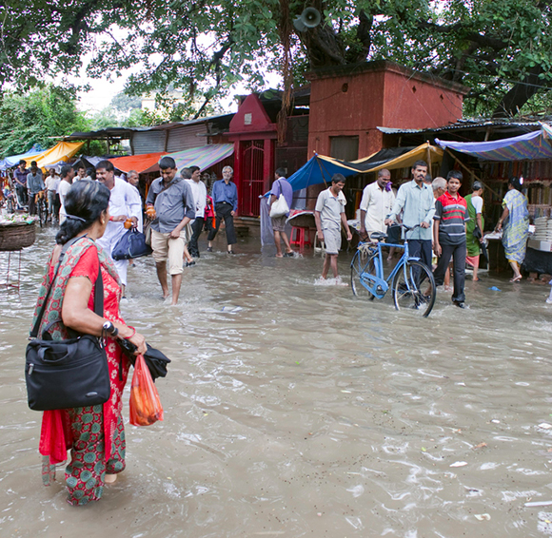
Climate
World’s tallest mountains Himalayas
Rainy season/Monsoons
Dry season/desert

Slide 8
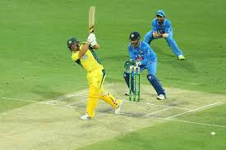
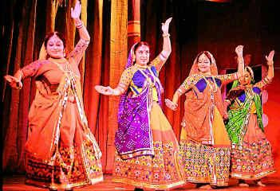
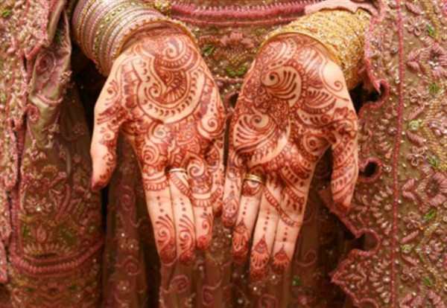
Indian Culture
Cricket and Soccer = major sports
Henna to decorate hands for religious ceremony
Did you know that chess was invented in India?

Slide 9
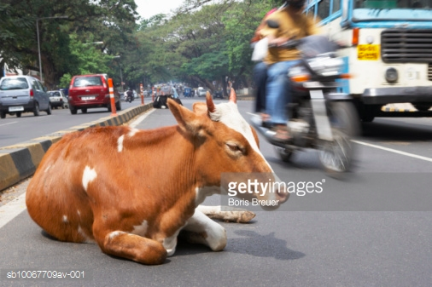
“holy” cows!
Amazing Wildlife: Bengal Tiger

Slide 10
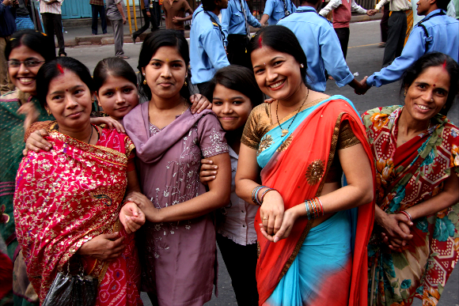
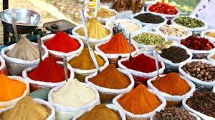
Indian Culture
Women wear Saris
Food contains many spices
(cumin, coriander, curry, chili)

Slide 11
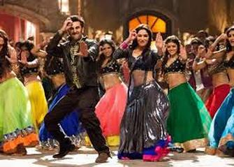
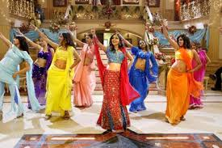
Bollywood 4 x’s more movies than Hollywood per year.

Slide 12
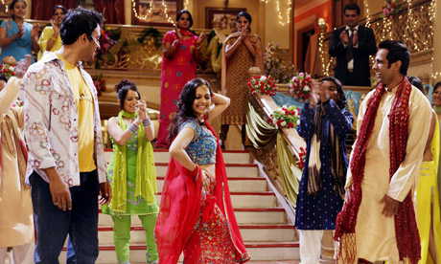
INDIA: Culture
The movie industry in India makes more movies than Hollywood and so its called Bollywood
70% of people work in farming villages = low standard of living = high level of poverty (they need help getting schools, roads, water & education)
Most popular holiday = Diwali - means “Festival of Lights” celebrates the coming of winter and victory of good over evil.
Literature: epic poem called The Mahabharata
Food: little to no meat for religious purposes, many spices
Family: often several related families live together
parents choose grooms for brides and pay dowry

Slide 13
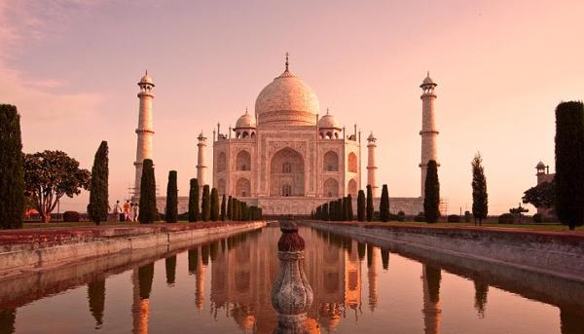
Taj Mahal

Slide 14
Colonization in India
BEFORE COLONIZATION
DURING COLONIZATION
Before the 1700s, India was a bunch of different kingdoms under the control of an Emperor
Last dynasty the Mughals, they were Muslim
Even though last Emperor was Muslim and the majority of Indians were Hindu, not a lot of religion issues
Indians were allowed to keep their religion
Paid empire in taxes
Great Britain takes over India and makes it a colony (brain pop on British colonization)
Needed India for its resources like gems and cotton, ESPECIALLY since they just lost the USA as a colony
Treats the native Indian people like second class citizens
Limited rights
Muslims treated slightly lower than Hindus
Little to no representation in government
Over taxed
Make English the official language
Controls natural resources of India

Slide 15
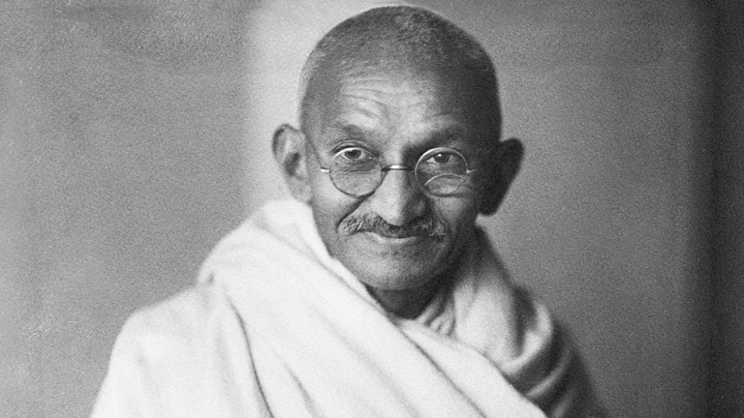
How did India get it’s freedom?
Non violent action under leadership of Gandhi
Brain pop on Gandhi
What is non violent action? Watch the clips below and respond to the questions on your worksheet:
The Salt March
The Amritsar Massacre
The Salt Work Factory

Slide 16
Discussion
Gandhi and his followers opposed the law without being violent.
How did he do this?
Could you have done it?
Think about a leader or a movement in America that may have been influenced by Gandhi and his non violent action.

Slide 17
IMMEDIATELY AFTER INDEPENDENCE,
1947 India gains independence.
India did gain some modern technology from British; railroads, telegraph and steam ship.
Many Muslims leave India to start Pakistan
They felt discriminated in government which was 80% Hindu.

Slide 18
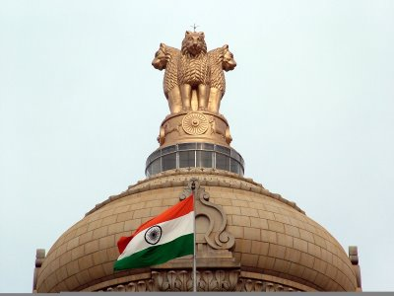
INDIA’s Government
VERY MUCH LIKE AMERICA!
Representative Democracy
(people vote for leaders and representation in Parliament)
Parliament (like Congress) = representatives who make laws.
1- Council of the States (like Senate)
2- House of People (like House of Representatives)
The Prime Minister = elected leader of India (like president)
Rights = Many = HIGH
All castes can vote
Freedom of speech like US
Civic Participation = HIGH

Slide 19
The Hindu Caste system
What its like today (click)

Slide 20
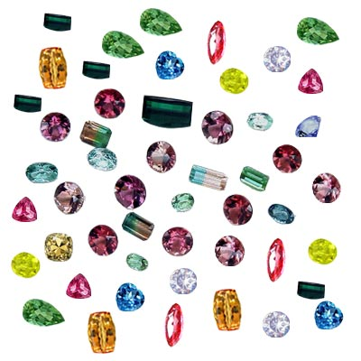
INDIA’S ECONOMY
move from Traditional to Market economy (Capitalism)
Imports: Oil
Exports: gems/ jewelry
Problems: Deforestation and river pollution
Types of Industry:
Primary- Bauxite, coal and iron
Secondary- making cotton cloth and jute rope, farming rice and wheat
Service- computer companies. Many US companies outsource computer or telecommunications to India
Cottage Industry: whole families make their own goods.
Companies: Jewelry, Henna, Silk clothing, Spices, Technology

