Slide 1
Symbolism
“Why do writers use symbolism?” Okay, so let’s say you have a headache and you wanna tell someone about it and you say, “I have a headache!” and other people are like, “Yeah, whatever. Everybody gets headaches.” But your headache is not a regular headache, it’s a serious headache, so you say, “My brain is on fire!” to try to help these people understand that this is a headache that needs attention! That’s a metaphor, right? And you use it so that you can be understood. Now let’s say you want to take those same imagistic principles but apply them to a much more complex idea than having a headache, like, for instance, the yearning that one feels for one’s dreams. And you can see the dream but you can’t cross the bay to get to the green light that embodies your dream. And you want to talk about how socio-economic class in America is a barrier – a bay-like barrier, some would say – that stands between you and the green light and makes that gap unbridgeable. Now, you can just talk about that stuff directly, but when you talk about it symbolically, it becomes more powerful, because instead of being abstract it becomes kind of observable…. So I think that’s why.” [The Great Gatsby]
------John Green

Slide 2
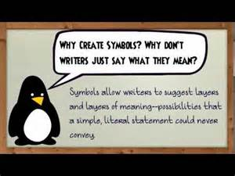
SYMBOLISM occurs when…
SOMETHING CONCRETE REPRESENTS SOMETHING ABSTRACT.
When trying to analyze a symbol, consider the symbol’s
physical characteristics.
the role the symbol plays in society.
how the symbol fits into the plot of the novel.
If a symbol is used over and over…..it becomes a theme

Slide 3
Symbolism………
Authors often use symbolism to bring an idea or theme to the forefront. In this lesson, we'll discuss three major symbols in John Steinbeck's ''Of Mice and Men''.
What is Symbolism?
In a literary context, symbolism is the use of a person, place, or thing to represent a larger, more abstract concept. Authors use symbols to engage readers, but also to address an important theme or topic. Symbols are sometimes used to discuss concepts that are large and complex, like war, for example, in order to make the topic more manageable and concrete.
Let's examine three major symbols from John Steinbeck's classic Of Mice and Men: Candy's dog, mice, and the dream farm.

Slide 4
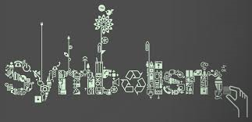
How does an object become a symbol? Good Question---Perhaps this short video can help…..☺
https://www.youtube.com/watch?v=YJgqkOG_TEg

Slide 5
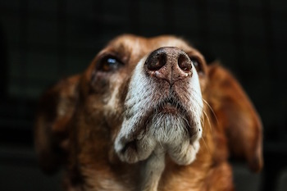
Candy’s Dog
Candy's dog symbolizes the fate of those who outlive their usefulness, like those who are seen as weak in the eyes of the world. Although Candy has protective and loving feelings toward his dog, because he's raised it from a puppy, this argument falls on deaf ears on the ranch. You can totally sympathize with Candy, right? (Reading Builds Empathy)You know what it's like to love a pet - that dog or cat or lizard or horse is your family member, your friend.
But, again, these feelings don't matter to anyone on the ranch but Candy. True, the dog used to be an excellent sheepdog, but the poor thing is crippled by age now and can't perform any useful duties. And though Candy pleads (what does this verb choice infer about the character of Candy?) for his pal's life, Carlson won't listen. (what does this sentence infer about the character of Carlson?) Sure, Carlson will kill the dog humanely and quickly so it feels no pain. But he still kills the dog.
The symbolism here is clear: Carlson's insistence that the dog must die because it no longer has any value other than sentimental illustrates a law of the farm, and of the book, that any creature that is more trouble than it's worth, whether through mental or physical weakness, cannot be allowed to survive. Candy fears this foreshadows the day when he, too, will be deemed useless; it also foreshadows Lennie's death at the hands of George later in the novel. Lennie, much like Candy's dog, is too weak (not physically, but mentally) to live in this world. Ranch life is cruel.
http://study.com/academy/lesson/symbols-symbolism-in-of-mice-and-men.html

Slide 6
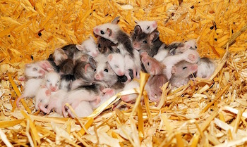
Mice
Mice are a symbol of false hope, mostly for Lennie. They're bound to be important (they're in the title, after all), and there are several mice images throughout the novel that support their importance.
The first is of a dead mouse that Lennie keeps in his pocket to pet. It's a comfort thing - Lennie likes to pet soft things, and is always hopeful that he'll get to keep them. But that hope is always dashed by Lennie's unfortunate talent for killing what he loves, like mice, his puppy, or Curly's wife.
Mice, like men, are also victims of cruel fate and destiny. Lennie may be hopeful for his future life - hopeful that he'll have more warm, cuddly creatures to love and pet - but Lennie, like these mice, like all men, is subject to the whims of destiny. (What term called?) Lennie becomes more like a mouse in this way than ever: all he hopes for is something warm and happy, but in the end he's victim to his own vulnerability, exactly like a mouse.
http://study.com/academy/lesson/symbols-symbolism-in-of-mice-and-men.html

Slide 7
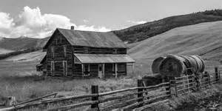
George and Lennie’s Farm (use the worksheet provided and fill out your answers independently)
What is a farm? (concrete)
What does the farm symbolize? (abstract)
How does the farm move from a concrete
farm to an abstract idea?
What role does the symbol play in society?
Especially during the great depression?
How does the symbol fit into the plot of the novel?
Is this symbol used over and over again?
If so, it turns into a motif/theme

Slide 8
George and Lennie’s Farm
What is a farm: A farm is a area that raises fool and animals for others. It is a profession that takes hard work, long hours, and tenacity. A farm is also on a large piece of land. It provides space and peace. The farm is an American icon. This is the backbone of our heartland.
What does the farm symbolize? How does it move from a concrete farm to an abstract idea? The farm symbolizes a life that is free, independent, idyllic life. A life where a man can make his own decisions, make his own money, have a purpose in life---a roof over his head.
What role does the symbol play in society? Especially during the great depression? This symbol reiterates that the men want a piece of the American Dream---a simple home and land of their own. A place to enjoy liberation and freedom. These are important ideas in the American fabric. Freedom is right in this country and the farm provides the evidence that it exists for the men. In addition, liberty---the right to pursue happiness---is something all men seek. This overshadows money and materialism. Instead the farm would give them these things. In addition, the farm would provide them companionship and value. ______________________________________________
How does the symbol fit into the plot of the novel?_________________
Is this symbol used over and over again? ____________________
If so, it turns into a motif/theme

Slide 9
Symbolism is a necessity in Literature
Why is symbolism important?
It gives nuance to a story. If you were to write a screenplay, it would not be very fun for either you or your audience if you had to flatly explain the significance of every single thing. Let’s look at some movies like the Star Wars franchise. It is not necessary for the characters onscreen to continually point who the good guys and bad guys are. There is plenty of symbolism around for the audience to pick up on. The Jedi are dressed in light colors, while the menacing Darth Vader looms large in all black. It is a thematic representation of light vs. darkness, only nobody is required to say it in order for audiences to understand it.
Symbolism also reinforces the ideas you want your audience to remember in your story. In the Harry Potter series, the main character was given a scar on his forehead when an evil wizard harmed him as a baby. As a young adult, whenever Harry’s scar begins to hurt, the audience understands that to mean that the villain must be nearby. The evil wizard’s ability to harm the main character without even being physically present is an action which symbolizes how dangerous he is.
https://blog.udemy.com/symbolism-in-literature/

Slide 10
Stretching the 9th grade brain…..look for nuanced symbols...
What Are Some Examples of More Subtle Symbolism in Literature?
Sometimes, symbols are far more subtle, and not as immediately obvious. These examples of symbolism are just as important to the plot of the story, but require a little more thought before they are identified.
In Harper Lee’s novel “To Kill a Mockingbird”, there is a scene where the character Atticus Finch is called upon to put down a rabid dog. The Sheriff of the town does not step in to do this, even though it is his job. This leaves Atticus, a lawyer, to stare down an angry animal himself. This scene is actually symbolic of the racial tension in the story. Atticus is also responsible for defending the innocence of a black man against a tide of angry townspeople. The two are similarly dangerous situations for Atticus, and in both cases, he alone is tasked with doing the right thing.
Another more subtle symbol is the Overlook Hotel in Stephen King’s “The Shining”. While there are frightening things happening all around in that novel, the aspect tying them all together is the setting itself. It represents isolation, and becomes a physical manifestation of everything happening inside the mind of the now-crazed caretaker.
Understanding literature does not have to be intimidating. It just takes some basic familiarity, and some good guidance to get you started. Check out some of these courses at Udemy, for more help interpreting the classics:

Slide 11
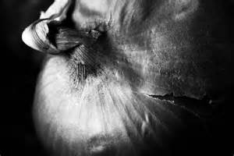
What did you learn?
What is symbolism?
Why is it important in literature?
What is an example of a symbol in The Seventh Most important Thing? Explain how the concrete symbol becomes a bigger idea.
What was a nuanced symbol in Of Mice an Men? Can you stretch to the 4-level?

