Slide 1
Digital Art 1
A Review of the Elements of Art

Slide 2
The 7 Elements of Art:
Line
Shape
Space
Form
Color
Value
Texture

Slide 3
LINE
A one-dimensional , identifiable path created by a point moving in space
Can vary in width (thick or thin), direction(horizontal, vertical or diagonal), and length (long or short)
Lines often define the edges of a form.
5 Main Types of Line are: horizontal, vertical, diagonal, curved and zigzag.

Slide 4
Lines lead your eye around the composition and can communicate information through their character and direction.

Slide 5
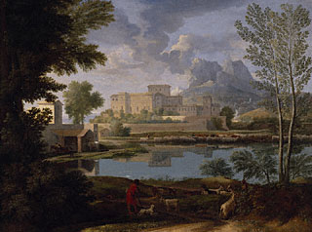
Horizontal Lines suggest a feeling of rest or
repose because objects parallel to the earth are
at rest.
They also imply
continuation
of the landscape
beyond the picture
plane to the left
and right.
Landscape with a Calm , Poussin

Slide 6
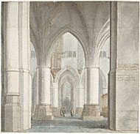
Vertical Lines often communicate a sense of
height because they are perpendicular to the earth,
extending upwards
toward the sky.
In this church interior,
vertical lines suggest
spirituality, rising
beyond human reach
toward the heavens.
Saint Bavo Pieter Jansz

Slide 7
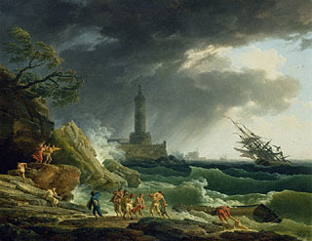
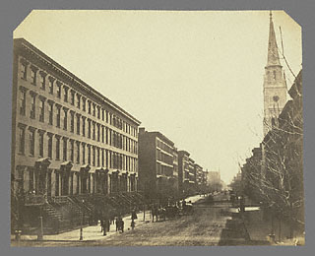
Diagonal Lines convey a feeling of movement.
Objects in a diagonal position are
unstable. Because they are neither
vertical nor horizontal,
they are either about to fall
or are already in motion.
Storm on the Mediterranean Coast Vernet
In a two-dimensional composition, diagonal lines can also indicate depth through perspective. These diagonal lines pull the viewer visually into the image.
Fifth Avenue looking South from
Thirtieth Street.

Slide 8
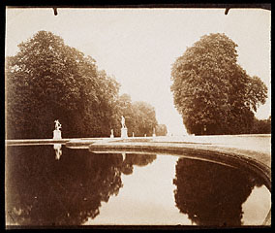
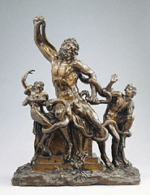
The curve of a line can convey energy.
Soft, shallow curves often have a pleasing, sensual quality and a softening effect on the composition. The edge of the pool in this photograph gently leads the eye to the sculptures on the horizon.
Pool,
Saint Cloud, 1915
Sharply curved or twisted lines can convey turmoil, chaos, and even violence.
Laocoon, Foggini

Slide 9
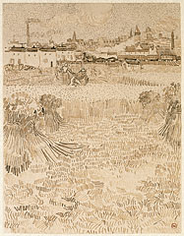
When repeated, lines can
create a pattern
In this example, the artist
repeated different kinds
of lines across the
composition to create
various patterns.
Patterned lines
also give the image rhythm.
Arles, View from the Wheatfields, Van Gogh

Slide 10
SHAPE
When lines meet, shapes are formed.
Shapes are flat.
Some shapes are geometric, such as squares, circles, triangles, rectangles, and ovals.
Other shapes are organic or freeform.

Slide 11
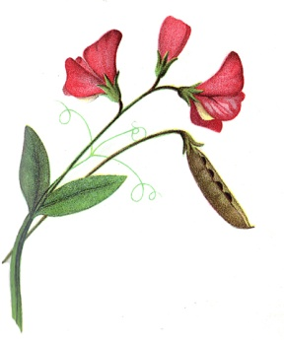
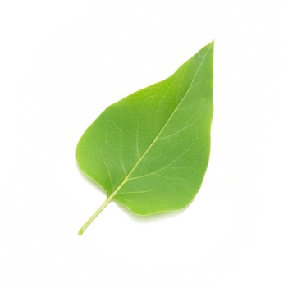
Two basic types of shapes:
1.) Geometric: regular and irregular
2.) Freeform: usually living objects
Shapes can be positive or negative.

Slide 12
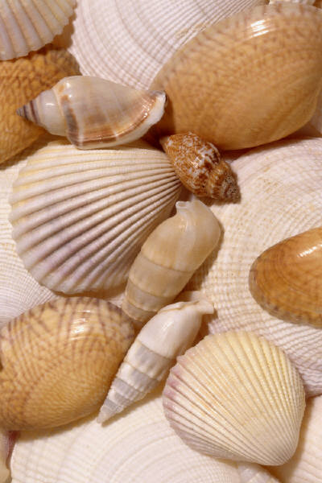
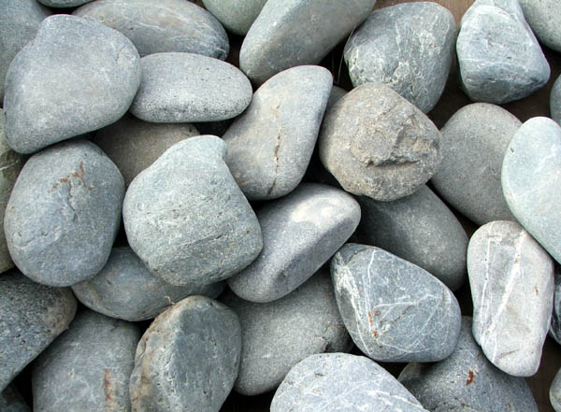
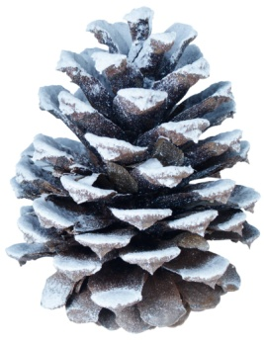
FORM
Shapes are flat, Forms are 3-D.
Forms can be:
Geometric
Free-form

Slide 13
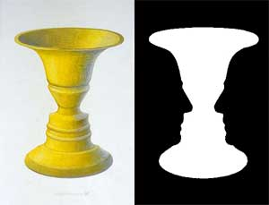
SPACE
The area between, around, above below or within objects.
Positive space is the area of an artwork where
the main figure is located.
Negative space is the
empty spaces between
the shapes and forms.

Slide 14
Artists can create an illusion of space on a picture plane by using various techniques;
Overlapping-
Size-
Placement
Color

Slide 15
COLOR
PRIMARY COLORS- Red, Yellow, & Blue. These colors cannot be mixed, the only way to produce them is to buy them in their true form.

Slide 16
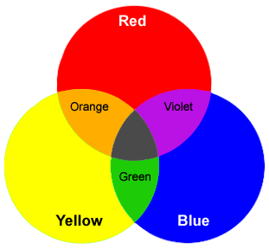
SECONDARY COLORS- Orange, Green, & Violet. These colors are made by mixing 2 primary colors together.

Slide 17
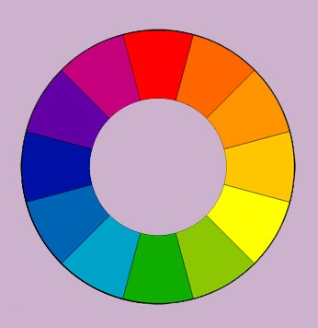
Red- Violet
Red -
Orange
INTERMEDIATE (TERTIARY) COLORS- Red-Orange, Blue-Green, Red-Violet, Yellow-Green, etc… These colors are made by mixing one primary color with one secondary color.
Blue -Violet
Yellow -Orange
Blue-
Green
Yellow-
Green

Slide 18
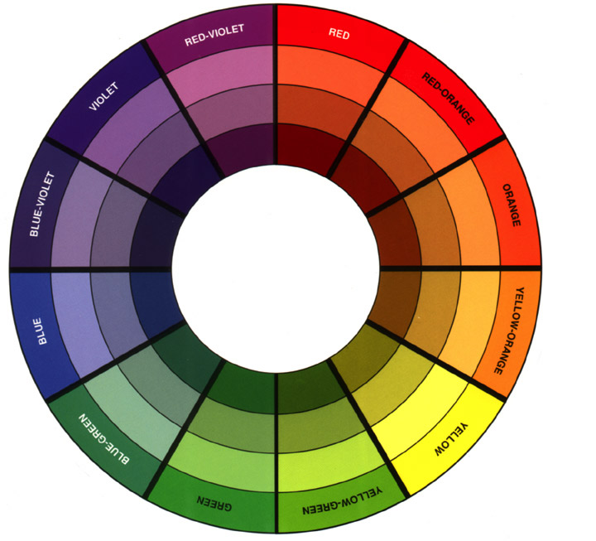
COMPLEMENTARY
COLORS- Colors
that are across
from each other
on the
color wheel.
Examples; Violet &Yellow, OR, Red & Green, OR
Red-Orange & Blue Green, etc... When used next together they look bright. If mixed together, they form a neutral color. The complement of a primary is always a secondary, and vice-versa. Intermediate colors are always complementary to another intermediate color.

Slide 19
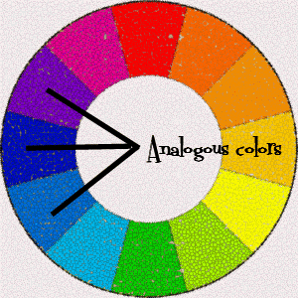
ANALOGOUS COLORS- Colors that are directly next together on the color wheel, used in a group. Example; Red-Orange & Red & Red-Violet & Violet

Slide 20
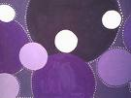
MONOCHROMATIC- Using only one color but adding white or black to create different values

Slide 21
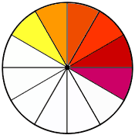
WARM COLORS- colors that give the feeling of warmth (think fiery colors, think of the sun)
Reds, Oranges & Yellows. These colors are all located on one side of the color wheel.

Slide 22
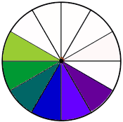
COOL COLORS- these colors are on the opposite side of the color wheel from the warm colors. They are colors that give a feeling of coolness to artwork (think cool grass, water).
Greens, Blues & Violets

Slide 23
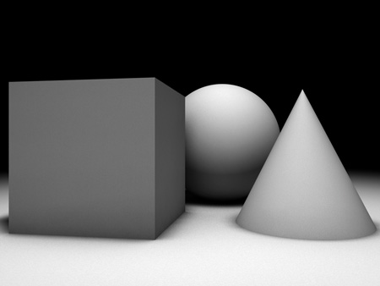
VALUE
Value describes the lightness or darkness of a color.
A tint is a light value of a color.
A shade is a dark value of a color.
Value is created by a light source
that creates shadows and
highlights on an object.
Artists add value to a piece of
artwork to make things look
more 3-D and to add more depth.

Slide 24
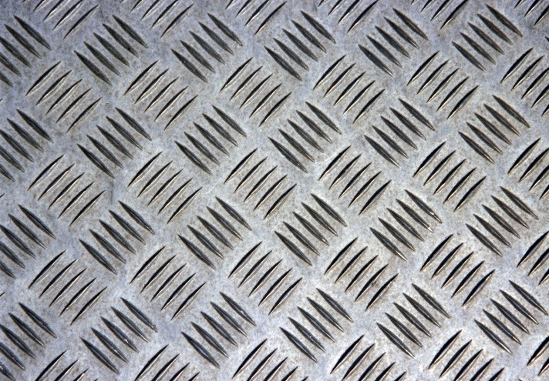
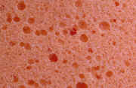
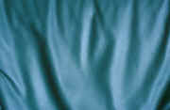
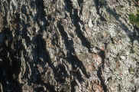
TEXTURE
Texture is how things feel or how they look like they might feel if they were touched.
Textures can be rough, smooth, matte or shiny.
Real textures are textures you can actually feel, visual textures is an illusion of an actual texture in an artwork.

