Slide 1
Imperialism
1800-1914

Slide 2
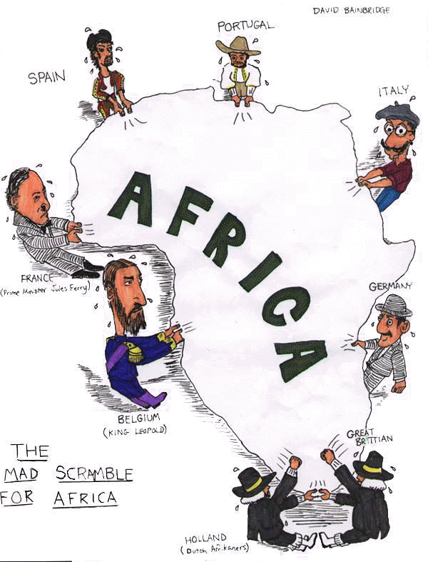
Imperialism (1800-1914)
The industrialized nations embarked upon a competition for overseas empires that had profound implications for the entire world.
embark- to make a start
empire- a major political unit having a territory of great extent or a number of territories or peoples under a single sovereign authority
profound- having intellectual depth and insight
implications- (implicate) to involve in the nature or operation of something

Slide 3
Imperialism (1800-1914)
This “new imperialism” focused on the underdeveloped world and led to the domination and exploitation of Asia, Africa and Latin America.
new imperialism- A time period of intense and stressed imperial expansion (when one empire looks outside its standing boundaries to colonize and engulf new regions in to its growing empire)
underdeveloped- having a relatively low economic level of industrial production and standard of living (as from lack of capital)
domination- supremacy or preeminence over another
exploitation- to make use of meanly or unfairly for one's own advantage

Slide 4
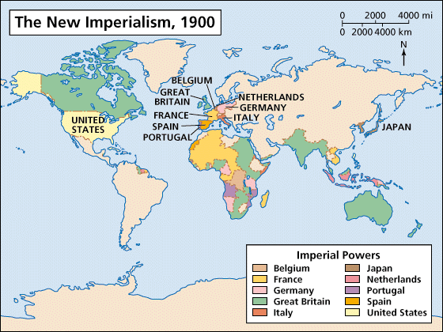

Slide 5
Content Statement #10
Imperial expansion had political, economic and social roots.
By the early 20th century, many European nations as well as Japan extended their control over other lands and created empires.
Their motivations had economic, political and social roots.

Slide 6
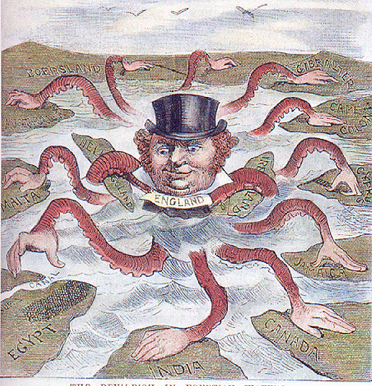
Roots of Imperialism
Political
desire to appear most powerful
bolster nationalistic pride
provide security through the building of military bases overseas

Slide 7
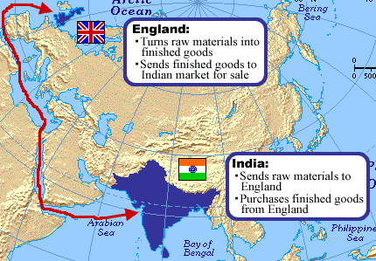
Roots of Imperialism
Economic
tied to production and consumption of goods
was a need for new markets, raw materials and outlets for population growth

Slide 8
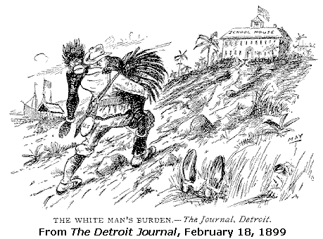
Roots of Imperialism
Social
included the vision of some that it was “the white man’s burden” to civilize those perceived as uncivilized
Rudyard Kipling, The White Man's Burden, 1899
also were humanitarian concerns and religious motivations

Slide 9
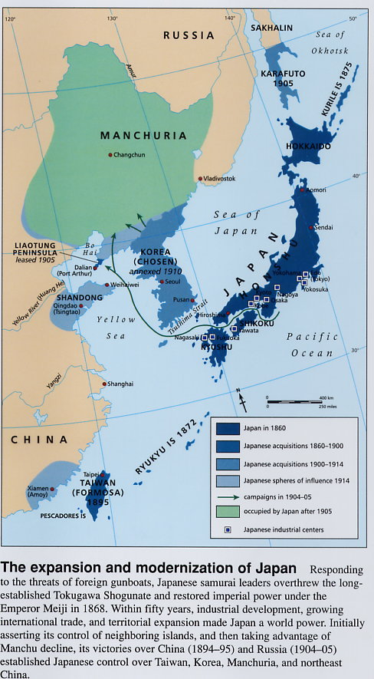
Japanese Expansion
Japanese leaders wanted to exert the power of Japan and confront Western imperialism by engaging in imperialist actions.
Japan used its military might to establish footholds in Taiwan, China and Korea.
exert- to use (influence, authority, etc.) forcefully or effectively
engage- To draw into; involve
foothold- A firm or secure position that provides a base for further advancement

Slide 10
Meiji Restoration/ Meiji Era (1868-1912)
Fill in the following chart with characteristics of the new Meiji government after reading Japanese Responses to Imperialism (pages 484-485) in your textbook. You should be able to identify three points for each heading.
Social Changes | Political Changes | Economic Changes
system of social classes was abolished all Japanese became free to choose their occupations universal compulsory education was established | centralized government was established constitution was accepted national assembly was formed, of which one house was elected | government enacted commercial policy to encourage private investment government built modern methods of transportation and communication Japan industrialized

Slide 11
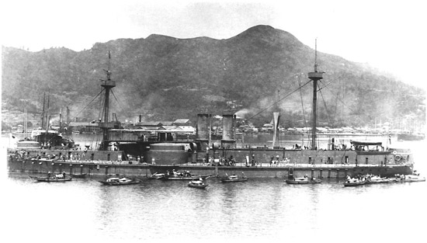
Sino-Japanese War (1894-1895)
Conflict between Japan and China that marked the emergence of Japan as a major world power and demonstrated the weakness of the Chinese empire
The war grew out of conflict between the two countries for supremacy in Korea
Sino-Japanese video
The Chinese battleship Zhenyuan captured by the Japanese during the Sino-Japanese War, 1895.

Slide 12
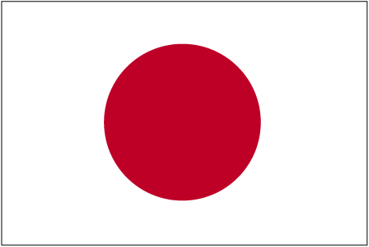
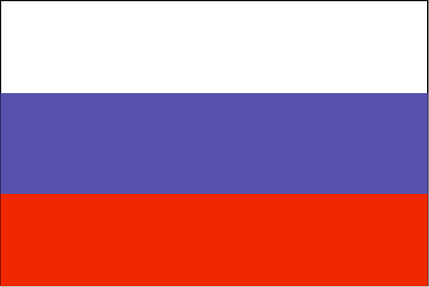
Russo-Japanese War (1904-1905)
War between Russia and Japan fought in Korea & Manchuria
Russia's defeat kept it from expanding farther east
Also encouraged the anti-czarist movements that led to the Russian revolution of 1905 and the Communist revolution of 1917
Japan won new territory and emerged as a world power
This showed the world that a nonwhite country could defeat Europeans
encouraged the rise of Asian and African nationalism that eventually led to the breakup of the European colonial empires.
Conflict in the Far East Video Clip

Slide 13
Content Statement #11
Imperialism involved land acquisition (gaining land), extraction (taking) of raw materials, spread of Western values and maintenance of (keeping) political control.
In the late 19th and early 20th centuries, European countries competed to establish colonies in Africa and Asia.
Raw materials needed for their growing industries were extracted from the colonies.

Slide 14
Western Values
Imperialism resulted in the spread of Western values:
Religion-Christianity
Customs- practices followed by people of a particular group or region
Ways of governing- democratic

Slide 15
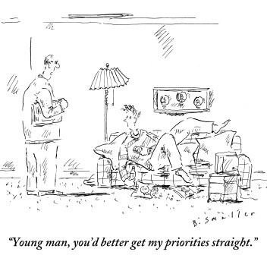
Direct Control
Some European powers (e.g., France, Belgium) preferred direct control over the colonies they established during this period.
A pattern of paternalism reflected a European belief that Africans should be governed by the European colonizers and protected like children.
Paternalism-A policy or practice of treating or governing people in a fatherly manner, especially by providing for their needs without giving them rights or responsibilities

Slide 16
Indirect Control
Some European powers (e.g., Great Britain, the Netherlands) preferred indirect control over their colonies, using local systems of authority.
They felt that working with the local native leaders would:
lessen the possibility of revolts
encourage the colonized to assimilate western traditions
culture
governing

Slide 17
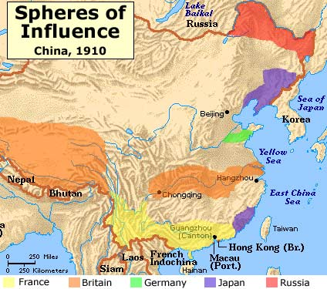
Imperialism in China
European powers used spheres of influence to establish economic control in China.
a spatial region or conceptual division over which a state or organization has significant cultural, economic, military, or political influence
Western nations were guaranteed specific trading privileges to each nation within its respective sphere

Slide 18
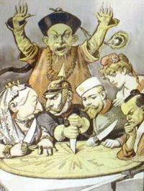
Open Door Policy
Eventually the United States demanded equal trading status within China, and rather than carve out its own sphere of influence, simply announced the Open Door Policy in 1899
stated that all nations should have equal trading rights regardless of spheres of influence.
China should be open to all nations that wish to trade with them
this policy did not include the consent of the Chinese, and was another form of imperialism
In this French cartoon, Britain, Germany, Russia, France, and Japan carve up China.

Slide 19
Content Statement #12
The consequences of imperialism were viewed differently by the colonizers and the colonized.
Dramatic differences in viewpoints existed between the European colonizers and those they colonized.
Different viewpoints between these two groups included:
the extension of Western cultural practices vs. loss of traditions
modernization vs. breakup of past institutions

